Slide 1
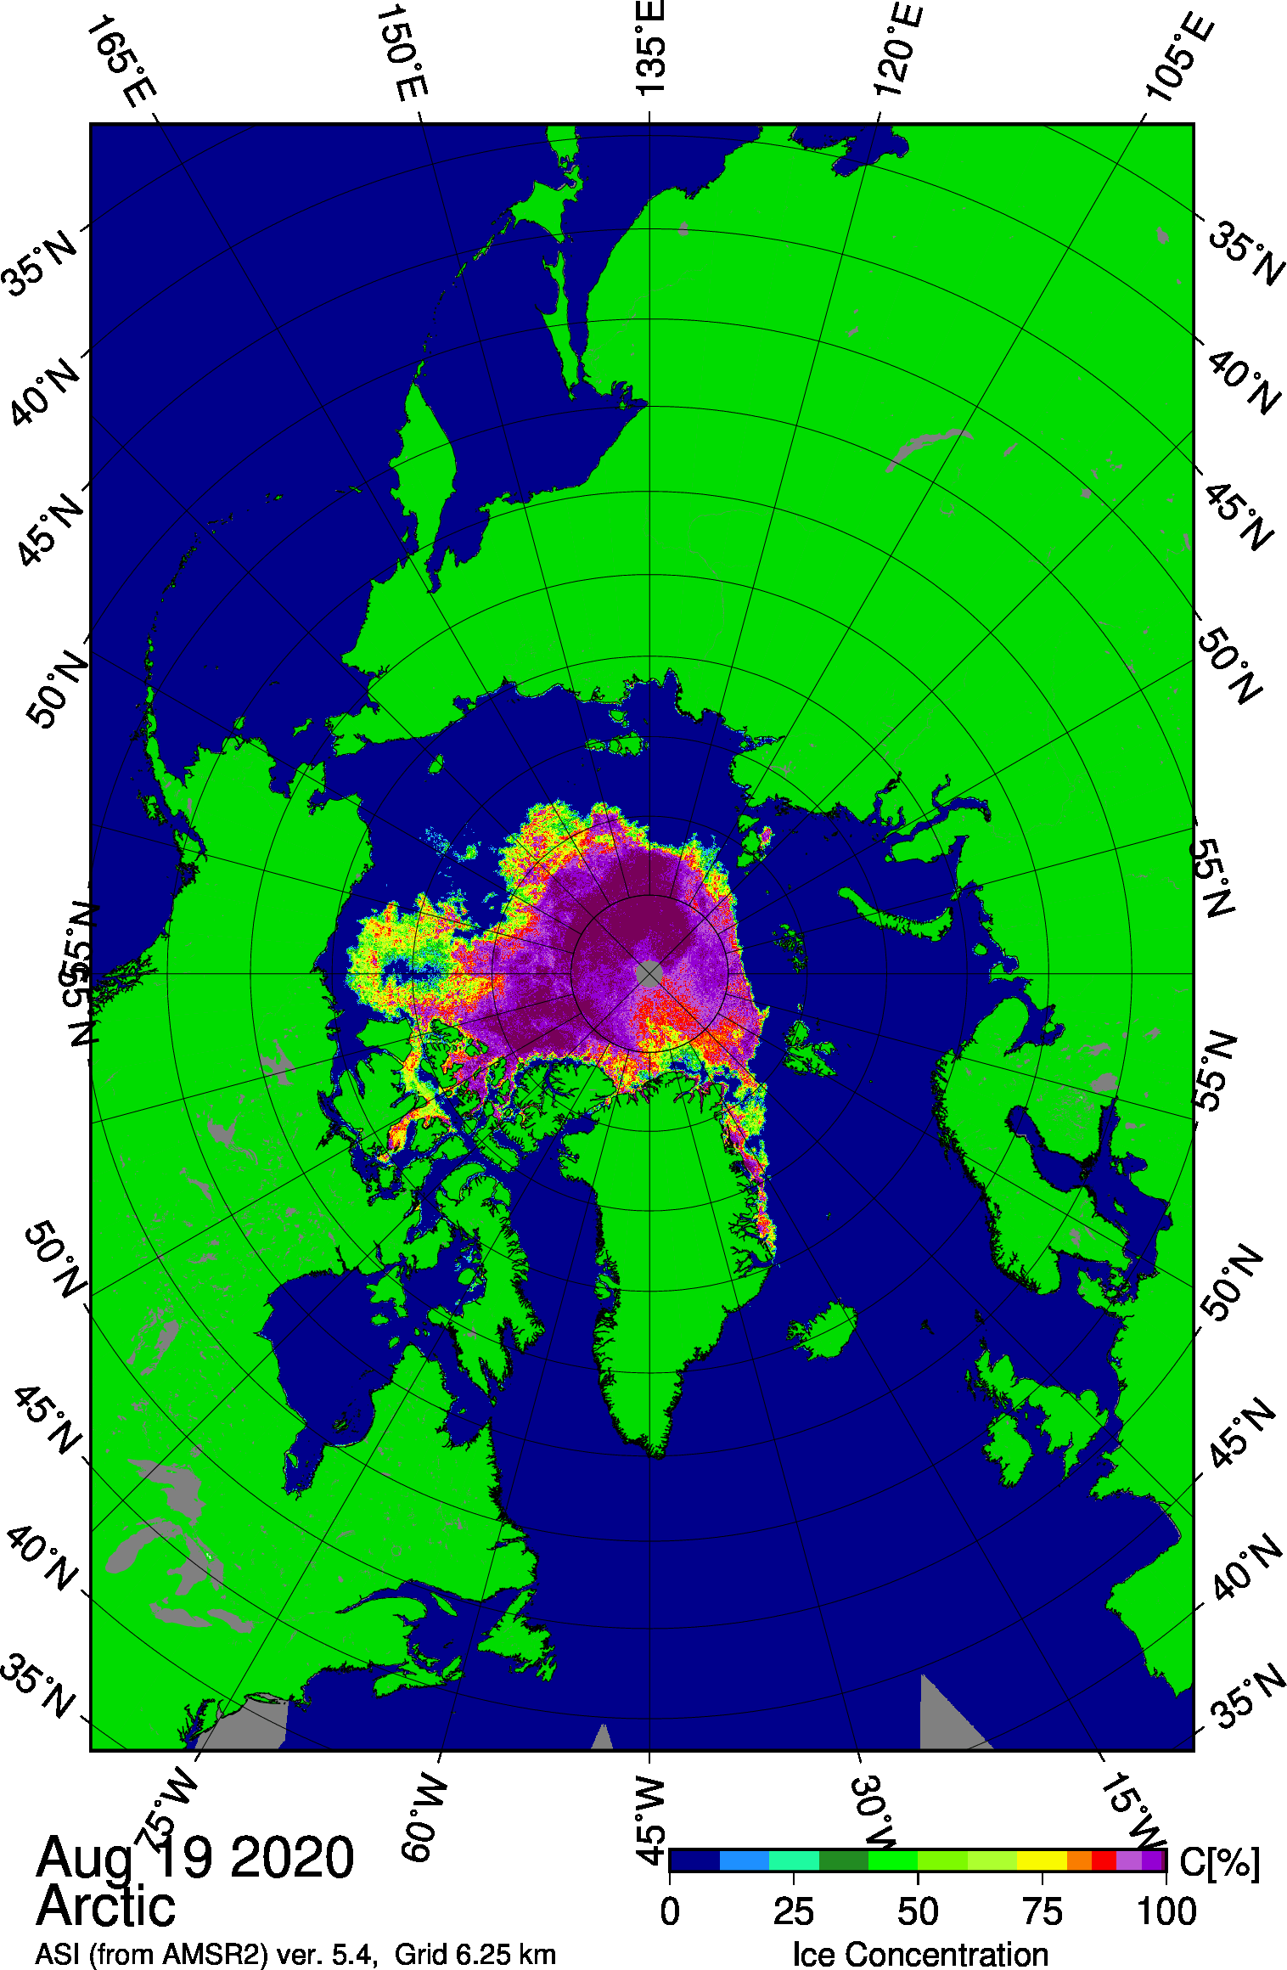

Sea Ice Outlook: Approaching the minimum
Modeling & Sea Ice Collaboration Team August Meeting
Author: Richard Cullather
Thanks to Gary Partyka, NASA GMAO

Slide 2
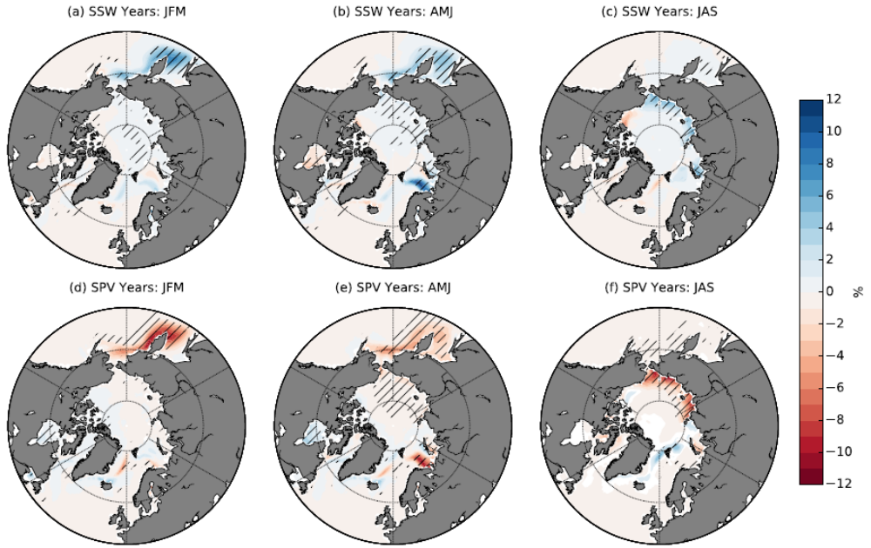
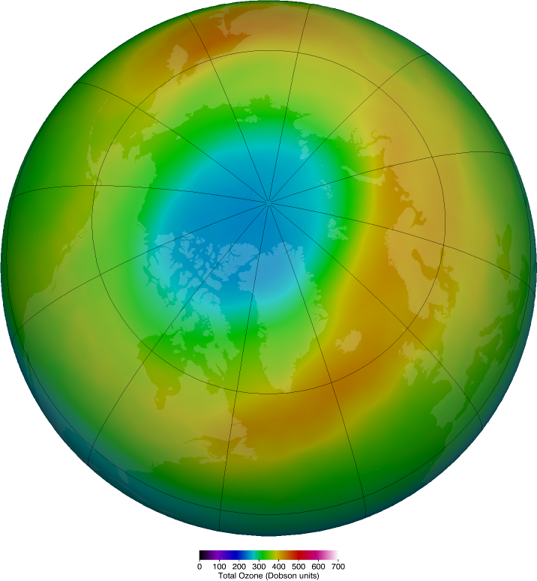

March Stratospheric Ozone
Sea Ice Extent Anomalies for Sudden Stratospheric Warming (SSW) and Strong Polar Vortex (SPV) Years
Average
2020
Smith, Polvani, Tremblay 2018
Williams, Tremblay, Newton, Allard 2016

Slide 3
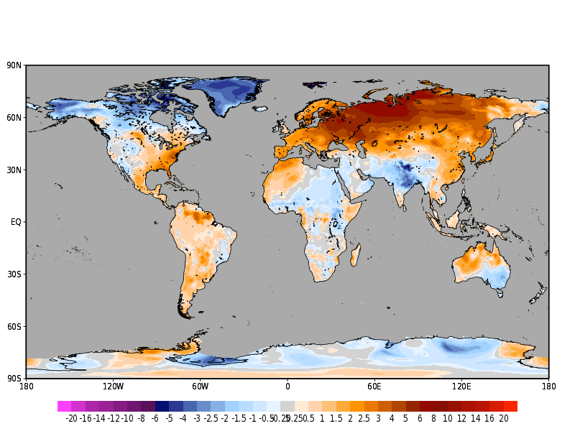
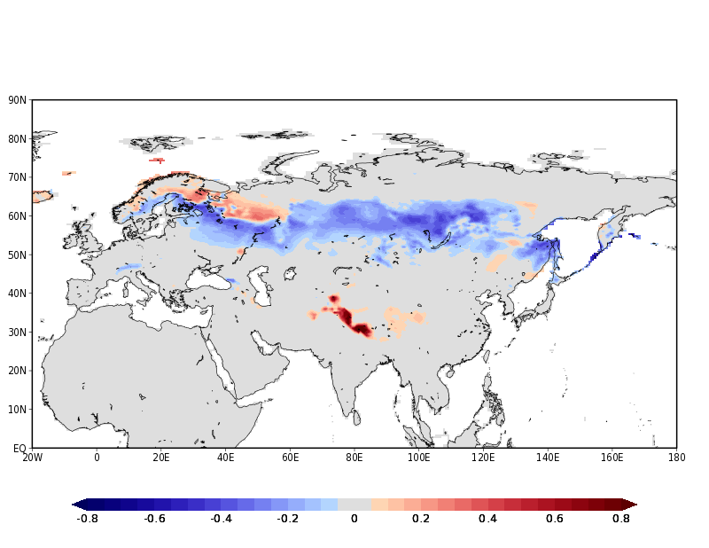
Feb/Mar 2020 T2m Anomaly
April 2020 Snow Cover Anomaly
In the low-levels, a long-fetch, fast WSW flow
was firmly established from the US East Coast
across the Atlantic and across much of northern
Eurasia. This ensured that the Siberian airmass
would never act a source region for frigid air.
Typically snow-covered latitudes between 50-60N
across much of Eurasia were either snow-free
or were otherwise anomalously bare by early
Spring 2020

Slide 4
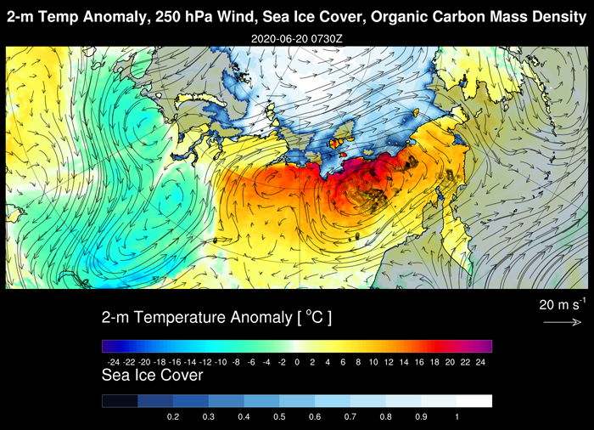
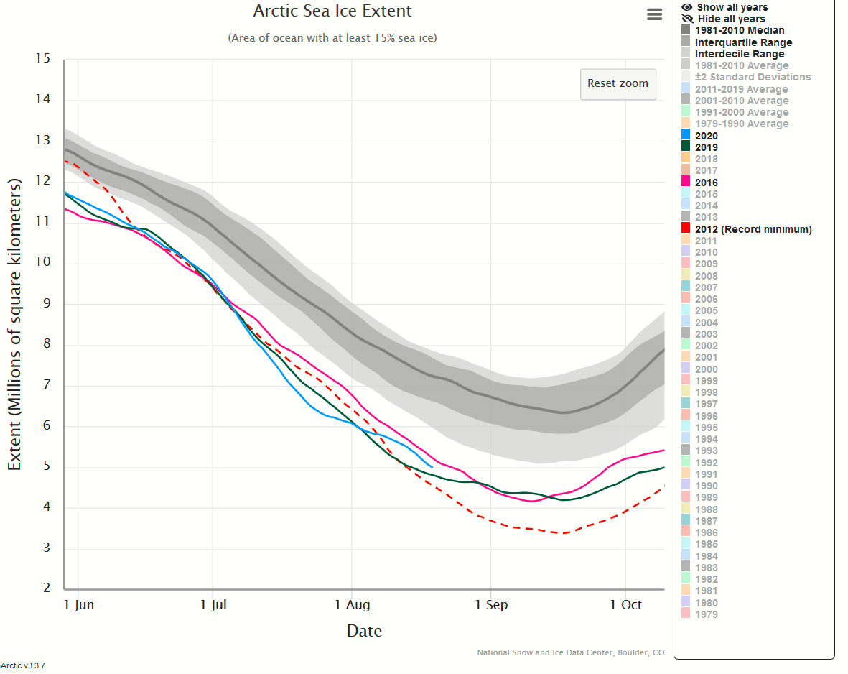
https://gmao.gsfc.nasa.gov/research/science_snapshots/2020/Siberia_high_temps.php

Slide 5
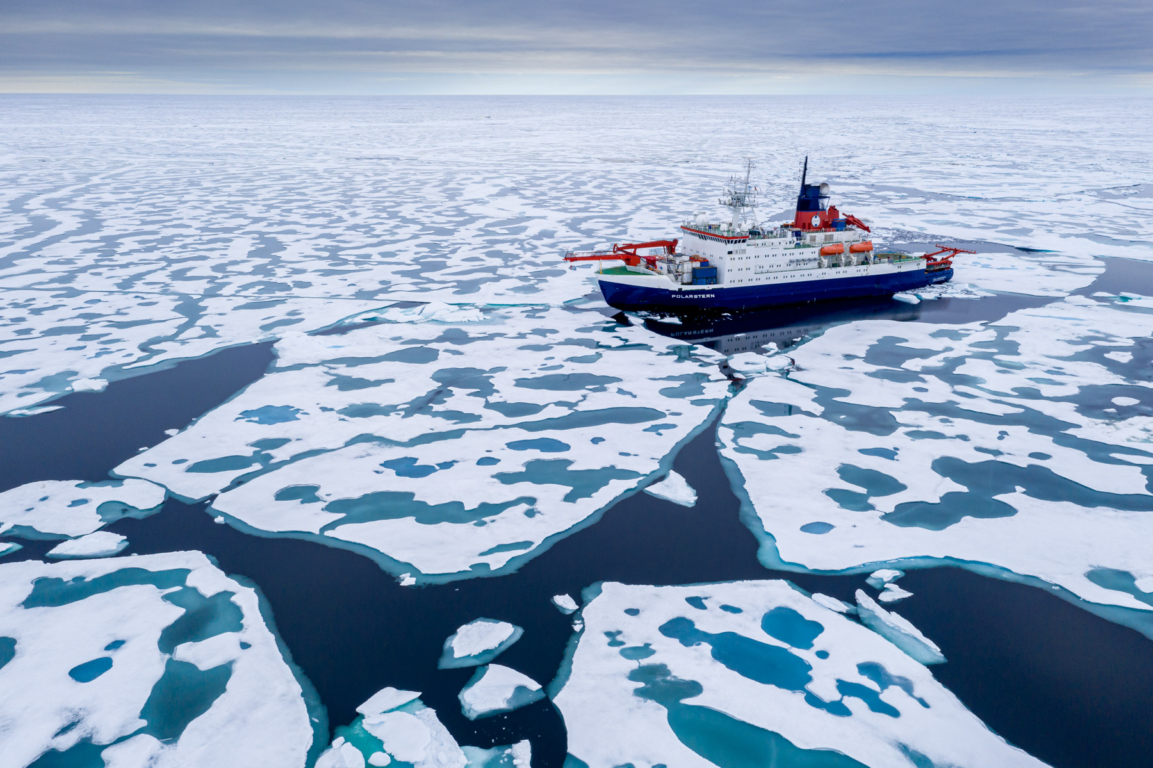
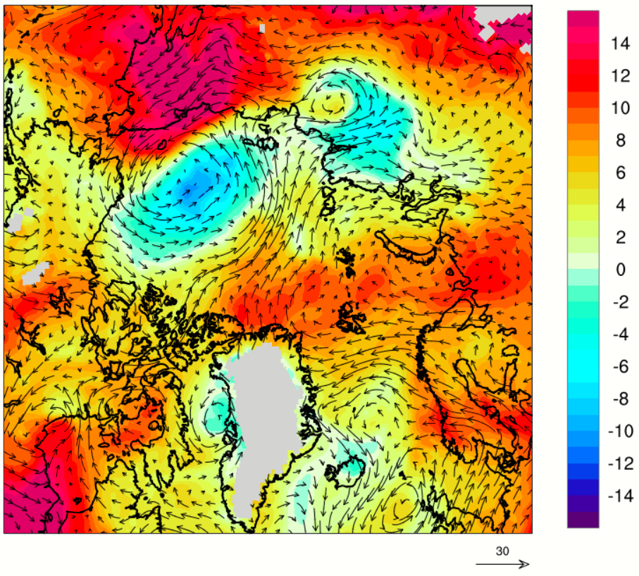
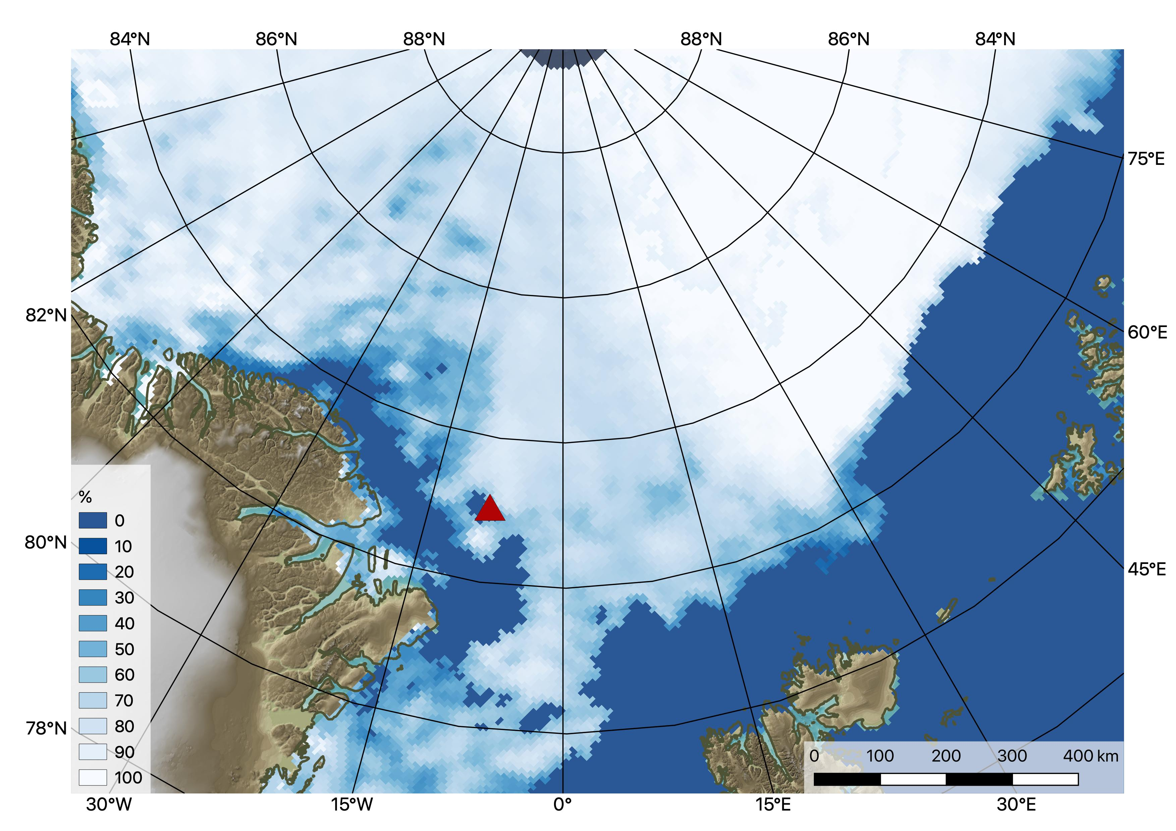
MOSAiC Reaches North Pole
850 hPa Temperature and Wind, 26-July 18Z

Slide 6
This slide intentionally blank.

Slide 7


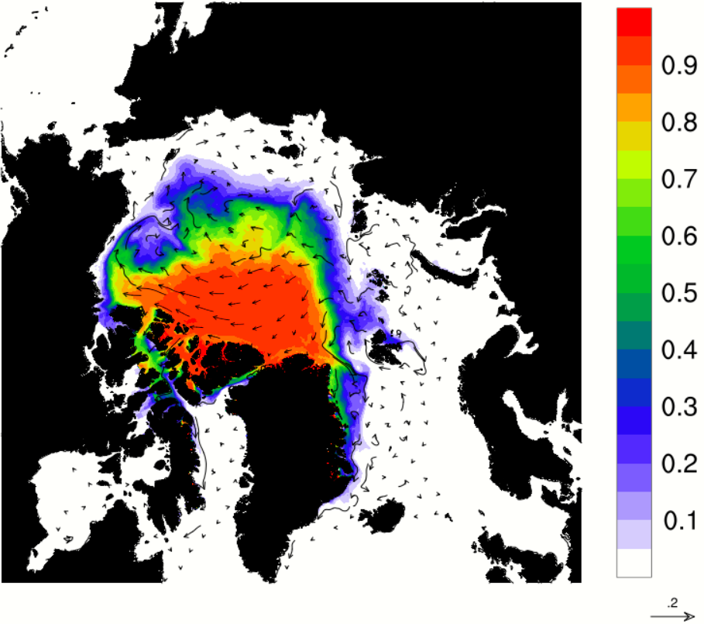
NASA Global Modeling and Assimilation Office
https://gmao.gsfc.nasa.gov/cgi-bin/products/climateforecasts/geos5/S2S_2/current/seaice.cgi
Valid September 2020
S2S system Version 2 (Molod et al., 2020, doi:10.1029/2019JD031767).
Real-time system generally forecasts erroneously low summertime ice extent.
For SIO, we have performed one-off experiments using CryoSat-2 ice thickness inserted into a parallel ODAS run.

