Slide 1
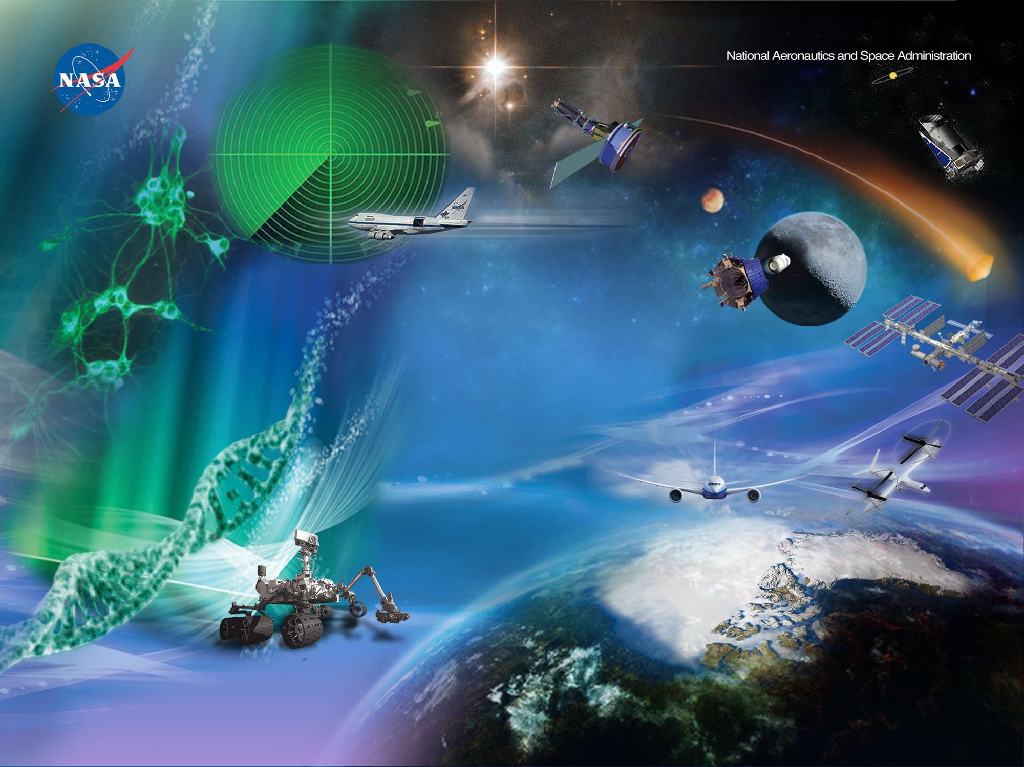
Aerospace Testing and Facilities Operations and Maintenance (ATOM-5)
Wind Tunnel Division (Code AO)
October 15, 2020
Frank Kmak
Chief, Wind Tunnel Division

Slide 2
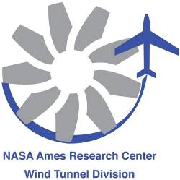
Agenda
Performance Work Statement (PWS)
Overview of NASA-Ames and Facilities
Ames Unitary Plan Wind Tunnel (UPWT) Overview
  Mission
  Organizational Structure
  Branch Functions/Requirements

Slide 3
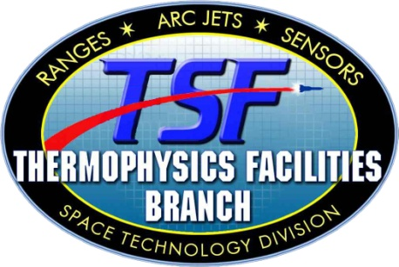
Performance Work Statement (PWS)
Testing Services
  Test Planning
  Test Preparation
  Test Operations
  Post-Test Operations
Development Services
  Test/Diagnostic Techniques
  Facility Development
  Model/Test Apparatus
  Data Systems Development
General Services
  Operation of Support Facilities
  Maintenance, Calibration, and Repair
  Health, Safety and Environmental Compliance
  Quality Management
  Configuration Management
Contract Management and Administration
  Property Management
  Procurement
  Contract Reporting

Slide 4

















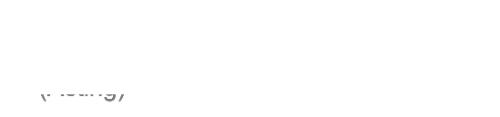




















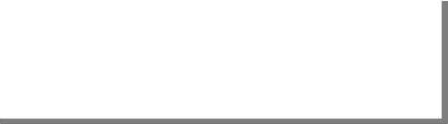


Office of the Director
Center Director: Eugene Tu
Deputy Center Director: Carol Carroll
Associate Center Director: Verron Brade (Acting)
Associate Director for Research and Technology: David Korsmeyer
Office of the Chief Engineer
Chief Engineer: Dean Kontinos
NASA Astrobiology Institute
Director: Jon Rask
Office of the Chief Scientist
Chief Scientist: Jacob Cohen
Solar System Exploration Research Virtual Institute (SSERVI)
Director: Gregory Schmidt
Office of the Chief Technologist
Chief Technologist: Harry Partridge III
Office of Diversity & Equal Opportunity
Division Chief: Barbara Miller
Office of the Chief Counsel
Chief Counsel: Thomas W. Berndt
NASA Research Park Office
Director: Mejghan Haider
Partnerships Office
Chief: Karen Bradford
Office of Communication
(Acting) Public Affairs Officer: Michele A Johnson
Aeronautics Directorate
Director: Huy Tran
Science Directorate
Director: (Acting) Jay Bookbinder
Exploration Technology Directorate
Director: Rupak Biswas
Programs and Projects Directorate
Director: Butler Hine
Center Operations Directorate
Director: Eddie Zavala
Engineering Directorate
Director: Daniel Andrews
Safety & Mission Assurance
Directorate
Director Andrew Demo
Human Capital & Education Directorate
Director: Steve Jensen
Information Technology Directorate
CIO: John Garrigues
Office of the Chief Financial
Officer
Director/CFO: Amir Deylami
Agency CFO
Updated: 6-21-20

Slide 5





Aeronautics Directorate
Aeronautics Directorate Code A
Director: Huy Tran Deputy Director: vacant.
Associate Director: Jeffrey McCandless, Dr. Assistant Director for University Research & Development: Karen Tambua
NASA Aeronautics Research Institute, NARI
Director: Parimal Kopardekar
Directorate Support Code A
Resource Executive, Mary Nguyen (Code CPM)
Admin Spec Suzie Cisneros
Aviation Systems Division
Code AF
Division Chief: Sandy Lozito
Deputy Chief: Katharine Lee
Assistant Chief, Simulation: Vacant
Assistant Chief, Operations: Julie Nguyen Senior Scientist:vacant
Wind Tunnel Division Code AO
Division Chief: Frank Kmak
AOI Wind Tunnel Systems Branch Branch Chief: James Bell
AOO Wind Tunnel Operations Branch Branch Chief: Maureen Delgado
System Analysis Office Code AA
Office Chief: Susie Go
Aeronautics Projects Office Code AT
Office Chief: Bimal Aponso
AFT Flight Trajectory Dynamics and Controls
Branch
Branch Chief: Todd Farley
AFH Aerospace High Density Operations Branch Branch Chief: Shannon Zelinski
AFS Aerospace Simulation Research &
Development Branch
Branch Chief: Steven Beard
Deputy Branch Chief:Fay Chinn (Acting)
AOX Experimental Aero-Physics Branch Branch Chief: Rabindra D. Mehta, Dr.
Aeromechanics Office Code AV
Advanced Aircraft Project Office Code AM
Office Chief: Douglas A. Wardwell
Office Chief: William Warmbrodt
AFO Systems Modeling and Optimization
Branch Chief: Confesor Santiago
Updated: 7-2-20

Slide 6
Wind Tunnel Division Organization
Wind Tunnel Division, Code AO
  Frank Kmak, Chief
Wind Tunnel Operations Branch, Code AOO
  Maureen Delgado, Chief
Wind Tunnel Systems Branch, Code AOI
  James Bell, Chief
Experimental Aero-Physics Branch, Code AOX
  Rabi Mehta, Chief

Slide 7
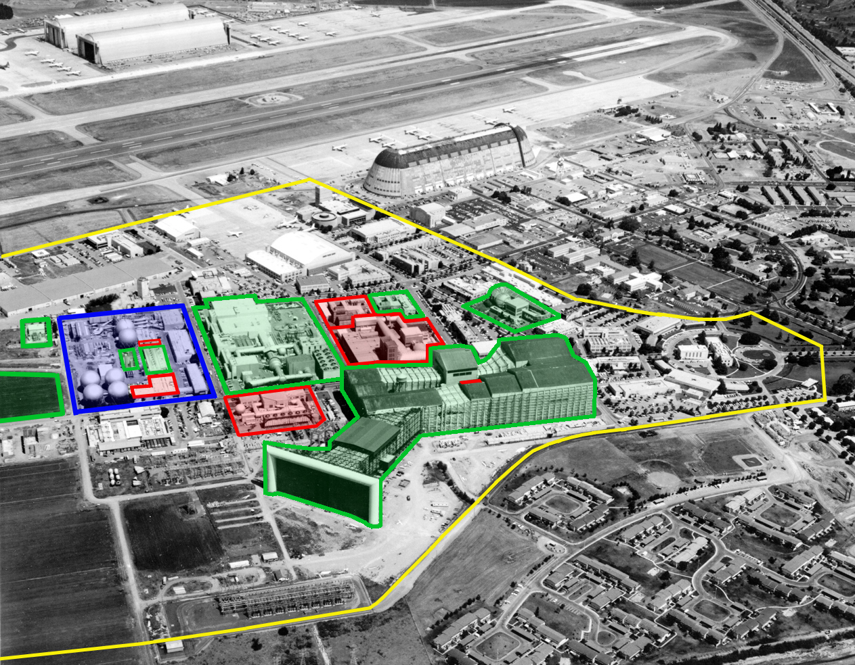
Ames Ground Testing Facilities
Arcjet Complex - NASA
UPWT - NASA
7x10 - Army
12-Foot Pressure Wind Tunnel - Closed
NFAC – Leased to USAF- AEDC

Slide 8
Wind Tunnel Division Facilities
High Pressure Air (HPA) Storage Tanks N250A
Fluid Mechanics Laboratory (FML) N260
High Pressure Air (HPA) Compressor C1D N250
High Pressure Air (HPA) Compressor C1A & HPA Control Room N229A
Unitary Plan
Wind Tunnel
(UPWT) N227A/B/C/D
12-Ft PWT Model Preparation Rooms (MPR) N206
Balance Calibration Laboratory N207
12-Ft PWT Mitsubishi Makeup Air (MUA) Compressor N206A
Compressor Blade Shop N207A

Slide 9
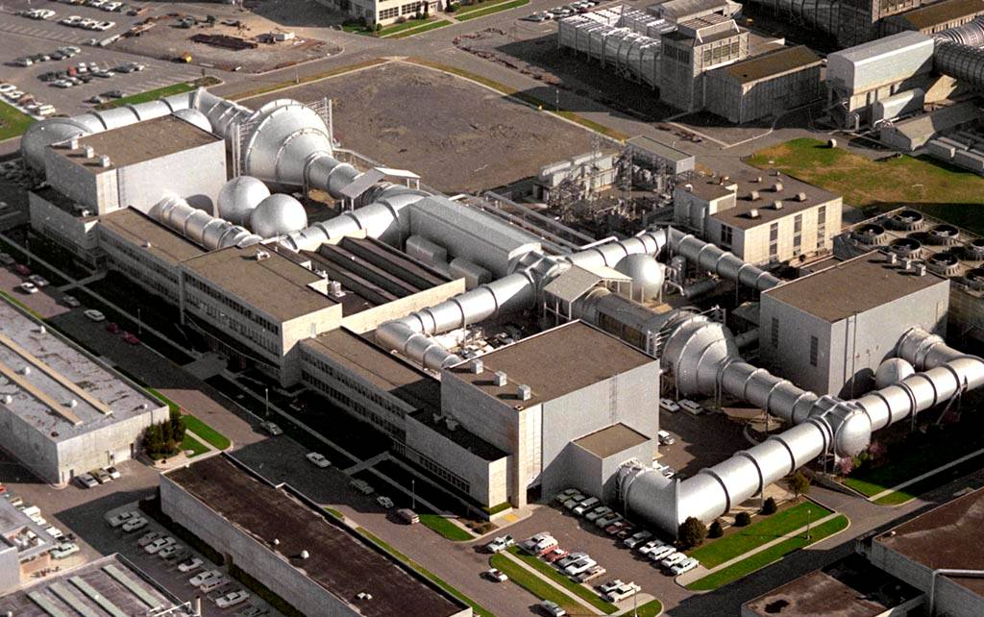
ARC Unitary Plan Wind Tunnel

Slide 10
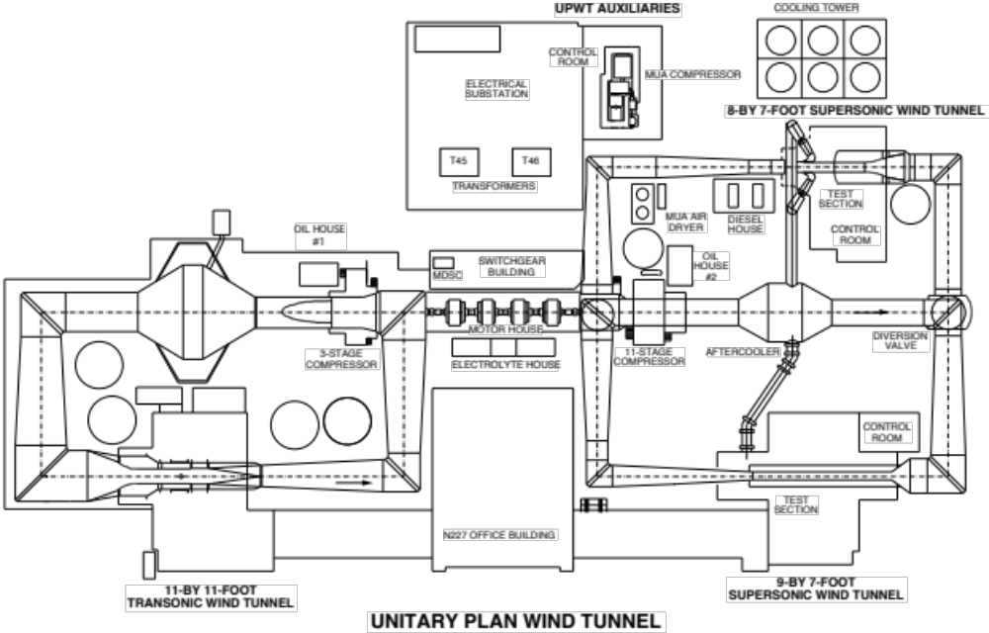
Unitary Plan Wind Tunnel

Slide 11
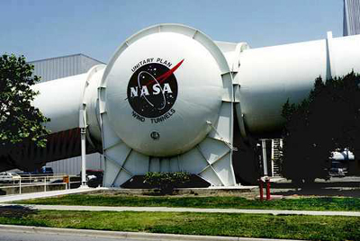
Ames Wind Tunnel Mission
Meet Customer Testing Requirements
Safely Operate and Maintain the Tunnels and Support Systems
Maximize Use of Facilities
  Improve Testing Capability
    Test Techniques
    Facility Maintenance Investment projects
    Capability Advancement projects
    Surpass Customer Expectations (Costs/Capabilities)
  Improve Cost Competitiveness

Slide 12
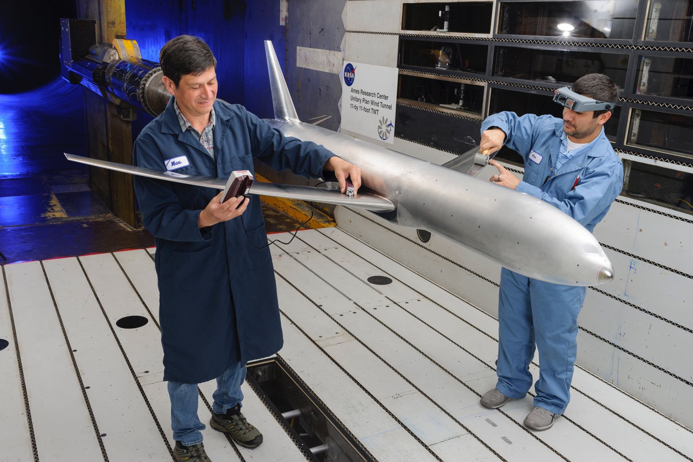
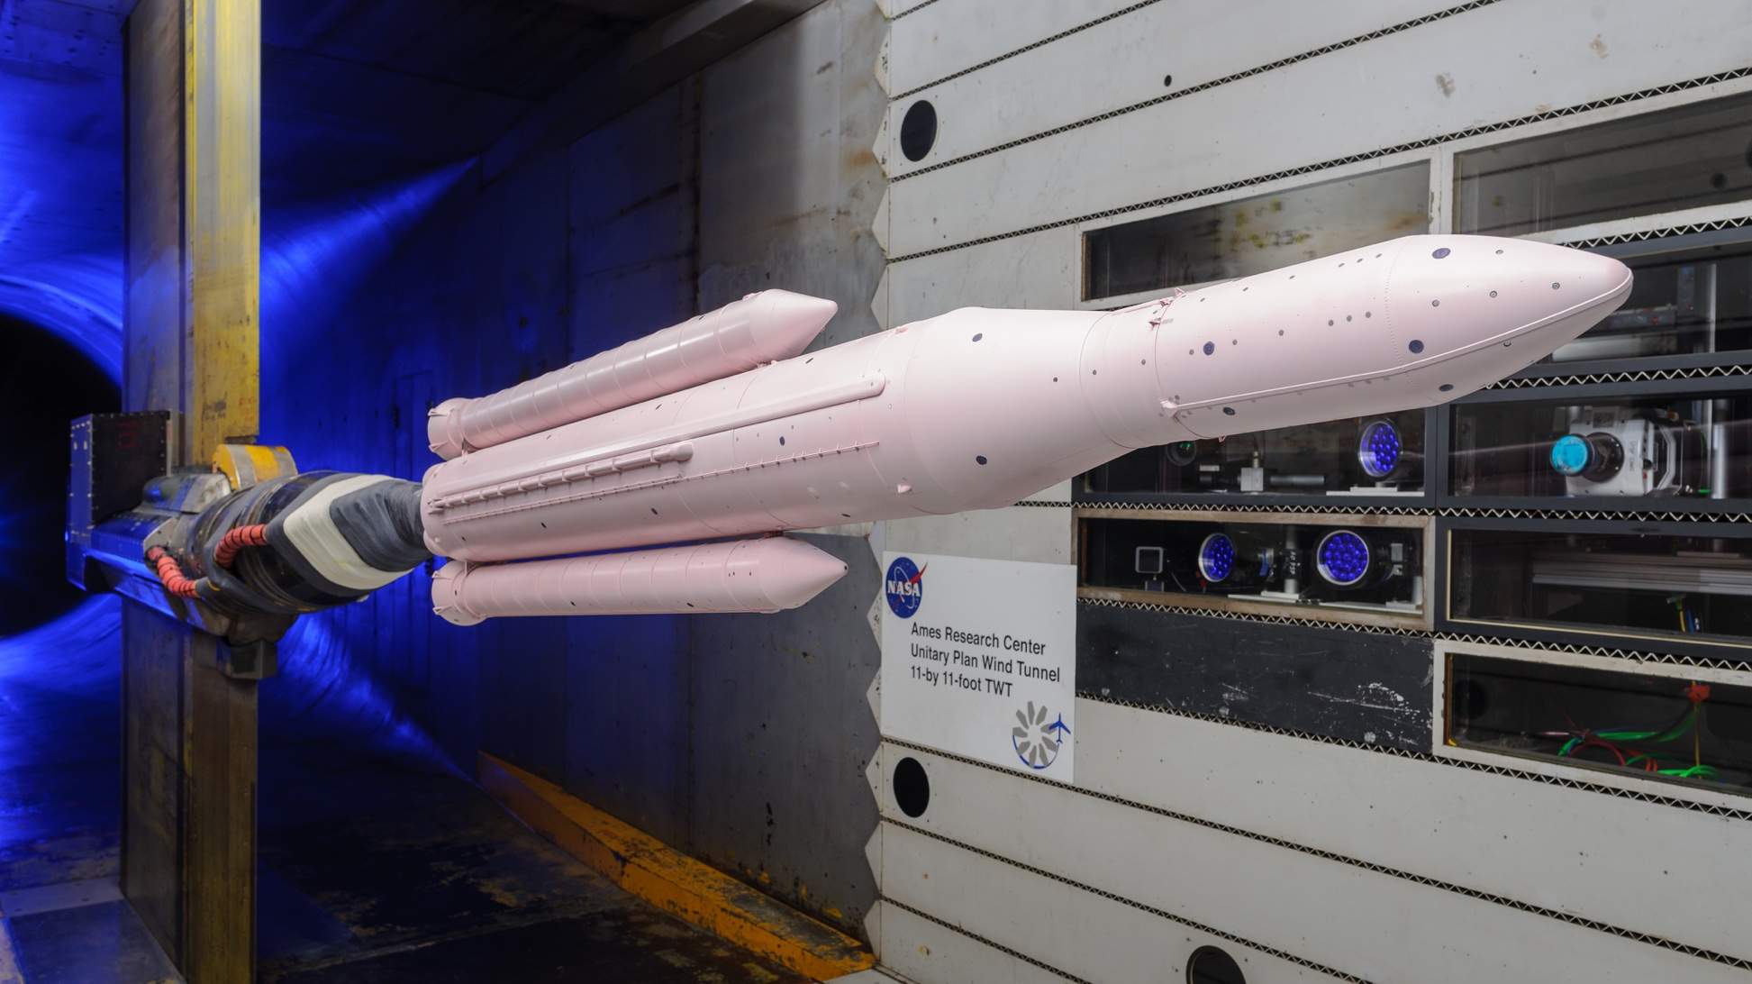
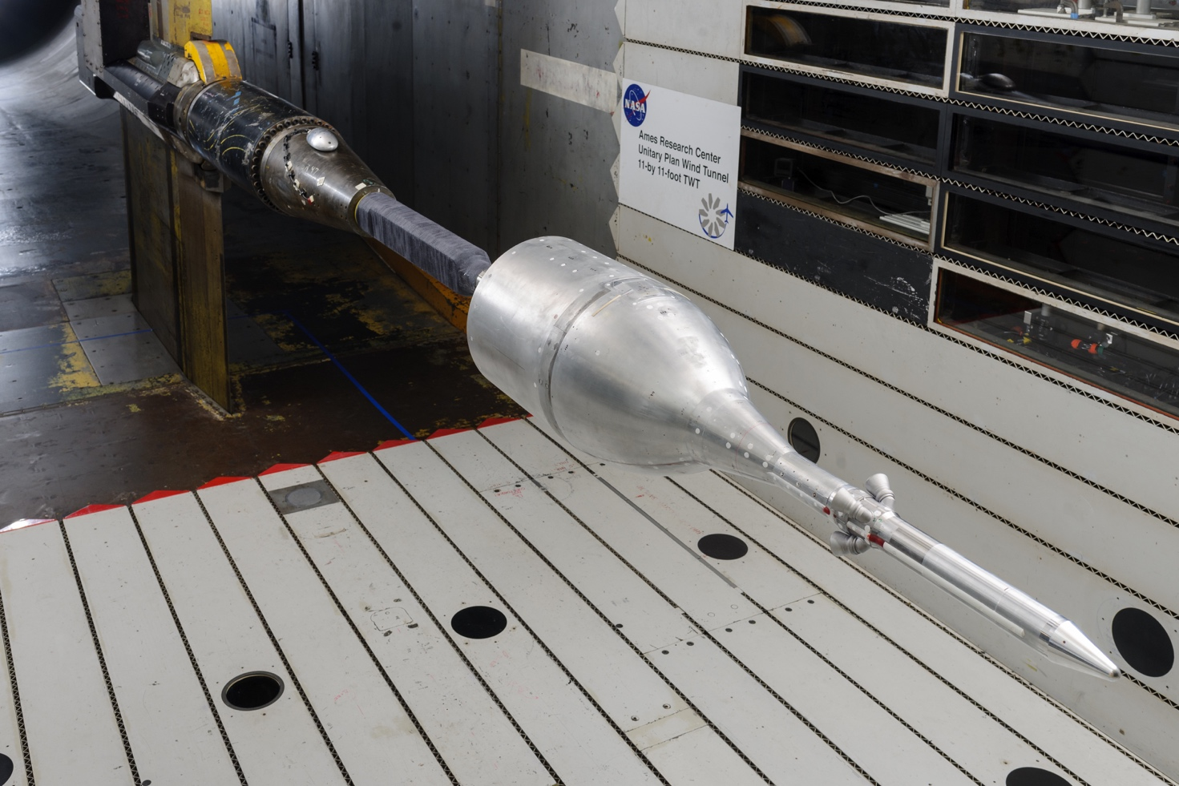
UPWT Transonic Testing

Slide 13
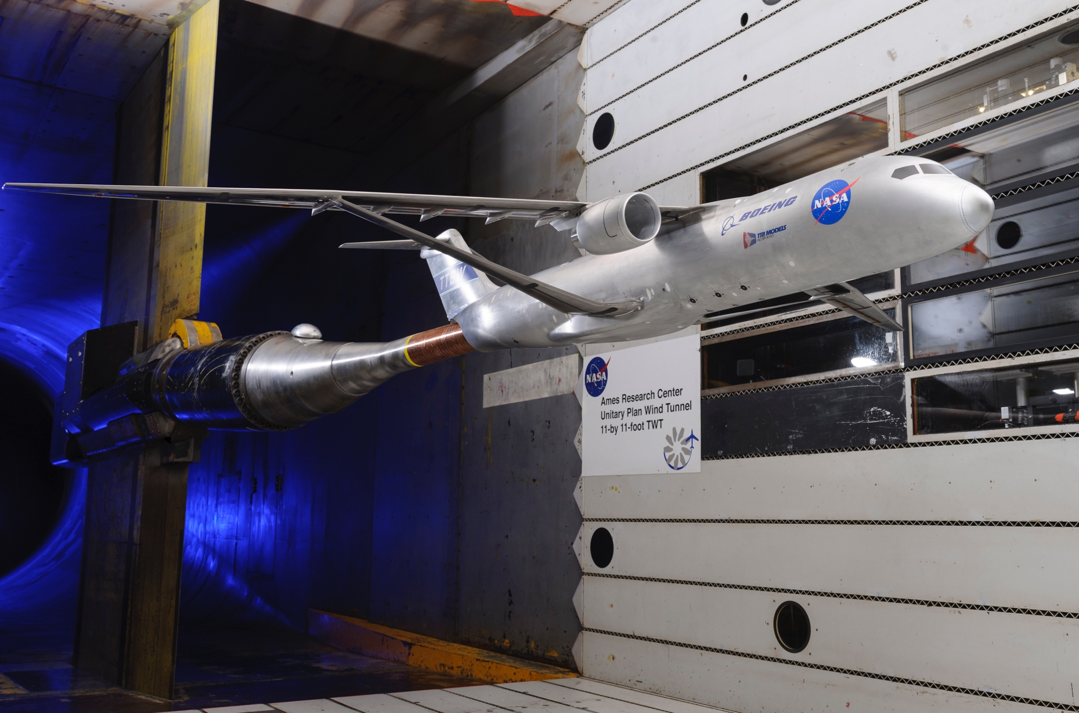
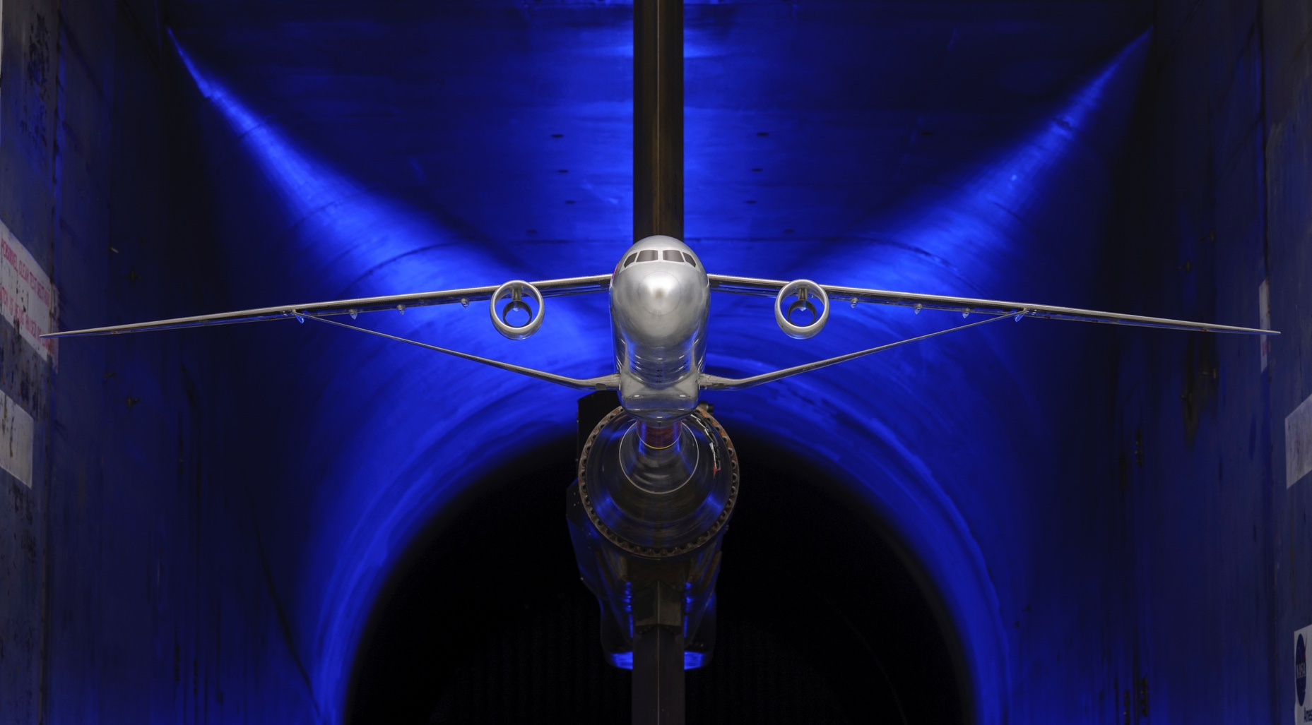
UPWT Transonic Testing

Slide 14
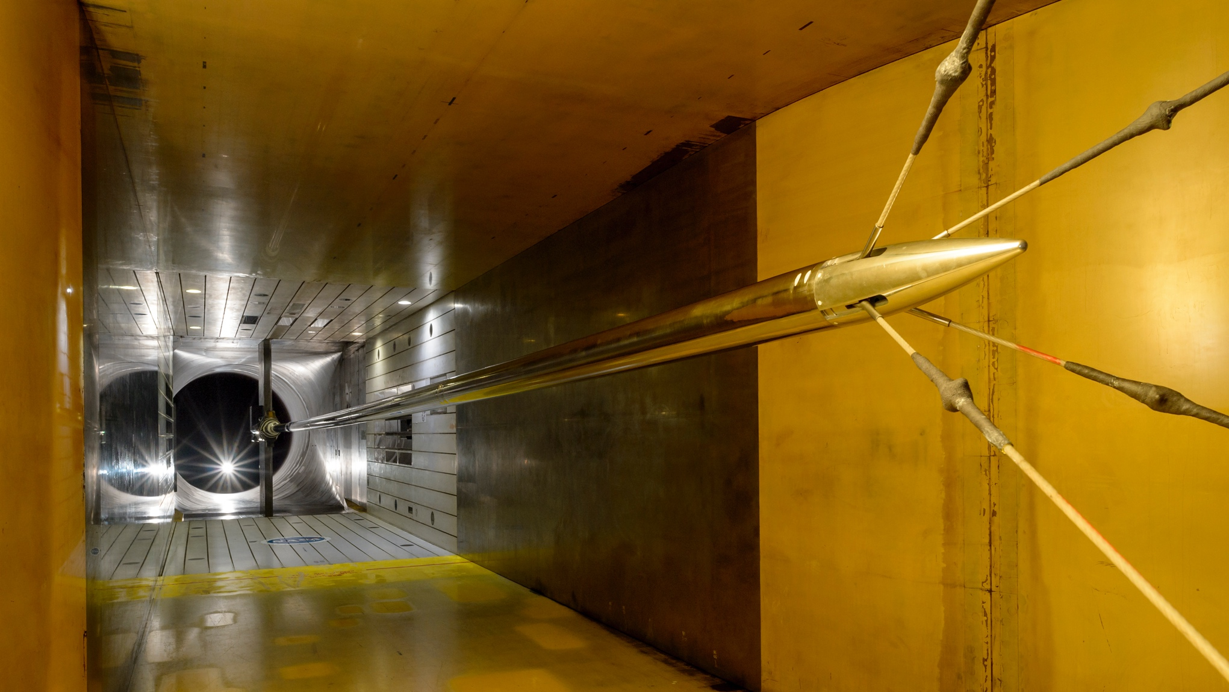
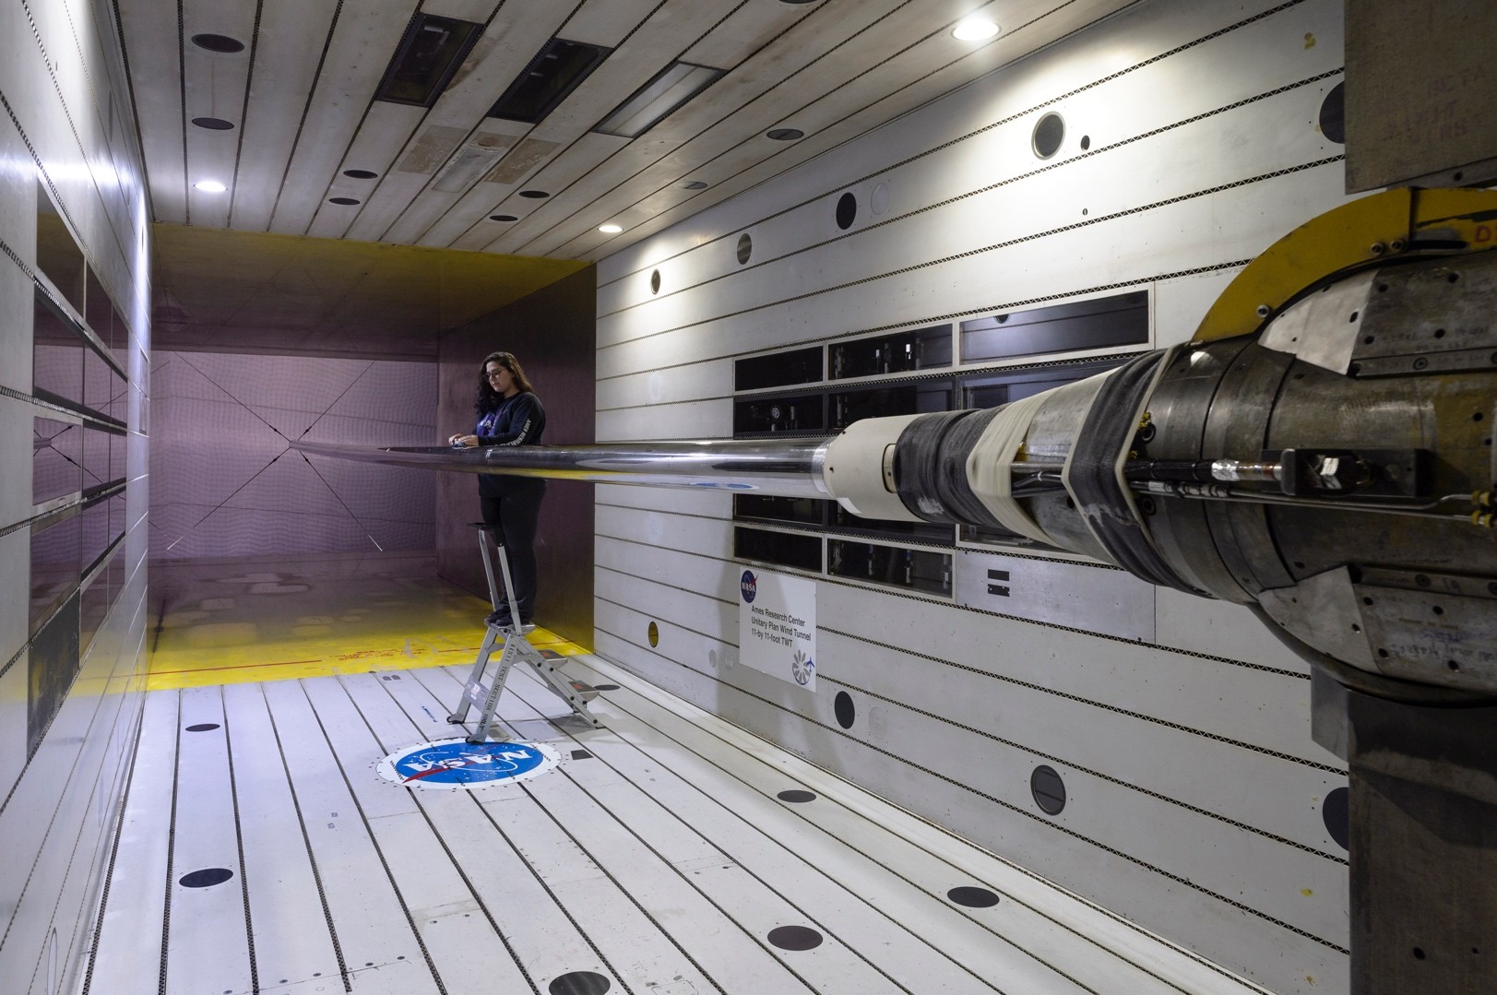
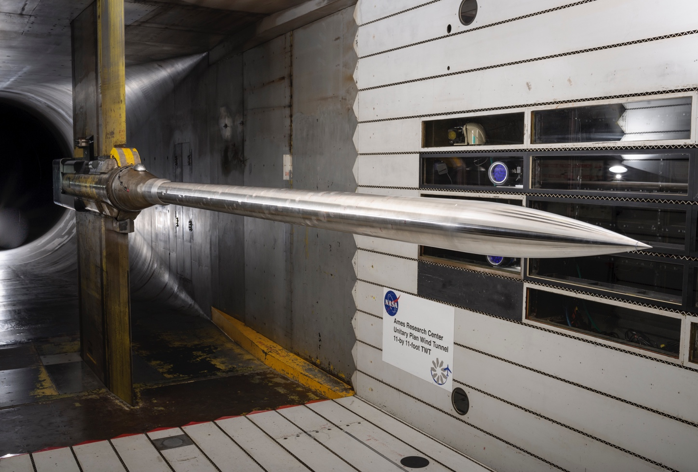
UPWT Transonic Testing

Slide 15
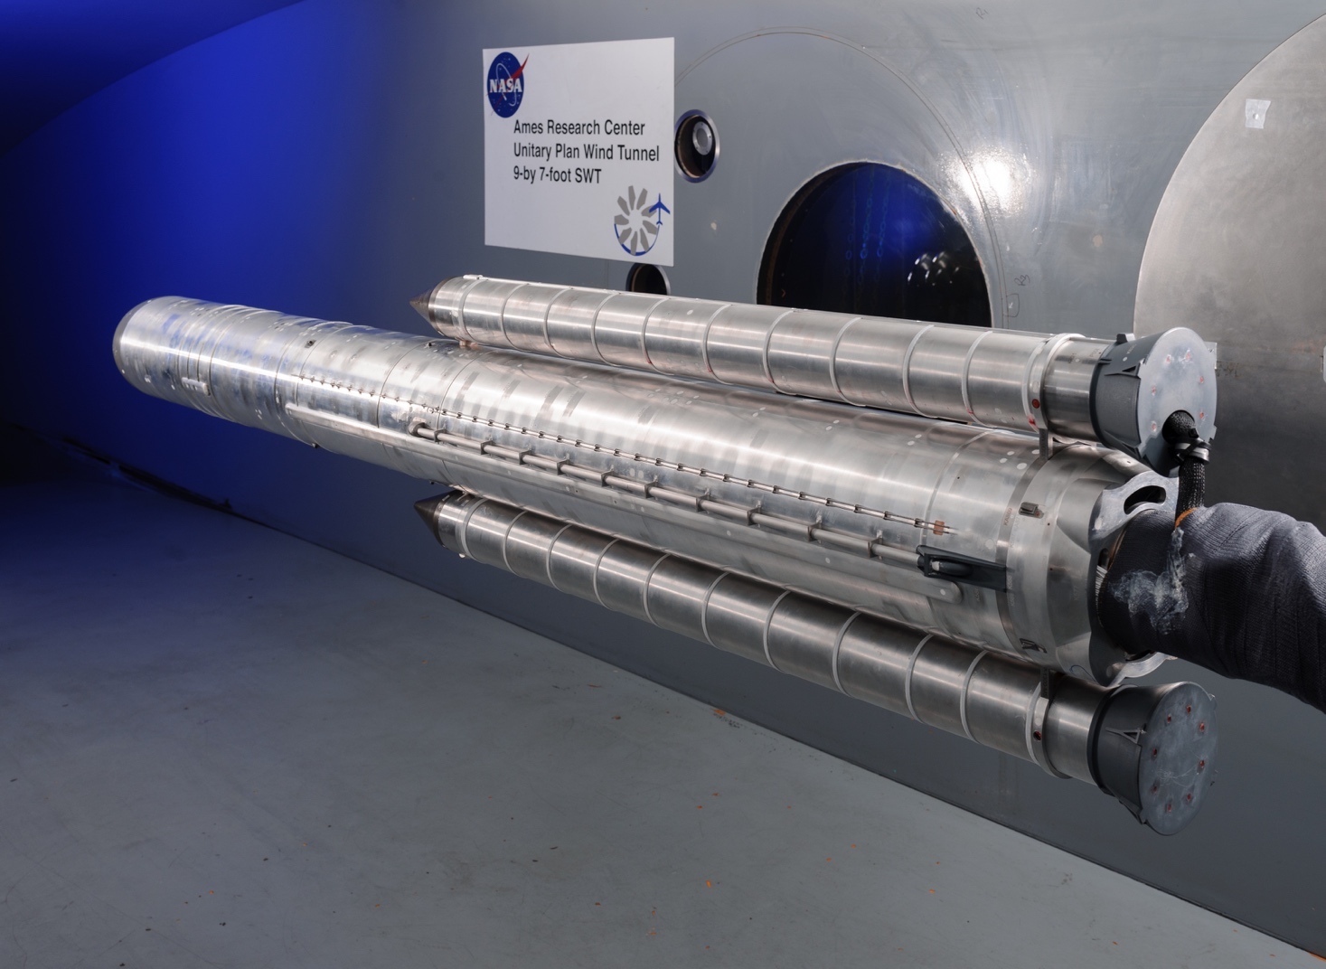
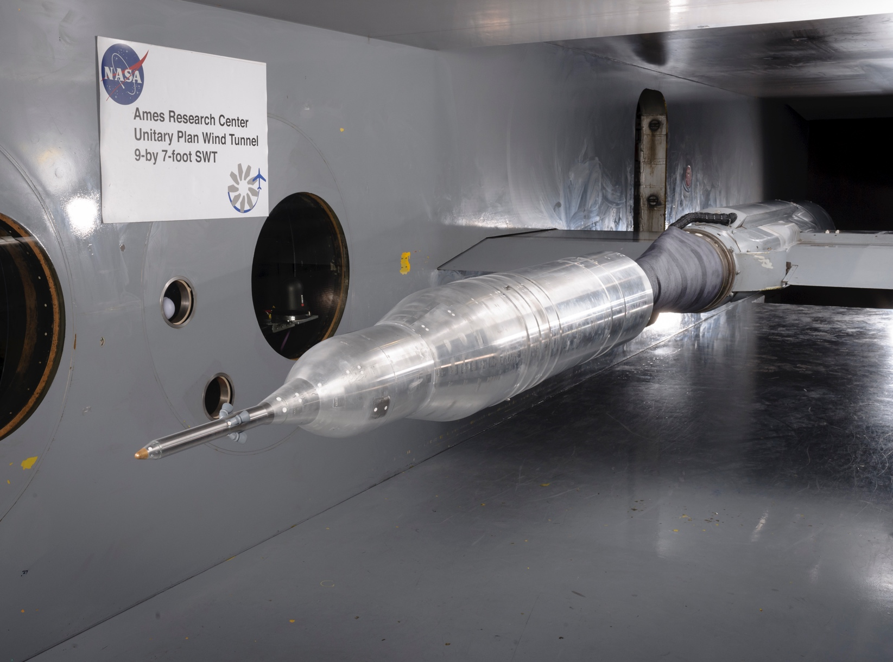
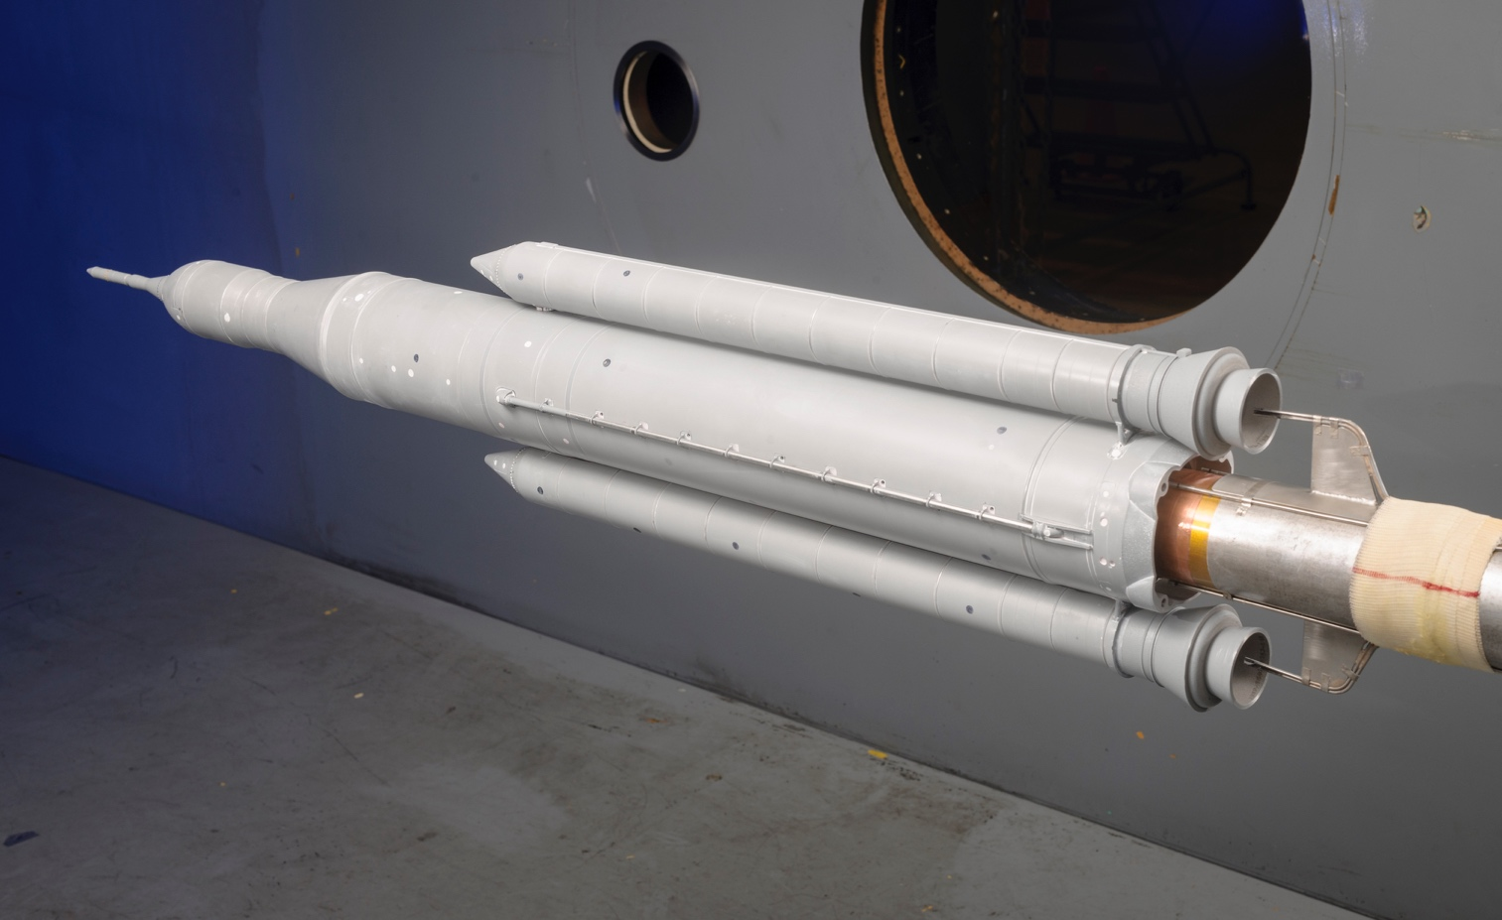
UPWT Supersonic Testing

Slide 16
Major Stakeholders
Unitary Plan Wind Tunnel Customers
  NASA Programs and Missions such as the Aeronautics Program, Space Launch System, and Orion
  Department of Defense
  Commercial industry, including NASA Commercial Crew Program partners
NASA Aeronautics Aerosciences Evaluation and Test Capabilities (AETC) Portfolio
  AETC provides basic funding for operations, test technology projects, maintenance projects, and capability advancement projects

Slide 17
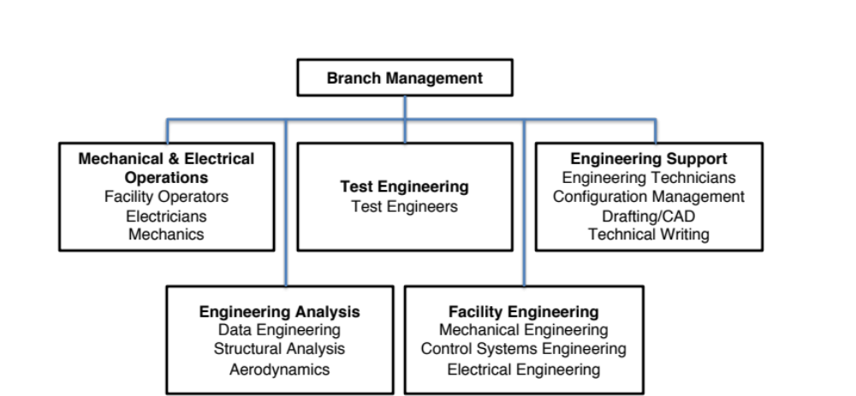
AOO Branch Structure

Slide 18
AOO Branch Mission
Plan, Direct, Lead, & Operate
Plan, Coordinate, and lead all test activities from test justification through data transmittal
Ensure that data quality meets customer requirements
Oversee day-to-day operation of all wind tunnels and facilities
Operate the tunnel and model control systems
Responsible for model integrity, system safety, and safe operating procedures
Develop and maintain test crew assignments
Develop advanced test techniques and procedures
Calibrate wind tunnel facilities
Develop test process and test planning guidelines

Slide 19
AOO Branch Mission (Cont.)
Plan, Direct, Lead, & Operate
Develop safety guidelines and procedures
Develop facility maintenance procedures and schedules
Manage the MAXIMO maintenance productivity software tool
Maintain wind tunnel facilities at a high state of readiness and productivity through active maintenance
Propose, develop, and coordinate major Construction of Facilities projects
Provide Configuration Management services to manage the change of documents, drawings, and software
Provide engineering support for development and repair of wind tunnel facilities

Slide 20
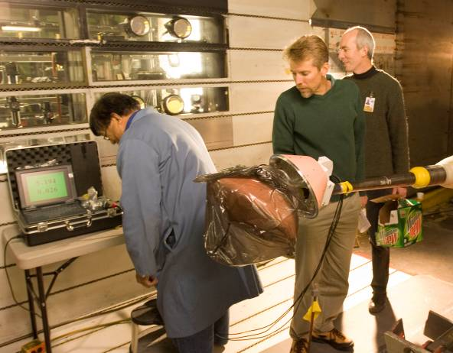
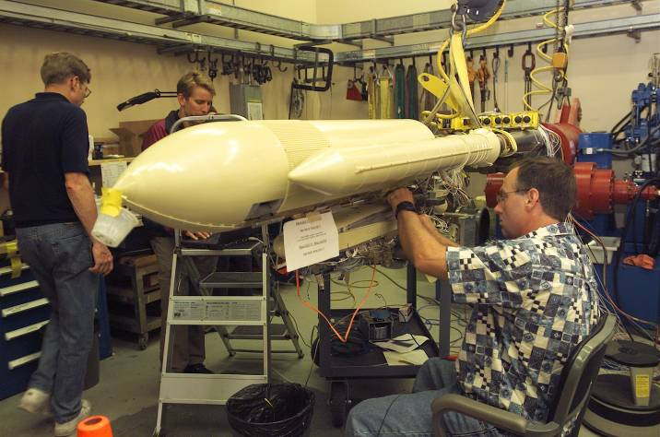
AOO Skill Categories
Wind Tunnel Test Engineers
  Test Managers
  Shift Engineers
Tunnel System Operators and Technicians
  Tunnel and Model Support Operators
  Auxiliaries Facility and HPA System Operators
High Voltage Electricians
Wind Tunnel Model Stress Analysts
Mechanical & Electrical Engineers
Control System Engineers
Aerodynamics Research Analysts
Configuration Management Specialists
  Drafting
  Technical Writing – MIS Support

Slide 21
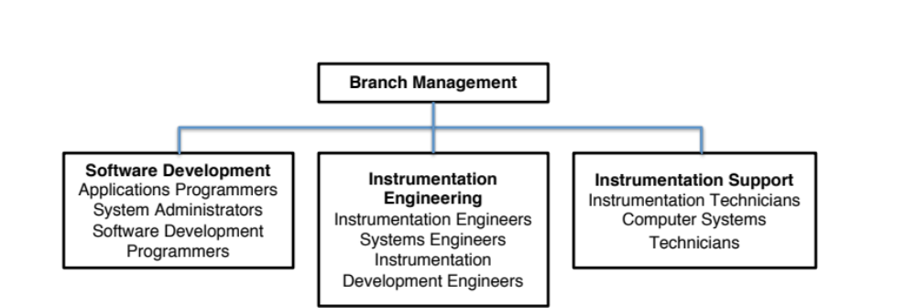
AOI Branch Structure

Slide 22
AOI Branch Mission
Collect Data
  Provide, configure, operate, and support (1) sensors, (2) instrumentation, (3) data systems and (4) related systems used to gather test data for customers
  Develop hardware, software, and processes to enhance and improve the quality of the data and the efficiency of the data gathering process
  Assist the customers and the AOO test team members in viewing/reviewing the data during and after a wind tunnel test

Slide 23
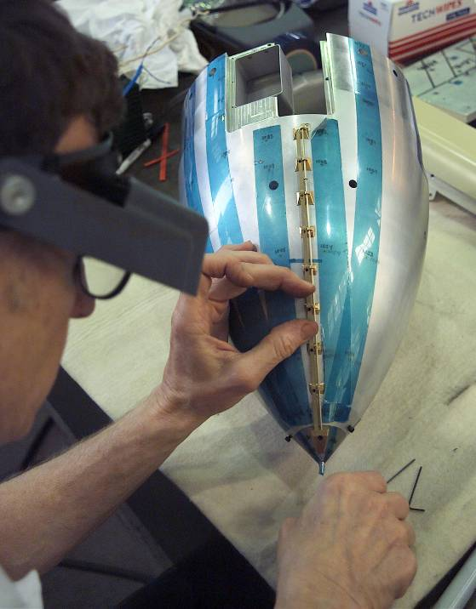
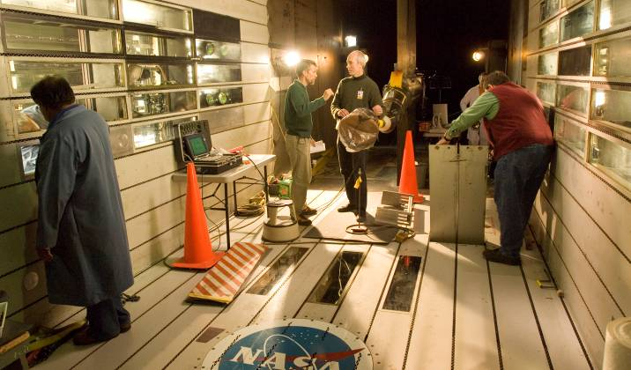
AOI Job Classifications
Instrumentation Engineers
Instrumentation Technicians
Applications Programmers
Computer Systems Technicians
Systems Administrators
Systems Engineers
Instrumentation Development Engineers
Software Development Programmers

Slide 24
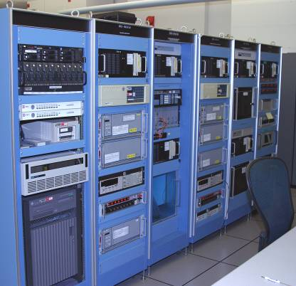
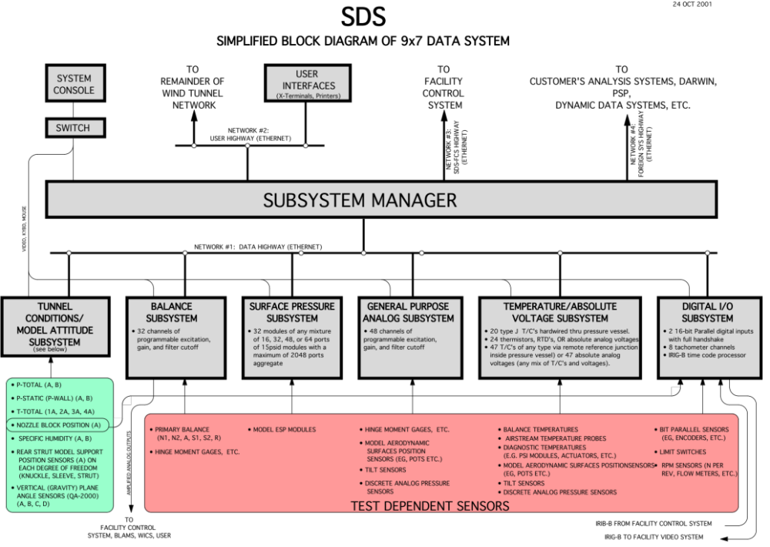
UPWT Standard Data System (SDS)

Slide 25
Ames Wind Tunnel Direction
Past
  High Demand for Wind Tunnel Testing
Present
  Diversity of Testing Customers
  A Critical National Asset
Future
  NASA’s role/mission in Aeronautics and Space Exploration is established
  Competitive Wind Tunnel Industry

Slide 26
Partnership
NASA and Contractor Must Partner to Succeed
  Equally Share in Wind Tunnel Mission/Vision
    Management
      Business Model Stakeholder
      Expanding Customer Base
    Workforce
      Watch Out for Each Other and Customers
        Improve Safety, Productivity and Overall Customer Experience
      Part of the Ames Community

Slide 27
Questions?

