Slide 1

Entry, Descent and Landing Panel
Humans to Mars Summit 2020
Michelle M. Munk
NASA’s EDL System Capability Lead
2 September 2020

Slide 2
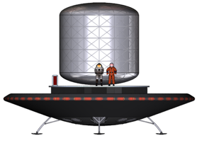

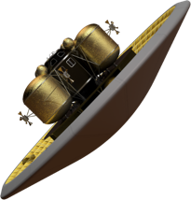


Human Mars Landers: A Leap in Scale
Human-scale Mars landers require new approaches to all phases of Entry, Descent, and Landing
Cannot use heritage, low-L/D rigid capsules → deployable hypersonic decelerators or mid-L/D rigid aeroshells
Cannot use parachutes → retropropulsion, from supersonic conditions to touchdown
No viable alternative to an extended, retropropulsive phase of flight
 | Viking | Pathfinder | MERs | Phoenix | MSL | InSight | M2020 | Human-Scale Lander (Projected)
Diameter (m) | 3.505 | 2.65 | 2.65 | 2.65 | 4.52 | 2.65 | 4.5 | 16 - 19
Entry Mass (t) | 0.930 | 0.584 | 0.832 | 0.573 | 3.153 | 0.608 | 3.440 | 40 - 65
Parachute Diameter (m) | 16.0 | 12.5 | 14.0 | 11.8 | 19.7 | 11.8 | 21.5 | N/A
Parachute Deploy (Mach) | 1.1 | 1.57 | 1.77 | 1.65 | 2.2 | 1.66 | 1.75 | N/A
Landed Mass (t) | 0.603 | 0.360 | 0.539 | 0.364 | 0.899 | 0.375 | 1.050 | 26 - 36
Landing Altitude (km) | -3.5 | -2.5 | -1.4 | -4.1 | -4.4 | -2.6 | -2.5 | +/- 2.0
Landing Technology | Retro-propulsion | Airbags | Airbags | Retro-propulsion | Skycrane | Retro-propulsion | Skycrane | Retro- propulsion
Entry Capsule
(to scale)
Low-L/D
Steady progression of “in family” EDL
New EDL Paradigm
Payloads up to ~ 1 t
Payloads 20-26 t
2

Slide 3
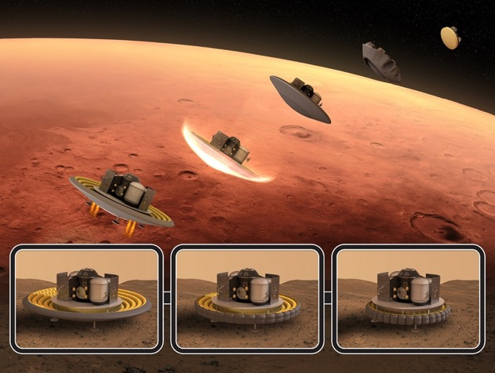
Human-Class Mars EDL ConOps
HIAD + SRP (point of departure)
Deorbit
From 1-Sol or 5-Sol orbit
Years of architecture and EDL systems studies have established today’s point of departure
  In 2018, narrowed from four designs to two, which bounded the flight performance space
  Given the NASA architecture assumptions, only HIAD/SRP is viable in SLS 8.4 m shroud (others have insufficient volume, are too massive)
  EDL is fairly insensitive to architecture, as long as a Mars parking orbit is used (exception is shroud diameter)
  Entry
  AOA= -10 deg
  Velocity = 4.7 km/s
  FPA = -10.6 deg
Deploy
16-18 m diameter
Powered Descent Initiation
Mach = 3.0
Alt = 8.3 km
Pitch to 0 deg angle of attack
Approach
8x100kN engines
80% throttle
Touchdown
HIAD Retract
Surface Ops

Slide 4















Mars EDL Notional Development Timeline
15
16
17
18
19
20
21
22
23
24
25
26
27
28
29
30
31
32
33
34
35
36
37
38
39
2020
2022
2024
2026
2028
M2020 EDL
SRL EDL
Mars Launch Windows
Deliver ~2 years before Launch
Humans
On
Mars
LOFTID Flight Test
HIAD Guided Earth Flight Tests (scaled)
EDL System Studies and Ground Development/Demonstration
HIAD Ground Scale-Up to 10, 15 m
First Mars Cargo Mission Development (full scale)
Testing/CFD
Retropropulsion Earth Flight Tests (scaled)
Second Mars Cargo Mission Development (full scale)
SPLICE
Precision Landing Earth and Lunar Testing
First Mars Human Mission Development (full scale)
PSI
Plume Surface Interaction Ground Testing/Lunar Flight Validation
Legend
Current Activity Planned Mission EDL
Spacecraft Development or Operations
Risk Reduction / Capability Maturation
Flight System Delivery
Launch (test flight LV TBD) Feed-in
Entry Systems/Foundational Modeling and High-End Computing (cross-cutting)
Competed Industry Participation

Slide 5





EDL is a Major Thrust within Space Technology
LEAD
THRUSTS
OUTCOMES
CAPABILITIES
Go
Rapid, Safe, & Efficient Space Transportation
Enable Human Earth-to-Mars Round Trip mission durations less than 750 days.
Enable rapid, low cost delivery of robotic payloads to Moon, Mars and beyond.
Enable reusable, safe launch and in-space propulsion systems that reduce launch and operational costs/complexity and leverage potential destination based ISRU for propellants.
Cryogenic Fluid Management & Propulsion
Advanced Propulsion
Ensuring American global leadership in Space Technology
Land
Expanded Access to Diverse Surface Destinations
Lunar Exploration building to Mars and new discoveries at extreme locations
Robust national space technology engine to meet national needs
U.S. economic growth for space industry
Expanded commercial enterprise in space
Enable Lunar and Mars Global Access with ~20t payloads to support human missions.
Land Payloads within 50 meters accuracy while also avoiding local landing hazards.
Human & Robotic Entry, Descent and Landing
Precision Landing
Live
Sustainable Living and Working Farther from Earth
Conduct Human/Robotic Lunar Surface Missions in excess of 28 days without resupply.
Conduct Human Mars Missions in excess of 800 days including transit without resupply.
Provide greater than 75% of propellant and water/air consumables from local resources for Lunar and Mars missions.
Enable Surface habitats that utilize local construction resources.
Enable Intelligent robotic systems augmenting operations during crewed and un-crewed mission segments.
Sustained human life support systems
Advanced Materials, Structures and Manufacturing
Sustainable Power
In-situ Propellant and Consumable Production
Autonomous Systems and Robotics
Enable new discoveries at the Moon, Mars and other extreme locations.
Enable new architectures that are more rapid, affordable, or capable than previously achievable.
Enable new approaches for in-space servicing, assembly and manufacturing.
Enable next generation space data processing with higher performance computing, communications and navigation in harsh deep space environments.
On-orbit Servicing, Assembly and Manufacturing
Small Spacecraft Technologies
Advanced Avionics
Advanced Communications & Navigation
Explore
Transformative Missions and Discoveries
Note: Multiple Capabilities are cross cutting and support multiple Thrusts. Primary emphasis is shown

Slide 6
Summary
NASA is maturing technology to address the challenges of Mars Entry, Descent and Landing, and leveraging Lunar exploration:
    Deceleration: Hypersonic Inflatable Aerodynamic Decelerator (HIAD) and Retropropulsion
    Precision Landing
    Plume-Surface Interaction
    System-level performance/Guidance, Navigation and Control (GN&C)
    Advanced Modeling/Computing (including instrumentation systems to acquire validation data)
Multiple programs and partnerships with industry and academia are being leveraged for a multi-faceted approach
Commercial lunar landers are a key component of technology demonstration
Robotic Mars science missions, along with focused technology maturation, pave the way for landing humans on Mars

Slide 7
THANK YOU

