Slide 1


NASA GEOS Composition Forecast System: “GEOS-CF”
K. Emma Knowland
USRA/GESTAR
NASA Global Modeling and Assimilation Office (GMAO)
In collaboration with:
GMAO: Christoph Keller, Lesley Ott, Steven Pawson, Pamela Wales, Nikolay Balashov, Larry Coy
Atmospheric Chemistry and Dynamics Lab: Bryan Duncan, Dan Anderson
18 August 2020

Slide 2
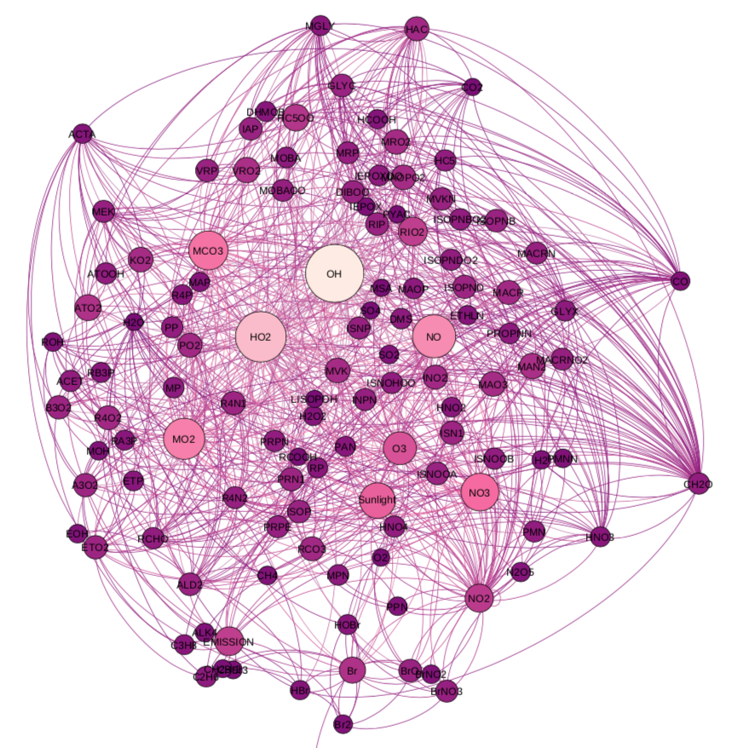
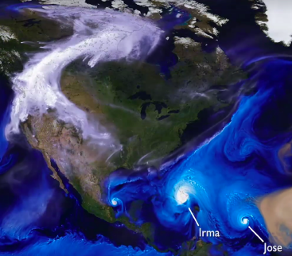

GEOS Composition Forecast
GEOS - CF
GEOS NWP
GEOS - Chem
25-km global resolution analyses based on daily weather/emissions and daily five-day forecasts
Released to the community on September 17, 2019; products start on January 1, 2018
https://gmao.gsfc.nasa.gov/weather_prediction/GEOS-CF/
k.e.knowland@nasa.gov christoph.a.keller@nasa.gov
Notes:
We run a coupled version of the GEOS model with the GEOS-Chem chemistry module, similar to the model set up used to produce the high resolution data used to make the synthetic TEMPO data. We started in early 2017 with our first experimental GEOS-CF forecast system, with a soft release in late 2018 of forecasts as images only on the GMAO FLUID website and last September we released the forecast and analysis data to the public.

Slide 3
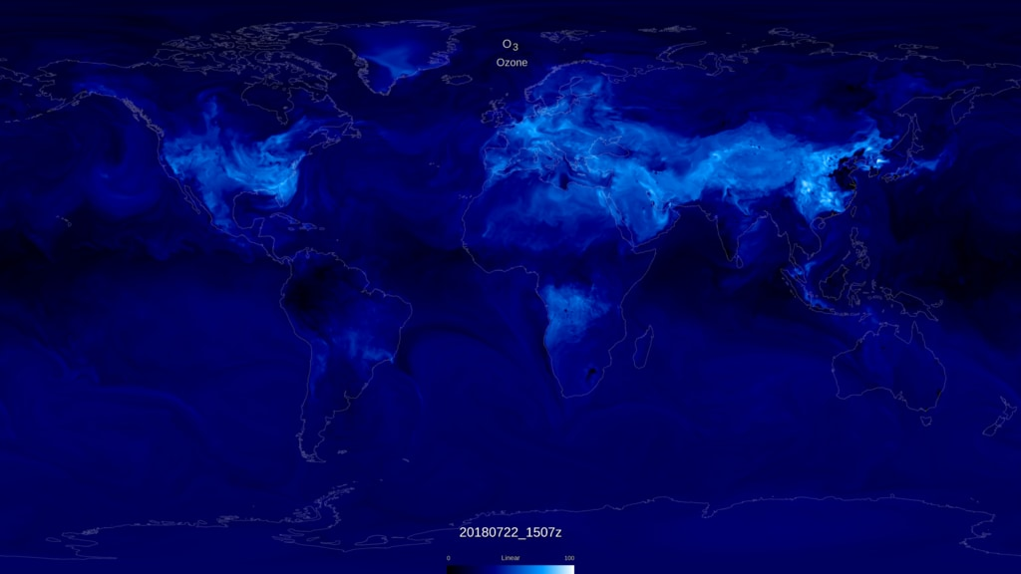
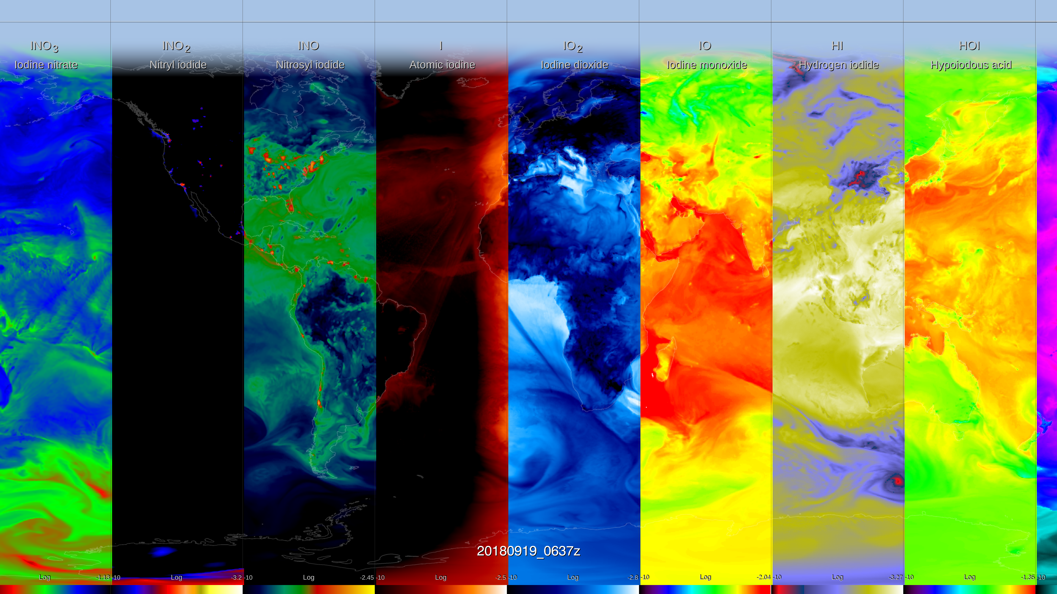
GEOS - Chem
  250 Chemical Species
  725 Chemical Reactions
https://svs.gsfc.nasa.gov/4754
GEOS-Chem v12
Tropospheric and Stratospheric chemistry
https://gmao.gsfc.nasa.gov/weather_prediction/GEOS-CF/
k.e.knowland@nasa.gov christoph.a.keller@nasa.gov
Notes:
GEOS-Chem is a state-of-the science chemistry transport model maintained by the Harvard folks with a global community of developers and users. It’s a complex chemistry model, with full tropospheric and Stratospheric chemistry with about 250 reactive species and over 700 reactions in the version 12 that we are running. These images are from two SVS animations produced last year, illustrating surface ozone in the top right, and in the animation, we can see the diurnal cycle of surface ozone, with highest concentrations in white during the day close to urban centers and near forest fires, while at night the ozone is low in these urban areas due to NOx titration.
The animation captured in the bottom left highlights the complexity of the GEOS-Chem chemistry, showing 96 species that play a part either directly or indirectly in simulating ozone chemistry. The bottom left shows just a few of these different species and you can see the interaction with the large-scale synoptic weather systems, as well as evidence for the emission sources like the ship tracks.

Slide 4
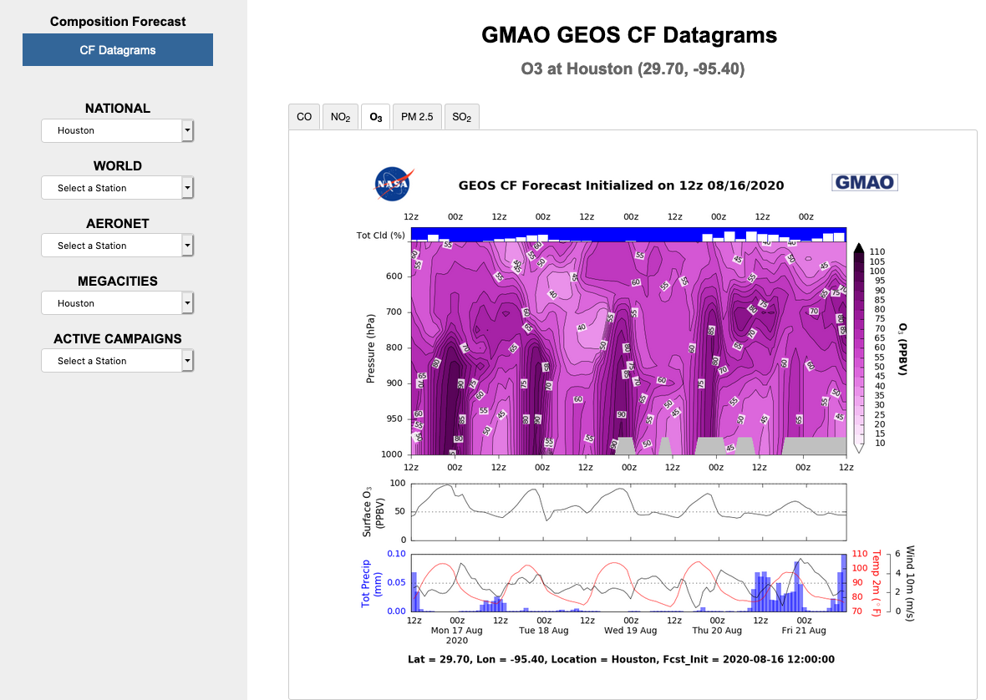
GEOS-CF Products
One 5-day global forecast per day:
  1-day meteorological replay (“analysis”)
  5-day forecast, initiated at 12Z
  c360L72 resolution (0.25°), ~25x25 km², 72 layers
  Chemistry: O₃, NO_{x}, CO, VOCs, PM, …
  Meteorology: T, U, V, RH ....
Data distributed via OpenDAP and web link:
  15 minute “surface” fields
  1-hour average and instantaneous 2D & 3D
  Summary plots on “FLUID” website
  Documentation in GMAO Office Note #17
https://fluid.nccs.nasa.gov/cf/
https://gmao.gsfc.nasa.gov/weather_prediction/GEOS-CF/
k.e.knowland@nasa.gov christoph.a.keller@nasa.gov
Notes:
Each day, starting around 3pm, we launch the GEOS-CF following the completion of the 12z GEOS-FPIT run. This is because, in order to have the best initial conditions for our 5-day forecast, we first run a meteorological replay to GEOS NWP model now with the GEOS-Chem chemistry. We run the model at the highest spatial resolution of a global composition forecast system that we are aware of, at 0.25 degree, and now we have the chemistry on the same spatial and temporal resolutions as the meteorology. Since the end of each replay simulation is the start of the next day’s simulation, we can stitch these together for a continuous dataset since January 2018. We released to the public high-temporal frequency data with a focus on air quality, so we have surface level concentrations and meteorological fields at 15-minute intervals, which makes for great animations as highlighted in the previous slide, and also 1-hourly intervals again for surface diagnostics and 3D composition and meteorology.

Slide 5
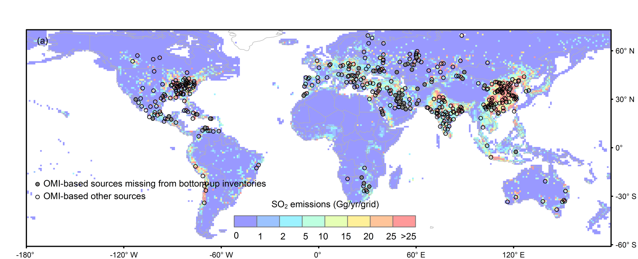
Year-to-year emissions changes
Emissions:
  HTAP (global bottom-up) for anthropogenic.
  Online dust, sea salt, plant emissions
  Annual gridded scale factors based on satellite data are applied to the emissions of CO (Oda et al., 2017) and SO₂ (Liu et al., 2018).
  “Business-as-usual” assumed for 2020
SO₂ emissions in the OMI-HTAP inventory
A new emission inventory, OMI-HTAP, combines OMI-based SO₂ emissions for large sources and the bottom-up inventory, HTAP, for smaller sources.
Liu, F., et al., Atmos. Chem. Phys., 18, 2018.
https://gmao.gsfc.nasa.gov/weather_prediction/GEOS-CF/
k.e.knowland@nasa.gov christoph.a.keller@nasa.gov
Notes:
But what goes into the model also helps us to correctly simulate air quality.
We use the monthly averages from HTAP v2.2 for the anthropogenic emissions, and several online parameterizations for things like dust, sea salt and biogenic emissions
To improve on the base emissions, we use a bunch of different scale factors, such as annual gridded scale factors based on satellite data to better capture sources and trends. Specifically, we use Fei Liu’s OMI-HTAP inventory.
Given COVID-19 era that we are living in right now, it is important to mention that our base year for emissions is 2018, and this was continued for 2019 and 2020, so any changes in anthropogenic emissions due to COVID-19 restrictions are not likely picked up by the model.

Slide 6
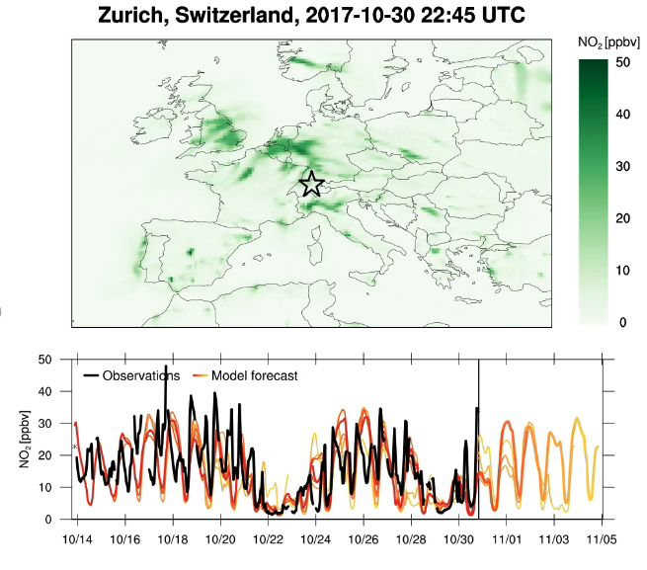
Daily variations of emissions
  Scale factors applied to emissions for diurnal and weekly variations
  These are clearly beneficial for surface NO₂ analyses and forecasts
  Shown for Zurich - weather and diurnal/weekly signals are prominent
  Surface observations obtained through emerging connection to OpenAQ (openaq.org)
Observation
0 +1 +2 +3 +4 +5
GEOS-CF
https://gmao.gsfc.nasa.gov/weather_prediction/GEOS-CF/
k.e.knowland@nasa.gov christoph.a.keller@nasa.gov
Notes:
In addition, the monthly average anthropogenic emissions are broken down into hourly values using sector-specific day-of-week and diurnal scale factors. This can be seen nicely in the example on the left of surface concentrations of NO2 over Europe. On the bottom is a time series comparing the observations of NO2, shown in black, from Zurich, Switzerland obtained from OpenAQ’s database, and the daily GEOS-CF replay (in red) and 5-day forecast (transitioning to more yellow colors). And what you can see, is the diurnal variability of the model agrees well with the observations, and we can see the flattening of the diurnal variability on Sundays October 22nd and October 29th. Next slide, please

Slide 7
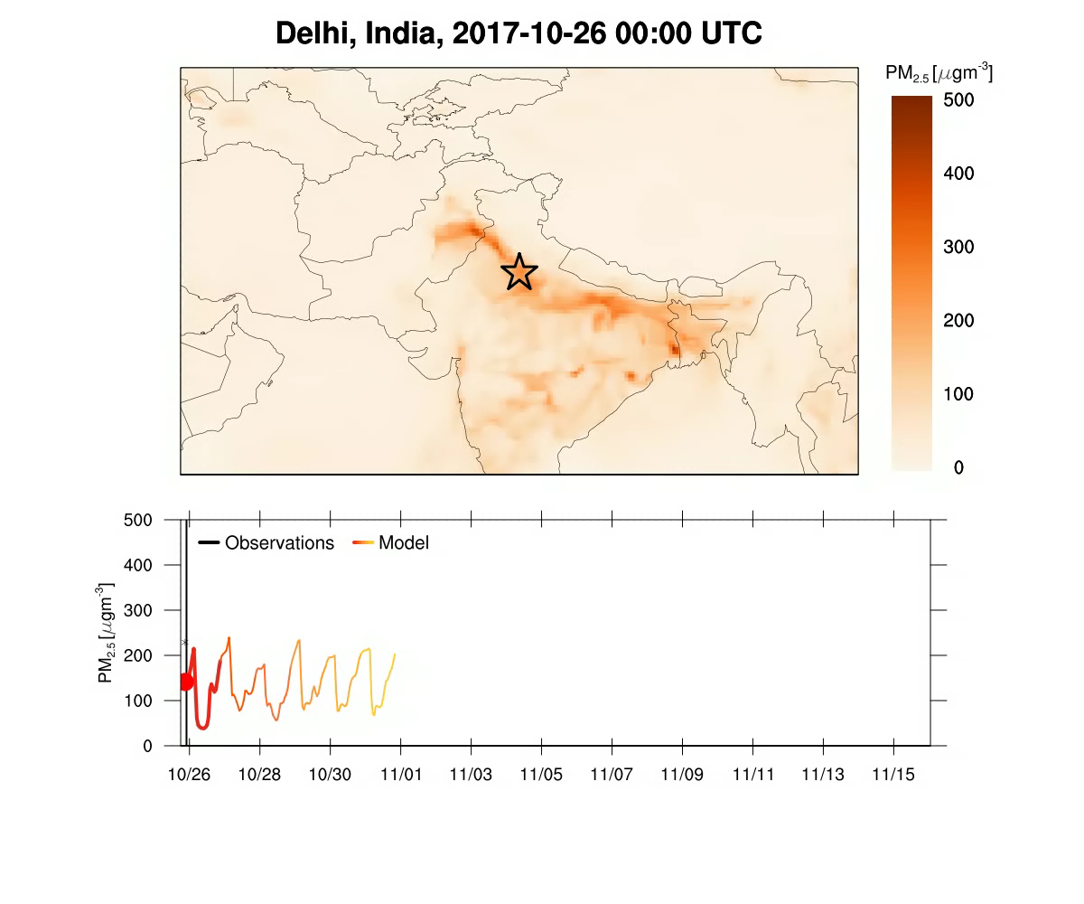
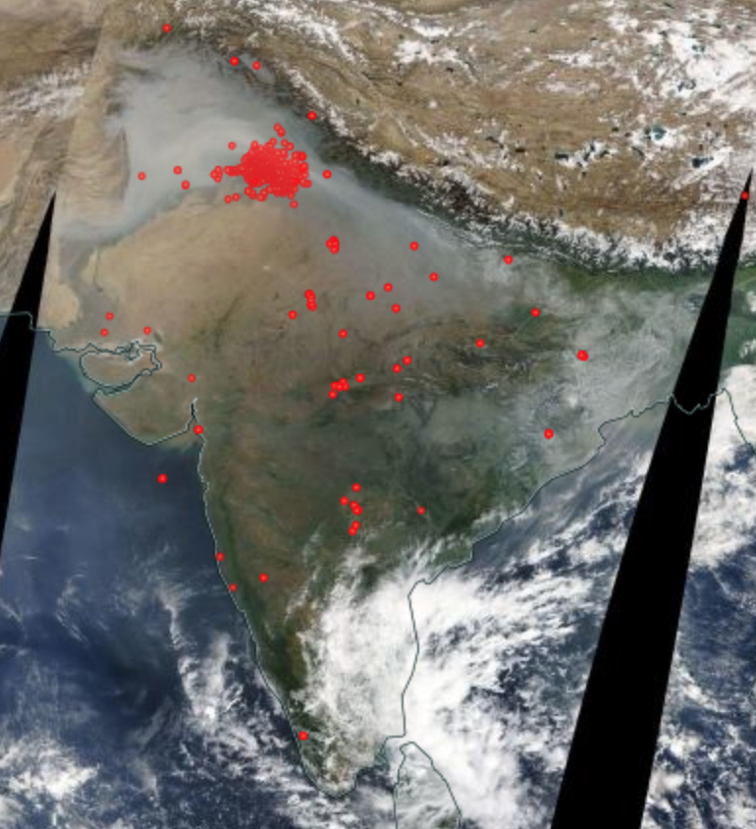
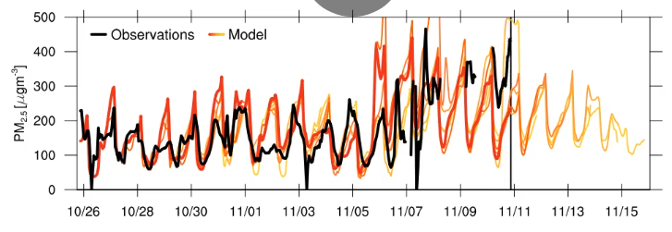
Near-real time updates from satellite data
  Biomass burning emissions from near-real time QFED v2.5
MODIS fires Nov 01, 2017
Observation
0 +1 +2 +3 +4 +5
GEOS-CF
https://gmao.gsfc.nasa.gov/weather_prediction/GEOS-CF/
k.e.knowland@nasa.gov christoph.a.keller@nasa.gov
Notes:
While there is no direct data assimilation of chemical species in the GEOS-CF system, there is near-real time information constraining parts of the system, even during this COVID-19 period. We use the near-real time QFED to inform the system of biomass burning emissions. On the right, is a MODIS image from Nov 2017, with the red dots indicating the fire locations. On the left, is a time series of PM2.5 for Delhi for this same time period. In the forecasts, with persistence of the biomass burning emissions, there can be large discrepancies between the forecasted PM2.5 and the observed PM2.5, depending on the meteorological conditions and the fire intensity.
In order to take advantage of the established GEOS ozone data assimilation system before we could implement the das in the GEOS-CF, we devised a way to nudge only stratospheric ozone toward the GEOS FP assimilated O3, with the intention to keep our ozone in line with observations while still allowing GEOS-Chem to do its thing. We’ll show examples for the ozone later. Next slide.

Slide 8
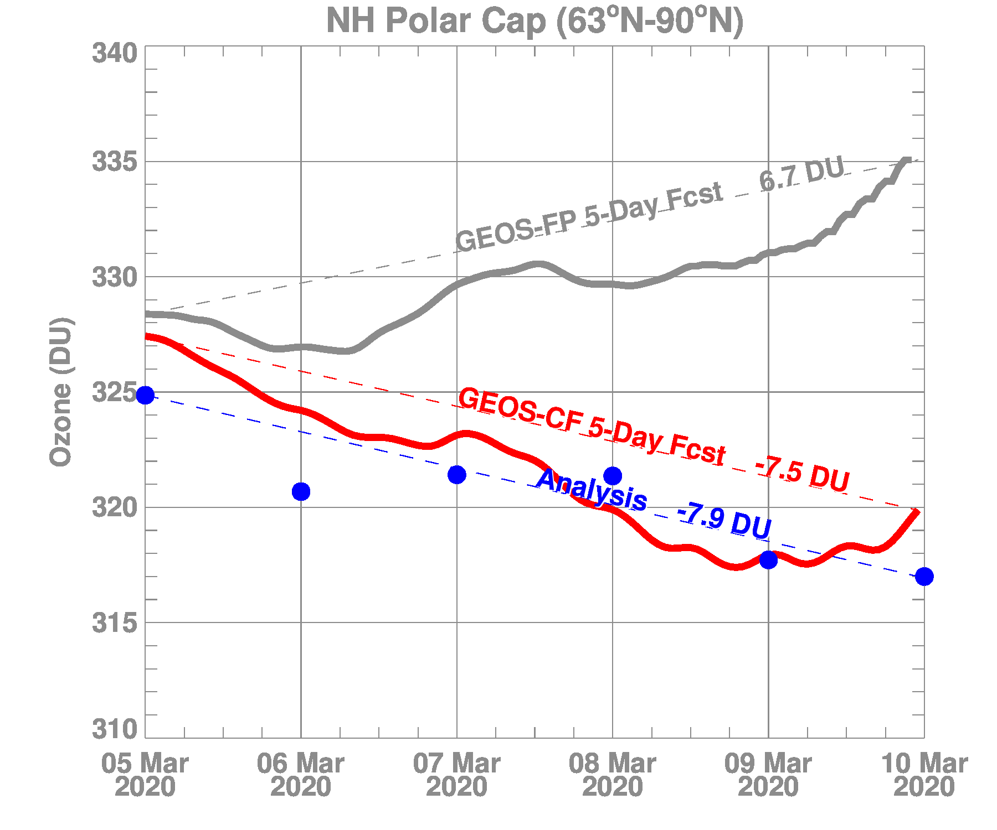
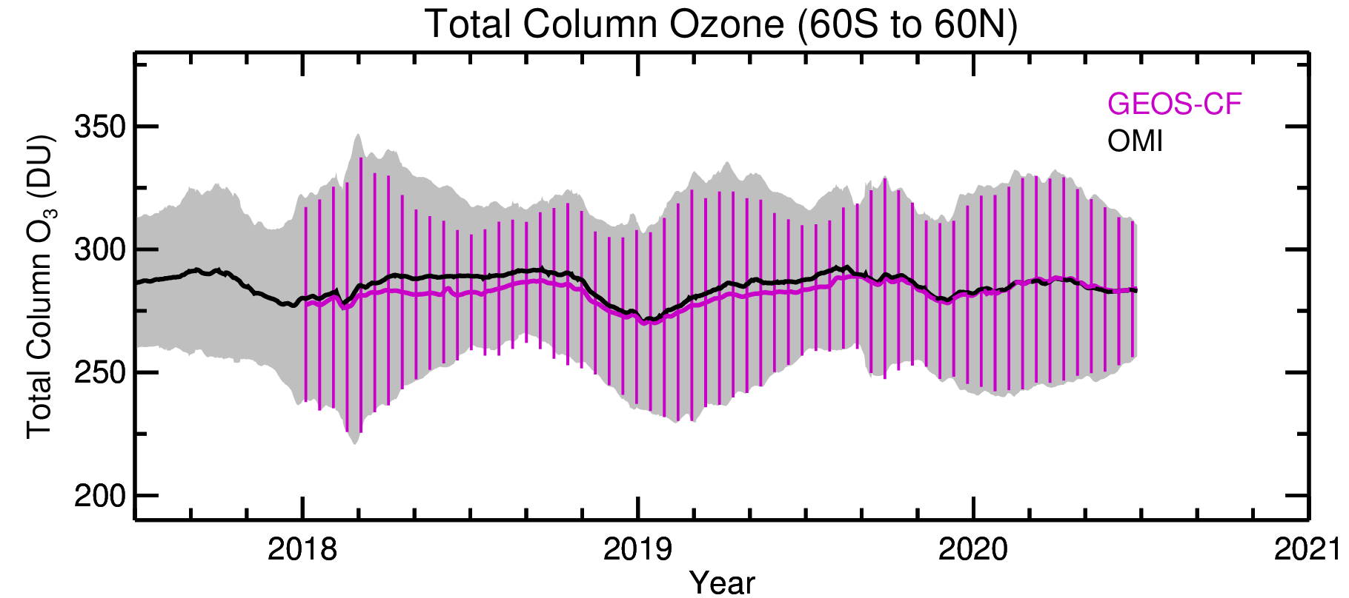
Near-real time updates from satellite data
  GEOS-CF Stratospheric O₃ is weakly nudged to the GEOS FP assimilated O₃
5 March 2020 Forecast
Average Column Ozone
NH Polar Cap
5-Days
https://gmao.gsfc.nasa.gov/weather_prediction/GEOS-CF/
k.e.knowland@nasa.gov christoph.a.keller@nasa.gov
Notes:
While right now there is no direct data assimilation of chemical species in the GEOS-CF system, there is near-real time information constraining parts of the system, even during this COVID-19 period. We use the near-real time QFED to inform the system of biomass burning emissions. In the center, is a MODIS image from Nov 2017, with the red dots indicating the fire locations in India. On the left, is a time series of PM2.5 for Delhi for this same time period. In the forecasts, with persistence of the biomass burning emissions, there can be large discrepancies between the forecasted PM2.5 and the observed PM2.5, depending on the meteorological conditions and the fire intensity.
In order to take advantage of the established GEOS ozone data assimilation system before we could implement the assimilation system in the GEOS-CF, we devised a way to weakly nudge only stratospheric ozone toward the GEOS FP assimilated O3, with the intention to keep our ozone in line with observations while still allowing GEOS-Chem chemistry to do most of the work.

Slide 9
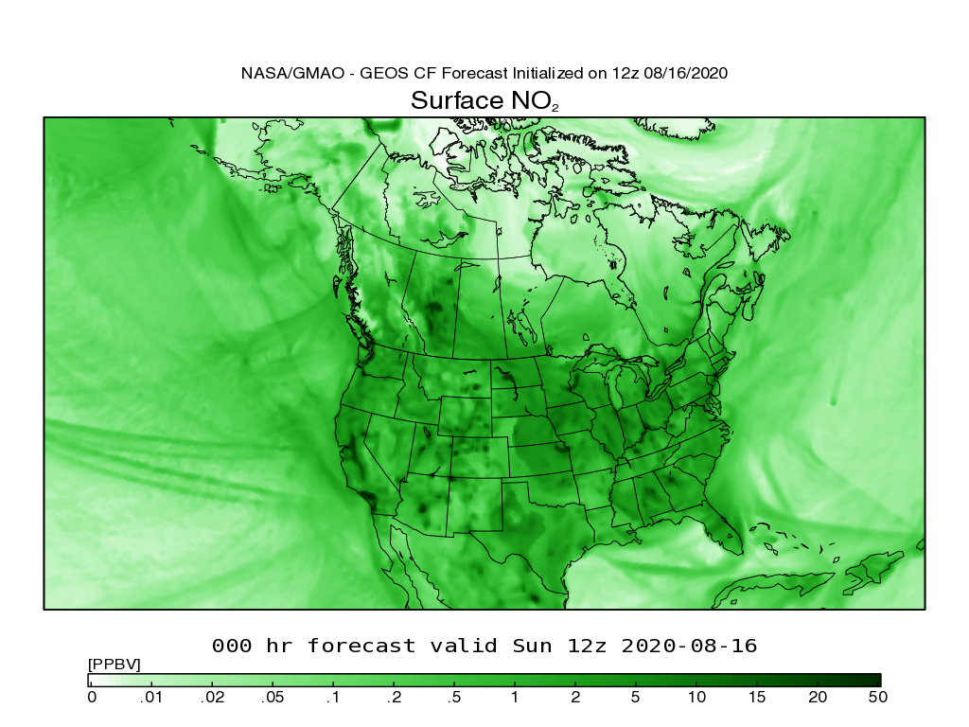
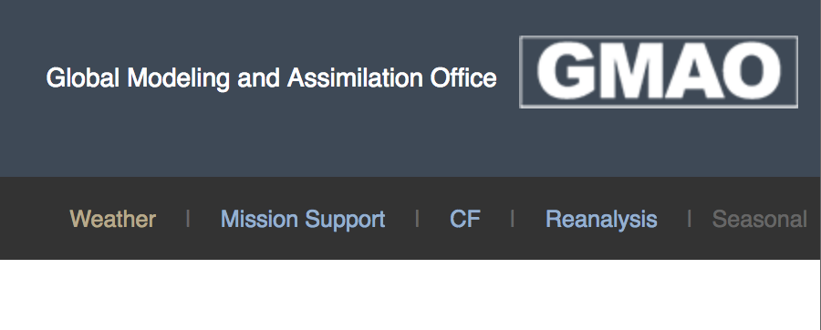
Where to find GEOS-CF
Maps available at fluid.nccs.nasa.gov/cf a mobile-friendly website
https://gmao.gsfc.nasa.gov/weather_prediction/GEOS-CF/
k.e.knowland@nasa.gov christoph.a.keller@nasa.gov
Notes:
For quick look of the data, the latest forecasts are available on our FLUID website as time series of surface and vertical profiles, but also regional maps which can be animated through the five-day forecast.

Slide 10
Where to find GEOS-CF
Maps available at fluid.nccs.nasa.gov/cf a mobile-friendly website
Vertical O₃
Surface O₃
Meteorology
https://gmao.gsfc.nasa.gov/weather_prediction/GEOS-CF/
k.e.knowland@nasa.gov christoph.a.keller@nasa.gov
Notes:
For quick look of the data, the latest forecasts are available on our FLUID website as time series of surface and vertical profiles, but also regional maps which can be animated through the five day forecast.

Slide 11
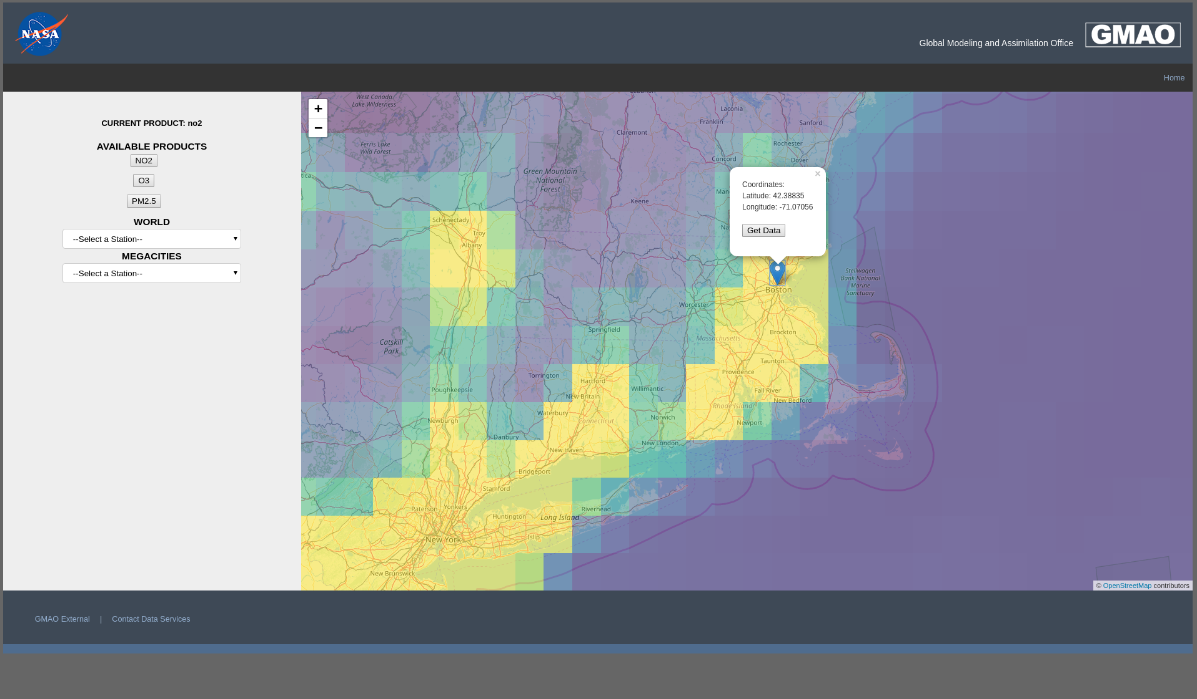
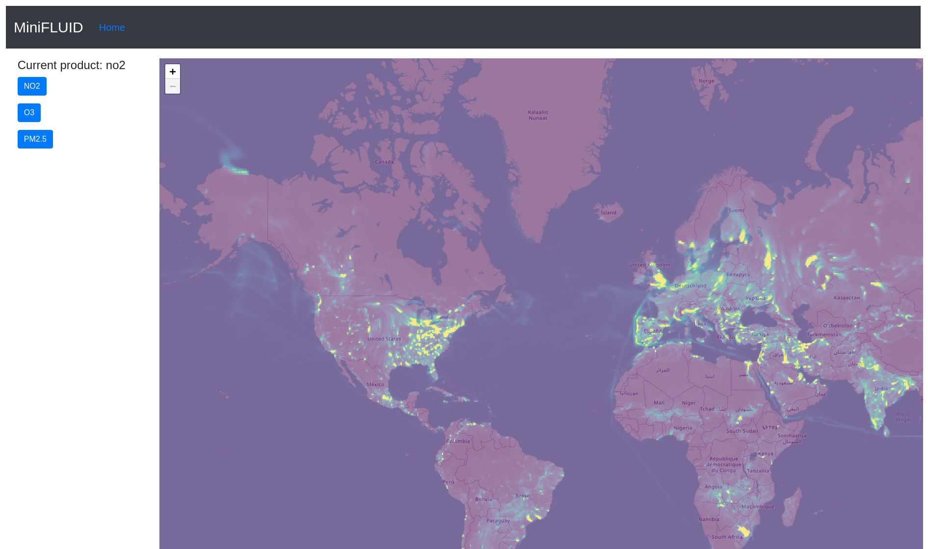
Added features to FLUID in Development ☺
Thanks to support from NASA HQ Applied Sciences and Army Public Health Center for the development of new capabilities in FLUID
Thanks to support from NASA HQ Applied Sciences and Army Public Health Center for the development of new capabilities in FLUID
Development by Brent Smith and Callum Wayman, SSAI/GMAO
Notes:
Thanks to some additional funding from NASA’s Health and Air Quality Applied Sciences Project Manager and the US Army Public Health, a new capability in FLUID is being developed (referred t as mini fluid in development). Investment from both Applied Sciences and interested stakeholder shows how this NASA product can be used beyond traditional scientific research. Starting from a global view of the GEOS-CF surface NO2, one can zoom in on a location, such as shown here for San Francisco, to access the data for that specific location by clicking on “Get Data”.

Slide 12
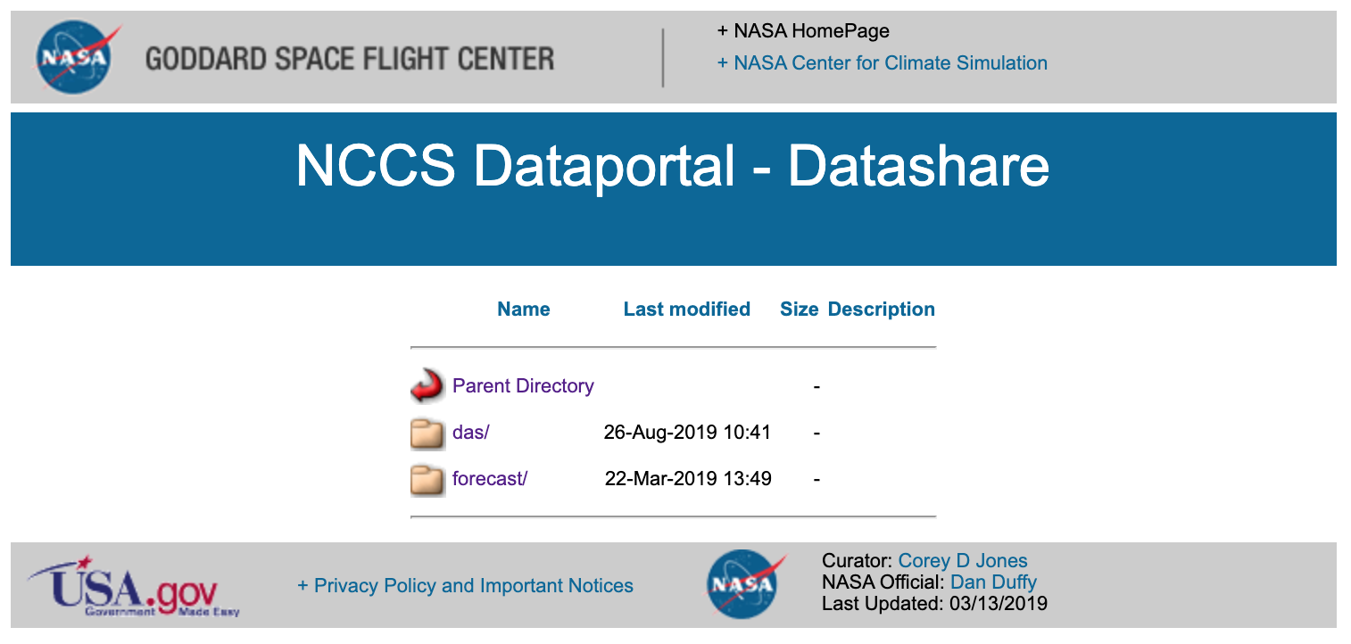
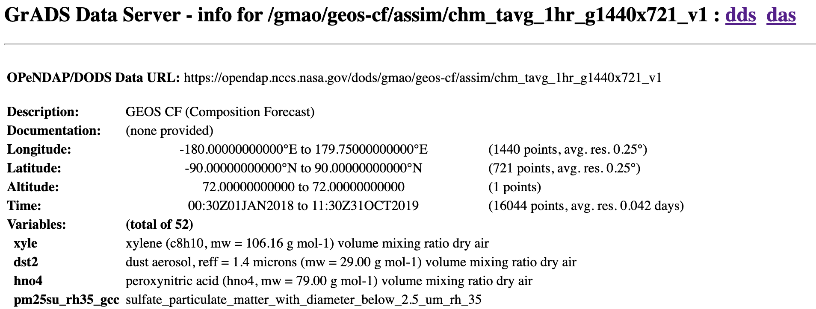
GEOS-CF are available online in near real-time
FLUID is a mobile-friendly website
https://portal.nccs.nasa.gov/datashare/gmao/geos-cf/v1/
https://fluid.nccs.nasa.gov/cf/
https://opendap.nccs.nasa.gov/dods/gmao/geos-cf/
https://gmao.gsfc.nasa.gov/weather_prediction/GEOS-CF/
k.e.knowland@nasa.gov christoph.a.keller@nasa.gov
Notes:
GEOS-CF 3D and 2D data since 1 January 2018:
Download from the NASA Data Portal https://portal.nccs.nasa.gov/datashare/gmao/geos-cf
Remote access through OPeNDAP https://opendap.nccs.nasa.gov/dods/gmao/geos-cf

Slide 13
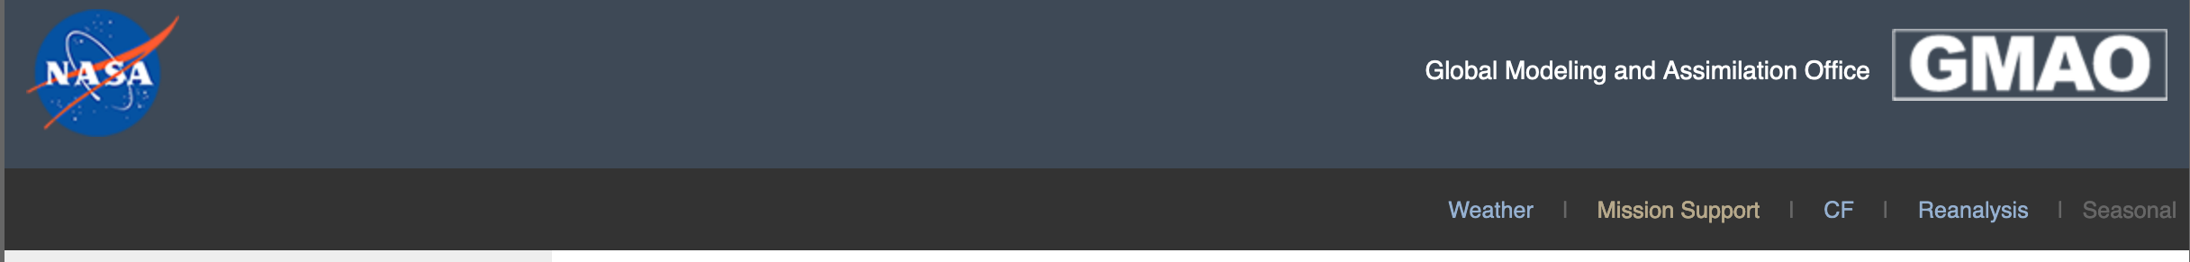
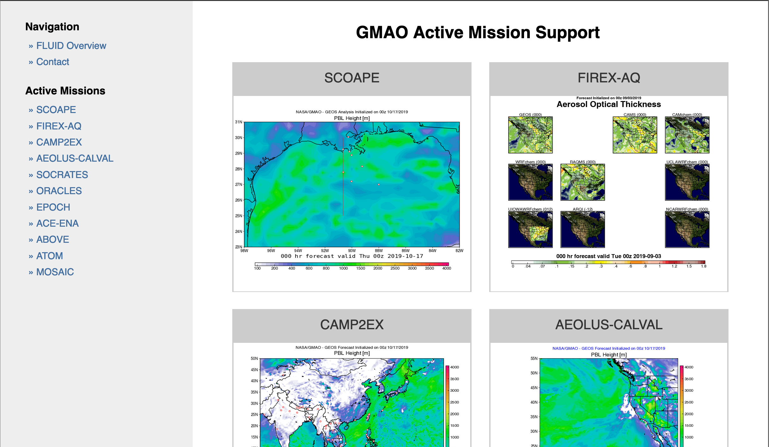
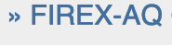
GMAO Mission Support for Field Campaigns
https://fluid.nccs.nasa.gov/missions/
http://fluid.nccs.nasa.gov/missions
https://gmao.gsfc.nasa.gov/weather_prediction/GEOS-CF/
k.e.knowland@nasa.gov christoph.a.keller@nasa.gov
Notes:
GMAO has a long history of supporting NASA field campaigns

Slide 14

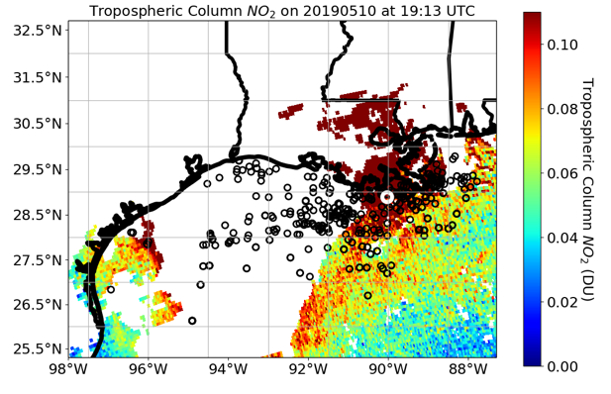
Satellite Coastal and Oceanic Atmospheric Pollution Experiment (SCOAPE)
“Can we use NASA resources to monitor off shore sources in the Gulf of Mexico which are impacting air quality onshore?”
      The Gulf of Mexico is a complex region for both meteorology and composition
      Frequent cloud cover
      Onshore and off shore flow
        Recirculation of onshore pollution
      May 2019 measurement campaign
      GSFC support
        Mission planning
        Post mission analysis
        Capacity building
k.e.knowland@nasa.gov christoph.a.keller@nasa.gov

Slide 15
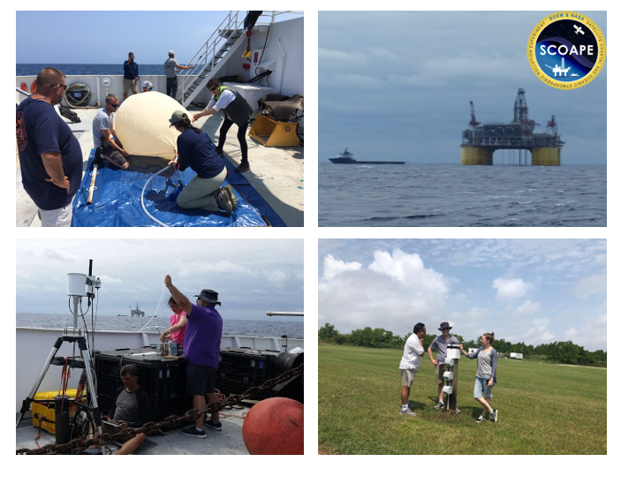
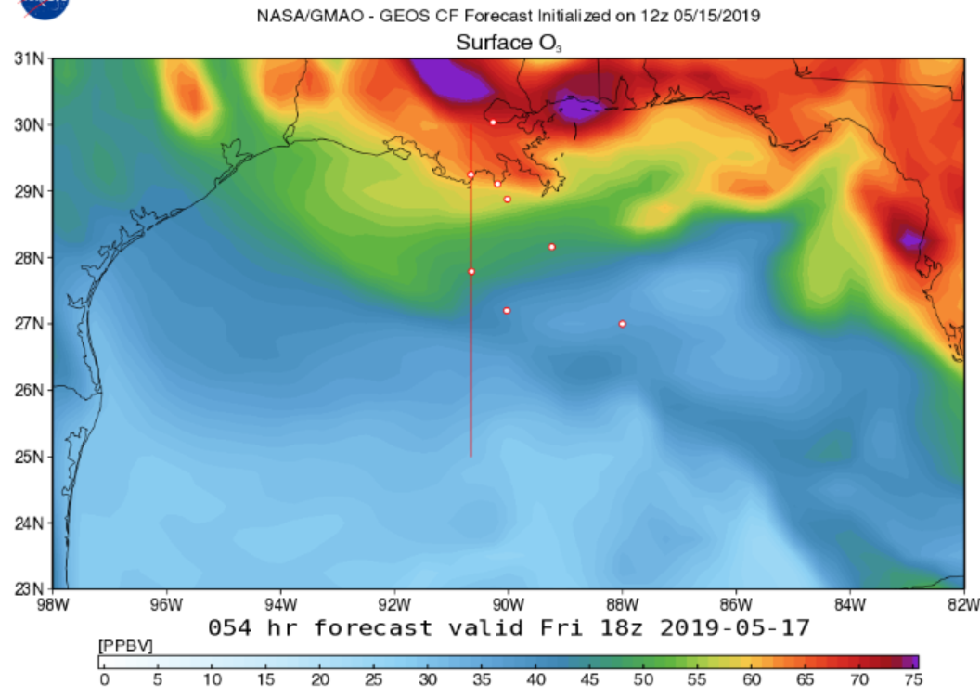
Satellite Coastal and Oceanic Atmospheric Pollution Experiment (SCOAPE)
“Can we use NASA resources to monitor off shore sources in the Gulf of Mexico which are impacting air quality onshore?”
      May 2019 measurement campaign
      GSFC support
        Mission planning
        Post mission analysis
k.e.knowland@nasa.gov christoph.a.keller@nasa.gov

Slide 16
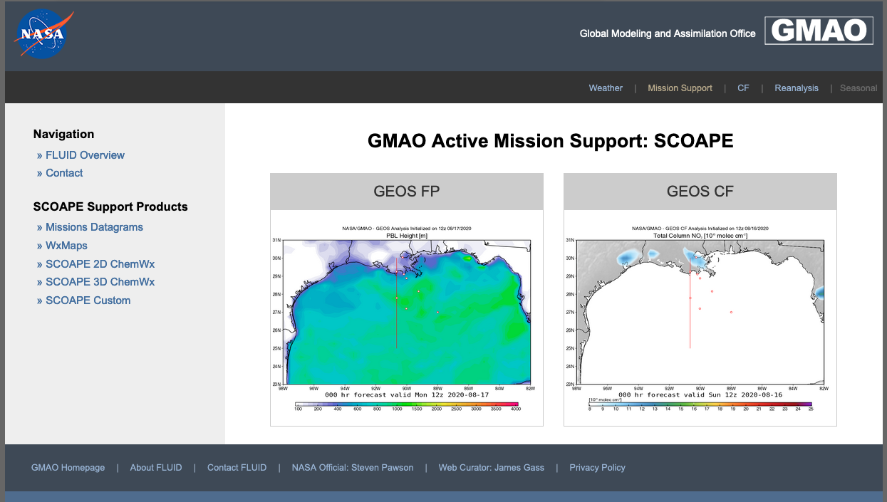
https://fluid.nccs.nasa.gov/missions/mission_SCOAPE/

Slide 17
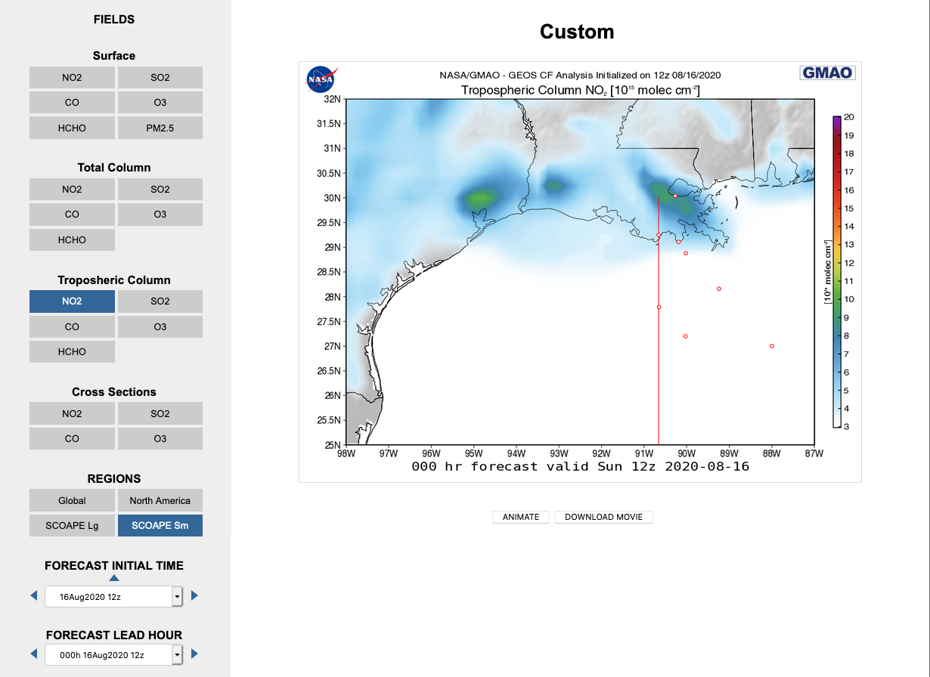
https://fluid.nccs.nasa.gov/missions/mission_SCOAPE

Slide 18
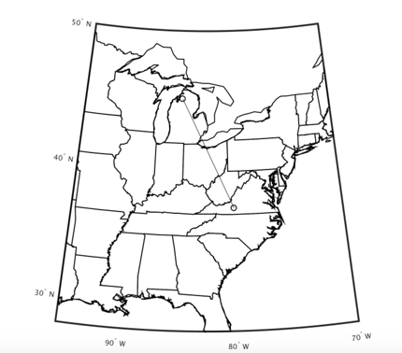
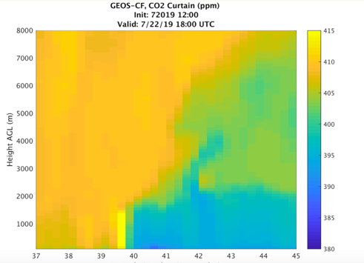
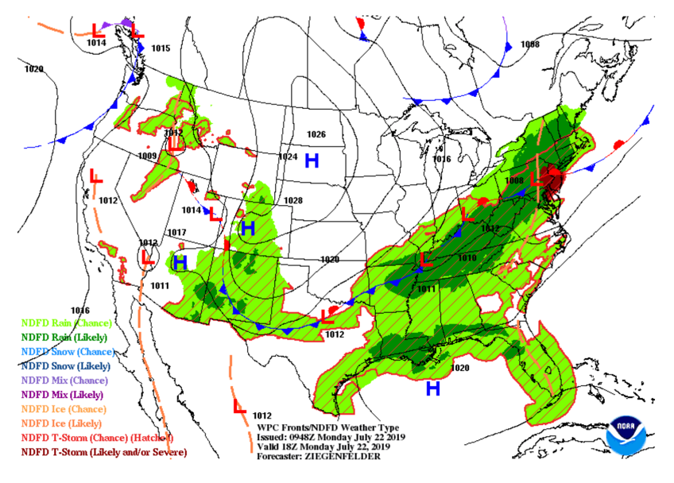
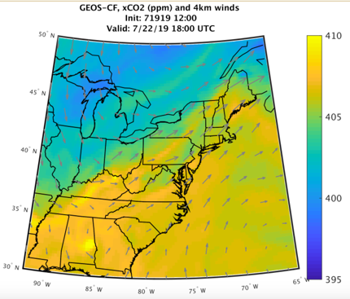
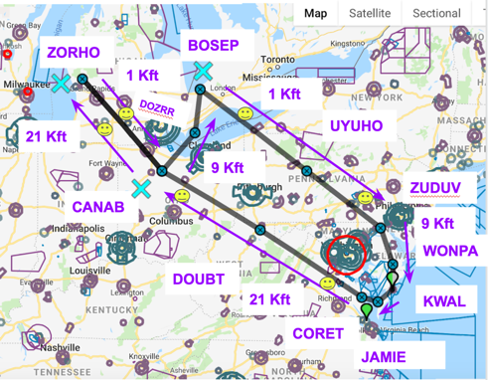
Forecasting Example for ACT-America
by Nikolay Balashov (USRA/NPP NASA GMAO)
NWS Fronts for 18Z Monday 07/22/19

Slide 19
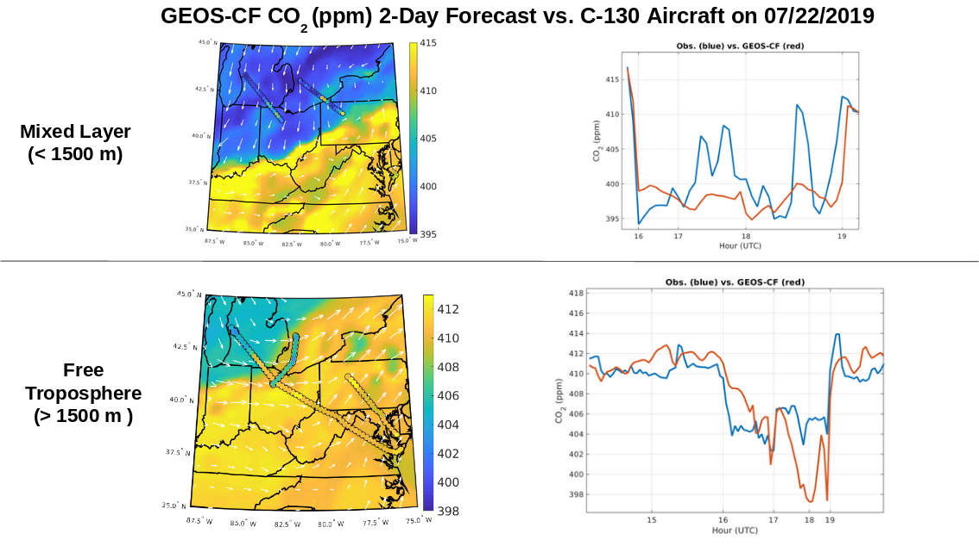
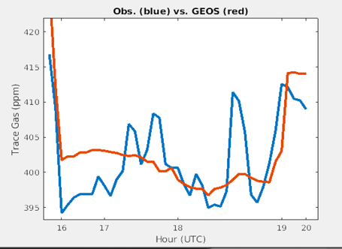
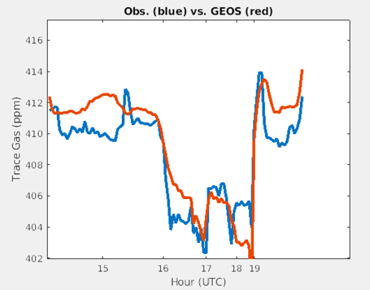
Forecast example evaluation
ACT-America

Slide 20
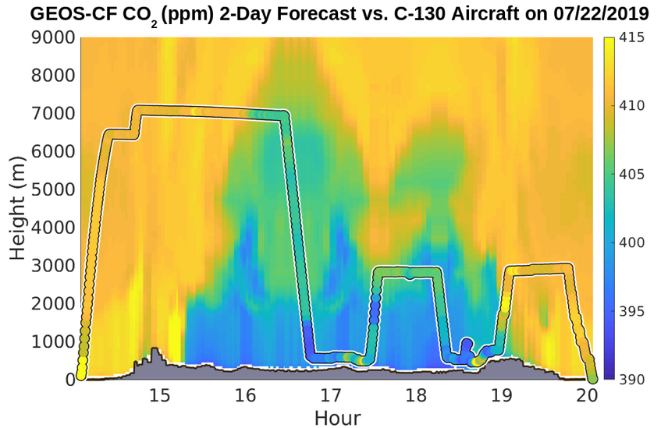
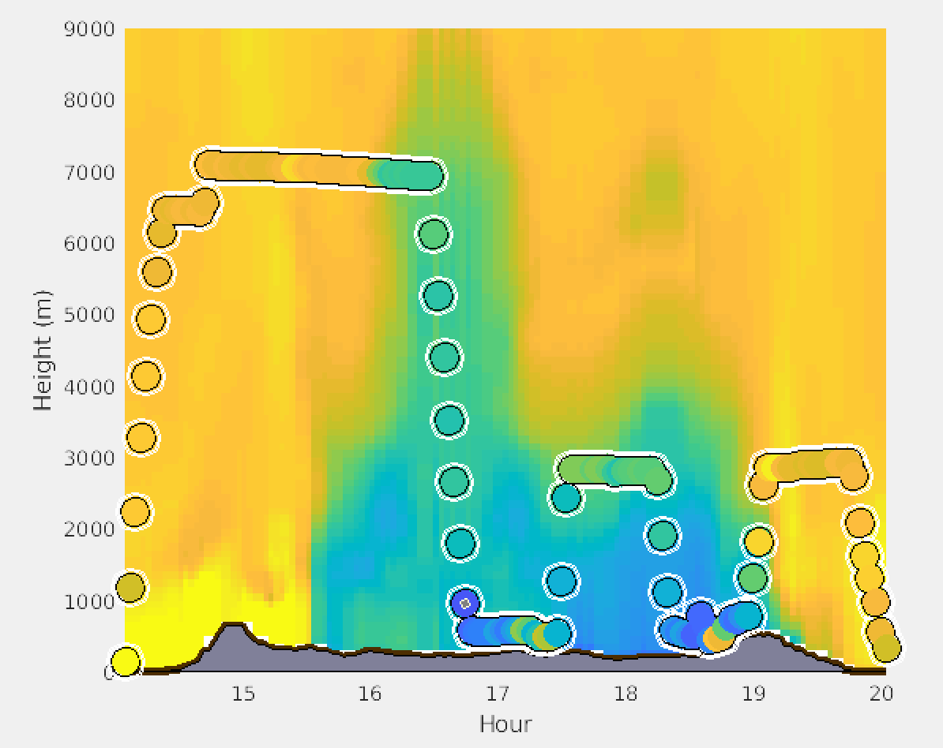
Forecast example evaluation
ACT-America

Slide 21
Summary of GEOS-CF Status
GEOS-CF daily global composition forecasts at 25km resolution are generated in near-real time:
  High-resolution “Analysis” fields are available since January 2018
  Forecasts remain available on data servers for two weeks
  The forecasts of the five most-requested surface pollutants (O₃, NO₂, CO, PM2.5, and SO₂ ) – remain accessible via data servers for January 2019-present
Forecast visualizations and links to data available at: fluid.nccs.nasa.gov/cf
Emerging applications users, including:
  NASA field missions (SCOAPE, FIREX-AQ, ACT-America)
  Daily alerts sent to NASA TOLNet lidar teams (Matt Johnson, NASA/Ames)
  TEMPO a priori for trace gas product
Notes:
for January 2019 – present

Slide 22

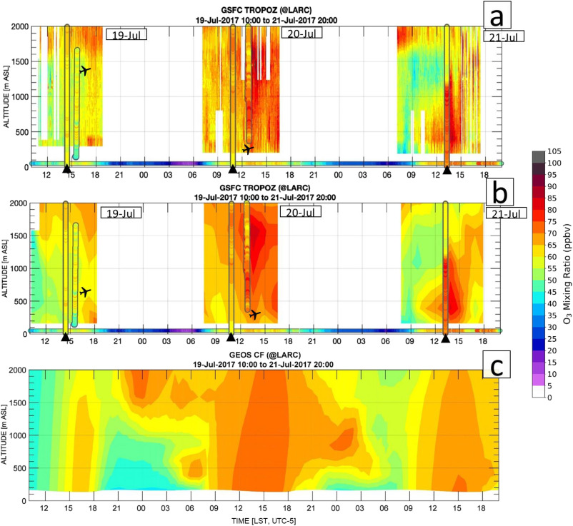
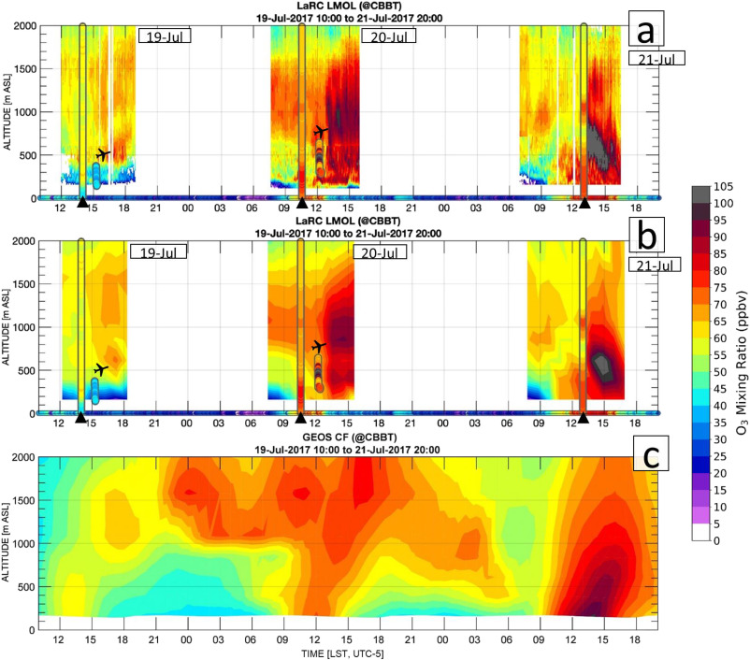
Model evaluation using TOLNet lidars: OWLETS-1
TROPOZ
LMOL
GEOS-CF
Dacic et al., 2020 Atmos. Environ. “Evaluation of NASA’s high-resolution global composition simulations: Understanding a pollution event in the Chesapeake Bay during the summer 2017 OWLETS campaign”
https://gmao.gsfc.nasa.gov/weather_prediction/GEOS-CF/
k.e.knowland@nasa.gov christoph.a.keller@nasa.gov
22
Notes:
First publication of evaluation of the GEOS-CF vs observations was by John Sullivan’s intern Natasha Dacic using the OWLETS observations. Left is Goddard’s lidar and on the right is Langley’s lidar for the same three days 19 to 21st July 2017, which have been shown before at this meeting, but now compared to the model at the bottom. We can see some very similar structures but we see the model is really missing the night time low ozone at the surface.

