Slide 1
Mapping Ocean-Reflected Radio Frequency Interference for the GPM Microwave Imager using Normalized Retrieval Cost Function
Ian S. Adams and S. Joseph Munchak
NASA / Goddard Space Flight Center

Slide 2
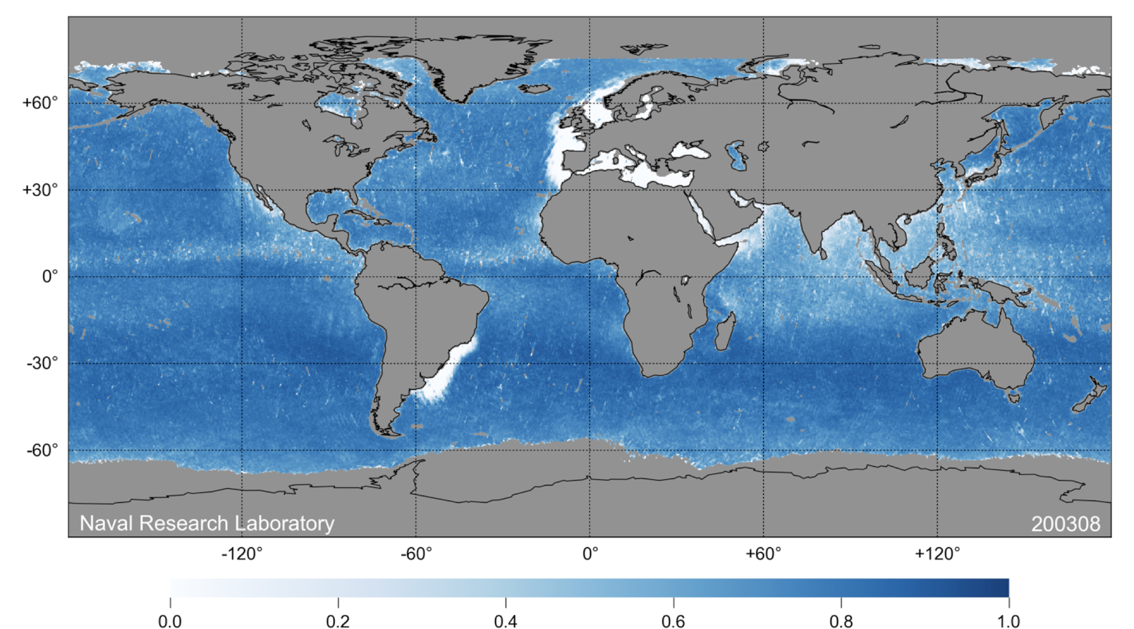
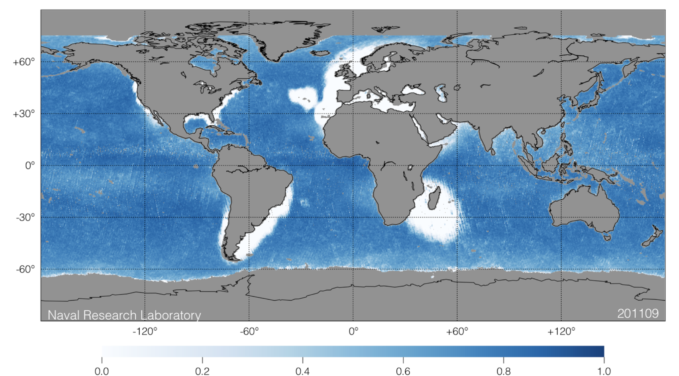
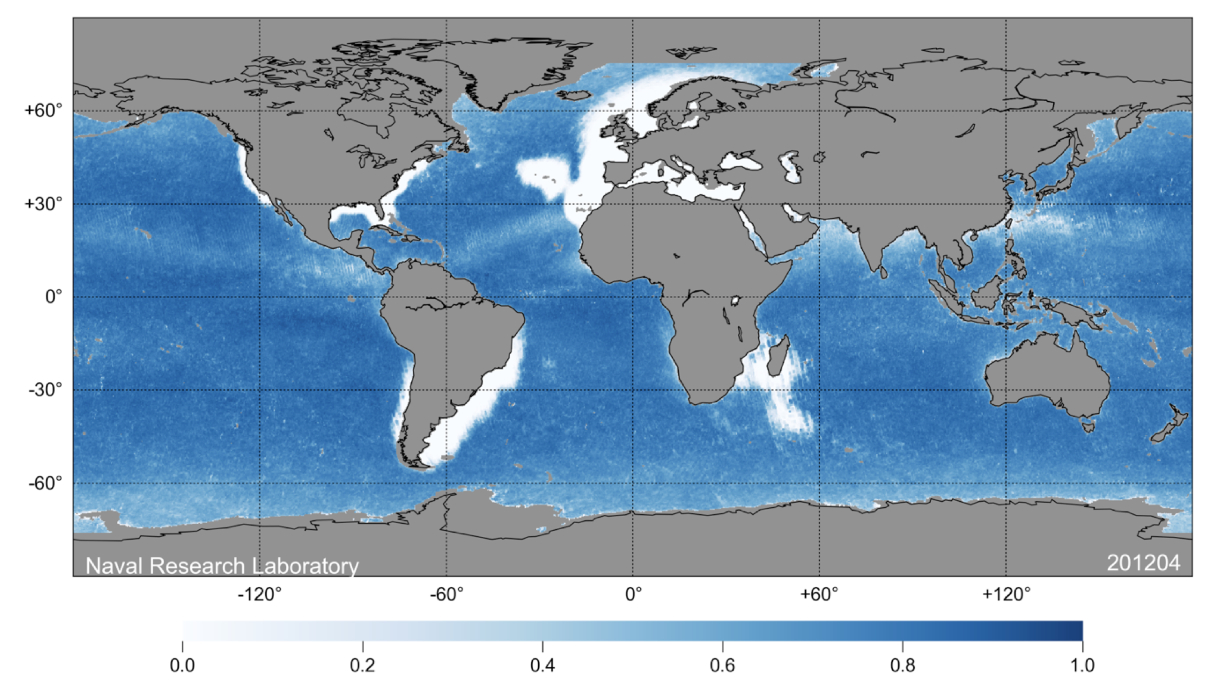
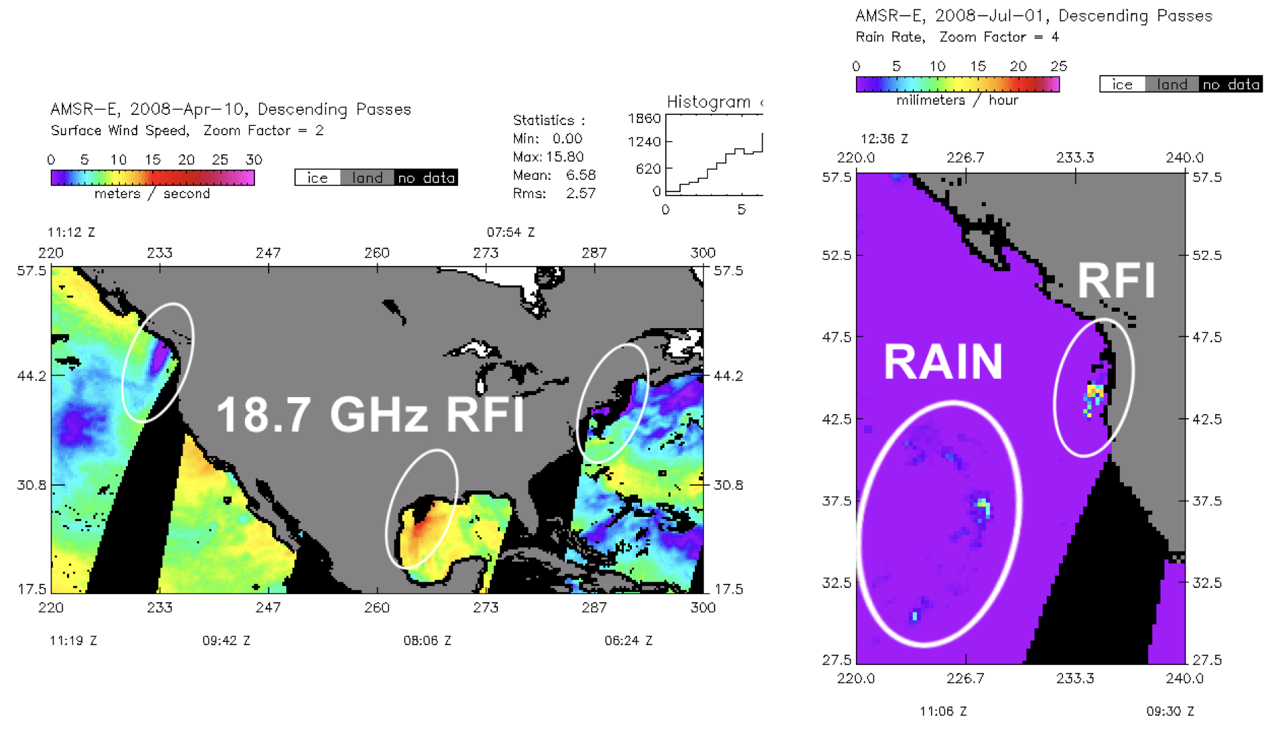
Background
Spurious ocean brightness temperatures noticed near European and South American coastlines
Source traced to X-band television satellites from multiple providers
Additional interference around, at K band, United States identified in 2007
Growth of continental halos observed by WindSat through peak in 2011
New satellite architectures have worked to mitigate RFI through better filtering
K-band interference persists due to shared allocation
Figure courtesy of Remote Sensing Systems

Slide 3
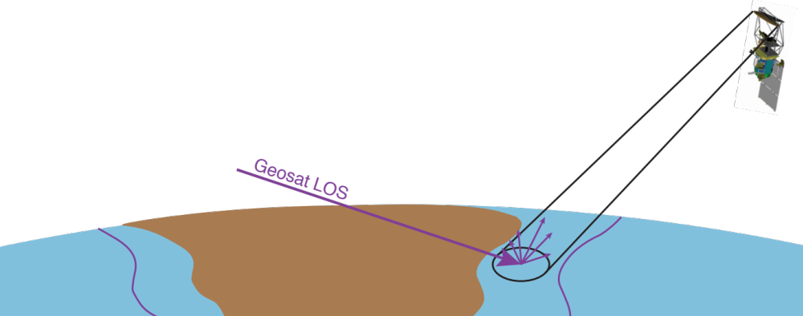
Phenomenology
Unambiguous spectral characteristics
Low temporal and spatial variability
  Geometric component
Surface dependent
  Higher roughness = more diffuse reflection
  Proportional to reflectivity

Slide 4
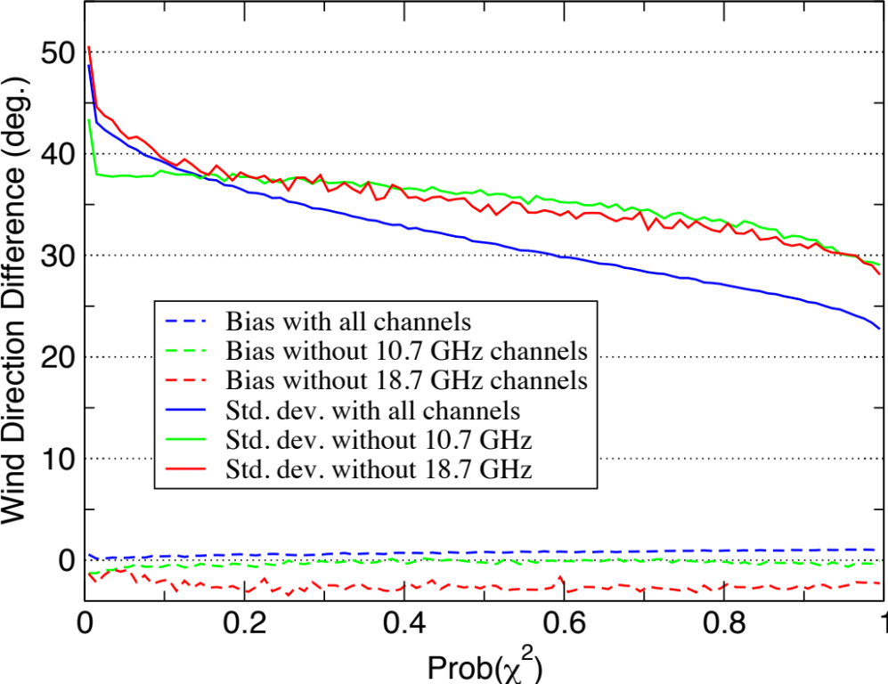
WindSat Solution
Early statistical approaches (Li et al. 2006) were insufficiently sensitive for catching low-level interference.
Instead we used retrieval chi-squared probability to identify regions of interference for initial masking.
During geophysical inversions, an additional geometry calculation was used to determine which observations could be contaminated, and those brightness temperatures were ignored in the inversion process (Adams et al. 2010) with minimal-to-moderate impact to the retrieval statistics (Adams et al. 2014).
Figure courtesy of M. Bettenhausen

Slide 5
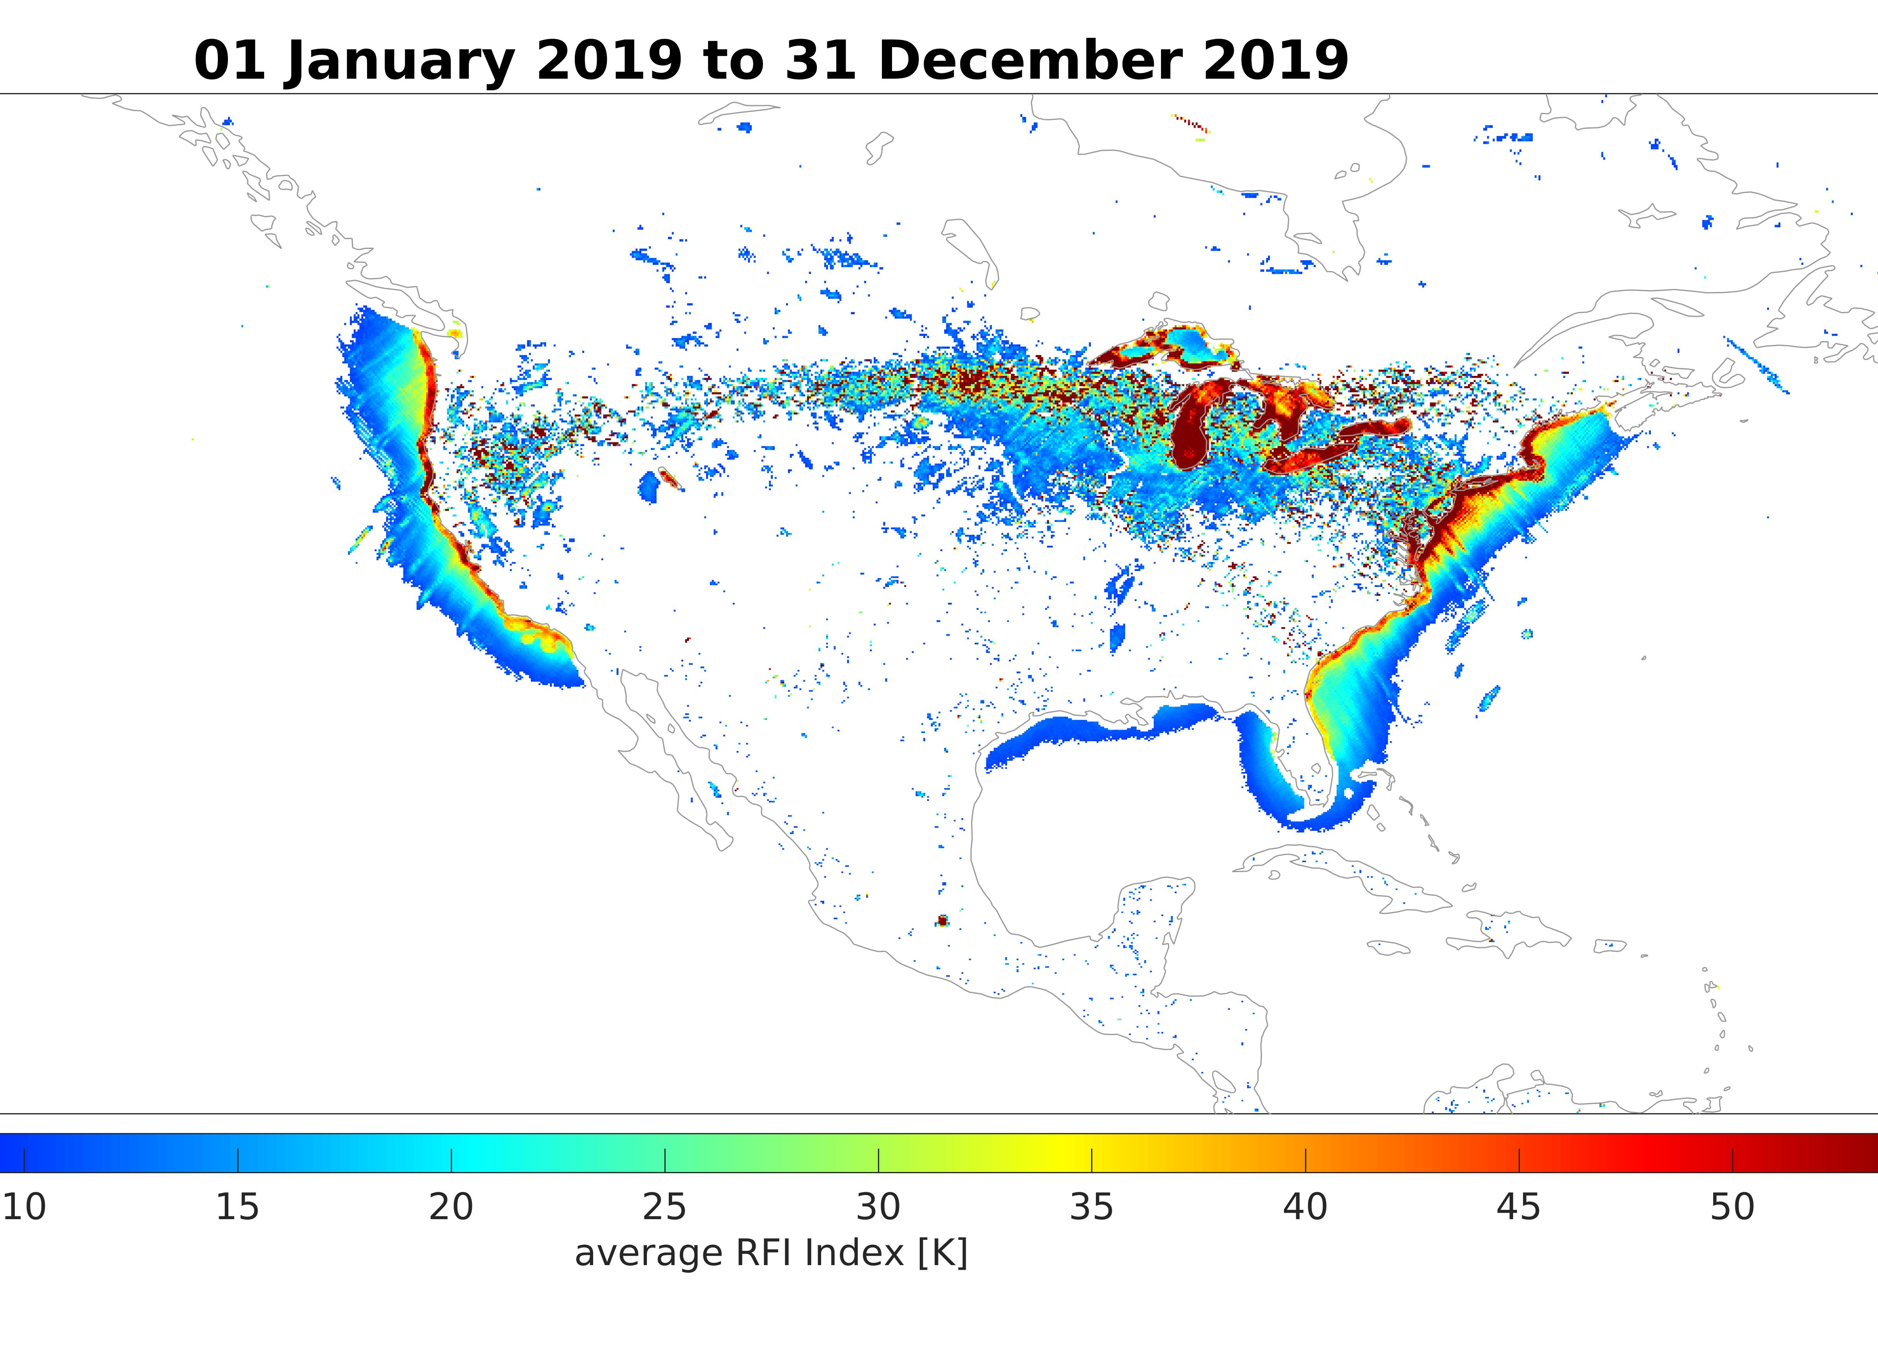
Fast Forward to GMI
The initial GMI approach follows the original statistical WindSat method for determining excess brightness due to interference.
This approach is more effective for vertical and horizontal polarizations, so it catches much of the interference.
However, it does not account for the variability in surface and atmospheric conditions.
This analysis (Draper 2018) found K-band interference surrounding the United States, but no X-band RFI.
Figure courtesy of P. de Matthaeis

Slide 6
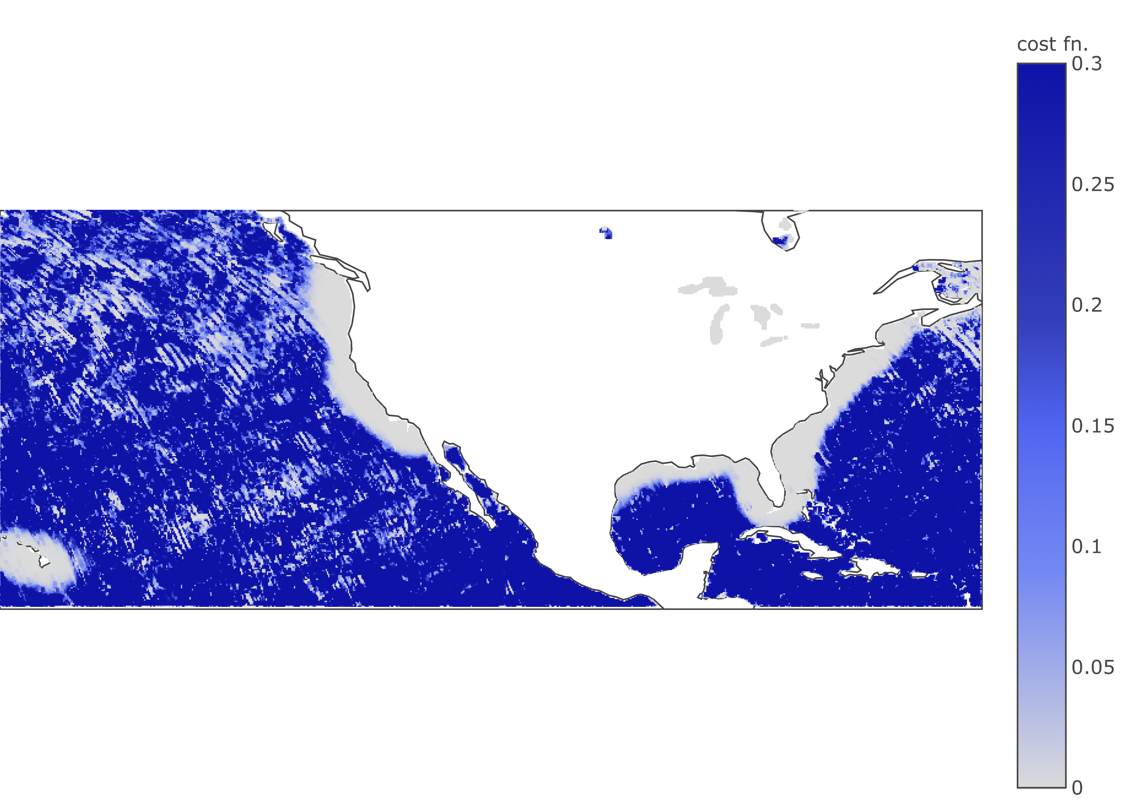
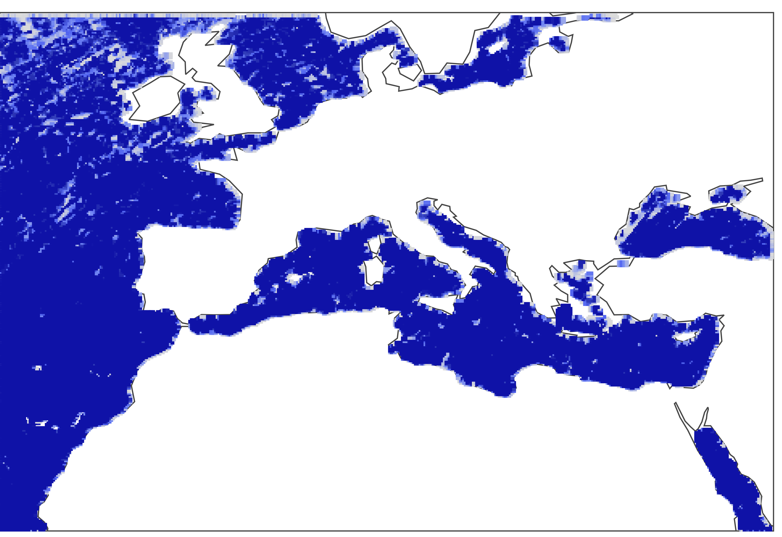
Adapting WindSat Methodology to GMI
The present work adapts the approach of using retrieval goodness-of-fit to GMI.
There are some minor differences to account for an unbounded cost function, in place of the chi-squared probability.
This approach both confirms the results of Draper (2018) and shows that the ability to consider the atmospheric and surface conditions improves sensitivity.

Slide 7
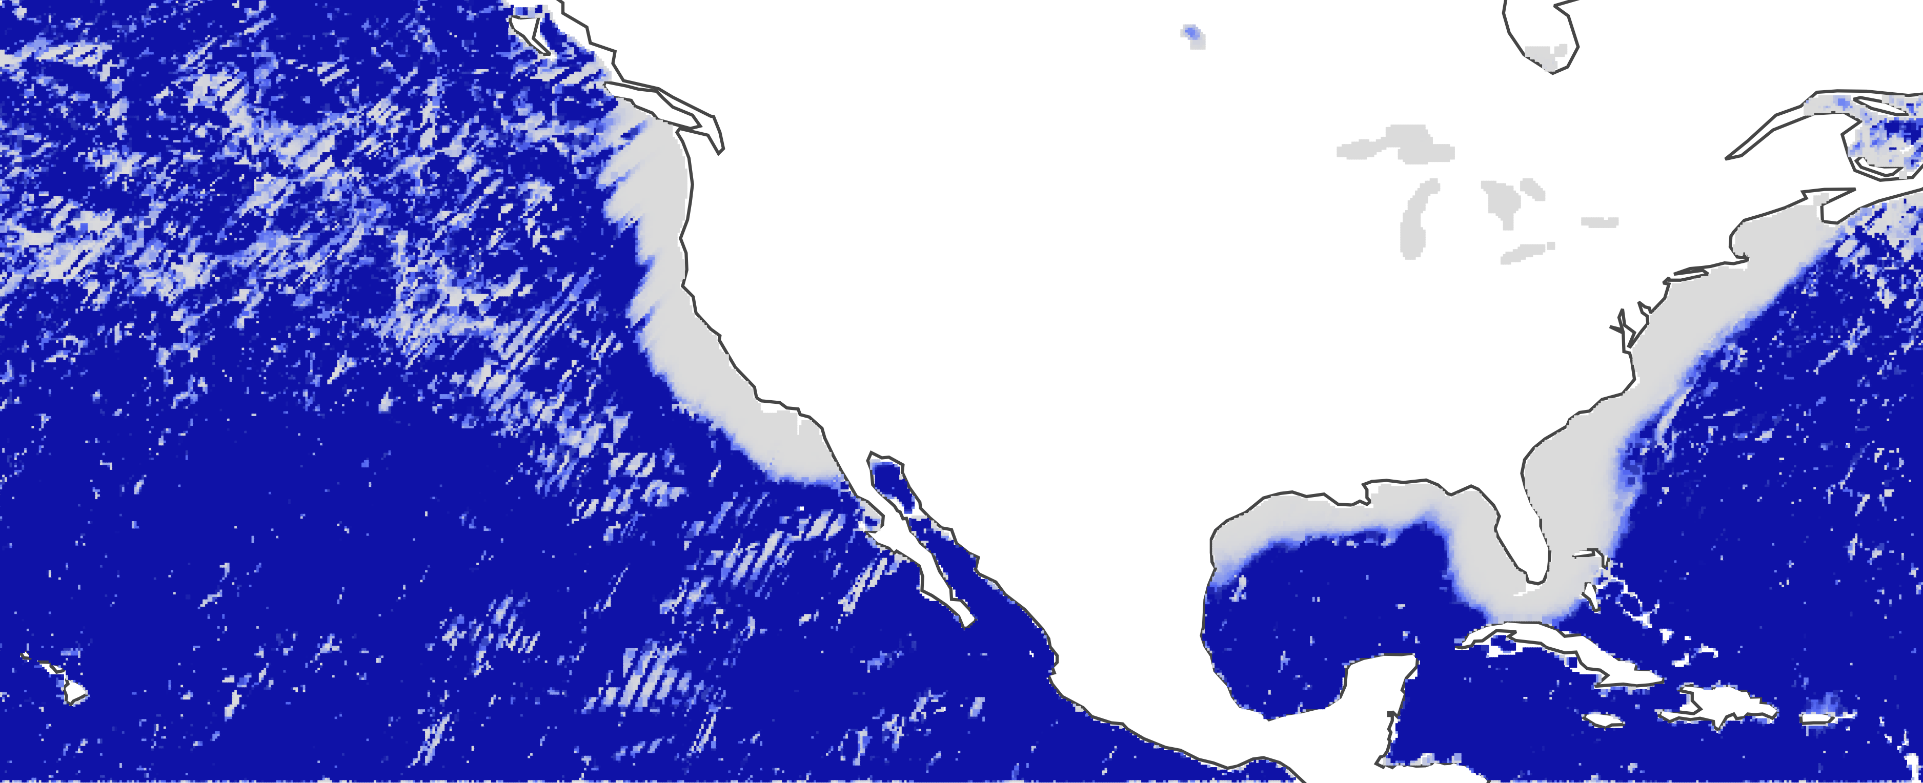
Descending
Ascending

Slide 8
Concluding Remarks
By adapting WindSat RFI detection methods to the GMI clear-sky ocean retrievals, we verified the results of Draper (2018) showing the GMI design mitigates X-band RFI surrounding Europe.
Interference around the United States is still present and seems to affect the coastal waters to a greater extent than determined using statistical methods.
Future work will use RFI flagging to determine when to ignore contaminated bands during geophysical inversion, and then use the clean forward-modeled brightness temperatures to determine excess brightness due to RFI.

