Slide 1



iRCS
Trade Study Series
Tyrone Boswell and Cameron Hines
September 17, 2020

Slide 2
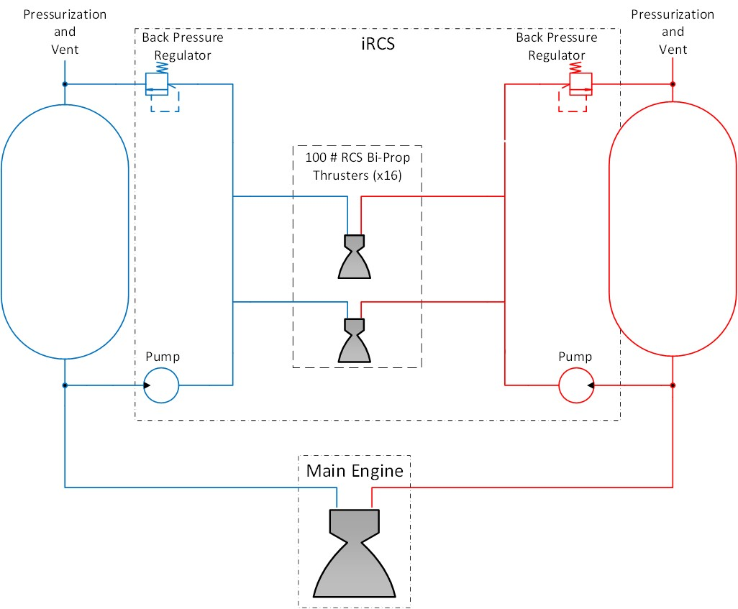
iRCS Background
The integrated RCS (iRCS) concept is designed to leverage the cryogenic propellants, tanks, and conditioning for Reaction Control System (RCS) use
In order to run a test program, the iRCS group is using the HLS DAC-2 descent element design as a foundation
  Looking for ways to implement HLS contractor designs and potentially help them get test data

Slide 3
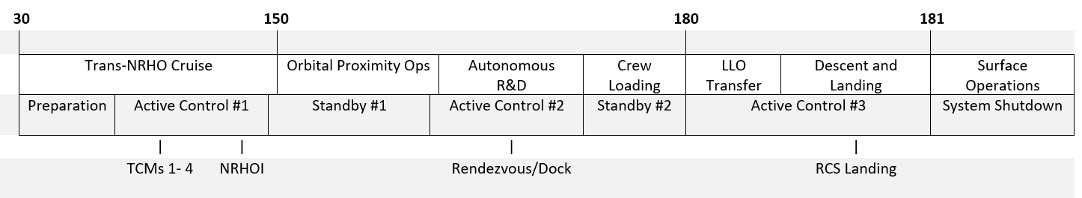
Trade Study Background
In order to maintain propellant conditioning, iRCS recirculates propellant from the tank to the thrusters, and then back into the tank
  Previously, this occurred even when the thrusters were not being used
  This presented an issue with pump power requirements and heat
The purpose of the Idle Mode trade study was to find out the best method to reduce the burden of recirculation
The key lies in the standby (coast) phases, circled below
  These are long periods of inactivity allow alternative modes of operation (idle mode, dormancy, etc.)
Notes:
The HLS DAC-2 mission timeline includes coast periods (long periods of inactivity). During coast, the iRCS must:
Maintain line chill during long periods between maneuvers
Reduce the amount of heat being reintroduced into the tank
Allow the thrusters to be used when needed
Motivation for trade:
Initial analysis showed a massive power requirement for current pump configuration due to constant idling during the long coast periods
Throttling the pump down to idle substantially reduces efficiency

Slide 4
Trade Study Methodology
Our trade study series features the Analytical Hierarchy Process ^{[1]}
Pairwise Comparisons are used to rank the criteria
  Criteria are ranked against each other and put into a matrix
  We iteratively solve for the eigenvector of that matrix
  The resulting eigenvector gives us our weighting for each criteria
Next, the alternatives are compared either qualitatively or quantitatively
  If a quantitative approach is possible, it is usually preferred
  For qualitative assessment, we either use the Pairwise Comparison method (above) or perform a rating on a 1/4/7 scale, depending on the type of criteria
Each alternative’s score is weighted based on the criteria weights found earlier, and the final result is determined
[1] An Illustrated Guide to the Analytical Hierarchy Process, Dr. Rainier Haas and Dr. Oliver Meixer
Institute of Marketing & Innovation, University of Natural Resources and Applied Life Sciences, Vienna

Slide 5
Trade Study Background
Going into the trade study we knew:
  Running at full flowrates for the entire mission was impractical
  Reduced recirculation flowrates might be helpful
  Our electric pump would be inefficient during idle mode
We didn’t know the impact or feasibility of low flowrates (idle mode) or no flow (dormant mode)
Would it be worth it to size a tiny “idle mode pump” which is efficient for the low flow rates?

Slide 6
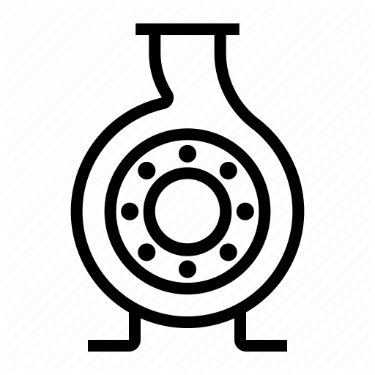


Alternatives
Four possible configurations:
  Option A: One pump; idle mode always on
  Option B: Two pumps; idle mode always on using second pump
  Option C: One pump; dormant when possible, idle mode when needed
  Option D: Two pumps; dormant when possible, idle mode when needed
1 Pump, Perpetual Idle | 1 Pump, Minimal Idle
2 Pumps, Perpetual Idle | 2 Pumps, Minimal Idle
A
C
B
D

Slide 7
Criteria for Evaluation
Identified 7 major criteria to evaluate configurations:
  Heat Addition to Tank: total heat (kJ) added to tank over mission
  Power Required: power (W) required to run pump
  Component Mass: mass (kg) of the components of the system
  System Startup Time: time (t) it takes for the system to fire thrusters
  Development: qualitative assessment of upcoming developments needed for use (scheduling concerns also factored in)
  Complexity: qualitative assessment of schematic complexity
  Fault Tolerance: qualitative assessment of fault-tolerance/redundancy
Cost appears later in the analytical hierarchy process and can be factored in future work

Slide 8
Criteria Weighting Example
 | Component Mass | Heat Addition | Power Required | System Startup | TRL | Complexity | Fault Tolerance
Component Mass | 1 | 2/3 | 2/3 | 1.5 | 2 | 2 | 2
Heat Addition | 1.5 | 1 | 1 | 2 | 3 | 3 | 3
Power Required | 1.5 | 1 | 1 | 2 | 3 | 3 | 3
System Startup | 2/3 | 0.5 | 0.5 | 1 | 2 | 2 | 2
TRL | 0.5 | 1/3 | 1/3 | 0.5 | 1 | 1 | 1
Complexity | 0.5 | 1/3 | 1/3 | 0.5 | 1 | 1 | 1
Fault Tolerance | 0.5 | 1/3 | 1/3 | 0.5 | 1 | 1 | 1

Slide 9
Heat Addition
 | Option A | Option B | Option C | Option D
Idle Heat Load | 40.9 W | 26.1 W | 40.9 W | 26.1 W
Total heat added | 8.7*10⁵ kJ | 5.6*10⁵ kJ | 1.1*10⁵ kJ | 7.1*10⁴ kJ
Equivalent boiloff | 4,069 kg | 2597 kg | 494 kg | 329 kg
Idle heat load includes the heat added by the pump and 20.5 W of heat leak from the recirculation line MLI and structure
Total heat added includes the heat removed from the recirculation line during chill
Equivalent boiloff is calculated based on the enthalpy of vaporization of liquid oxygen at 1 atmosphere

Slide 10
Power Required
 | Option A | Option B | Option B | Option D
Idle mode power | 20.2 W | 5.4 W | 20.2 W | 5.4 W
Total energy required | 192 kW-h | 70.1 kW-h | 45.4 kW-h | 33.5 kW-h
Equivalent battery mass | 1200 kg | 438 kg | 284 kg | 209 kg
Idle pump power is calculated using flow rates of .1 lbm/s and 5 psid of head rise.
Single pump options use the efficiency of the active-mode-sized design throttled to the new flow rate. The second pumps have an assumed efficiency of 40%. Motor efficiency is an assumed 85%.
Equivalent battery mass is based on energy density of 160 W-h/kg.

Slide 11
Component Mass
This category compares the component masses between options
  Mass differences due to heat addition and power components are bookkept in their respective criterion
  Estimated ~5 kg increase to Dual Pump Option to factor in lines, valves, and a slight increase in Idle Pump mass
Totals | Total (One Pump Options) | 14,582.2 | kg
 | Total (Dual Pump Options) | 14,587.3 | kg

Slide 12
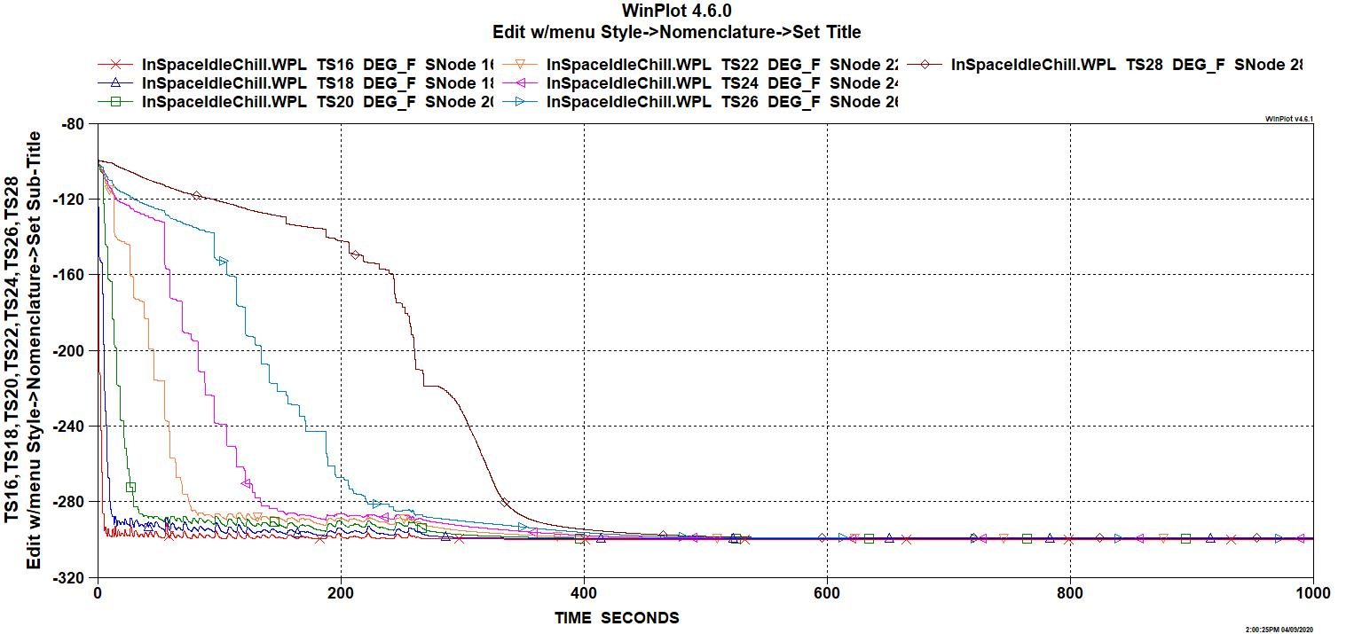
System Startup Time
For perpetual idle cases, startup is near instantaneous. 6 seconds is assumed for the time for the pump to spin up
For minimal idle cases, startup time is calculated using the chilldown times. A GFSSP model of the line predicts 400s for chill down. 50% margin was added to account for masses of pumps, valves, etc.
Notes:
Add GNC guidance or an explanation of how ours is conservative and ready for GNC guidance. We will coordinate with GNC to facilitate a balance between readiness with minimizing active flow

Slide 13
Development Needed
This metric is similar to TRL level of the technology, but uses a different scale
  Several options might end up with the same TRL level, but would require different levels of development
A score of 1 was assigned to the single-pump options because the wide range of flowrates required to operate at both active and idle points was deemed to require a substantial new development effort
A score of 4 was assigned to the dual-pump options because both pumps are believed to require some development effort, but not as much as the wide flowrate range demand that the single-pump option requires

Slide 14
Complexity
A score of 7 was assigned to the single-pump options, as they have the simplest schematic layout
A score of 4 was assigned to the dual-pump options, as they are slightly more schematically complex due to the addition of a separate flow path for the idle pump that must be regulated somehow to prevent backflow

Slide 15
Fault Tolerance
The two-pump options were assigned a fault-tolerance score of 7. If the idle pump fails during operation, the system may be able to operate in a reduced state without the pre-conditioned lines
The single-pump minimal idle option was assigned a fault-tolerance score of 4. A failure of the pump during idle would prevent the operation of the pump in active mode, preventing the system from meeting pressure requirements
The single-pump, perpetual idle option was assigned a fault-tolerance score of 1, as it has the same drawbacks as the other single-pump option, but must also operate the pump over a much longer period

Slide 16
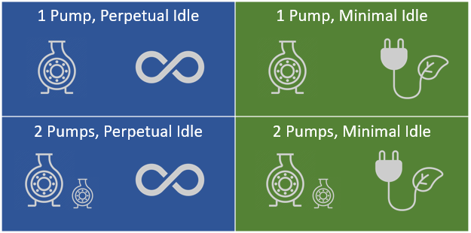
Initial Results
 | Weight | Option A | Option B | Option C | Option D
Component Mass | 16% | 14,582 kg | 14,587 kg | 14,582 kg | 14,587 kg
Power Required | 24% | 20.5 W | 5.5 W | 20.5 W | 5.5 W
Heat Added | 24% | 8.7*10⁵ kJ | 5.6*10⁵ kJ | 1.1*10⁵ kJ | 7.1*10⁴ kJ
System Startup | 13% | 6 s | 6 s | 600 s | 600 s
Development Score | 8% | 1 | 4 | 1 | 4
Complexity Score | 8% | 7 | 4 | 7 | 4
Fault Tolerance Score | 8% | 1 | 7 | 4 | 7
Final Score |  | .1786 | .2941 | .2018 | .3255
Option D (Dual Pump, Minimal Idle) is the highest scoring alternative

Slide 17
Sensitivity Analysis
The criteria were evaluated using Monte-Carlo analysis
The trade study was performed 10 million times, using random weights for each criteria every run
Afterward, there was a tally for the highest & lowest scores of each run
The data suggests that no matter the weighting:
  Option D is the overall best performer
  Option B is also a strong contender
  Baseline was a staggeringly low performer
 | Option A | Option B | Option C | Option D
%Highest Score | <1% | 31% | 8% | 52%
%Lowest Score | 86% | 2% | 9% | 3.3%

Slide 18
Adaptability
The MATLAB script was created with adaptability in mind
This is crucial given the quickly changing landscape of early concept development
For example: after the Idle Mode Trade Study was complete and the next Pump Layout Trade Study was under way, we found a way to substantially cut down the idle mode time
This led us to rerun the Idle Mode Trade Study and determine that single pump options improved substantially
We were able to add in single pump options in the second trade study and one of them ended up winning
The turnaround time for this was less than a day
 | Option A | Option B | Option C | Option D
Original Score | .1786 | .2941 | .2018 | .3255
Revised Score | .1828 | .2304 | .2959 | .2908

Slide 19
Subsequent Trades
The trade study series continued onward to investigate other questions the iRCS team needed to solve.
Pump Layout Trade Study: determined the placement of the pump, and investigated a new concept for a magnetically coupled pump located inside of the propellant tank
  Explored schematic layouts, dual pump placement, and in-tank pump possibilities
Thruster Inlet Conditioning Study: compared very different concepts for pressure controlling components
  Explored back pressure regulators, flow control valves, solenoid banks, and paired thruster configuration
  This trade study had the largest variety of options and merits for each option. This tested the robustness of the trade study tool

Slide 20
Future Work
The trade study tool/method looks to be useful for our future investigations
Certain quality of life improvements are being made, potentially allowing other users to be able to use the tool
  Generalizing script to require less manual input from user
  Developing generic tools for generating pairwise comparison matrices
Undesired quirks do appear during the trade study, which require a careful eye and team consensus to deal with
  In particular, if the magnitude between the options is small, but the ratio difference is large (i.e. 5kg vs 10 kg), then that criteria may be skewed and need adjustment
  The sensitivity analysis and the results table are helpful in getting a bird’s-eye view and allowing the trade study conductors to spot these trends
Notes:
Things that need improvement
Quality of life improvements
Weaknesses
Extensibility / possible expansion

Slide 21
Backup

Slide 22
Objective / Definitions
Objective: To reduce the impact of constant propellant recirculation by evaluating pump configuration and varying idle mode length
  Single pump vs dual pump configuration
    Single pump configuration has one pump that throttles down to an idle flowrate when needed
    Dual pump configuration has a full-sized pump and a smaller “idle-mode” pump, which is optimized for the lower flowrates
  Perpetual idle mode vs minimal idle mode
    Perpetual idle mode would have the idle mode active during every mission phase in which the RCS is not needed
    Minimal idle mode would have zero flow during long periods of inactivity. This is effectively a “soft shutdown and restart”
      Idle mode is still necessary during certain mission phases (e.g. Rendezvous and Docking)
      Idle mode reduction depends on GNC requirements and iRCS startup time

Slide 23
Option A: 1 Pump, Perpetual Idle
Option A: One pump, idle mode always on
Pump information:
  Single pump, throttles down for idle mode
    Mass: 1.94 lbm
    Operational flowrate: 2.16 lbm/s
    Idle flowrate: .1 lbm/s
    Power required: 4,280 W
    TRL (readiness): large developments required
Mission summary:
  Active Mode: 6.9 hours
  Idle Mode: 7,385 hours
Active
Idle

Slide 24
Option B: 2 Pumps, Perpetual Idle
Option B: Two pumps, idle mode always on
Pump information:
  Large pump for operations:
    Mass: 1.94 lbm
    Operational flowrate: 2.16 lbm/s
    Power required: 4,280 W
  Small pump dedicated to idle mode flow
    Mass: .13 lbm
    Idle flowrate: .1 lbm/s
    Power required: 5.5 W
    TRL (readiness): Moderate development required
Mission summary:
  Active Mode: 6.9 hours
  Idle Mode: 7,385 hours
Active
Idle

Slide 25
Option C: 1 Pump, Minimal Idle
Option C: One pump, idle mode off when possible
Pump information:
  Single pump, throttles down for idle mode
    Mass: 1.94 lbm
    Operational flowrate: 2.16 lbm/s
    Idle flowrate: .1 lbm/s
    Power required: 4,280 W
    TRL (readiness): large developments required
Mission summary:
  Active Mode: 6.9 hours
  Chill Mode: 1.5 hours
  Idle Mode: 725.9 hours
  Dormant Mode (Off): 6,658 hours
Dormant
Active
Idle
Chill

Slide 26
Option D: 2 Pumps, Minimal Idle
Option D: Two pumps, idle mode off when possible
Pump information:
  Large pump for operations:
    Mass: 1.94 lbm
    Operational flowrate: 2.16 lbm/s
    Power required: 4,280 W
  Small pump dedicated to idle mode flow
    Mass: .13 lbm
    Idle flowrate: .1 lbm/s
    Power required: 5.5 W
    TRL: Moderate development required
Mission summary:
  Active Mode: 6.9 hours
  Chill Mode: 1.5 hours
  Idle Mode: 725.9 hours
  Dormant Mode (Off): 6,658 hours
Dormant
Active
Idle
Chill

Slide 27
Pump Trade

Slide 28
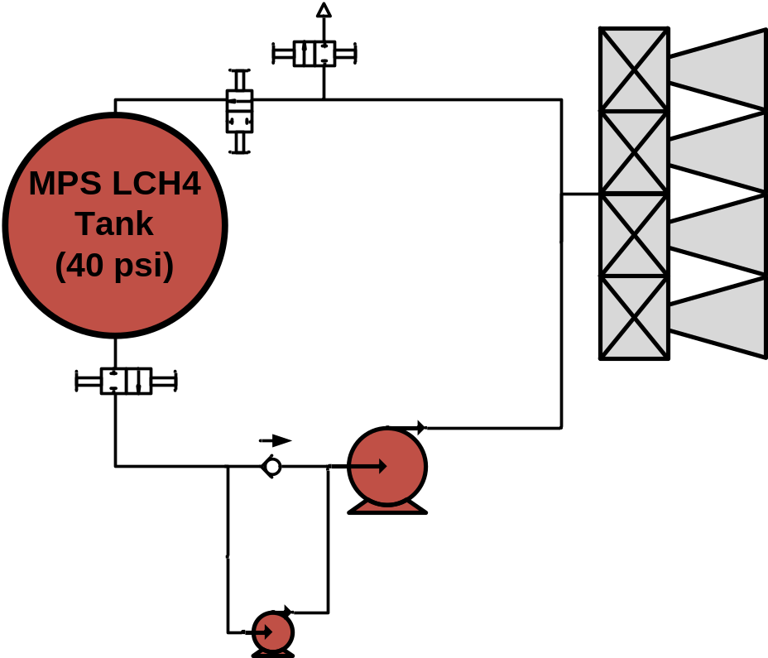
Baseline (2 Pumps)
  Baseline Configuration (Dual pump, parallel layout)
    Simple design
    Doesn’t lean on pump tech development
    Requires vent for chilldown operations
Notes:
Favors centrifugal; but positive displacement pump still possible with workarounds; (might not be an issue)

Slide 29
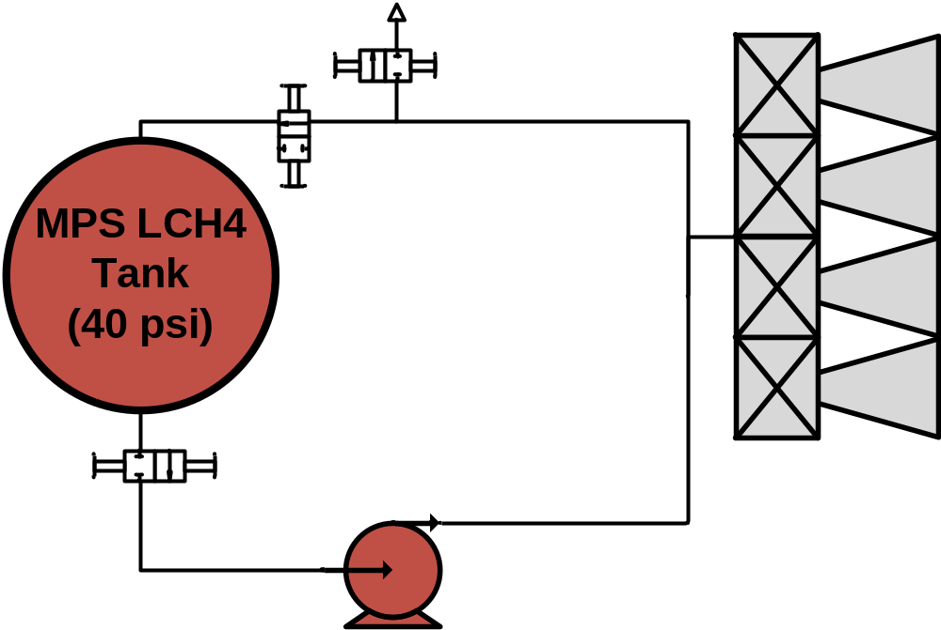
Single Pump Option
  Single Pump Option (One pump; similar layout to the baseline)
    Simplest design
    Doesn’t lean on pump tech development
    Requires vent for chilldown operations
Notes:
Favors centrifugal; but positive displacement pump still possible with workarounds; (might not be an issue)

Slide 30
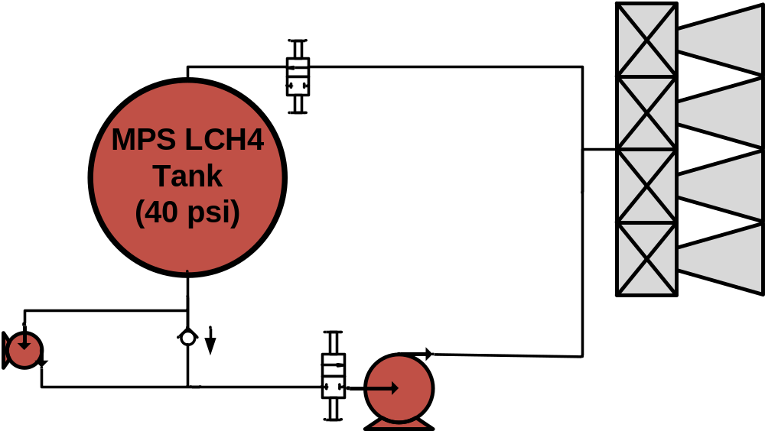
Under-Tank Option
  Under-Tank Option
    Idle pump always chilled in
    No vent necessary
    Adds heat penetration into the tank
Notes:
We’ll need to analyze the heat absorption of the exposed pump. Assume that there’s no leakage and no two-phase flow in the primed pump section. (It’ll just be a requirement)

Slide 31
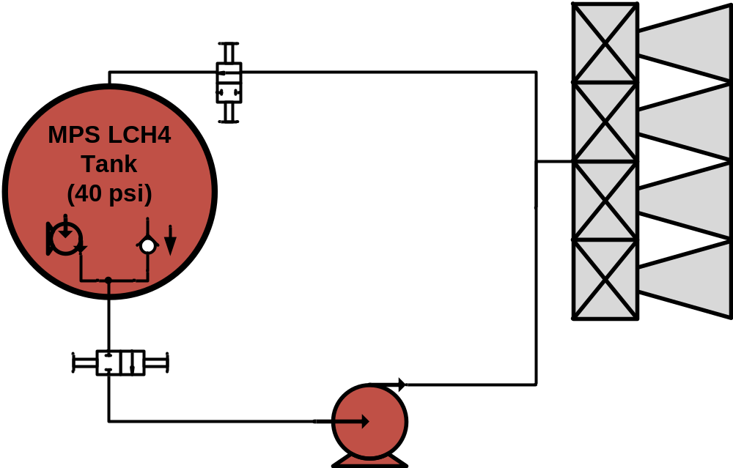
In-Tank Option
  In-Tank Option
    Idle pump is always chilled
    Vent no longer necessary
    Pump/motor heat contributes directly to the tank
    Pump technology needs development

Slide 32
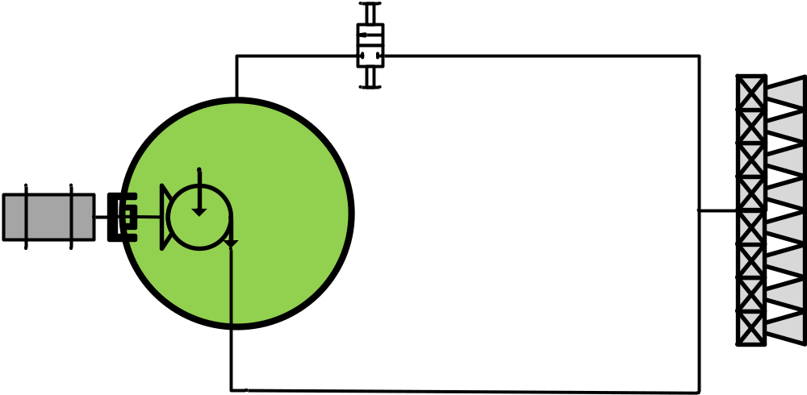
Magnetic In-Tank Option
  Magnetic In-Tank Option
    Single pump operation
    Magnetic coupling decreases efficiency drop when throttled down
    Vent no longer necessary
    Pump contributes some heat directly to the tank
    Pump technology needs development
Notes:
Assumes centrifugal pump; MAIN BENEFIT is that it can effectively be a one pump design (it’s a “super pump”)
Motor will absorb heat similar to design 2, however it will have its own cooling mechanism and its magnetic coupling reduces heat introduction into the tank (also this heat isn’t going into the RCS compartment and will be distributed)

Slide 33
Criteria for Evaluation
Alternatives will be evaluated using an analytic hierarchy process
Identified 6 major criteria to evaluate configurations
  Pump Heat Contribution [20%] – negative impacts of heat on active line operation
  Tank Heat Penetration [20%] – negative impacts on the tanks due to heat generation (during dormant mode)
  Integration Complexity [20%] – qualitative assessment of operational and integration complexity (i.e. how easy is it for a contractor to implement)
  Component Development [10%] – qualitative evaluation of expected development effort for major components of the system
  Fault Tolerance [20%] – how easily does this system accommodate fault-tolerance/redundancy (in terms of risk)
  Dry Mass [10%] – system mass of each configuration (not counting fluid mass, which is handled above in the “heat contribution” criterion)
Notes:
Thrifty mode = when the system locked (what type of heat generation do we see?),

Slide 34
Results
 | Weight | Baseline 2-Pump | Single Pump | Under tank | In-Tank | Magnetic
Tank Heat Penetration | 20% | 0 W | 0 W | 1.4 W | 0 W | 0.5 W
Pump Heat Contribution | 20% | 15,544 Wh | 15,612 Wh | 15,542 Wh | 15,026 Wh | 11,797 Wh
Integration Complexity | 20% | .2394 | .2972 | .2396 | .0983 | .1255
Fault Tolerance | 20% | 4th | 3rd | 2nd | 5th | 1st
Component Development | 10% | .2290 | .2864 | .2291 | .1430 | .1125
Dry Mass | 10% | 460 lbm | 457 lbm | 458 lbm | 456 lbm | 459 lbm
Final Score |  | .2121 | .2293 | .1976 | .1467 | .2143
Single Pump is the highest scoring alternative!
Magnetic and Baseline 2-Pump also scored fairly well (2nd and 3rd respectively)

Slide 35
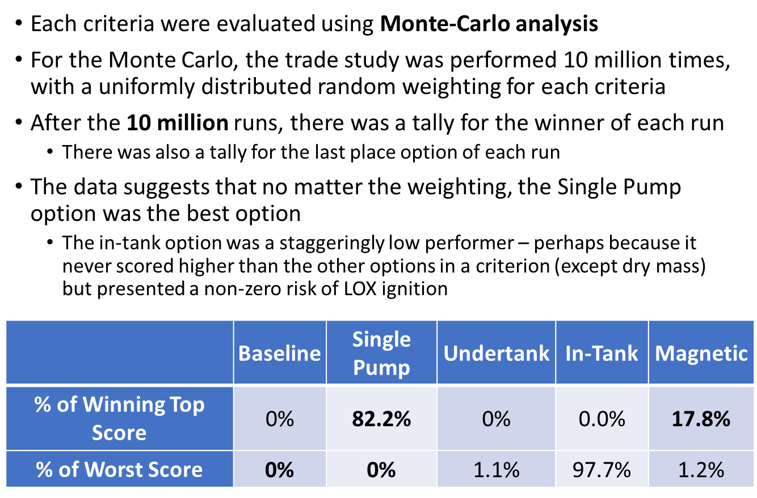
Sensitivity Analysis

Slide 36
Thruster Inlet Conditioning

Slide 37
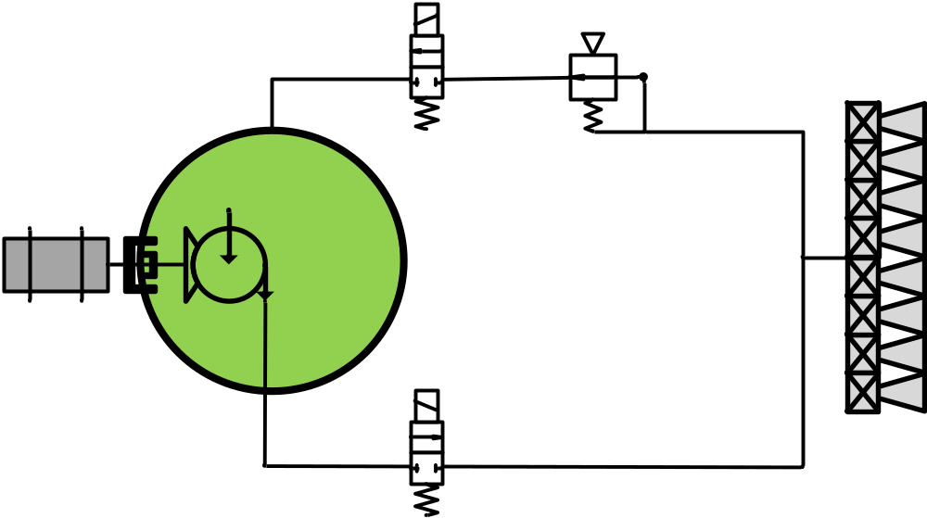
Back Pressure Regulator
Pressure-balanced diaphragm controls flow resistance of valve
  Upstream line pressure loads one side of the diaphragm
  An independent gas supply loads the other side of the diaphragm
  A load imbalance on the diaphragm causes it to flex and change the effective flow area of the BPR
Notes:
Favors centrifugal; but positive displacement pump still possible with workarounds; (might not be an issue)

Slide 38
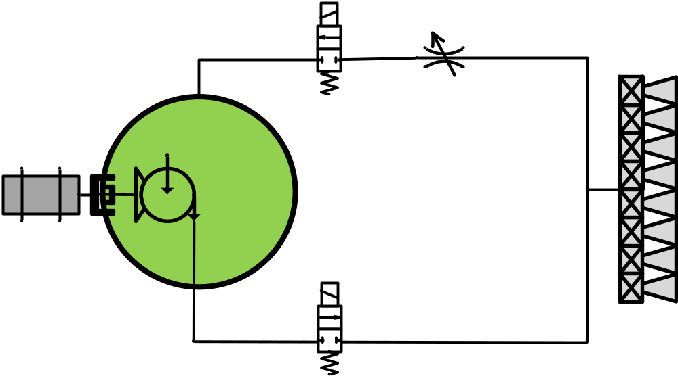
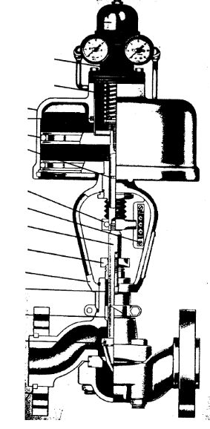
Variable Position Valve (VPV)
BPR layout, but replace BPR with FCV
  A traditional actuator positions the valve stem to affect a variable flow resistance.
  The actuator could be motorized such that either set predetermined valve positions could be commanded in correspondence to the quantity of thrusters firing, or it could be automated to modulate with feedback from a pressure transducer.
Notes:
Favors centrifugal; but positive displacement pump still possible with workarounds; (might not be an issue)

Slide 39
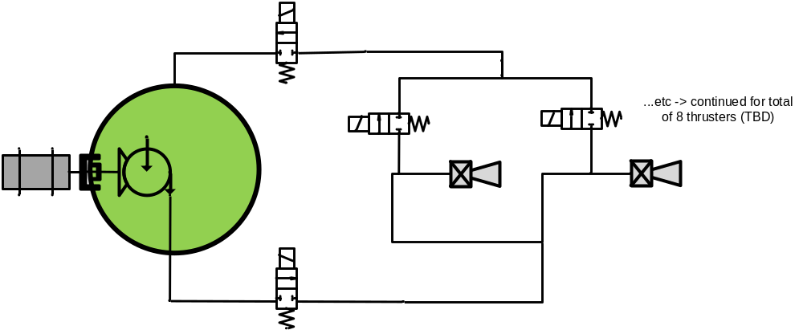
Paired Thruster/
Recirculation Valves
Paired valves cycle together
  For every thruster valve, there exists a recirculation valve with similar flow/pressure drop characteristics. The paired valves cycle together.
  When a thruster valve cycles open, the paired recirculation valve cycles closed.
  When a thruster valve cycles closed, the paired recirculation valve cycles open.
Notes:
Favors centrifugal; but positive displacement pump still possible with workarounds; (might not be an issue)

Slide 40
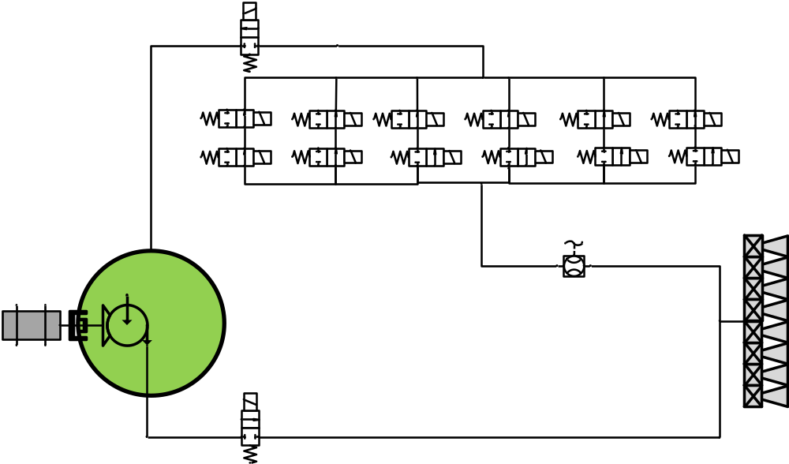
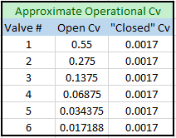
Solenoid Bank Option
Uses multiple solenoid valves to vary flow (equivalent orifice area)
Uses lookup table to command solenoid combinations
Valves could have small orifice machined in seat
  Allows constant flow through (idle mode purposes)

Slide 41
Criteria for Evaluation
Alternatives will be evaluated using an analytic hierarchy process
Identified 5 major criteria to evaluate configurations
  Performance Features (25%) – qualitative assessment of vital capabilities and characteristics of each options (pressure response, bypass flow, etc)
  Response Time (25%) – how quickly does the system reach steady state
  System Complexity (15%) – number of interfaces or failure modes
  Mass (15%) – mass of components/lines
  Component Development (20%) – development time per component
Notes:
Does each option support pump speed change? (results in way more return flow = more heat); Ask Mike about Fault Tolerance of our system based on the 4 tank design

Slide 42
Performance Characteristics
Metric / Features | Wt. | BPR |  | VPV |  | SOV Bank |  | Paired
 |  | Self-Loaded | Externally-loaded | Modern VPV | Future VPV | Large SOV Bank | Small SOV Bank | Distributed SOV
Operationally Flexible (Flow) | + | Yes | Yes | Yes | Yes | Yes | No | No
Operationally Flexible (Pressure) | + | No | Yes | Yes | Yes | Yes | No | No
Fixed Resistance Capable | - | No | No | Yes | Yes | Yes | Yes | Yes
Resistance Resolution | + | High | High | High | High | Med | Low | Low
Closed Loop Control | + | No | No | Yes | Yes | Yes | No | No
Active Pressure Control | + | Yes | Yes | Yes | Yes | Yes | No | No
No-Bypass Operating Mode | - | Yes | Yes | Yes | Yes | Yes | Yes | Yes
Closely Coupled Dynamics | - | No | No | No | No | No | No | Yes
Actuation Type | - | Pass. | Passive | Active | Act. | Active | Active | Active
Score |  | 5.5 | 7.5 | 10 | 10 | 9 | 0 | 1

Slide 43
Results
 | Weight | Self-load BPR | Ex-load BPR | Modern VPV | Fast VPV | Lg. SOV Bank | Sm. SOV Bank | Paired
Performance | 25% | .1276 | .1740 | .2320 | .2320 | .2088 | .0023 | .0232
Response Time | 25% | .1878 | .1878 | .0275 | .0337 | .1878 | .1878 | .1878
System Complexity | 15% | .1969 | .1969 | .1969 | .1969 | .0583 | .0888 | .0653
Mass | 15% | .2158 | .2158 | .1510 | .1510 | .0703 | .0703 | .1259
Component Development | 20% | .1333 | .1333 | .1333 | .0667 | .1333 | .1333 | .2667
Final Score |  | .1675 | .1794 | .1445 | .1334 | .1457 | .0971 | .1324
Externally-Loaded BPR is the highest scoring alternative!
Self-Loaded BPR, Large Solenoid Bank and Modern VPV also scored well
(2nd , 3rd , and 4th respectively)
Notes:
Check differences between the self-load and externally-loaded

Slide 44
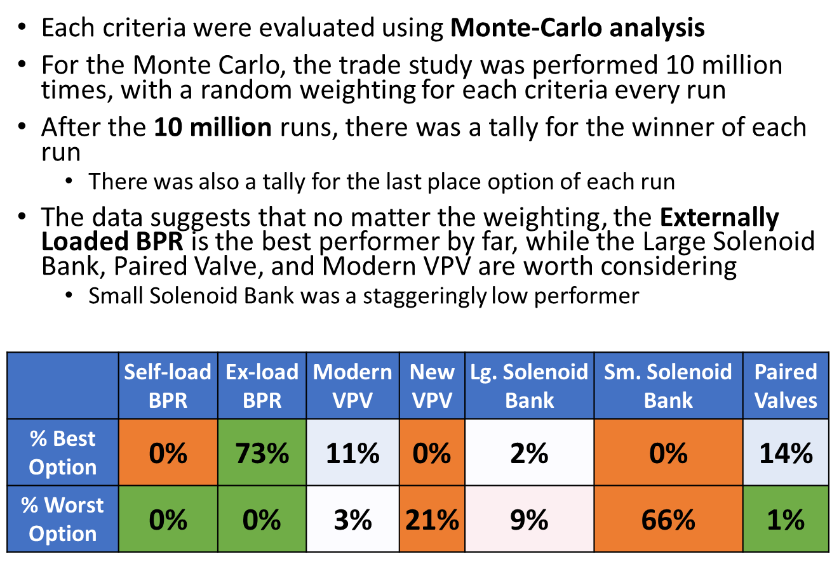
Sensitivity Analysis
Notes:
Check differences between the self-load and externally-loaded

