Slide 1

Flood Pilot Update
Committee on Earth Observation Satellites
Guy Schumann, Remote Sensing Solutions
Andrew Molthan, NASA Marshall
Mitch Goldberg, NOAA/NESDIS
CEOS WG Disasters Meeting #14
1 September 2020

Slide 2
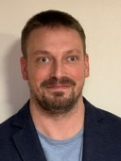

Co-Leads and Introductions
Dr. Guy Schumann, Remote Sensing Solutions
  Principal Scientist at Remote Sensing Solutions Inc. His research and expertise focus around flood risk, from local to global scale, using flood modeling, prediction and remote sensing
Dr. Mitch Goldberg, NOAA/NESDIS
  NOAA’s Chief Scientist for Low Earth Orbiting Satellites; leads the NESDIS Satellite Proving Ground program to improve NOAA services
Dr. Andrew Molthan, Marshall Space Flight Center
  Research Meteorologist at NASA Marshall, collaborates with NASA’s Disasters Program to help the disasters community use NASA data and tools

Slide 3
Highlights Since Last Meeting
WGDisasters Meeting in March (virtual)
  During a one-day session, established case studies of interest for optimal combination of optical imaging from geostationary and polar orbit, and complementary SAR observations.
Virtual Follow-Ups
  Through email exchanges, we identified regional case studies with CEOS Flood Pilot partners diverse across impacted regions and emphasized local types of flood challenges
Monthly Tag-Ups
  Beginning in June, a recurring monthly tag-up to update participants and share outcomes of ongoing case study work.
  Developing formal Pilot documentation required by CEOS and identifying needs for data sharing and processing platforms.

Slide 4
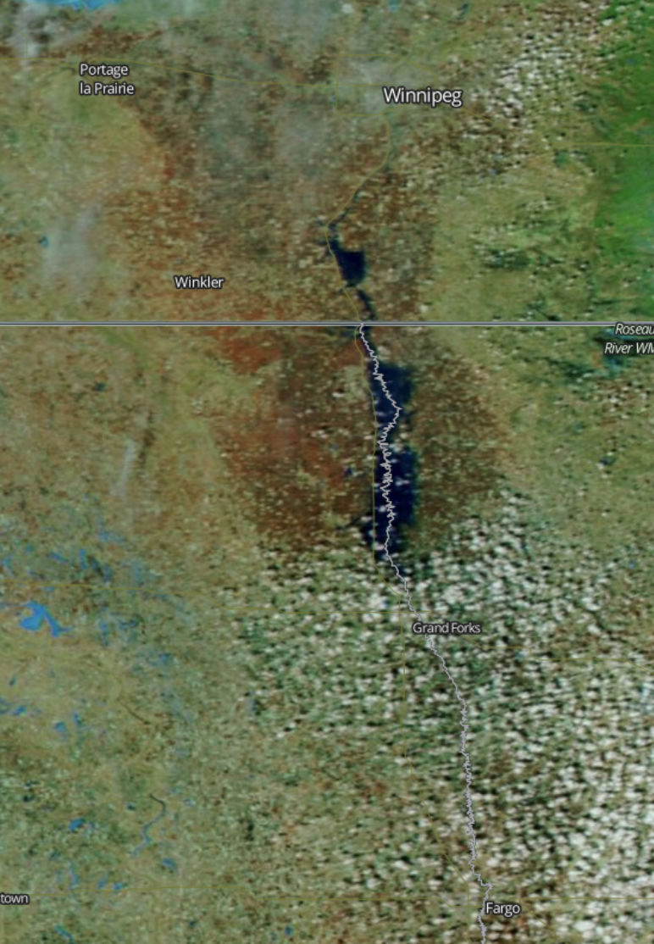
Red River of the North
Winter-Spring 2020
Seasonal, significant flooding often due to rapid snowmelt and rainfall in late winter and early spring
Unique advantages for SAR in helping penetrate cloud cover
Optical NIR/SWIR help to separate water, snow and other features
Expected Outcomes
                SAR-based maps of flood extent generated through Radarsat-2 and Radarsat Constellation Mission (RCM) imaging
GEO and LEO optical imaging provided by GOES ABI and JPSS/VIIRS instruments
Additional flood mapping available from Sentinel-2 and Landsat imagers
Commercial data (Planet) exploration potential through the NASA (TBC)
Explore combinations of optical/SAR for individual daily and maximum extent mapping
Winnipeg
Fargo
NASA MODIS via Worldview
Status and Level of Effort
Data Needs, Challenges, and Risks
                Leads: NRCan, NOAA, NASA
                Radarsat-2 and RCM maps have been developed for recent extremes in April 2020, along with products available from ABI/VIIRS instruments
                Additional mapping available from Sentinel-1
                Pursuing data access through other platforms, including Sentinel-2/Landsat and Planet
                Seeking other SAR data to expand frequency and polarization diversity; coherence-based approaches.
                Identify in situ data for individual daily product validation and maximum flood extent through high water marks or other approaches.
                Additional data collection potential
                DigitalGlobe/Planet Labs imaging
                Commercial SAR collections
                Civil Air Patrol / other aerial imaging or information shared via social media

Slide 5
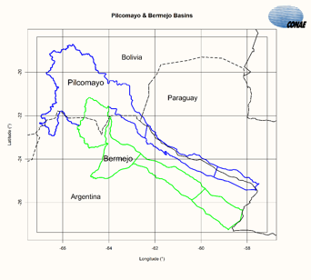
Picomayo and Bermejo Transboundary Basins
July 2020 (TBC)
Shared by Argentina, Bolivia, and Paraguay (Pilcomayo) and by Argentina and Bolivia (Bermejo) with basin headwaters in the Andes Range.
2.5M people, extreme poverty, with annual floods December to April from heavy rain in Bolivia
Expected Outcomes
                SAR-based mapping of flood extent from events of interest, complemented by GEO and LEO via GOES/ABI and JPSS/VIIRS
Additional flood mapping available from Sentinel-2 and Landsat imagers
Commercial data (Planet) exploration potential through the NASA (TBC)
Collaborations among affected partners to better understand needs for data sharing, flood mapping, and response efforts
NASA MODIS via Worldview
Status and Level of Effort
Data Needs, Challenges, and Risks
                Leads: CONAE
                Regional Partners: Regional Commission of the Bermejo Basin (COREBE, Argentina)
                SAOCOM data available for sharing but similar flood events have not yet occurred in this area during mission time.
                Look for additional in situ data to help characterize success of mapping efforts.
                SAOCOM data available to be shared but a major flood event has not yet occurred in this region in the SAOCOM database.
                Additional data collection potential
                DigitalGlobe/Planet Labs mapping available through NASA Commercial Data Buy
                Interest in in-situ data from partners, topographical data, past event mapping and understanding of human factors.

Slide 6
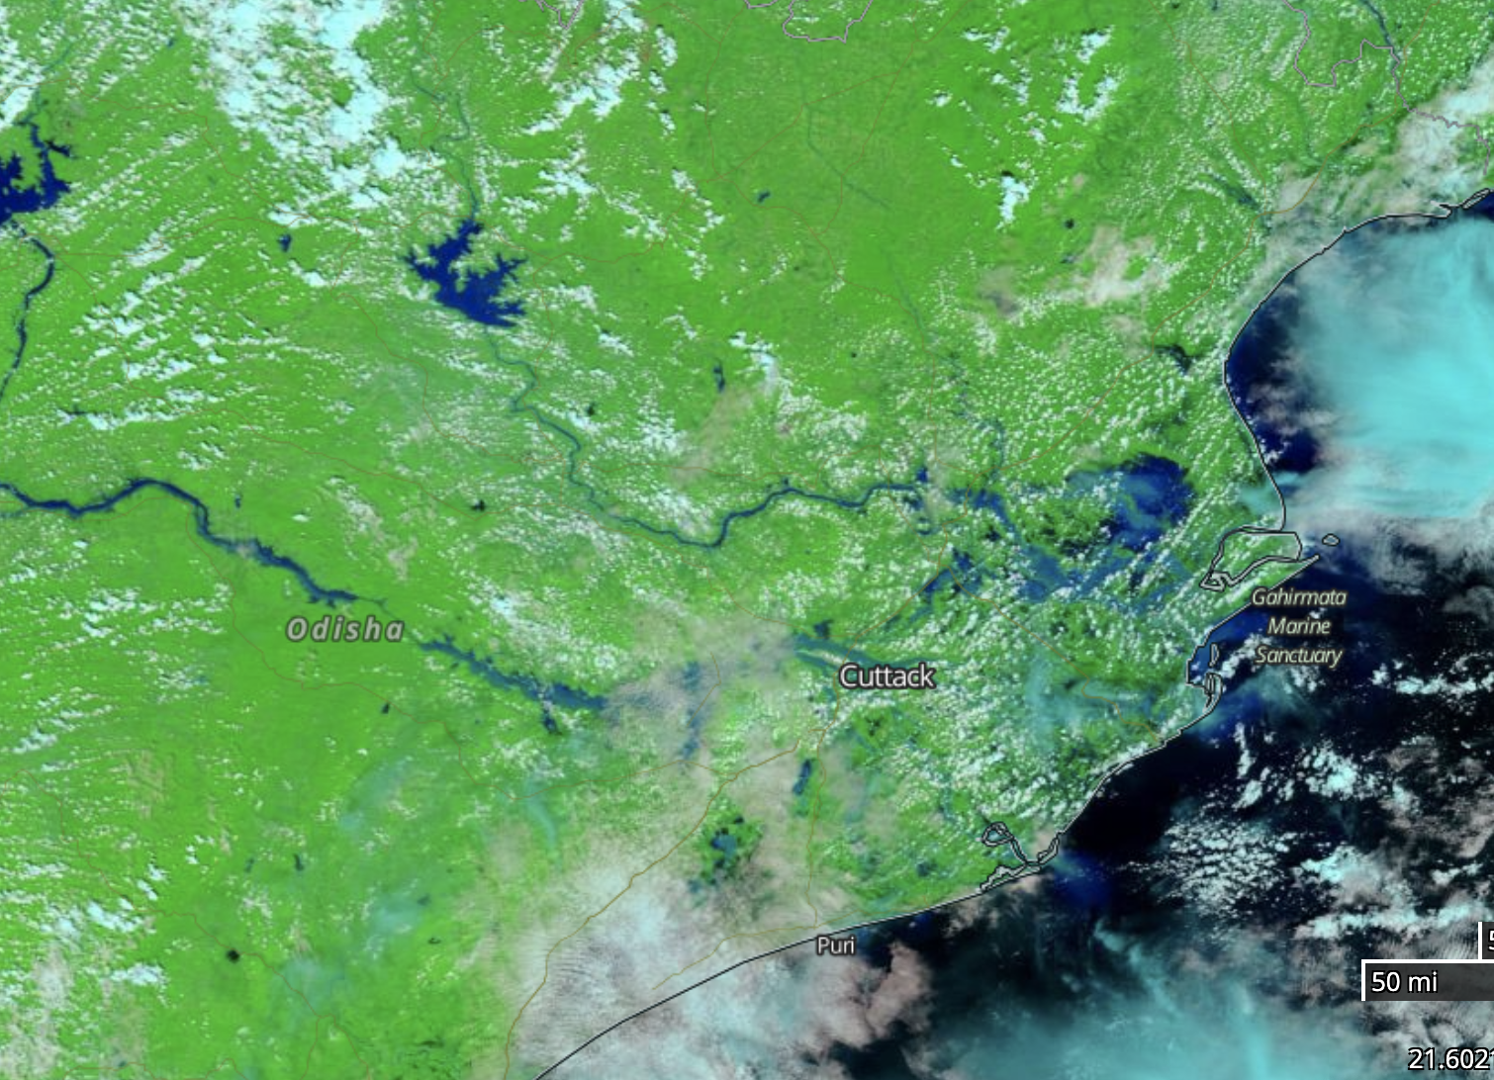
Mahanadi River Delta – Coastal Flooding
Cyclone Amphan (2020) or Cyclone Fani (2019)
A large, relatively flat and expansive basin in eastern India, the Mahanadi experiences flooding from heavy monsoonal rains, typhoons, and related storm surge
Recently impacted by Typhoon Amphan, in addition to past storm events
Expected Outcomes
                Improved capability to map flood extent from combined optical and SAR; continued development of algorithms to benefit during NISAR operations period
                Produce flood inundation maps, hazard maps, vulnerability maps, and combine with available flow data and other in situ observations
NASA MODIS via Worldview
Status and Level of Effort
Data Needs, Challenges, and Risks
                Leads: ISRO, TBD
                Region of interest and potential events have been defined, need to bring together available data sets from free and open sources or those shared (Sentinel-1, geostationary/LEO, Landsat/Sentinel-2) and others
                In situ data needed for flood observations at any given time and to understand maximum extent or high water mark coverage
                Looking for additional data coverage from multiple sensors including ASTER, CARTOSAT-1, ALOS DEM, CARTOSAT-2 high resolution images, Radarsat-1, 2 and RISAT-1 images and Sentinel-1 A/1B datasets
                DigitalGlobe/Planet Labs mapping may be available through NASA Commercial Data Buy or other Charter assets

Slide 7
Pearl River Basin – Coastal / Interior Flooding
TBC
A large, relatively flat and expansive basin in eastern India, the Mahanadi experiences flooding from heavy monsoonal rains, typhoons, and related storm surge
Recently impacted by Typhoon Amphan, in addition to past storm events
Expected Outcomes
                Improved capability to map flood extent from combined optical and SAR; continued development of algorithms to benefit during NISAR operations period
                Produce flood inundation maps, hazard maps, vulnerability maps, and combine with available flow data and other in situ observations
NASA MODIS via Worldview
Status and Level of Effort
Data Needs, Challenges, and Risks
                Leads: ISRO, TBD
                Region of interest and potential events have been defined, need to bring together available data sets from free and open sources or those shared (Sentinel-1, geostationary/LEO, Landsat/Sentinel-2) and others
                In situ data needed for flood observations at any given time and to understand maximum extent or high water mark coverage
                Looking for additional data coverage from multiple sensors including ASTER, CARTOSAT-1, ALOS DEM, CARTOSAT-2 high resolution images, Radarsat-1, 2 and RISAT-1 images and Sentinel-1 A/1B datasets
                DigitalGlobe/Planet Labs mapping may be available through NASA Commercial Data Buy or other Charter assets

Slide 8
Pilot Proposal to CEOS
Formal statements of CEOS Flood Pilot goals, partners, objectives, and timelines are being developed as an Implementation Plan for review by CEOS leads.
Key Milestones:
  2020-21
    Begin regional studies; collect data; establish relationships
  2021-22
    Provide derived products to users for feedback and explore refinement of monitoring strategies. Initial evaluation of pilot results to GFP and international conferences.
  2022+
    Develop reports from users on derived products, best practices, and evaluate results from study sites. Explore whether broader EO strategies can be developed.

Slide 9
Questions and Discussion

