Slide 1
LISA Telescope Technology Development Update
J. Livasª, R. Keski-Kuhaª, and the LISA Telescope Team
ªNASA-GSFC, 8800 Greenbelt Rd, Greenbelt, MD-20771, USA;
LISA Symposium XIII
September 2, 2020

Slide 2
US Telescope Team
J. Livas ª, K. Boyce ª, A. Davis ª, R. DeRosa ª, P. Fulda ^{b}, J. Gleason ^{b}, T. Hardwick ª, W. Hayden ª, J. Howard ª, J. Ivanov ª, J. Kelly ª, R. Keski-Kuha ª, S. Kulkarni ^{b}, H. Legasse ª, J. Lehan ª, H. Li ª, G. Mathews ª, G. Mueller ^{b}, J. Sanjuan Munoz ^{b}, S. Sankar ª, L. Seals ª, Ada Uminska ^{b}, Andrew Weaver ª, Alexander Weaver ^{b}, M. Wilson ª
ª NASA-GSFC, 8800 Greenbelt Rd, Greenbelt, MD-20771, USA
^{b} University of Florida, Gainesville, FL, 32611, USA
Development Partner: L3Harris Corporation, Rochester, NY

Slide 3
LISA Mission Timeline
Date | Milestones
October 2013 | The “Gravitational Universe” selected as the science theme for the 3rd ESA flagship mission (L3)
June 2016 | LISA Pathfinder reports Sub-Femto-g test mass acceleration performance
October 2016 | Call for L3 mission proposals
June 2017 | Selection of LISA as L3 with a nominal 2034 launch
May 2018 | (ESA) Phase A kick-off
2018-2021 | LISA mission Phase A
Oct 2020 – Oct 2021 | Phase A Extension
<end 2021 | Formulation Review and Phase A end
>2021 | Mission Phase B
=<2024 | Mission Adoption
Adoption | Mission Implementation (Phase B2/C/D)
~2034 | Nominal Launch
Launch | Science operations (4 years (6 under consideration) baseline)
We are here
3

Slide 4
Telescope Engineering Unit Development Timeline
Date | Milestones
Sep 16, 2019 | Final Request For Proposals posted
Mar 19, 2020 | Contract start date with L3Harris, Rochester, NY
Mar 27, 2020 | Kick-off meeting
Jun 26, 2020 | System Requirement Review
Aug 21, 2020 | Integrated Baseline Review
Sep 18, 2020 | Preliminary Design Review
Dec 18, 2020 | Critical Design Review
Sep 30, 2021 | Structural Thermal Model (STM) Delivery
Mar 28, 2022 | Engineering Development Unit 1 (EDU1) Delivery
< Sep 30, 2022 | EDU1 shipment to UF for optical pathlength stability
Sep 30, 2022 | Engineering Development Unit 2(EDU2) Delivery
Mar 19, 2023 | Contract end
Apr 2023 | Delivery of an EDU to ESA

Slide 5
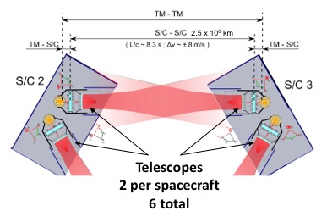
Telescope Functional Description
Efficiently deliver power on-axis between spacecraft (2.5 million km)
Simultaneous transmit and receive (TX/RX)
Afocal beam expander
  300 mm dia. large beam
  2.24 mm dia. on bench
  134X magnification
TM-TM
S/C - S/C: 2.5 x 10⁶ km
TM-S/C
L/c ~ 8.3 s, ∆υ ~ +/- 8 m/s
TM-S/C
Application is PRECISION LENGTH MEASUREMENT, not image formation
  Keep optical pathlength stable to ~ 1 pm/√Hz over the measurement BW
  Minimize phase noise from coherent transmitter backscattered light
  Minimize tilt to length (TTL) coupling
Livas: LISA Symposium XIII September 2, 2020
Notes:
The LISA Telescope is designed to enable a precision length measurement between two widely space test masses. The measurement budget between pairs of proof masses is roughly 10 pm/√Hz.
There are two telescopes in series with the measurement, so their optical pathlength must be stable to ~ 1 pm/√Hz over the measurement band.

Slide 6
Key Telescope Optical Specifications
Specification | Value | Units | Comments
Wavelength | 1064 | nm | nominal system operating wavelength
Conjugates | Afocal |  | Telescope is an afocal transceiver, i.e. object and image at infinity. Specifications generally assume ”receive” mode, where the entrance pupil is the “large” pupil in object space
Field of Regard for Acquisition | +/- 225 | µrad | Circular field of view
Field of view for Science | +/- 20 | µrad | Circular field of view
Wave-front error | < 35 | nm | wavelength/30 (telescope only)
Large Pupil diameter | 300+/- 1 | mm | Large pupil is associated with M1, inertial space
Small pupil diameter | 2.24 +/- 0.0075 | mm | Small pupil is located at the system stop on the OB
Base ray deviation from optical axis (large pupil) | < 10 | µrad | The “base ray” is the center-field center-pupil ray. Boresight error associated with the large pupil
Base ray deviation from optical axis (small pupil) | < 1.3 | mrad | Interface requirement with the optical bench
Tilt-to-length (TTL) | < 0.6 | pm/nrad | “as built” over the science FOV
Livas: LISA Symposium XIII September 2, 2020

Slide 7
Key Challenges/design drivers
Dimensional Stability
  Low CTE material and thermal stability at the 1 x 10⁻⁵ K/√Hz level, using baffles fixed to the spacecraft that act as a passive thermal filter
  Spacecraft is stable at the 1 x 10⁻³ K/√Hz level per LISA Pathfinder experience.
Minimize Coherent backscattered light
  Adopt an unobstructed optical design and plan the design to accommodate contamination
  Low scatter coatings and dimensionally stable structure so scattered light phase is stable
  Keep spacing between the telescope and optical bench stable
Minimize Tilt-to-length (TTL) coupling
  Careful design to minimize pathlength differences with field angle (dOPL vs Field)
  Careful alignment of measurement axes (bench to bench and bench to GRS) such that spacecraft jitter does not couple to the length measurement (movable aperture stops help during integration)
  Wavefront errors projected into the far-field will also couple TX angular jitter into an apparent length signal (keep wavefront error low: WFE < 35 nm RMS = λ/30 at 1064 nm)
Brzozowski: Stray Light on the LISA Optical Bench
Pizzella, et al: A testbed for Tilt-To-Length coupling and Differential-Wavefront-Sensing performance
Livas: LISA Symposium XIII September 2, 2020
Notes:
Key challenges and design drivers for the telescope.

Slide 8
Key Interfaces
Next talk in this session: Taylor, et al: Optical Bench Overview
Wells and Milanova: Beam orientation on the LISA Optical bench– opto-mechanical options
Optical
  Small pupil/stop on the optical bench
  Large pupil located at the center of mass of the test mass
  Careful mapping between the stop and the large pupil to minimize TTL coupling in the telescope itself
Mechanical
  3 pairs of bipod flexure interfaces to the MOSA Support Structure (MSS)
  Adequate mechanical clearance with the optical bench
  Designed for a fundamental mode of 115 Hz to accommodate worst case launch loads
Thermal
  Nested set of thermal baffles mounted to the spacecraft to filter thermal fluctuations to an acceptable level
  Sized to accommodate MOSA articulation
  Baffle to shield the optical bench
  Notional conduction paths through the bipod interface and from a cable harness to the optical bench
Livas: LISA Symposium XIII September 2, 2020
Notes:
Key challenges and design drivers for the telescope.

Slide 9
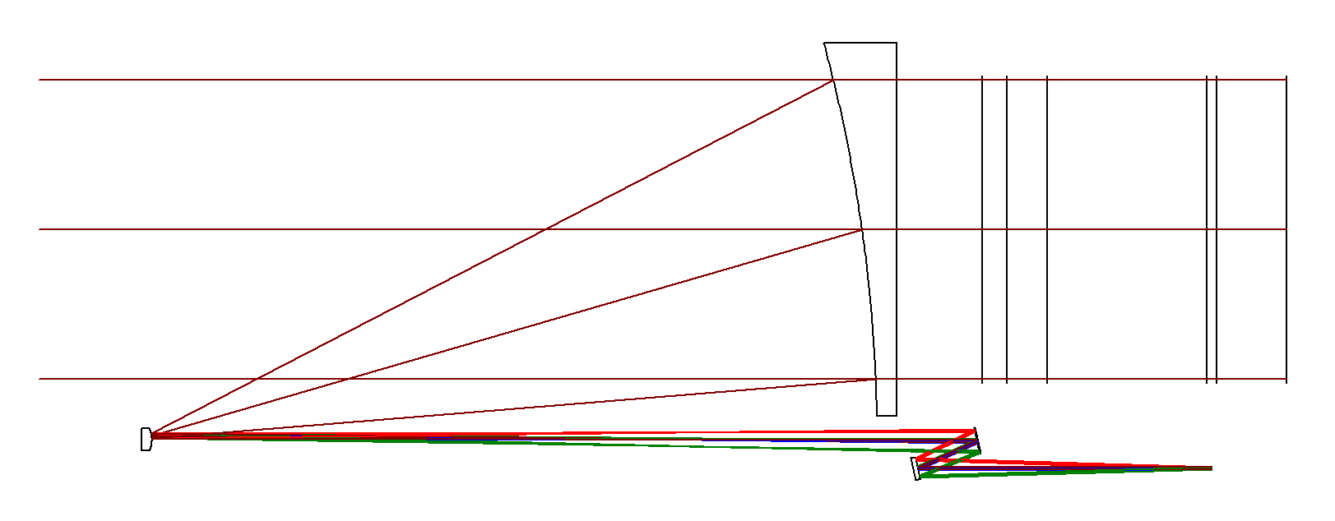
Baseline Optical Design
Optical Bench, 170 mm to M1
Optical Bench
OB Fold limit, 130 mm to M1
Small Pupil Limit, Minimum, 330 mm to M1
M3/M4 optical center limit, 105 mm to M1
Small Pupil Limit, Maximum, 340 mm to M1
M1
Center plane of Test Mass (TM), 410 mm to M1
Test Mass
Y
Beam folded onto bench
Large Pupil (∅300 mm, 100.5 mm to Test Mass Center)
M3
M2
Small Pupil /stop (∅2.24 mm, 334.47 mm to M1)
X
Z
M4
Intermediate focus ( Z = – 150 mm)
Global Origin M1 Vertex
The spacing between M3 and M4 is 65 mm
Global Coordinate System
Origin at M1 Vertex
Z-axis: parallel to optical axis (object and image space)
Y-axis: perpendicular to optical axis, within screen
X-axis: perpendicular to optical axis, into screen
 | Type | Conic | Radius (mm) | Clear Aperture (mm) | Edge Diameter (mm)
M1 | Parabola | -1 | -1475.246 | 345.3 | 365
M2 | Hyperbola | -1.0928 | -25.813 | 6.4 | 25.4
M3 | XY Polynomial | 0 | Infinity | 24.6 | 27.4
M4 | Flat | 0 | Infinity | 21.0 | 27.4
”freeform” optic
Notes:
Latest design layout. The telescope maps the small aperture STOP from the bench to the center of mass of the TEST MASS. The main unusual feature is M3, which is a generalized asphere, commonly called a “freeform” optic. The departure from a biconic is slight, and the additional degrees of freedom enable essentially zero pupil wander. The primary is kept near F/1 to control cost and fabrication risk.

Slide 10
Pupil wander/dOPL vs. Field
TTL over Science FOV in pm/rad
X 10⁻⁴
-20
8
0.4
Chief Ray Positions vs Fields at M1
Science FOV +/- 20 µrad
7
6
Chief Ray/delta X/Y with on-axis (mm)
5
Y Field Angle in µrad
TTL (pm/rad)
0
4
Acquisition FOR +/- 225 µrad
3
-0.4
Acquisition Field of Regard in µrad
2
1
20
0
-20
0
20
X Field Angle in µrad
“Intrinsic” to the telescope optical path length variation nearly eliminated by design.
Max over science field of view is 10⁻³ pm/rad = 1 fm/rad.
Livas: LISA Symposium XIII September 2, 2020
Notes:
Shown is the near-zero “intrinsic” tilt-to-length coupling due to the telescope design by itself. The very low value, even over the complete Acquisition field of regard means that most of the tilt-to-length coupling is due to the residual misalignment between the optical bench, telescope and GRS. This residual misalignment will be partially compensated with a moveable clip aperture/stop during assembly.

Slide 11
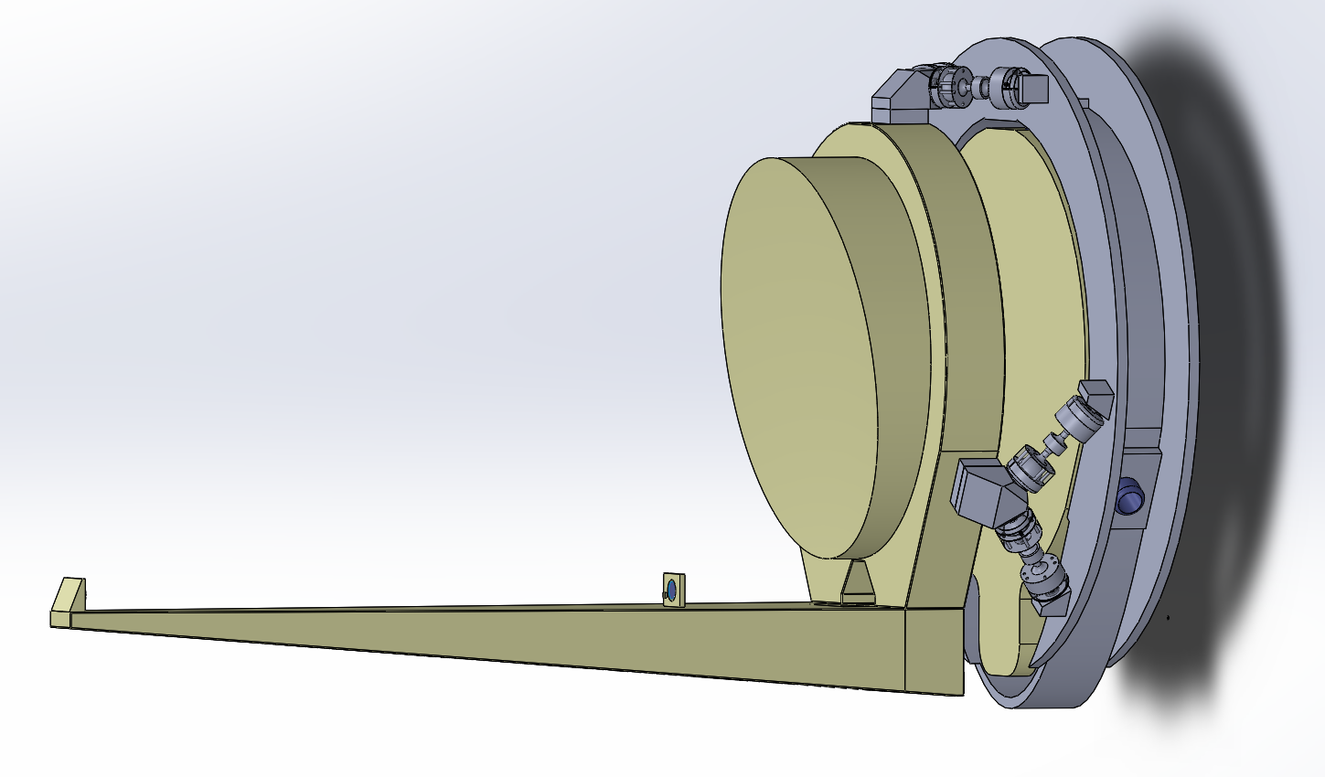
Notional CAD Model
MOSA Support Structure (MSS)
Optical bench
Single low-CTE material (Zerodur)
2-piece structure for ease of manufacturing
  Adhesives used to join the pieces and mount the small optics (M2, M3, M4)
  M1 is integral to the backplane
Titanium bipod interfaces to the MSS
Primary is oversized for beam (300 mm) to allow for optimization of alignment with optical bench to minimize TTL
Primary
365 mm
GRS
(test mass) support not shown
secondary
M3/M4 hidden
725 mm
Bipod supports (3x)
11
Livas: LISA Symposium XIII September 2, 2020

Slide 12
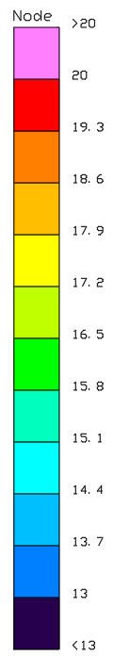
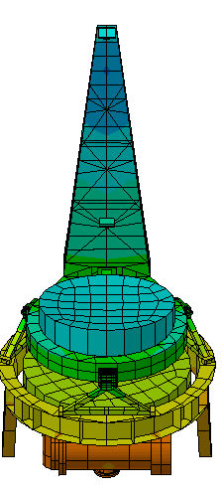
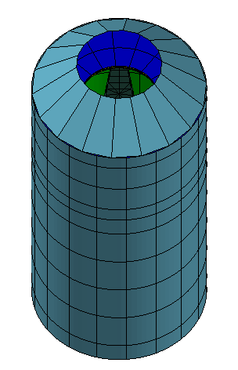
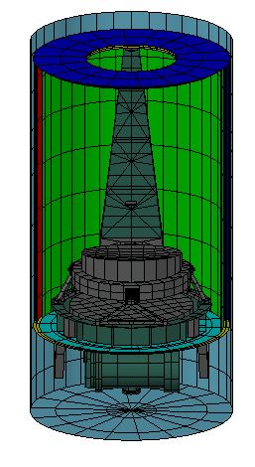
Thermal Model Summary
Outer Baffle: only the Primary Mirror sees space
Steady State Temperature (C)
3 Inner Baffles
∆T ~ 3 C
Mounted to the spacecraft
Livas: LISA Symposium XIII September 2, 2020

Slide 13
Summary
Sanjuan, et al: The LISA telescope testing at the University of Florida
Kulkarni, et al: The development of the Telescope Test Structure for LISA telescope stability measurements
Uminska, et al: LISA Telescope Test Structure Simulations
Guzmán, et al: Optical Truss Interferometer for the LISA Telescope
Proposed design meets key requirements
    Excellent dimensional stability
    Extremely low coherent backscattered light
    Low “Intrinsic” tilt-to-length coupling
    Can accommodate dynamic stop placement during alignment
Tertiary mirror design is a freeform optic
  small (< 2 microns RMS) deviations from a sphere
  Controls TTL internal to the telescope by reducing pupil mapping aberrations
Alignment requirements are tight, but possible
Mechanical design with all-glass construction meets stiffness requirements
STM delivery expected Sep 2021
Currently developing plans for EDU testing
Livas: LISA Symposium XIII September 2, 2020

