Slide 1
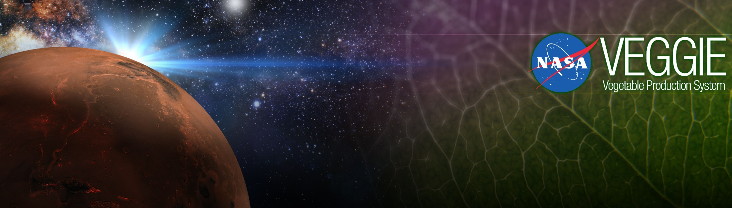
Space Crop Production
Gioia Massa
Exploration Research and Technology Programs
NASA, Kennedy Space Center, FL, USA

Slide 2
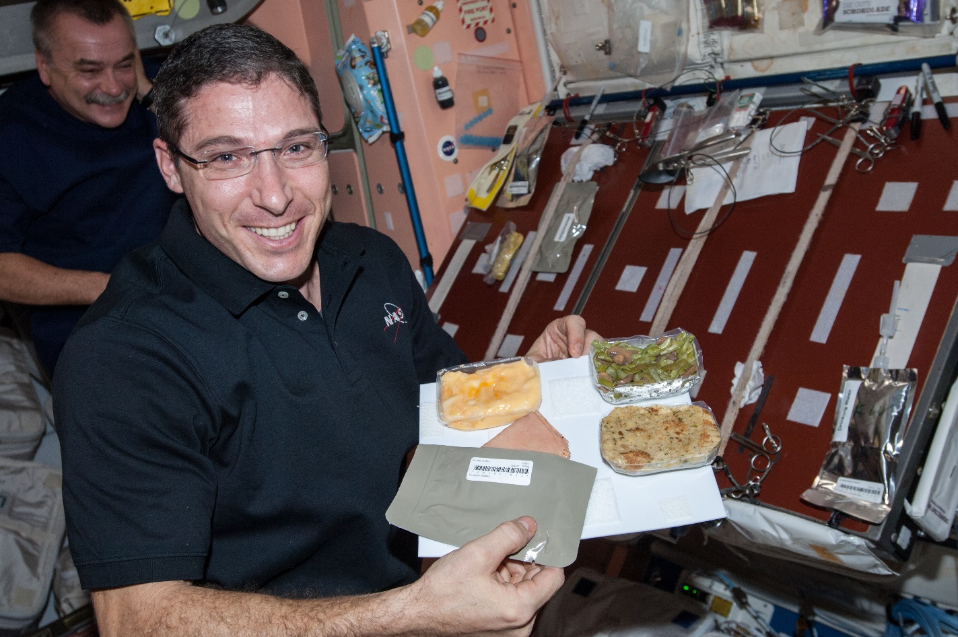
Why grow plants in space?
Food
Psychological well being
Atmosphere
Water

Slide 3
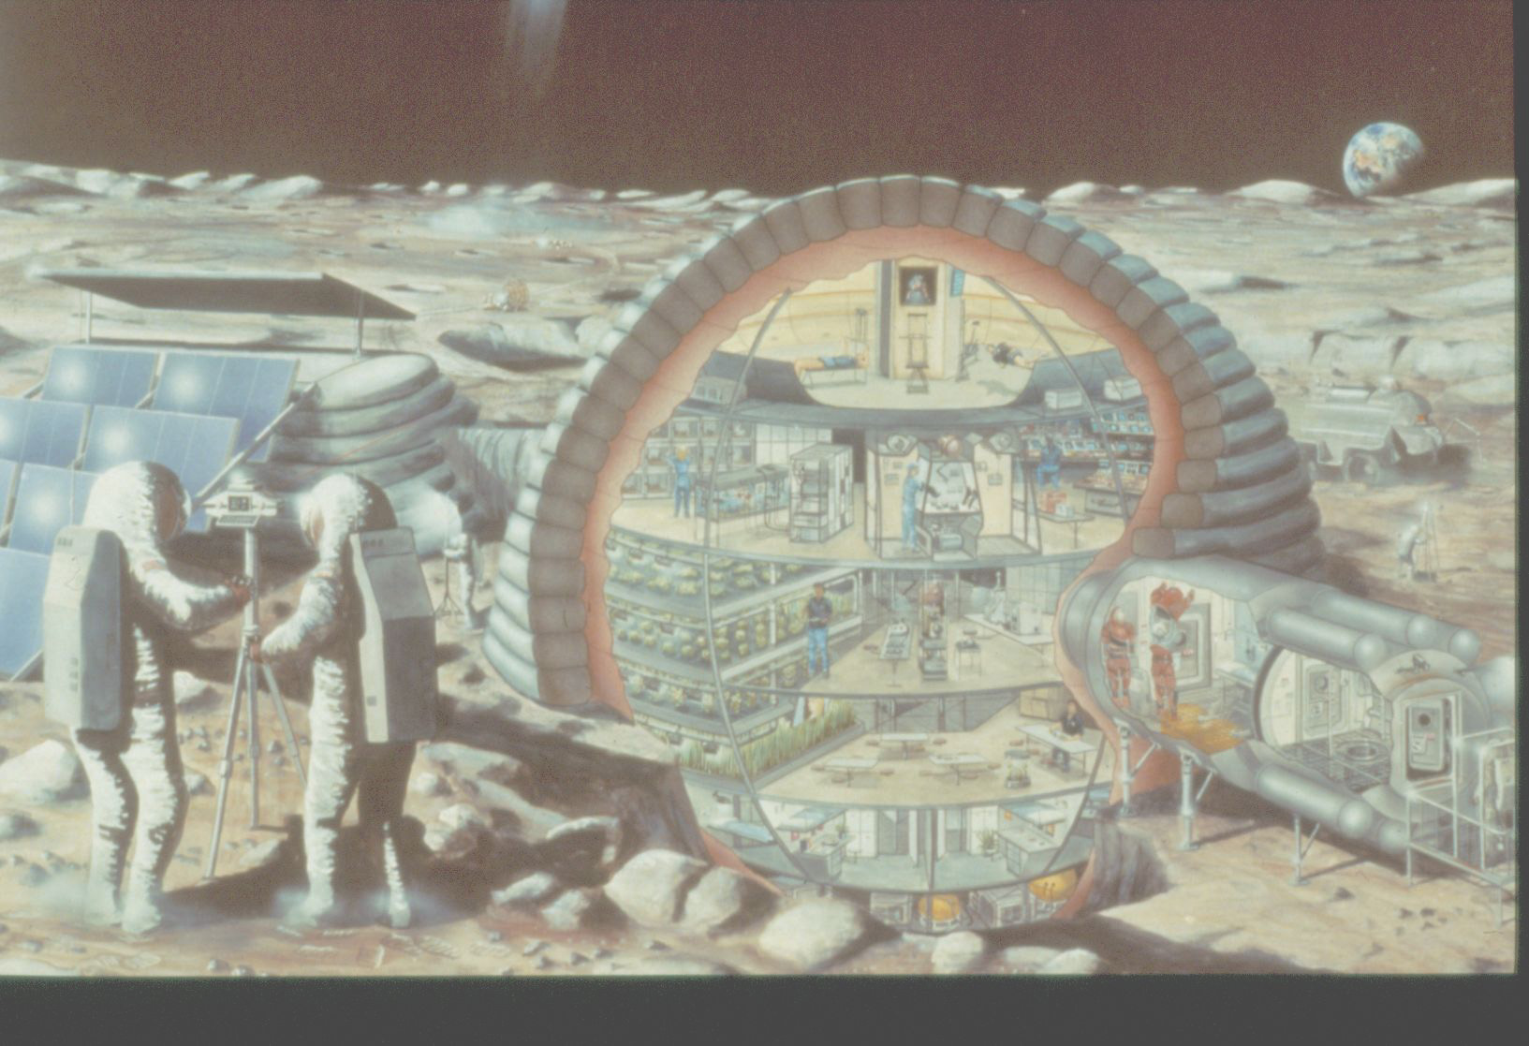

Slide 4
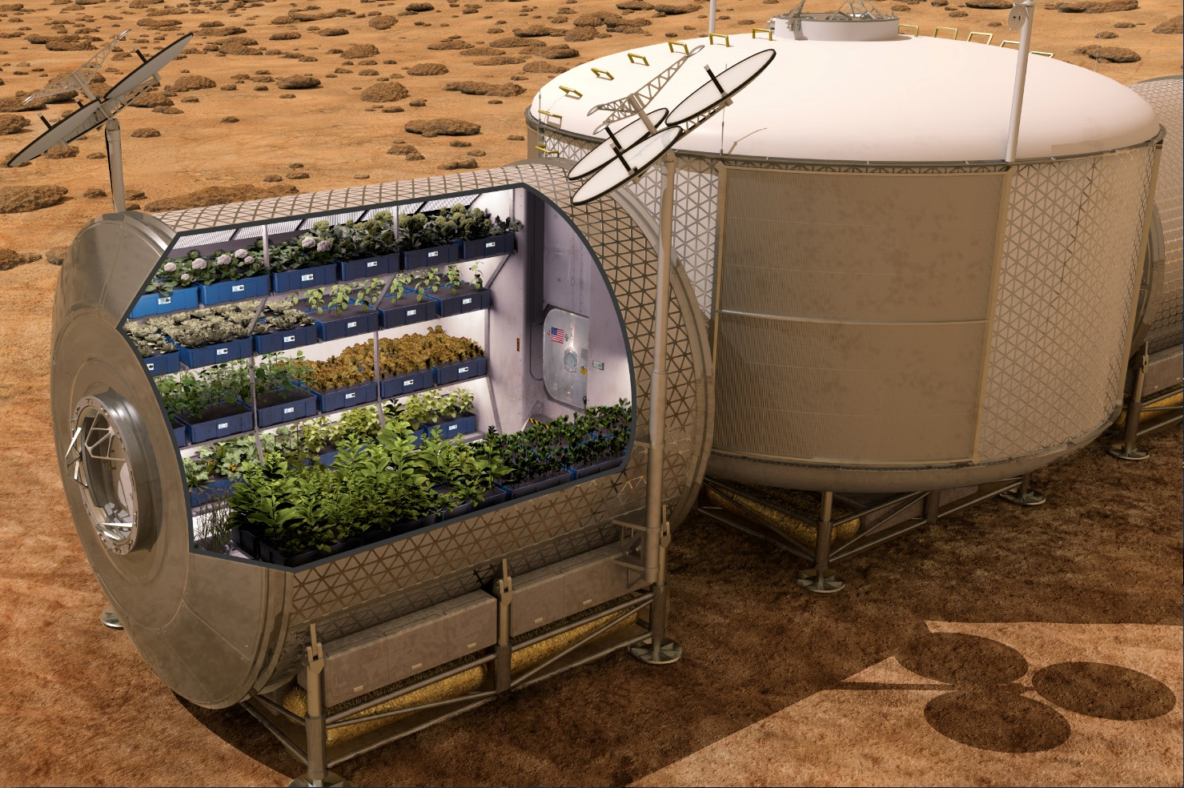

Slide 5
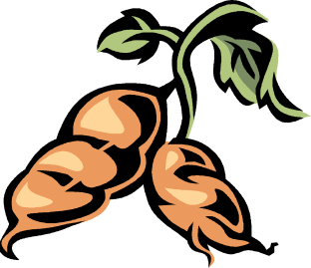


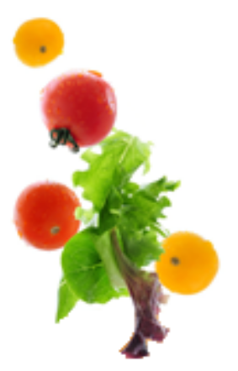



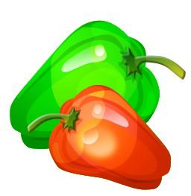

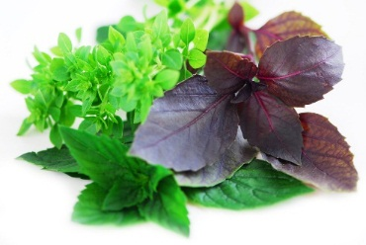


Space Crop Production Candidates
Salad
Leafy Greens
Tomato
Pepper
Radish
Strawberry
Green Onion
Pea
Carrot
Lettuce, Chinese cabbage, Swiss chard, Mizuna, Spinach
Staple Crops
White Potato
Sweet Potato
Rice
Wheat
Dried Bean
Soybean
Peanut
MINIMAL PREPARATION / COOKING
SIGNIFICANT PREPARATION / COOKING
CONSUMED FRESH WITHOUT PROCESSING
Herbs
Basil
Mint
Chives
Dill

Slide 6


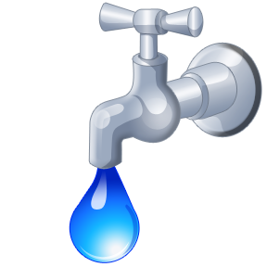

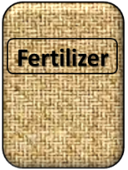

Plant Growth and the Environment
5 Cardinal Factors of Plant Growth…..
O₂

Slide 7

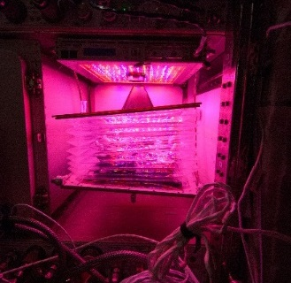
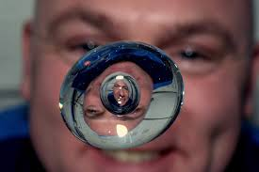


The Space Environment
….and how these work with and without Gravity!
Humans like white light, but plants may grow well with other wavelengths
No convection in space so need to mix the air
O₂
Water forms a ball, and water and air don’t mix well, and roots need both!
Fertilizer is heavy to launch so we need to learn how to recycle plant waste

Slide 8
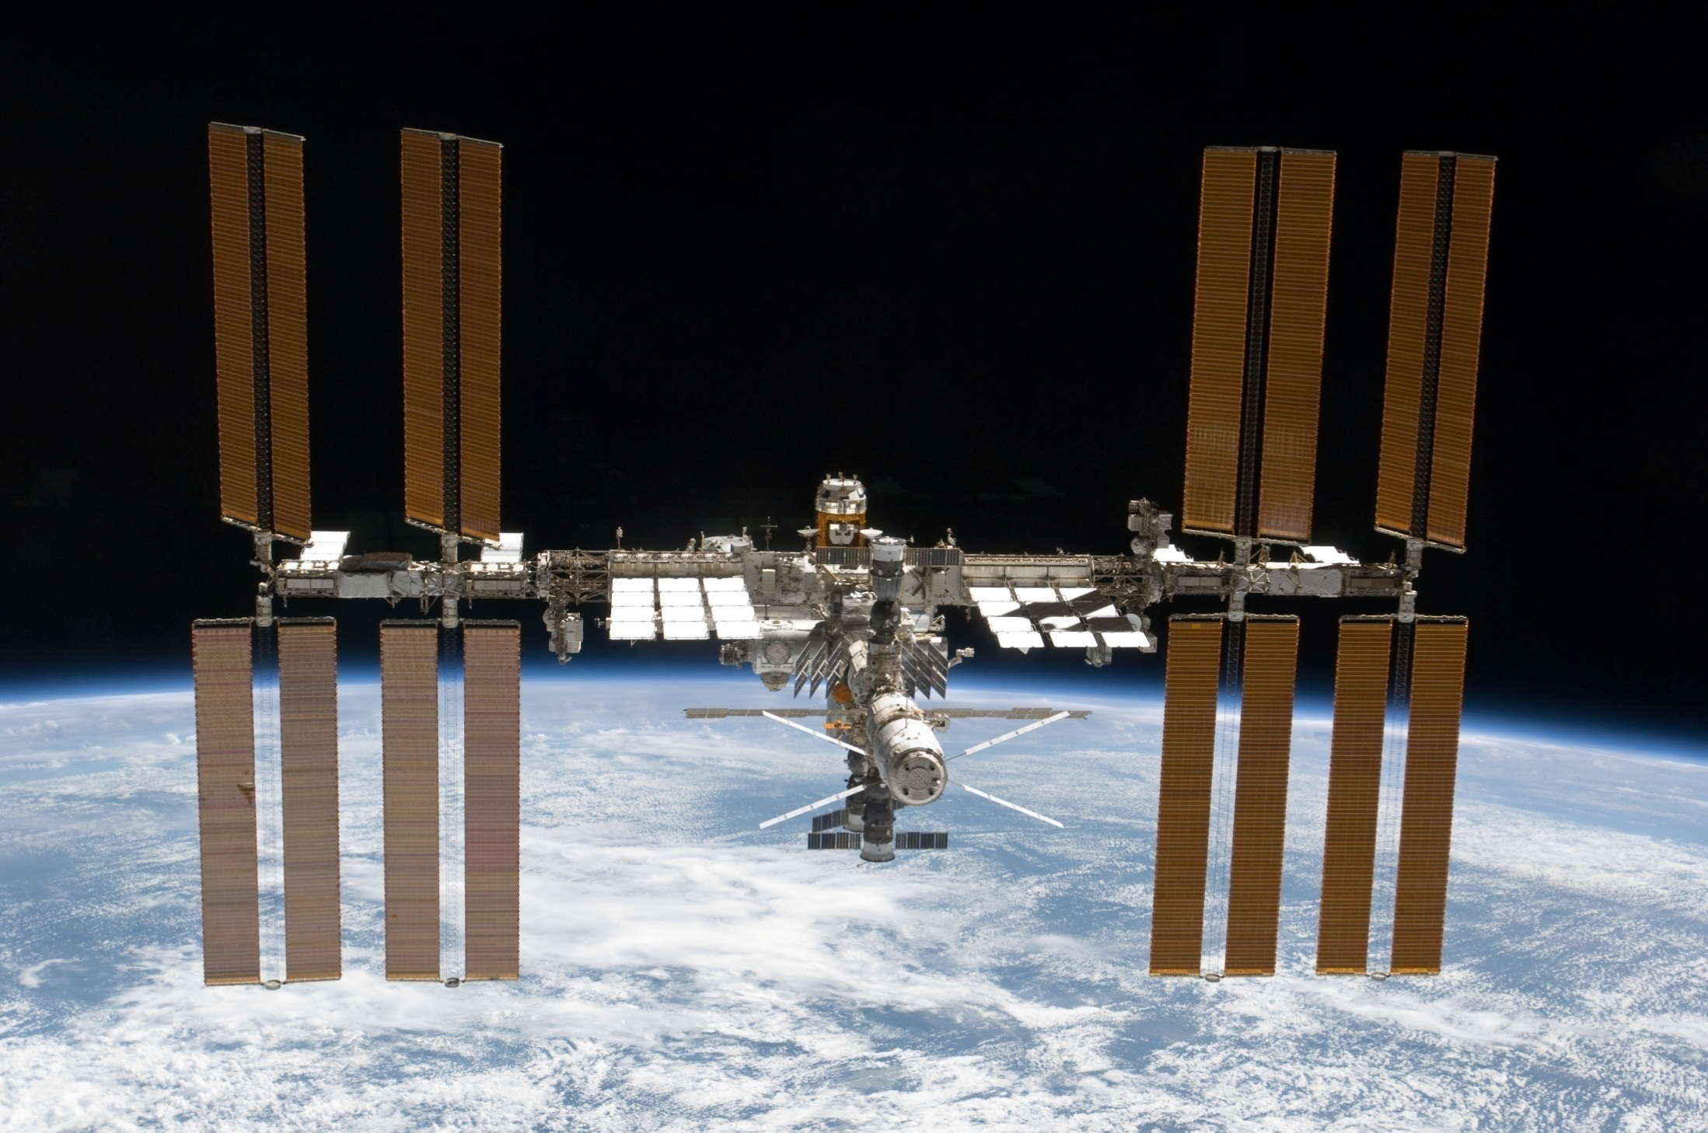
The International Space Station

Slide 9
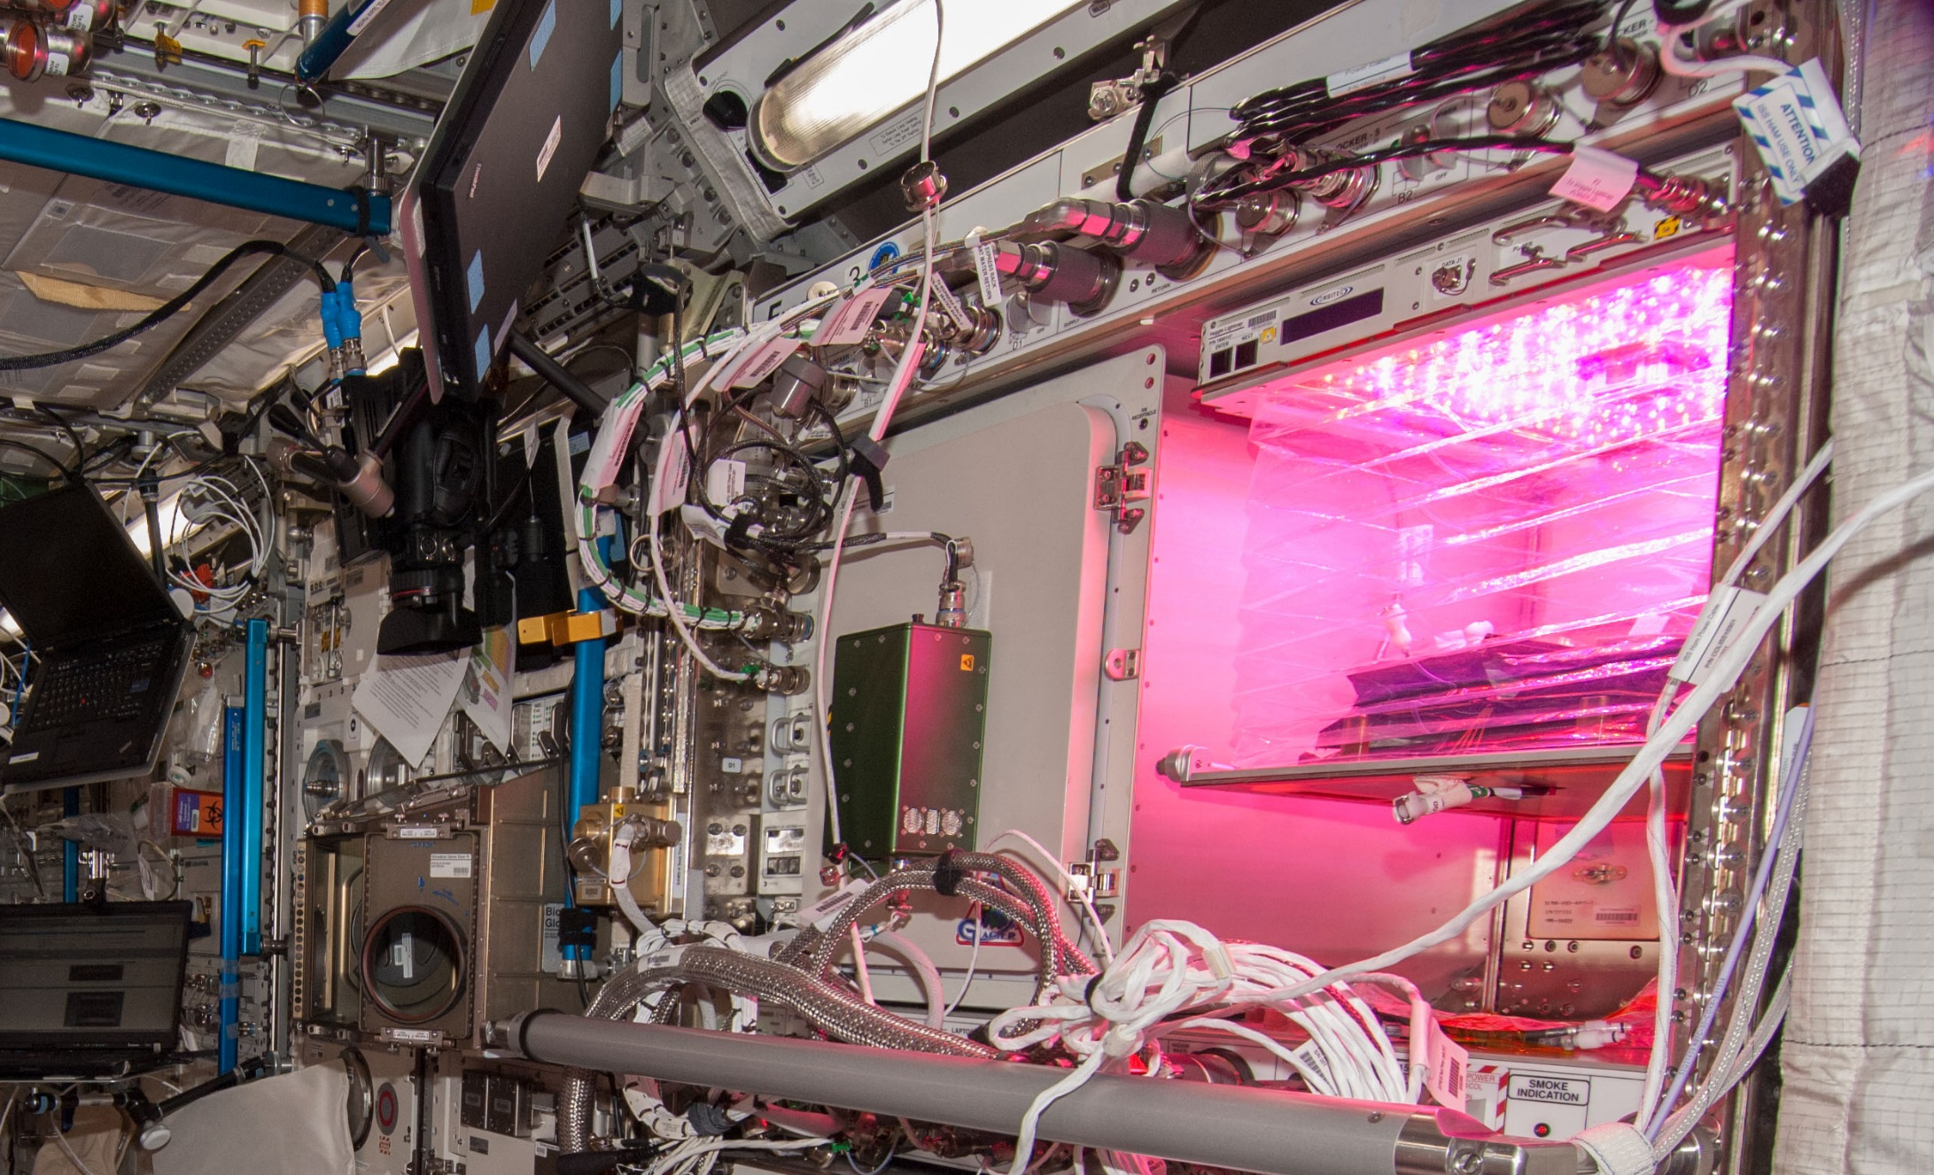
Veggie on ISS

Slide 10
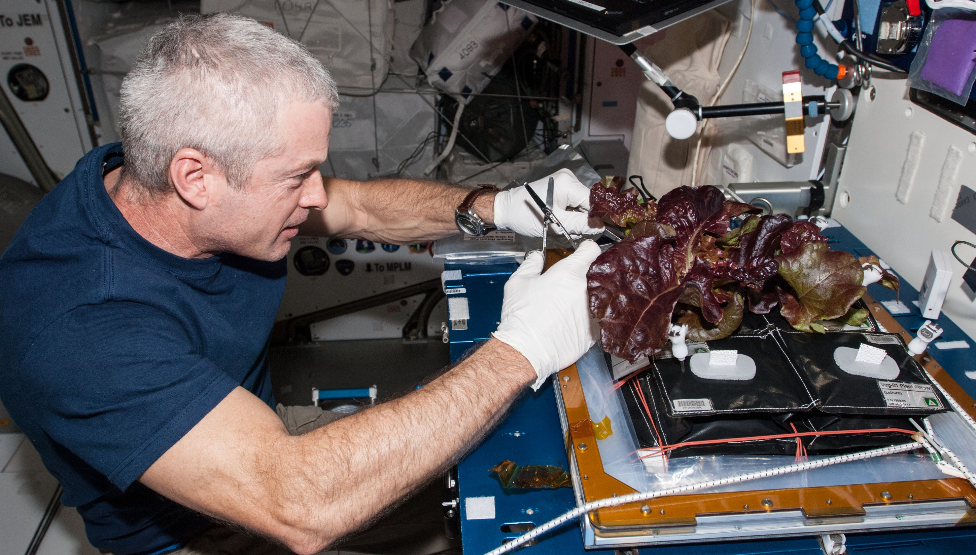
Veg-01A Harvest

Slide 11
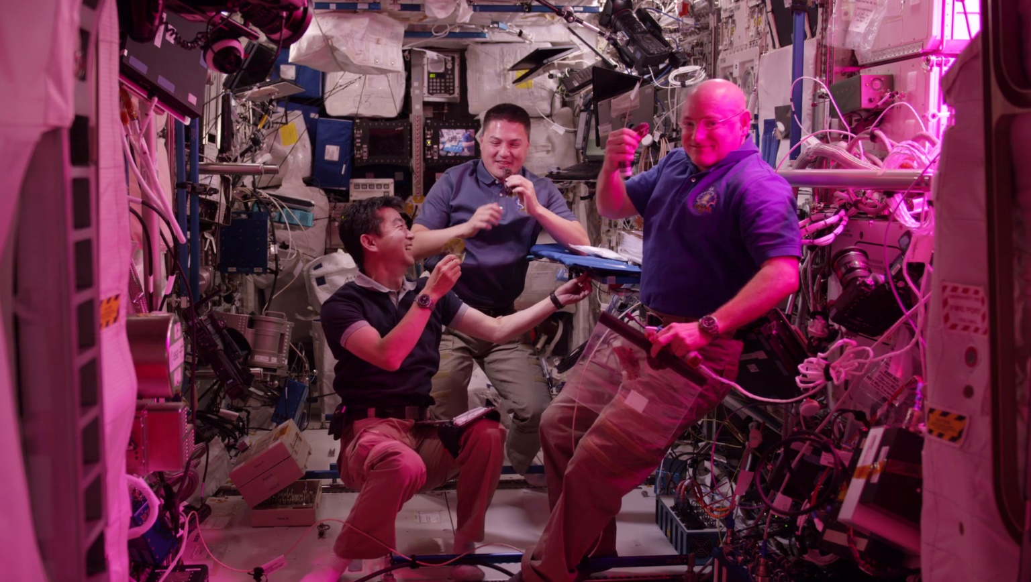
Veg-01B Harvest

Slide 12
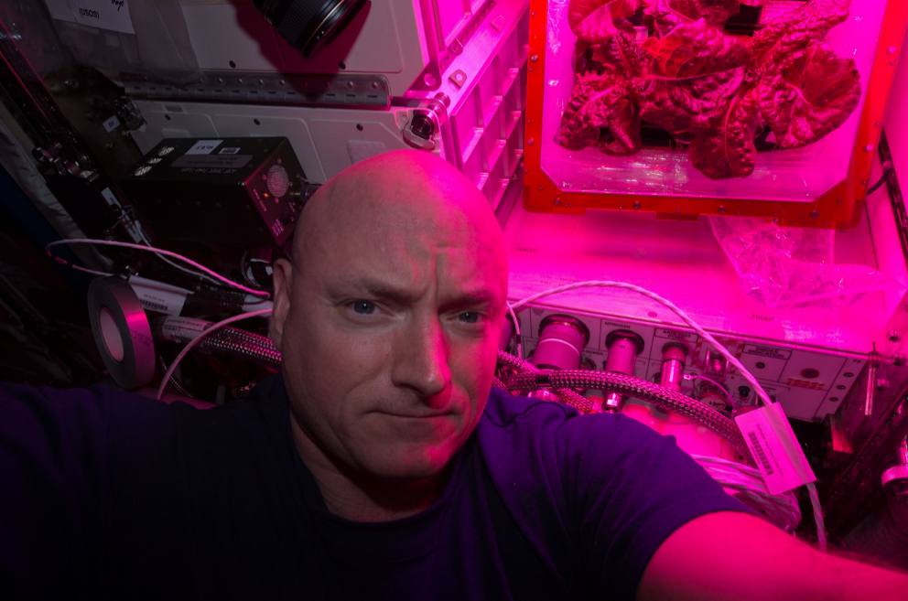
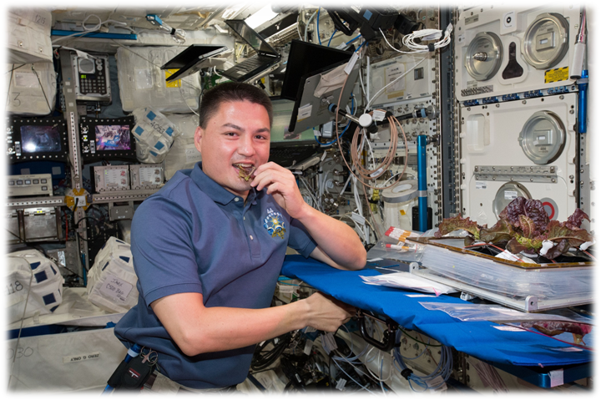
Astronaut Comments
Scott Kelly
  the logistical complexity of having people live and work in space for long periods
  the supply chain that is required
  For Mars, need a space craft that is more self-sustainable with regards to its food supply
Kjell Lindgren
  benefit of eating the fresh food
  contribution that plants have to the ISS ecosystem
  psychological benefit - it’s really fun to see green growing things in the sterile environment of the ISS

Slide 13
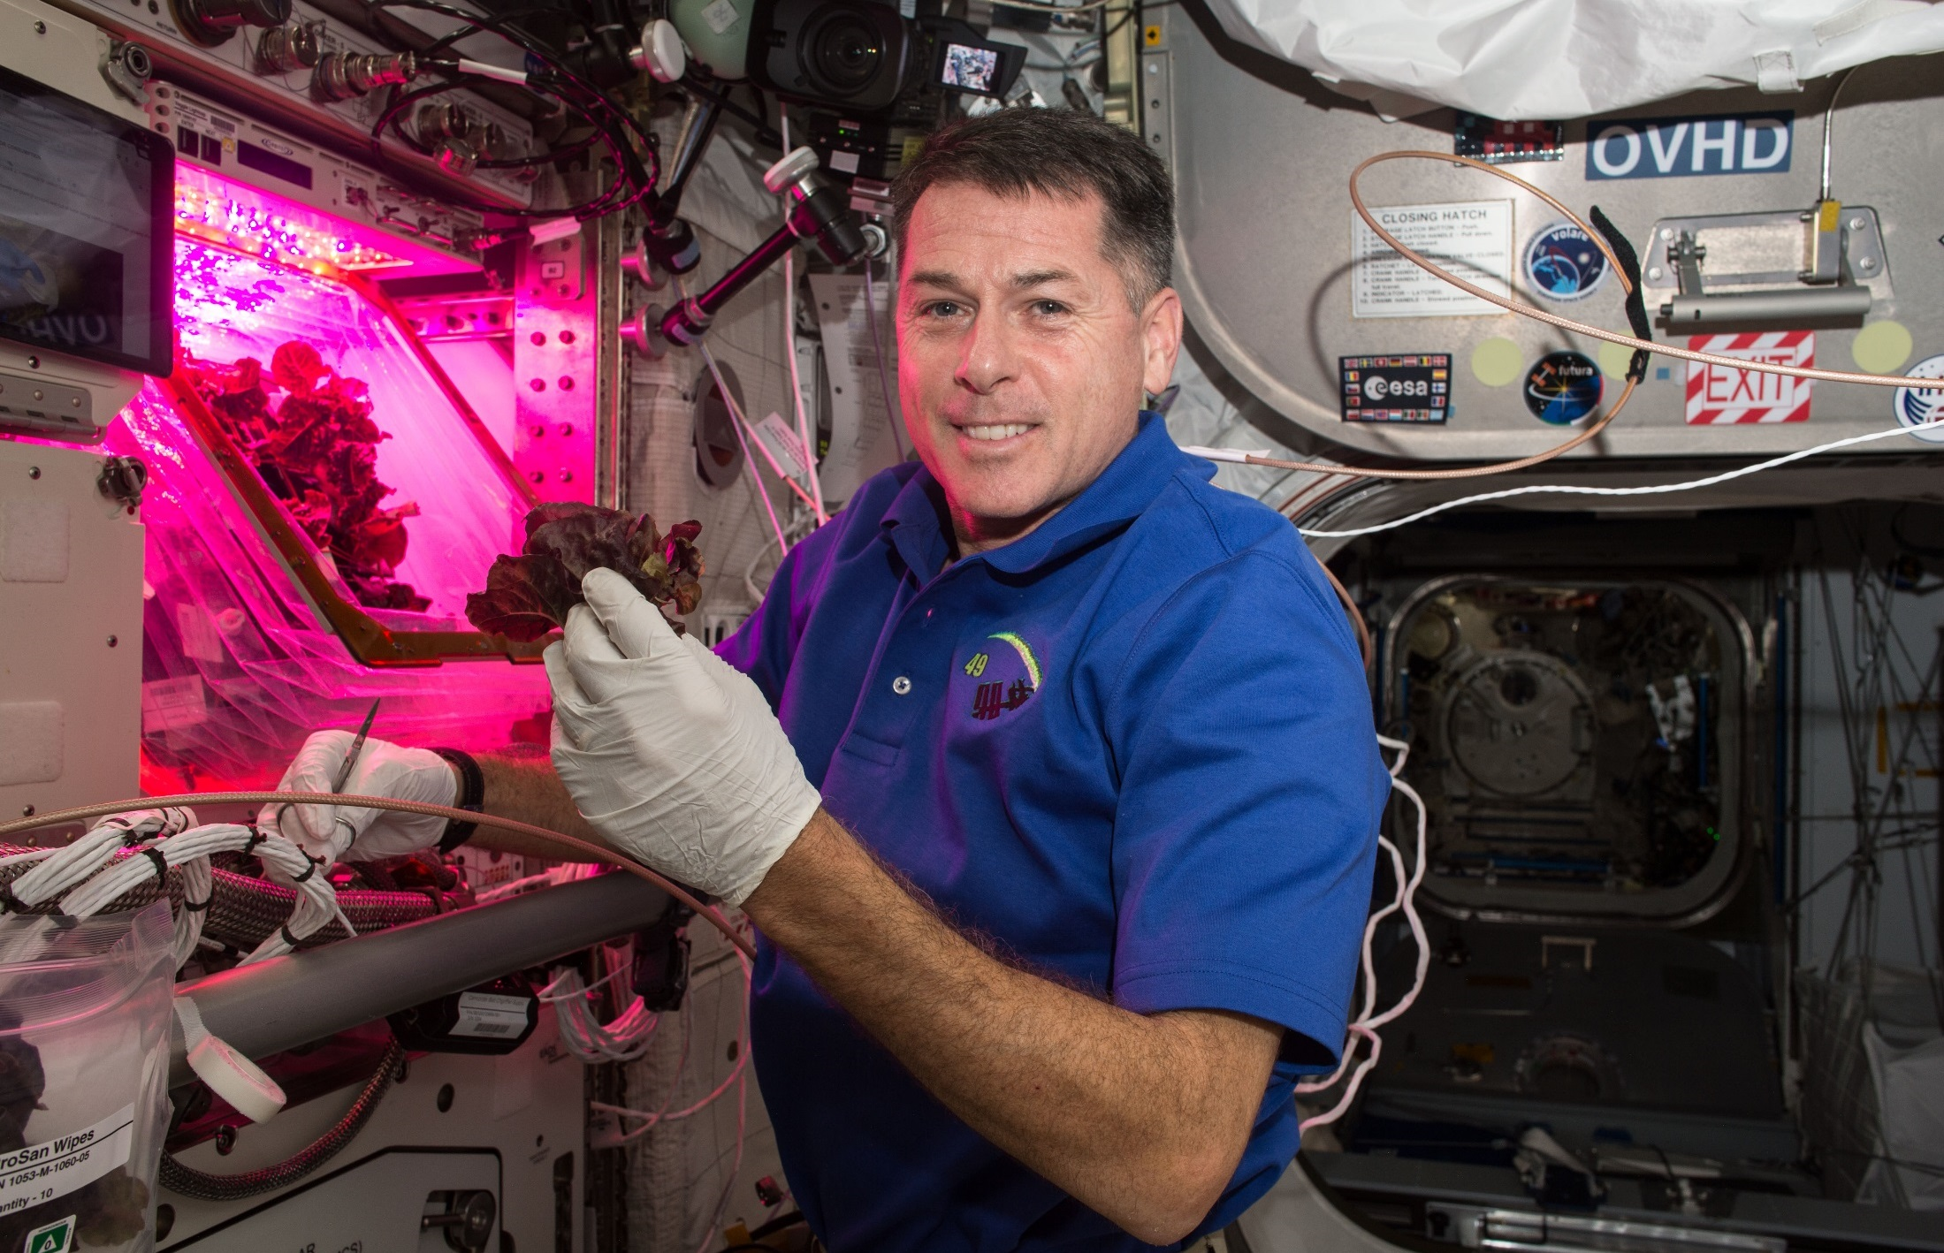
Red Lettuce Cut-and-Come-Again

Slide 14
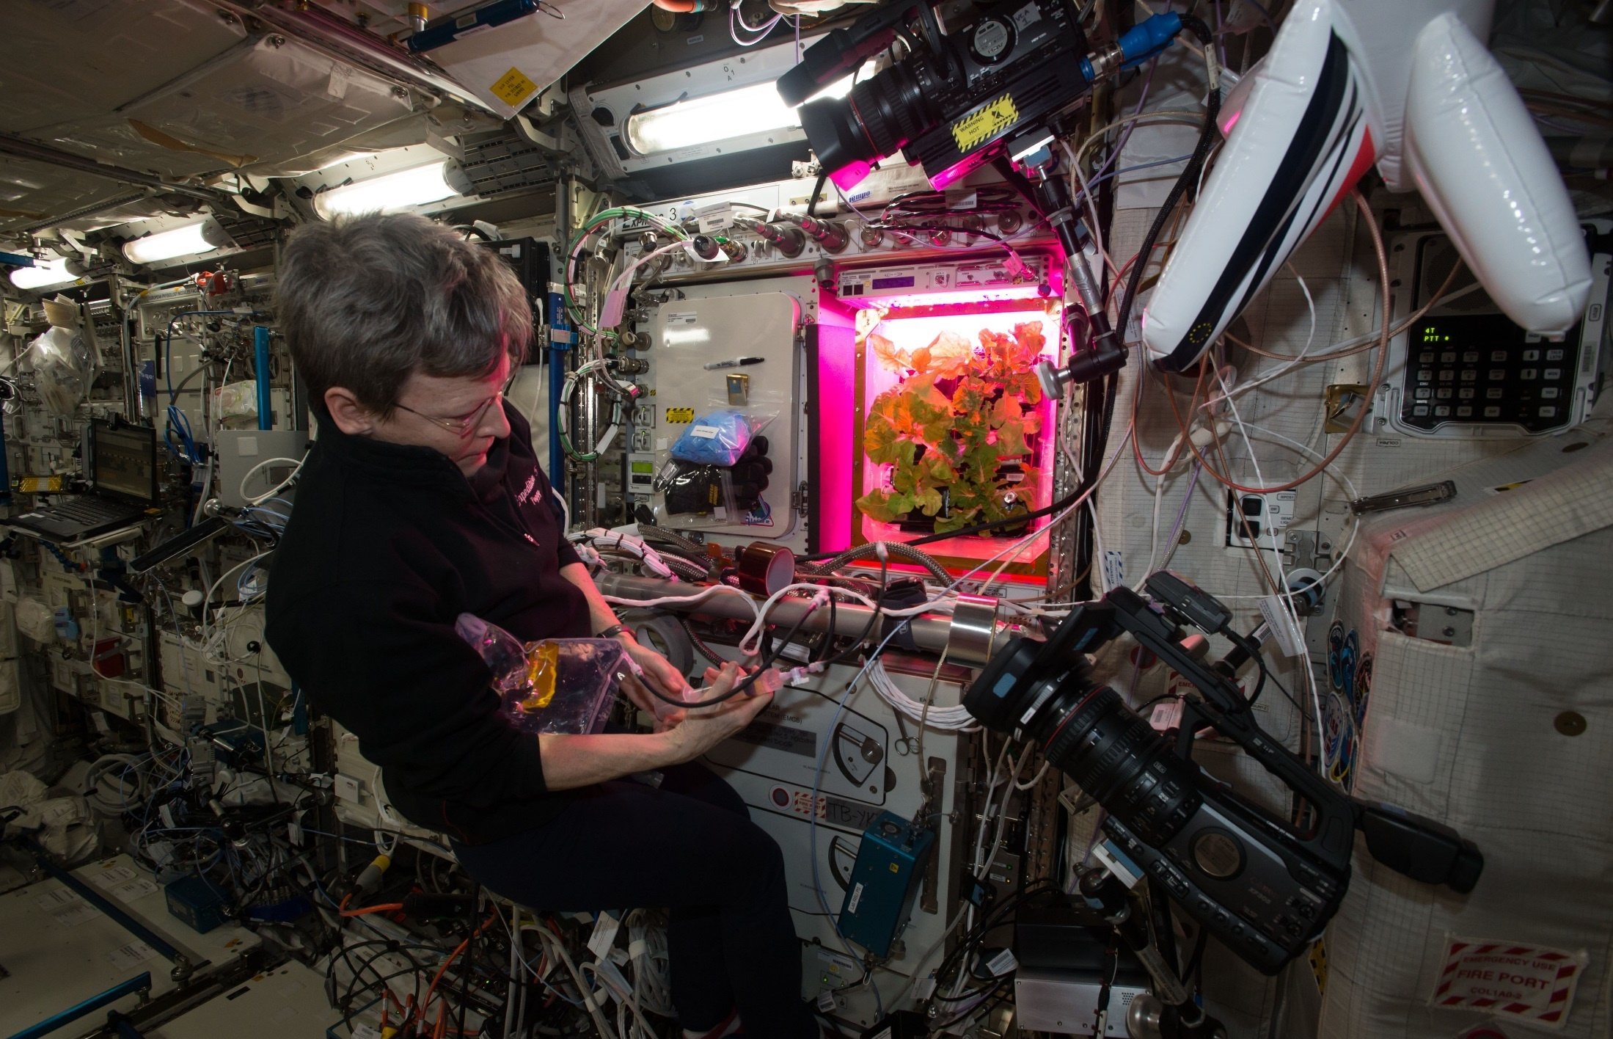
Chinese Cabbage Cut-and-Come-Again

Slide 15
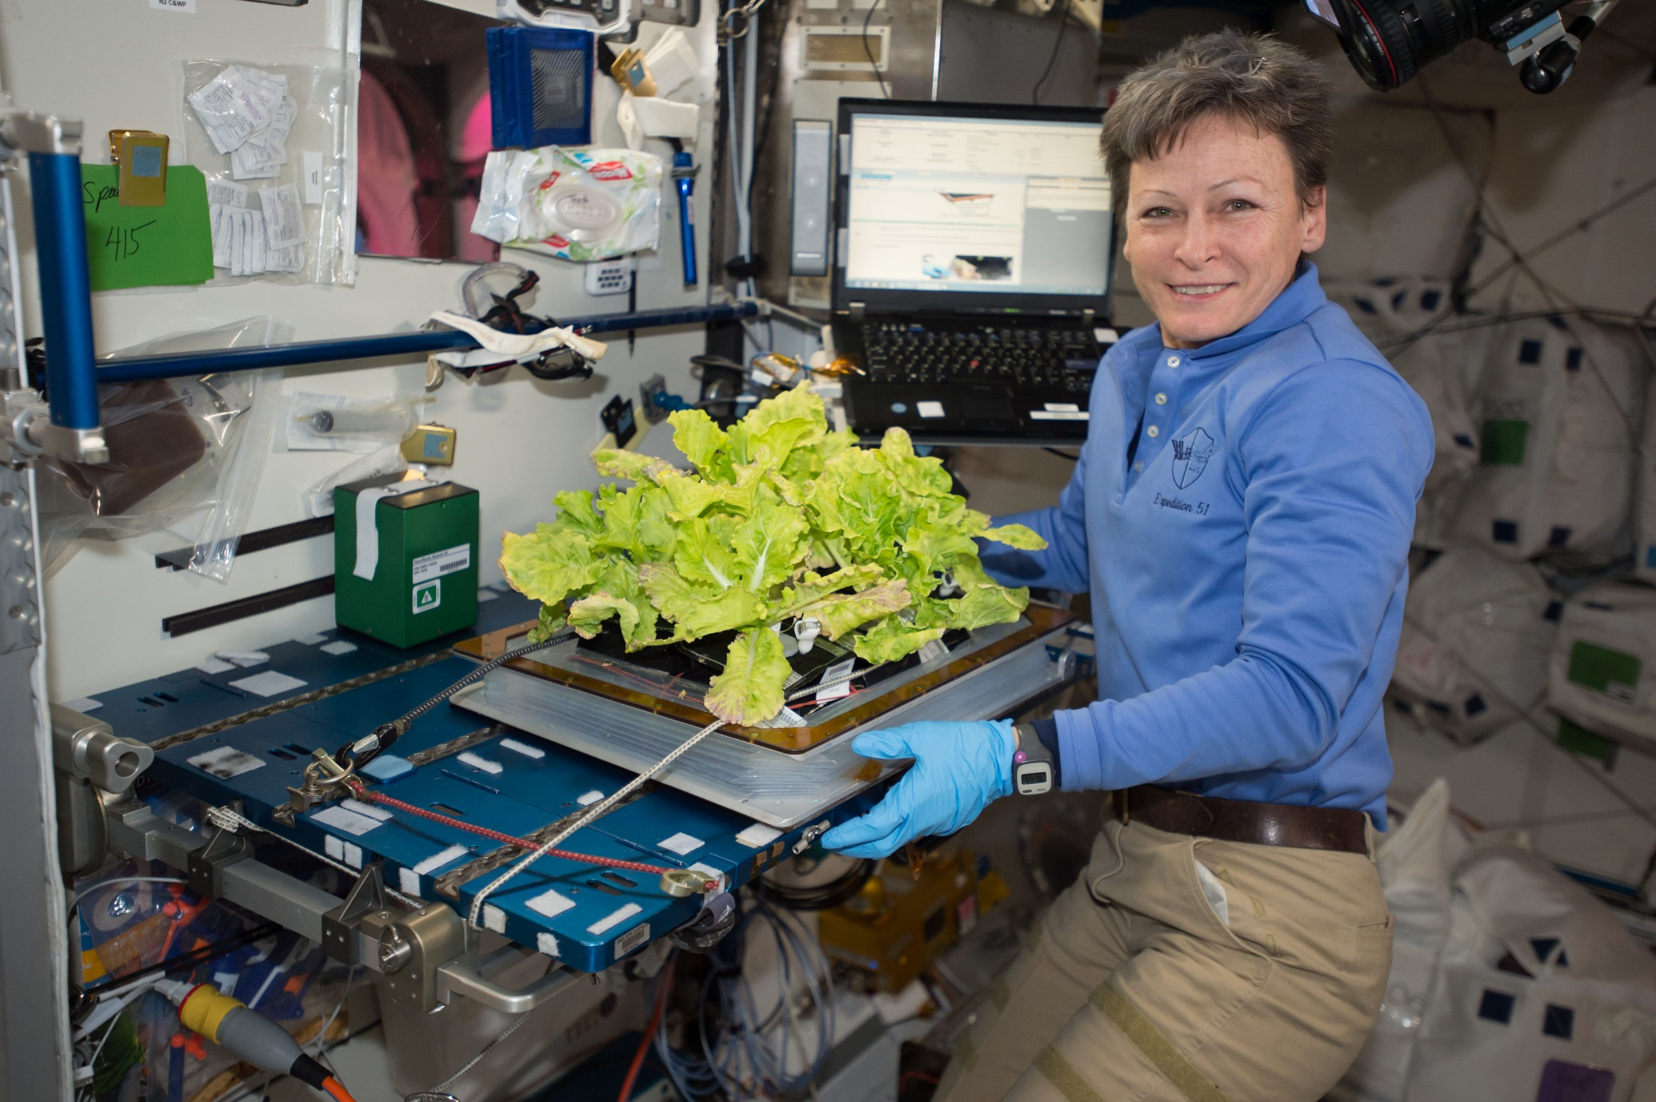
VEG-03C Cut-and-Come-Again

Slide 16
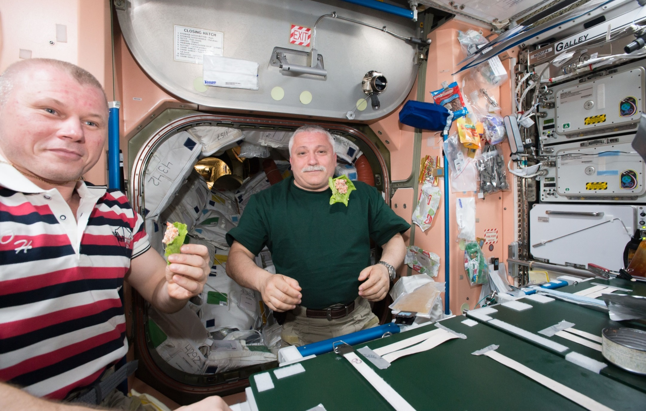
Happy Crew

Slide 17
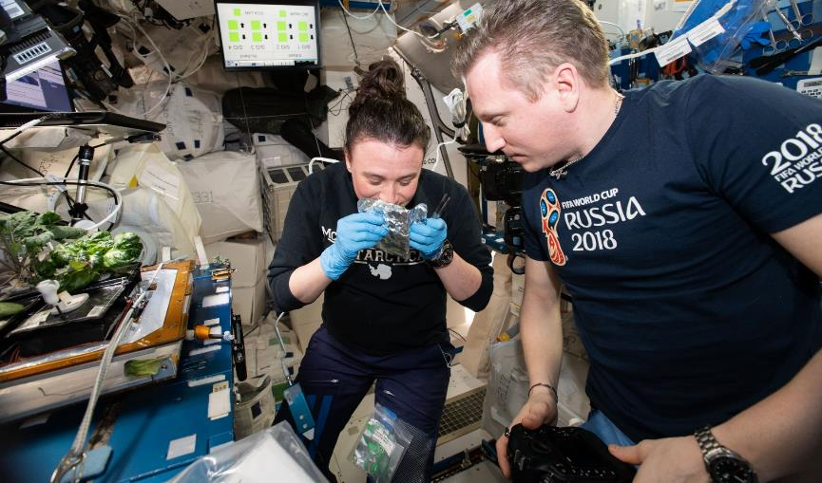
Plant Aromas Also Enhance Astronaut Experiences

Slide 18
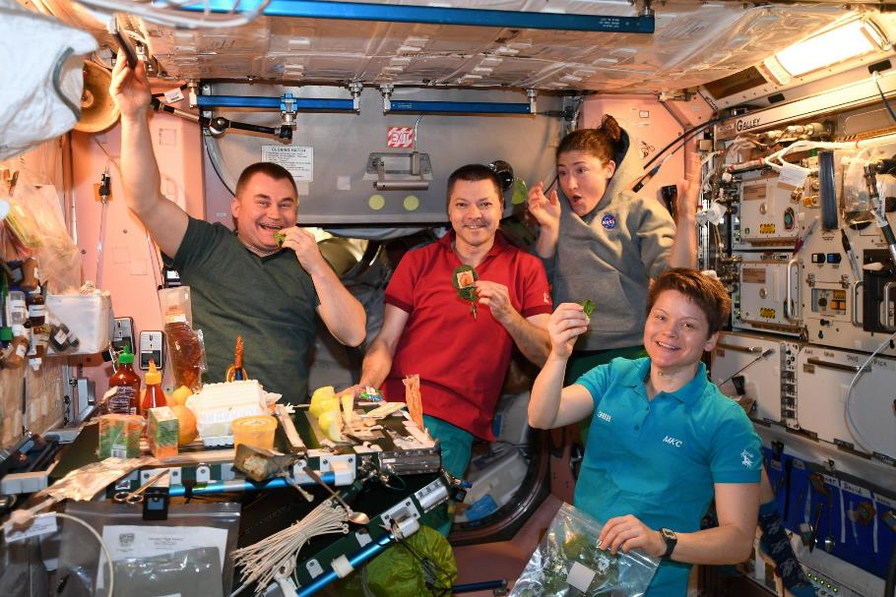

Slide 19
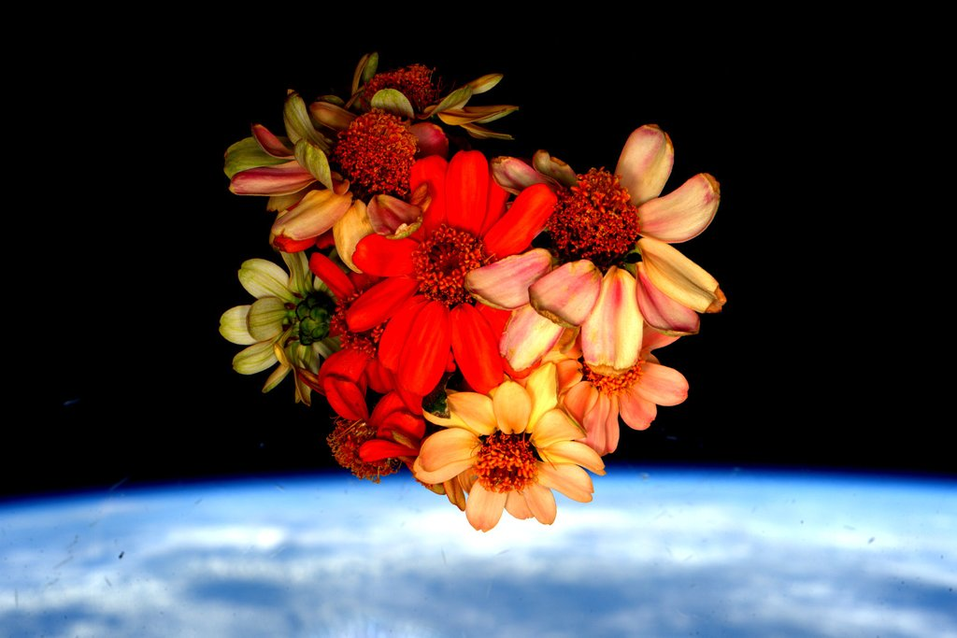
Valentine’s Day Bouquet on the ISS

