Slide 1
Estimating Errors in GLM Detection Efficiency and False Alarm Rate
Katrina Virts (UAH) and William Koshak (NASA)
GLM Science Team Meeting
8 September 2020

Slide 2
Estimating Errors in DE and FAR
Analysis to date of GLM DE and FAR (Bateman and Mach 2020; Murphy and Said 2020; Zhang and Cummins 2020; others in this section) has focused on GLM performance as a function of geography, storm type, cloud characteristics, time of day, flash size and duration, etc.
Other factors that can affect the calculated GLM DE and FAR:
  Reference network DE and FAR
  Location and timing accuracy of GLM and reference networks
  Spatial and temporal matching criteria
The challenge: Estimate the error bars on GLM DE and FAR as a function of these factors by means of a computer simulation

Slide 3
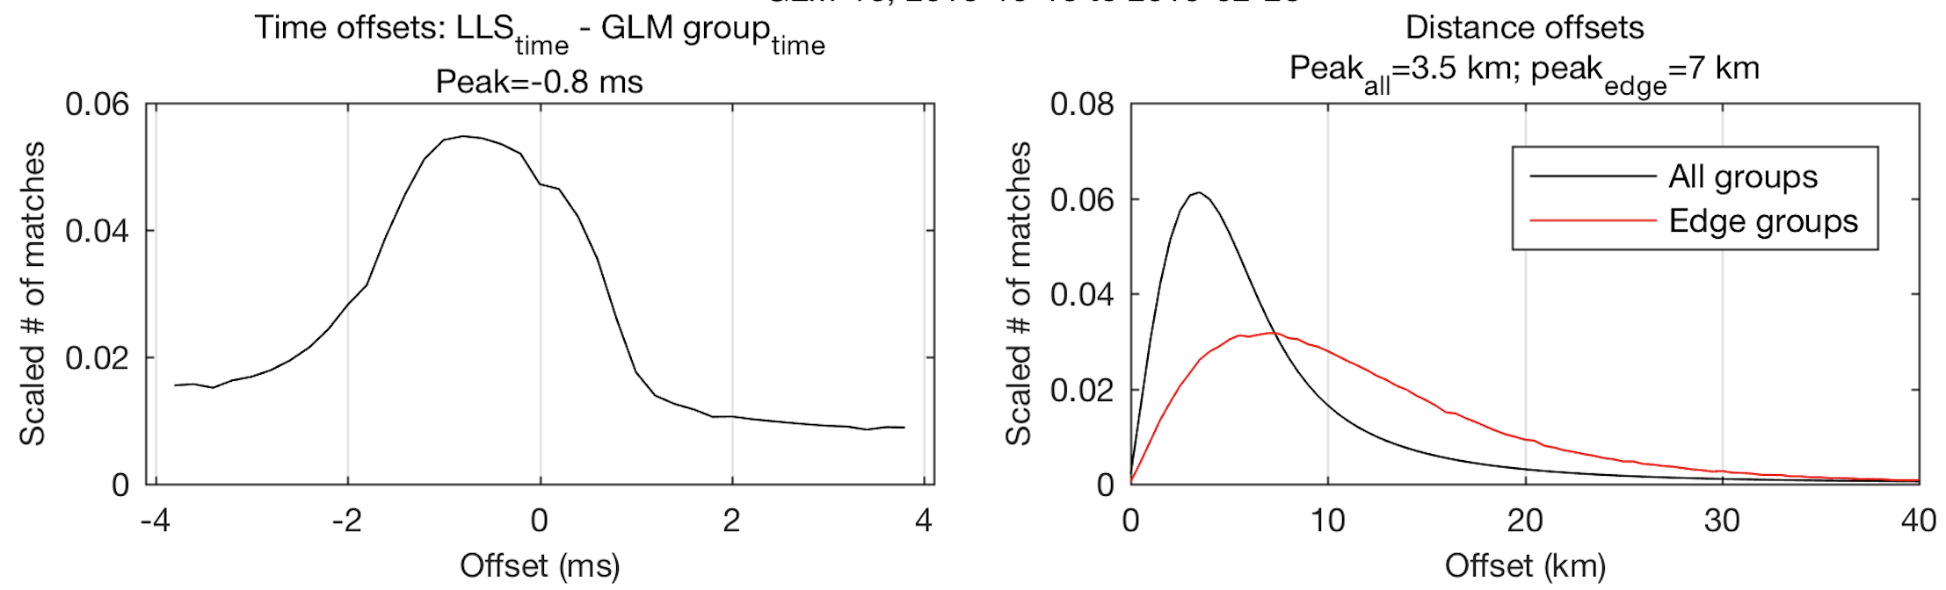
Simulation Procedure
Simulate “reference” data
“Reference” flashes
Define reference DE
Define reference FAR
Apply time/location offsets characteristic of reference network
“Truth” flashes
Rematch
Retrieved DE and FAR
“GLM” flashes
Define GLM DE
Define GLM FAR
Apply time/location offsets characteristic of GLM
Simulate “GLM” data
Run simulations with combinations of varying GLM and reference DE, FAR, time/location offsets, and matching criteria

Slide 4
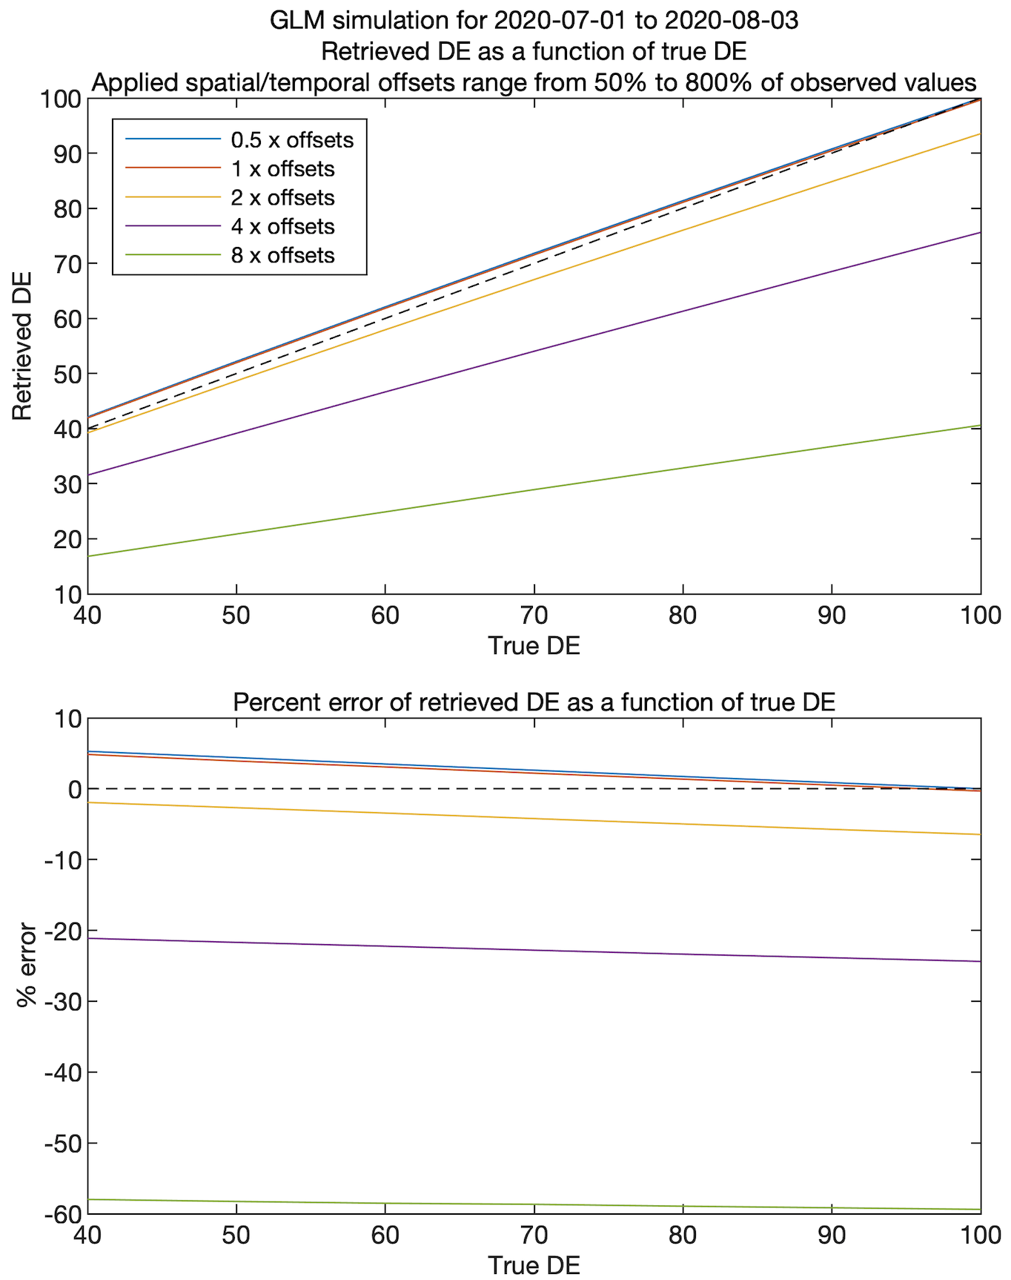
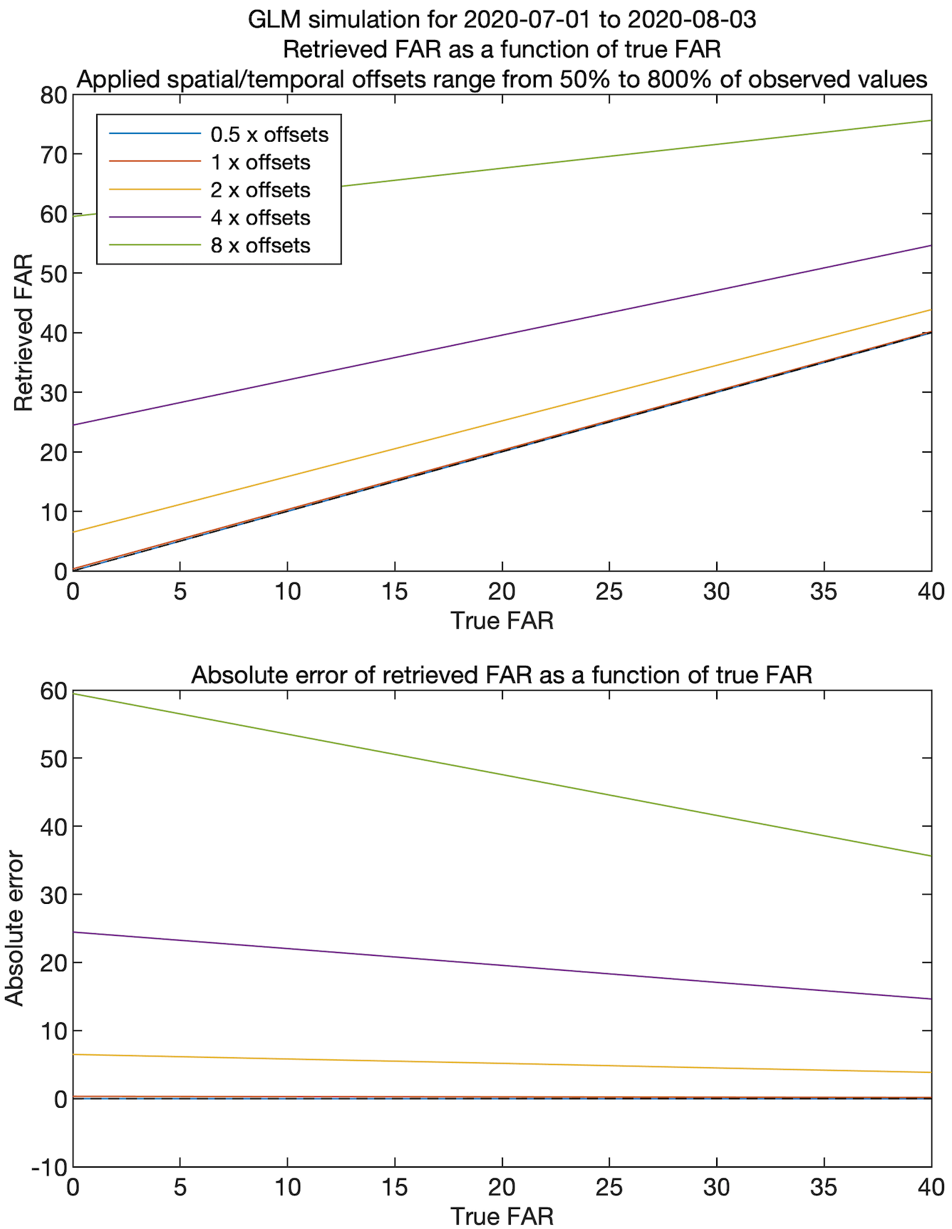
Preliminary Results

Slide 5
Future Work
Via simulation, calculate the retrieved GLM DE and FAR as a function of:
  The “true” (applied) DE and FAR of GLM
  The “true” (applied) DE and FAR of the reference data
  GLM location and timing errors
  Reference location and timing errors
  Spatiotemporal matching criteria
Use simulation results to derive error bars (or error surfaces) for the calculated GLM DE and FAR
Evaluate the performance of various spatiotemporal matching criteria

