Slide 2
Evaluation Methodologies For Virtual Reality and Physical Test Environments For Spacecraft Design
Harry Litaker, Jr¹, Ron Archer¹, Brett Montoya² and Robert Howard³
¹Leidos, JSC, Houston, Texas
²MEI Technologies, JSC, Houston, Texas
³Johnson Space Center, NASA, Houston, Texas

Slide 3


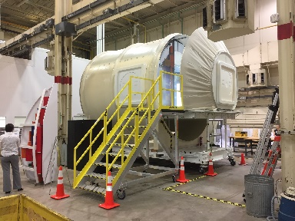
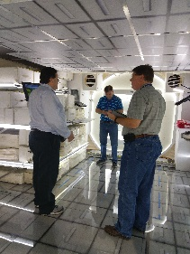
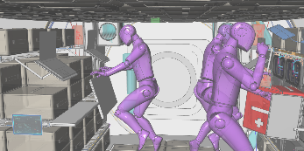
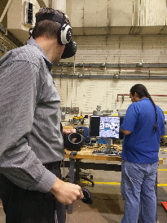
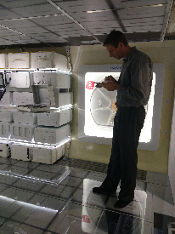
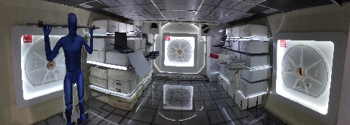
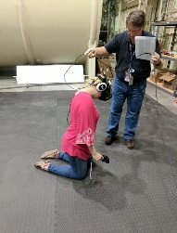
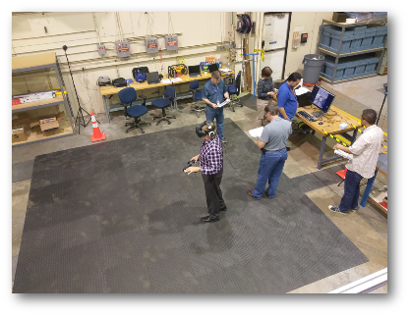
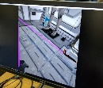
Evaluation Methodologies For Virtual Reality and Physical Test Environments For Spaceflight Design
Harry Litaker, Jr¹, Ron Archer¹, Brett Montoya² and Robert Howard³
¹Leidos, JSC, Houston, Texas; ²MEI Technologies, JSC, Houston, Texas; ³Johnson Space Center, NASA, Houston, Texas
ABSTRACT
An evaluation of two identical environments (physical vs. virtual) was conducted with subject matter experts (SMEs). Results indicated when testing a design concept at an early stage, a high correlation between the two environments exists. There are advantages and limitations to both environments. At the early design life cycle phase, virtual reality shows great promise as an evaluation environment.
INTRODUCTION
Recent studies have shown that human-scale immersive virtual environments are being considered as a useful verification and evaluation tool for early design concepts. In fact, research indicates that virtual prototyping has become increasing relevant. However, virtual reality (VR) has its limits. In providing tangible objects for a participant to touch and interact with, and sight lines in regard to special orientation, the physical environment has been much more successful. With this in mind, human factors engineers wanted to investigate if any differences existed on a conceptual habitat design layout when tested in a virtual environment compared to a physical environment.
METHODS
Test Environment and Equipment
Conducted at Johnson Space Center (JSC) in Houston, Texas, the test team was able to match the fidelity for both the virtual and physical mockups. Subsystems and payloads were volumetrically represented in each habitat. There was no system functionally; however, system representation was available and close out panels were used. Mannequins were used to illustrate task volumes for both environments (Figures 1 and 2).
.
RESULTS
Demographics of SMEs
Eight highly qualified SMEs with an a average work experience of 22 years (M = 22.14, min 7, max 32) (Table 1).
Comparison Analysis
Scoring from the volume questionnaires as well as the data collected from the comparison questionnaire were analyzed for the comparison analysis. A pairwise t-test and Pearson correlation coefficient [r] were employed (Table 2).
The Physical Test Equipment
The physical mockup dimensions were 5.1 meters in length and 4.2 meters in diameter with a hatch size of 800 millimeters in diameter. The outer shell was constructed of fiberglass. The interior secondary structure used 80/20 aluminum, plywood, and steel. Payloads within the habitat were from excess Space Shuttle Mid-Deck Locker (MDL) and Cargo Transfer Bags (CTBs) (Figure 4).
Table 2. Pairwise & Pearson Correlation for Eight Habitat Areas
Functional Areas (VR vs Physical) | Paired Samples Test |  | Paired Samples Correlation
 | t | Sig (p) | r | Sig (p) | Relationship
General Layout | 0.614 | 0.542 | 0.644 | < 0.001 | strong
Multi-Function Workstation | 2.360 | 0.023 | 0.598 | < 0.001 | strong
Galley | 2.005 | 0.057 | 0.844 | < 0.001 | very strong
Hygiene | -0.215 | 0.836 | 0.466 | 0.245 | moderate
Exercise | 1.661 | 0.110 | 0.815 | < 0.001 | very strong
Medical | 0.162 | 0.872 | 0.709 | < 0.001 | strong
Stowage | -0.269 | 0.791 | 0.378 | 0.149 | weak
Sub-Systems | 1.481 | 0.147 | 0.639 | < 0.001 | strong
Scenarios
Eight areas of functionality were depicted:
A low-fidelity walk-through type human-in-the-loop (HITL) evaluation was performed.
General Layout
Multi-Functional Workstation(s)
Galley
Hygiene
Exercise
Medical
Stowage
Subsystems
Figure 4. The physical mockup in Building 9 South at JSC.
The relationship between SME scores were strong between the two test environments (r = 0.598). This also true for six out of eight functional areas. Two functional areas, hygiene and stowage, showed a moderate to weak correlation.
The hygiene area
More exploratory as designers were asking for assistance.
Tended to locate hygiene in same habitat area regardless of test environment (Figure 7).
The stowage area
Preferred physically touching and moving the stowage bags.
Type of interaction not available in the virtual environment.
Liked the ability to fly around and over the stowage in the virtual mockup (Figure 8).
Gave a real feel for the stowage volume in microgravity.
Procedures
Pre-test brief explaining the walk-through tasks.
A 15-mimute familiarization session on moving in the virtual space.
Processed with virtual habitat walk-through, scoring 30 questions on the conceptual design.
All scoring in VR was recorded through the VR headset using a custom software (Figure 5).
A short 5-minute break, then escorted to the physical mock-up.
A 10-minute familiarization session on mockup aspects.
Given an iPad with custom software to score the same 30 questions (Figure 6).
Given a post-test comparison questionnaire.
To counterbalance the evaluation, half of the participants used the aforementioned process while For the other half, the order of the procedures was reversed.
Figure 7. SME in physical environment.
Perception of Volume
50% of SMEs thought volume in both environments felt the same.
Surprised how close the VR volume compared to the physical.
VR had feeling of being constrained much like the physical.
VR gave a better sense of realism, offered better situational awareness and a cleaner look with imagining the microgravity environment.
Physical environment, SMEs felted volume was static and not as interactive.
Perceived a different feeling, but could not explain why.
Factors could have been material choices, such as word or foam, had a less flight-like quality giving a more 2-dimensional feel.
7 out of 8 SMEs deemed virtual reality the best test environment for evaluating early conceptual designs.
Figure 1. Interior screen shot of the virtual environment.
Figure 2. Interior photography of the physical environment.
Virtual Reality Test Equipment
The team used the High Tech Computer (HTC) Vive headset with a refresh rate of 90 Hertz (Hz) and a field of view of 110 degrees. A lighthouse tracking system integrated into the Vive Headset and controllers allowed users to move in a 3-D space to interact with precision in the environment (Figure 3).
Figure 5. SME in VR environment.
Figure 6. SME in physical environment.
Figure 8. SME in VR. Note photo insert.
Table 1. Demographics of SMEs
Gender | Design Criteria Category | Years of Experience (in years)
M | Human System Integration | 7
M | Programmatic | 29
M | Engineering | 28
M | Manufacturing/Assembly | 32
M | Human System Integration | 8
F | Engineering | 16
F | Training/Operations | 17
F | Human Systems Integration | 25
CONCLUSIONS
Results indicated when testing an early design concept, there was a high correlation between the two environments, meaning SMEs found little to no difference when evaluating a design in either a physical or virtual environment. There are advantages and limitations to both environments. The virtual world gave the experts a better sense of the microgravity space environment and the relationships of space and human presence that are difficult to simulate in a 1-g physical environment. However, the interaction between human and mechanical mechanisms is better enhanced in the physical world compared to the virtual world. In the early design life cycle phase, virtual reality shows great promise to support walk-through evaluations for testing early design concepts that will give more options and increase designer’s time to design.
Figure 3. The VR setup in Building 9 South at JSC located next to the physical setup.

Slide 4
Abstract
Evaluation of two environments (virtual vs. physical) using an identical habitat mockup
  Results indicate a high correlation between the two environments exists
  There are advantages and limitation to each environment
Virtual reality (VR) shows great promise as an evaluation test environment for early conceptual design

Slide 5
Introduction
Recent studies have shown immersive virtual environments are a useful verification and evaluation tool for early designs [1-4]
Research indicates that virtual prototyping has become increasing relevant [5]
VR has its limits
  In providing tangible objects to touch and interact with the physical environment has been more successful
The objective:
  To investigate if any differences existed between a virtual test environment versus a physical one when using the same conceptual habitat design

Slide 6
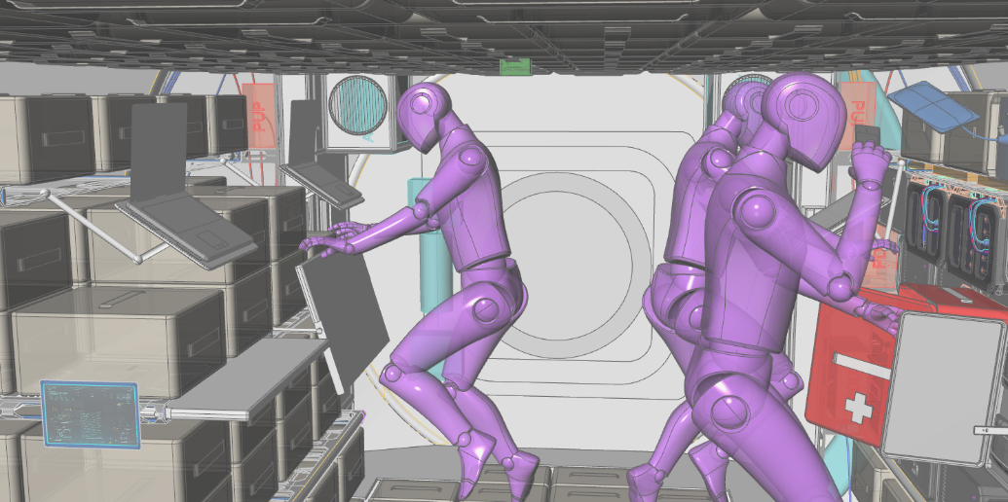
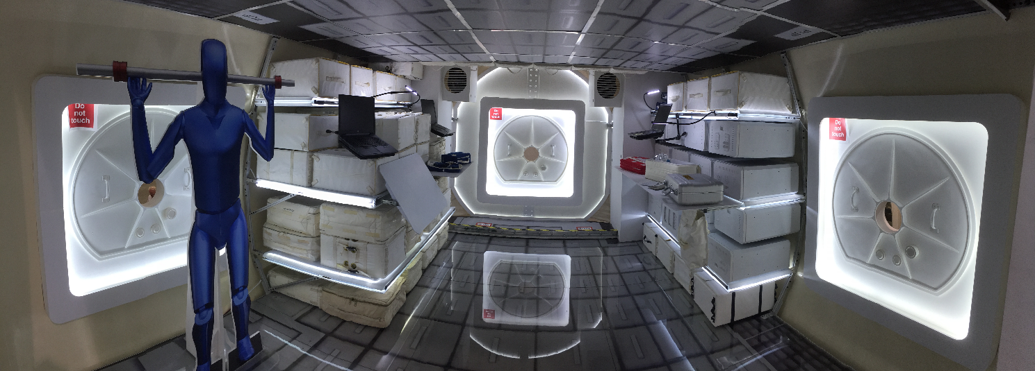
Methods (Environments and Equipment)
Two versions of NASA reference habitat for lunar orbit (virtual and physical)
Able to match fidelity for both environments
No system functionality; however, system representation was available
Mannequins were used to illustrate task volumes in both environments
Interior screen shot of the VR environment
Interior photograph of the physical environment

Slide 7
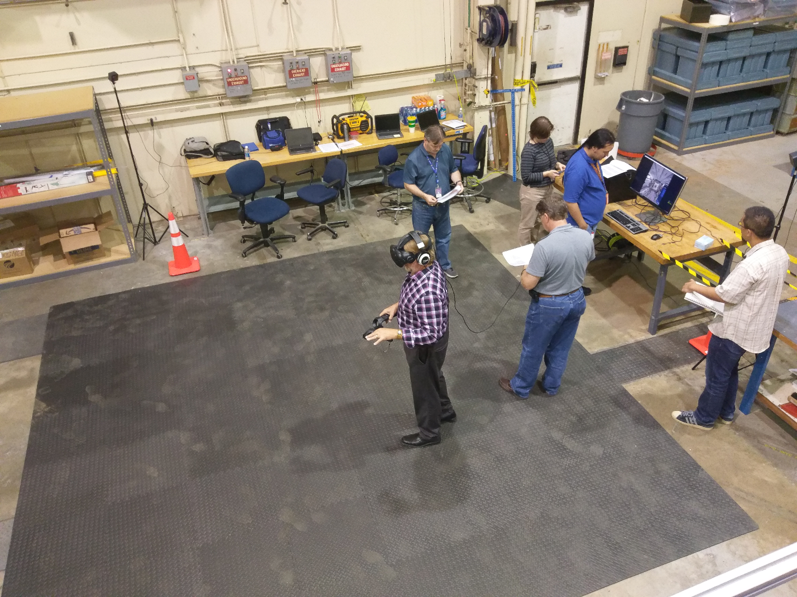
Methods (Environments and Equipment)
Virtual Reality Test Equipment
  The team used the High Tech Computer (HTC) Vive headset
    Refresh rate of 90 Hertz (Hz)
    Field of view of 110 degrees
    Lighthouse tracking system integrated into the Vive headset and controllers allowing users to mover in 3-D space and interact with precision in the environment
The VR setup in Building 9 South at JSC located next to the physical setup

Slide 8
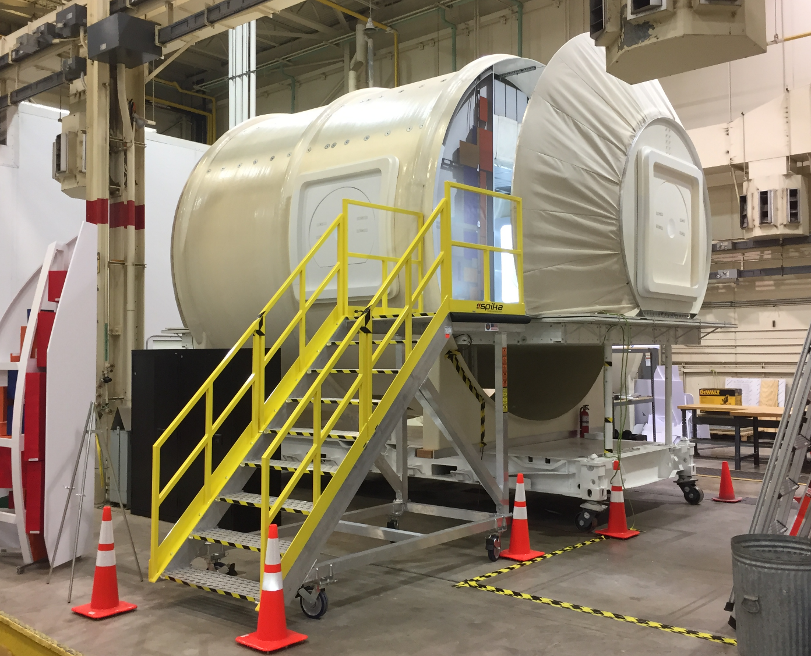
Methods (Environments and Equipment)
Physical Test Equipment
  The team built a 5.1 meter in length by 4.2 meter in diameter physical habitat with 800 millimeter in diameter hatches
    Outer shell constructed of fiberglass
    Secondary structure 80/20 aluminum, plywood, and steel
    Payloads were excess Space Shuttle Mid-Deck Lockers (MDL) and Cargo Transfer Bags (CTBs)
The physical mockup in Building 9 South at JSC

Slide 9
Methods (Scenarios)
Eight areas of functionality were depicted:
  General Layout
  Multi-Functional Workstation(s)
  Galley
  Hygiene
  Exercise
  Medical
  Stowage
  Subsystems
A low-fidelity walk-through type human-in-the-loop (HITL) evaluation was performed

Slide 10

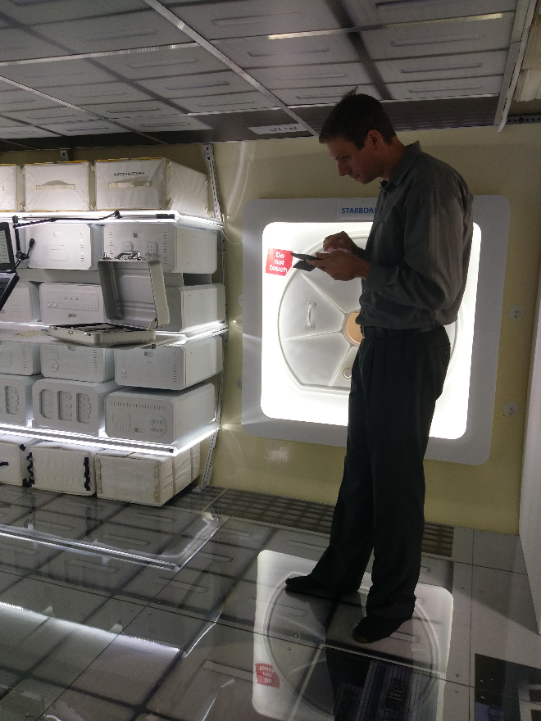
Methods (Procedures)
Pre-Test brief explaining the walk-through tasks
A 15- minute familiarization session on moving around in the virtual space
Proceeded with virtual habitat walk-through, scoring 30 questions on the conceptual design
All scoring in VR was recorded through VR headset using custom software
Short 5-minute break, then escorted to physical mockup
A10-minute familiarization session on mockup aspects
Given an iPad with custom software to score same 30 questions
Given a post-test comparison questionnaire
To counterbalance evaluation:
  Half of the subjects used the aforementioned process
  For the other half, the order of the procedures were reversed
SME in VR environment
SME in physical environment

Slide 11
Results (Demographics)
Eight highly qualified SMEs participated
  5 males and 3 females
  Average work experience 22 years (M = 22.14, Range min 7 max 32)
Table 1. Demographics of SMEs
Gender | Design Criteria Category | Years of Experience (in years)
M | Human System Integration | 7
M | Programmatic | 29
M | Engineering | 28
M | Manufacturing/Assembly | 32
M | Human System Integration | 8
F | Engineering | 16
F | Training/Operations | 17
F | Human Systems Integration | 25

Slide 12
Results (Comparison Analysis)
Data from volume and comparison questionnaires were analyzed
A pairwise t-test and Pearson correlation coefficient [r] were employed
Table 2. Pairwise & Pearson Correlation for Eight Habitat Areas
Functional Areas (VR vs Physical) | Paired Samples Test |  | Paired Samples Correlation
 | t | Sig (p) | r | Sig (p) | Relationship
General Layout | 0.614 | 0.542 | 0.644 | < 0.001 | strong
Multi-Function Workstation | 2.360 | 0.023 | 0.598 | < 0.001 | strong
Galley | 2.005 | 0.057 | 0.844 | < 0.001 | very strong
Hygiene | -0.215 | 0.836 | 0.466 | 0.245 | moderate
Exercise | 1.661 | 0.110 | 0.815 | < 0.001 | very strong
Medical | 0.162 | 0.872 | 0.709 | < 0.001 | strong
Stowage | -0.269 | 0.791 | 0.378 | 0.149 | weak
Sub-Systems | 1.481 | 0.147 | 0.639 | < 0.001 | strong

Slide 13
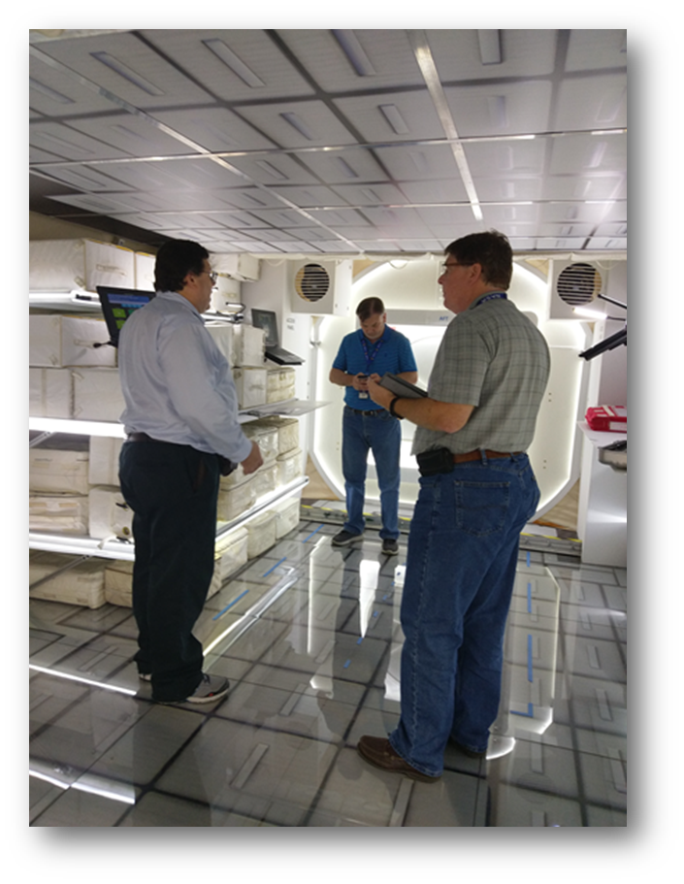
Results (Comparison Analysis)
Relationship between SME scores were strong between the two test environments (r = 0.598)
Strong correlations were also seen in 6 out of 8 functional areas
Two functional areas, hygiene and stowage, showed a moderate to weak correlation among SMEs
  Hygiene Area
    Area was mainly exploratory as designers were asking assistance from SMEs
    Tended to place hygiene in same location of habitat regardless of test environment
SME in physical environment

Slide 14
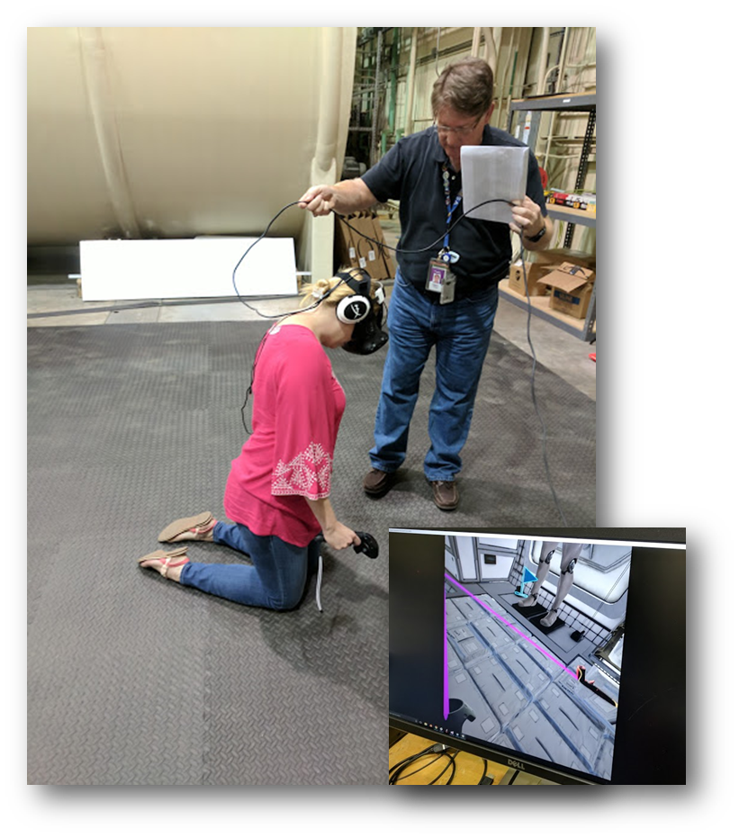

Results (Comparison Analysis)
  Stowage Area
    Preferred physically touching and moving stowage bags
    Not able to have this type of interaction in virtual environment
    Liked the ability to fly around and over stowage in VR and felt this was essential
    VR gave SMEs a real feel for the stowage volume

Slide 15
Results (Comparison Analysis)
Perception of Habitat Volume
  General perception
    50% of SMEs thought the volume in both environments felt the same
    Were surprised how close the virtual volume felted compared to the physical one
  Virtual Environment
    Feeling of being constrained much like in the real space environment
    Virtual volume gave better sense of realism
      Offered better situational awareness
      Clearer look with imaging microgravity environment
  Physical Environment
    Felted volume in mockup as static and not as interactive
    Perceived a different feeling, but could not explain why
      Material choices could have been one factor
      Materials, such as wood or foam, had less flight-like qualities giving a more 2-dimensional feel

Slide 16
Results (Comparison Analysis)
Final results indicated 7 out of 8 SMEs deemed VR the best test environment for evaluating early conceptual designs

Slide 17
Conclusions
When testing early habitat design concepts, there is a high correlation between the virtual and physical testing environments
SMEs found little to no differences when evaluating the design in either environment
There are advantages and limitations to both environments
  The virtual environment
    Gave experts a better sense of the microgravity space environment
    Enhance the relationships of space and human presence that are difficult to simulate in 1-g
  The physical environment
    Interaction between human and mechanical mechanisms is enhanced in a physical world when compared to a virtual one
    Especially important when evaluating tight or confined spaces
Thus, the virtual environment can support, with confidence, the testing of early design concepts without the cost of building a physical mockup.
Provides designers more time and flexibility to design

Slide 18
References
[1] Ryu, J., Hashimoto, N., Sato, M., Soeda, M., and Ohno, R. (2007). Application of human-scale immersive VR system for environmental design assessment-A proposal for an architectural design evaluation tool. Journal of Asian Architecture and Building Engineering, Vol. 6, No.1, May 2007.
[2] Kalay, Y.E. (2004). Architecture’s new media: principles, theories and methods of computer-aided design, MIT Press, Cambridge, MA.
[3] Maing, M. (2012). Physical or virtual? Effectiveness of virtual mockups of building envelope systems, BEST3 Conference, 2012.
[4] Johansson, J. (2012). Patient rooms of a California based hospital: Benefits of physical mock-ups vs. benefits of virtual mock-ups. Direct Study by the University of Minnesota. Retrieved November 14, 2017, from http://vr.design.umn.edu/portfolio/documents/VRReport_JJohansson.pdf.
[5] Pontonnier, C., Dumont, G., Smani, A., Madeleine, P., and Badawi, M. (2013). Designing and evaluating a workstation in real and virtual environment: Toward virtual reality based ergonomic design sessions. Journal on Multimodal User Interfaces, Springer, 2013, pp. 1-10.

Slide 19
Other Sources
Maldovan, K.D., Messner, J.I., and Faddoul, M. (2006). “Framework for Reviewing Mockups in an Immersive Environment,” CONVR 2006: 6th International Conference on Construction Applications of Virtual Reality, Orlando, Florida, August 2006, pp. 3-4
Weir, I. (2011, December). Spearman’s correlation. Retrieved November 12, 2017 from www.statstutor.ac.uk/resources/uploaded/spearmans.pdf
Ryu, J., Hashimoto, N., Sato, M., Soeda, M., and Ohno, R. (2006). Game engine based architectural simulator on multi-projectors displays, Computer Aided Architectural Design Research in Asia (CAADRIA) 2006, pp. 613-616.

