Slide 1
Autonomous Freeflying Drones for Spacecraft Inspection
Sami Mian¹, Tyler Garrett¹, Alexander Glandon², Christopher Manderino¹, Swee Balachandran³, Cesar A. Muñoz⁴, and Chester V. Dolph⁴
¹ NSF SHREC Center, University of Pittsburgh ²Old Dominion University ³National Institute of Aerospace ⁴NASA Langley Research Center 39th Digital Avionics Systems Conference (DASC 2020)
Virtual Conference
October 11-16, 2020

Slide 2
Introduction
A major hazard for spacecraft is structural damage from collisions with orbital debris or ablations
Can degrade performance or cause catastrophic failure
There is estimated to be nearly one million pieces of space debris greater than 1cm in length and over 128 million pieces less than 1cm [2]
Prior work has considered damage detection prior to orbit [3,4]
This project considers the novel problem of in-orbit damage detection
Our proposed solution simulates a swarm of autonomous free-flyer satellites surveying a larger spacecraft for possible damage

Slide 3
Swarm UAVs for Inspection
We look to unmanned aerial vehicles (UAVs) for a simulation basis
UAVs have been used for visual inspections of roads, bridges, buildings, and other outdoor structures
Includes a variety of sensors systems (IR, LIDAR, RGB, Acoustics, etc.)
Data streams from multiple UAVs can be combined for more accurate analysis and visual representations
Multi-agent approach allows for robustness against mission failure
Also allows for use of diverse, payload-specific platforms

Slide 4
Project Overview & Goals
Proof-of-concept mission demonstrating a multi-agent system performing visual inspection of damage
Free-flying satellites simulated by unmanned aerial vehicles (UAVs)
Free-flyers are responsible for independently coordinating their flights while executing mission tasks
Damage analysis on the surface of the mock space module is performed in real-time using computer vision
Extend existing onboard software architecture ICAROUS to autonomous spaceflight for in-orbit systems

Slide 5
ICAROUS Overview
ICAROUS: Independent Configurable Architecture for Reliable Operations of Unmanned Systems
Onboard software architecture for distributed collaboration among free flying agents
Enables modular development and accelerated incorporation of new applications and features
Applications communicate via a publish/subscribe framework

Slide 6
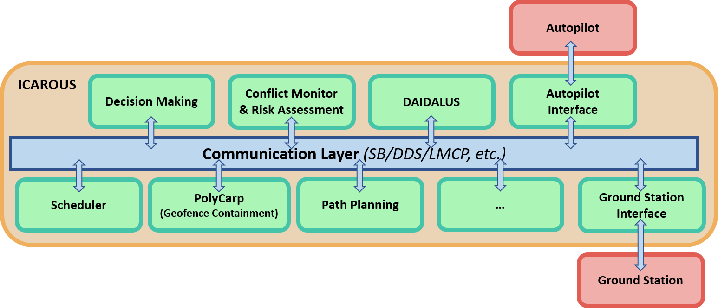
ICAROUS Overview
© NASA Langley, ICAROUS website

Slide 7
System Design
New ICAROUS modules provide high-level mission management and multi-agent coordination
Cognition determines various levels of mission tasks for each of the free-flyer
Guidance issues low-level commands to each free-flyer based on their allocated tasks
Coordination manages the multi-agent aspects of the mission
Developed a cFS Vicon™ interface for indoor localization
Inspection protocol uses computer vision (CV) techniques on video streams provided by each free-flyer to identify potential damage or anomalies

Slide 8
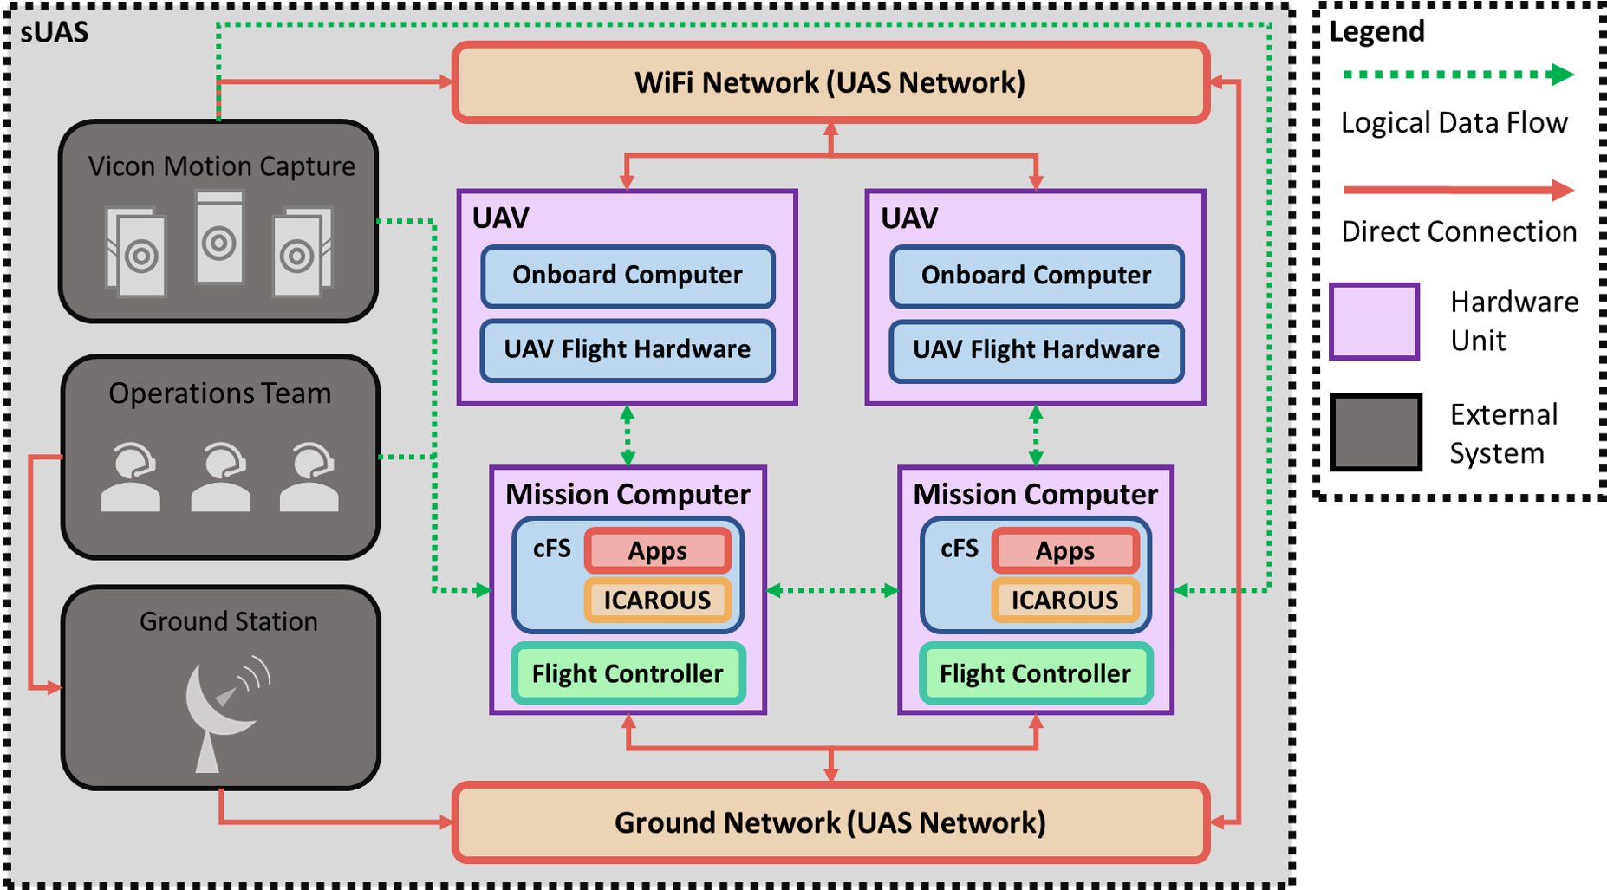
System Design

Slide 9
Main Software Apps
Coordination
Manages multi-agent aspects of mission
Accepts mission parameters from human operators
Detects number of platforms available, splits up mission tasks for each platform
Cognition
Determines high-level mission tasks for each platform
Includes takeoff/land, assigning waypoints, modifying positions for data collection
Guidance
Issues low-level commands to each UAV platform for local motion planning
Changes in velocity/position/altitude

Slide 10
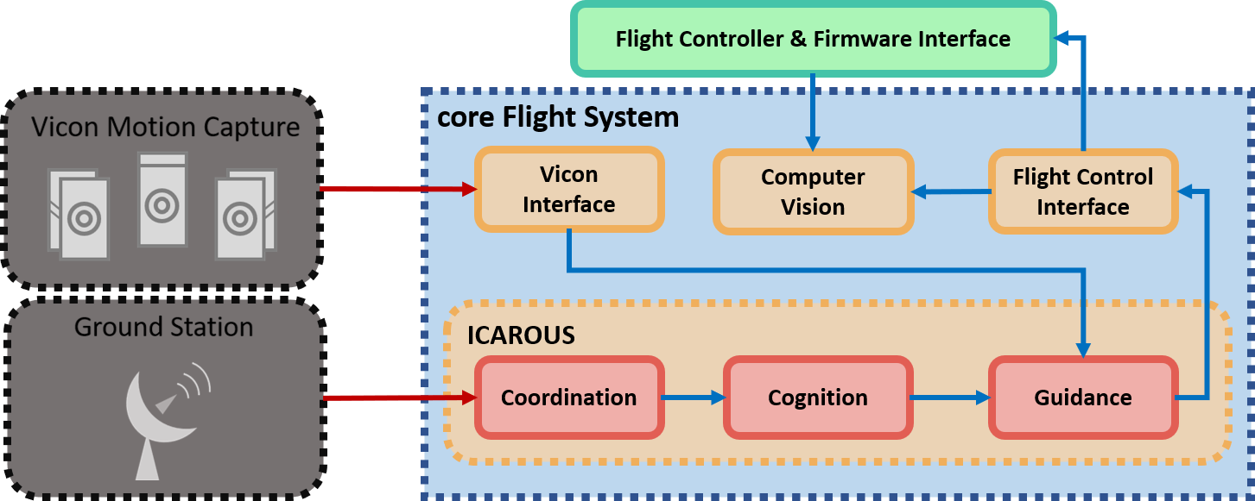
Flight Software Architecture

Slide 11
Support Apps
Hardware Interface
In order to use COTS platforms with ICAROUS, we needed an application that can interface with existing drone APIs to send control + data commands
Created a cFS application to interface with open source APIs for AT commands
Positioning System Interface
Utilize a Vicon motion capture system for simulated GPS
Created a cFS module to interface with system, spoof GPS data
Communication Bus
Multiple instances of ICAROUS need to communicate and share data
Created a cFS application built around Software Bus Network (SBN) to share telemetry data and waypoint mission lists

Slide 12
Vicon System
Indoor Positioning and Localization System
Used to Simulate GPS
Captures 3D Frames Utilizing 15 Vicon Motion Capture Cameras
Feeds messages to cFS applications over the software bus
Position
Rotation
Velocity
Vicon cFS Application converts END to GPS Coordinates required by ICAROUS

Slide 13
Vicon System
Cameras
Drones

Slide 14
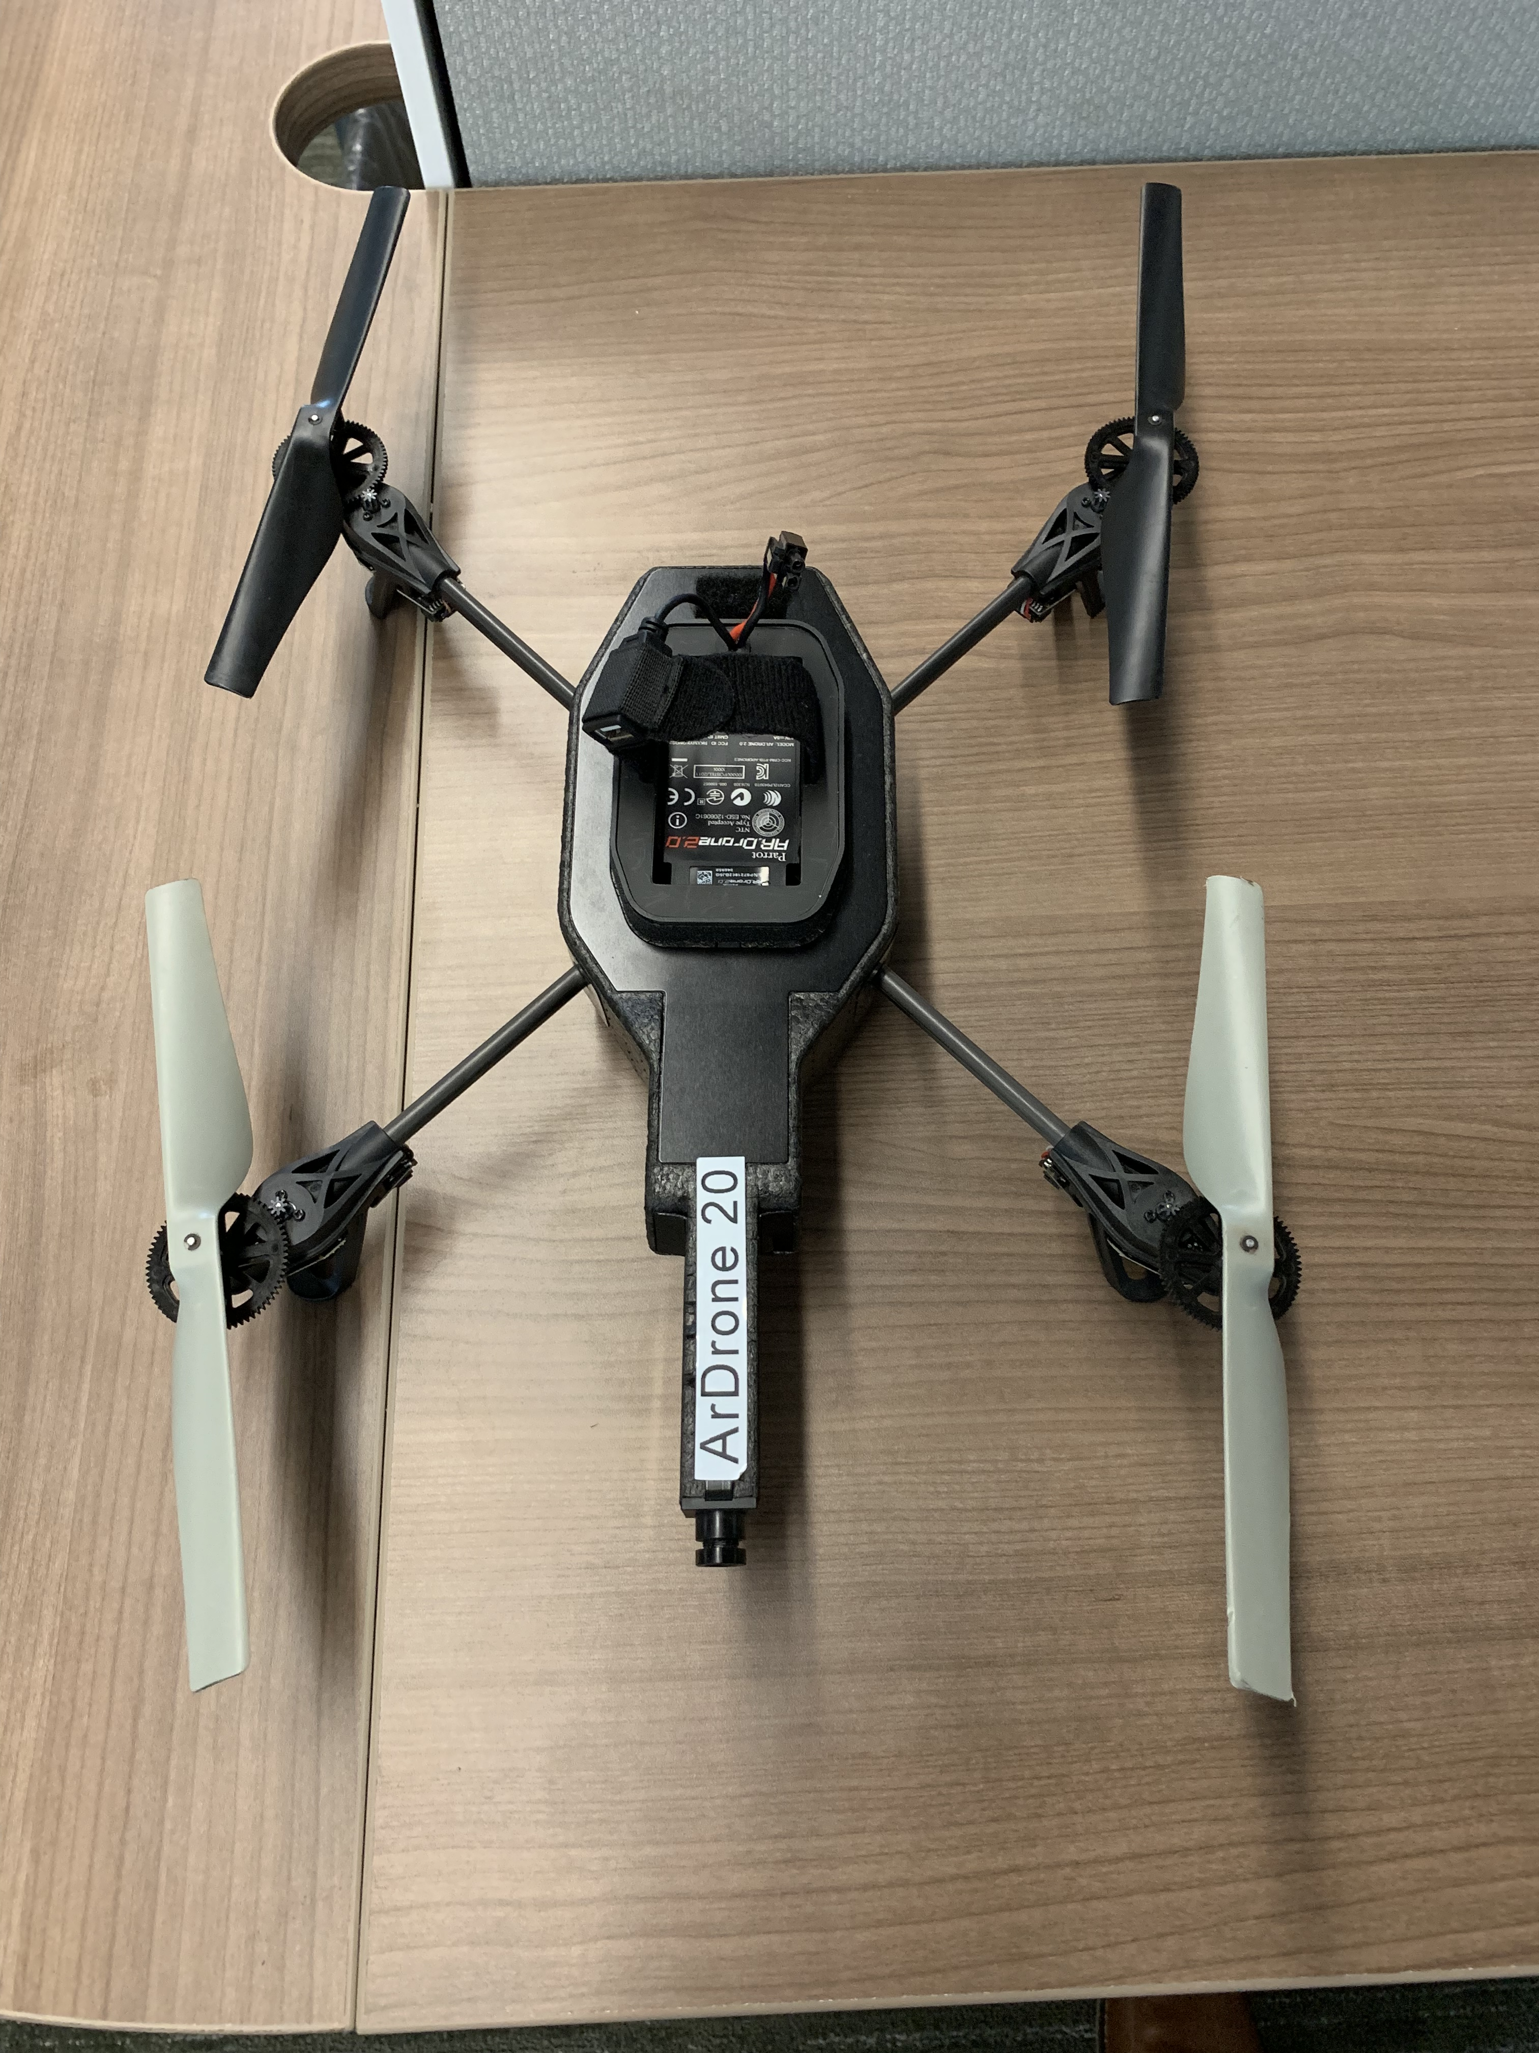
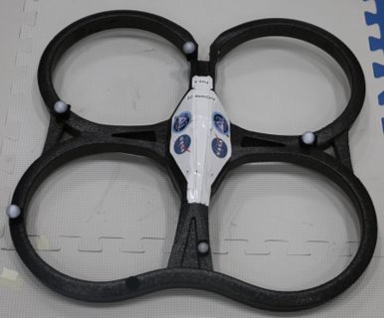
Drone Platform: AR Parrot 2.0
ARM Cortex A8 1 GHz Processor
OS: Linux 2.6.32
RAM: DDR2 1 GB @ 200 MHz
WiFi b/g/n 2.4Ghz
3 Axis Gyro, 3 Axis Accelerometer, Magnetometer, Pressure Sensor
4 brushless motors, 14.5 W @ 28,500 rev/min
720p 30 FPS HD camera, Wide Angle lens 92°, H264 encoding
Vertical camera: QVGA 60 FPS to measure ground speed
Ultrasonic Sensor for height measurement

Slide 15
Drone API
AR Drone Python API (PyARDrone)
Video Client (OpenCV support)
AT Command Library
Navigation Data Feedback
Provided Commands:
Takeoff/Land
Move(F/B,L/R,U/D,CW/CCW)
Controls Roll, Pitch, Yaw, Gaz
Hover
Emergency
© Python.org, nugent.org
Notes:
Connect over IP
Create a Drone Object

Slide 16
Offboard Computing Proxy: Intel NUC
Intel NUC used for complex computing tasks
Onboard drone CPU limited in capability
Running Ground Station, CFS, Drone API, and Computer Vision
Connects to drones using local network (TCP/IP)
Each drone has its own NUC, to simulate onboard computer
© Intel

Slide 17
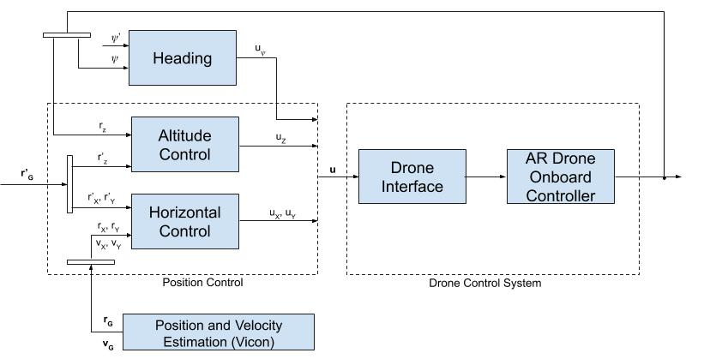
Drone Controller
Dynamics for UAV flight are different for various platforms
This system needs a way to normalize the flight characteristics for test platforms
Developed an in-house flight controller, works with most COTS systems

Slide 18
Computer Vision Problem Specification
Segment Space Module (Cylinder) from Ambient Background in Flight Space
Detect Any Portion of Cylinder that is Damaged
Report Damage Assessment to System
3D Damage Reconstruction Solution

Slide 19
Computer Vision Techniques Explored
Segmentation
Otsu Thresholding
Template Matching
Grab Cut
Color Based Segmentation
Damage Localization
Sobel Edge Detection
Convolution Neural Network Classification and Painting of Cylinders
3D Navigable Reconstruction

Slide 20
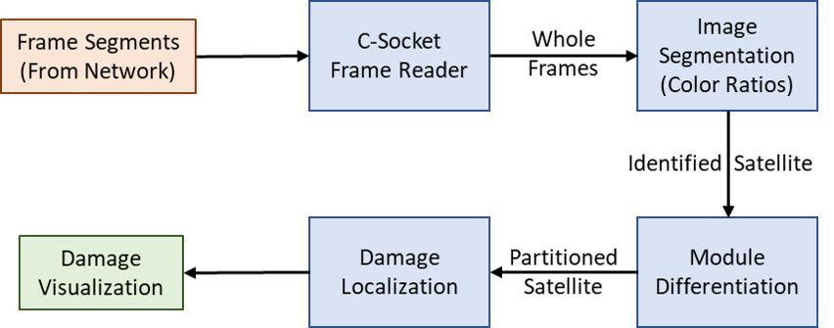
Damage Inspection cFS App Interface

Slide 21
Computer Vision Offline 3D Damage Reconstruction
Photogrammetry based algorithm allowed offline 3D Reconstruction
Compliments the Real Time 2D Damage Localization
User in the loop can navigate 3D visualization of damage to modules

Slide 22
3D Reconstruction System Diagram

Slide 23
Testing & Demonstration
Simulation of dynamic, multi-agent mission distribution
Verify new localization data streams
Assess optimal mission distribution and robustness
Conducted a set of flight experiments to tune and test the systems
Explored trade-off of performance vs accuracy of damage detection

Slide 24
Final Demo Description
Free-flyer 1 enters flight space
Coordination module detects one freeflyer in swarm and distributes full flight plan from ground station
Free-flyer 1 begins orbit of top half of mock satellite
Free-flyer 2 is dispatched
Coordination module detects new free-flyer in swarm and dynamically updates mission into two subtask lists
orbiting top-half
orbiting bottom-half
Subtask lists are distributed between Free-flyer 1 and 2

Slide 25
Final Demo Description
7. Free-flyer 1 and 2 begin executing mission subtasks
8. Free-flyer 2 abruptly departs
9. Coordination module detects Free-flyer 2 loss
10. Calculate new task list for Free-flyer 1 with remaining waypoints
11. Free-flyer 1 completes visual analysis of top-half
12. Free-flyer 1 enters downward helix pattern to complete analysis of bottom-half using inherited waypoints
13. Free-flyer 1 completes remainder of mission

Slide 26
Results
Embedded video: 2_drones_demo.mp4

Slide 27
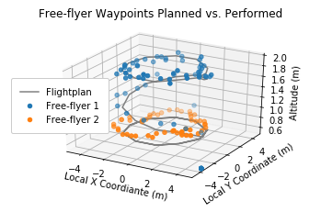
Drone Controller Results
Drone physical position versus waypoints
Based on MAVLink recorded odometry and post-flight analysis

Slide 28
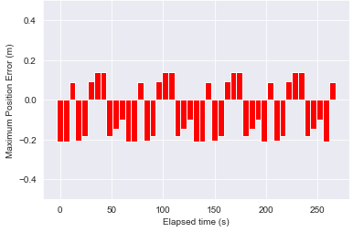
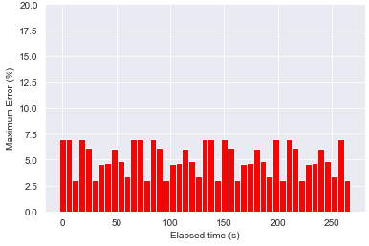
Drone Controller Results
Drone position error diagrams
Relative Error
Absolute Error

Slide 29
Computer Vision Results
CNN damage localization
Sobel filter damage localization
Multi-cylinder segmentation and damage spotlighting
3D reconstruction

Slide 30
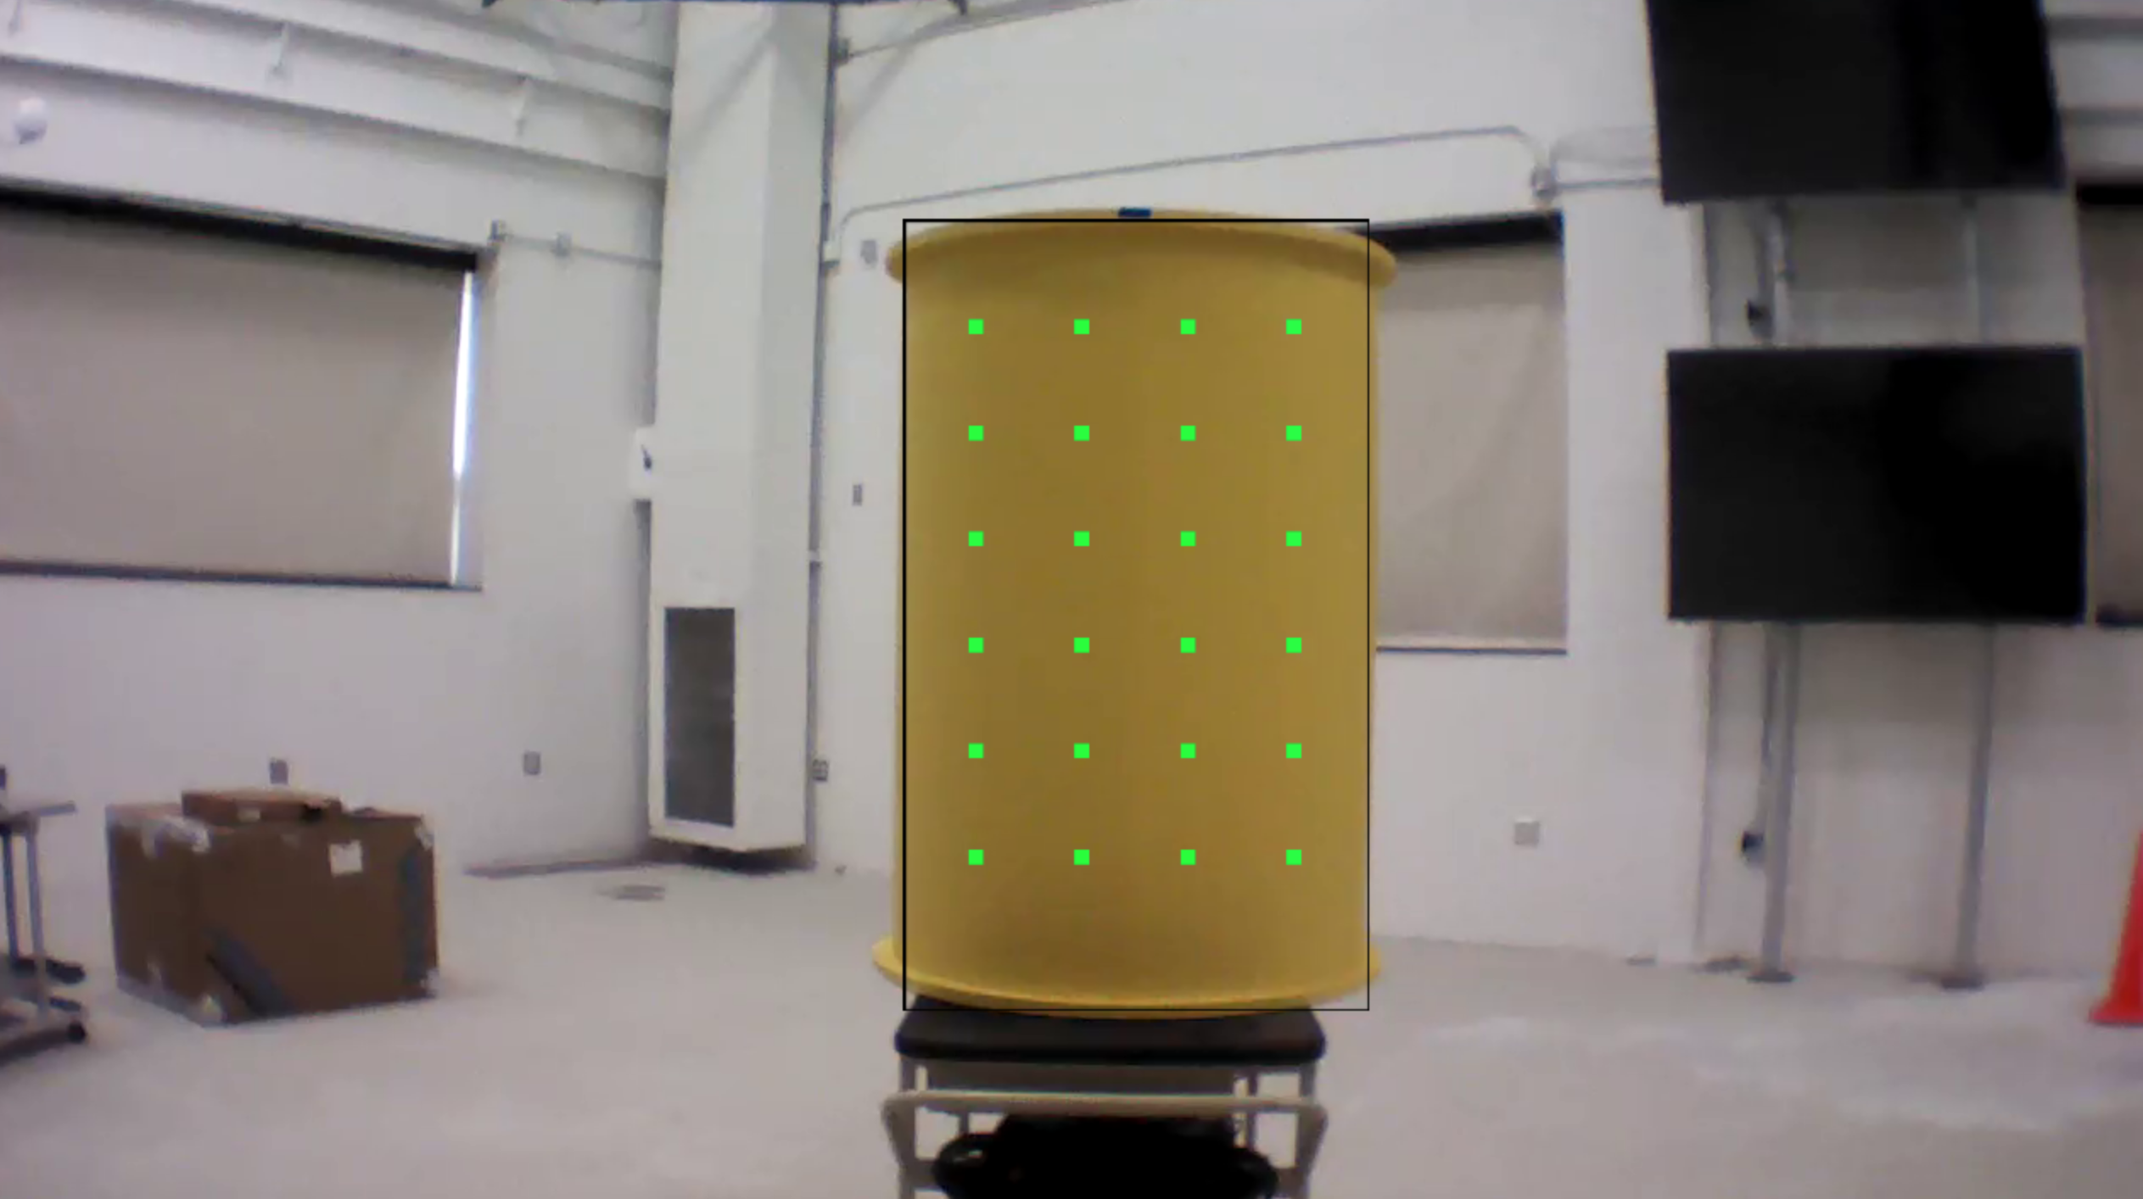
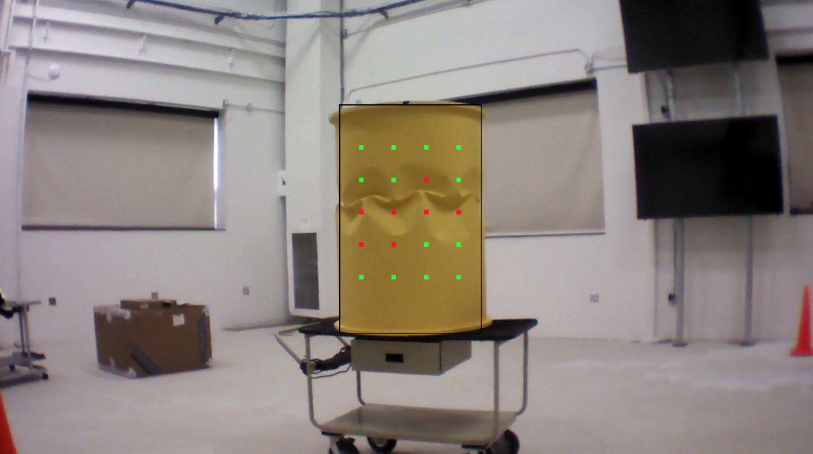
Convolutional Neural Network Damage Localization
Window Based CNN Localized Damage Classification

Slide 31
Sobel Filter Damage Localization
Tunable Threshold allows Reduction of False Negatives
Minimizes risk of overlooking mission critical damage

Slide 32
Complete Multi Cylinder Segmentation and Damage Localization Solution
Realtime In Flight Module Localization and Damage Localization Output

Slide 33
Offline 3D Reconstruction
Robust Human Navigable Damage Visualization
Given surface feature that do not represent damage, model comparison can detect discrepancies

Slide 34
Discussion
Individual UAV Control
Custom controller works extremely well, minimal position deviations
Multi-Agent Implementation
Coordination app for dynamic mission distribution, robust performance
Modular design allows for future extensibility
UAVs cover 100% of object of interest guaranteeing full coverage inspection
Computer Vision System
Comparative before and after models to detect damage
3D models for visualizing damage offline in an interactive environment

Slide 35
Future Work
Enhance the Coordination module to utilize more complex mission allocation algorithms
Extend support for other UAV hardware platforms
Incorporate the use of Data Distribution Service (DDS) into the cFS communication bus
Allows for advanced networking and data sharing techniques
Implement the 3D reconstruction program in real-time

Slide 36
Conclusions
Successful integration within ICAROUS framework
UAVs were successfully used to simulate free-flyer spacecraft
Localized damage was successfully detected on a uniform metallic surface
Efficient mission planning and completion based on a variable number of resources
Free-flyers are a viable platform for in-situ, real-time damage detection of spacecraft structures

Slide 37
References
[1] D. McComas, “Nasa/gsfc’s flight software core flight system,” 2012.
[2] N. L. Johnson, “Orbital debris: the growing threat to space operations,” in 33rd Annual Guidance and Control Conference, 2010.
[3] D. Doyle, A. Zagrai, B. Arritt, and H. C¸ akan, “Damage detection in bolted space structures,” Journal of Intelligent Material Systems and Structures, vol. 21, no. 3, pp. 251–264, 2010.
[4] A. Zagrai, D. Doyle, and B. Arritt, “Embedded nonlinear ultrasonics for structural health monitoring of satellite joints,” in Health Monitoring of Structural and Biological Systems 2008, vol. 6935. International Society for Optics and Photonics, 2008, p. 693505.

Slide 38
Questions?

