Slide 1
NASA-STD-6030
Additive Manufacturing Requirements for Crewed Spaceflight Systems
Foundational Principles
Rick Russell¹, Doug Wells²
¹NASA Langley Research Center, ²NASA Marshall Spaceflight Center,,
ASTM F42.07.02
Spaceflight Applications Subsection
September 2020

Slide 2
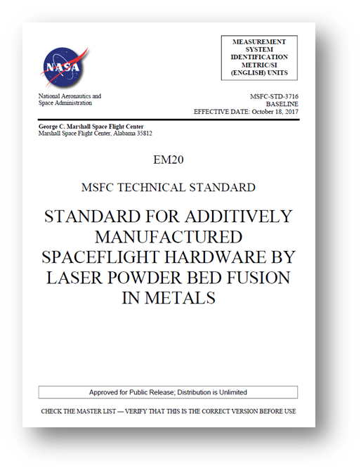
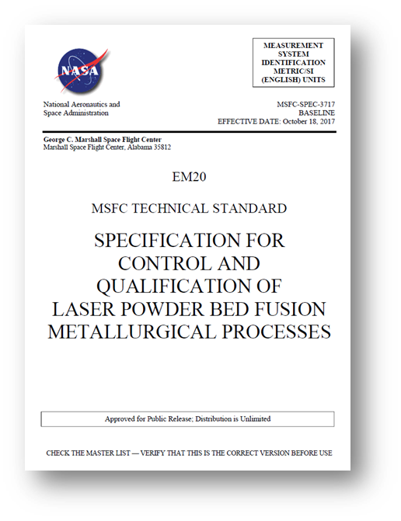
Original AM Standards at NASA
Center-level Documents (as opposed to Agency-level) at MSFC, released October, 2017
MSFC-STD-3716
MSFC-SPEC-3717

Slide 3

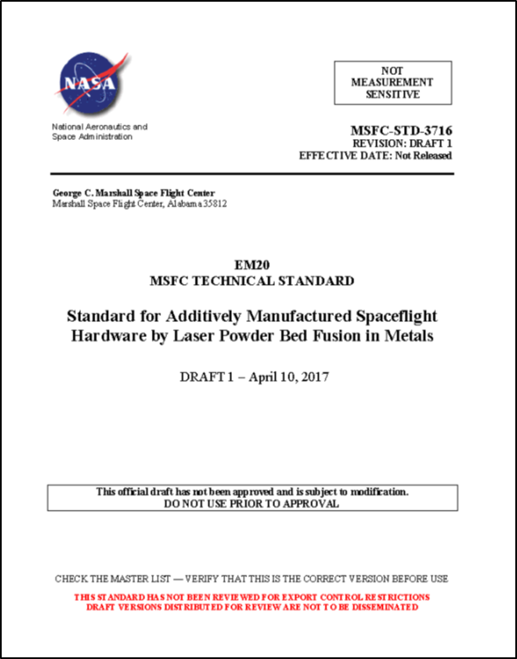
New Agency Document Structure
MSFC-STD-3716
65 AMRs
NASA-STD-6032
NASA-STD-6030
AM Standard for Crewed
Appendix B
AM Standard for Aero
Non-crewed Tailoring Guidelines
  PCQRs for:
  Process definition
  QMPs
MSFC-SPEC-3717
NASA-SPEC-6033
NASA-HDBK-6034
PCQRs for:
Equipment and facility process control
AM Spec for Equipment and Facilities
Handbook to AM Standards

Slide 4
AM Certification: Governing Principles
Understanding and Appreciation of the AM process
Integration across disciplines and throughout the process
Discipline to define and follow the plan
Have a plan
Integrate a Quality Management System (QMS)
Build a foundation
  Equipment and Facility
  Training
  Process and machine qualification
  Material Properties / SPC
Plan each Part
Design, classification, Pre-production articles
  Qualify and lock the part production process
Produce to the plan – Stick to the plan

Slide 5
Applicability
Adaptive technologies—where process parameters change based on active feedback during the manufacturing process—are not allowed without a tailored, point-design methodology.
  e.g. Electron beam powder bed fusion (E-PBF)

Slide 6
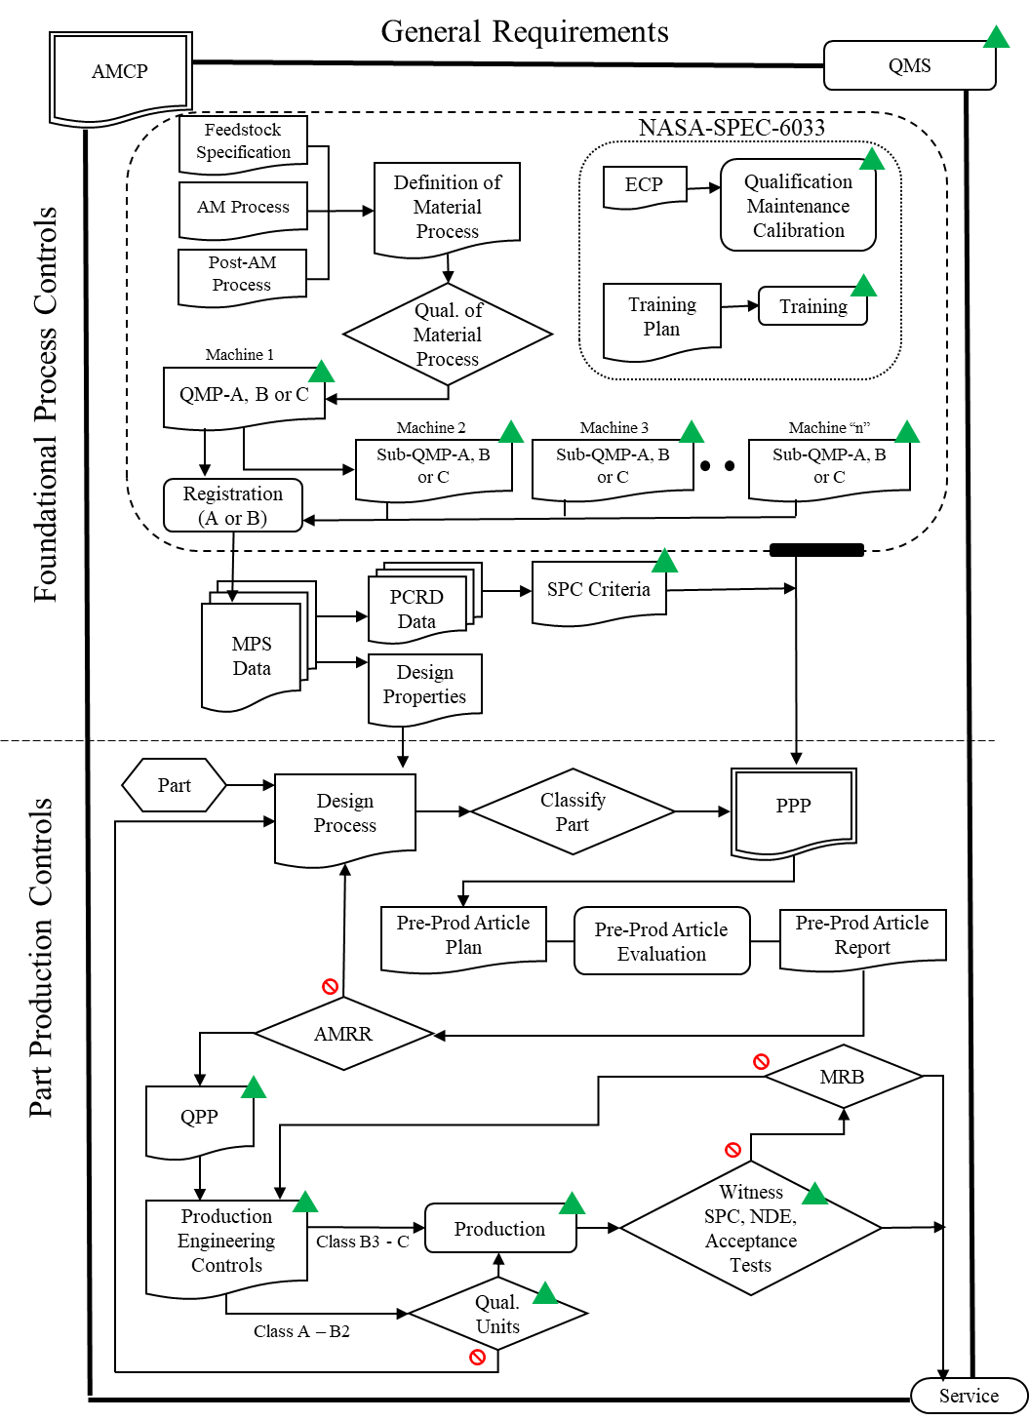
Summary of Methodology

Slide 7
General Requirements
General Requirements
Additive Manufacturing Control Plan (AMCP)
  Critical to define implementation policies for program or project
  Describes implementation of all requirements
    Includes tailoring of requirements
  Becomes governing document in place of standards
Quality Management System (QMS)
  Critical to maintain consistent implementation policy
  Ensures you stick to your plan and tailoring
  Ensures consistent training, processes and procedures
AMCP
QMS
Feedstock
Specification
NASA-STD-6033
Definition of
Material Process
ECP
Qualification Maintenance Calibration
AM Process
Post-AM Process
Qual. of Material Process
Training Plan
Training
Machine 1
QMP-A, B or C
Foundational Process Controls
Machine 2
Machine 3
Machine “n”
Sub-QMP-A, B or C
Sub-QMP-A, B or C
Sub-QMP-A, B or C
Registration
(A or B)
MPS
Data
PCRD
Data
SPC Criteria
Design
Properties
Design Process
PPP

Slide 8
Foundational Process Controls
Feedstock
Specification
NASA-STD-6033
Foundational Process Controls provide the basis for reliable part design and production
Qualification Maintenance Calibration
AM Process
Definition of
Material Process
ECP
Post-AM Process
Qual. of Material Process
Training Plan
Training
Machine 1
QMP-A, B or C
Foundational Process Controls
Machine 2
Machine 3
Machine “n”
Sub-QMP-A, B or C
Sub-QMP-A, B or C
Sub-QMP-A, B or C
Registration
(A or B)
MPS
Data
PCRD
Data
SPC Criteria
Design
Properties
Design Process
PPP

Slide 9
Equipment and Facility Control Plan and Training
EFCP
  Plan required by Standard
  Flexibility in implementation
  Governs AM equipment and facility
    Qualification
    Maintenance
    Calibration
Training
  Training Plan required by Standard
    Expectations in Specification
  Flexibility in implementation
  Covers all personnel involved in AM
Feedstock
Specification
NASA-STD-6033
Definition of
Material Process
ECP
Qualification Maintenance Calibration
AM Process
Post-AM Process
Qual. of Material Process
Training Plan
Training
Machine 1
QMP-A, B or C
Foundational Process Controls
Machine 2
Machine 3
Machine “n”
Sub-QMP-A, B or C
Sub-QMP-A, B or C
Sub-QMP-A, B or C
Registration
(A or B)
MPS
Data
PCRD
Data
SPC Criteria
Design
Properties
Design Process
PPP

Slide 10
Qualified Material Process (QMP)
Begins as a Candidate QMP
Defines aspects of the basic, part agnostic, fixed AM process:
  Feedstock
  Fusion Process
  Thermal Process
Enabling Concept
  Machine qualification and re-qualification, monitored by…
  Process control metrics, SPC, all feeding into…
  Design values
Feedstock
Specification
NASA-STD-6033
Definition of
Material Process
ECP
Qualification Maintenance Calibration
AM Process
Post-AM Process
Qual. of Material Process
Training Plan
Training
Machine 1
QMP-A, B or C
Foundational Process Controls
Machine 2
Machine 3
Machine “n”
Sub-QMP-A, B or C
Sub-QMP-A, B or C
Sub-QMP-A, B or C
Registration
(A or B)
MPS
Data
PCRD
Data
SPC Criteria
Design
Properties
Design Process
PPP

Slide 11
Material Properties
The Material Property Suite (MPS) consists of four inter-related entities:
Data Repository
Design Values
Process Control Reference Distribution (PCRD)
SPC acceptance criteria for witness testing
Feedstock
Specification
NASA-STD-6033
Definition of
Material Process
ECP
Qualification Maintenance Calibration
AM Process
Post-AM Process
Qual. of Material Process
Training Plan
Training
Machine 1
QMP-A, B or C
Foundational Process Controls
Machine 2
Machine 3
Machine “n”
Sub-QMP-A, B or C
Sub-QMP-A, B or C
Sub-QMP-A, B or C
Registration
(A or B)
MPS
Data
PCRD
Data
SPC Criteria
Design
Properties
Design Process
PPP

Slide 12
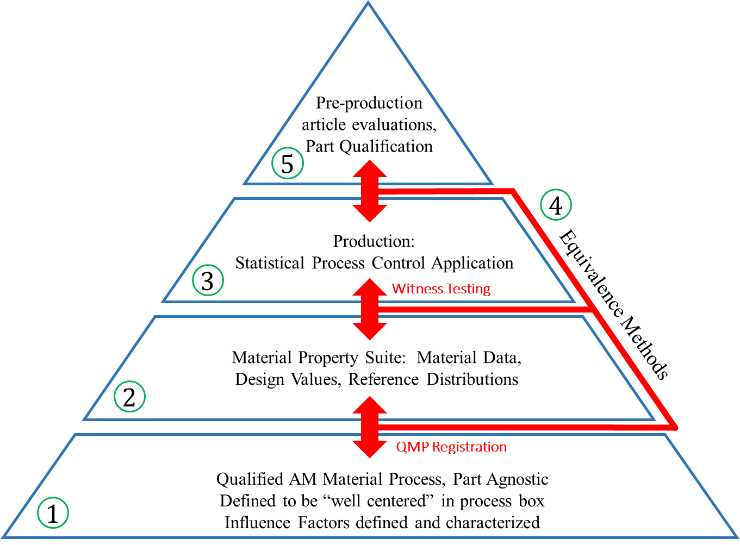
Material Properties – SPC
Statistical process controls are important in sustaining certification rationale
Statistical equivalency evaluations substantiate design values and process stability build-to-build
  Process qualification
  Witness testing
  Integration to existing material data sets
  Pre-production article evaluations
Equivalency of material performance is an anchor to the structural integrity rationale for additively manufactured parts
The dark and scary place most manufacturers are NOT used to operating….

Slide 13
Part Production Controls
Part
Design Process
Classify Part
PPP
Part Production Controls are typical of aerospace operations and include design, part classification, pre-production and production controls
Part Production Controls
Pre-Prod Article Plan
Pre-Prod Article Evaluation
Pre-Prod Article Report
AMRR
MRB
QPP
Witness SPC, NDE, Acceptance Tests
Production Engineering Controls
Class B3 - C
Production
Qual. Units
Class A – B2
Service

Slide 14
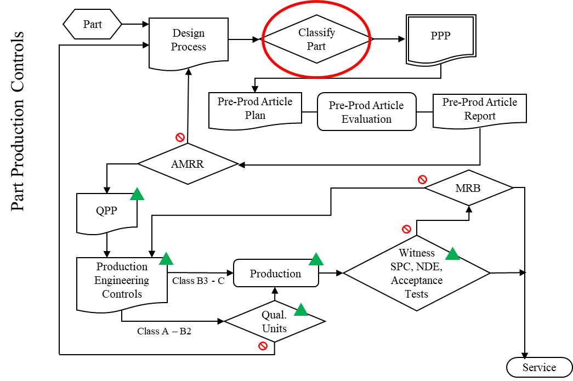
Part Classification
Part Classification system is a risk communication tool
Established criteria at each step for consistency
The higher a part’s classification, the more stringent the downstream requirements become
  B4 parts should need less scrutiny than an A1 part
  Non-destructive evaluation needs also likely to differ
Part-specific tailoring starts with classification

Slide 15
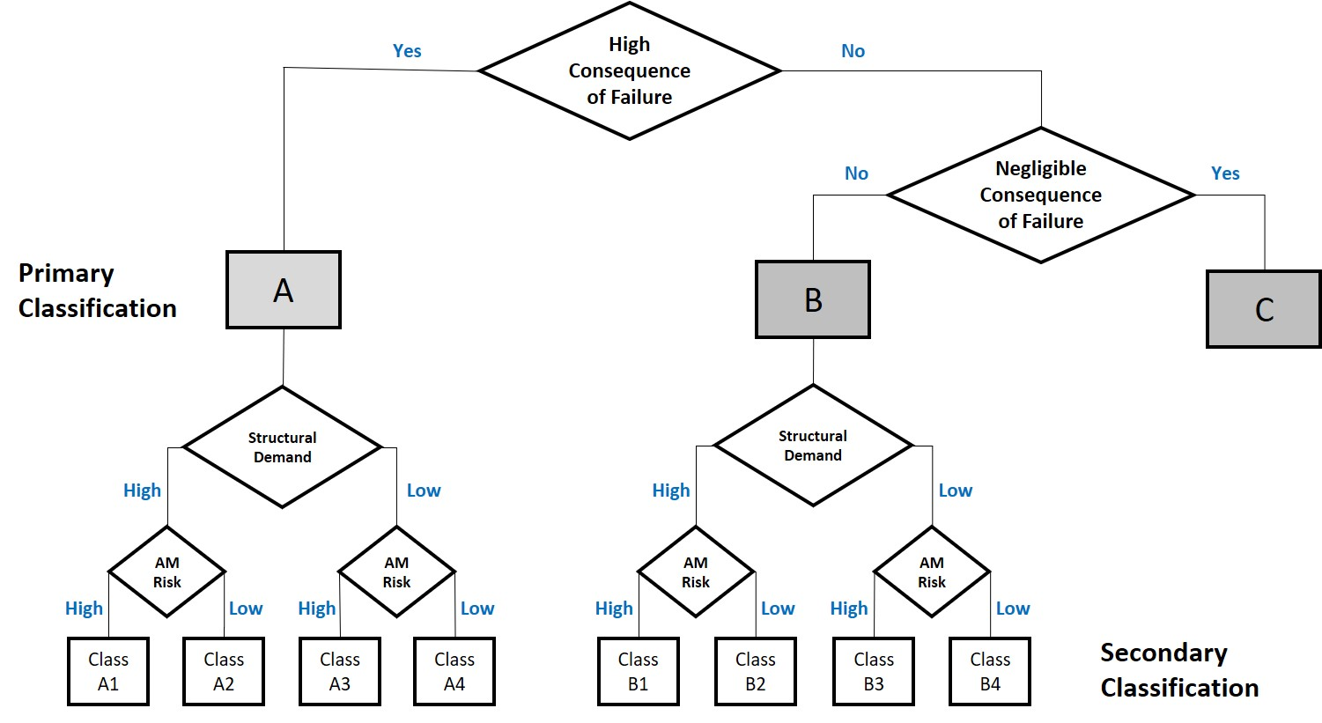
Classification

Slide 16
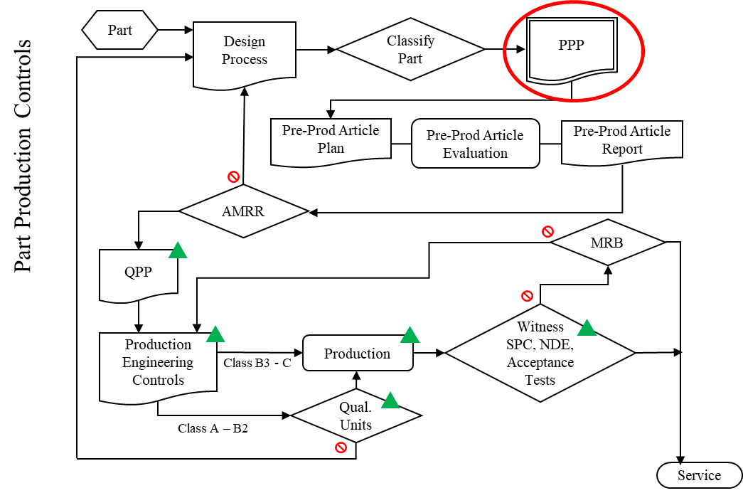
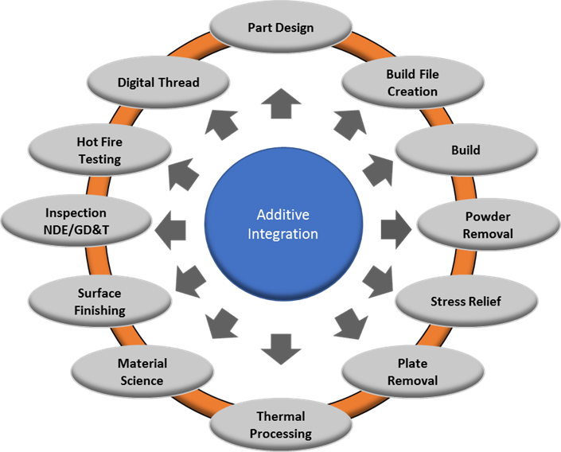
Part Production Plan
AM parts do not yet have a common industry standard of practice
  Challenge to integrate all required aspects of AM design requirements through drawing content
  Requires many aspects to be integrated
    Build layout
    Specification of qualified process ID
    Witness test and acceptance
    Post processing details
    Inspection requirements and limitations
Requiring a AM Part Production Plan as a drawing companion is best option currently

Slide 17
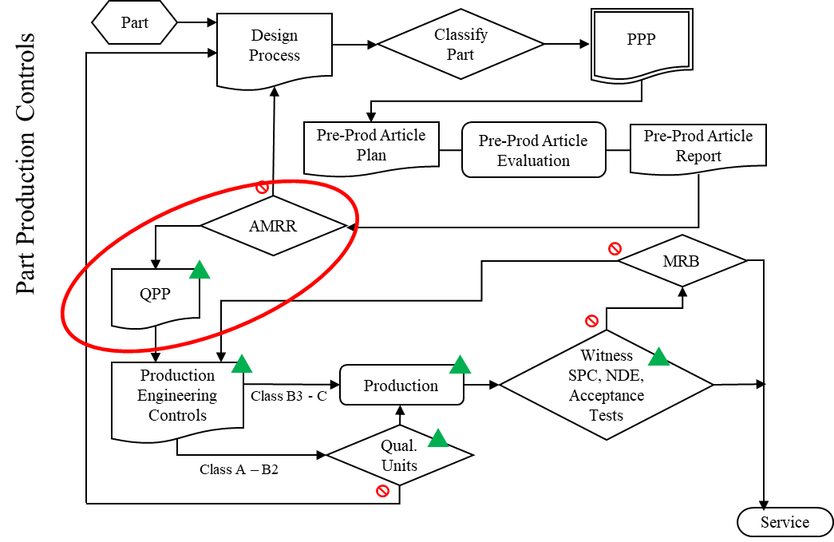
Qualified AM Part Process
Agreed upon and approved AM Part Production Plan
Pre-production article evaluation
AM Manufacturing Readiness Review (Do we have our ducks in a row?..)
  All stakeholders agree AM part development is successful and complete for qualification or production articles to be produced
  Demarcates the point in time when changes to AM part definition (digital files, engineering instructions, etc) are locked. NO MORE CHANGES
  Qualified Part Process (QPP) state is documented in the Quality Management System
Produce to the Plan and STICK TO THE PLAN
Locked Process Is the QPP! Must be documented in the QMS!

Slide 18
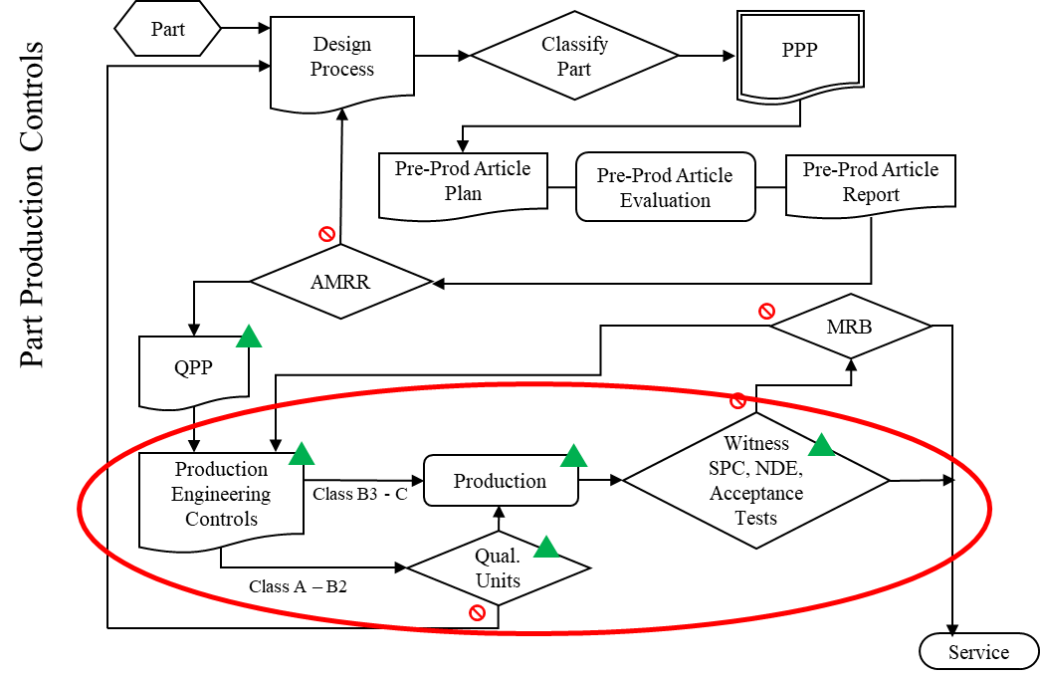
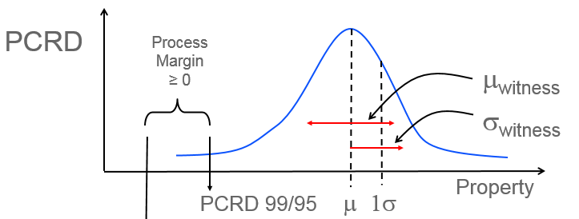
AM Part Production
Part Production – Follow-through on controls!!

