Slide 1
FINDING SPACE FOR BEES
Darcy Gray
NASA DEVELOP
New England Food Security & Agriculture Project Team: Jeremy Rapp, Victor Lenske,
Eyob Solomon, & Ryan Young
Notes:
Thanks Noah, and thank you all for joining us today. As Noah mentioned, Best Bees partnered with the NASA DEVELOP in the summer of 2018 on a project that used NASA data to look at some of these complex questions around bee health. So today I’ll talk to you a bit about the project that this project team of Jeremy Rapp, Victor Lenske, Eyob Solomon, and Ryan Young completed.

Slide 2

NASA EARTH FLEET
NISTAR, EPIC (DSCOVR/NOAA)
CURRENT OPERATING MISSIONS
GRACE-FO (2) (GFZ)
SUOMI NPP (NOAA)
ICESAT-2
LANDSAT 8 (USGS)
INVEST/CUBESATS
RainCube
TEMPEST-D
CSIM-FD
HARP
OCO-2
CALIPSO (CNES)
SMAP
CYGNSS (8)
CLOUDSAT (CSA)
LANDSAT 7 (USGS)
GPM (JAXA)
ISS INSTRUMENTS
SAGE III
TSIS-1
OCO-3
GEDI
LIS
ECOSTRESS
TERRA (JAXA, CSA)
AURA (NSO, FMI, UKSA)
AQUA (JAXA, AEB)
06.29.20
Notes:
You may be asking, “what does NASA have to do with honey bees?” Something that often surprises people is that a large part of the research done at NASA is Earth science research, and NASA has a network of satellites which look down at Earth and collect data, and this is what we mean when we refer to NASA Earth observations. These satellites collect images, with cameras giving us a way to visually see earth from space, but many of them, through different methods, also capture metrics that we can’t see with our eyes, including thermal radiation, precipitation, infrared and other non-visible light sources.

Slide 3
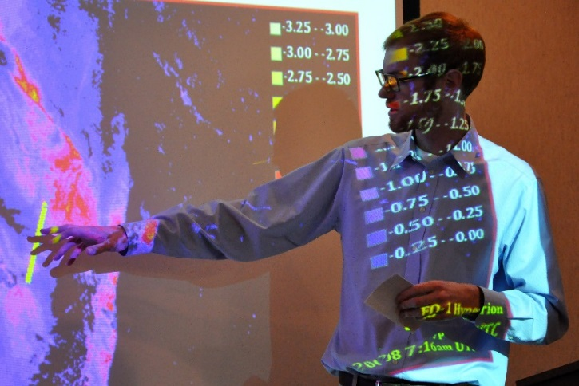
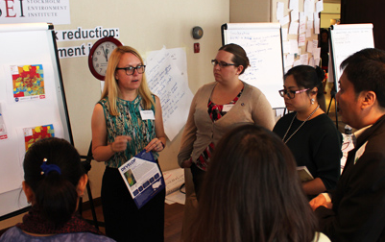
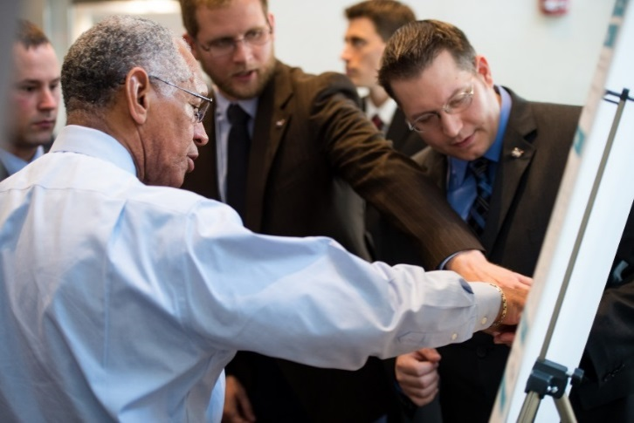
WHAT IS NASA DEVELOP?
NASA DEVELOP
Measurements & Predictions
Communities
DEVELOP bridges the gap between NASA Earth Science and society, building capacity in both its participants and end-user organizations to better prepare them to handle the environmental challenges that face society.
Notes:
NASA DEVELOP is a program within NASA’s Applied Sciences Program. DEVELOP collaborates with decision makers to conduct feasibility projects that apply NASA Earth observations, so data from those satellites you just saw, to address environmental issues. These projects engage young professionals (students and recent graduates) and decision makers in 10-week projects that identify opportunities to use NASA satellite data to create methodologies and tools for project partners. This directly supports both individuals and institutions, and increases the use of Earth observation data and enhances decision and policy making.
Every year at the Goddard Space Flight Center we complete several projects, and in 2018 one of those was the New England Food Security and Agriculture project,.
Image credit: NASA DEVELOP

Slide 4
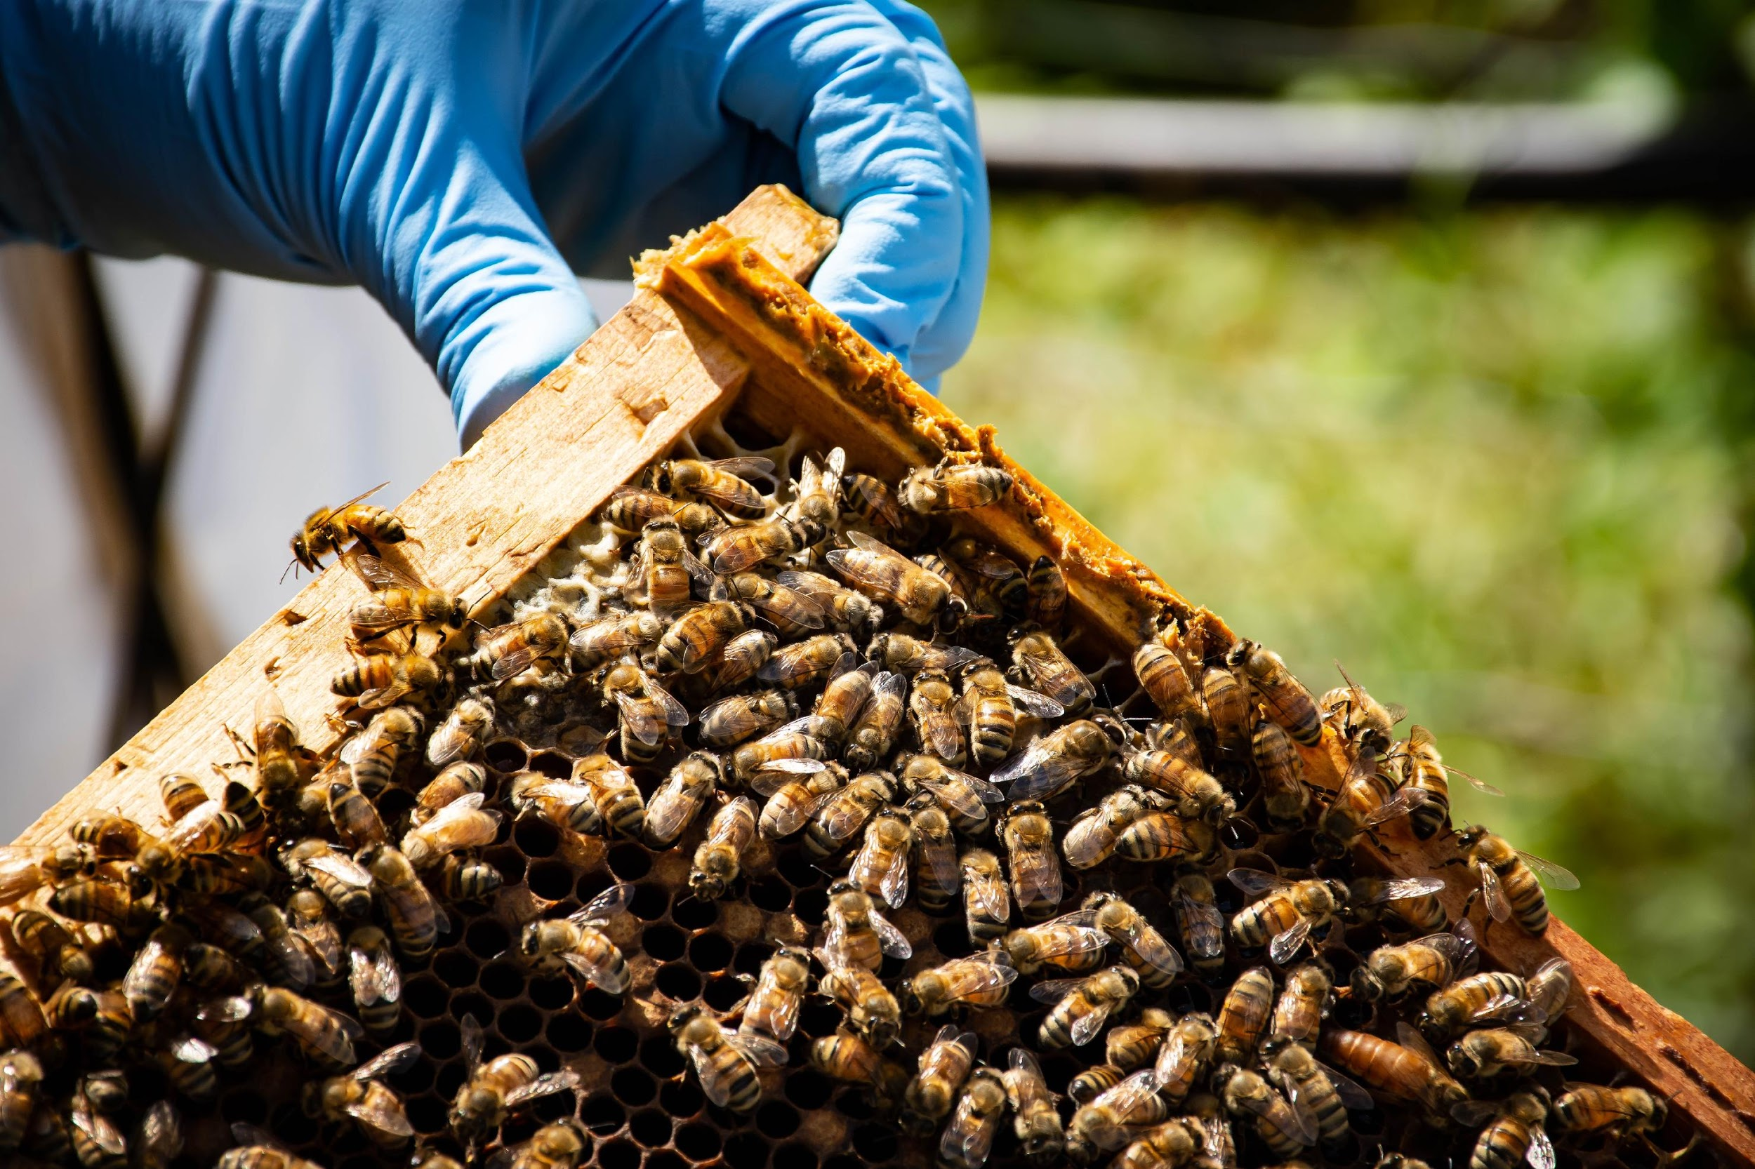
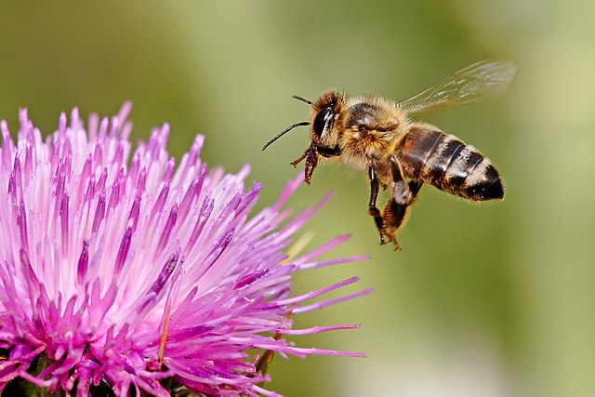
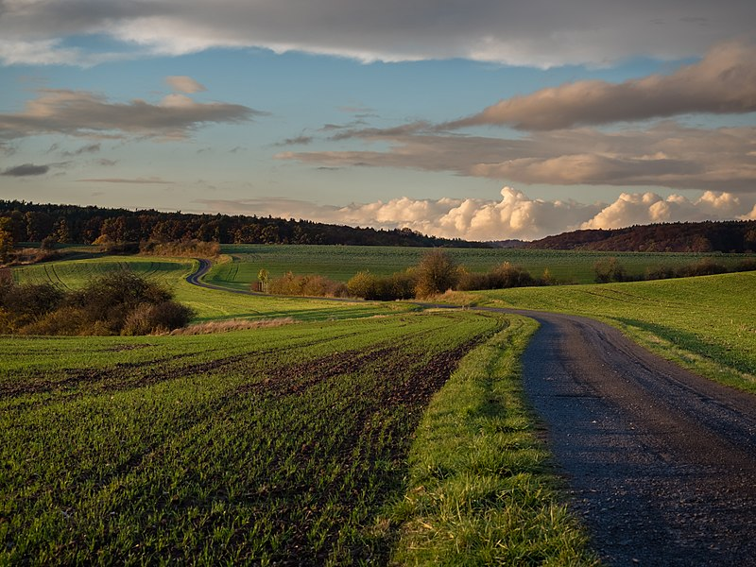
FINDING SPACE FOR BEES
Factors affecting bee health:
  Nectar availability
  Pesticides
  Seasonality
  Climate variability
  Access to water
Image credits: NASA DEVELOP, Reinhold Moller, fir0002
Notes:
As Noah mentioned, there is so much complexity to this honeybee- environment relationship and while scientists have a number of tools to investigate this, no tool will really provide a full picture on its own. What this project aimed to do was provide end-users with a way to visualize some of the factors associated with bee health from space, so that the partners could make decisions about hive placement and could also start to explore some of these variables. The project partnered with the bee informed partnership, Bee Counted and the Best Bees Company’s nonprofit arm- the urban beekeeping lab and sanctuary.
These are some of the factors associated with bee health, and we also know that relationships between these can have compounding effects. We can’t look at all of these things from satellite data, but we are able to look at some of them on scales that would otherwise be impossible.
Photo 1: Image credit: NASA DEVELOP
Photo 2: Image credit: Fir0001/ Flagstaffotos, Image source: https://commons.wikimedia.org/wiki/File:Honeybee_landing_on_milkthistle02.jpg
Photo 3: Image credit: Reinhold Moller, Image Source: https://commons.wikimedia.org/wiki/File:Ha%C3%9Fberge_fields_PB060078.jpg

Slide 5
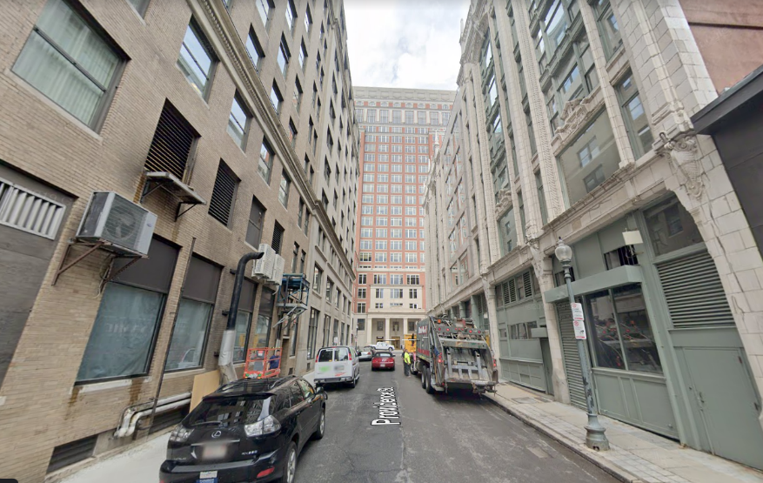
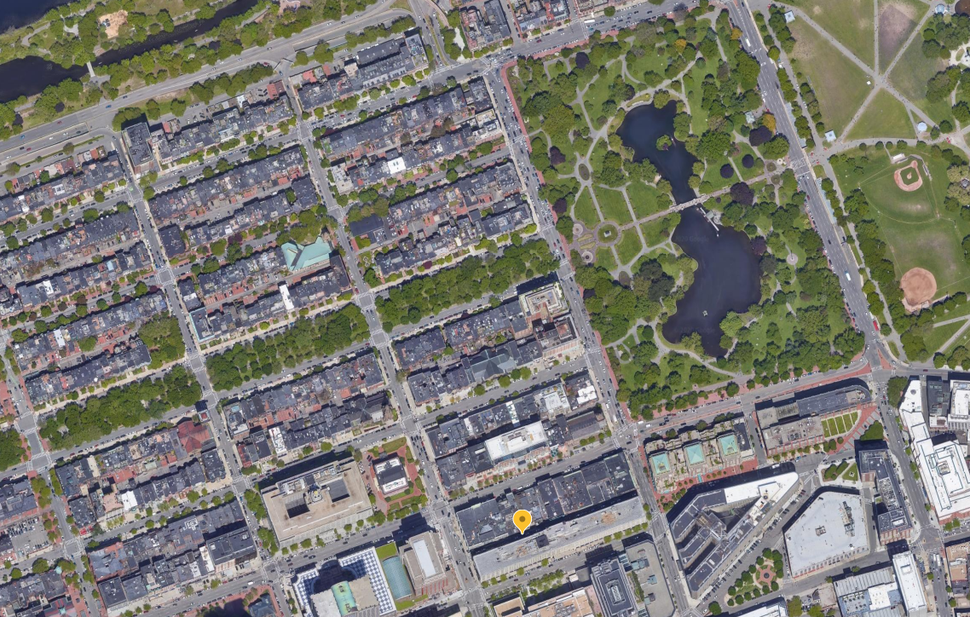
Image credits: 2020 Google Earth
Notes:
If you lived in an apartment in this building in Boston and you had the opportunity to set up a rooftop beehive, it would be easy to make the assumption that this is not a hospitable environment for bees, because that’s what we see from the ground. But looking from above- even just using this google earth image- we can see that there’s actually plenty of not just green space but trees, and even a water body. Bees have a foraging range that is usually estimated up to 5 miles, and when we look from the ground, it’s not easy to understand the conditions within that wide range. But when we look from above we get a much more robust picture.
Image source: Google Earth/ Google earth Street view

Slide 6
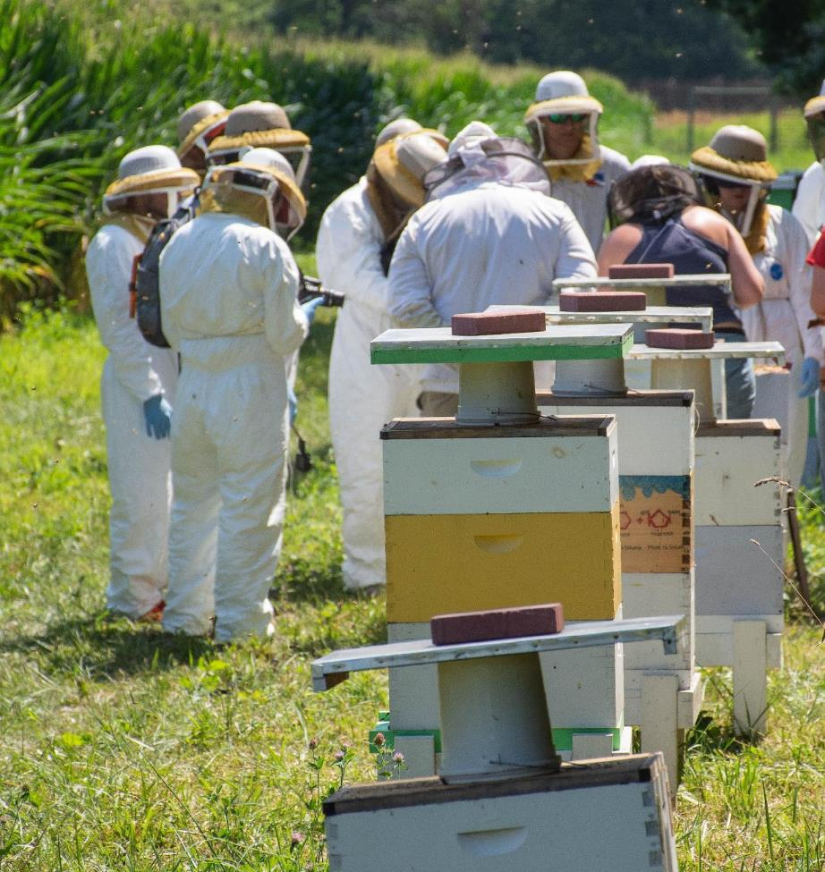
OBJECTIVES
Create a tool to explore apiary locations
Combine on-the-ground hive data with satellite data to further honey bee research efforts
Assemble a user intuitive tutorial for partners and future researchers
Image credit : NASA DEVELOP
Notes:
So this project wanted to do that in a way, but also to look at some of the things we don’t see in just on picture, including time series and some of those variables I mentioned earlier that satellites can capture even though the human eye can’t see them. So the objectives of this project were to create a tool that explored potential apiary locations. This tool would be able to ingest ground data and ultimately help the partners make decisions about hive locations. The team also put together a tutorial for these partners on how to use the tool.
The team was even lucky enough to join the Bee Informed Partnership in the field for a day of data collection.
Image Credit: NASA DEVELOP

Slide 7
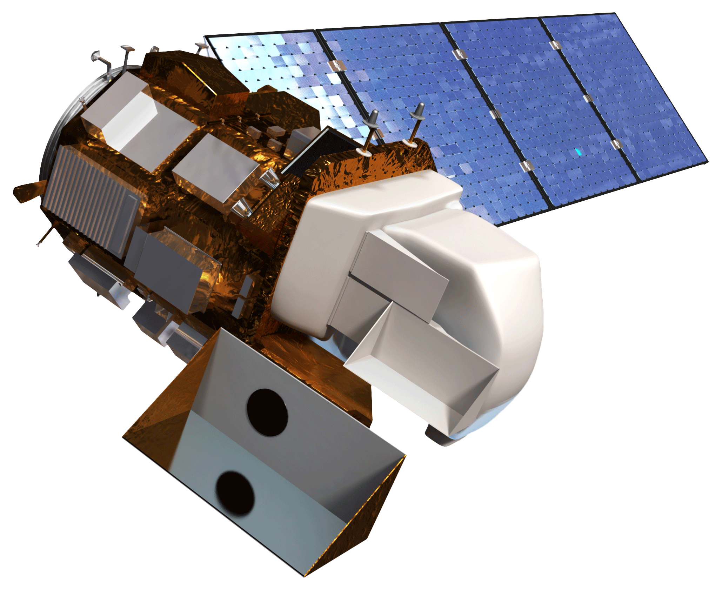
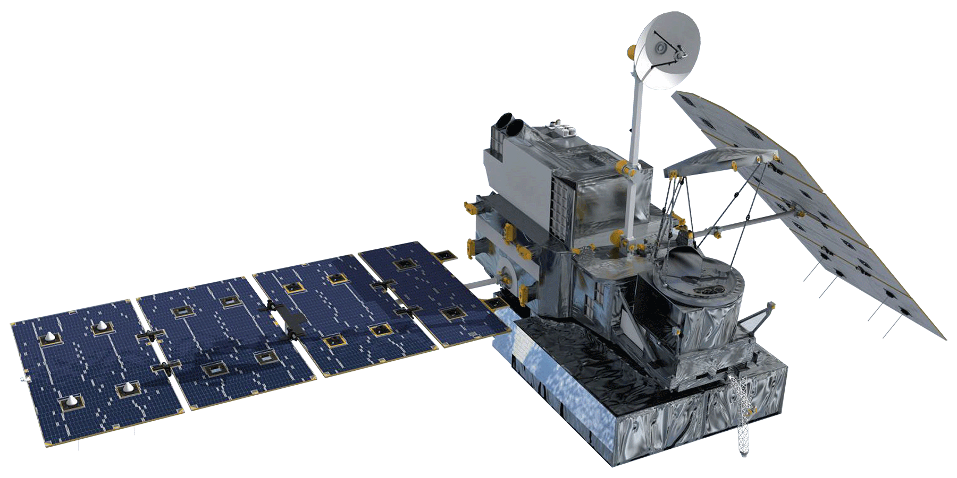
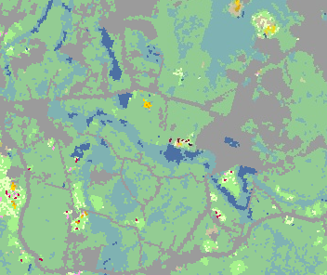
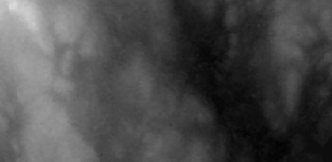
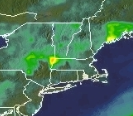
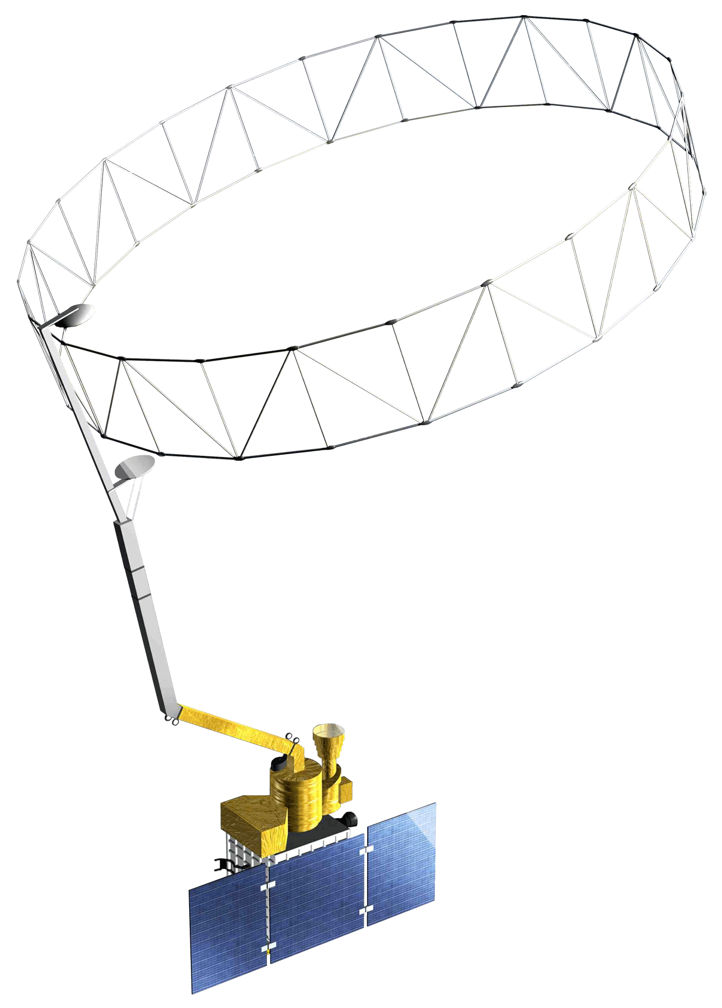
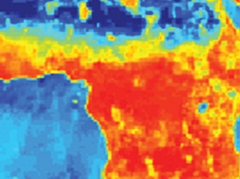
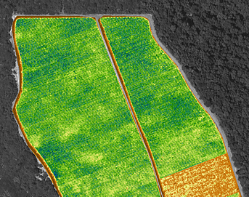
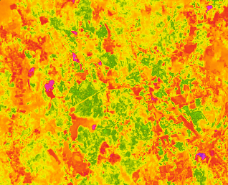
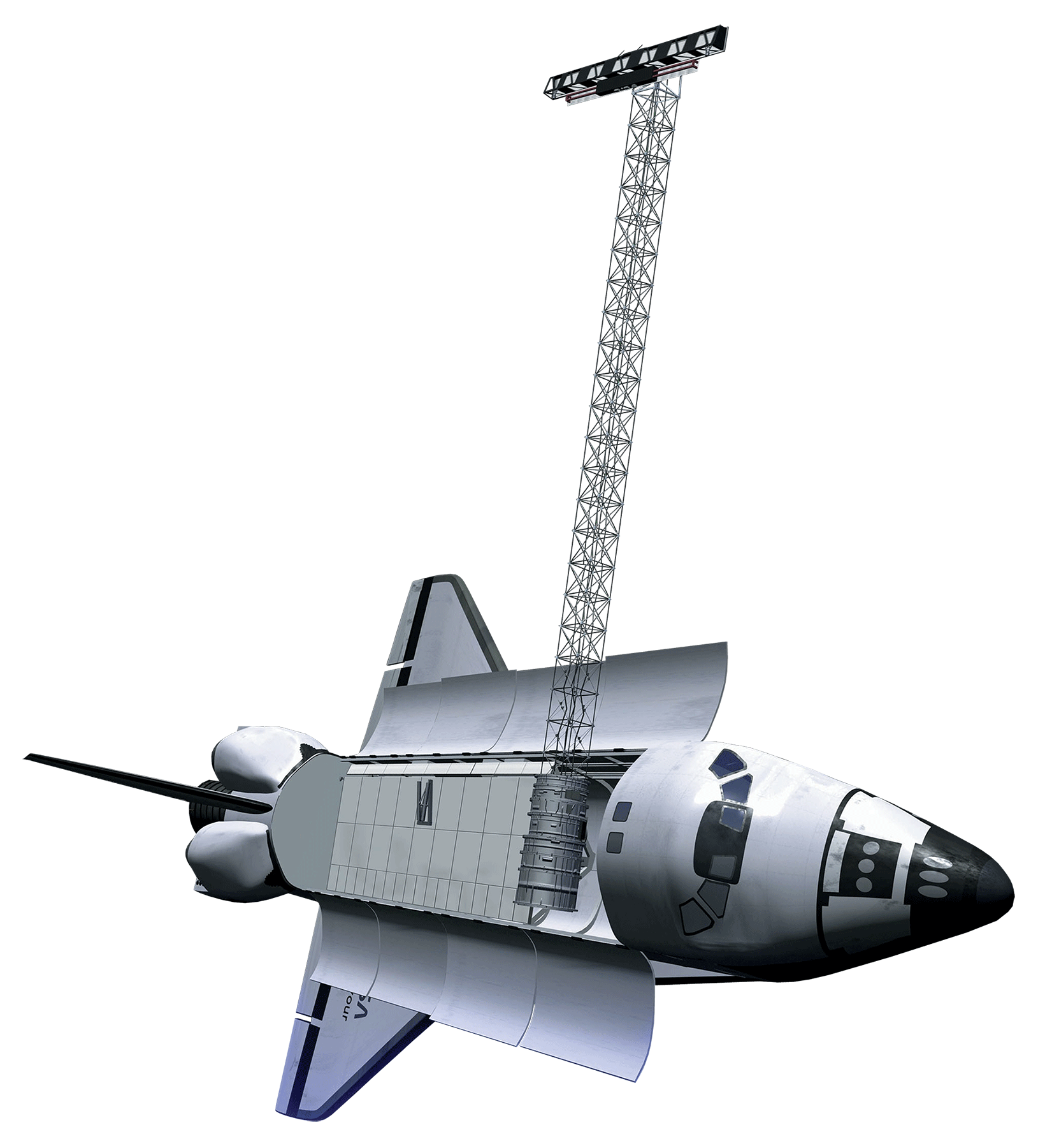
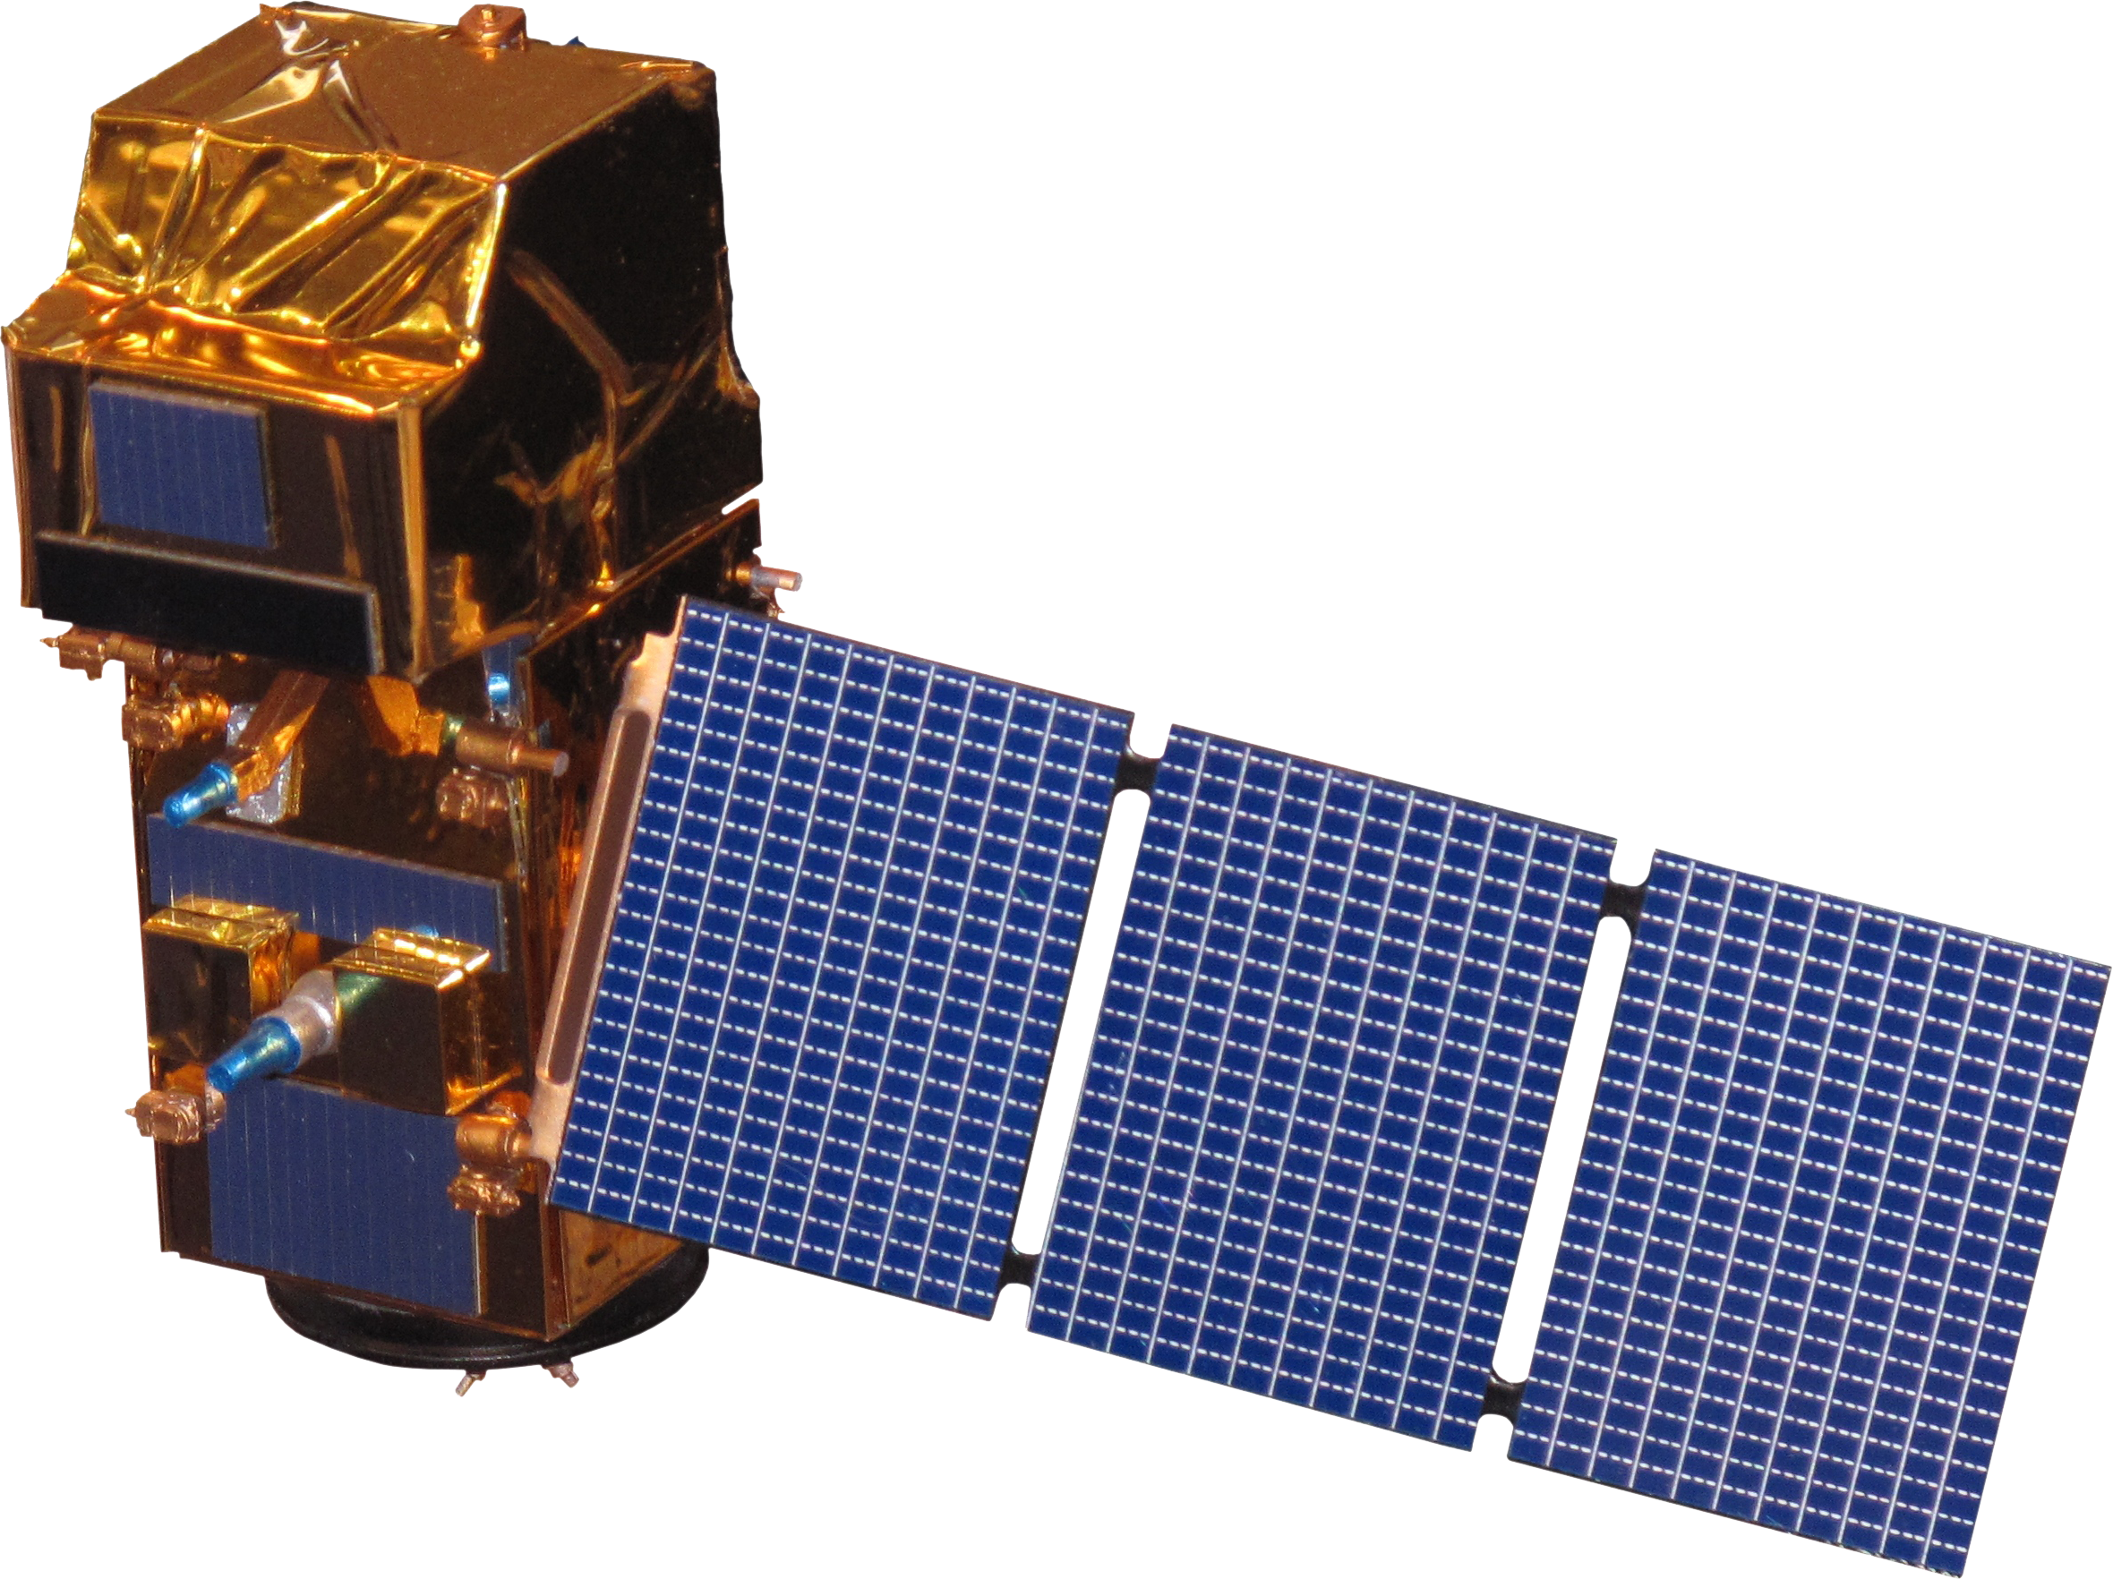
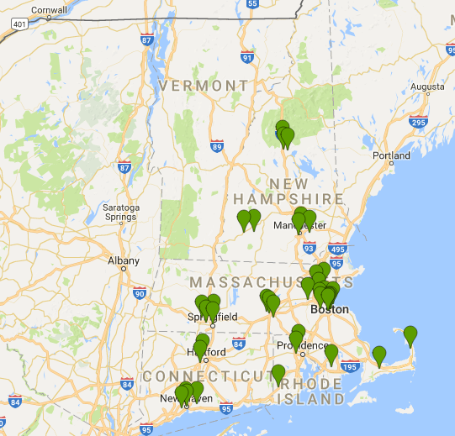

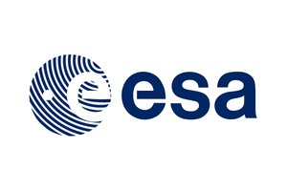
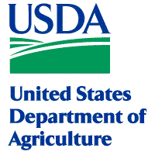
INPUT DATA
Land Classification
Elevation
Precipitation
GPM
Landsat 8
Soil Moisture
EVI
NDVI
SMAP
SRTM
Sentinel-2
Hive Locations
with temperature, humidity, and weight *
Notes:
The team sought to incorporate data into the tool that would help honey bee researchers untie the complex knot of bee health factors. There were a number of variables that went into this, from different NASA satellites.
The team used the crop land data layer which is developed by the USDA based on Landsat and classifies not only land cover type but crop type- this is especially pertinent because honeybees have shown an affinity towards specific crops, i.e. almonds over blueberries.
Elevation data from the Shuttle Radar Topography Mission were used. Since elevation is connected to temperature and humidity, users will be able to examine its relationship to honeybee health. This allows us to look at macro elevation changes- so here we’re talking less about what we would see between a 2 and 20 story building and more about the differences in the geology.
Precipitation data were gathered at from the Global Precipitation Mission. Humidity of a hive is important for the overall fitness of a hive. Studies have shown levels below 50% humidity result in lower egg hatch rates abd Varroa mite reproductive rates fall with increasing humidity so precipitation is a really critical variable as well.
Soil moisture supports vegetation which then subsequently supports honeybee diets. Soil moisture data were incorporated using SMAP ( Soil Moisture Active Passive)
To measure vegetation around each hive we used two indices, EVI or Enhanced Vegetation Index) , and NDVI (Normalized Difference Vegetation Index). NDVI quantifies the vegetative biomass of each land surface. EVI minimizes the effects of soil brightness. EVI tends to be more sensitive to plant canopy differences like leaf area index (LAI), canopy structure
So the team put all of these into a tool constructed on Google Earth Engine, which is an open sources software for exploring satellite data, conducting analyses, and building tools like this one

Slide 8
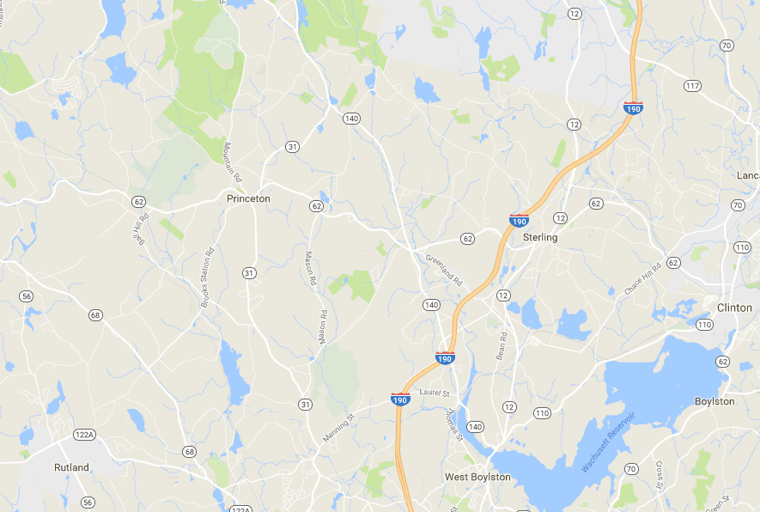
BEE HABITAT HEALTH ASSESSMENT TOOL
Notes:
So when a user pulls up the tool and hovers over say Princeton,

Slide 9

BEE HABITAT HEALTH ASSESSMENT TOOL
Notes:
They can select a point for their potential apiary, or they can upload the GPS locations for multiple apiaries, These are visualized with a black circle..

Slide 10
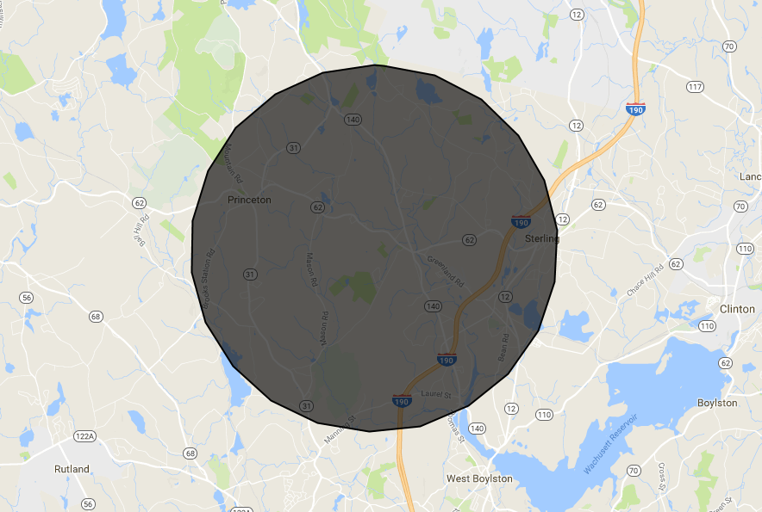
BEE HABITAT HEALTH ASSESSMENT TOOL
Notes:
The radius of which depends on what the user input for foraging range. Each user defines the honey bee foraging range. The estimated forage range for bees is still largely unknown, some estimates say up to 5 miles, and it probably varies geographically, so we allow the user to customize this.

Slide 11
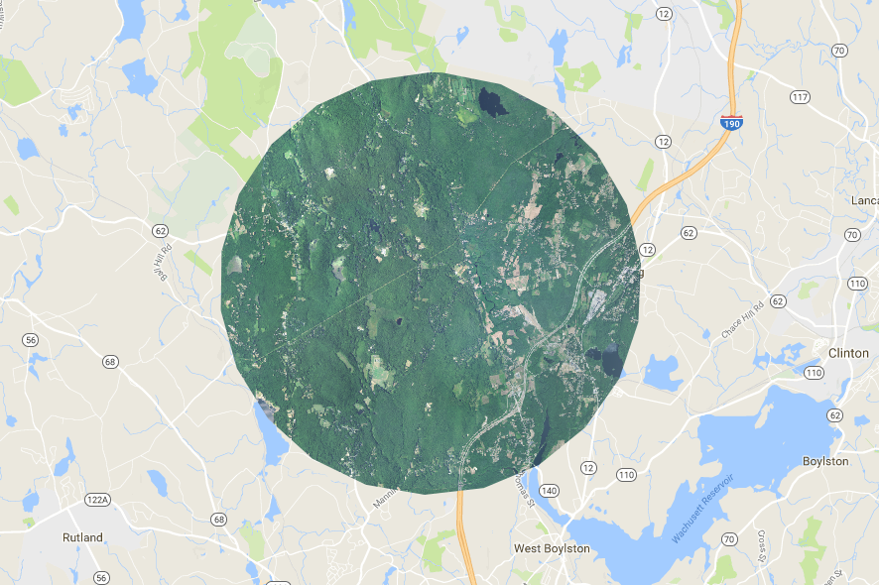
BEE HABITAT HEALTH ASSESSMENT TOOL
Notes:
And the map then populates with all of the variables I mentioned before. So this is a composite of satellite imagery that’s helpful for visualization and upon which many of these other variables were built. You can also go through and look at each month of the satellite images, but the indices like NDVI and EVI those were based on composites. Making composites from each sensor allows us to take the best/ cloud free pixels from the whole year or the whole summer and calculate based on those.

Slide 12
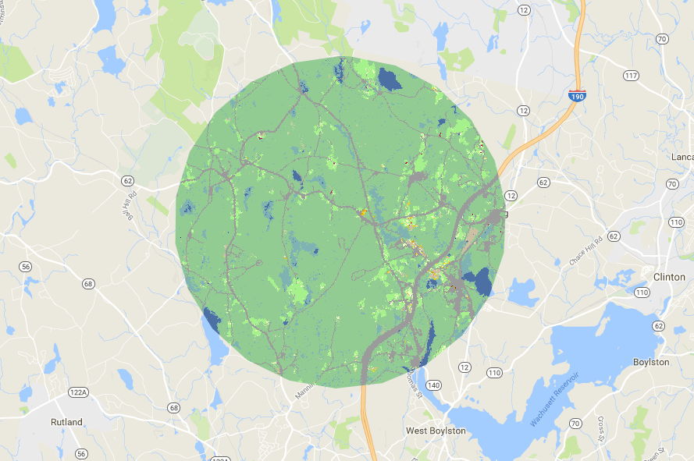
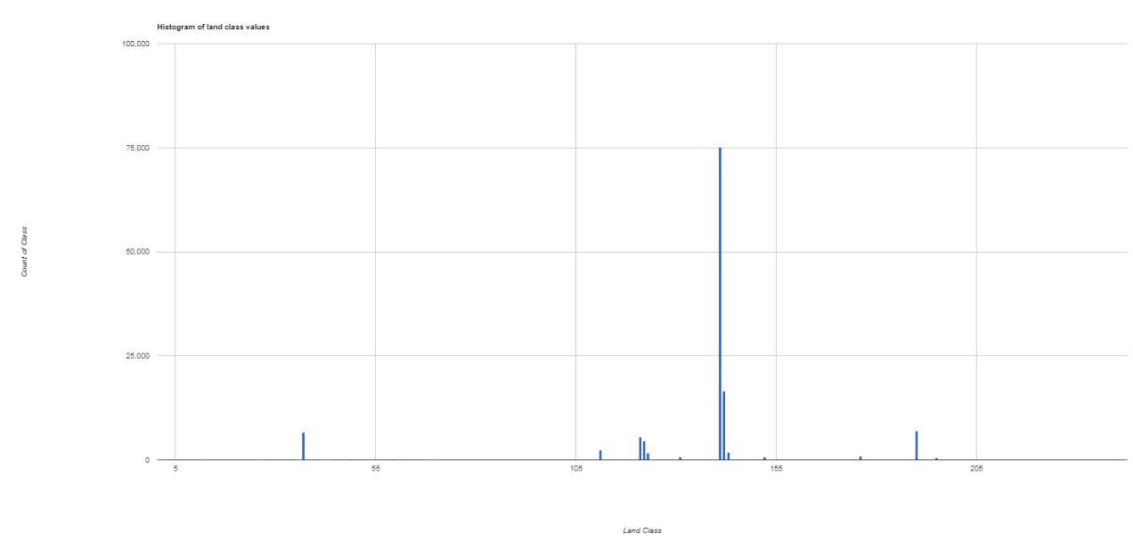
BEE HABITAT HEALTH ASSESSMENT TOOL
Notes:
This is that Crop Land Data Layer and this distinguishes between land cover types. The tool also provides a histogram chart here in the corner which tells you which of the land cover types are the most prevalent within your foraging range. This is nice because it allows the user to quickly understand the dominant class and diversity of vegetation that is available to each hive.

Slide 13
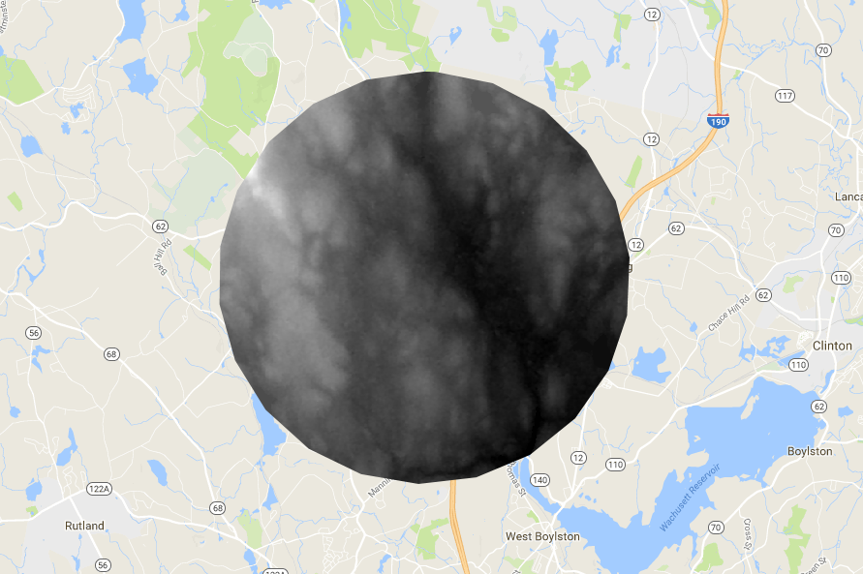
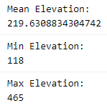
BEE HABITAT HEALTH ASSESSMENT TOOL
Notes:
This elevation layer gives researchers the mean, max, and min elevation within each foraging range. When looking at hives across multiple locations, elevation in correlation with other variables may give rise to trends not previously known. For example, hives in the Rocky Mountains seem to not be as productive as hives in low coastal beaches.

Slide 14
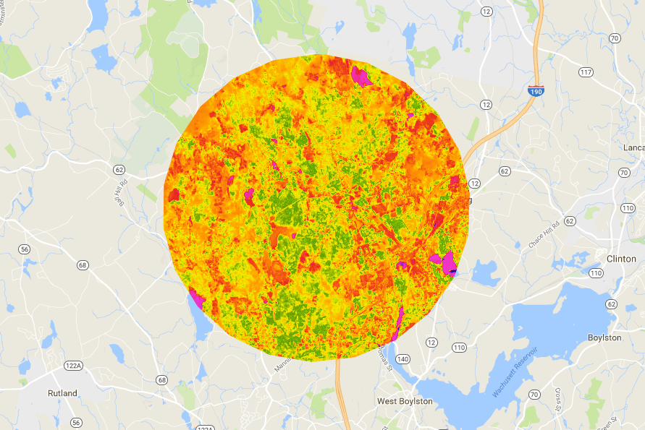
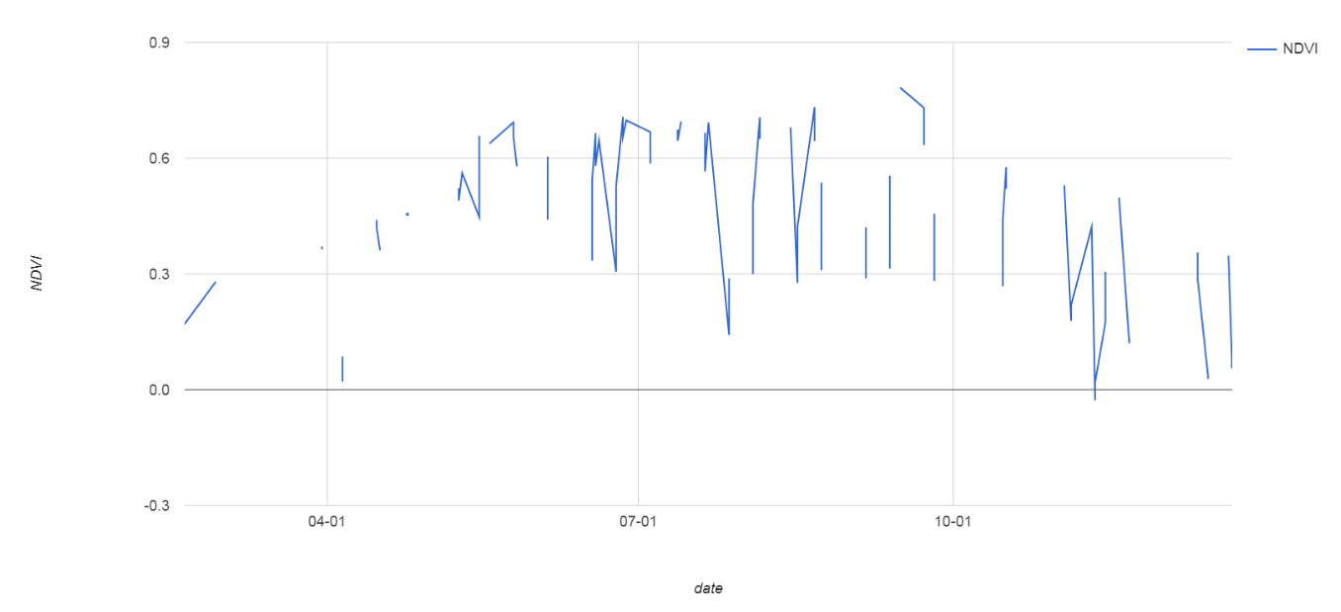
BEE HABITAT HEALTH ASSESSMENT TOOL
Notes:
Our NDVI and EVI layers- those vegetation indices- layers will allow researchers to investigate links between vegetative productivity, available water content in leaves, and those potential links to honey bee vitality. Also, time series data will be displayed for quick reference within the tool and will be exported for use in statistical analysis.
These time series of greenness are especially relevant under our changing climate conditions, as they’ll allow the partners to see how the seasons might be changing in their selected foraging range, which as you can imagine is really critical for honeybees since earlier springs would mean earlier blooms and we don’t fully know how that could be impacting honeybee populations.
Our tool allows users to generate exploratory analysis to inspect trends that may be correlated with honey bee health within a given forage range, i.e. examining the effect of a drought on honey bee health.
Users will be able to export data in CSV format, charts in PNG, and raster images in SVG.
So all of the Earth observation imagery within each unique hive forage range can be exported for further analysis in your favorite GIS platform along with the data trends represented from those images ^^ as seen here.

Slide 15
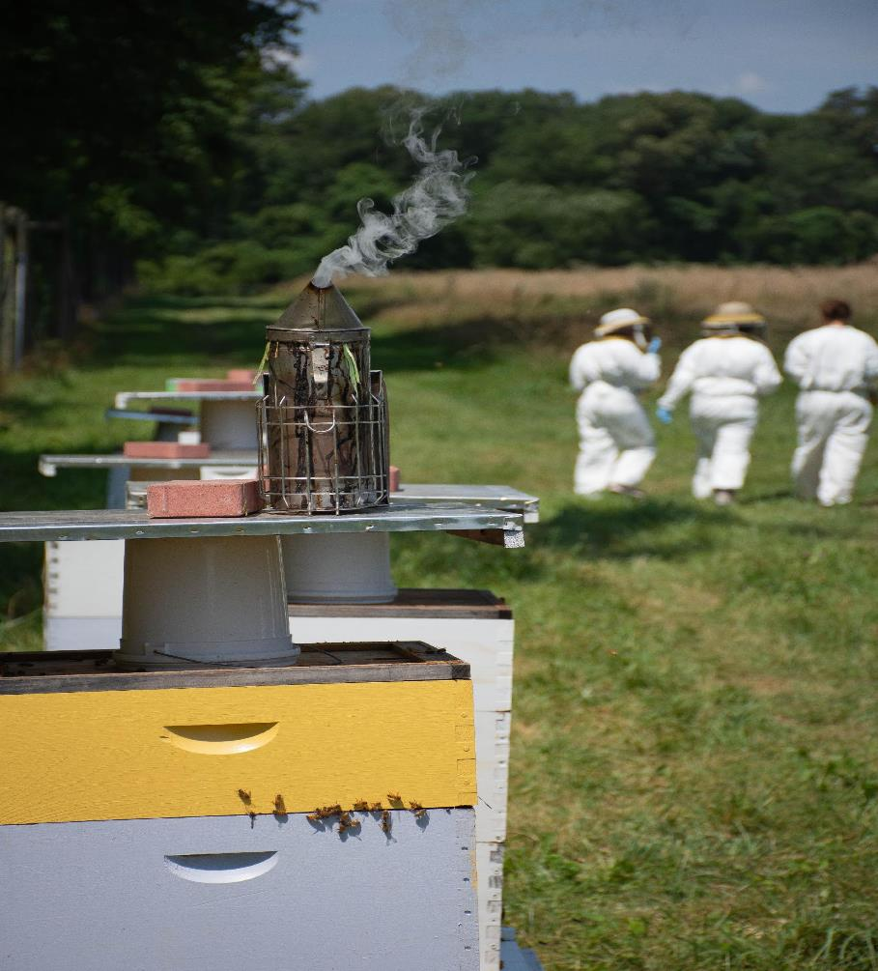
LIMITATIONS
Scale: tiny bees v. large pixels!
Complexity of pollinator relationships
Vegetation indices are proxies for nectar availability
Accessibility of data and tool
Image credit: NASA DEVELOP
Notes:
As I mentioned, this research was carried out over the course of ten weeks and just like any research, had certain limitations. One of these that’s a common limitation when looking at a single species from space is that we’re looking at the habitat on a landscape scale, using pixels that are 30 meters or larger, and so that means while we are able to generally characterize the habitat surrounding a hive, the diversity within that pixel isn’t represented. Honeybees are small and are able to access microhabitats within each of these pixels that may not be fully captured.
Additionally, there is so much complexity in any ecosystem, but pollinator plant relationships are particularly complex, and so many factors play into this including climate, hive management by beekeepers, etc.
Another limitation is that those vegetation indices we talk about look at the greenness of each pixel, which in itself doesn’t hold significance for bees, but is here used as a proxy for availability of plants that bees can forage at. However, as we know not all plants are of equal quality for bees so that’s not fully represented here- Noah will talk about one possible solution to this when he talks about HoneyDNA
Also, when using ground data collected from beekeepers it’s important to remember who those people are. Access to submitting data to bee counted and bee informed partnership is easier for people with reliable internet connections. Additionally, the tool was generated really for partner use, and while it is open source, it requires a baseline understanding of coding, so it’s not entirely equitable and accessible to everyone who might want to use it.

Slide 16
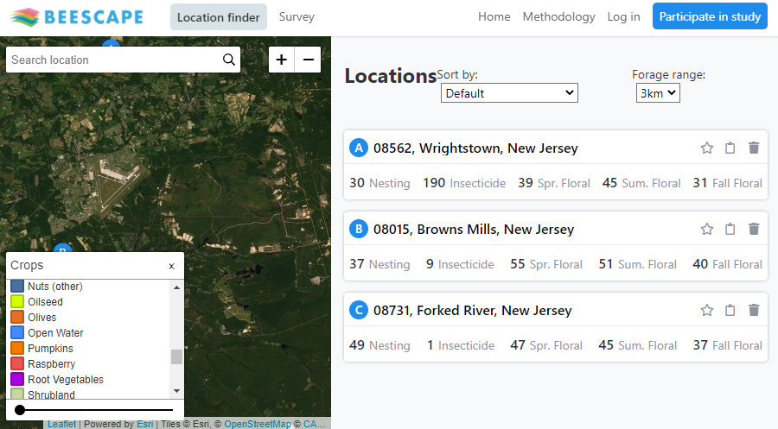
FUTURE WORK
Expanding exploratory zone
Adding forecasting and suitability capabilities
Implementing native pollinator data
HoneyDNA
Image credit: Beescape
Notes:
Ultimately, I think what this project has given us is some really great insight into what can be accomplished with satellite data to look at honeybee habitat. There are so many possibilities that this draws attention to- of course, it would be great to expand the exploratory zone of this tool and it’s pretty scalable wherever similar datasets are available. Being able to add forecasting and suitability capabilities could be really interesting to give more of a quantitative rank to each site. And looking at native pollinators in this way could also provide insight for habitat provision and protection.
As we mentioned, this tool was created in 2018 and in the meantime a lot of other great work has been happening. One example which I’ve shown here is Beescape which is an open source tool made by a team at the Center for Pollinator Research at Penn State in partnership with a number of other universities. This lets you compare between locations for things like nesting sites, insecticide exposure, floral abundance in the spring summer and fall. I definitely recommend looking this tool up, it’s now available across the continental US and it provides a great example of how beneficial spatial analysis can be to beekeepers- it even uses some of the same satellite data- you can see here that it lets you explore that crop land data layer and see what crops are in your foraging range.
Lastly, other future work could include using that honey DNA data in conjunction with satellite data to really paint a full picture of forage availability for honeybees- and so with that, I’ll hand it back to Noah
There is still a lot of work that can be done in regards to incorporating more remotely sensed and environmentally conditional data. For starters, from our research and per conversations with project partners it would be extremely beneficial to incorporate air quality data in to correlation model building. We feel that looking at trends in poor air quality may have a significant impact on the success of the bees functionalities in foraging, and for the health of or the diversity of the vegetation that they prefer.
Our tool is able to be scaled to anywhere in the world. Gathering additional data points of hive locations can help to reveal the global trends but may also allow for significant factors to reveal themselves as we whittle away at the regional or localized factors.
We think it would be great to add habitat suitability models in to this approach by determining which hives were successful and seeing which factors were similar or replicated elsewhere. Also, it would be neat to select out the variables that best represent the model of success and devise ways to alter non-successful habitats in to those that would promote healthy hives.
Finally, adding in HoneyDNA data we could validate which vegetation was most preferred be the bees, determine a more reasonable forage range around certain hives given the vegetation diversity and coverage from the Cropland Data Layer, and further validate the remotely sensed data with citizen-science / on the ground measurements.
Photo credit: By Taken byfir0002 | flagstaffotos.com.au Canon 20D + Sigma 150mm f/2.8 [GFDL 1.2 (http://www.gnu.org/licenses/old-licenses/fdl-1.2.html)], from Wikimedia Commons

Slide 17
Project Team
Jeremy Rapp
Victor Lenske
Eyob Solomon
Ryan Young
Partners
Contact Information:
Darcy Gray, NASA DEVELOP Fellow
Darcy.Gray@ssaihq.com
Visit the DEVELOP website!
https://develop.larc.nasa.gov/
The Urban Beekeeping Laboratory and Bee Sanctuary, Inc.
The Bee Informed Partnership, Inc.
The University of Maryland’s vanEngelsdorp Honey Bee Research Lab
BeekeepingIO
Science Advisors
Dr. John Bolten, NASA GSFC
Sean McCartney, Science Systems & Applications, Inc.
Notes:
Thank you all again for joining us and listening to this talk, I again want to give thanks and full credit to the project team, and to the partners and science advisors without whom this project wouldn’t have been possible!

