Slide 2
Understanding Human Movement Patterns within Cislunar Habitats
Harry Litaker, Jr.¹, Omar Bekdash², Steve Chappell², Kara Beaton² and Michael Gernhardt³
¹Leidos, JSC, Houston, Texas
²KBR, JSC, Houston, Texas
³Johnson Space Center, NASA, Houston, Texas

Slide 3




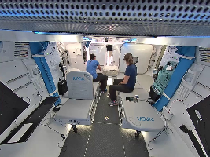
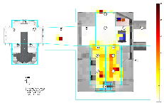
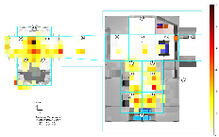
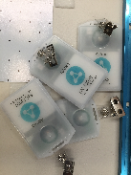
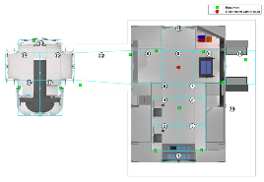
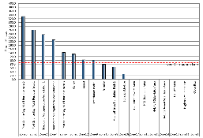
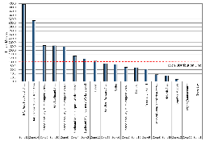
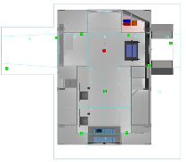
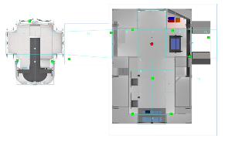
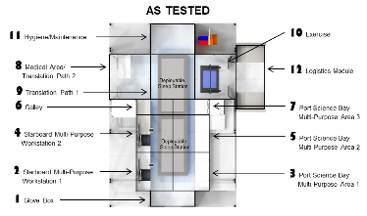
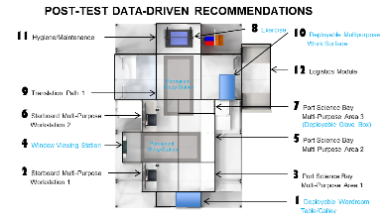
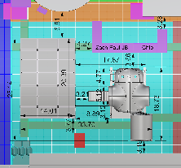
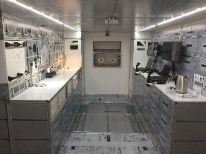
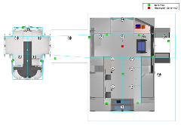
Understanding Human Movement Patterns within Cislunar Habitats
Harry Litaker, Jr.¹, Omar Bekdash², Steve Chappell², Kara Beaton² and Michael Gernhardt³
¹Leidos, JSC, Houston, Texas;²KBR, JSC, Houston, Texas;³Johnson Space Center, NASA, Houston, Texas
ABSTRACT
In preparation for testing five Broad Agency Announcement (BAA) commercial cislunar habitat designs, the National Aeronautics and Space Administration (NASA) embarked on a yearlong in-house training program. This consisted of in-house testing for subject matter experts (SMEs) and crew to informed and ensure evaluation data collection techniques for each of the contractor options. Many evaluation techniques were tested with some continuing forward. Two-test conditions were employed - 1) habitat centric functions with one space element and 2) distributed functions across two or more space elements. This paper will look at one of these techniques—human circulation patterns—to assess a spacecraft habitat’s internal configuration while the crew is working a three day simulated cislunar mission. Results indicated distributing functions across elements decreased crew interference and task wait times. Additionally, areas of underutilization were located, which lead to interior layout design changes.
Habitable Airlock (HAL) Module (Figure 3)
Dimensions: Height 6.97 feet, Length 11.5 feet, Width 10.73 feet
Habitable Volume: 403 cubic feet
Side Hatch (2): Length 40 inch, Width 40 inch
Forward Hatch (1): Diameter 31.5 inch
Aft Hatch (2): Length 34.06 inch, Width 26 inch
Environmental Control Life Support System (ECLSS)
Avionics, habitation systems, workstations
EVA compatible equipment
Heat Map Analysis
Each zone is subdivided into a grid of 10 by 10-inch squares. The amount of time spent in each square can be inferred from the density of the geolocations within that area. In order to visualize the time spent in a particular area, a color gradation scale ranging from white (representing 0 minutes) to dark red (representing 60 minutes) (Figures 7 and 8). The heat maps show a clear reduction of cumulative zone utilization time in the distributed functional design over the single habitat design.
Figure 3. The HAL Module.
AllTraq© Test Equipment (Figure 4)
Collects human movement data
Receivers (13): Ultra-wideband (UWB) frequency
Radio Frequency Identification (RFID) tag (4):
-Accuracy: 6-8 inch between zones
-Small, non-intrusive
- Body worn
Stationary RFID Tag (1):
-Position accuracy
-27,000 data points per day
Figure 7. Single Habitat-Centric configuration
Figure 8. Distributed Function configuration
INTRODUCTION
Human movement patterns have been a technique used by architects for several years to understand the efficiencies and pitfalls of traffic flow for a certain configurational layout. Architectural flow or movement refers to the way people move through and interact with a space. Layout and traffic flow are extremely important to any habitational configuration regardless if it is an Earth dwelling or a spacecraft. The objective of the three-day in-house testing was to study the distribution and layouts of the functions within the cislunar spacecraft and see if it could be a predictor of crew performance. The effects of these different distributions on crew performance used objective and subjective metrics to define the most acceptable distributions. Investigators for this study employed the AllTraq© real-time tracking and monitoring system to track test subjects within the mocked up space habitation configuration.
Histogram Analysis
Histograms were generated to show the relative distribution of high- and low-use zones; an equal distribution reference line was added that represents the total amount of time that would be spent in each zone if the crew spent an equal amount of time in each zone (Figures 9 and 10). This data provides insight into cabin layout, volume utilization, and efficiency of task/function distributions throughout the configuration.
Figure 4. The AllTraq© RFID tags and test setup.
Procedures
Subjects worked inside the mockup spacecraft for three-days executing a cislunar timeline. Their objective was to test the functional arrangement of each element configuration. Day 1 tested the Habitat-Centric Functional Allocation where all habitat functions were in a single habitat element. Day 2 tested the Distributed Functional Allocation, which spread the required habitat functions across multiple elements (Figure 5).
Figure 9. Single Habitat-Centric histogram
Figure 10. Distributed Function histogram
METHODS
Subjects
Sixteen participants took part in four separate evaluations. Eight were engineers and eight were astronauts with flight experience. Each evaluation used a crew of four participants.
Discussion of Results
Results indicated subjects preferred distribution functionality of multiple habitat modules especially in regards to habitation and science functions. Separating functions aided in minimizing cross contamination of food, sweat (from exercise), noise, etc., with science payload activities. Additionally, duplicating devices, such as workstations, helped minimize interference and task wait times as tasks could be simultaneously. Habitat layout modifications included (Figures 11 and 12):
  Move the sleep stations from Zones 2-5 to Zones 8 and 9
  Move exercise station from Zone 10 to Zone 8
  Move galley from Zone 6 to Zone 1
Test Environment and Equipment
Conducted at NASA Johnson Space Center (JSC) in the Integrated Power, Avionics, and Software (iPAS) facility in Building 29 with ground support using the Analog Mission Control Center (AMCC) located in Building 30 (Figure 1). The mockup consisted of two elements and AllTraq©:
Main Habitat Module (Figure 2)
Dimensions: Length 20.4 feet, Diameter 14.04 feet
Habitable Volume: 1,059.4 cubic feet
Hatch (4): Diameter 31.5 inch
Docking Tunnel (1): Length 12 foot
Payloads were Space Shuttle Mid-Deck Lockers (MDL) Cargo Transfer Bags (CTBs) were used for logistics
Lighting and work surfaces were also provided
Figure 5. Habitat-Centric setup on left. Distributed Function Allocation setup on right.
RESULTS
During four three-day testing sessions, both subjective and objective data was collected on the test subjects as for their movement patterns and behavior in two test conditions. For subjective data, the Exploration Analogs and Mission Development (EAMD) project’s 10-point scale of acceptability was used which measures the acceptability of different prototype systems and operations concepts. Alltraq© collected the objective subject movement data.
HAB
HAL
Location Frequency Distribution Analysis Each zone, in the location frequency distribution, corresponds to a specific functional element. Zone numbers were assigned in a linear direction when viewed from above; where practical, the same zone number was assigned to a given function for both configurations (Figure 6 and Table 1).
Table 1. Functional Zones of the Tested Habitat Configuration
Zones | Zone Description
1 | Glove Box
2 | Starboard Multi-purpose Workstation 1
3 | Port Science Bay Multi-Purpose Area 1
4 | Starboard Multi-purpose Workstation 2
5 | Port Science Bay Multi-Purpose Area 2
6 | Galley
7 | Port Science Bay Multi-Purpose Area 3
8 | Medical Area/Translation Path 2
9 | Translation Path 1
10 | Exercise
11 | Hygiene/Maintenance
12 | Tunnel
13 | HAL Aft Area
14 | HAL Starboard Side Hatch Area
15 | HAL Port Side Hatch Area
16 | HAL Starboard Area
17 | HAL Port Forward Area
18 | Logistics Module
Figure 11. The As Tested habitat layout.
Figure 12. The Post-Test Data-Driven habitat layout.
Figure 1. iPAS test area in Building 29 at JSC.
Figure 2. The Main Habitat Module.
CONCLUSIONS
Habitability is about quality of life [1]. Movement data, from AllTraq©, showed lower spikes in frequently used zones when tasks were distributed across elements compared to a single habitat. Both underutilized zones and highest density zones were identified by also using this method. Furthermore, the movement and frequency data enabled human factors engineers to make data-driven design recommendations to improve the layout configuration for optimal crew performance.
Figure 6. The plan view of the test configuration with zones.

Slide 4
Abstract
In preparation for 5 commercial habitats, NASA embarked on a yearlong evaluation program
Many evaluation techniques were tested and some continued forward
Two test conditions were examined:
  Habitat-Centric functions with one space element
  Distributed Function Allocations functions across multiple elements
This paper looked at one technique, human circulation patterns, within a habitat layout
Results indicated distributing functions across elements decreased crew interference and identified underutilization areas within the design

Slide 5
Introduction
Human movement patterns a technique used by architects for years to understand the efficiencies and pitfalls of a configurational layout
Architectural flow refers to the way people move and interact with a space
Layout and flow is extremely important to any habitational configuration
The objective of the test:
  To study the distribution and layouts of functions within the cislunar spacecraft and see if it could be a predictor of crew performance
The effects of these different distributions on crew performance used objective and subjective metrics
For collecting human movement, the Alltraq© system was used to track the test subjects

Slide 6
Methods (Subjects)
Sixteen participants took part in four separated evaluations
  Eight were engineers
  Eight were flight-experience astronauts
Each evaluation used a crew of four working through a 3-day cislunar mission timeline

Slide 7
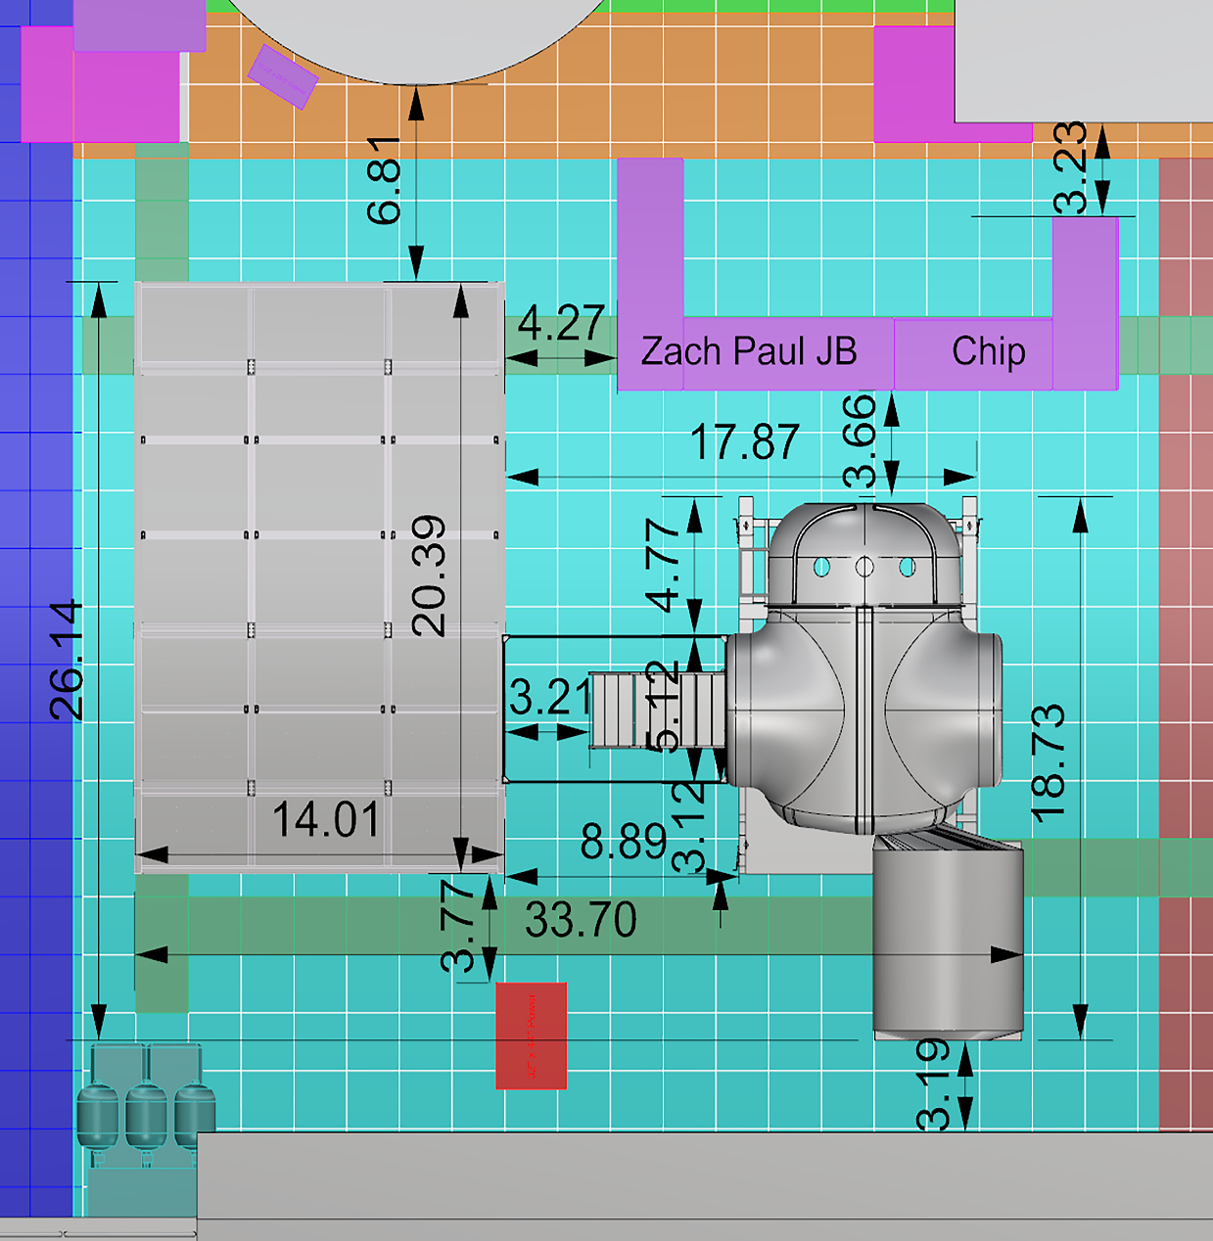
Methods (Test Environment)
Testing was conducted at JSC Integrated Power, Avionics and Software (iPAS) facility in Building 29
Ground support used the Analog Mission Control Center (AMCC) located in Building 30
HAB
HAL
iPAS test area in Building 29 at JSC

Slide 8

Methods (Test Equipment)
Main Habitat Module
  Dimensions: Length 20.4 feet, Diameter 14.05 feet
  Habitable Volume: 1,059.5 ft³
  Hatch (4): Diameter 31.5 inch
  Docking Tunnel (1): Length 12 foot
  Payloads were Space Shuttle Mid-Deck Lockers (MDL)
  Cargo Transfer Bags (CTBs) were used for logistics
  Lighting and work surfaces were also provided
The Main Habitat Module

Slide 9
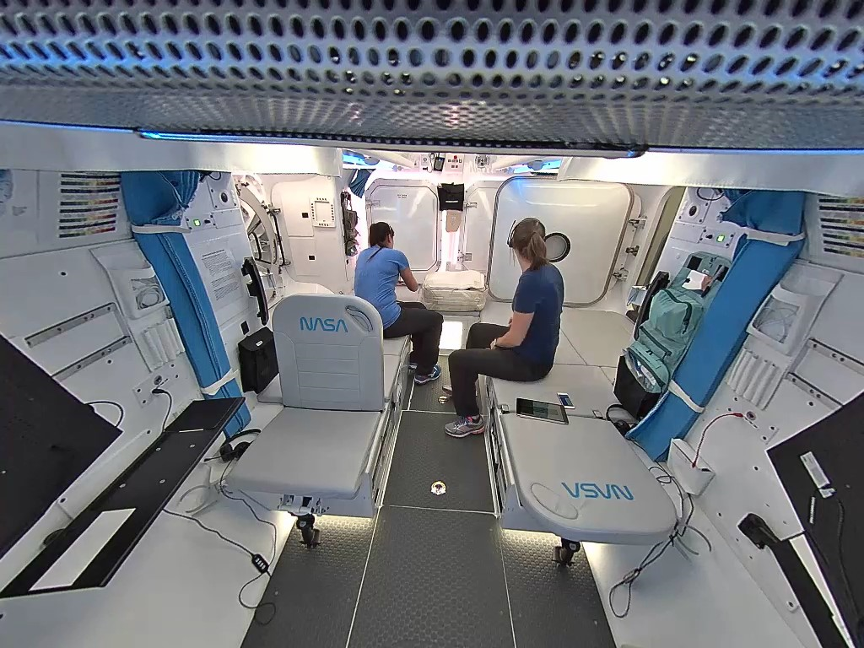
Methods (Test Equipment)
Habitable Airlock (HAL) Module
  Dimensions: Height 6.97 feet, Length 11.5 feet, Width 10.73 feet
  Habitable Volume: 403 ft³
  Side Hatch (2): Length 40 inch, Width 40 inch
  Forward Hatch (1): Diameter 31.5 inch
  Aft Hatch (2): Length 34.06 inch, Width 26 inch
  Environmental Control Life Support System (ECLSS)
  Avionics, habitation systems, workstations
  EVA compatible equipment
The HAL Module

Slide 10
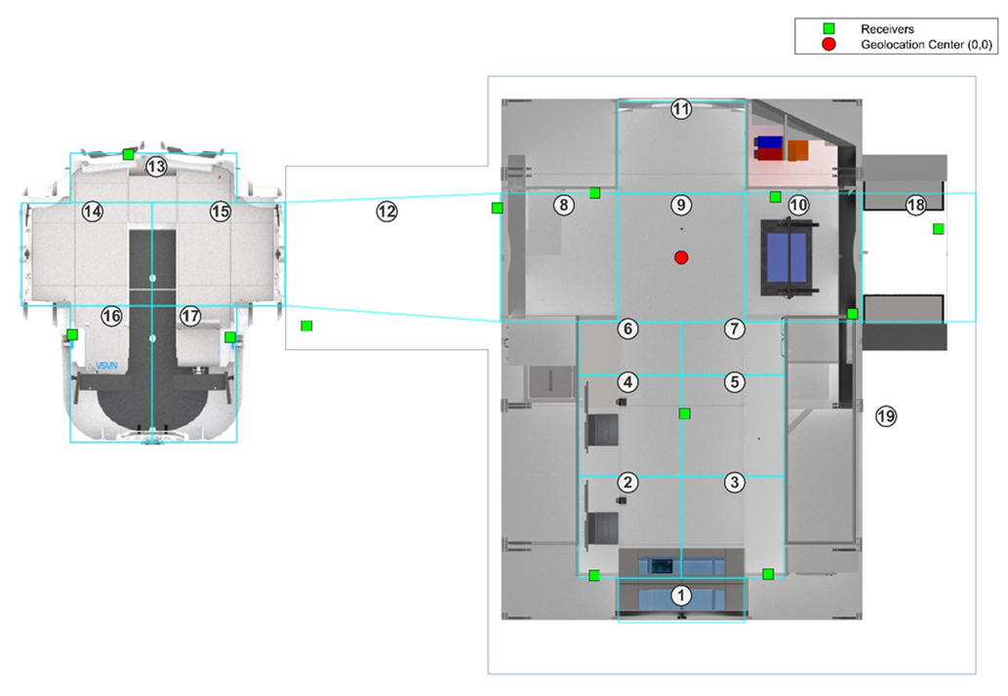

Methods (Test Equipment)
Alltraq© Test Equipment
  Collects human movement data
  Receivers (13): Ultra-Wideband (UWB) Frequency
  Radio Frequency Identification (RFID) tag (4):
    Accuracy: 6 – 8 inch between zones
    Small, non-intrusive
    Body worn
  Stationary RFID Tag (1):
    Position accuracy
    27,000 data points per day
The Alltraq© RFID tags and test setup

Slide 11

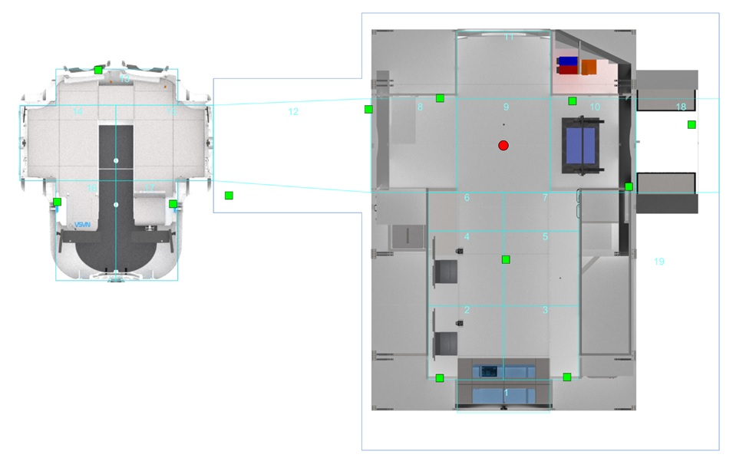
Methods (Procedures)
Subjects worked inside the mockup spacecraft for 3-days executing a cislunar timeline
Their objective was to test the functional arrangement of each element configuration
Day 1 tested the Habitat-Centric Functional Allocation:
  All habitat functions in a single habitat element
Day 2 tested the Distributed Functional Allocation:
  All habitat functions spread across multiple elements
Habitat-Centric setup
Distributed Functional Allocation setup

Slide 12
Results
During four 3-day testing sessions, both subjective and objective data was collected on test subjects as for their movement patterns and behavior in two design conditions
Subjective data use the Exploration Analog and Mission Development (EAMD) 10-point acceptable scale
  Measures the acceptability of different prototype systems and operation concepts
Objective movement data was collected using Alltraq©

Slide 13
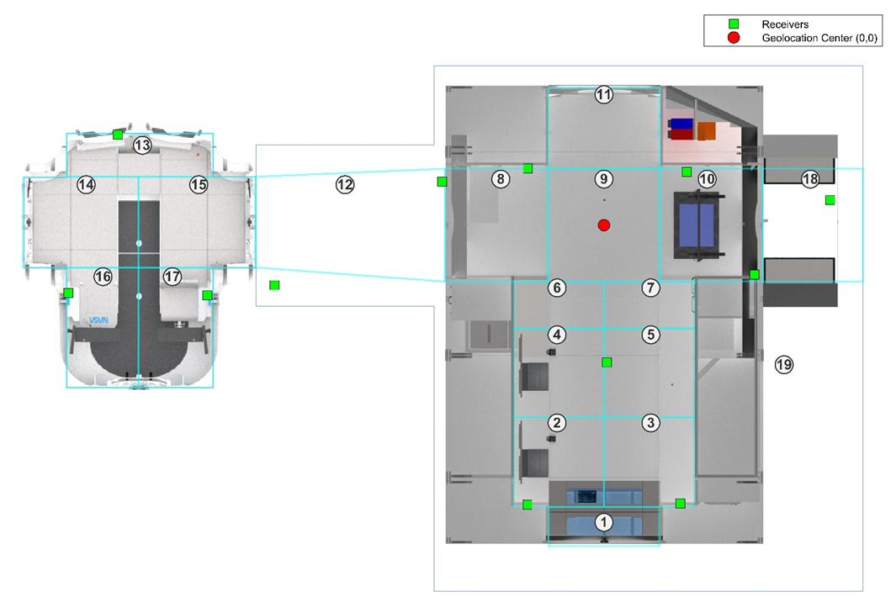
Results
Location Frequency Distribution Analysis
  Each zone corresponds to a specific functional element
  Zone numbers were assigned in a linear direction when viewed from above
  Where practical, the same zone number was assigned to a given function for both configurations
The plan view of the test configuration with zones
Table 1. Functional Zones of the Tested Habitat Configuration
Zones | Zone Description
1 | Glove Box
2 | Starboard Multi-purpose Workstation 1
3 | Port Science Bay Multi-Purpose Area 1
4 | Starboard Multi-purpose Workstation 2
5 | Port Science Bay Multi-Purpose Area 2
6 | Galley
7 | Port Science Bay Multi-Purpose Area 3
8 | Medical Area/Translation Path 2
9 | Translation Path 1
10 | Exercise
11 | Hygiene/Maintenance
12 | Tunnel
13 | HAL Aft Area
14 | HAL Starboard Side Hatch Area
15 | HAL Port Side Hatch Area
16 | HAL Starboard Area
17 | HAL Port Forward Area
18 | Logistics Module

Slide 14
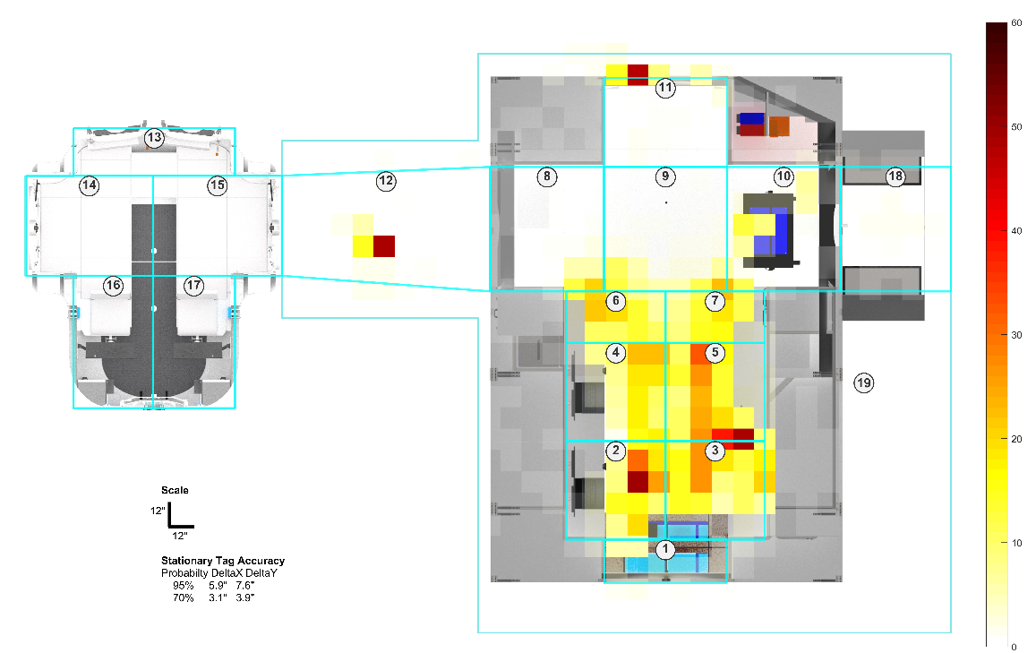
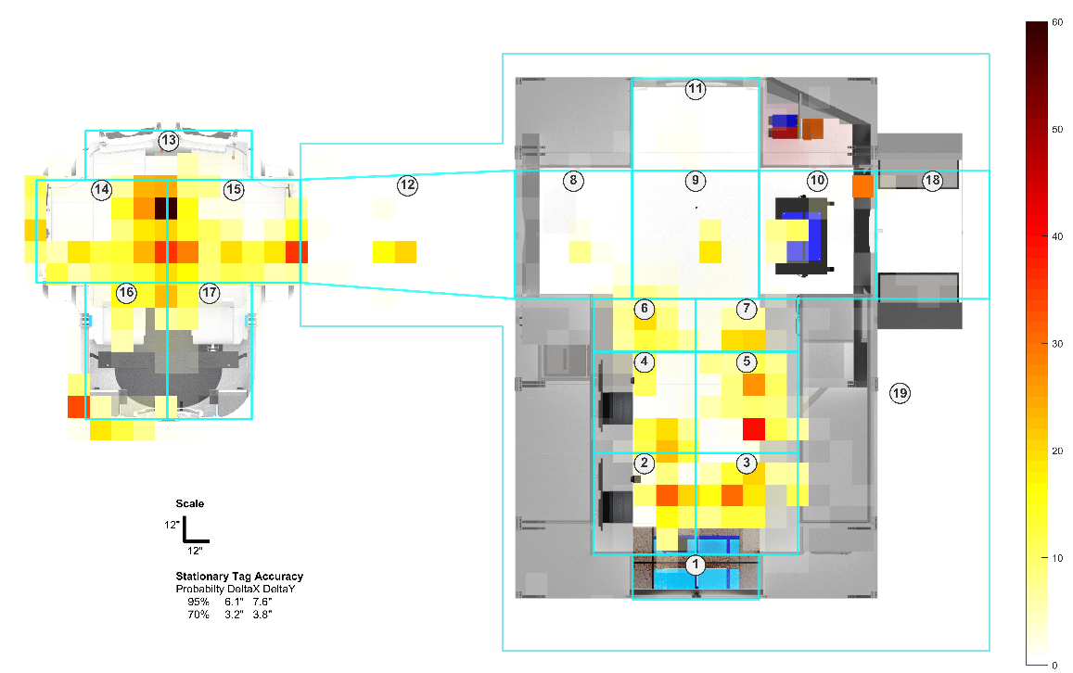
Results
Heat Map Analysis
  Each zone is subdivided into a grid of 10 x 10 inch squares
  The amount of time spent in each square can be inferred from the density of the geolocations within that area
  To visualize the time spent, a color gradation scale was used:
    White represents 0 minutes
    Dark red representing 60 minutes
  The heat maps show a clear reduction of cumulative zone utilization time in the distributed functional design over the single habitat design
Single Habitat-Centric configuration
Distributed Functional configuration

Slide 15
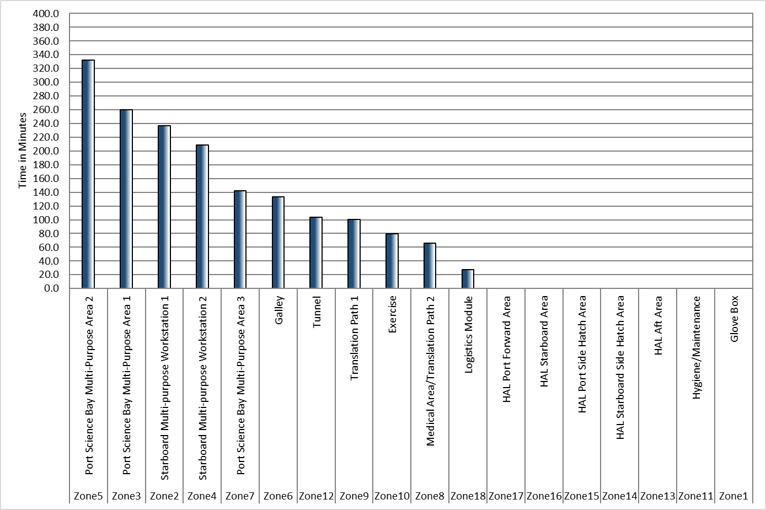
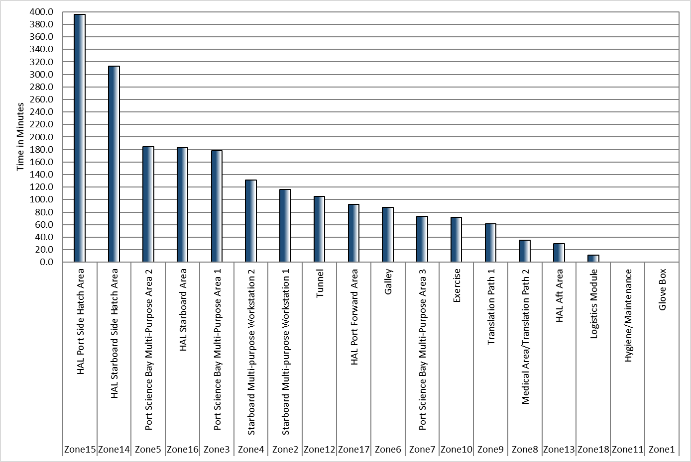
Results
Histogram Analysis
  Histograms were generated to show the relative distribution of high- and low-use zones
  An equal distribution reference line was added that represents the total amount of time spent in each zone if the crew spent an equal amount of time in each zone
  This data provides insight into cabin layout, volume utilization and efficiency of task/function distributions throughout the configuration
Single Habitat-Centric histogram
Distributed Function histogram

Slide 16
Results
Discussion of Results
  Results indicated subject preferred distribution functionality of multiple habitat modules especially in regards to habitation and science functions
  Separating functions aided in minimizing the following:
    Cross contamination of food
    Sweat (from exercise)
    Noise
  Additionally, duplicating devices such as workstations, helped minimized interference and task wait times as tasks could be done simultaneously

Slide 17

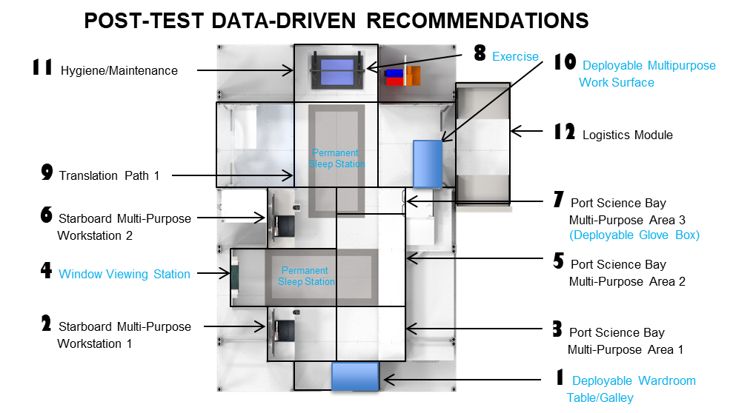
Results
Habitat Layout Modifications
  Move the sleep stations from Zones 2-5 to Zones 8 and 9
  Move exercise station from Zone 10 to Zone 8
  Move galley from Zone 6 to Zone 1

Slide 18
Conclusions
Habitability is about quality of life [1]
Movement data showed lower spikes in frequently used zones when tasks were distributed across elements compared to a single habitat
Both underutilized zones and highest density zones were identified by using this method
The movement and frequency data enabled human factors engineers to make data-driven design recommendations to improve the layout configuration for optimal crew performance

Slide 19
References
[1] Wise, J.A. (1985). “The quantitative modelling of human spatial habitability,” NASA Technical Reports Server, Document No. NASA-CR-179716, NAS 1.26:179716, 01 February 1985, pp. 1-154.

Slide 20
Other Sources
Litaker, Jr., H.L., Thompson, S.G., Szabo, R., Twyford, E.S., Conlee, C.s. and Howard, Jr., R.L. (2013). “Dual rover human habitation filed study,” Acta Astronautic, Vol. 90, No.2 (2013), pp. 378-390.
Litaker, Jr., H.L., Archer, R.D., Newton, C.E., Howard, Jr., R.L., Kennedy, K.J., Martin, C.S., & Montoya, B.D. (2018). “A comparison of early conceptual design testing using virtual reality and physical environments,” NASA/Johnson Space Center, NASA/TM-220301.
Benedikt, M.L. (1979). “To take hold of space: Isovists and isovist fields,” Environment and Planning, B 47-65.
Tullis, T.S. and Bied, B.R. (1988). “Space station functional relationships analysis final technical report,” NASA Contractor Report 177497, August 1988, NASA/Ames Research Center, pp 1-112.
Michalek, J.J., Choudhary, R., and Paplambros, P.Y. (2002). “Architectural layout design optimization,” Eng. Opt, Vol. 34(5), pp. 461-484.

