Slide 1

National Aeronautics and Space Administration
ACC HiCAM Industry Day
Advanced Composites Consortium (ACC)
Hi-Rate Composite Aircraft Manufacturing (HiCAM) Project
Rick Young, Planning Lead

Slide 2
Special Notice: ACC HiCAM Industry Day and Capabilities Statement Request
https://beta.sam.gov/opp/cbf7ee934a044aa9afbba0dbdba317cb/view
Advanced Composites Consortium (ACC)
  Public-private partnership, formed by NASA and selected partners in 2015
  NASA has approved leveraging the ACC as appropriate, including the potential addition of new members, to support new work
Hi-Rate Composite Aircraft Manufacturing (HiCAM)
  New NASA project in pre-formulation
  Approved to execute early start activities to support HiCAM formulation
Current Opportunity:
  NASA, on behalf of the ACC Executive Steering Committee (ESC), is requesting information from organizations interested in becoming a member of the ACC
  ACC membership is limited to United States (U.S.) industry, including not-for-profit institutions, and U.S. universities/colleges
Information requested:
  One (1) page summary that includes an organizational overview, anticipated contribution to the ACC to address HiCAM objectives, and willingness to accept the terms and conditions of the AoC as written.
  Capabilities statement detailing qualifications, bullet format, limited to three (3) pages, organized by and addressing five topic areas:
Design and manufacture of composites for aerospace
Ability to engage in cost sharing (50/50)
Certification experience for aircraft
Focus technology experience: material development and qualification, progressive damage modeling, bonding, manufacturing tooling, …
Partnership experience in PPPs or similar

Slide 3
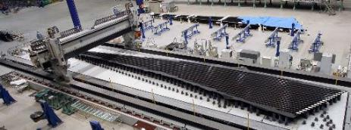
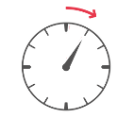
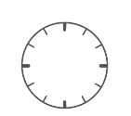
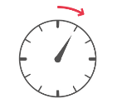
Hi-Rate Composite Aircraft Manufacturing (HiCAM)
Game-changing manufacturing/delivery rate needed to meet single aisle demand
Goal: enable 4–6X manufacturing rate increase for composite airframe structures (~15 ➔ ~100/month)
Shift from focus on weight to balance rate, cost, & weight
Demonstrate high-rate manufacturing concepts at full scale (TRL/MRL 3+ ➔ 6 at close)
  Evolving SoA thermosets
  Thermoplastics
  Resin Transfer Molding
  Materials, processes, and architectures
Demonstrate model-based engineering tools
for efficient design, development, and certification
Partner with Industry & FAA for realistic requirements
  Leverage industry expertise and efforts
  Partnership model similar to Advanced Composites Project
Current SoA
Future State
Layup
Cure
t /6
Assemble
t
Inspection
PRODUCTION
TIME REDUCTION
Paint
Rapid prototype and evaluation of manufacturing concepts, down-select at smaller scale, agile development to mature concepts at larger scale

Slide 4
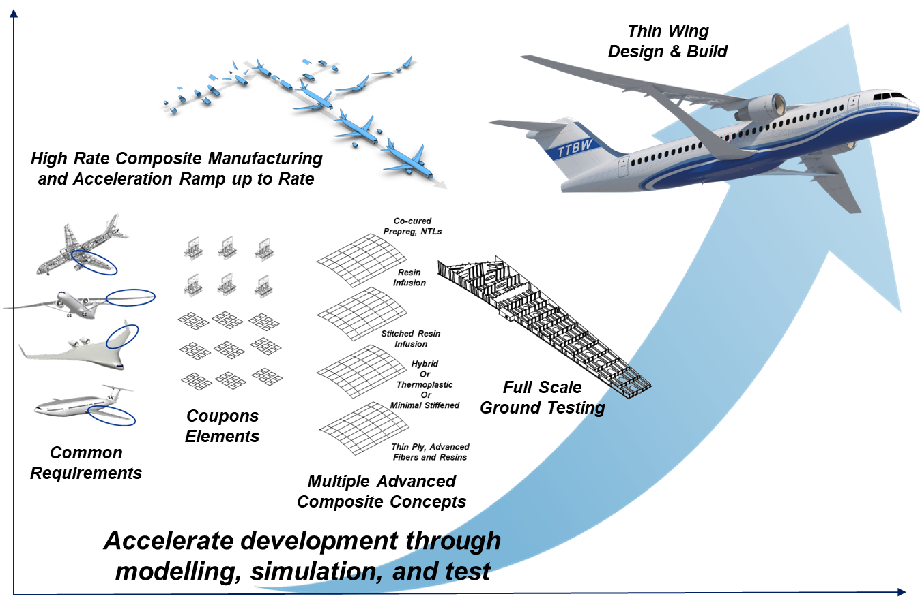
HiCAM Technical Content and Approach
System-Level Requirements Definition
System level rate measures
Capstone test articles
Down-select criteria
Concept Screening and Trades
Multiple approaches to consider
(rapid build, cure, assembly)
Leverage recent advances
Develop system-level concepts for potential benefit
Select concepts, develop with building block approach
Model Based Engineering Tools
Reduce physical testing
Accelerate concept maturation
Optimize design and manufacturing parameters
Assess and accept defects
Rapid prototype and evaluation of manufacturing concepts, down-select at smaller scale, agile development to mature concepts at larger scale

Slide 5
HiCAM Project Overview
Goal: Demonstrate manufacturing approaches and associated technologies for large composite primary airframe structures that enable a 4-6x production rate increase without cost or weight penalty for composite structures versus 2020 best in class for early 2030s entry into service (EIS) single-aisle aircraft
Potential Milestones
Budget Request, FY21 ($M)
Proposed Acquisition Strategy
Public Private Partnership (PPP)
  Focused, applied R&D
  Multi-party teams with integrated tasks
  50:50 cost share
Approved to leverage the Advanced Composites Consortium (ACC) as appropriate, including the potential addition of new members
Down-select Concepts for Full-Scale
FY21 | FY22 | FY23 | FY24 | FY25 | FY26 | FY27
Investment Approach
Select Concepts to Evaluate
TRL/MRL 4 Technology Demos
Airframe Component Demo Complete (TRL/MRL 6)
FY21 | FY22 | FY23 | FY24 | FY25 | FY26 | FY27
12 | 16 | 16 | 23 | 25 | TBD | TBD

Slide 6
Advanced Composites Consortium (ACC) Information

Slide 7


















ACC: Current Membership and Management Structure
Tier 1 Members
Tier 2 Members
Executive Steering Committee controls the size and composition of the ACC
Expertise to conduct envisioned work
Reasonable number of Tier I and Tier II Members
Executive Steering Committee (ESC)
Technical Oversight Committee (TOC)
Cooperative Research Teams (CRT)

Slide 8
ACC Membership Structure
Tier I members:
Members of the Executive Steering Committee (ESC) and Technical Oversight Committee (TOC)
Meet all 5 criteria:
  Technical expertise in design and manufacture of composites
  Funding willingness and ability to engage in cost sharing
  Composites certification experience (vehicles or components) with FAA or DoD
  Focus technology experience
  Experience in PPP or similar relevant collaborative partnerships
Tier II members:
Members of the TOC only
Do not meet all 5 criteria of Tier I membership
NOTE: All members have same cost share requirements and similar IP provisions

Slide 9
ACC Work Package and CRT Formation
ACC research topics align with goals of supporting Project(s) :
  Previously, ACP : reduce timeline to develop and certify composite structures
  Current, HiCAM: 4-6x manufacturing rate for composite primary airframe structure to meet single aisle demand
ACC workshops (gov’t, industry) held to identify and prioritize potential research topics
  Potential impact on Project objectives
  Multiple members having interest
  Willingness to openly share products (data, IP) with partners on a work activity
  Ability to cost share 50/50
Call for Proposals based upon select research topics issued to ACC members
  Cooperative Research Teams then formed with Gov’t and Industry partners defining content, and delegating responsibilities and cost distribution (mutually negotiated)
  Work Activities approved by ESC, with funding approved by NASA and participating CRT members
  Work initiated via cooperative agreements
Upcoming ACC Work Activities based upon ACC planning workshops Summer and Fall, CY20, to support HiCAM formulation

Slide 10
ACC: Cost of Membership
There is no membership fee
Industry partners contribute 50/50 on full cost of each Work Activity
Any member’s participation in a CRT and the level of funding and work split is negotiated between all members of that CRT (industry and gov’t)
Active participation in ACC is required of members (“no watchers”);
members may participate in few Work Activities if investment is limited
NASA is managing the ACC and will award Cooperative Agreements to each member performing work.
Consortium management cost is part of NASA’s contribution, to be matched by partners in the full cost of research.
Multi-member teams can reduce cost per member on a Work Activity, and work products are shared by all team members
  Leverage expertise
  Leverage funding: NASA cost share, Partner contributions
Example ACC Work Activity Funding
= 50% NASA cost share
Cash to partner
NASA participation
ACC management
Partner A
Partner C
Partner B
Partner A pays for ~1/6 of the work, performs 1/3 of the work, & gets access to all results
NASA cash varies with NASA participation to maintain 50:50

Slide 11
Cost Sharing Details
Allowable contributions from non-gov’t partners
  Cash
  Non-cash (in-kind): examples are equipment, facilities, labor, office space, database, materials, tooling, etc.
    Acceptance and valuation of in-kind resources established in 3 steps:
      Accepted by CRT, confirming value to the team
      Evaluated by TOC
      Formal review by NASA Procurement
  Industry matching contributions cannot be from gov’t sources or previously counted as cost match
Matching NASA contributions include: cash to non-gov’t partners, government furnished equipment, FTE and resources for NASA ACC tasks, consortium management cost
Proposed Project Work Plans must define contributions (monetary or in-kind) before NASA funds work under a CA
Actual cost-share is tracked. Final milestone payment amount will be adjusted unilaterally by the Agreement Officer to achieve an overall 50/50 cost share amount, to ensure compliance with the cost sharing terms.

Slide 12
ACC IP Provisions

Slide 13
Intellectual Property: Basic Structure
NASA Funded
  Cooperative Agreements, between NASA and each Member, with Articles of Collaboration attached
  Governs rights in inventions and data resulting from Work Activities (NASA funded)
  Applies to all subcontracts and lower tier agreements, regardless of tier
  General requirements identified by referencing the Articles of Collaboration (AoC)
  Addresses large, small and non-profit Consortium Members and/or subcontractors
  Inventions:
    Small entities can elect to retain title
    Allows large entities to petition for an advanced waiver prior to work execution
No NASA Funding or Participation
  Articles of Collaboration
  Governs rights in inventions and data for Projects (No NASA funding or participation)
  Any data/inventions solely developed on a Project are owned by the CRT member(s)

Slide 14
Intellectual Property: Key Terminology
Background Technology:
  Technology in existence prior to commencement of any work performed under a Work Activity or Project or Technology developed independently of performance on a Work Activity or Project
  Reserved Background Technology (Data)
    Must identify to TOC and note restrictions
    Industry CRT Members agree to grant upon request by other CRT Members a royalty-bearing, non-exclusive license to use and further disclose as necessary to enjoy the specified rights in Project Technology
    Maintained in confidence and disclosed and used by NASA and its contractors only for the purpose of carrying out NASA’s responsibilities under the CA
  Contributed Background Technology (Data)
    Industry CRT Members grant to other CRT Members a non-exclusive, irrevocable, royalty-free, paid-up, worldwide license to use as necessary to enjoy the specified rights in Project Technology
    Maintained in confidence and disclosed and used by NASA and its contractors only for the purpose of carrying out NASA’s responsibilities under the CA
NASA Background Data
  Industry CRT Members shall use only under Work Activities (NASA-funded)
  Upon completion of Work Activities, Industry CRT Member will dispose of as requested unless greater rights are granted

Slide 15
Intellectual Property: Data Provisions
Data First Produced by Industry with NASA funding under a Cooperative Agreement
  Up to 5 years protection if considered trade secret/privileged/confidential – TBD for each activity
  Industry CRT Member cannot disclose to any third party during protection period other than to CRT Members for internal use only, without NASA’s approval
  Disclosed/used by NASA and its contractors for experimental, evaluation, research, and development purposes during protection period
  After protection period may be used/disclosed by Government and others acting on its behalf for Government purposes only unless greater rights granted
  License in 10.3(c) of AoC applies after protection period for non-NASA CRT Members: “a paid up irrevocable, non-exclusive license to Project Technology, Inventions, Patents and Copyrights”
Data First Produced by NASA with NASA funding under a Cooperative Agreement
  Up to 5 year protection if considered trade secret/privileged/confidential – TBD for each activity
  Industry CRT Member cannot disclose to any third party during protection period other than to CRT Members for internal use only, without NASA’s approval
  Disclosed/used by or on behalf of the Government for Government purposes during protection period and thereafter for any purpose with no restriction on disclosure
  License in 10.3(c) of AoC applies after protection period for non-NASA CRT Members
ACC Data
  Data developed in a Project (No NASA funding)
  NASA will maintain in confidence; NASA and its contractors may use only to carry out NASA responsibilities under CA
  NASA will dispose of as requested unless greater rights are granted
  Use by Industry Partners governed by the AoC

Slide 16
Intellectual Property: Data Rights
Unlike patent provisions, the data rights can be tailored up to a maximum of 5 years protection
Categories for Data brought into each Work Activity are clearly defined in the AoC and CA; CRTs need only select the category (Reserved or Contributed) to be used during proposal development
Background Data, contributed or reserved, and Data produced is freely shared among the CRT conducting a Work Activity

Slide 17
Intellectual Property: Invention Rights
At a minimum, Government retains an irrevocable, royalty-free right to practice invention throughout the world by or on behalf of the United States
Large Entities
  Title vests in Government
  Can petition for waiver of NASA’s rights; generally granted unless exceptional circumstances
Small Entities
  CRT member can elect to retain title
Joint Inventions
  Process defined when 2 or more inventive Industry CRT Members having ownership elect to retain title or receive a waiver grant
  Process defined when NASA and one or more inventive Industry CRT Members having ownership elect to retain title or receive a waiver grant
NASA Inventions
  Licensing subject to 37 CFR Part 404

Slide 18
Back to ACC HiCAM Industry Day and Capabilities Statement Request
Next Steps

Slide 19
Process for expanding ACC Membership
Post announcement for Industry Day and Information Request as Special Notice on beta.sam.gov
NASA host virtual “Industry Day” to provide further information and answer questions
Potential partners respond to the information request:
  One (1) page summary that includes an organizational overview, anticipated contribution to the ACC to address HiCAM objectives, and willingness to accept the terms and conditions of the AoC as written.
  Capabilities statement detailing qualifications, limited to three (3) pages, organized by and addressing five topic areas, which are the criteria for ACC membership (same criteria as applied to current ACC members)
ESC evaluate submissions to determine whether to admit as ACC member, Tier 1 or 2
  If necessary, we will set up web meetings with select applicants to discuss their submissions prior to voting

