Slide 1
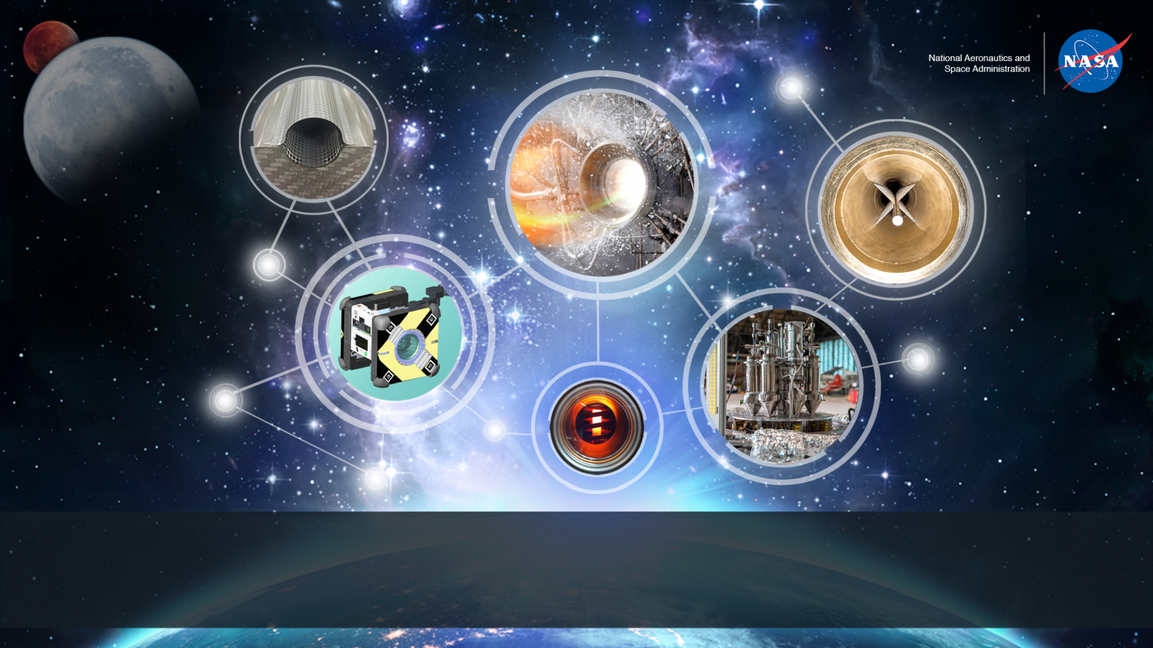
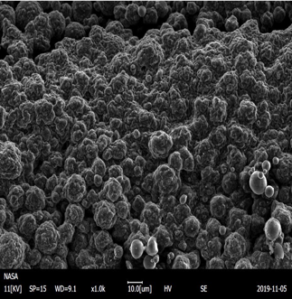
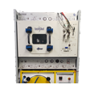
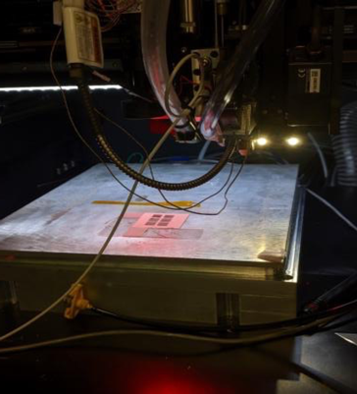
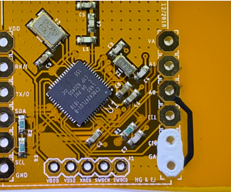
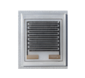
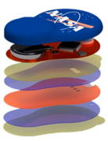
Space Technology Mission Directorate
Game Changing Development Program
Phil Hall | FY20 In-Space Manufacturing Annual Performance Review (APR) | 09.17.20

Slide 2

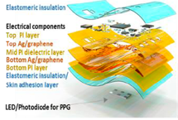
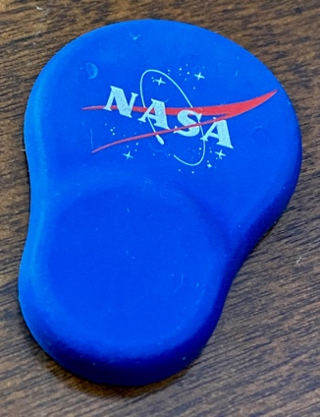
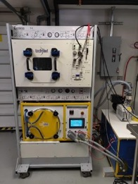
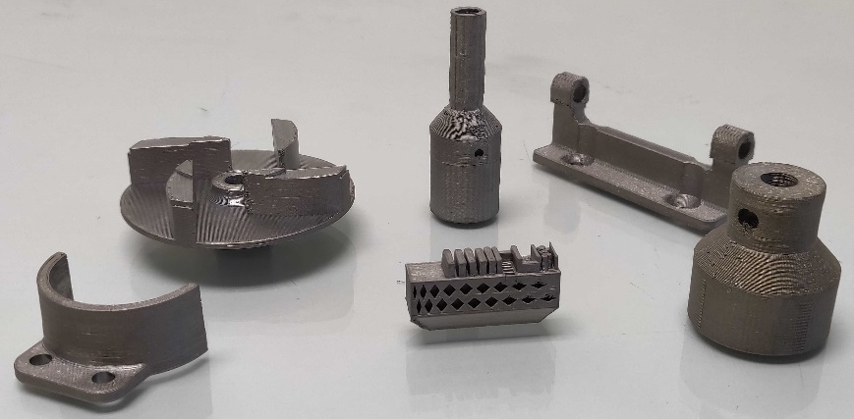
Technology Overview
Technology Product Capability
ISM develops and enables the technologies, materials, and processes required to provide affordable, sustainable on-demand manufacturing, recycling, and repair during Exploration missions.
ISM is key to addressing significant logistics challenges for long-duration missions by reducing mass, providing flexible risk coverage, and enabling new capabilities that are required for Exploration missions and to the Moon and Mars.
Multilayer thin film printed device work with Georgia Tech
AstroSense wireless wearable sensor (cortisol, temp, humidity)
Ti-64 Challenge Build Parts from Techshot FabLab
Techshot Multi-material fabrication laboratory (FabLab)

Slide 3

Mission Infusion and Partnerships
Describe infusion/transition plan
  The operations & logistics approach utilized for ISS is not feasible for long-duration missions.*
    Based on historical data, 95% of spares will never be used
    Impossible to know which spares will be needed
    Unanticipated system issues always appear, even after years of testing and operations
  ISM provides a “pioneering” approach which will help to enable sustainable, affordable Exploration mission operations and logistics.
Exploration & Science Applicability
  An unanticipated failure in low earth orbit can be addressed through a resupply launch or return to earth, but this is impractical for extended missions and may result in a loss of mission or life.
  ISM leverages rapidly-evolving capabilities in industry, academia, and Other Government Agencies, in order to adapt these capabilities for in-space, on-demand manufacturing, repair, and recycling applications on first generation exploration systems.
  ISM is participating in gap assessments (i.e. Gateway Payloads Working Group, STMD, HEOMD) to identify in-space manufacturing needs for extended missions.
* Quantitative Benefit Analysis performed in 2016 for ISM Utilization study. The analysis used data from ISS maintenance and logistics tracking, as well as EMC Deep Space Habitat studies.

Slide 4

On-Demand Manufacturing of Metal (ODMM) Components Goals & Project Objectives
Technology Goals
Goal #1 | Develop and demonstrate the feasibility of a low-gravity, on-demand manufacturing system for metal parts on the International Space Station.
Project Objectives
Objective #1 | Design, build, and demonstrate two on-demand manufacturing approaches in low gravity for metal parts.
Objective #2 | Deliver to ISS a flight-ready, on-demand manufacturing system.
Objective #3 | Demonstrate the manufacture of metal parts in a low-gravity environment on ISS.
Objective #4 | Evaluate parts made on ISS against parts produced on the ground.
Objective #5 | Develop, verify, and validate physics-based models to predict processing parameters and material outcomes under low-gravity conditions for metals.
Pre-Decisional.

Slide 5
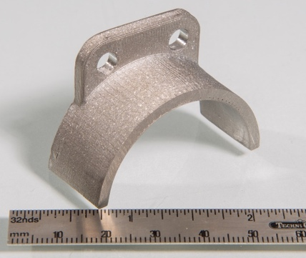
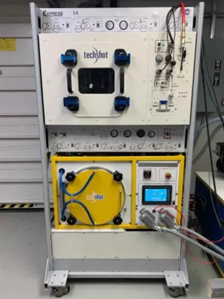
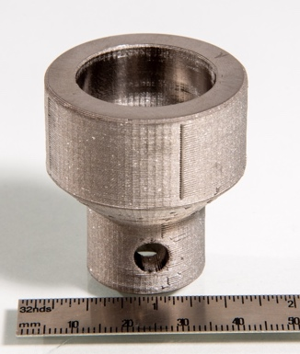
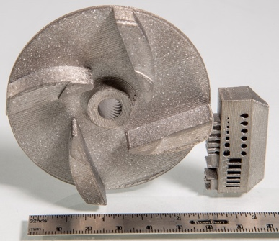
ODMM Project Accomplishments FY20
Techshot Fabrication Laboratory (FabLab):
  24-month activity with Techshot, Inc., for development of a multi-material manufacturing facility for demonstration on ISS; Phase A ended 6/29
  Phase A accomplishments include:
    Construction and testing of prototype system for metal and polymer 3D printing using a Ti-64 feedstock, which includes furnace system for post-processing, end mill for finishing, and laser line profilometer for in-process monitoring of 3D printing process
    Viable filament development work by University of Louisville
    Delivery of materials characterization specimens
    Delivery of five representative parts produced with the system
    Modeling of bound metal deposition process and prediction of part shrinkage during sintering by NASA ARC and UofL
Upcoming development plans:
    ISM project is coordinating with ISS Program Office and GCD stakeholders to continue maturing system to a flight demonstration through a subsequent contract
Techshot FabLab Prototype System in ISS EXPRESS rack-sized enclosure.
Motor Support
Arthroscopy Cannula Housing
Impeller and Manufacturing Test Artifact
Hinge Base
Clutch Adapter

Slide 6
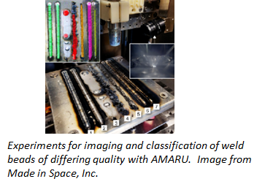
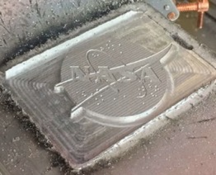
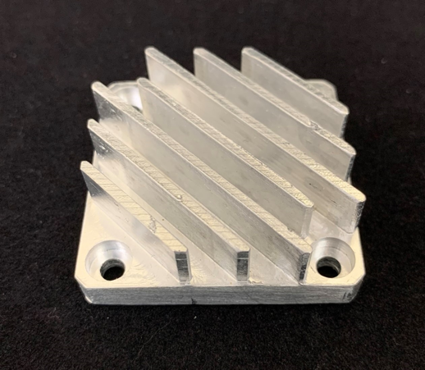
ODMM Project Accomplishments FY20
Vulcan from Made in Space:
  Metal 3D printing system for ISS under development through a phase II-E and phase III Small Business Innovative Research (SBIR)
    System includes multiple heads for metal 3D printing, polymer 3D printing, and subtractive manufacturing
    AMARU in-process monitoring system to evaluate each layer following deposition
  Significant accomplishments in FY20 include:
    Design and successful demonstration of Vulcan subsystems in laboratory
    CDR for engineering development unit
Upcoming development plans:
    Construction of modified EDU with integrated polymer AM, metal AM, and subtractive machining
    Delivery of small set of materials characterization specimens produced with EDU to MSFC for evaluation
Parts produced with Vulcan subsystems; NASA logo (left) and heat sing (right)

Slide 7
On-Demand Manufacturing of Electronic (ODME) Components Goals & Project Objectives
Technology Goals
Goal #1 | Develop technology for on-demand fabrication and assembly of selected electronic devices in microgravity.
Goal #2 | Develop and deliver for flight an ISM multiple-material system that can fabricate selected electronic devices on demand in microgravity.
Goal #3 | Develop functional verification methods for on-demand printed electronic devices.
Goal #4 | Demonstrate the ISM system capable of fabricating and functionally verifying selected electronic devices aboard the ISS.
Project Objectives
Objective #1 | Demonstrate a flight-capable system for thick film deposition of electronic materials.
Objective #2 | Demonstrate a flight-capable system for thin film deposition of electronic materials.
Objective #3 | Integrate “pick & place” technology for placement of integrated circuits and components.
Objective #4 | Demonstrate in-situ post processing of printed components.
Objective #5 | Demonstrate 3D layering of multi-material prints.
Objective #6 | Demonstrate in-situ verification & validation capabilities of printed electronics (inspection to design, rework of misprints, and electrical testing).
Objective #7 | Ground-based and flight demonstration of project objectives.
Pre-Decisional.

Slide 8
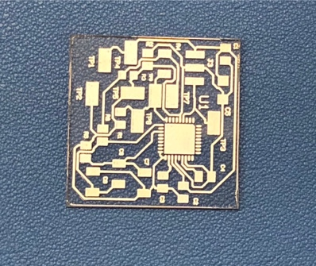
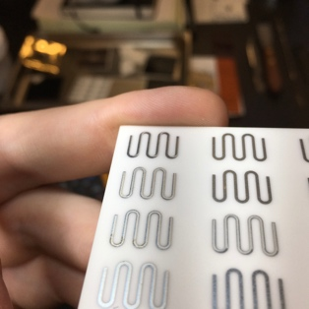

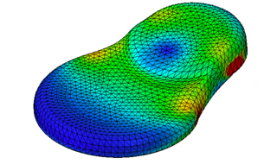
ODME Project Accomplishments FY20
On-demand printed electronics capability development:
  Development of multi-material 3D printing capability on nScrypt
    Added new nMill subtractive capability and laser sintering head; successful demo on both polymer and metals
  Further development on thin film deposition capability with in-situ laser/photonic sintering
    Development of processes for using thin film deposition methods as crucial circuit elements
    Development of in-situ and high intensity light photonic sintering processing for thin and thick film electronic inks including copper. Tested versus thermal curing methods.
    Early collaborative work on developing nanofabrication processes for creating complex thin-film multilayer stacks
AstroSense wearable wireless sensor development (NextFlex project)
  Completion of Phase I effort March 8: evaluation of materials, development of cortisol sensor electrodes and materials, biocompatibility testing of materials
  Parallel development of RFID wireless sensing. JSC REALM developing a direct mount RIFD chip design in late 2020.
  Auburn University NSTGRO Fellow developed models for AstroSense mechanical strain from removal of biosensor.
Laser sintered printed conductors
Thin film print demo – Dimatix print / photonic curing
Nano Fabricated thin film stack work with Georgia Tech
Phase I AstroSense development with NextFlex
AstroSense encapsulant model

Slide 9
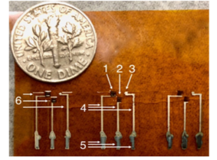
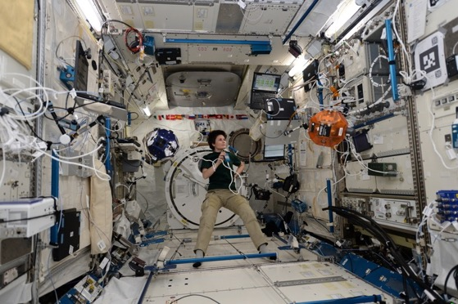
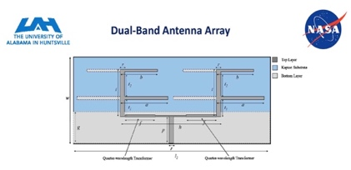
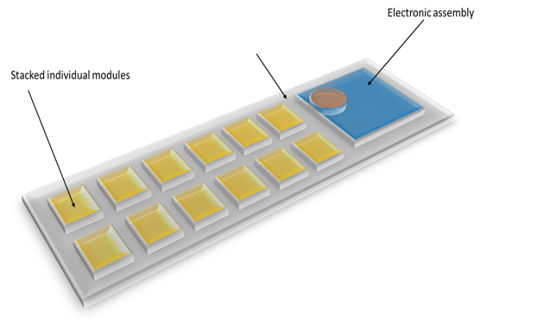
ODME Project Accomplishments FY20
Technology Development - Printed electronics, wireless sensing, & printed power devices
  Development of RFID Wireless Sensing with AES REALM for utilization of ISS network for energy harvesting and communication
  Developed on-demand printed sensors for: temperature, humidity, UV, and CO₂
  Developed on-demand printed cortisol sensor, with parallel cortisol sensing technology at ARC and Caltech (CAN collaboration.)
Technology Development – Power Harvesting
  Developing a printed power dual-band harvesting antenna for RFID and WiFi via a collaboration with UAH. Prototype devices completed before COVID-19 shutdown.
  Developing a printed thermoelectric device for powering wireless RFID sensors and communications via an EPSCoR collaboration with Boise State University. Initial devices show high energy density.
Development of printed sensors: cortisol (biosensor - left), UV, (right)
Power harvesting printed antenna (UAH collaboration)
Utilization of ISS REALM RFID network
Printed thermoelectric device (Boise State collaboration)

Slide 10
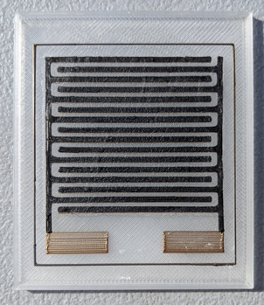
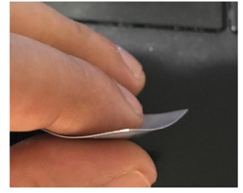
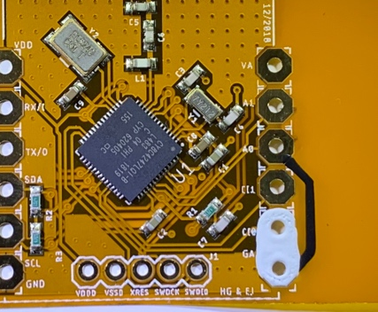
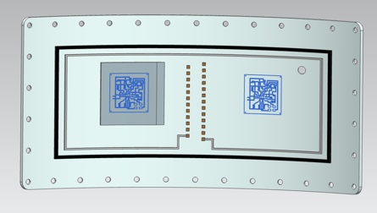
ODME Project Accomplishments FY20
Technology Development – Energy Storage
  Collaboration with Auburn University to develop a flexible, printable energy storage device from Spark Plasma Sintered (SPS) supercapacitor
  Collaboration with Georgia Tech University to develop an optimized printed supercapacitor from carbon nanotubes (CNTs) functionalized with ionic liquids.
  Development of a carbon-carbon printed supercapacitor at ARC. Initial testing is showing very good results and characterization of the devices is continuing.
Technology Development – Sounding Rocket Test Flight
  Planned flight demo in early 2022 of printed electronics and sensors on Sounding Rocket flight
  Kick off meeting with flight team on June 8; collaboration with GSFC, Wallops, LPS
Printed supercapacitor
Flexible Supercapacitor from SPS dielectric (Auburn CAN)
Sounding Rocket Test Flight
Printed electronics & sensors on rocket door

Slide 11
Recycle and Reuse (RnR) Goals & Project Objectives
Technology Goals
Goal #1 | Develop in-process monitoring technology to ensure recycled polymer filament production quality.
Goal #2 | Develop and assess launch packaging materials for recyclability.
Goal #3 | Demonstrate and evaluate the recycling of launch packaging materials on-orbit.
Project Objectives
Objective #1 | Evaluate the Refabricator unit to determine the likely root cause of the inability produce recycled material.
Objective #2 | Develop an in-process monitoring system to measure filament diameter and characterize local variations in diameter.
Objective #3 | Develop an in-process monitoring system to measure the flexural modulus of the filament.
Objective #4 | Demonstrate active control of the filament production process with a ground-based prototype system using diameter and modulus measurements as input.
Objective #5 | Evaluate the recyclability of existing launch packaging materials by assessing the effects of thermal, chemical, and mechanical degradation with repeated cycling.
Objective #6 | Develop and assess materials designed to be recycled and reused on space missions.
Objective #7 | Optimize processing parameters for recycling within the ground unit.
Objective #8 | Develop a physics-based model to modify the optimal ground processing parameters for demonstration in microgravity.
Pre-Decisional.

Slide 12
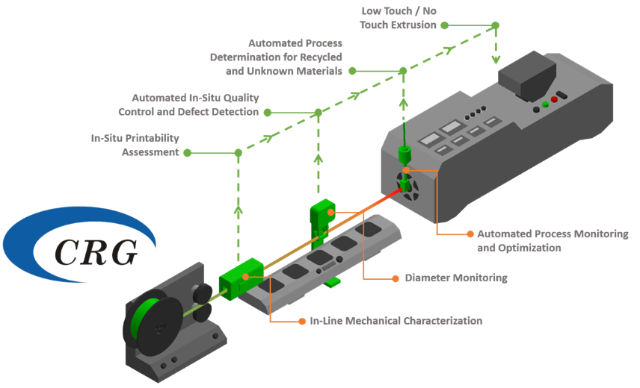

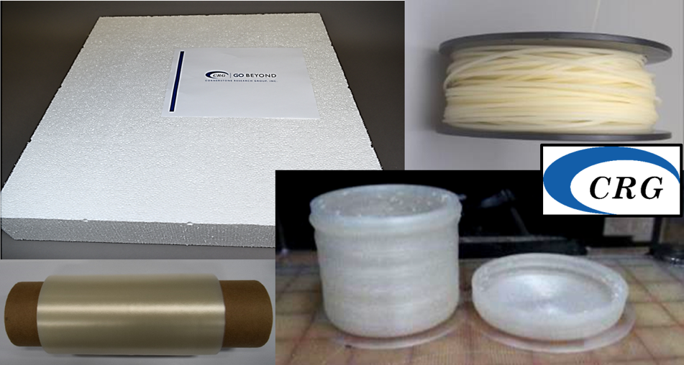
RnR Project Accomplishments FY20
In-Process Monitoring of Feedstock Production (Cornerstone Research Group (CRG)):
Completed quarter 3 of a two-year effort to develop an in-process monitoring system for polymer filament production. Initial studies comparing the in-line flexural modulus sensor to traditional techniques have begun.
Preliminary Recyclability Assessment of Existing ISS Packaging Materials:
An internal NASA team was established in May 2020 to assess existing ISS packaging materials for their potential to be recycled. A draft of preliminary findings was completed on 7/01/20 and will inform the project on which materials should be the focus of subsequent efforts.
Overview of in-process monitoring of filament feedstock production (courtesy of CRG)
RVT film, foam, and filament material designed for recyclability (courtesy of CRG)

Slide 13
RnR Project Accomplishments FY20
Faculty Fellow Partnership:
A faculty fellow from Louisiana State University completed a study of terrestrial recycling technologies and their application to sustainable space ecosystems on August 12, 2020. The study provided a framework for establishing the efficiency of a recycling process and a system for determining the average crew time needed for individual recycling operations.
Yet2 Sterilization Technology Search:
Initiated a technology search through the NASA at Work program with Yet2 to identify sterilization technologies that can be adapted for use aboard ISS and are compatible with common thermoplastics and aerospace grade alloys. These technologies are needed to enable the manufacturing of medical and food grade components.
Refabricator ISS Technology Demonstration:
Successfully demonstrated printing of a dog bone specimen in February of 2020 and bonding of filament segments in August of 2020. The team is pursuing additional bonding demonstrations prior to the unit’s planned down-massing near the end of the calendar year.
Typical steps in the recycling process considered during the faculty fellow’s study

Slide 14
ISM Risk Status September 2020
Likelihood
5
4
3
01
03
2
02
Risk ID | LxC | Trend | Risk Title | Approach
01 | 2 x 4 |  | ISS Availability | Closed - OBE
02 | 2 x 4 |  | Printed Electronics Resource Availability | Watch
03 | 3 x 4 |  | Printed Electronics ISS Demonstration | Mitigate
1
1
2
3
4
5
Consequence
Legend
 | Decreasing LxC
 | Increasing LxC
 | Unchanged LxC
 | New Since Last Period

Slide 15

ISM Assessment Summary
Technology | Performance |  |  |  | Comments – COVID-19 Impacts causing Schedule to go Yellow
 | C | S | T | P
GCD On-Demand Manufacturing of Metal (ODMM) Components |  |  |  |  | TECHNICAL: Yellow At the conclusion of the phase A activity which resulted in a ground-based prototype system, the Techshot FabLab is not within power constraints for the ISS EXPRESS rack it would interface with on-orbit. The primary technical challenge is the sintering furnace, which was designed to sinter a part with a maximum volume of 6”x6”x6.” The company reported on potential strategies to reduce furnace power requirements in a subsequent contract in their final phase A report. A feasibility assessment of the Techshot system, which occupies an EXPRESS rack, is in process by the ISS Research Office. The results of this assessment will inform the path forward, selection of a contract mechanism, and definition of subsequent tasking. Project is also tracking safety approaches for Vulcan chip capture and power management strategies; documentation in preparation for a phase 0 safety TIM will be a contract deliverable in 2nd quarter FY21.
GCD On-Demand Manufacturing of Electronics (ODME) |  |  |  |  | Technical : Yellow TECHNICAL Yellow is due to AstroSense Beta delays due to new contract issues. The Phase II contract with NextFlex for AstroSense Beta design and fabrication is delayed due to NASA procurement and legal direction for a different contract mechanism. Procurement currently estimates that the new Phase II contract will be in place by January 2021, so planned work on the project is expected to resume on February 1, 2021. All project milestones are being revised to reflect these new dates.
Recycle and Reuse (RnR) |  |  |  |  | SCHEDULE: Yellow A successful printing demonstration of an ULTEM 9085 tensile specimen occurred on 1/27/20. On 2/04/20, Refabricator attempted to print a second tensile specimen, but the team canceled the print after the tensile specimen fill showed a position offset, relative to the outline, in the y-axis. Further printing was not attempted since it would require crew to open the print chamber (to reset the stage) and there is a possibility of FOD in the chamber. ReFabricator performed a successful bonding demonstration on 8/6/2020. This test of the die bonder resulted in 3 bonded filament segments, which will undergo single filament tensile testing following downmass. The TUI team is pursuing a cartridge swap, after which another 3 bonded filament segments can be produced. Refabricator is scheduled for return on SpaceX-21 in September of 2020.

Slide 16
EPO Update*
 | ISM Conferences, Publications, Education and Public Outreach
4/07/20​ | Tracie Prater participated as a virtual keynote speaker at the Southern Appalachian Science and Engineering Fair​
4/18/20 | Publication on wireless antenna for composite sensor, “Characterization of Dielectric Properties of Non-Magnetic Materials Using Superstrate-Loaded Antennas,” Saininad Naik, Maria Pour, and Curtis Hill, IEEE Electronics Journal, April 2020
4/21 – 4/23/20​ | Tracie Prater participated in a video conference for high schoolers as part of the NASA X-Hab program
4/24/20 | Tracie Prater was interviewed for NASA TechBriefs “Here’s an Idea” podcast
4/28/20 | Curtis Hill was a featured panelist in a webinar for “3D Manufacture Electronics Now”, sponsored by nScrypt and the Department of Defense (DoD).
4/20 | Publication in Applied Energy Materials Journal April 2020, “All-Printed In-plane Supercapacitors by Sequential Additive Manufacturing Process," Seol, Myeong-Lok; Nam, Inho; Ribeiro, Erick; Segel, Becca; Lee, Dongil ; Palma, Tyler; Wu, Honglu; Mukherjee, Dibyendu; Khomami, Bamin; Hill, Curtis; Han, Jin-Woo; Meyyappan, Meyya.
6/3/20​ | NASA ARC physics-based modeling group co-authored an article published in the Journal of Polymer Science. The article was titled “Welding dynamics in an atomistic model of an amorphous polymer blend with polymer-polymer interface.”​
6/12/20 | Tracie Prater was a featured panelist at the Tennessee Governors School for STEM
6/22-25/20 | Curtis Hill presented at the NSMMS conference. The title of the presentation was “Metal Fused Filament Fabrication of Titanium Alloy for In-Space Manufacturing”. A virtual edition was released in August of 2020.
6/29/20 | Susan Martinez was a featured panelist on NASA STEM Stars
7/28/20​ | Tracie Prater and Jennifer Edmunson attended the Annual ISS National Lab Manufacturing In Space workshop
7/29-30/20​ | Tracie Prater attended the Lunar Surface Science Workshop.​
7/30/20​ | Tracie Prater presented to Rogers Scholars and Rogers Explorers camps in Kentucky virtually during a 1-hour career exploration Q&A session.​
8/14/20 | Tracie Prater was interviewed for the “Flash Forward” podcast
*Reflects E/PO since MYR

Slide 17
Summary
and demonstrated.
ISM core development areas focus on three key capabilities for first generation exploration systems:
  ISM On-Demand Metal Manufacturing (ODMM) and with the capability to manufacture multi-material components, including metals and polymers.
  On-Demand Manufacturing of Printed Electronics (ODME) has the critical function of building crew and structural monitoring systems and sensors in orbit.
  Recycle and Reuse (RnR) Polymer Facility capable of fabrication, recycling, and sterilization of plastic materials, including food-grade and medical-grade parts.
In-Space Manufacturing is focused on a critical need for long-duration human space exploration and has made considerable progress against that need:
  FY20-24 is focusing on getting these capabilities developed and demonstrated in time to support the first Exploration missions.
  The ISM Team is participating in many gap assessments to insure in-space manufacturing needs for extended missions and Moon/Mars habitat are met.
In order to develop application-based capabilities for Exploration, ISM heavily leverages the significant and rapidly-evolving terrestrial technologies for on-demand manufacturing.
  Requires innovative, agile collaboration with industry and academia.
  Focuses NASA-unique Investments primarily on developing the skillsets and processes required and adapting the technologies to the microgravity environment & operations.
17

Slide 18
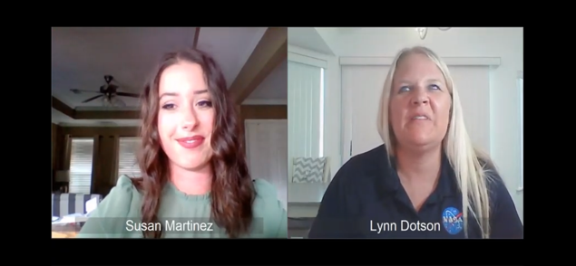
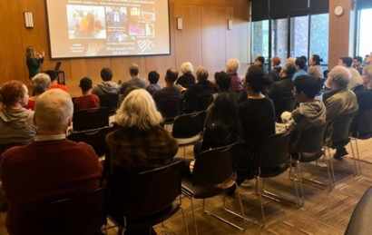
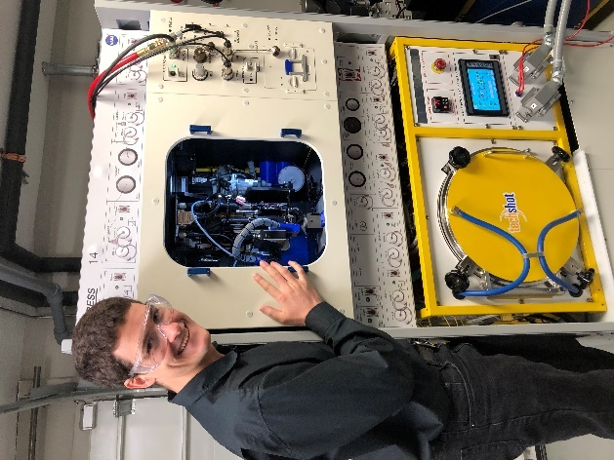
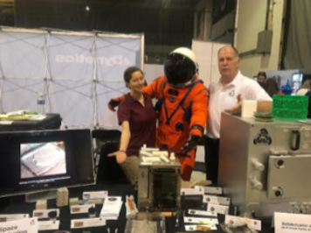
In-Space Manufacturing Scrapbook
Susan Martinez at NASA STEM STARS
Tracie Prater presenting at “Space Talks” at the Brentwood Public Library
Dr. Paul Deffenbaugh, nScrypt, posing with the FabLab EXPRESS rack
ISM team members touring Techshot facilities for FabLab technology demonstration
ISM team members Robert Gower and Jennifer Gelmis at ISM booth during Artemis Day

Slide 19

BACKUP

Slide 20
Risk Charts
Risk 01: ISS Availability | 2 x 4
Risk Statement: Given that the ISS has limited science racks, power allocation, and crew availability; there is a possibility that it may be difficult to schedule demonstrations of in-space manufacturing technologies to satisfy project deliverables and milestones. Recent experiences with the difficulty in obtaining command time and priority in down massing the Refabricator from ISS indicate project milestones and deliverables could be delayed or impacted if ISM project tasks are not prioritized for critical space station resources and launch/return opportunities. | Risk Type: Performance and Schedule Assigned to: Strategy: Mitigate then Watch
Action | Due Date | Mitigation Actions | L x C
- | May 2020 | Date Submitted | 3 x 4
1 | May 2020 | Develop list of ISM planned ISS demonstrations | 3 x 4
2 | June 2020 | Feasibility assessment performed by ISS Research Office (RO) on Techshot FabLab | 3 x 4
3 | July 2020 | Justification package requested by and delivered to ISS RO on ISS resources (volume, power, etc.) for Techshot FabLab | 2 x 4
4 | August 2020 | ISS RO recommends to ISS Program the inclusion of Techshot FabLab on Integrated Payloads List | 1 x 4
5 | August 2020 | ISM has determined that this risk is beyond project control and coordination with ISS RO is part of normal work. | Closed - OBE
Likelihood
1 2 3 4 5
1 2 3 4 5
Consequence
20

Slide 21
Risk Charts
Risk 02: Printed Electronics Resource Availability | 2 x 4
Risk Statement: Given that the On Demand Printed Electronics Project is heavily dependent on EM and ES in house technology development, there is a possibility that critical key personnel could be unavailable. ES has expressed interest in building up an in house printed electronics capability as the opportunities for this technology area increase. Project allocation has been provided to the department to hire additional civil servant engineering support but not yet executed. Additional technician support has been provided through the support contractor. EM has limited resources available to support the project lead. | Risk Type: Technical, Schedule and Performance Assigned to: Strategy: Watch
Likelihood
1 2 3 4 5
Steps | Watch Plans
1 | Define tasks and resources needed to achieve
2 | Communicate with management resource needs
1 2 3 4 5
Consequence
21

Slide 22
Risk Charts
Risk 03: Printed Electronics ISS Demonstration | 3 x 4
Risk Statement: Given that the objective of ISM is to develop manufacturing capabilities for metals, polymers and printed electronics, there is a need for the design, development and integration of the printed electronic subsystems into an EXPRESS rack for flight to ISS. The printed electronics task involves in house development of materials and processes for printing electronics. However, we do not have the resources for a contractor to design and integrate the required sub systems into an EXPRESS rack and satisfy the requirements for an ISS flight demonstration. | Risk Type: Technical, Schedule, Cost, Performance Assigned to: Strategy: Mitigate
Likelihood
Action | Due Date | Mitigation Actions | L x C
- | May 2020 | Date Submitted | 3 x 4
1 | Jun 2021 | Determine print head requirements and compatibility with existing ISM print systems. | 3 x 4
2 | Dec 2021 | Submit RFI to potential vendors for incorporation of electronics print head into ISS system | 2 x 4
3 | Mar 2022 | Acquire resources as necessary, obtain stakeholder buy in | 1 x 4
4 | Sep 2022 | Develop system for demonstration of printed electronics on ISS | Eliminate (Retire)
1 2 3 4 5
1 2 3 4 5
Consequence
22

Slide 23
GCD Project Performance Evaluation Criteria
 | Technical/Performance
Green | Project is demonstrably making progress on the Learning Trajectory (e.g. milestones met, knowledge advanced) or advancing TRL. Project is on track to meet L1 requirements.
Yellow | Project is making progress on the Learning Trajectory or advancing TRL with issues. Project is on track to meet L1 requirements but issues exist that may threaten achievement.
Red | Project has ceased to make progress on the Learning Trajectory or advance TRL. Project is unable to meet one or more L1 requirements.
 | Cost
Green | Project can meet its commitments with its planned/allocated budget.
Yellow | Project cannot meet its commitments within its planned/allocated budget but will not be requesting additional budget from Program. Mitigation plans have been developed.
Red | Project cannot meet its commitments within its planned/allocated budget and will be requesting additional budget from Program.
 | Schedule
Green | Project can meet its commitments within its planned/allocated schedule baseline for critical milestones.
Yellow | Project cannot meet its commitments within its planned/allocated schedule baseline but mitigation plans have been developed to pull it back in.
Red | Project cannot meet its commitments within its planned/allocated schedule baseline.
 | Programmatic (Institutional, Internal/External Dependencies **)
Green | Relevance of technology to stakeholders and/or technology infusion path is maintained. Mission sponsor still actively interested. No issues exist with workforce, test facilities, etc.
Yellow | Relevance of technology to stakeholders and/or technology infusion path are threatened. Mission sponsor backing off. Issues exist with workforce, test facilities, etc. but plans to mitigate are available.
Red | Relevance of technology to stakeholders and/or technology infusion path are not projected to be met, or has lost relevance to stakeholders. Mission sponsor cancelled interest. Issues pertaining to workforce, test facilities, etc. are preventing progress along the Learning Trajectory.
Source: BPR Assessment Criteria for NASA R&T Projects, OCE/S. Hirshorn, 09/17/2015

