Slide 1
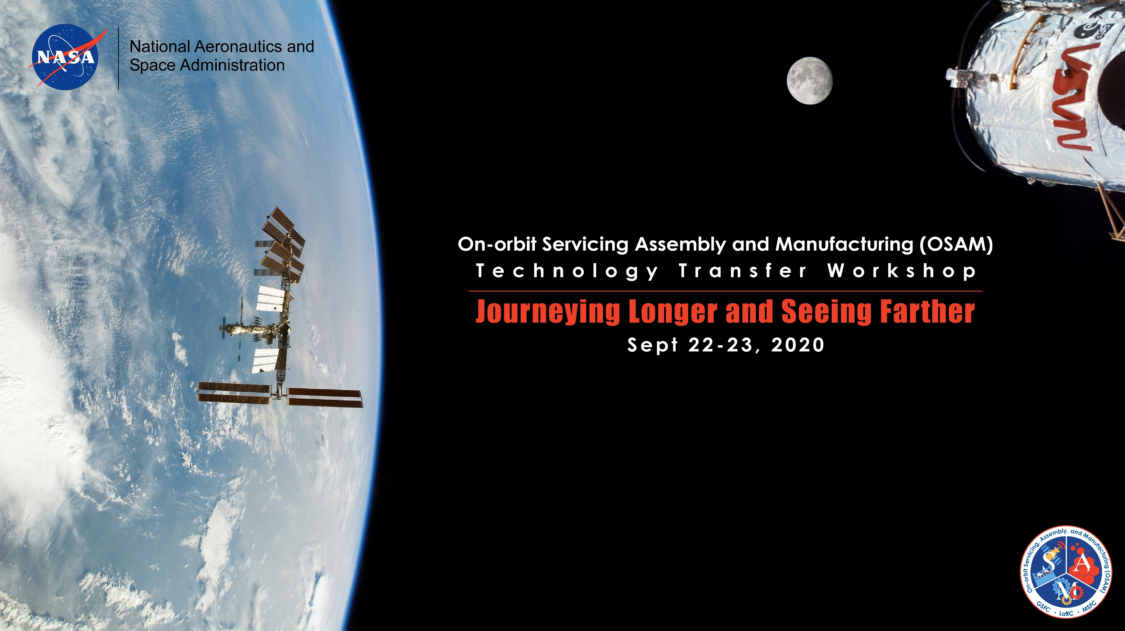
Architectures and Modular Concepts
Dale Arney
This document is approved for public release.

Slide 2
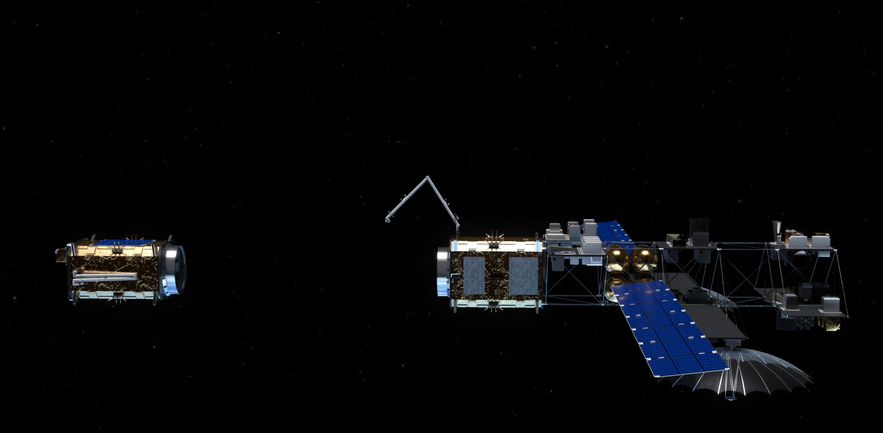
OSAM Enables Persistence in Space
Pay As You Go
Upgrade and Repair
Shared Robotics & Infrastructure
Reduced Barrier of Entry
Reduced Time to Orbit
Resilient and Adaptable
OSAM enables a new paradigm in science, technology demonstration, and operations.
Notes:
Image Source: NASA/Advanced Concepts Lab

Slide 3
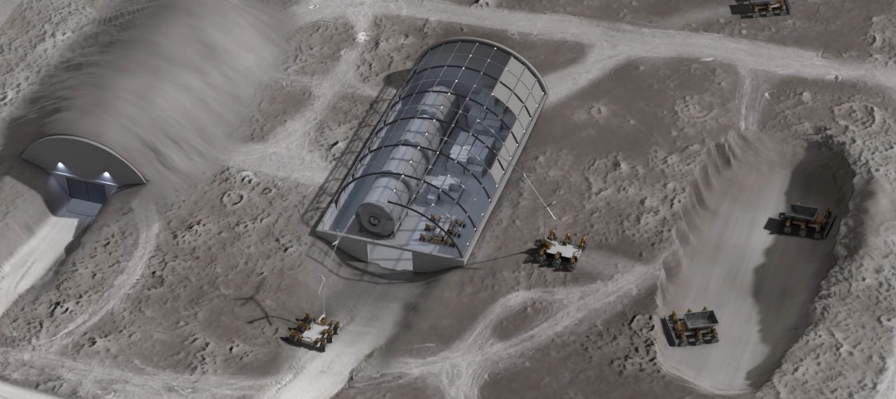
OSAM is the Foundation for Sustainable Exploration
Infrastructure (Comm, Nav, Power, etc.)
Autonomous robotics
Refueling
Maintenance & Inspection
Upgrade and Repair
Landing site preparation
Payload Offloading & Manipulation
OSAM enables reusable, multi-purpose, reconfigurable systems and enables Earth independent spares and logistics.
Notes:
Image Source: NASA/Advanced Concepts Lab

Slide 4

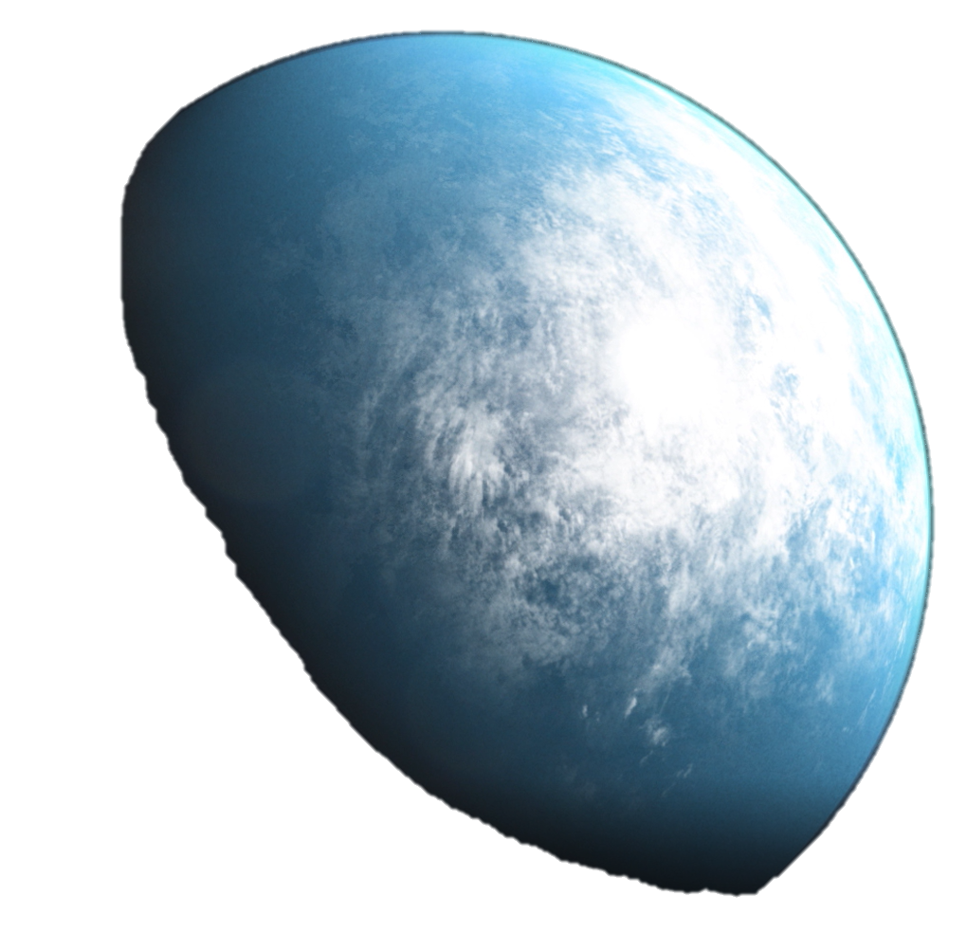
OSAM Enables New Scientific Discoveries
Modular Design
Relaxed Mass and Volume Constraints
Launch Failure ≠ Mission Failure
Upgrade, Repair, and Servicing
Utilize Multiple Medium Launch Vehicles
Maintenance and Inspection
In-Space Verification and Validation
OSAM capabilities enable new missions previously considered impossible.
Notes:
Image Source: NASA/Advanced Concepts Lab

Slide 5
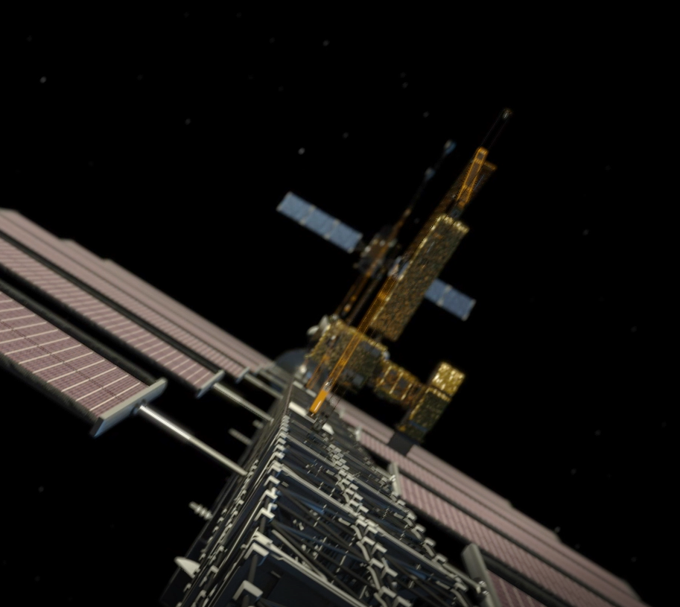
Modular Technologies Enabling OSAM
Materials & Structures
Recyclable Feedstock
Z-Shielding
MMOD Impact Detection
Joining Technologies
Erectable Joint w/ Square Cross-Section
MAJIC Composite Joints
Electron Beam Welding
Modular Assembly
TriTruss
Deployable Composite Booms (DCB)
NINJAR & SAMURAI
Manipulators
LSMS
TALISMAN
ASSEMBLERS
OSAM catalog highlights several assembly technologies that enable new concepts.
Notes:
Image Source: NASA/Advanced Concepts Lab

Slide 6
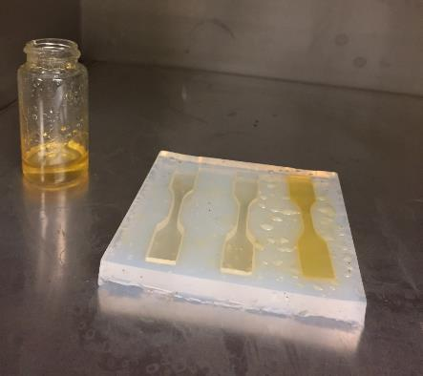
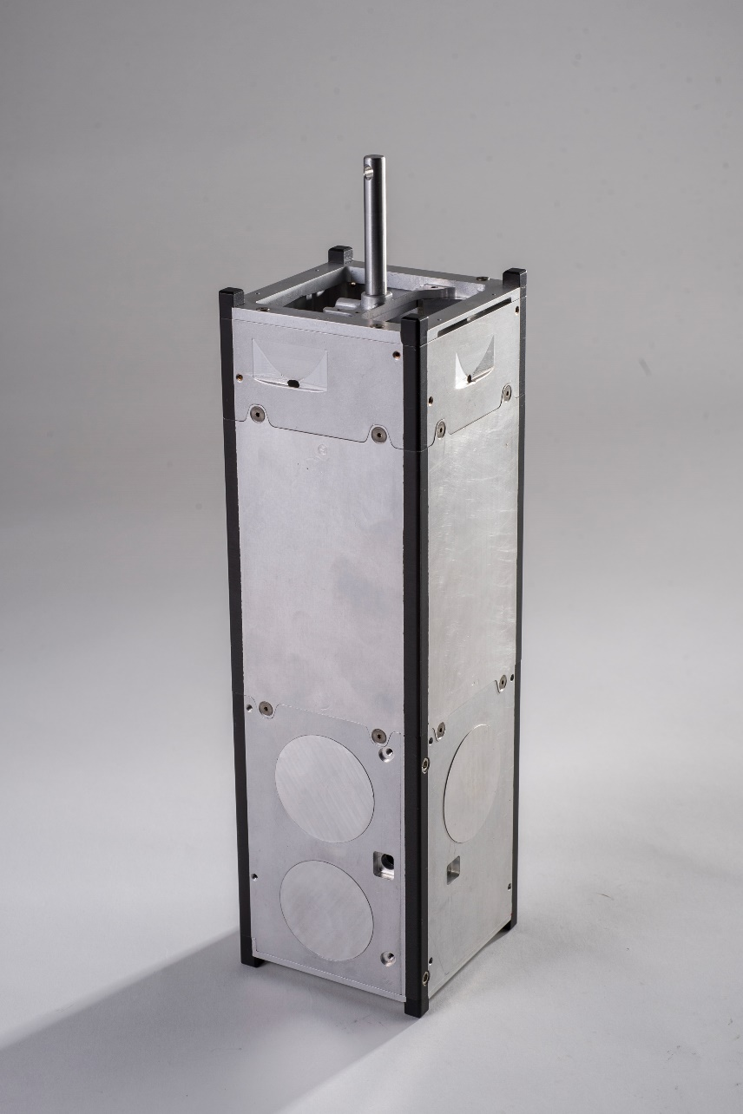
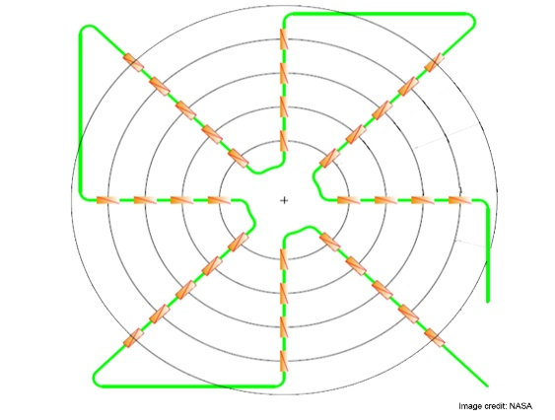
Modular Technologies Enabling OSAM
Materials & Structures
Recyclable Feedstock
Z-Shielding
MMOD Impact Detection
Joining Technologies
Erectable Joint w/ Square Cross-Section
MAJIC Composite Joints
Electron Beam Welding
LaRC Shields-1 CubeSat Structure
LaRC
Z-Shielding Vault
Recyclable Feedstock
Modular Assembly
TriTruss
Deployable Composite Booms (DCB)
NINJAR & SAMURAI
Manipulators
LSMS
TALISMAN
ASSEMBLERS
MMOD Impact Detection
LaRC Z-Shielding Test Samples
OSAM catalog highlights several assembly technologies that enable new concepts.
Notes:
Image Source: NASA/Advanced Concepts Lab

Slide 7
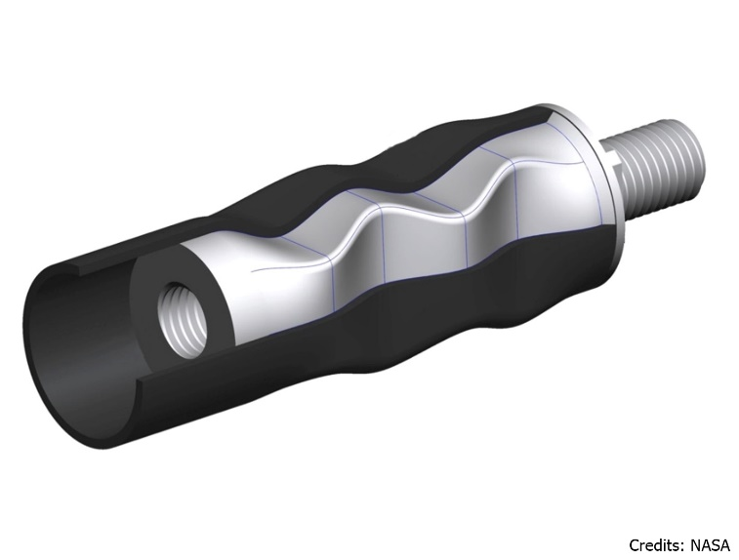
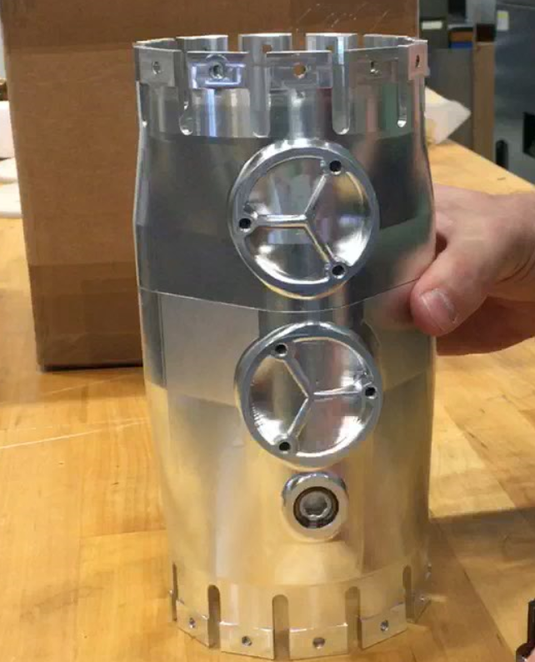
Modular Technologies Enabling OSAM
Materials & Structures
Recyclable Feedstock
Z-Shielding
MMOD Impact Detection
Joining Technologies
Erectable Joint w/ Square Cross-Section
MAJIC Composite Joints
Electron Beam Welding
MAJIC
Erectable Joint
Modular Assembly
TriTruss
Deployable Composite Booms (DCB)
NINJAR & SAMURAI
Manipulators
LSMS
TALISMAN
ASSEMBLERS
E-Beam Welding
OSAM catalog highlights several assembly technologies that enable new concepts.
Notes:
Image Source: NASA/Advanced Concepts Lab

Slide 8
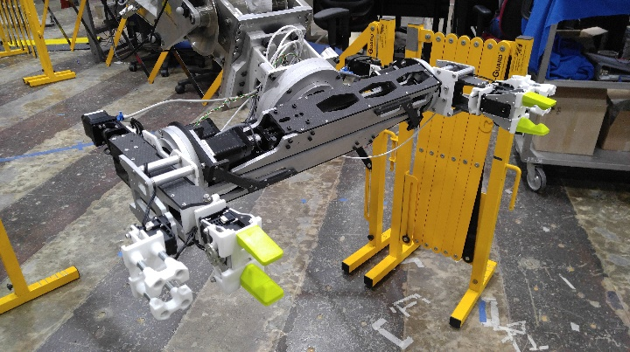
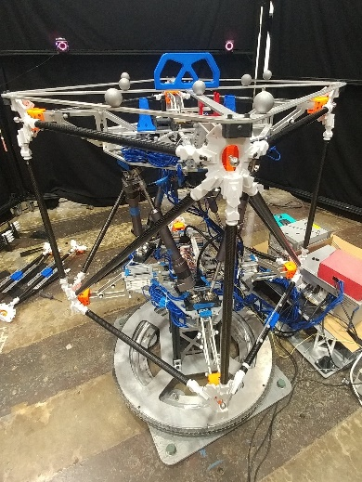
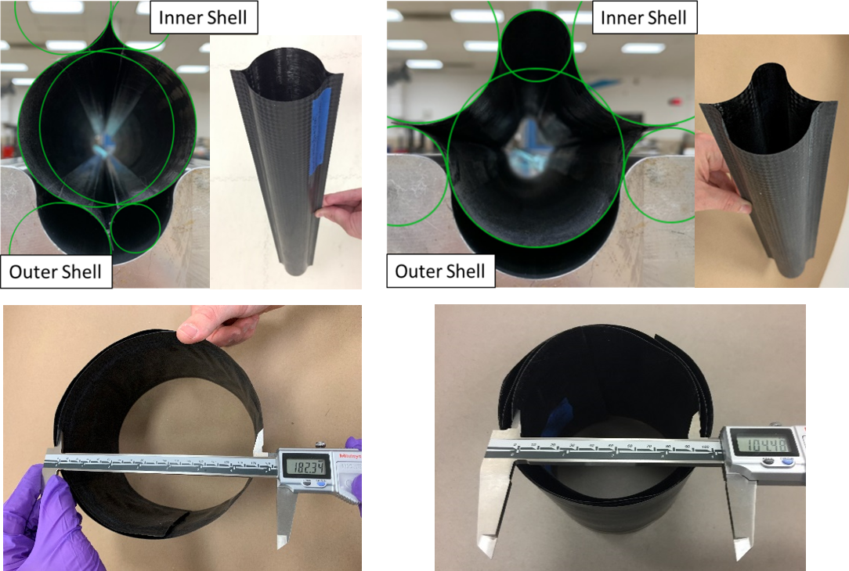
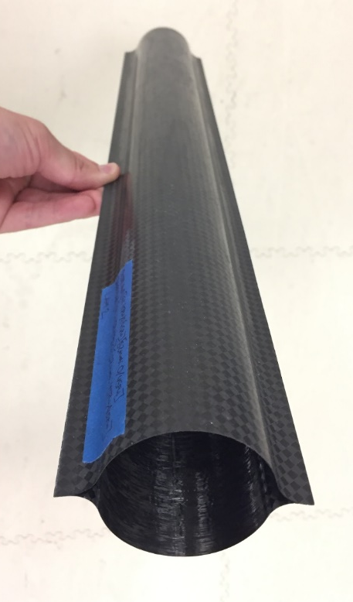
Modular Technologies Enabling OSAM
Materials & Structures
Recyclable Feedstock
Z-Shielding
MMOD Impact Detection
Joining Technologies
Erectable Joint w/ Square Cross-Section
MAJIC Composite Joints
Electron Beam Welding
SAMURAI
Modular Assembly
TriTruss
Deployable Composite Booms (DCB)
NINJAR & SAMURAI
Manipulators
LSMS
TALISMAN
ASSEMBLERS
NINJAR
DCB
OSAM catalog highlights several assembly technologies that enable new concepts.
Notes:
Image Source: NASA/Advanced Concepts Lab

Slide 9
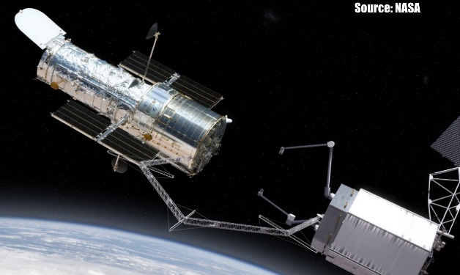
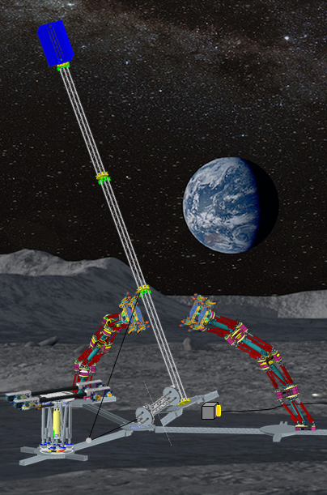
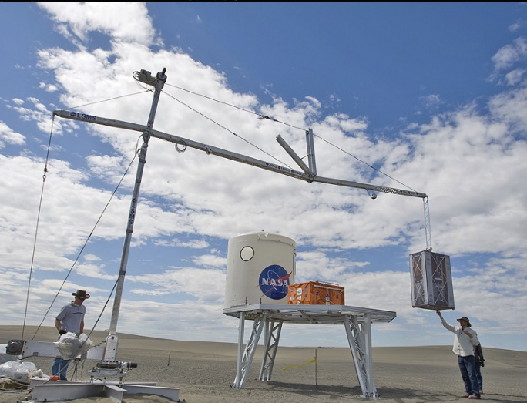
Modular Technologies Enabling OSAM
Materials & Structures
Recyclable Feedstock
Z-Shielding
MMOD Impact Detection
TALISMAN
Joining Technologies
Erectable Joint w/ Square Cross-Section
MAJIC Composite Joints
Electron Beam Welding
Modular Assembly
TriTruss
Deployable Composite Booms (DCB)
NINJAR & SAMURAI
Manipulators
LSMS
TALISMAN
ASSEMBLERS
ASSEMBLERS
OSAM catalog highlights several assembly technologies that enable new concepts.
LSMS
Notes:
Image Source: NASA/Advanced Concepts Lab

