Slide 1
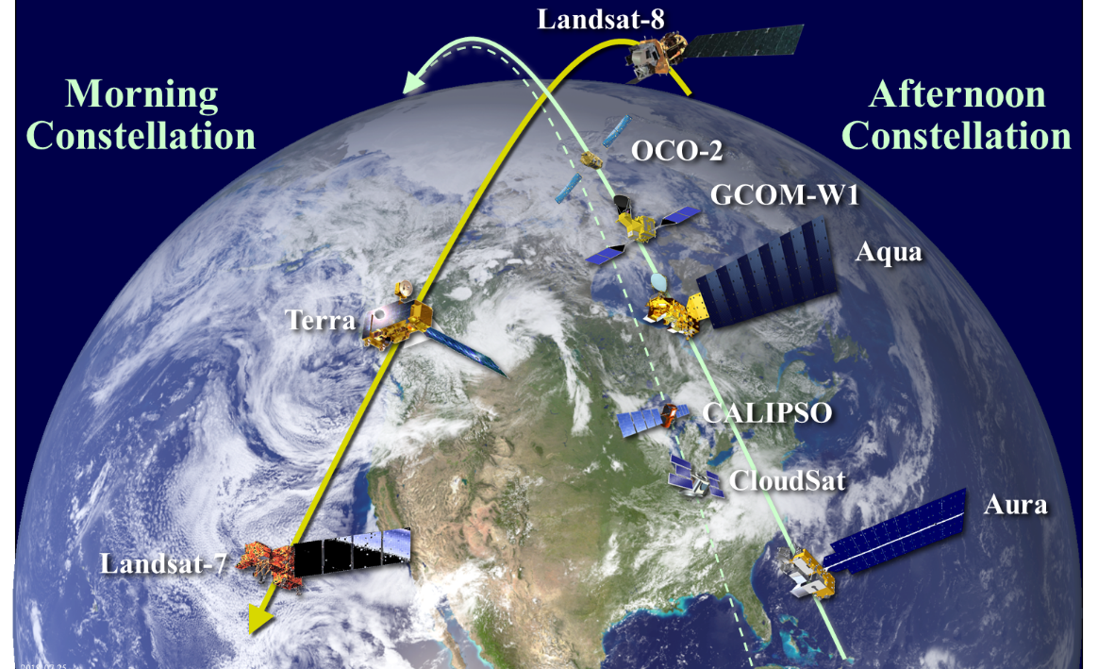
INTRODUCTION
INTRODUCTION
Michael J. Machado
Constellation Mission Operations Manager
Mission Validation and Operations Branch – Code 584
Earth Science Mission Operations (ESMO) Project – Code 428
NASA/Goddard Space Flight Center

Slide 2
Welcome
Welcome to all the members of the Mission Operations Working Group (MOWG) of the International Earth Observing Morning and Afternoon Constellations (A-Train & C-Train)!
Special thanks to Cindy Leaper, Nancy Herndon, Bill Guit and Warren Case for helping with a Virtual MOWG meeting.
Thanks to everyone who is supporting at unusual hours due to being in a different time zone
Welcome to our guests and first time attendees.
THANK YOU as always for your support especially during this challenging time of pandemic and social unrest!
Notes:
Claire Parkinson (Aqua Project Scientist) is here to show Satellite Observations of Climate Change. This year Aqua marked a 15-year anniversary!
Some changes since last meeting (New faces or people returning):
Cheryl Yuhas is retiring; Greg Dell currently assigned as Program Executive
PJ Guske moved on: Mark Garcia new OCO-2 Project Manager
CALIPSO: Denis Perriot moved to a new position; Claude Audouy now head of the Application Mission Operation division; Franck Darnon took over as CALIPSO Mission Operations Manager
Landsat 9 attendees:
Don Dichmann here to observe and learn for LandSat 9 ascent planning
Del Jenstrom & Steve Pszcolka here to present Landsat 9
Flight Dynamics: Shane Stezelberger and Thomas Noyes
CARA: Dave Adams (Goddard Space Asset Protection Lead)
ESA: Kate Symonds
SNPP/S5P: Jose Davis & Bryan Mattfeld

Slide 3
Recent Challenges
COVID-19 (Coronavirus Disease 2019)
  Forced teams to work remotely since mid-March
  Some work has been delayed
  Excellent communication among teams resulted in successful execution of the Spring IAM series
Social Unrest
  Be mindful that some colleagues have faced additional challenges
Anomalies
  Aqua anomaly; Delays to Fall IAM series
  CloudSat anomaly; Began drifting toward CALIPSO
MOWG is family, we are here to support!

Slide 4
Earth Science Mission Operations (ESMO)
Conjunction Assessment Risk Analysis (CARA)
Manager: Lauri Newman
Deputy: Alinda Mashiku
Project Scientists
Earth Observing System (EOS) Senior Project Scientist & A-Train Project Scientist: Steven Platnick
Aqua: Claire Parkinson
Deputy - Lazaros Oreopoulos
Aura: Bryan Duncan
Deputy - Joanna Joiner
Terra: Kurt Thome
Deputy - Si-Chee Tsay
Deputy – Robert Wolfe
Project Manager
Wynn Watson
Deputy Project Manager – Operations
Jamie Pawloski
Deputy Project Manager – Technical
Eric Moyer
Deputy Project Manager – Resources
Tracy Parlate
Project Admin
Selene Annadale
Diane Trakas
Mission Directors / Managers
Aqua: Bill Guit
Aura: Dominic Fisher
Terra: Dimitrios Mantziaras
GPM: Jamie Pawloski
ICESat-2: James Jaranyi &
Megan Gorham
GEDI/TSIS-1: Julie Owens
Flight Dynamics
EOS Operations & Analysis Manager: Tiffany Hoerbelt
EOS Deputy: Yasir Tufail
Software Development: Nancy Smith
Earth Science Constellation Manager
Mike Machado
Constellation Support
Warren Case
Nancy Herndon
Notes:
Ask all teams for org charts

Slide 5
MOWG Charter
The Constellation mission teams
enable nearly simultaneous
science observations by
coordinating their operations and
cooperating with each other to
ensure the safety of the constellations.

Slide 6
Constellation History
A-Train Mission Operations Working Group (MOWG): Exploratory discussions between LaRC (John Stadler) and GSFC (Angie Kelly, Bill Guit and Lauri Newman) in 2002. Officially met for the first time in March 2003
Morning Constellation: Officially began with Landsat-7 (April 1999) and Terra (December 1999), followed by joint EO-1/SAC-C launch (November 2000) and Landsat-8 (February 2013), Landsat-9 (Planned)
Afternoon Constellation (A-Train): Began with the Aqua (May 2002) and Aura (July 2004), then PARASOL (December 2004), and joint CALIPSO/CloudSat launch (April 2006)
Later ESC missions followed:
  OCO (2010) and Glory (2011) launches failed
  GCOM-W1 (May 2012)
  Landsat 8 (February 2013)
  OCO-2 (July 2014)
Formation of the C-Train:
  CloudSat exited A-Train on February 22, 2018
  CALIPSO exited A-Train in mid-September 2018
  C-Train operational orbit configuration achieved on November 1, 2018
Recent Major Anniversaries:
  Last year, OCO-2 celebrated a 5-year anniversary while Aura celebrated 15-years on orbit and Landsat-7 and Terra both enjoyed 20-year milestone anniversaries!
Notes:
As missions get older and use up fuel we need to help determine how the A-Train evolves; afternoon presentations will help show what is possible
TanSat launched above us and could join the A-Train
Landsat 7 investigates refueling and hope to overlap with Landsat 9

Slide 7
Significant Meeting Topics
COVID-19: How has it affected operations and what science opportunities have come as a result - Aura science highlights
NASA Headquarters Perspective, including Senior Review
Current state of the missions
  Review A-Train’s Fall 2020 inclination adjust maneuvers (IAMs) and plans for Spring 2021
  Aqua anomaly update and constellation exit plans
  Landsat 7 update / Working Group to analyze 2021 crossings
  C-Train status / CloudSat negative relative acceleration
  Operations Coordination Plan update
Constellation Updates
  Landsat 9 development status, I&T, ascent briefing updates, and preparations for launch
  Mega-Constellation Status Updates (CARA) plus presentation from OneWeb team
  NOAA/JPSS Constellation Updates
Conjunction Assessment (CA) Topics
  CARA updates / Changes to Probability of Collision and Brute Force Monte Carlo
  Space Force overview
  Conjunction Assessment and Risk Mitigation Automation (CARMA) update

Slide 8
State of the Constellations
Morning Constellation
  Landsat 7, Landsat 8 and Terra are performing nominally.
  SAC-C stopped operations in August 2013
  EO-1 was decommissioned and passivated on March 30, 2017
  Landsat 9 progressing toward launch
Afternoon Constellation (A-Train & C-Train)
  Aqua Formatter Multiplexor Unit (FMU) / Solid State Recorder (SSR) Anomaly
  CloudSat under-voltage condition and reaction wheel anomaly
  Aura, GCOM-W1, and OCO-2 are performing nominally
  PARASOL exited the A-Train in 2013
  CloudSat & CALIPSO continue successful operations in the C-Train (formed November 1, 2018) and continue to be Constellation MOWG family!
Constellations are operating successfully
and producing valuable science data
Excellent cooperation! Still evolving and learning!
Notes:
CloudSat Anomaly - Sun-Point-Spin mode; Reaction Wheels & Cloud Profiling Radar (CPR) have been turned off; Return to Do-Op late June at earliest

Slide 9
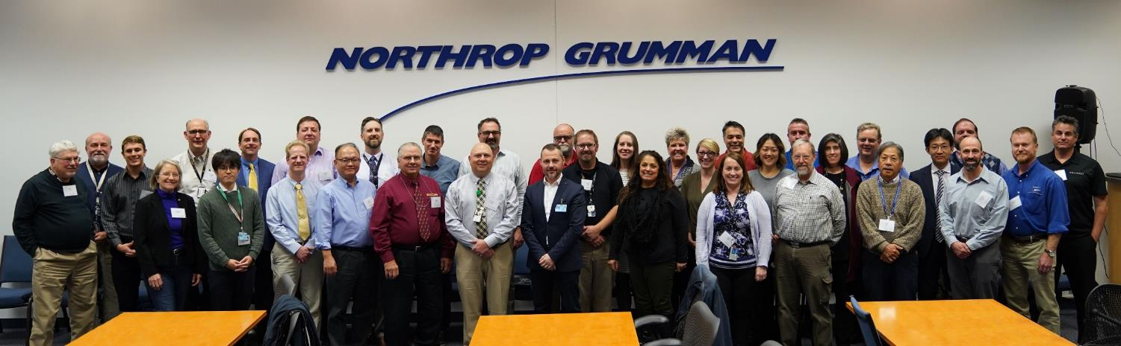
International Earth Observing Constellation
Mission Operations Working Group Meeting
December 3-5, 2019
Northrop Grumman Information Systems
Gilbert, Arizona

Slide 10
Since the last meeting . . .
  The A-Train successfully conducted it’s Spring 2020 Inclination Adjust Maneuver (IAM) campaign despite COVID-19 pandemic
  The Fall 2020 IAM series began in August but completion delayed due to Aqua anomaly
  CloudSat anomaly in August caused drift toward CALIPSO
  Mega-Constellations OneWeb and Starlink have begun launches
  We continue to monitor TanSat crossings with Constellation missions. The next TanSat – Aqua crossing occurs between TBD, 2021 (using a range of Schatten solar flux predictions)

Slide 11
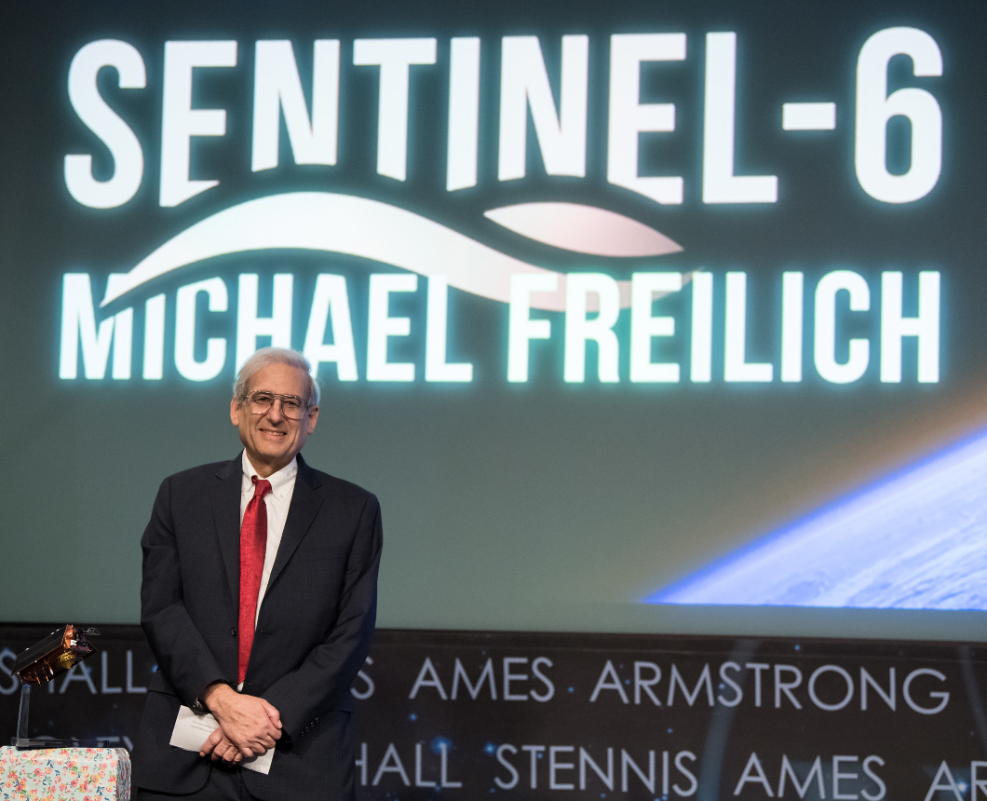
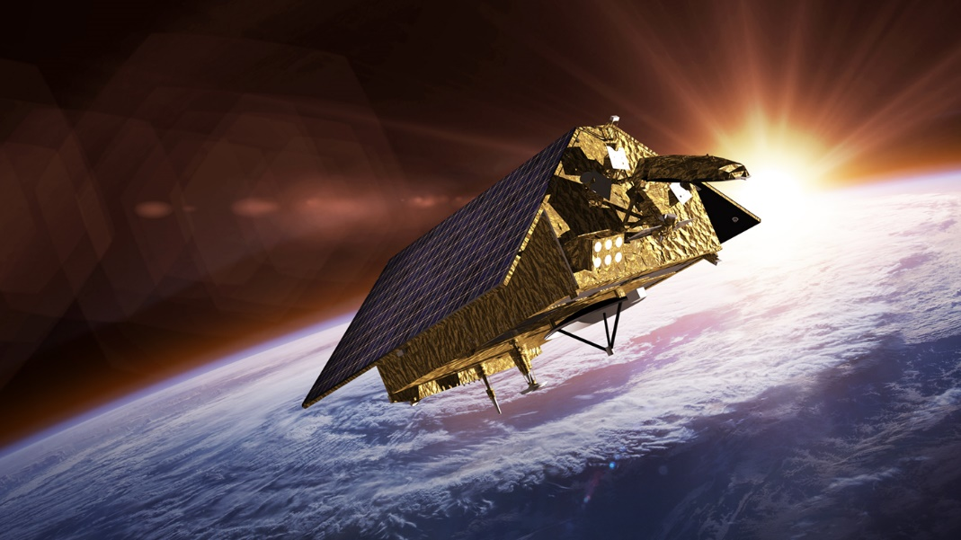
  The Sentinel-6A satellite was renamed Sentinel-6 Michael Freilich and is scheduled to launch in November 2020
  We lost Dr. Michael Freilich (former NASA head of Earth Science)
  Tribute: https://blogs.nasa.gov/drthomasz/2020/08/05/tribute-to-nasa-earth-trailblazer-dr-michael-freilich/
Credits: ESA/NASA
Credits: NASA/Aubrey Gemignani

Slide 12
Upcoming Events . . .
EVENT | DATE
A-Train Spring IAM Series | March-April 2021
Landsat-7 Crossing with L-8/A-Train Crossing | April 13, 2021
CloudSat/CALIPSO 15-year Anniversary! | April 26, 2021
2021 MOWG Meeting (Virtual?) Sponsor: TBD, Location: TBD | TBD (May 2021)?
Landsat-7 Crossing with Aura | May 15, 2021
Landsat-7 Crossing with Aqua | August 16, 2021
Landsat-7 Crossing with GCOM-W1 | September 14, 2021 (TBC)
Landsat-7 Crossing with OCO-2 | December 2021
Notes:
Still need a sponsor for FALL MOWG and decide on location.

Slide 13
Potential Future MOWG Meetings . . .
Past Locations
Boulder/Ft. Collins, CO
KAFB, Albuquerque, NM
France
GSFC, MD
Gilbert, AZ
Japan
JPL/Pasadena area, CA
KSC area, FL
LaRC/Norfolk area, VA
OSC ATK, Dulles, VA
Sioux Falls, SD
Other Locations Discussed
Alaska Ground Station Facility
JSC, TX
Stennis, MS
Host desired location or Virtual?
Sponsors
CALIPSO/CNES
CALIPSO/LaRC
CloudSat/JPL
CloudSat/KAFB
ESMO missions/GSFC
GCOM-W1/JAXA
Landsat/NGIS
Landsat/USGS
OCO-2/JPL
OCO-2/OSC ATK
Notes:
Still need a sponsor for FALL MOWG and decide on location.

Slide 14
ESC MOWG Action Items
From June 2019 MOWG meeting
# | Assignee | Description | Status / Due Date
1906-01 | ESMO/ OCO-2 teams | Conduct Constellation-Near Earth Network (NEN) Working Group meeting to discuss station scheduling changes which allow OCO-2 to use ground station contacts currently used by Aqua/Aura. OCO-2 requires an X-band downlink that doesn’t have any Star Tracker Assembly (STA) occultation's and would like to work with Aqua/Aura to identify and resolve any potential antenna scheduling constraints. | CLOSED / July 12, 2019 Per email from M. Garcia/JPL. OCO-2, Aqua, Aura and EDOS met on June 11 and agreed to investigate the required ground station certification.
1906-02 | ESMO / USGS | Organize a working group to conduct an orbital safety review of Landsat-7 drifting through the A-Train during the 2021 timeframe. Teams may need to supply long term ephemeris in support of these meetings. | OPEN / December 2020
1906-03 | All teams | Generate questions for Landsat-7 regarding Restore-L to address MOWG missions concerns. | CLOSED / October 2019 No responses received
1906-04 | All teams | CCS support will be reduced in the future as it moves to a maintenance only mode of operations. Identify any critical operations that CCS performs for your team. | CLOSED / December 2019 No responses received
1906-05 | Mike Machado | Send out email asking for feedback/ideas on the future of the MOWG and its meetings. | CLOSED/ December 2019 Discussed at MOWG

Slide 15
Meeting Logistics
Presentations
  Please e-mail your presentation updates to michael.j.machado@nasa.gov and nancy.c.herndon@nasa.gov
  All the presentations will be made available after the meeting via a large file transfer service. Download instructions will be sent.
  Presentations will be recorded! Let us know beforehand if your presentations are “not for public view”.
Webex meeting information:
  See Agenda or email announcement for Webex meeting links
Group photo Idea – Take “team” snapshots of members associated with a presentation (during the setup) - everyone on the team will show video and say “cheese” so that a team grouping of webex participant boxes can be screen captured, then put together later into a collage photo

Slide 16
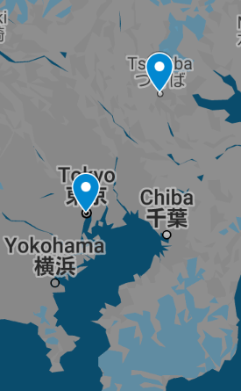
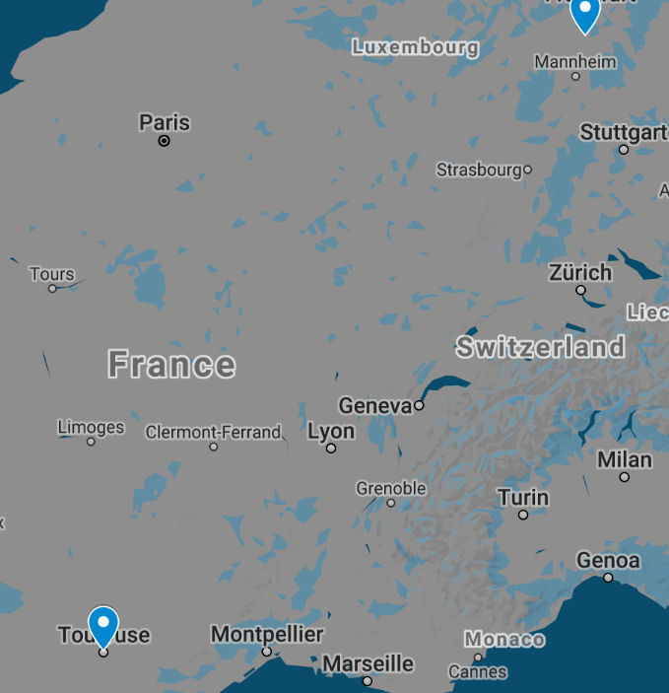
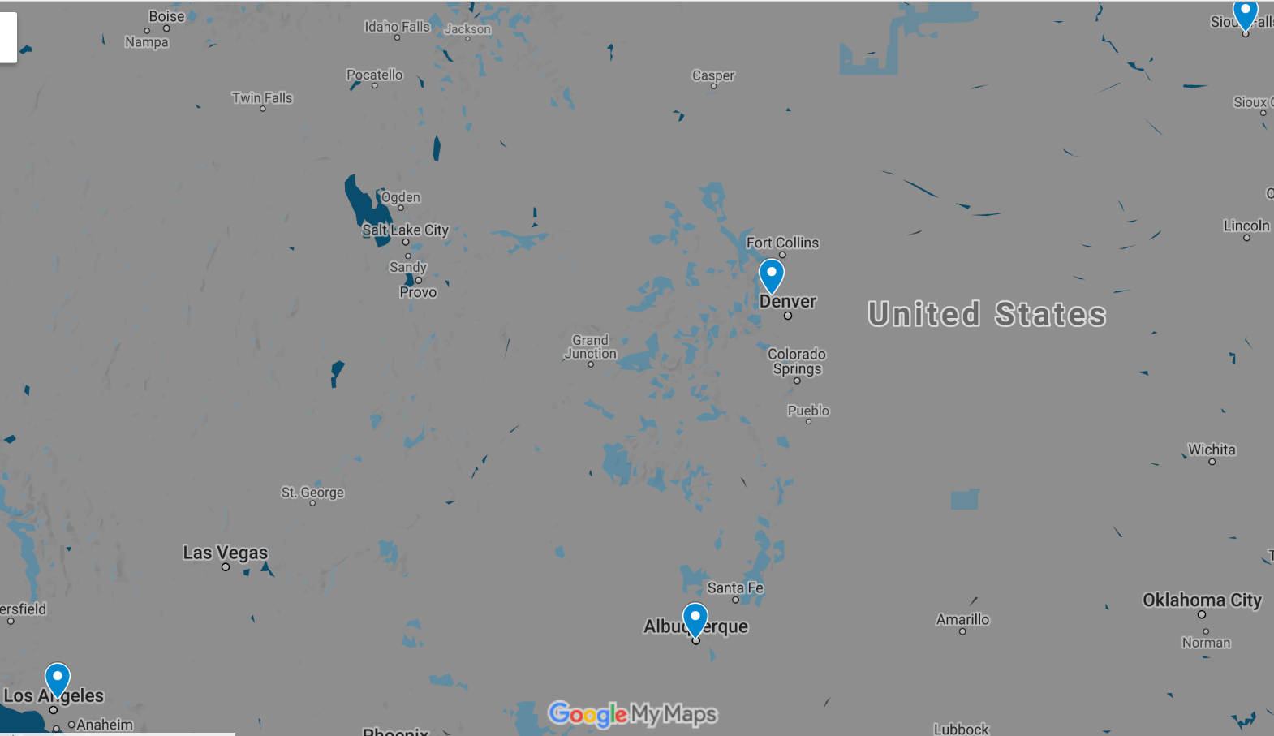
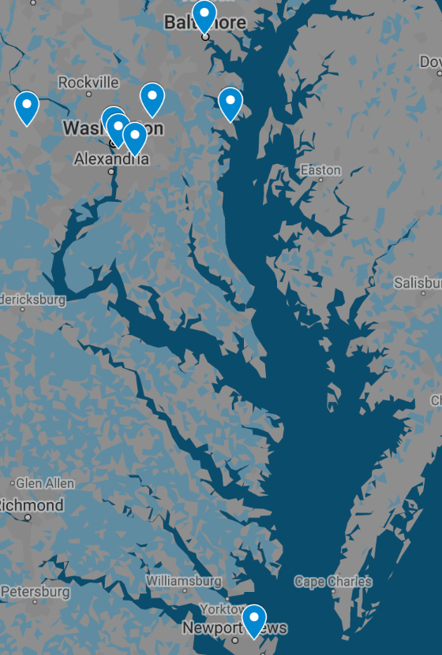
MOWG Meeting Icebreaker
  Annotate Map in Webex with your location using the arrow pointer
Notes:
CANCELLED – will have alternate event for those who responded

Slide 17
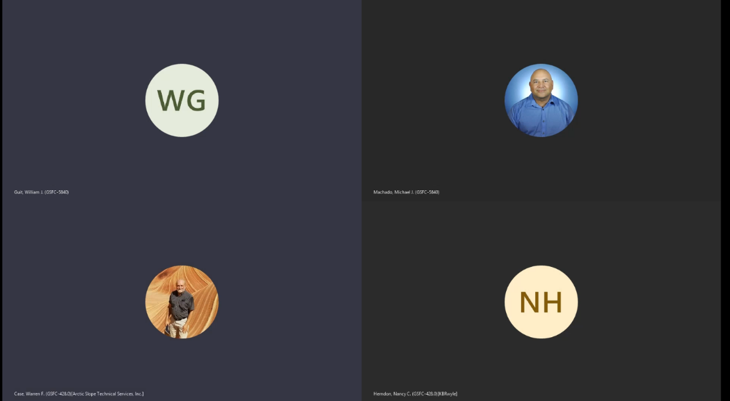
Group Virtual Mingle
Date/time: Wednesday 5:00-6:00 p.m. ET (2100 - 2200 UTC) using same webex link as main meeting
Logistics: Guests allowed.
Source: https://www.hubgrill.com/
Notes:
CANCELLED – will have alternate event for those who responded

Slide 18
ありがとうございます
Arigatou Gozaimasu
Merci
Thank you
Questions?
Notes:
Pronounce arigatou gozaimasu as ah-ree-gah-toh goh-zah-ee-mas.
State "arigatou gozaimasu."[4] This phrase essentially means "thank you very much."
You can use arigatou gozaimasu with people who have a higher status than you, including supervisors, family elders, teachers, and strangers or acquaintances who appear older than you.
You can also use this phrase to express formal or heartfelt gratitude to someone close to you.
In its non-romanized form, write 有難う 御座います.

Slide 19
Abbreviations / Acronyms List
  AFRL Air Force Research Laboratory
  AIRS Atmospheric Infrared Sounder
  ALI Advanced Land Imager
  AMSR-E Advanced Microwave Scanning Radiometer for EOS
  AMSR2 Advanced Microwave Scanning Radiometer 2
  ASTER Advanced Spaceborne Thermal Emission and Reflection Radiometer
  CA Conjunction Assessment
  CAM Command Authorization Meeting
  CALIPSO Cloud-Aerosol Lidar and Infrared Pathfinder Satellite Observations
  CARA Conjunction Assessment Risk Analysis
  CARMA Conjunction Assessment and Risk Mitigation Automation
  CCR Configuration Change Request
  CCS Constellation Coordination System
  CNES Centre National d’Etudes Spatiales
  COVID-19 Coronavirus Disease 2019
  CRMS Collision Risk Management System
  CVT Constellation Visualization Tool
  DAM Debris Avoidance Maneuver
  DB Direct Broadcast
  DO-OP Daylight Only Operations
  EAR Export Administration Regulations
  EO Earth Observation
  EO-1 Earth Observing-1
  EOMP End of Mission Plan
  EOS Earth Observing System
  EROS Earth Resources Observation and
  Science
  ESA European Space Agency
  ESC Earth Science Constellation
  ESDIS Earth Science Data and Information System
  ESMO Earth Science Mission Operations
  ETM+ Enhanced Thematic Mapper Plus (Landsat 7)
  FAQ Frequently Asked Question
  FDS Flight Dynamics System
  FOT Flight Operations Team
  FMU Formatter Multiplexer Unit
  FSW Flight Software
  FY Fiscal Year
  GEDI Global Ecosystem Dynamics Investigation
  GCOM-W Global Change Observation Mission – Water
  GMT Greenwich Mean Time
  GS Global Survey
  GSFC Goddard Space Flight Center
  HIE High Interest Event
  HQ Headquarters
  IAM Inclination Adjustment Maneuver
  ISS International Space Station
  ITAR International Traffic in Arms Regulations
  JAXA Japan Aerospace Exploration Agency
  JPL Jet Propulsion Laboratory
  JPSS Joint Polar Satellite System
  JSC Johnson Space Center
  JSpOC Joint Space Operations Center
  KSC Kennedy Space Center
  LaRC Langley Research Center
  MetOp Meteorological Ops Satellite
  MLT Mean Local Time
  MMOD Micrometeorite Orbital Debris
  MOWG Mission Operations Working Group
  NASA National Aeronautics & Space Administration
  NET No Earlier Than
  NGAS Northrop Grumman Aerospace Systems
  NOAA National Oceanic and Atmospheric Administration
  OCO Orbiting Carbon Observatory
  OIIR NASA Office of International and Interagency Relations
  ORR Operational Readiness Review
  PS Project Scientists
  RMM Risk Mitigation Maneuver
  RWA Reaction Wheel Assembly
  SAC-C Satellite de Aplicaciones Cientificas (Scientific Application Satellite)
  SC Spacecraft
  S5P Sentinel-5 Precursor
  SNPP Suomi National Polar-orbiting Partnership
  SSR Solid State Recorder
  SWIR Short Wave Infrared
  TBD To Be Determined
  TES Tropospheric Emission Spectrometer
  TSIS Total and Spectral Solar Irradiance Sensor
  USGS U.S. Geological Survey
  WRS World Reference System

