Slide 1

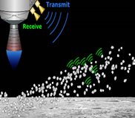
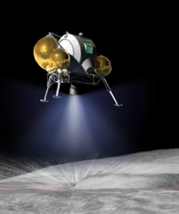
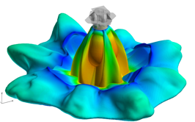
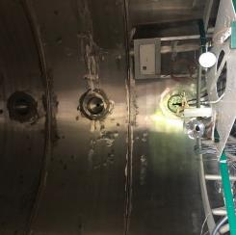
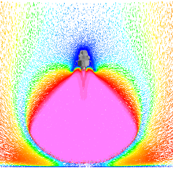
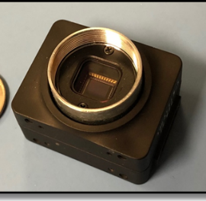
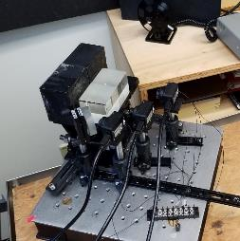
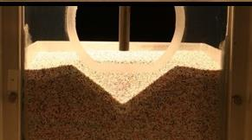
Space Technology Mission Directorate
Game Changing Development Program
Melanie Dervan | Manish Mehta | FY20 Plume Surface Interaction Annual Review Presentation | 09.22.20

Slide 2

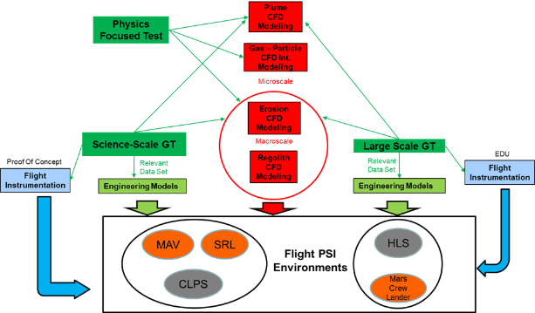
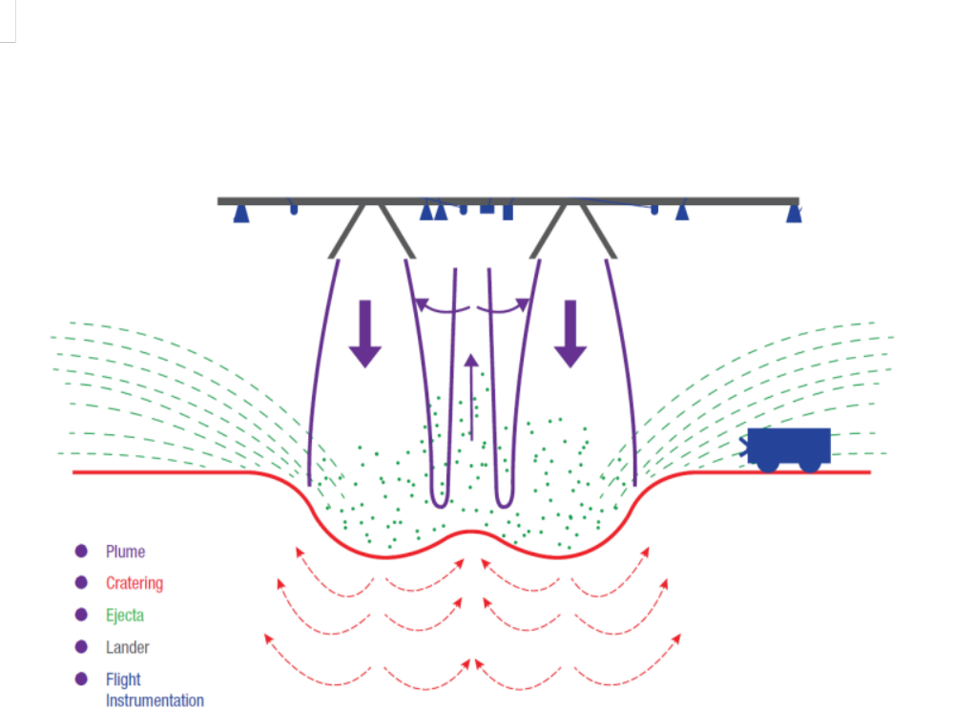
PSI Technology Overview
Technology Product Capability
  Plume-surface interaction (PSI) describes the lander environment due to the impingement of hot rocket exhaust on regolith of planetary bodies. This environment is characterized by the plume flow physics, erosion physics and ejecta dynamics.
  The PSI Project will provide tools and data to predict the environments that enable smart design and risk analysis of Entry Descent & Landing architectures driven by PSI. With this work, NASA will be able to predict landing environments and develop mitigating strategies.
Plume
Cratering
Ejecta
Lander
Flight Instrumentation

Slide 3
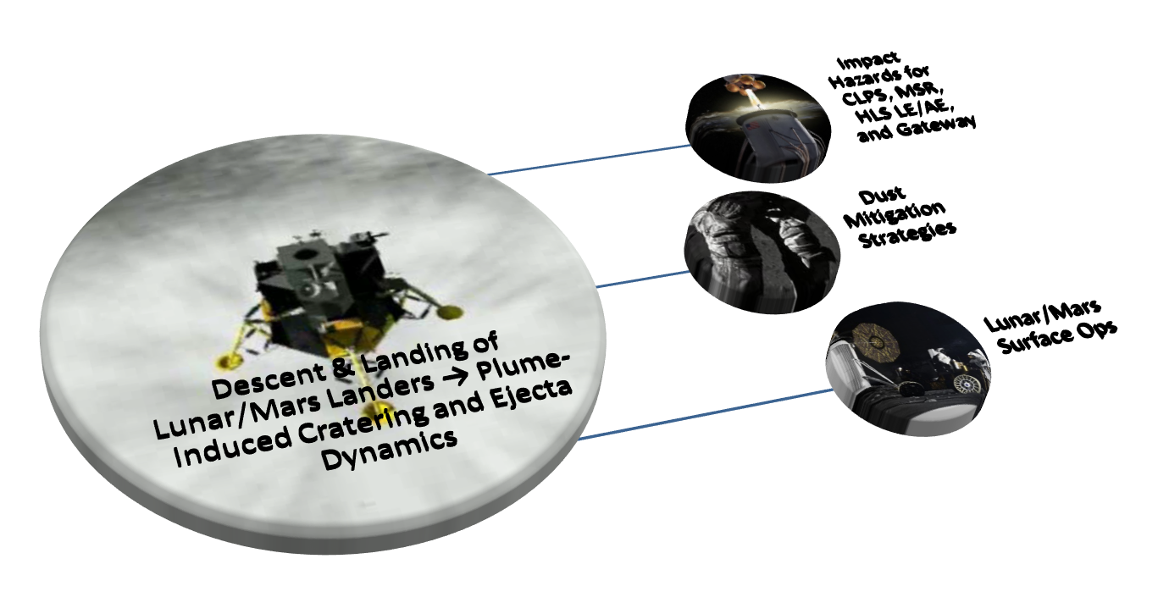
Mission Impact
Direct application to the design of HEOMD and SMD Landers through the following mechanisms:
  Identifies environments and ejecta transfer and strikes
  Reduces design uncertainty due to landing environments
  Informs instrumentation/hardware placement & protection
  Informs lander system design and operation requirements
  Identifies keep-out zones
  Defines landing visibility threshold requirements & mitigations
  Defines landing tilt and stability requirements due to plume induced erosion
Exploration & Science Applicability
  HEOMD Landers – HLS, Commercial, Human Mars Lander
    Several potential HLS partners are already evaluating PSI related support from NASA
  SMD – CLPS, Mars 2020, Mars Sample Return
Leverages Current/Previous Investments in:
ESIs, SBIRs, STTRs, GCD, LSII, NPLP
Images from NASA.gov

Slide 4

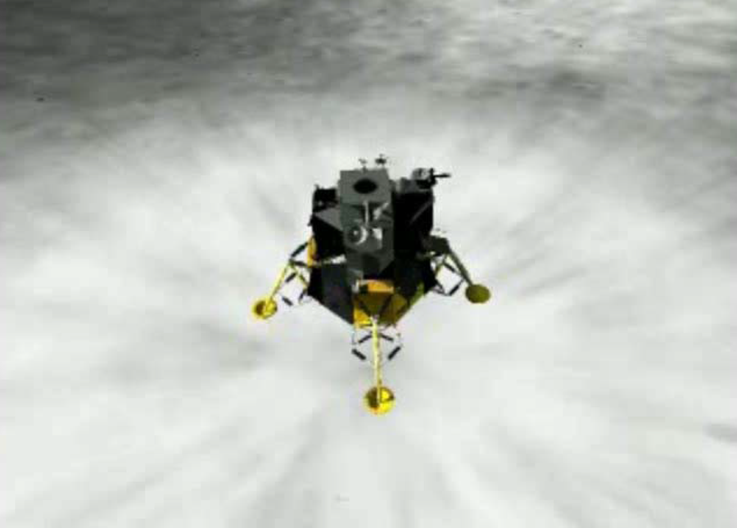
The Benefit
Generates Unique Test Databases of PSI Environments Across Multiple Scales
Informs CLPS Providers and HLS Designs
PSI Project
Leverages Current/Previous Investments in:
ESIs, SBIRs, STTRs, GCD, LSII, NPLP
Informs Dust Mitigation Tech Dev
Matures PSI Prediction Capability
Informs Designs for Mars Lander Architecture
Enables Maturation of PSI Flight Instruments for Future Lunar and Mars Landers
Notes:
The Benefit
<Value provided by the concept itself, not the value of the need> Develop the first suite of sensors dedicated to measuring PSI effects in-situ during terminal descent of a planetary lander in which plume-induced surface regolith erosion, lofted dust, and high-speed ejecta particles are produced by a CLPS lunar lander.
<Describe the benefit> The only existing PSI-related data from the all planetary landers consists of still, uncalibrated images or videos taken during descent and landing by a lander or from orbital imaging systems, or else from post-landing images of damage to the lander or a rover that could be attributed to PSI. A suite of Payload Sensors for a CLPS lander that is specifically dedicated to directly measuring PSI effects will provide invaluable data to NASA that will inform current technology development efforts to address Dust Mitigation, to design Artemis, and to validate ongoing PSI Computational Modeling work and development of engineering models under the GCD PSI project.
Goals and Objectives
<What the project going to achieve – output of the its approach> Lunar PSI data from in-situ measurements obtained by a suite of sensors to measure PSI effects operating as a CLPS Payload during terminal descent (TRL 9).
<Align goals with the Agency needs and STMD strategic thrust. Clearly define the objectives to develop technology from TRL 3 to 5/6> CLPS Payload Sensors for PSI Measurements will address NASA strategic knowledge gaps for Moon and Mars: LEAG SKG III.D.4 “Descent/Ascent Engine Blast Ejecta – In-Situ Measurements”, and MEPAG SKG B7-1 “Regolith Physical Properties and Structure”.
Quantitative Impact
<Quantitative assertions (e.g., x% improvement of y, x kg of mass saving , x meters of accuracy, etc.)> At least an order of magnitude improvement in measuring PSI effects during terminal descent of a lander.
<advancement over the Status Quo> Unknown but substantial improvement in measuring PSI effects due to a lander during EDL: Quantitative PSI Data (direct in-situ PSI measurements) vs Qualitative PSI Data (indirect estimates based on interpretations of lander videos and still images).
<may be based on a typical mission or application to make the case, with the addition of a backup slide describing assumptions> The GCD project will deliver a Suite of Sensors for PSI Measurements for a CLPS Payload.
<Likely used as performance and or cost metrics to measure progress> Data from the proposed CLPS Payload will be used to validate ongoing PSI Computational Modeling work under the current GCD PSI project.

Slide 5
Plume Surface Interaction
Technology Goals & Project Objectives
Technology Goals
Goal #1 | Develop an integrated modeling, simulation, instrumentation capability, and testing approach to Plume Surface Interaction (PSI) definition in the areas of: plume flow physics, erosion physics and ejecta dynamics, closing the identified gaps in physics modeling that are first order to accurate prediction.
Project Objectives
Objective #1 | Develop a computational capability that can adequately predict landing environments and provide uncertainty quantification in the areas of plume flow physics, erosion physics and ejecta dynamics, for various Moon and Mars landing missions being planned by the Human Exploration Mission Directorate (HEOMD) and Science Mission Directorate (SMD).
Objective #2 | Conduct three ground tests (GT) at relevant conditions and physical scales to obtain data that can be used to (1) improve, validate and increase the technology readiness level (TRL) of computational codes; (2) generate flight design landing environments and uncertainty quantification from scaling methodologies independent of computational predictions*; (3) support dedicated PSI flight instrumentation development. Data collected will be focused on plume flow physics, erosion physics and ejecta dynamics. (* Item (2) is out of scope for this project. Data will be available for current and future projects to utilize.)
Objective #3 | Develop and advance PSI dedicated flight instrumentation focused on collecting data on plume flow physics, erosion physics and ejecta dynamics, so that they are available for consideration to future landing missions. Advancement of instrumentation will be evaluated through TRL maturity of selected instruments.

Slide 6
PSI Key Performance Parameters (KPP) Status
Key Performance Parameters – Lunar Environment
Parameter | Units | State of the Art (SOA) | Threshold Value | Project Goal | Current Value To Date | Current Value: Technical Basis of Estimate | Expected Exit Value | Exit Value: Technical Basis of Estimate
Prediction of plume-induced pressure distribution | Pa | TBD ⁽¹⁾ | Predict within +/- 50% | Predict within +/- 10% | TBD | Estimate | < 50% | Substantiated based on comparisons with ground test
Prediction of surface erosion/crater geometry as a function of time ⁽²⁾ | m | N/A ⁽³⁾ | Predict within +/- 50% | Predict within +/- 10% | TBD | Estimate | < 50% | Substantiated based on comparisons with ground test ⁽⁴⁾
Prediction of ejecta energy flux ⁽⁴⁾ | W/m² | N/A | Predict within +/- 50% | Predict within +/- 10% | TBD | Estimate | < 50% | Substantiated based on comparisons with ground test ⁽⁴⁾
Notes: ⁽¹⁾ Data sources for impinging plumes in vacuum environments are scarce to non-existent. Physics-Focused Ground Test (PFGT) vacuum testing will provide relevant validation data for plume physics in a near-vacuum ambient environment. ⁽²⁾ Onset and time-evolution of crater formation in relevant environments is an existing gap in the PSI discipline. ⁽³⁾ Apollo-era reconstructions for cratering have very large uncertainties, limiting their use as a validation source. Lunar-relevant cratering data is a goal under PSI. Sensitivity to ambient pressure decreases with increasing proximity to the surface, permitting Mars-relevant test data to be partially applicable to Lunar scenarios. ⁽⁴⁾ SCALPSS and MWDR data from SSGT and LSGT, combined with theory, will be used to derive transient erosion morphologies and energy flux.

Slide 7
PSI Key Performance Parameters (KPP) Status
Key Performance Parameters – Mars Environment
Parameter | Units | State of the Art (SOA) | Threshold Value | Project Goal | Current Value To Date | Current Value: Technical Basis of Estimate | Expected Exit Value | Exit Value: Technical Basis of Estimate
Prediction of plume-induced pressure distribution | Pa | +/-35% | Predict within +/- 25% | Predict within +/- 10% | +/- 24% ⁽¹⁾ | Substantiated | < 25% | Substantiated based on comparisons with ground test
Prediction of surface erosion/crater geometry as a function of time ⁽²⁾ | m | N/A ⁽³⁾ | Predict within +/- 25% | Predict within +/- 10% | N/A | Estimate | < 25% | Substantiated based on comparisons with ground test ⁽⁴⁾
Prediction of ejecta energy ⁽⁵⁾ | W/m² | N/A | Predict within +/- 25% | Predict within +/- 10% | N/A | Estimate | < 25% | Substantiated based on comparisons with ground test
Notes: ⁽¹⁾ Preliminary comparisons with existing free-jet data documented in an MSFC internal report; Impingement pressure data comparisons will be completed in FY21. ⁽²⁾ Onset and time-evolution of crater formation in relevant environments is an existing gap in the PSI discipline. ⁽³⁾ Qualitative comparisons have been completed with InSight lander data; Quantitative comparisons will be completed in FY21 with PFGT data. ⁽⁴⁾ All 3 PSI GTs will deliver time-dependent cratering data at Mars relevant conditions. ⁽⁵⁾

Slide 8
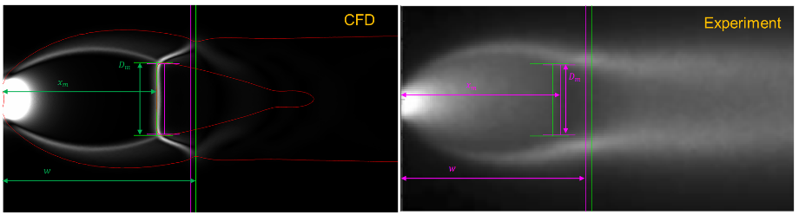
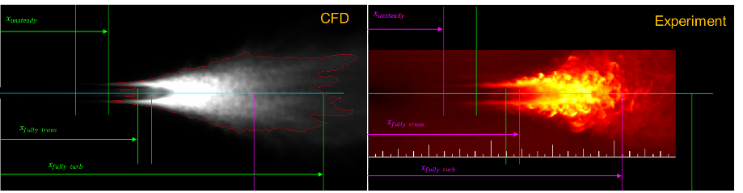
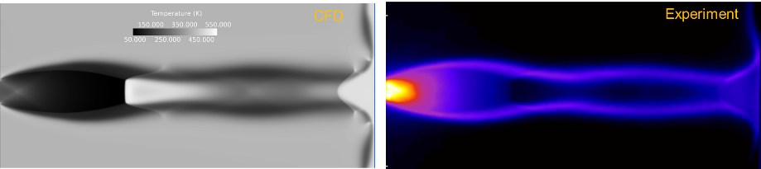
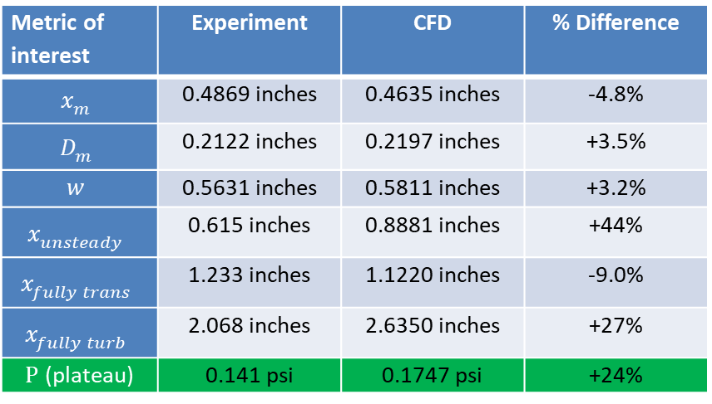
PSC Accomplishment: Initial comparison to Martian environment Plume Structure/Impingement Data
Requirement drill-down
A predictive Plume Surface Interaction capability must first get the plume correct
KPP #1 is Plume Structure, in particular plume surface impingement pressure
Loci/Chem is MSFC’s production mode plume prediction tool
Validating Loci/Chem for plume structure/impingement in Martian-like environments is the first part of PSC Task 1 (the second part is Lunar-like environments using Loci/Chem-Boltzmann)
An initial comparison of multiple plume structure metrics to experimental results (Inman, 2007) at Martian-like conditions has been completed
Forward work to performed detailed solution verification on these comparisons as well as perform V&V for a larger fraction of Inman’s data
Forward work to perform V&V with plume structure results of the PFGT
Metric of interest | Experiment | CFD | % Difference
$$x_{m}$$ | 0.4869 inches | 0.4635 inches | -4.8%
$$D_{m}$$ | 0.2122 inches | 0.2197 inches | +3.5%
$$w$$ | 0.5631 inches | 0.5811 inches | +3.2%
$$x_{unsteady}$$ | 0.615 inches | 0.8881 inches | +44%
$$x_{fully trans}$$ | 1.233 inches | 1.1220 inches | -9.0%
$$x_{fully turb}$$ | 2.068 inches | 2.6350 inches | +27%
$P$ (plateau) | 0.141 psi | 0.1747 psi | +24%
Issues/Concerns:
Continuum laminar time-accurate solution
Initial, pre-solution verification, comparison indicates plume impingement result is within threshold value, +/- 25%, for KPP #1
Notes:
8

Slide 9
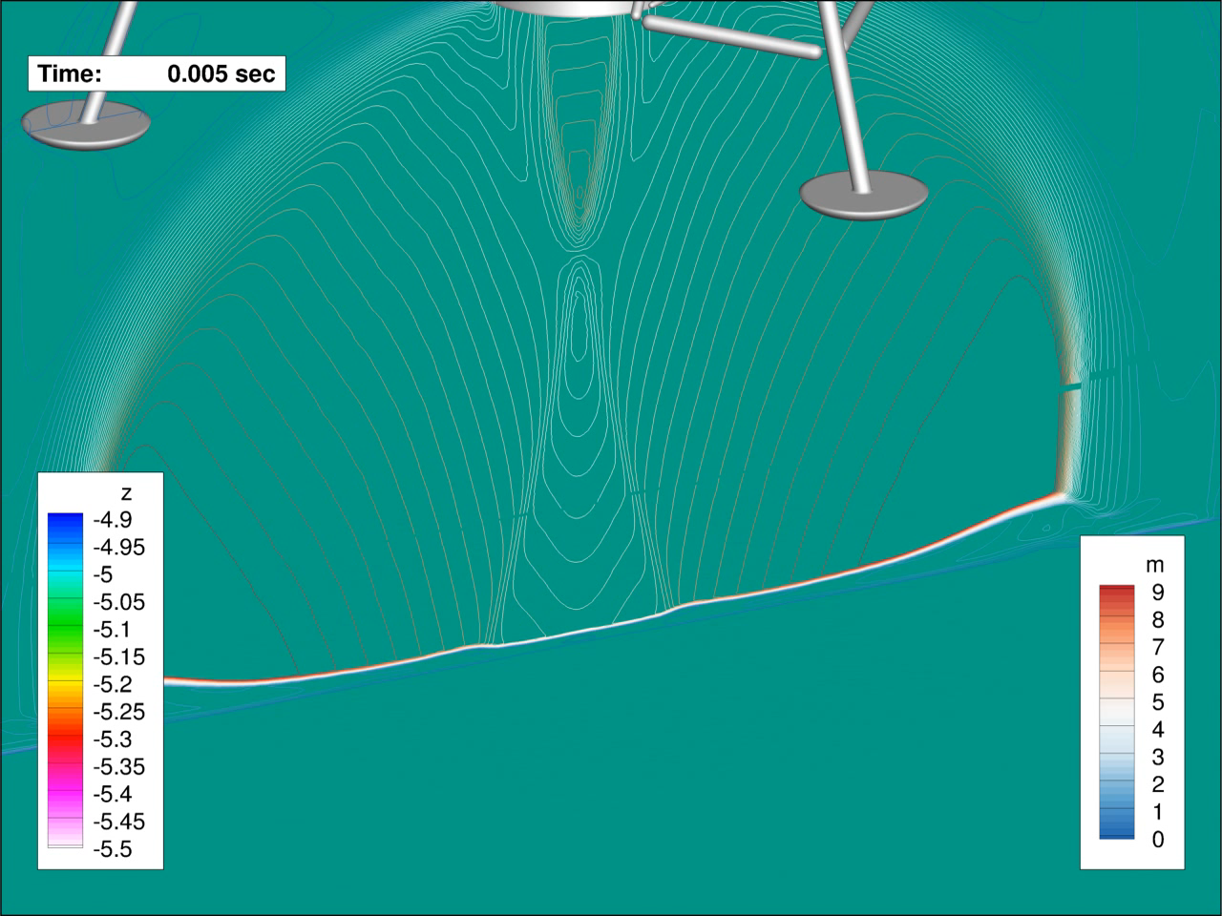
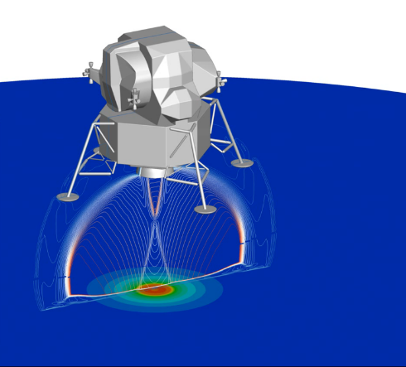
PSC Accomplishment: Demonstration of Loci/GGFS in a low (Lunar-like) pressure environment
Task 3
Requirement drill-down
KPP #2 is the prediction of PSI-driven cratering which is the objective of PSC Task 2
Loci/GGFS is MSFC’s development crater prediction tool
Lunar cratering application require Loci/GGFS to operate in very low, Lunar-like ambient pressure
Development of a production-mode Loci/GGFS requires demonstration of operation in a low pressure environment
Forward work to address other requirements of a production-mode Loci/GGFS
Forward work to perform V&V with cratering results of the PFGT for low pressure environments
Forward work to perform V&V with cratering results of Apollo Program, PSI Science Scale Ground Test (SSGT), Large Scale Ground Test (LSGT) as well as other relevant data to be identified
Animation
Loci/GGFS cratering demonstration of Apollo Lunar Lander
Continuum model only
Intermediate ambient pressure of 1 Pa
  Martian: 600 Pa
  Lunar: 10⁻⁸ Pa
Quasi-steady simulation at 5 m above surface
Issues/Concerns:
Successful demonstration of low pressure operation of Loci/GGFS, a pre-requisite for Lunar cratering prediction
Notes:
9

Slide 10
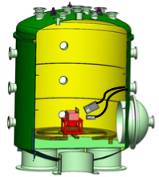
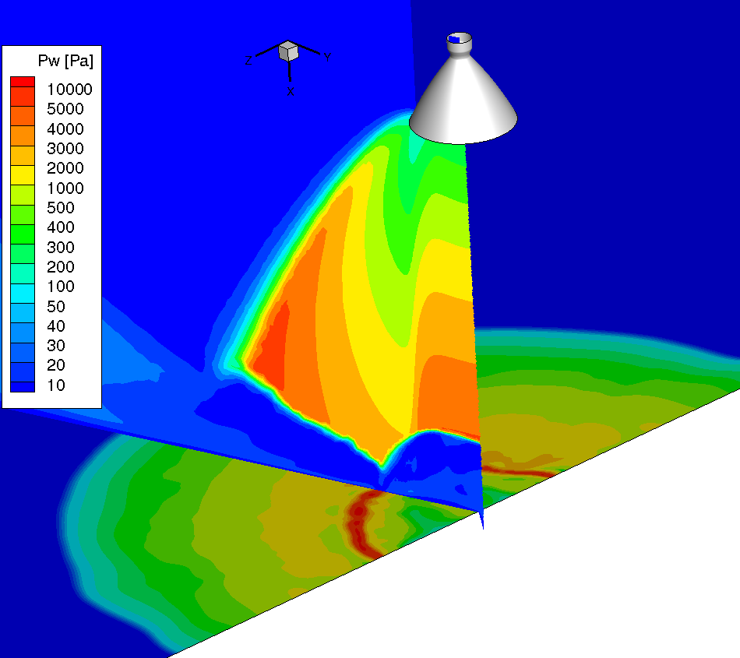
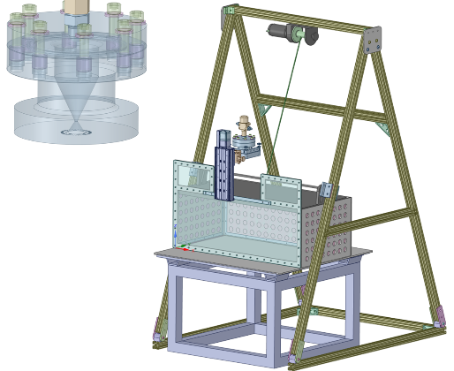

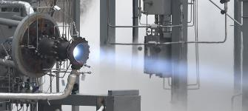


FY 20 Accomplishments – Ground Testing
Progress across all 3 PSI ground tests, leveraging complimentary, in-line development of critical test hardware
Physics-Focused Ground Test (PFGT): MSFC TS300
  Test requirements defined
  Preliminary design work completed for the flow rig, soil bin, and diagnostics integration
  Target test start: Nov. 2020
Science-Scale and Large-Scale Ground Tests: MSFC TS300 and Plumbrook Station
  Test requirements formulated, test design underway
  Hot-fire testing continues for AMPed LCH₄/LOx engine, testing from 650 lbf to 5,000 lbf sea-level thrust
  Target test starts: FY22, FY24
PFGT Preliminary Design and Analysis
Pressure profiles for a 2 torr test condition
TS300 optical diagnostics integration
1
Heated GN₂ manifold
Hot-fire test of engine for Large-Scale Ground Test
Lab demonstration of diagnostics for crater formation (JHU)
Instrumented impingement plate
Test rig with soil bin and transparent splitter plate

Slide 11
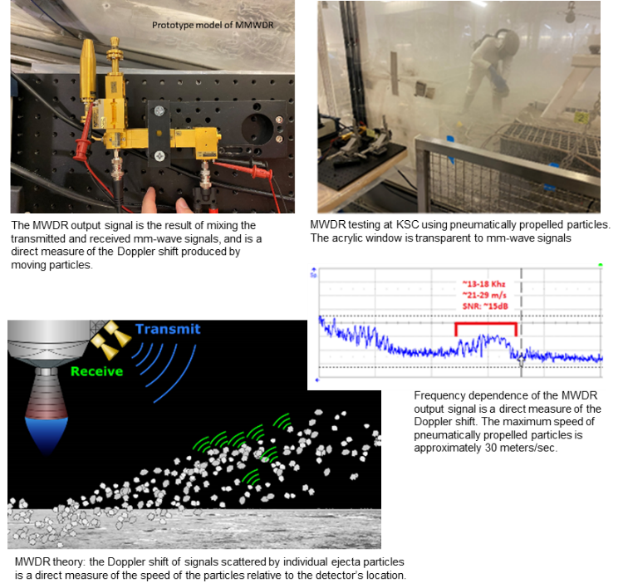
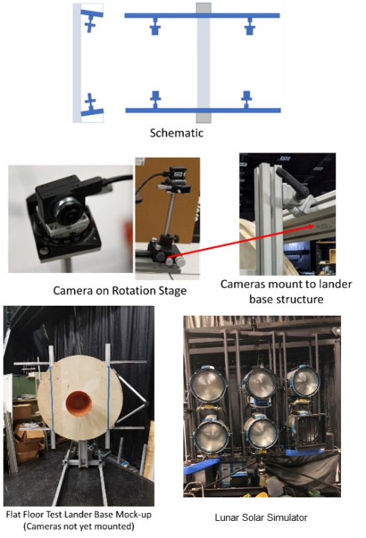
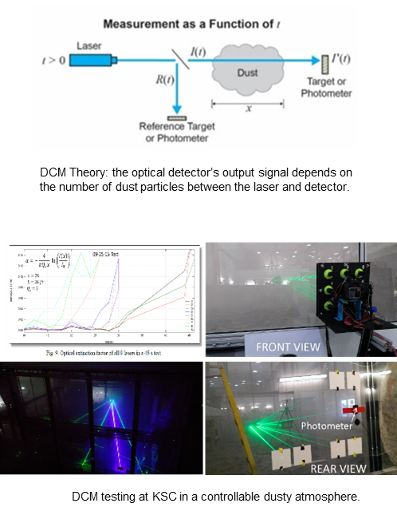
Accomplishments: Flight Focused Instrumentation
Millimeter Wave Doppler Radar (MWDR)
Design/Development completed
SL Low-speed particle (<30 m/s) testing validated at KSC
New Technology Report (NTR) submitted
Stereo Camera (SCALPSS)
Design/Development completed
Camera Settings/Uncertainty quantified in FFF Testing
Dust Concentration Monitor (DCM)
Design/Development completed
SL various particle loadings calibrated at KSC

Slide 12
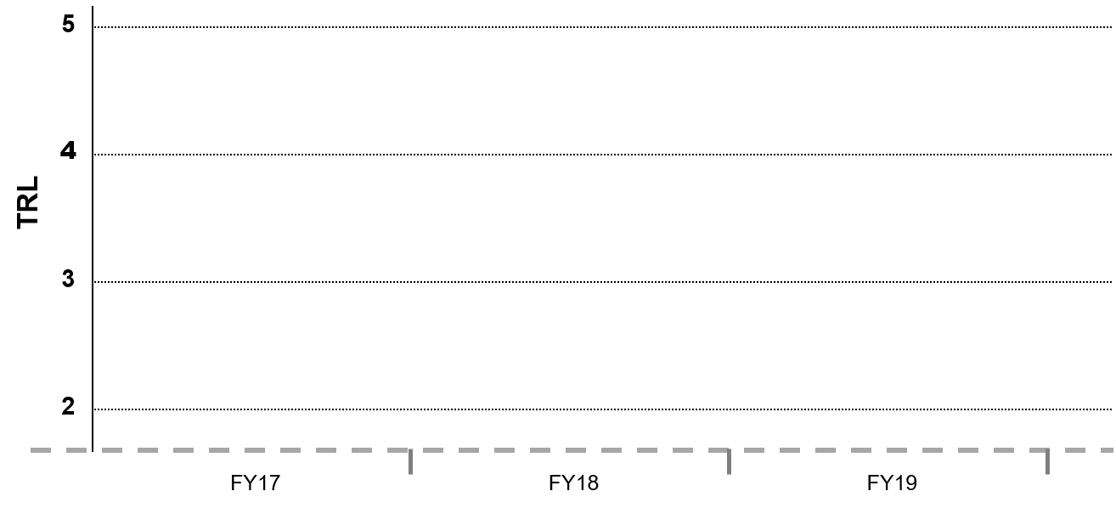
PSI
Lifecycle Milestone/Maturity Schedule
Project Milestone
GCD (Key) Milestone
Controlled Milestone
TRL Progression
FI = Flight Instrumentation
TRR = Test Readiness Review
RPT = Report
TR = Test Report
Demo = Demonstration
Dev = Development
Comp = Comparisons
Part = Particle
FI
Demo
RPT
DSMC
V&V
SSGT
TR
PFGT
CFD
Comp
SCALPSS
Demo
MWDR
DCM
Demo
SSGT
TRR
Transient Erosion Models
New
Gas/Part Models
DSMC
Dev
PFGT
TR
Irregular
Part Models
Comparison
Study
PFGT
TRR
Existing Gas/Part Models
Existing Bi-Disperse Models
FY17
FY20
FY21
FY22

Slide 13
PSI
Lifecycle Milestone/Maturity Schedule
Project Milestone
GCD (Key) Milestone
Controlled Milestone
TRL Progression
LSGT
FI RPT
PSI Final
Rev
LSGT
TR
LSGT
CFD Comp
FI = Flight Instrumentation
TRR = Test Readiness Review
RPT = Report
TR = Test Report
Demo = Demonstration
Dev = Development
Rev = Review
Comp = Comparisons
Part = Particle
SSGT
CFD
Comp
Validated New Gas/Part Models
Poly-Disperse
Part Models
LSGT
TRR
FY17
FY23
FY24

Slide 14
Technical Assessment (1/2)
Technical Elements | TRL |  |  |  | AD²
 | Entry | Current¹ | Exit | TRL Verification² | Entry | Current
Gas-phase Physics for Plume Impingement in Reduced Atmospheric Environments | 3 | 3 | 6 | K3, C1, K6, C2, K10, C3, K12, C4, K19, K21, K22, K23, K27, C5, K33, K34, K35 | 6 | 6
Gas-phase Physics for Plume Impingement in a Vacuum Environment | 2 | 2 | 5 | K3, C1, K6, C2, K10, C3, K12, C4, K19, K21, K22, K23, K27, C5, K33, K34, K35 | 6 | 6
Time-Varying Surface Erosion/Crater Geometry in Reduced Atmospheric Environments | 2 | 2 | 5 | K1, K2, K4, K5, C1, K6, C2, K7, K8, K9, K10, C3, K13, K14, K15, K16, C4, K18, K19, K20, K21, K22, K24, K25, K26, K28, K30, K31, C5, K33, K34, K35 | 6 | 6
Time-Varying Surface Erosion/Crater Geometry in a Vacuum Environment | 2 | 2 | 5 | K1, K2, K4, K5, C1, K6, C2, K7, K8, K9, K10, C3, K13, K14, K15, K16, C4, K18, K19, K20, K21, K22, K24, K25, K26, K28, K30, K31, C5, K33, K34, K35 | 6 | 6
¹Date of last TA was June 2020 ²TRL verification references refer to milestones noted in Draft PSI Project Plan submitted for GCD Review. Milestone titles included in back-up charts.

Slide 15
Technical Assessment (2/2)
Technical Elements | TRL |  |  |  | AD²
 | Entry | Current¹ | Exit | TRL Verification² | Entry | Current
Ejecta Flux in Reduced Atmospheric Environments | 2 | 2 | 5 | K1, K2, K4, K5, C1, K6, C2, K7, K10, K11, C3, K13, K14, K15, K16, K17, C4, K18, K19, K20, K21, K24, K25, K26, K28, K29, K30, K31, K32, C5, K33, K34, K35 | 7 | 7
Ejecta Flux in a Vacuum Environment | 2 | 2 | 5 | K1, K2, K4, K5, C1, K6, C2, K7, K10, K11, C3, K13, K14, K15, K16, K17, C4, K18, K19, K20, K21, K24, K25, K26, K28, K29, K30, K31, K32, C5, K33, K34, K35 | 7 | 7
mm-Wave Doppler Radar | 2 | 2 | 6 | K6, K11, K17, C4, K19, K21, K22, C5, K33, K34, K35 | 6 | 6
¹Date of last TA was June 2020 ²TRL verification references refer to milestones noted in Draft PSI Project Plan submitted for GCD Review. Milestone titles included in back-up charts.

Slide 16
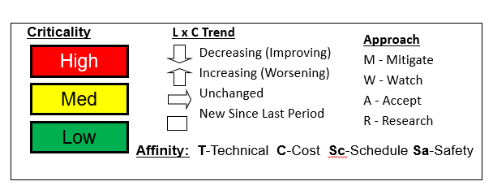
Preliminary Risk Summary
L
I
K
E
L
I
H
O
O
D
Risk ID | Affinity | Description/Status | Trend
TBD | T | Given the limited understanding of the physics involved, the non dimensional parameters may not be adequately correlated resulting in an inaccurate modeling capability.
TBD | T | Given that uncertainty quantification for all instrumentation and predictions have not been identified, the uncertainty of the correlation may be too great and result in poor and inaccurate comparisons.
TBD | T | Given that the physical scope of the PSI is extensive, there is a risk that computational costs will exceed baselined computing capabilities.
TBD | Sc / T | Given the high demand for personnel in the field of plume surface interaction, there is a risk that key personnel required to complete our scope will be pulled away for competing, higher priority agency efforts (e.g., SLS, HLS, Commercial Crew).
TBD | T | Given that the mm-Wave Doppler radar is based in theory with no current experimental data collected, the ejecta mass flow may not be measured (accurately).
5
4
3
2
1
1
2
3
4
5
CONSEQUENCES
Formal PSI Risk Management Process is currently being established. Candidate risks are identified above. Order does not indicate relative LxC evaluation.

Slide 17
Project Assessment Summary
Project Name | Performance |  |  |  | Comments
 | C | S | T | P
Mid Year |  |  |  |  | Technical – Strong collaboration is occurring between the PSI technical elements. An executable plan has been established to improve the SOA. Cost – Resources are flowing allowing formal partnerships to be established and required procurements to meet the schedule. Schedule – On track to meet planned milestones for FY 20. Programmatic – Currently under formulation for the PCD and Project Plan. Draft PCDs currently being reviewed. Technical Assessment being prepared by team. Formal partnership being pursued with HLS.
Annual |  |  |  |  | Technical – Progress is being made across all PSI technical elements. Technical approach has been approved by PSI PCB. Cost – COVID impacts resulting in increased personnel costs to complete planned scope, combined with delay in PFGT and instrumentation development due to facility access restrictions. Schedule – Schedule impacted due to COVID related facility access restrictions. All technical elements impacted to various degrees. Programmatic – PSI Project Plan completed GCD review and in process of final revisions. Technical Assessment is complete. All academic partnerships in place. Partnership with HLS delayed due to CR funding concerns.

Slide 18
EPO Update
Summary of Education and Public Outreach
Event | Info
Humans to Mars Summit 2020: Human EDL Panel | A. Korzun, 2 Sept 2020
AFESB Summer Student Seminar Series: Propulsive Descent and Landing | A. Korzun, 27 July 2020
Multiple planned PSI EPO opportunities were cancelled due to COVID related restrictions. Future opportunities will be planned.

Slide 19
Summary
This is a very complex project—multiple centers, stakeholders, industry and academic partners, changing and growing every day.
The PSI project is hugely significant and timely, and the energy and expertise are extremely valuable to the Agency and the broader planetary landing community.
  PSI is advancing the state of the art, giving the Nation a validated capability, and training the next generation
  Project is critical for helping mitigate risks for both SMD and HEOMD landers.
Results have started flowing from each of our technical elements showing we can deliver on our scope.
  PSC Code enhancements and comparisons with existing data
  Planning for each of the ground tests
  Early development for the MWDR, SCALPSS, and Dust Concentration Monitor
Next Steps Include:
  Additional PSC Code enhancements and computational comparisons with PFGT
  Complete PFGT test design and test program
  Complete SSGT/LSGT Trade Study, test requirement documents, integrated CAD test designs, propellant valve development and test matrices
  Obtain SCALPSS ground test data to quantify uncertainty, measure MWDR at higher particle velocities and prove out MWDR mass flow measurements
We have a strong, integrated, executable plan to deliver on the PSI technical goals and objectives.

Slide 20

BACKUP

Slide 21
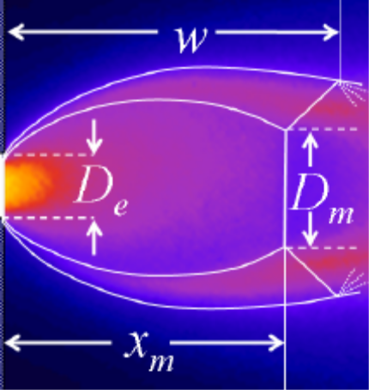
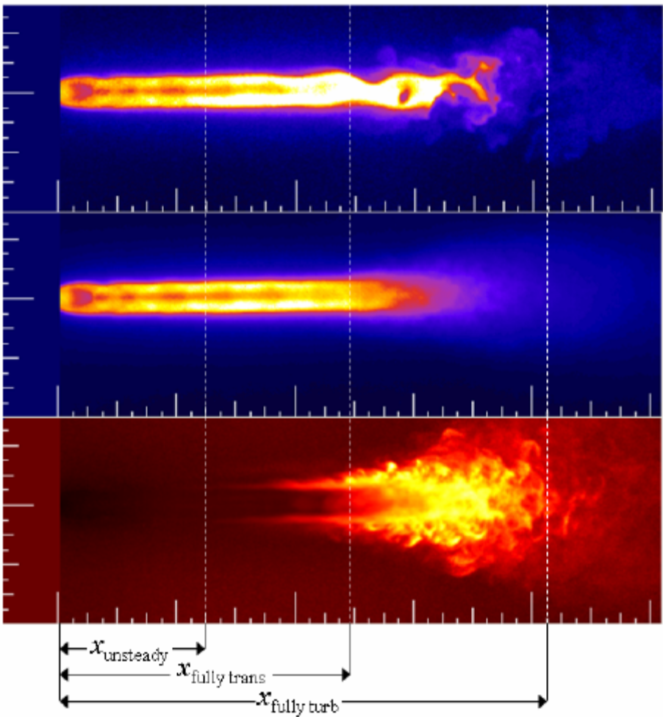
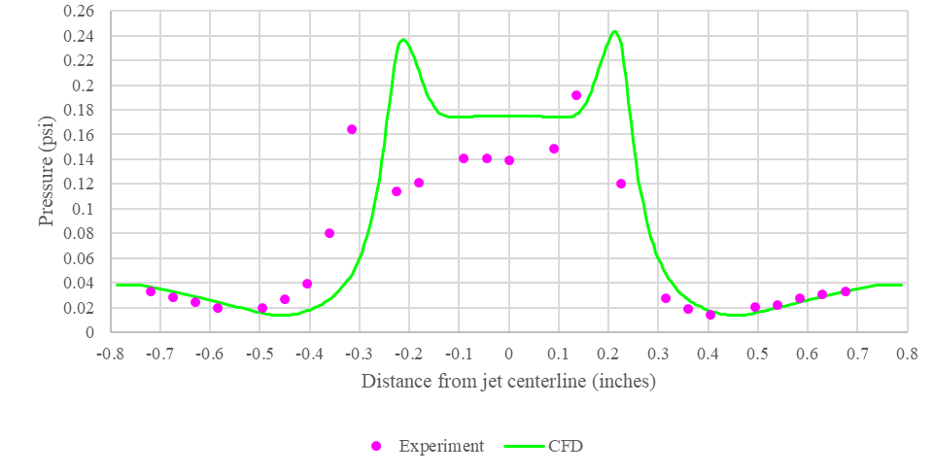
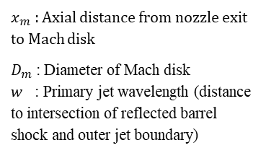
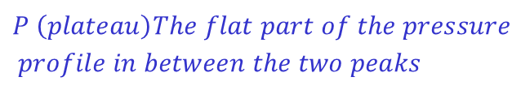
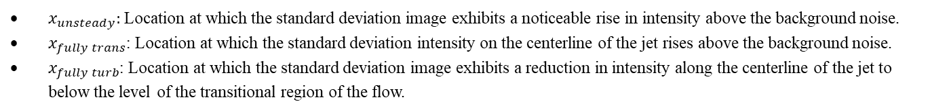
Parameter Descriptions for PSC Plume Comparisons in Martian Environment
Instantaneous PLIF image
$x_{m}$ : Axial distance from nozzle exit to Mach disk
$D_{m}$: Diameter of Mach disk
$w$ : Primary jet wavelength (distance to intersection of reflected barrel shock and outer jet boundary)
Average of 100 PLIF images
$$P \left(plateau\right)The flat part of the pressure$$
$$profile in between the two peaks$$
Standard deviation of 100 PLIF images
$x_{unsteady}:$Location at which the standard deviation image exhibits a noticeable rise in intensity above the background noise.
$x_{fully trans}$: Location at which the standard deviation intensity on the centerline of the jet rises above the background noise.
$x_{fully turb}$: Location at which the standard deviation image exhibits a reduction in intensity along the centerline of the jet to below the level of the transitional region of the flow.

Slide 22
PSC Accomplishment: Simulation and Analysis Support of PFGT Design
Task 3
Requirement drill-down
PFGT support not part of PSC proposal
Participated with PSI community devising PFGT concept
PFGT provides data not available elsewhere for PSC validation
All KPPs improved by successful PFGT execution
Significant PSC stake in PFGT parametric space, simulant selection, test matrix and test hardware design
Since January 2020, significant PSC accomplishments:
  Dimensional analysis of Reference Lunar Lander to establish PFGT parameter space
  Soil bin design requirements
  Simulant selection logic
  Significant input to test matrix design
Forward work to support detailed design, data analysis, and problem resolution during execution of PFGT
Forward work to perform V&V with PFGT results (consistent with baseline PSC proposal)
Issues/Concerns:
Notes:
22

Slide 23
EPO Summary Chart (1/2)
Conferences/seminars from Leveraged Tasks
Conferences/seminars planned (FY20 scheduled opportunities were cancelled)
Conference Name | Papers/Posters/Panel Discussions
2020 AIAA SCITech | Validation of Boltzmann discrete velocity methods for diatomic gases and multi-component monatomic gas mixtures [CFDRC/Miss. State Phase II]
2020 AIAA SciTech | Realistic Regolith Models for Plume-Surface Interaction in Spacecraft Propulsive Landings [CFDRC/Miss. State STTR Phase II]
Conference Name | Papers/Posters/Panel Discussions
2021 AIAA SCITech | Stereo Camera Simulation for Lunar Surface Photogrammetry
2021 AIAA SciTech | Photogrammetric Development of a Lunar Lander Descent Stereo Imager
2021 AIAA SciTech | Fluidization and Cratering of a Granular Particle by the Downward Impingement of a Sonic Turbulent Jet
Johns Hopkins University ME Dept. Seminar | Rocket Plume Interactions for NASA Launch Vehicles and Landing Systems
AIAA JSR InSight EDL Special Issue (in rev) | Flight Reconstruction of Plume-Induced Site Alteration from InSight
JANNAF NASA In-Space Chemical Propulsion TIM [Sept 2020] | Flow Simulations for Martian and Lunar Lander Plume-Surface Interaction Prediction
JANNAF 38th Plume and Signatures [Dec 2020] | A Comparison of CFD Simulations of Supersonic Jets in Mars-like Environments to Experimental Data

Slide 24
EPO Summary Chart (2/2)
Conferences/Meetings cancelled, searching for alternate forums
Original Forum | Papers/Posters/Panel Discussions
International Planetary Probe Workshop (IPPW) | Advances in Plume-Surface Interaction Simulation Capability and Application in Support of Validation Experiment Campaign
ASCE Earth & Science Space Conference | Gas-Particle Flow Simulations for Martian and Lunar Lander Plume-Surface Interaction Prediction
Academic Involvement
# of Students | Education Level | School Name
1 | 1st Year PhD Student (NASA OSE Fellow) | University of Michigan
1 | 4th year PhD Student (NSTGRO Fellow) | University of Michigan
1 | 2nd year PhD Student (NSTGRO Fellow) | Johns Hopkins University

Slide 25
Excerpt of PSI Key and Controlled Milestones from 8/19 Project Plan Draft (1/3)
Project Key and Controlled Milestone List
ID | Title
K1 | Initial Bi-disperse model in Loci-GGFS
K2 | Implementation of PTKE
K3 | PSI Ground Test Trade Study
K4 | Loci-GGFS Implementation
K5 | JPL Milestone TBR
C1 | Computation Capability Comparison Study
Project Key and Controlled Milestone List
ID | Title
K6 | Data and computational prediction comparison methodology
C2 | Physics Focused TRR
K7 | JPL Milestone TBR
K8 | SCALPSS Ground Test Data Delivered
K9 | DEM tool delivered
K10 | Physics Focused Ground Test - Test Data
Project Key and Controlled Milestone List
ID | Title
K11 | Prototype demonstrations of MWDR and dust concentration monitor
C3 | Physics Focused Ground Test - Test Report
K12 | Loci-Chem-Boltzmann CFD Initial Analysis
K13 | Multi-Species GGFS CFD Analysis
K14 | Bi-Disperse CFD Initial Analysis
K15 | PTKE CFD Analysis

Slide 26
Excerpt of PSI Key and Controlled Milestones from 8/19 Project Plan Draft (2/3)
Project Key and Controlled Milestone List
ID | Title
K16 | JPL Milestone TBR
K17 | Ground test data for mm-wave doppler radar and dust concentration monitor
C4 | TRR for Science Scale Ground Test
K18 | JPL Milestone TBR
K19 | Science Scale Ground Test: Test Data
K20 | CFDEM Tool Delivered
Project Key and Controlled Milestone List
ID | Title
K21 | Science Scale Ground Test : Instrumentation Performance Analysis
K22 | Science Scale Ground Test: Test Report
K23 | Loci-Chem-Boltzmann CFD Analysis Update
K24 | Loci-GGFS/Boltzmann CFD Analysis
K25 | Bi-Disperse CFD Analysis Update
K26 | Gas Particle Closure Model Initial Comparison
Project Key and Controlled Milestone List
ID | Title
K27 | Loci-Chem-Boltzmann CFD Final Analysis
K28 | Loci-GGFS-Chem-Boltzmann CFD Analysis
K29 | CFDEM Poly-disperse CFD Analysis
K30 | Gas Particle Closure Model Comparison Update
K31 | JPL Milestone TBR
K32 | JPL Milestone TBR

Slide 27
Excerpt of PSI Key and Controlled Milestones from 8/19 Project Plan Draft (3/3)
Project Key and Controlled Milestone List
ID | Title
C5 | Large Scale Ground Test TRR
K33 | Large Scale Ground Test: Test Data
K34 | Ground Test 3: Instrumentation Performance Analysis
K35 | Large Scale Ground Test: Test Report
C6 | PSI Final Review
C5 | Large Scale Ground Test TRR

Slide 28
Project Name – Annotated Cover Pictures
MWDR Theory
CFD Model of PSI
Computational Model of PSI
SCALPSS Camera
Notional Lander Scouring Surface
Metzger test set-up for PSI evaluations

Slide 29
GCD Project Performance Evaluation Criteria
 | Technical/Performance
Green | Project is demonstrably making progress on the Learning Trajectory (e.g. milestones met, knowledge advanced) or advancing TRL. Project is on track to meet L1 requirements.
Yellow | Project is making progress on the Learning Trajectory or advancing TRL with issues. Project is on track to meet L1 requirements but issues exist that may threaten achievement.
Red | Project has ceased to make progress on the Learning Trajectory or advance TRL. Project is unable to meet one or more L1 requirements.
 | Cost
Green | Project can meet its commitments with its planned/allocated budget.
Yellow | Project cannot meet its commitments within its planned/allocated budget but will not be requesting additional budget from Program. Mitigation plans have been developed.
Red | Project cannot meet its commitments within its planned/allocated budget and will be requesting additional budget from Program.
 | Schedule
Green | Project can meet its commitments within its planned/allocated schedule baseline for critical milestones.
Yellow | Project cannot meet its commitments within its planned/allocated schedule baseline but mitigation plans have been developed to pull it back in.
Red | Project cannot meet its commitments within its planned/allocated schedule baseline.
 | Programmatic (Institutional, Internal/External Dependencies **)
Green | Relevance of technology to stakeholders and/or technology infusion path is maintained. Mission sponsor still actively interested. No issues exist with workforce, test facilities, etc.
Yellow | Relevance of technology to stakeholders and/or technology infusion path are threatened. Mission sponsor backing off. Issues exist with workforce, test facilities, etc. but plans to mitigate are available.
Red | Relevance of technology to stakeholders and/or technology infusion path are not projected to be met, or has lost relevance to stakeholders. Mission sponsor cancelled interest. Issues pertaining to workforce, test facilities, etc. are preventing progress along the Learning Trajectory.
Source: BPR Assessment Criteria for NASA R&T Projects, OCE/S. Hirshorn, 09/17/2015

