Slide 1
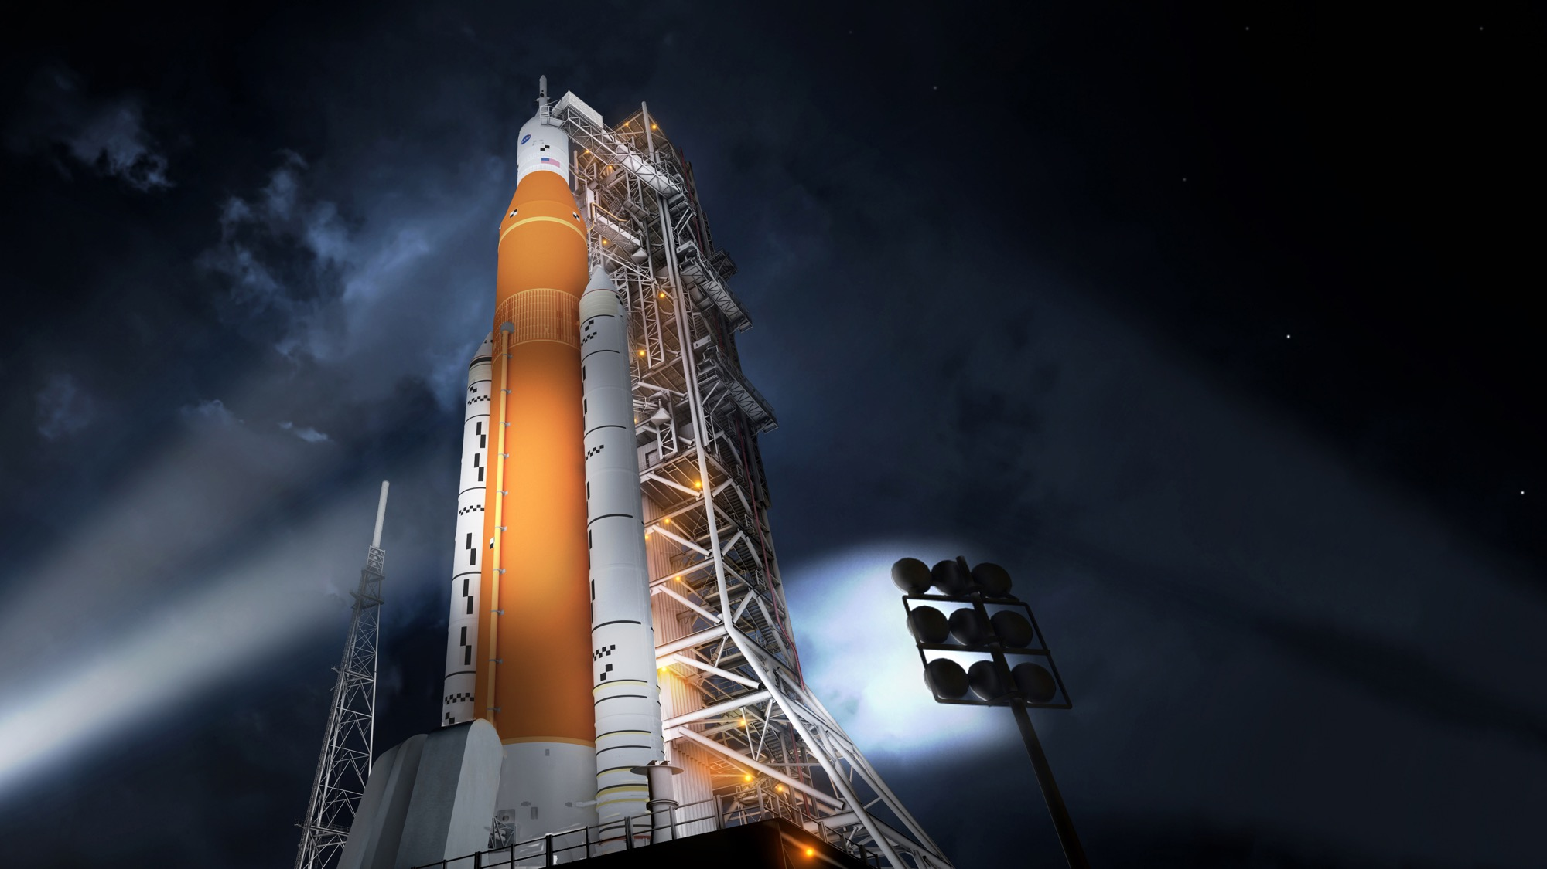

STATEMENT A: APPROVED FOR PUBLIC RELEASE; DISTRIBUTION IS UNLIMITED.
NASA’s
Space Launch System
Begins Moving to
the Launch Site
Sept. 29, 2020
BRUCE ASKINS
SLS Infrastructure Management Lead
Space Launch System Program
Notes:
Welcome
What you will see and I hope remember:
This is an all-hardware presentation. SLS Block I and Artemis I are real.
We are knocking down technical challenges. No technical advances required.
Work is under way on Artemis II and III and the next evolution of SLS to the Block IB.
No other existing vehicle has this capability, and this capability translates into greater exploration and greater opportunities for success in the harshest environment we know of.

Slide 2

SPACE POLICY DIRECTIVE-1
REINVIGORATING AMERICA’S HUMAN SPACE EXPLORATION PROGRAM
“Lead an innovative and sustainable
program of exploration with commercial
and international partners to enable human expansion across the solar system and to bring back to Earth new knowledge and opportunities.
Beginning with missions beyond low-Earth orbit,
the United States will lead the return of humans to the Moon for long-term exploration and utilization, followed by human missions to Mars and other destinations.”
Notes:
Space Policy Directive 1 signed in 2017 is very clear about a return to the Moon.
Going forward to the Moon, because we are going like never before. And, all of that is imbedded in SPD-1
Sustainably – going to stay…not a permanent human presence starting in 2024, but continual access to any part of the Moon, at any time for a strategic presence…with landers, rovers, robots…and with humans.
With Commercial Partners – instead of NASA purchasing, owning/operating the systems – in many cases we will buy services from companies. Leaves NASA to use our tax dollars to focus on those things ONLY NASA can do.
With International Partners – building a coalition of nations that will be involved in these missions. Canada has already signed up – committing to 24 years!
Utilization of resources – 2008/2009 we learned there were 100s of 1000’s of tons of water ice at the south pole. Air, water, rocket fuel.
We knew this was coming – and because we knew it, NASA had a plan to put humans back on the Moon by 2028.

Slide 3
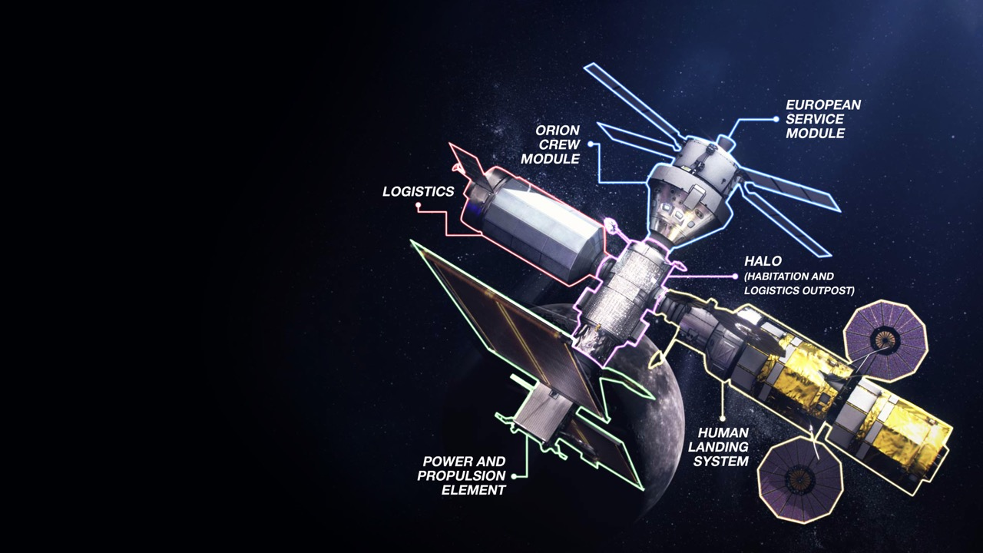
Gateway Enables Lunar and
Mars Exploration
Strategic presence around
the Moon
Resilience, sustainability, and robustness in the lunar architecture
Open architecture and interoperability standards are building blocks for partnerships and future expansion
Notes:
Initial Gateway focuses on the minimum systems required to support a 2024 human lunar landing.
Provides command center and aggregation point for 2024 human landing
Establishes strategic presence around the Moon – US in the leadership role
Creates resilience and robustness in the lunar architecture
Provides building block for the future, expanded capabilities on and around the Moon
The initial Gateway configuration will comprise only those components absolutely necessary for the landing in 2024.
However, it will form the hub around which we will build out for ongoing exploration. It is, in effect, a permanent command service element at the Moon.
It will be in a near-rectilinear halo orbit around the moon balanced between the earth’s gravity and the moon’s gravity. Solar electric propulsion (very light thrust) to maneuver and give access.

Slide 4
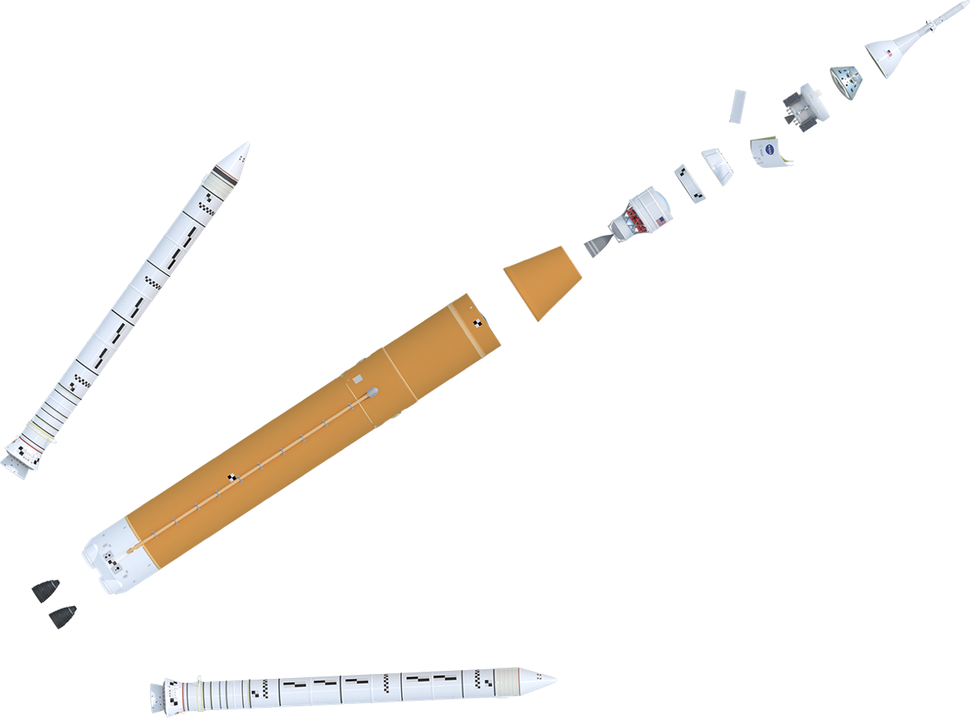
NASA’S SPACE LAUNCH SYSTEM
BACKBONE OF DEEP SPACE EXPLORATION
Launch Abort System (LAS)
BLOCK 1 CONFIGURATION
Crew Module (CM)
Service Module (SM)
Encapsulated Service Module (ESM) Panels
Spacecraft Adapter
Orion Stage Adapter
Orion Multi-Purpose
Crew Vehicle
Lockheed Martin
RL10 Engine
Aerojet Rocketdyne
5 Segment Solid Rocket Booster (2)
Northrop Grumman
Interim Cryogenic
Propulsion Stage (ICPS)
Boeing/United Launch Alliance
Launch Vehicle Stage Adapter
Teledyne Brown Engineering
Core Stage & Avionics
Boeing
RS-25 Engine (4)
Aerojet Rocketdyne
Notes:
Let’s take a look at the SLS Block I configuration for our maiden Artemis 1 mission:
Standing 322’ tall, weighing in at 5.75 million pounds and boasting 8.8m lbs of thrust… that’s enough thrust to hoist 57K lbs to TLI (154K to orbit. Block 1 will be our workhorse for the first phase of the Artemis Program…all about getting there!
Block 1 will be more capable than any current launch vehicle, able to deliver >27 metric tons (59.5k lb) to the Moon.
All major hardware for structural testing and for first flight have completed welding or assembly, and all are undergoing installation of insulation, wiring, piping, brackets, and other internal structures. We’ve completed engine section structural testing and intertank testing is under way.
On our first mission, Artemis I, will take the Orion crew vehicle farther into space than humans have ever ventured before.
Visible are the major elements of the Artemis I vehicle – solid rocket boosters, core stage, (engine section, LH tank, intertank, LOX tank, forward skirt) LVSA and ICPS, OSA, and Orion/SM/LAS.
Block 1 is just the first of larger and even more powerful and capable configurations that will take astronauts and cargo to Mars

Slide 5
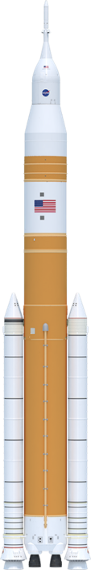
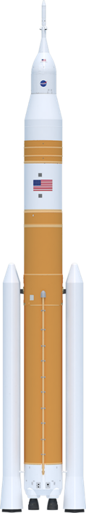
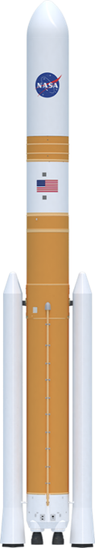
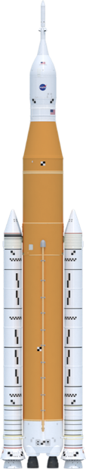
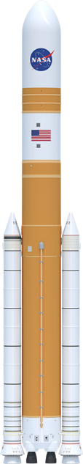
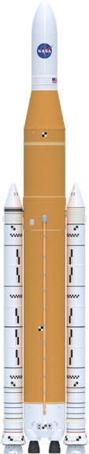
SLS Evolvability
Foundation for a generation of deep space exploration
322 ft.
Up to 313 ft.
365 ft.
325 ft.
365 ft.
355 ft.
Universal
Stage Adapter
Universal
Stage Adapter
Launch Abort System
5m Class Fairing
(up to 63’)
8.4m Fairing
Short (Up to 63’)
8.4m Fairing
Long (Up to 90’)
Orion
Interim Cryogenic
Propulsion Stage
Exploration Upper Stage
Exploration Upper Stage
Exploration Upper Stage
Launch Vehicle
Stage Adapter
Interstage
Interstage
Interstage
Core Stage
Core Stage
Core Stage
Solid
Rocket
Boosters
Solid
Rocket
Boosters
Evolved
Boosters
RS-25 Engines
RS-25 Engines
SLS Block 1
SLS Block 1 Cargo
SLS Block 1B Crew
SLS Block 1B Cargo
SLS Block 2 Crew
SLS Block 2 Cargo
> 27 t (59.5k lbs)
> 27 t (59.5k lbs)
38 t (83.7k lbs)
42 t (92.5k lbs)
> 43 t (94.7k lbs)
> 46 t (101.4k lbs)
Payload to TLI/Moon
Notes:
We are focused on Block 1, 2021 first launch and 2024 human landing.
But SLS was designed to evolve to greater power, mass and volume based on the basic core stage design and evolved propulsion systems.
There are 3 Block variants with crew and cargo versions of each.
This capability allows us to grow from more than 27 metric tons (59,000 pounds) to the Moon to more than 46 metric tons (101,000 pounds) to the Moon.
In space exploration, bigger, heavier stuff isn’t just a convenient nice-to-have capability. It translates into less hardware complexity, less mission complexity, less risk, and greater chances of success in the unforgiving space environment.
While SLS is focused on the early Artemis missions, we are also making tangible progress toward future lunar and Mars exploration.

Slide 6
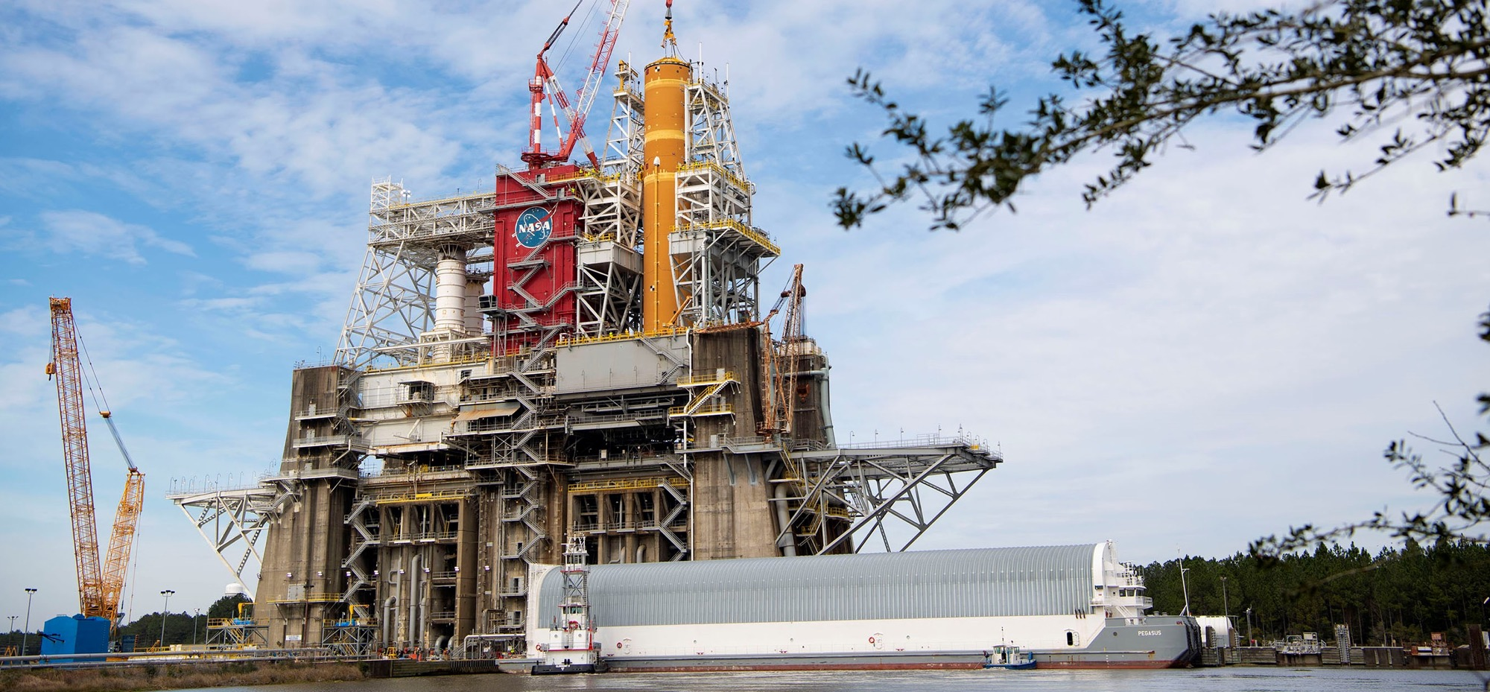
ARTEMIS I CORE STAGE complete
Artemis I Core Stage in Green Run testing at SSC
Core Stage ships to KSC late 2020/early 2021
Notes:
Image: Artemis I core stage lifted into SSC B2 test stand
The SLS core stage is an all new development.
The SLS Core Stage will be the tallest rocket stage ever flown. When completed, the Core Stage will be 212 feet tall (64.6 m) and 27.6 ft. (8.4 m) in diameter. And weigh 2.3 million pounds when fueled.
The core stage holds 537,000 gallons of liquid hydrogen and liquid oxygen.
The Core Stage is built by prime contractor Boeing at Michoud Assembly Facility outside New Orleans, LA,
Completed stage shipped to Stennis Space Center in January 2020 for “green run” testing to demonstrate stage systems integrated functionally and performance; collect performance data for validating analytical models used to verify requirements, collect dynamic response data used in model correlation.
Green run test series of 8 test cases – scheduled to complete TC-4 in August. Working toward TC8 Hotfire in October. Test series includes:
Green run test series of 8 test cases –
Modal
Avionics
Safing
MPS/engine leak/functional checks
Pneumatics/TVC
Simulated Countdown Demo
Wet Dress Rehearsal
Hotfire
NASA shutdown in March 2020. Michoud also resumed work in May. More than 300 people return to work.
Lost 2.5 to 3 months
Completed Test Case 2 in June.
SITFQ/ Stage controller orderly resumption of work in May
Phase 1 stage controller software complete and operating for test cases up to Wet Dress Rehearsal.
Completed CS1 stage controller Phase 2 software FQT in June. Undergoing validation. Will be used for terminal countdown sequence and fill/drain ops
Completed 8 component qualifications in 2020.
Forecasting shipment to KSC in late 2020 or early 2021
All major Core Stage 2 structural components complete. Targeting June 2022 delivery date
Forecasting 22% reduction in labor hours and 55% reduction in discrepancy rate.
Core Stage 3 procurement almost complete. Materials arriving at machine houses. Targeting February 2024 delivery
Core Stage 4 schedule and procurement activity under way.

Slide 7
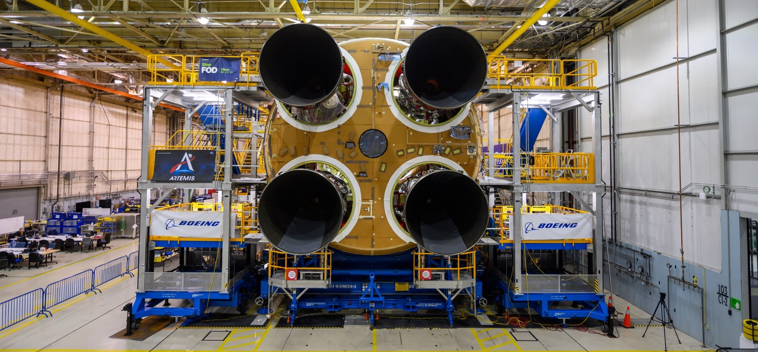
ARTEMIS I ENGINES Installed
Artemis I: Engines installed on Artemis I core stage
Artemis II engines processed. Artemis III engines in processing
Notes:
Image: engines integrated into core stage 1 at Michoud
SLS core stage engine is the Aerojet Rocketdyne RS-25, formerly known as the Space Shuttle Main Engine. The first four flights will be powered by 14 flown and two new engines from the shuttle program.
More than 500,000 pounds of vacuum thrust.
Operational power level increased from 104.5% during shuttle to 109% for SLS.
All four Artemis I engines are installed in the core stage at MAF and the stage is now in green run testing at SSC.
There are 256 engine installation steps.
Program has been hot-fire testing the RS-25 engines since 2015 to ensure the engines can perform under the different SLS pre-launch conditions, higher heating environment, and flight thrust profiles, and also to qualify the new controllers
32 tests and nearly 15,000 seconds hot fire time to date.
Testing resumes this fall with “Retrofit 3” series to include new parts as part of the “Restart” engine program to restart manufacturing with the goal of making engines expendable, operate at 111% thrust, and reduce cost by 30% over SSME.
Artemis II flight engine set processed and awaiting need date from Boeing for core stage installation.
First Artemis III flight engine completed processing. Other three scheduled to be finished this year.
Total of 18 engines under contract as part of the “Restart” engine contracting with Aerojet Rocketdyne. Work on first six ongoing.
AR is also working to build 10 RL10 engines for SLS. First six complete. Four assigned to Exploration Upper Stage for the Block IB variant and two originally for EUS redesignated for two additional Block I flights added to the early manifest.
Sea-level engines for green run in design, saving the cost and time for a diffuser in the A-1 stand.
Engine Fast Facts:
4 RS-25 engines vs 3 for shuttle,
109% thrust vs 104.5%,
new controller and software and nozzle insulation,
more than 500,000 lbs thrust each, more than 1 million seconds total ground and flight time
Program began with 14 flown engines and 2 new serial number engines built from spares

Slide 8
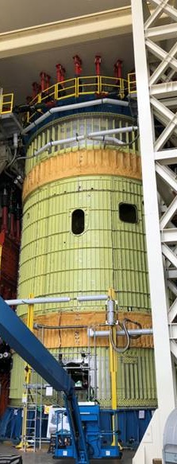
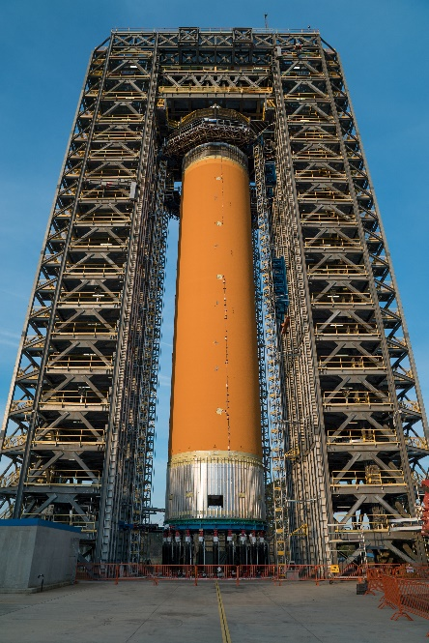
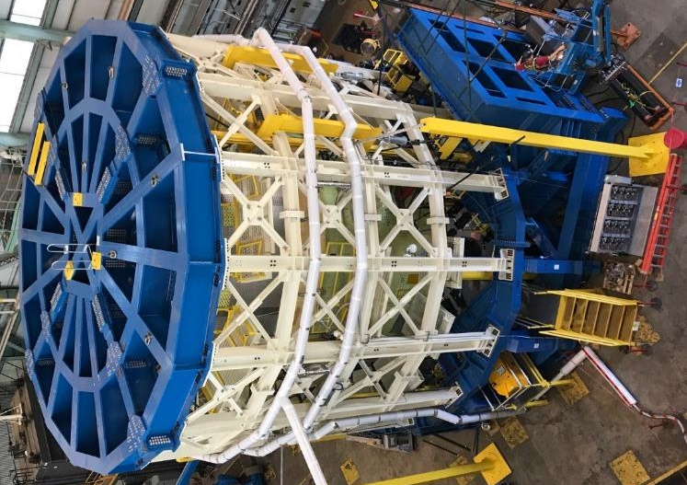
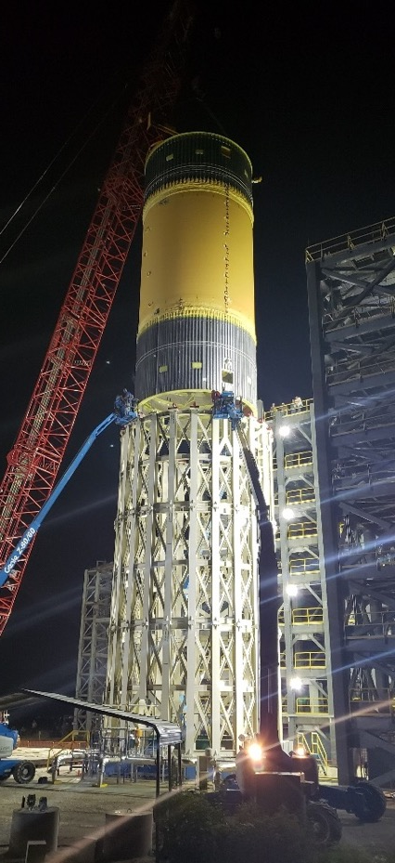
STRUCTURAL TESTING complete
Notes:
SLS structural testing 2015 – 2020 – largest structural test campaign at MSFC since Shuttle
Boeing test articles structurally identical to flight stage subjected to combination of axial, shear and moment loads replicating flight loads.
Left – Right: engine section, intertank, LH tank, LOX tank structural test articles at MSFC
Not shown: Integrated Structural test of the ICPS, Orion Stage Adapter, LVAS and adapters (not shown)
LOX STA Test to Failure in June using 196,000 gallons of water.
LH2 STA Test to Failure December 5, 2019.
Summary: 5 structural test articles underwent 199 separate test cases and more than 421 gigabytes of data were collected to add to computer models used to design the rocket
Three-year campaign results indicate health margin in the designs and equally important strong correlations to modeling, which justifies calculated margins.

Slide 9
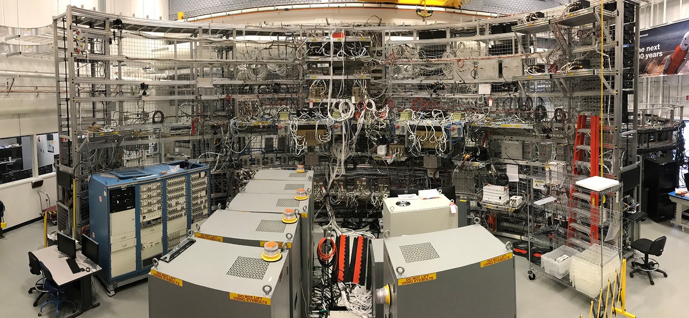
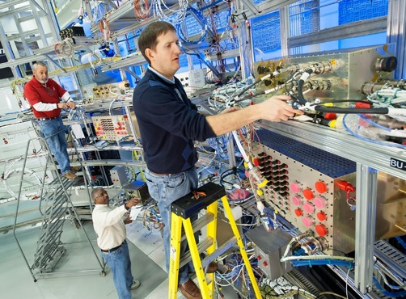
SOFTWARE INTEGRATION AND TESTING
Notes:
Image: MSFC SIL/SITF
Flight software developed in-house at MSFC
Stage Controller Phase 1 Development Test Complete
Core Stage (CS) 1 final integrated functional test (including avionics) at Michoud complete
The SLS Core Stage Controller Phase II Functional Qualification Testing (FQT) Test Readiness Review (TRR) took place on June 23, 2020. The test will cover 266 software requirements to be closed through verification and six software requirements closed by analysis. The test team tested 24 hour per day seven days per week (excluding July 4th) from June 23 through July 14.
Green Run Test Cases 2 avionics power on and 3 safing checks complete
The Phase II Stage Controller Validation Test Readiness Group (TRG) review took place on June 25, 2020. The purpose of the Phase II Validation test is to verify the Stage Controller operates as intended in support of Green Run Wet Dress and Hot Fire. The test will consist of eight nominal tests, and 121 Off-Nominal test cases. The team has loaded FR 2.0.0 (Pre-Formal Qual Test) Stage Controller Software (SW). The test team is currently still running dry runs on both Nominal and Off-Nominal test cases. The completion of the TRG review and availability of Pre-FQT Stage Controller SW will give the test team flexibility to complete final test runs when test cases are ready.

Slide 10
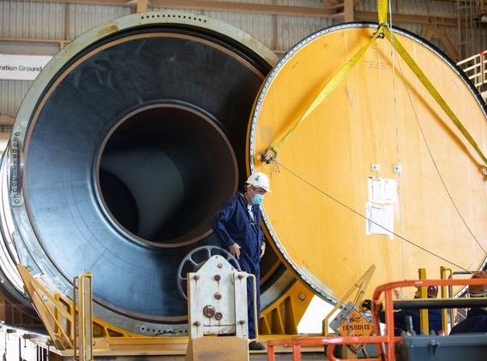
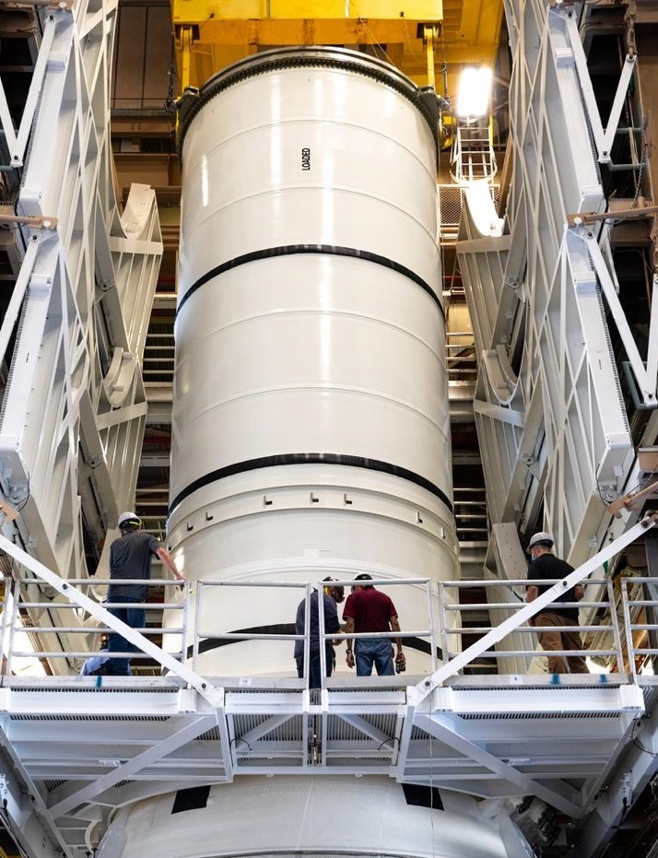
ARTEMIS I SOLID ROCKET BOOSTERS COMPLETE
Artemis I: all segments delivered to KSC and booster assembly has begun
Artemis II motor segments complete
Notes:
Left: booster segments delivered to KSC
Right: Assembly of first booster aft assembly
Boosters are built by Northrop Grumman
Each 177 feet or 17 stories tall – taller than the Statue of Liberty
Each is 12 feet in diameter
Provides 75 percent of vehicle thrust for the first two minutes of flight.
Each booster burns through 1,385,000 pounds of propellant in two minutes – an average of 5.5 tons of propellant every second
SLS boosters leverage shuttle boosters
Five segments, instead of four
All-new avionics, asbestos-free insulation
All booster segments complete and delivered to KSC for Artemis 1
Assembly for the first booster aft assembly has begun
Transferred Artemis I aft skirt assemblies to EGS/TOSC.
Both Artemis I forward assemblies in pre-transfer inspections and on track for October delivery to EGS/TOSC.
Motor segments for Artemis II complete and casting under way for third flight set boosters
Development work underway for new next-generation boosters, after the ninth flight, when shuttle-era hardware is expended.
Flight Support Booster-1 nearing assembly completion and on track for Sept. 2 test.

Slide 11
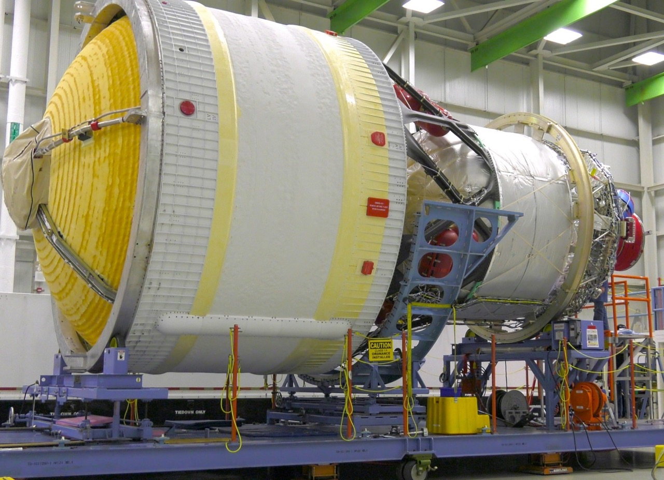
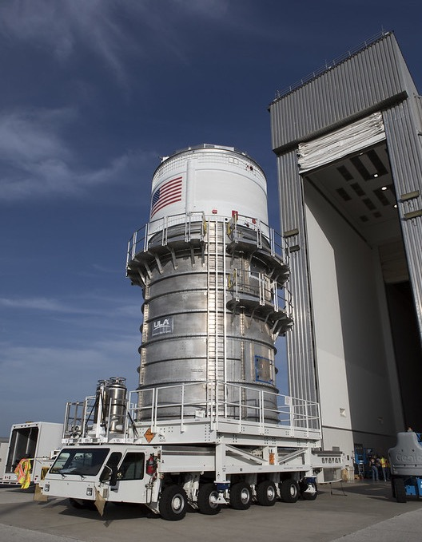

ARTEMIS I INTERIM CRYOGENIC PROPULSION STAGE COMPLETE
Notes:
Built by Boeing/ULA
Two more ICPS missions added to Artemis manifest
modified Delta Cryogenic Second Stage by lengthening LH2 tank, adding hydrazine bottles for attitude control and minor avionics changes
42’ tall x 16’ wide
Powered by one AR RL-10B-2 engine/LH2/LOX
24,750 lbs thrust
Provides TLI burn for Orion (Artemis I)
Artemis I ICPS delivered to KSC in 2017.
Artemis II/ III stages authorized.
Artemis III ICPS manufacturing under way at ULA in Decatur, Alabama
Artemis III ICPS production starts Spring 2021.

Slide 12
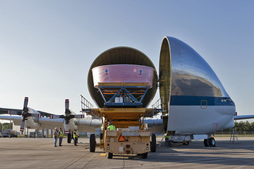
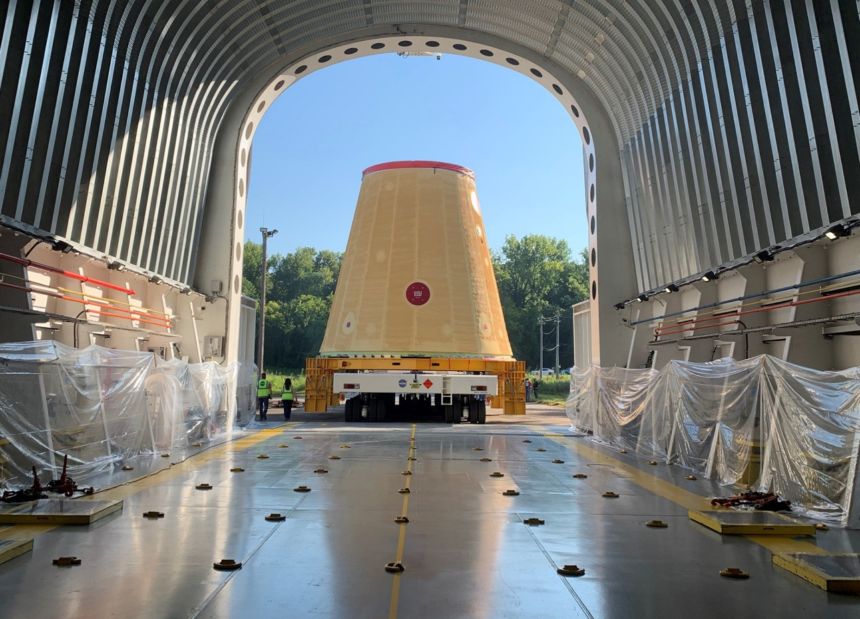
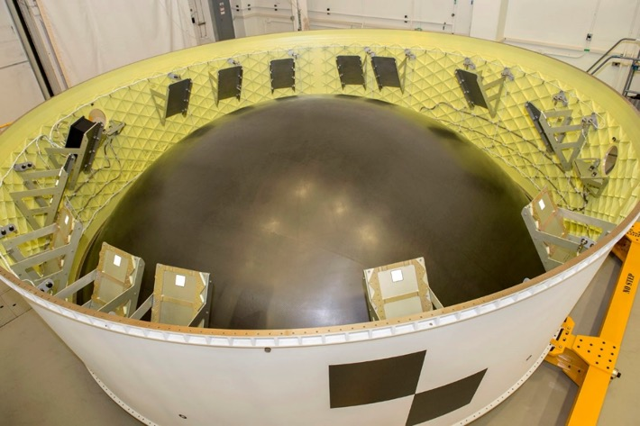
ARTEMIS I STAGE ADAPTERS complete
Orion Stage Adapter delivered to KSC
Launch Vehicle Stage Adapter delivered to KSC
Notes:
Payloads
LVSA connects core and upper stages
27.5’ long and 27.5’ wide at base, tapers to 5 m at top
Friction-stir welded lightweight aluminum alloy
Manufactured by Teledyne Brown @ MSFC
Right: LVSA after final processing, installation of the frangible joint assembly and other hardware and final leak checks, shipped to KSC and arrived in July.
Artemis II LVSA – forward panels welded, aft cone panels ready for welding, preparing to weld aft ring.
OSA connects ICPS and Orion
5’ high, ~18’ diameter
Holds 13 cubesats and avionics unit for Artemis 1
Left top: OSA transported in Super Guppy.
Left Bottom: OSA complete @ MSFC; you can see the brackets for the secondary payload deployment system. IT is now at KSC.
Artemis II OSA barrel panel welding complete. Fore and aft rings at MSFC. Diaphragm complete and ready to ship to MSFC.
Artemis III OSA procurement initiated for barrel panels. Preparing to ship material to AMRO. Fore and aft rings procured and at MSFC.

Slide 13
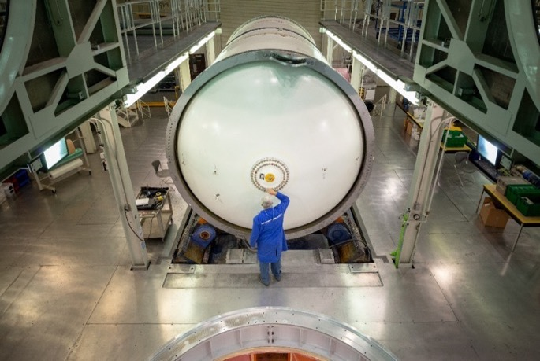
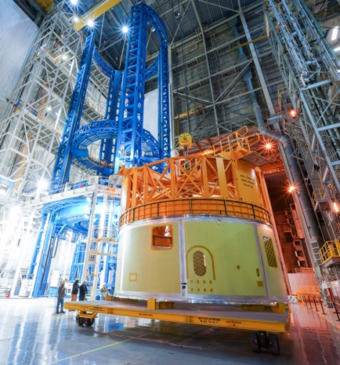
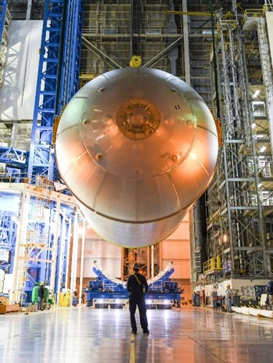
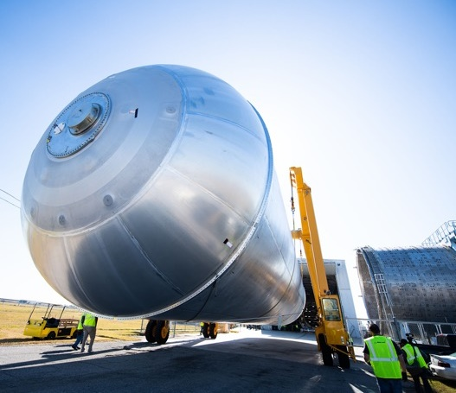
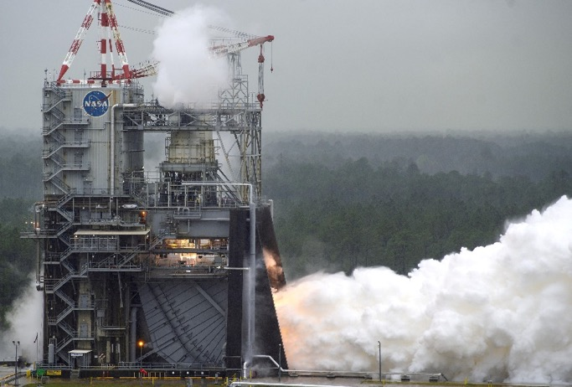
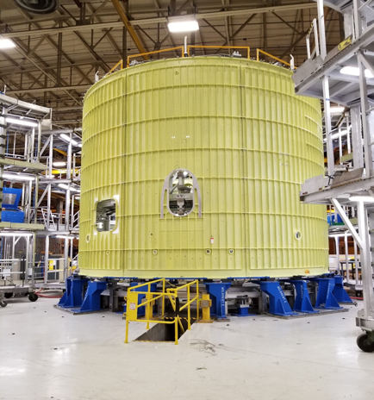
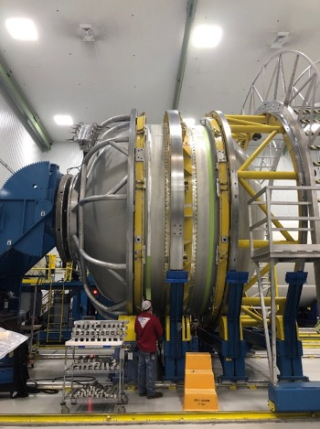
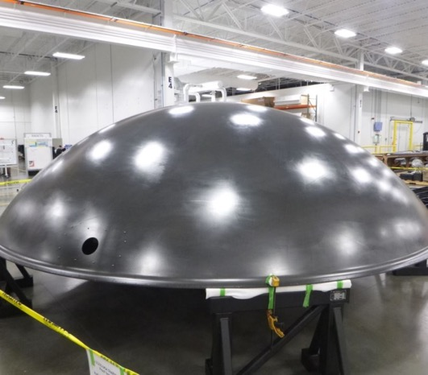
SLS PROGRESS TOWARD ARTEMIS II
All Booster motor segments complete
Core stage forward skirt
Liquid oxygen tank
Liquid hydrogen tank
RS-25s engines complete,
controllers green run
Intertank
ICPS LOX tank
OSA diaphragm complete
Notes:
Top Left: All 10 booster motor segments for Artemis II are complete and in storage. Segment casting for the third flight set is underway.
Top Left/middle, right/middle, right: Core Stage 2: All components manufactured and in various stages of prep and outfitting
Bottom/right/middle: In-Space Stage adapters being welded at MSFC; Interim Cryogenic Propulsion Stage in progress
Bottom Left: All four Artemis II flight engines complete and stored in place; all controllers green run
Also realizing production improvements in building CS-2 for Artemis II:
Although we have prioritized our resources to complete CS-1, the Artemis 2 core stage production schedule currently is averaging 50% improvement in schedule over the Artemis 1 core stage
We have so far seen a 70% improvement in labor hours on the engine section and 33% improvement on the intertank.
To break that down further, for the engine section, the most complex section of the core stage, we have seen a significant improvement in manufacturing discrepancies, a 97% improvement in rework hours and an overall 70% improvement in baseline labor hours required.

Slide 14
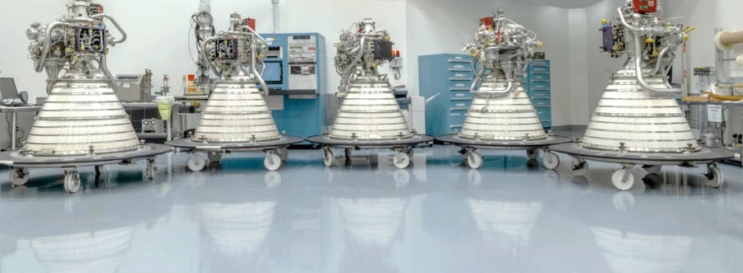
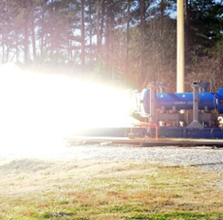
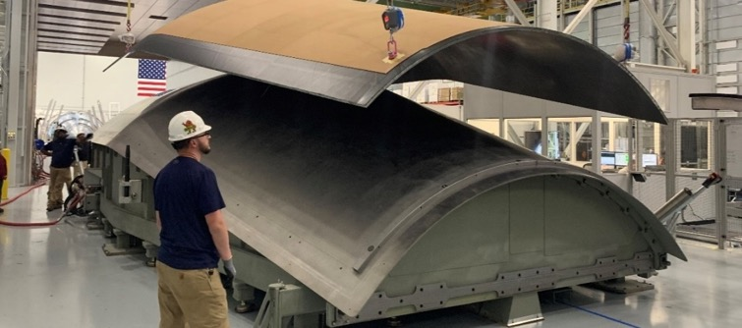
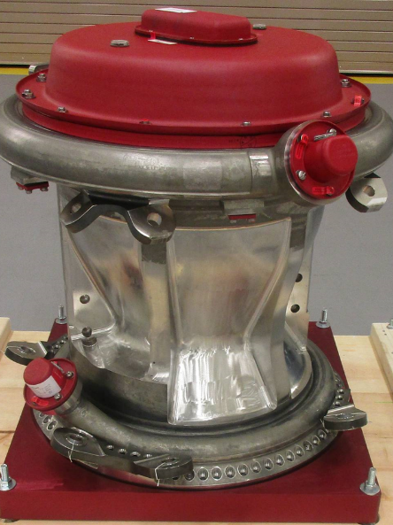
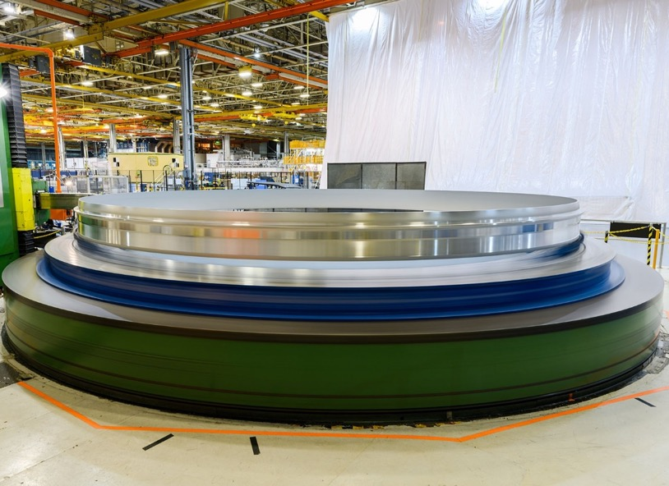
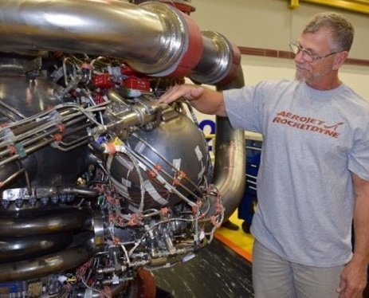
BEYOND Artemis II
RL10s complete
BOLE subscale motor test fire
Universal stage adapter manufacturing demonstration article
RS-25 HIP-bonded main combustion chamber
EUS weld confidence, development articles
Additively manufactured pogo accomulator
Notes:
Top left: Six RL-10s tested and complete for Artemis II, Artemis III and EUS for Block IB. (five shown)
Top center: Development work on next-generation boosters is underway
Top right: Payload adapter manufacturing work @ MSFC for Block IB
Bottom Left: Much work is under way on developing a new more affordable, expendable variant of the RS-25 that costs at least 33 percent less and operates at 111% (521,000 lbs) thrust. In September, we will resume hotfire tests that continue testing new components like a 3D printed pogo accumulator (bottom right) and a hot isostatic pressure (HIP) bonded main combustion chamber (bottom left).
AR awarded initial contract for 6 new “restart” engines, which are under way AND a follow-on contract for additional 18 engines that will operate at 111% thrust and cost 30% less than the shuttle engines.
Bottom center: EUS weld confidence articles: on the right is a ring segment; left is a barrel panel; mention EUS JOFOC
Bottom right: Artemis III LH2 tank – former first flight article re-welded to meet strength requirements.
Not Shown: Artemis II ICPS in construction and planning underway for modifications at Michoud Assembly Facility to accommodate expanded core stage/EUS production.
Not Shown: First Artemis III RS-25 completed processing for flight and stored in place till needed.

Slide 15
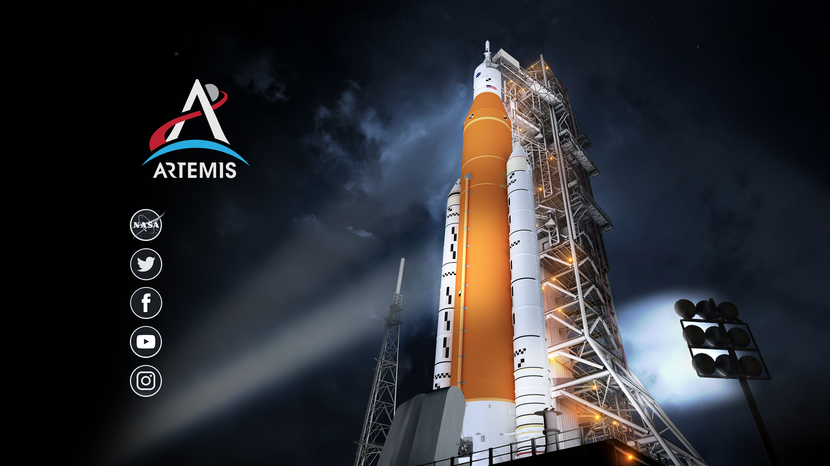

www.nasa.gov
@NASA_SLS
NASASLS
youtube.com/nasa
@explorenasa
Notes:
The best way to follow developments with SLS, Orion, Ground Systems and the Artemis program is to follow us on social media at the links listed here.
Thanks for tuning in. I’ve always wanted to say that.
I’ll come back to where I started. What I hope you saw and and will remember:
SLS Block I and Artemis I are real. We’re testing the core stage now. Everything else is at KSC, and we’re almost ready to start stacking this rocket for launch.
We are knocking down technical challenges. No technical advances required.
Work is under way on Artemis II and III and the next evolution of SLS to the Block IB.
No other existing vehicle has this capability, and this capability translates into greater exploration and greater opportunities for success in the harshest environment we know of.

