Slide 1
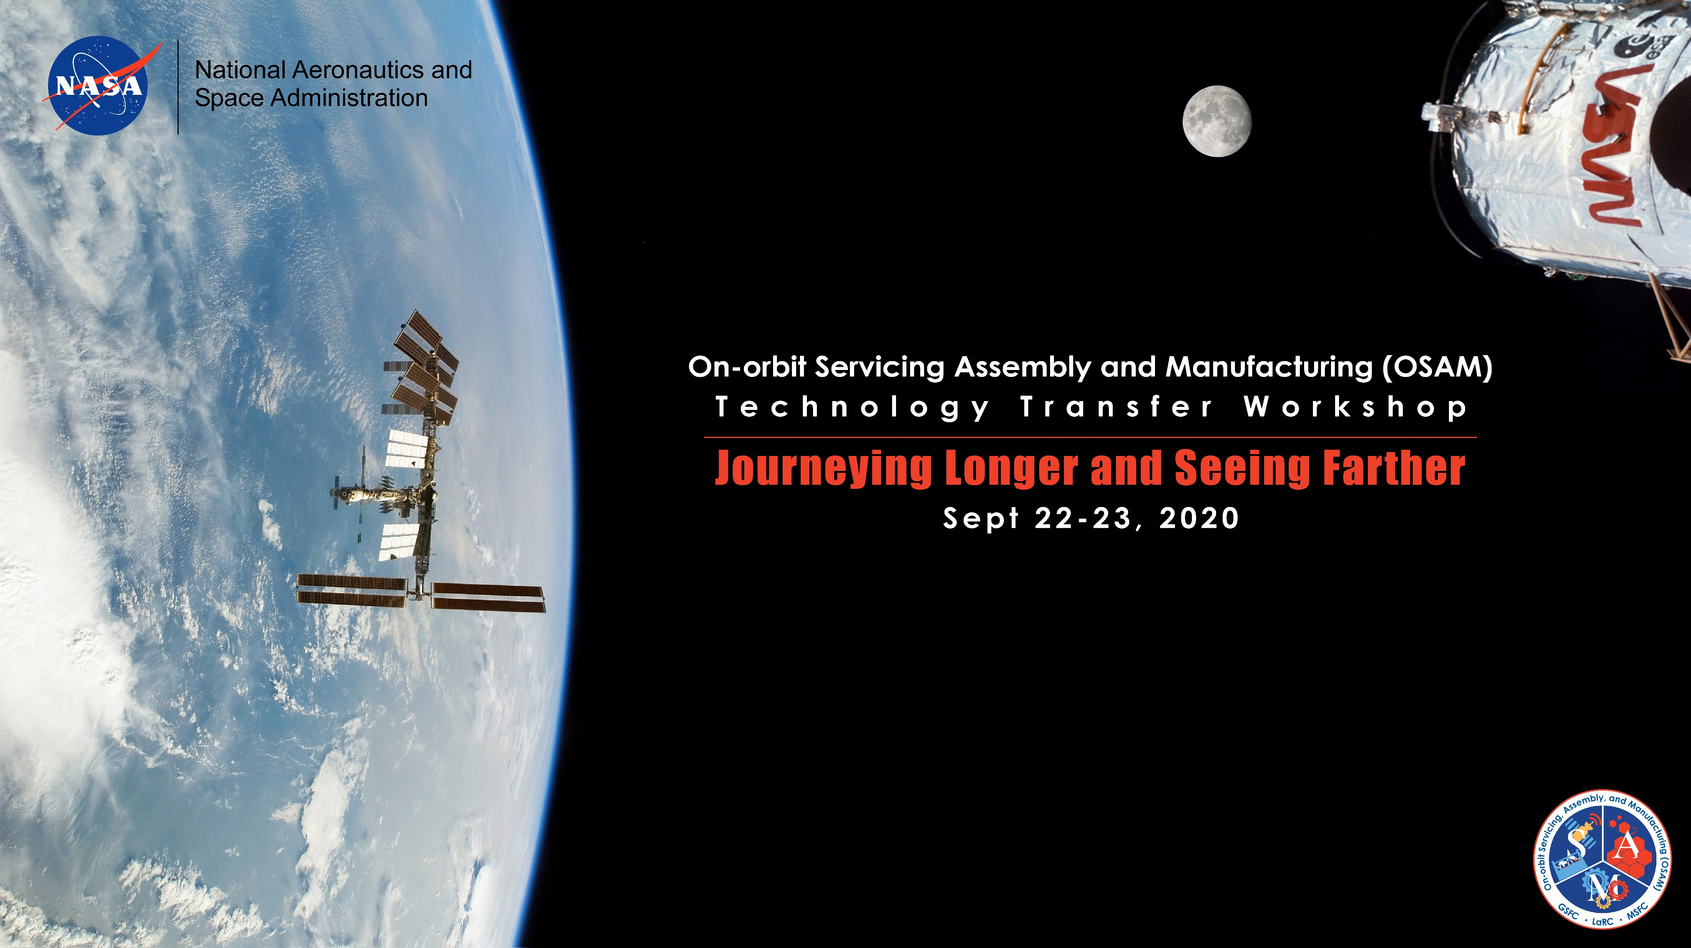
OSAM Architectures and Modular Concepts Session
Session Chair: Dr. Meghan Chandarana
This document has been approved for public release.

Slide 2
Persistent Presence
Goal: Develop necessary technologies to enable future sustainable missions.
Technologies
Sustainable
Adaptable
Long-life
Building block

Slide 3
Enable Necessary Capabilities
Construct infrastructure – on-orbit/on-surface
Repair infrastructure – on-orbit/on-surface
Persistent assets
  Examples:
    Large Space Telescopes
    Communication networks
Refueling
Exploration
Access to new environments
Missions: Moon to Mars, Earth Science, etc.
Notes:
Access – harsh environments, new (space, Mars, etc.)

Slide 4
Session Outline
Architectures and Modular Concepts Overview | Dr. Dale Arney
Persistent Orbital Assets
Surface Infrastructure
E-beam Welding | Ms. Karen Taminger
Safe Haven | Mr. Pat Cosgrove
Surface Construction | Dr. Bob Moses
Modular Structures and Assembly | Mr. Bill Doggett and Mr. John Dorsey

