Slide 1
CARA Large Constellation Status
Megan Johnson

Slide 2
Agenda
Starlink and OneWeb Event Stats
Review of completed work
  General work to support large constellations
  Starlink specific work
  OneWeb specific work
Future work

Slide 3
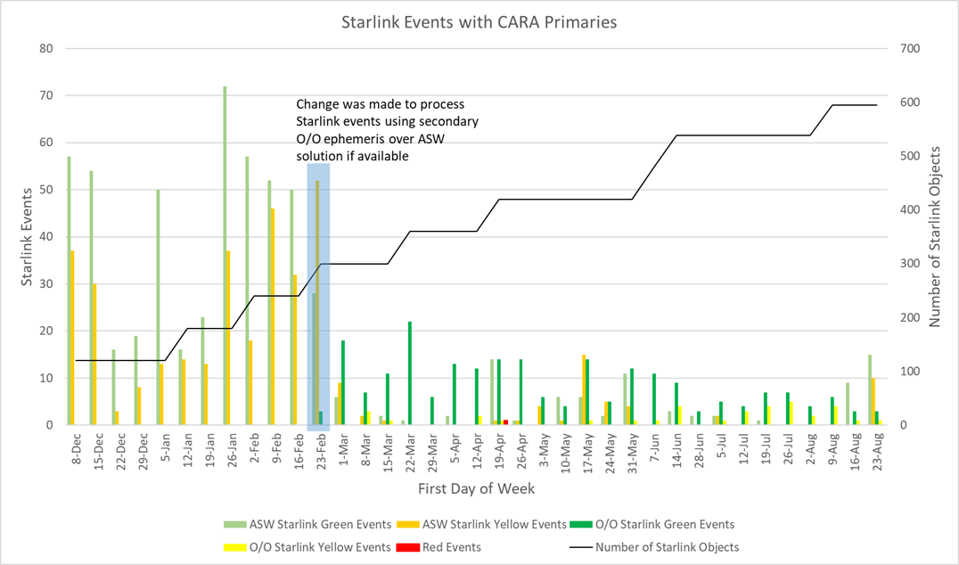
Starlink Event Stats
(as of 23 Aug)
Number of events has been low; about 10 per week total
  To date, two red events have been identified
Starlink performed an avoidance maneuver on 18 August to avoid NASA payload
  Highest event Pc 3.78E-3 based on CARA analysis

Slide 4
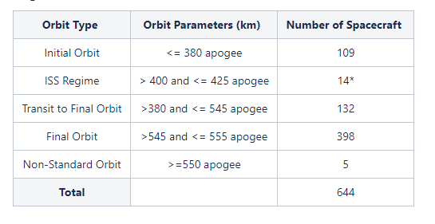
Starlink Payloads
(as of Aug 27)
Starlink launches have continued routinely with 644 payloads currently in orbit
  Latest launch was 28 August
  109 payloads currently in initial orbit
  132 payloads currently in transit
  398 payloads currently in the operational orbit
34 Starlink payloads have been identified as non-maneuverable
  Include both dead and active payloads
  Starlink indicated low likelihood that non-maneuverable payloads would resume maneuvering
Mission routinely delivering 3 day O/O ephemeris
*ISS Regime payloads also counted as in transit

Slide 5
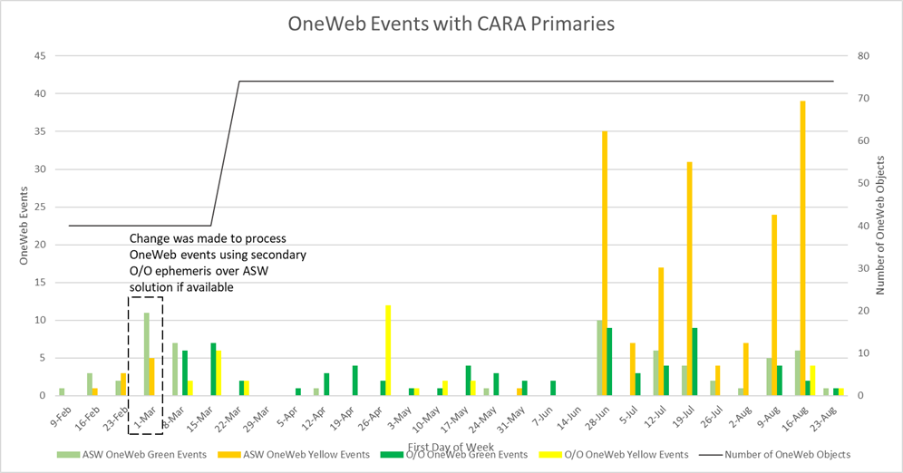
OneWeb Event Stats
(As of 23 Aug)
Erroneous inclusion of ASW OneWeb data in July/August led to increase in yellow events
  ASW solution determined inadequate for CA
Low number of O/O events identified < 10 per week
First batch of ascent maneuvers through A-Train completed without any events of concern identified
  Second batch began ascent mid-September

Slide 6
CARA Large Constellation Work
CARA has implemented many procedure and software updates over the last 8 months to support an increasing number of secondary payloads and large constellations on-orbit
  Updated CARA Summary Reports to utilize multiple data sources for secondary object
    All available secondary O/O data to be used in nominal screenings
  Created Automated Maneuver Screening (AMS) script for CARA OSAs that allows automatic repeated screenings of special maneuver ephemerides at an eight-hour cadence
  Fast-tracked CA Handbook to provide industry best practices
  Contacted additional secondary O/Os such as Amazon’s Project Kuiper, BlackSky, and Planet Labs to coordinate CA practices

Slide 7
CARA Starlink Work
Established weekly (now bi-weekly) working group with Starlink team in January 2020
Developed Emergency Contact Procedure describing when and how CARA will reach out to Starlink for a CA event
Updated CAS to generate CDMs for Starlink for CARA missions that do not provide covariance data
Hosted multiple Users Forums to present Starlink CONOPS information to CARA Users
Forward out weekly ascent maneuver information from Starlink
Developed daily Starlink spacecraft status email based on latest maneuverability information on Space-Track

Slide 8
CARA OneWeb Work
Began meeting with OneWeb in 2017 to help develop CA CONOPS
Presented CA CONOPS information in April Users Forum
Worked with OneWeb Flight Operations team to discuss August-September 2020 ascent maneuvers
  Identified potential covariance issues and mitigation strategy
  Set-up M-W-F meetings with OneWeb operations team to discuss any high interest events identified with their ascent plan

Slide 9
Future Work
Continue dialog with Starlink and OneWeb teams to identify any potential issues and develop mitigation strategies as needed
Work with future secondary O/O missions to understand their CONOPS and CARA support approach
Publish CA Handbook of best practices to provide a reference for other space actors
Update internal CARA training program to include large constellation information
Implement CARA website for Summary Report delivery to resolve any concern over report size due to increase in CA events with secondary O/Os

