Slide 1
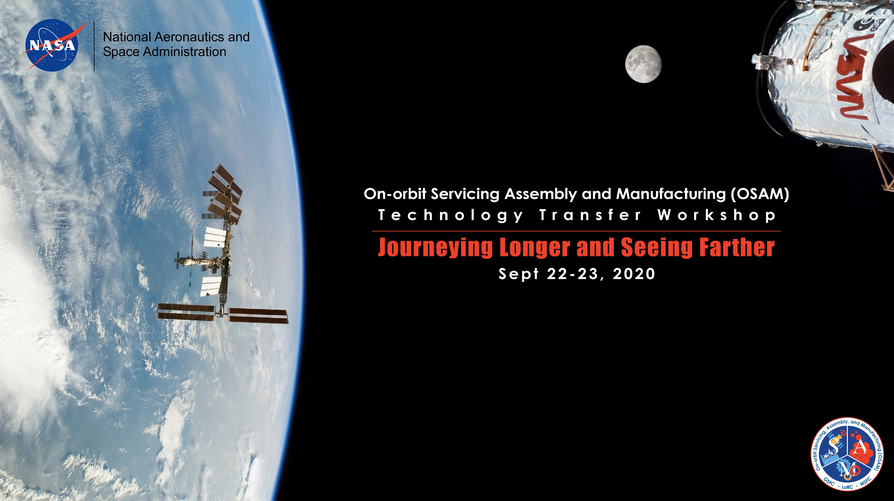
Lunar Safe Haven
Seedling Study
Presenter: Mr. Patrick Cosgrove

Slide 2

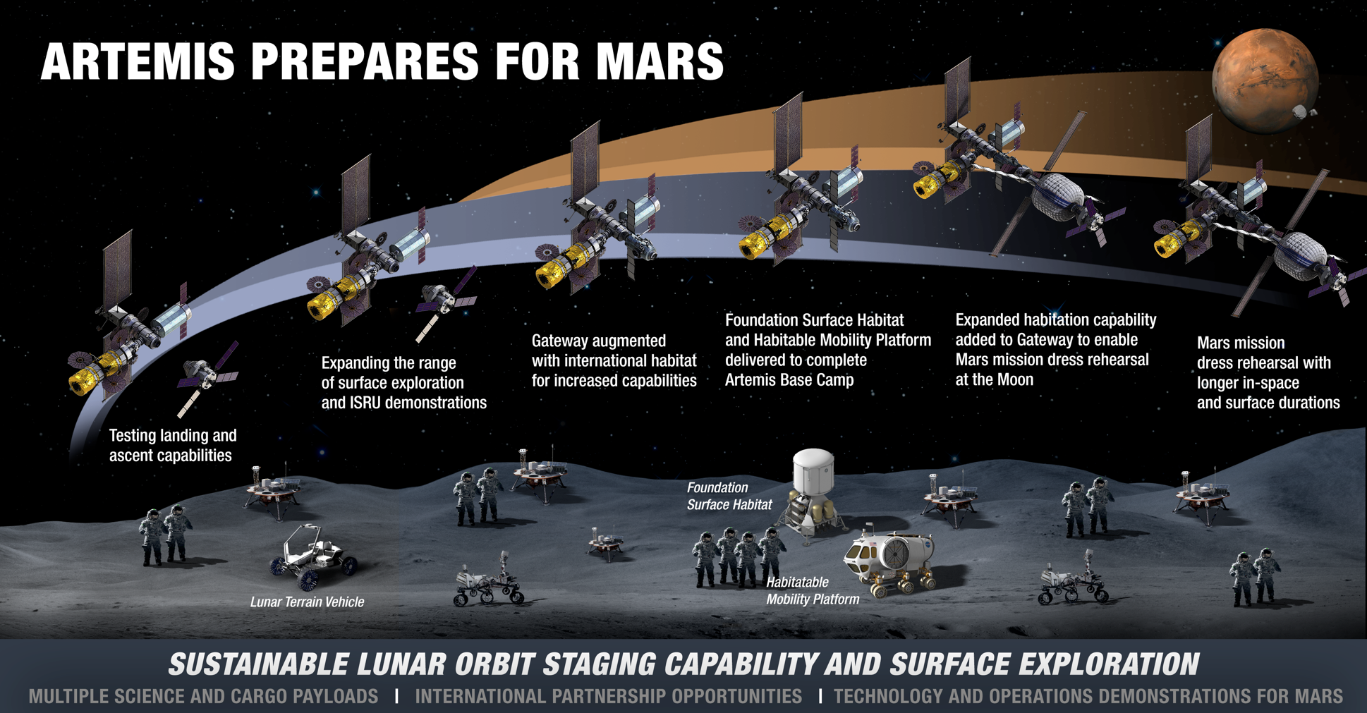
NASA’s Plan for Sustained Lunar
Exploration and Development
NASA Exploration Level Zero Goals
Expand U.S. human spaceflight operations at the Moon to support sustained lunar surface activities and to demonstrate elements of a Mars-forward architecture.*
Artemis After 2024
After Artemis III, the overall plan is to conduct operations on and around the Moon that help prepare us for the mission durations and activities that we will experience during the first human mission to Mars, while also emplacing and building the infrastructure, systems, and robotic missions that can enable a sustained lunar surface presence.*
This Seedling Study will flesh out NASA’s plan to protect our astronauts and assets with a Lunar Safe Haven!
Small Team from Langley, KSC, and MSFC to survey NASA technologies and capabilities for inclusion
With needs and gaps we will look to industry, academia and OGA’s for potential solutions
Notes:
Our study is to fill a gap in the current architecture studies and strategy Planning (above report released Friday)
1: Level zero construction requirements. Level 0 Reqt’s are the top-level, motherhood requirements, basic functionality that must be met, e.g.:
The Safe Haven shall provide radiation protection for crew with a total dosage of XXX over XXX days
…provide micrometeorite (MM) protection from a direct impact of a XX diameter MM traveling at XX km/s
….provide protection from launch/landing blast ejecta of 100 micron regolith particles traveling at 2,000 m/s
….provide thermal swing protection to provide a stable thermal environment at XX degree Celsius
…..be structurally safe with a structural loads factor of safety of 3:1
…. capable of withstanding seismic loads that occur during Moonquakes at maximum XXX Richter scale

Slide 3


Lunar Safe Haven Seedling Study
Timeline / Budget: 12 months beginning October 1 2020 / ~$ 400k
Deliverables:
Intended Outcomes:
Pre-phase A assessment of several shelter concepts that enable required crew safety, minimize delivered mass, and maximize utilization of planned Artemis mission assets.
Integration with other GCD and LSII proposals dealing with ISRU, surface construction, assembly, landers etc.
Leverage previous STMD investments to advance needed technologies
Identification of other experts and related activities inside and outside the Agency
Level 0 Lunar construction requirements for a safe haven shelter
Trade Study Results of several concepts and identify current mission assets that could be used or leveraged
Development Plan for the construction of a Lunar Safe Haven for sustained operations by 2028
Ensuring astronauts and their equipment are safe on the lunar surface
Notes:
2) Next chart please
The proposed Lunar Safe Haven Seedling Study will take 12 months beginning this October, and will cost $1.67M
We define a Safe Haven as a part of the lunar infrastructure that protects crew and systems from the harsh lunar environment. We envision it to be a structure that is constructed on the surface and then covered with regolith to minimize launch and landing mass. There are many potential ways to construct this structure. Determining the best way will be the focus of this Seedling Study.
A Lunar Safe Haven-like surface element is currently a gap in the Artemis plans as well as the Exploration Architecture teams plans.
Since last March’s announcement by the Vice President, HEOMD and Artemis have been focused on the first Artemis landing by 2024. HEOMD has a development gap in the Taxonomy area of TX12 12-21 Surface Habitation, which to be clear, this study WILL NOT focus on.
HEOMD also declared Development gaps in TX6 06-38 Radiation shielding, and TX12 12-07 Construction of Unpressurized Structure for Protection; both of these gaps are the focus of our Study.
Last Friday NASA released the Plan for Sustained Lunar Exploration and Development which defines Exploration Level Zero Goals. Goal 4 includes… “Expand U.S. human spaceflight operations at the Moon to support sustained lunar surface activities and to demonstrate elements of a Mars-forward architecture.”
In the Section addressing Artemis After 2024, it states that our activities in and around the Moon are to prepare us for Mars, “while also emplacing and building the infrastructure, systems, and robotic missions that can enable a sustained lunar surface presence.”
Our study will focus on that infrastructure and the systems it includes and supports, potentially enhancing the Artemis architecture and surface operations.
The study will examine NASA developments in surface and in-situ construction, advanced materials and structure design, assembly, handling and manipulation, in-space manufacturing, and In situ resource utilization to determine the best approach and provide a plan to develop a Lunar Safe Haven by 2028
Our Team knows that we can only deliver the required report by reaching all of NASA’s Centers and all of our human exploration expertise. Among other Teams, we will interface with HEOMD’s Lunar Surface Operations Team, the EVA and Astronaut Office, and the Human Research Program, all at lead by JSC.
Our deliverables will be:
1: Level zero construction requirements, which are the top-level requirements that define basic functionality that must be met, e.g.:
The Safe Haven shall provide radiation protection for crew with a total dosage of XXX over XXX days
…provide micrometeorite (MM) protection from a direct impact of a XX diameter MM traveling at XX km/s
….provide protection from launch/landing blast ejecta of 100 micron regolith particles traveling at 2,000 m/s
….provide thermal swing protection to provide a stable thermal environment at XX degree Celsius
…..be structurally safe with a structural loads factor of safety of 3:1
…. capable of withstanding seismic loads that occur during Moonquakes at maximum XXX Richter scale
These requirements are critical, and can inform other STMD and Artemis projects needing defined requirements to reference (ie. loads, environments)
Pause
2: the 2nd deliverable is Trade study: The report of what we did and why and how it came out. We intend this to be the Agency consensus recommendations for the Lunar Safe Haven concept.
3: Development plan: clear recommendations of everything to be done between now and Safe Haven delivery to the Cape in 2026 to enable 2027 launch and 2028 operability.
4: Last the Outcomes of our study: We intend to enhance crew safety and mission assurance and operational flexibility, to minimize down mass by maximizing ISRU, to leverage and infuse STMD proposed and ongoing work, and to expand NASA’s collaboration through technical forums with Industry, Academia and Other Government Agencies.

