Slide 1
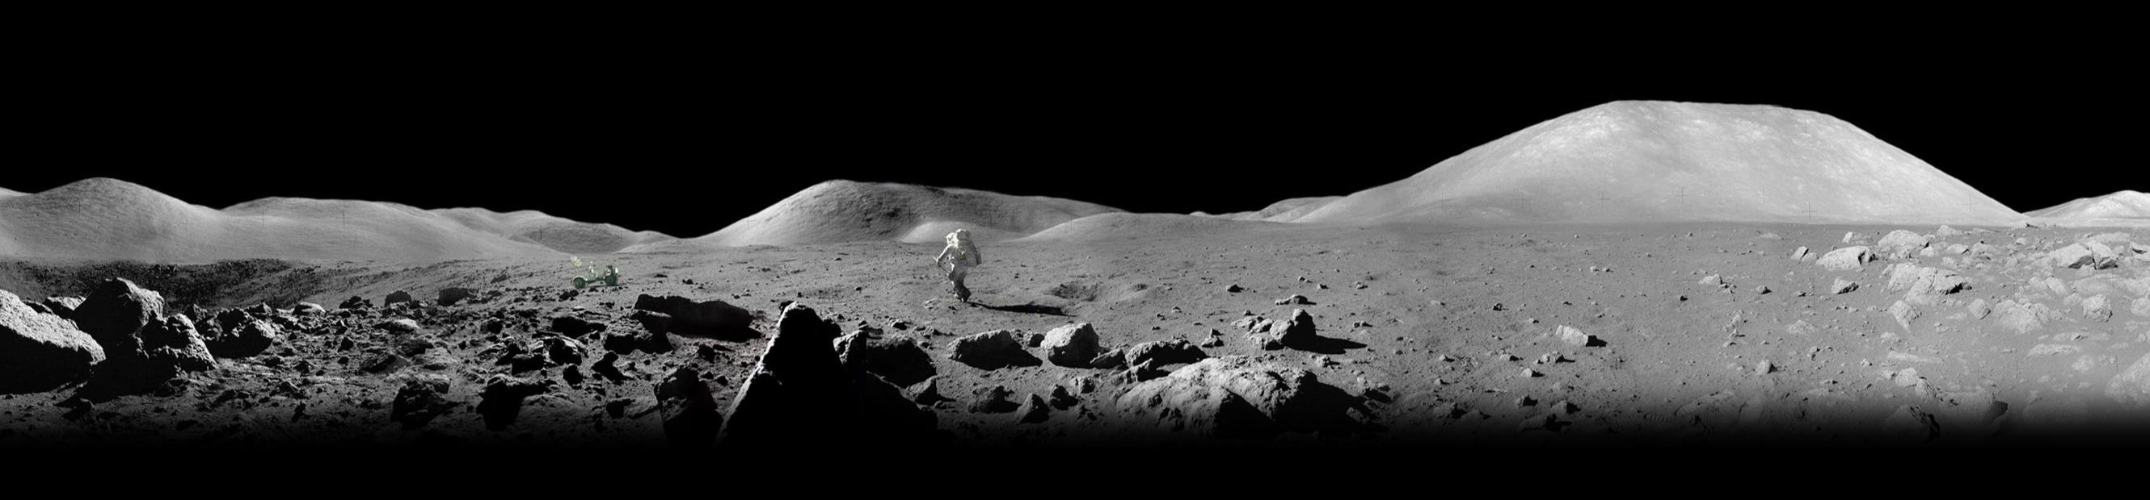

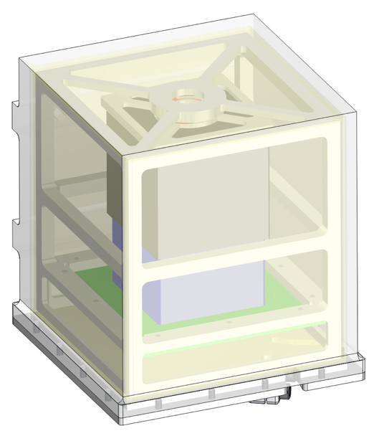
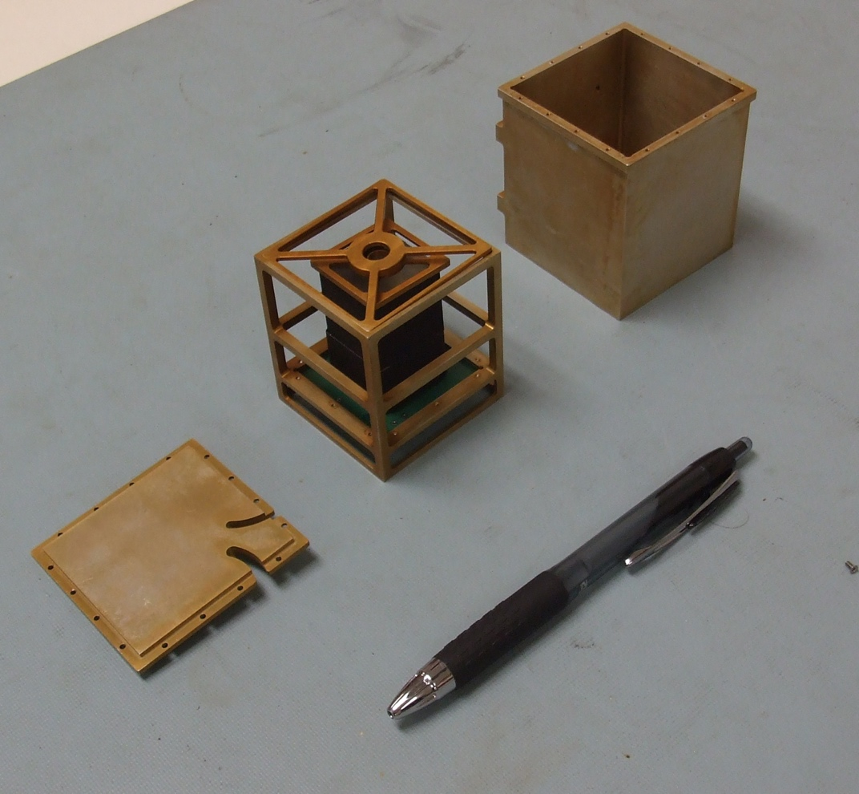
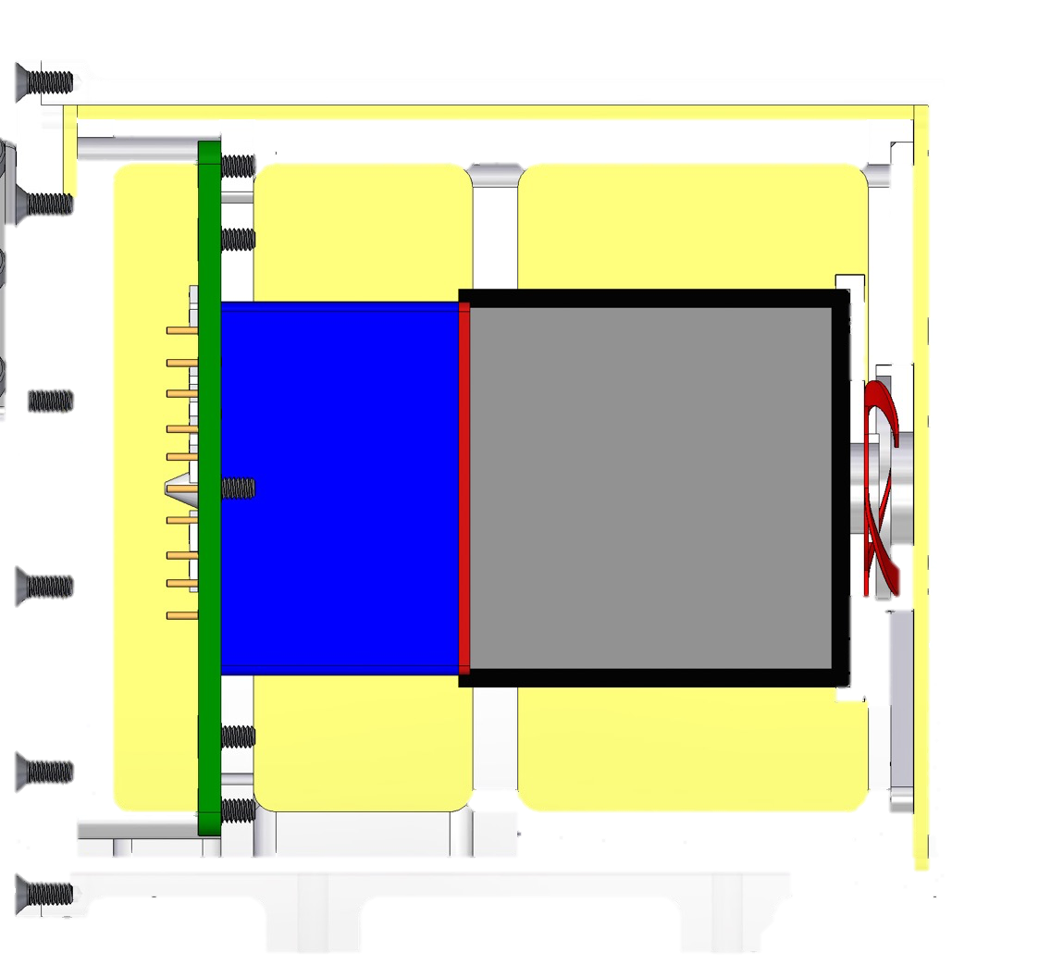
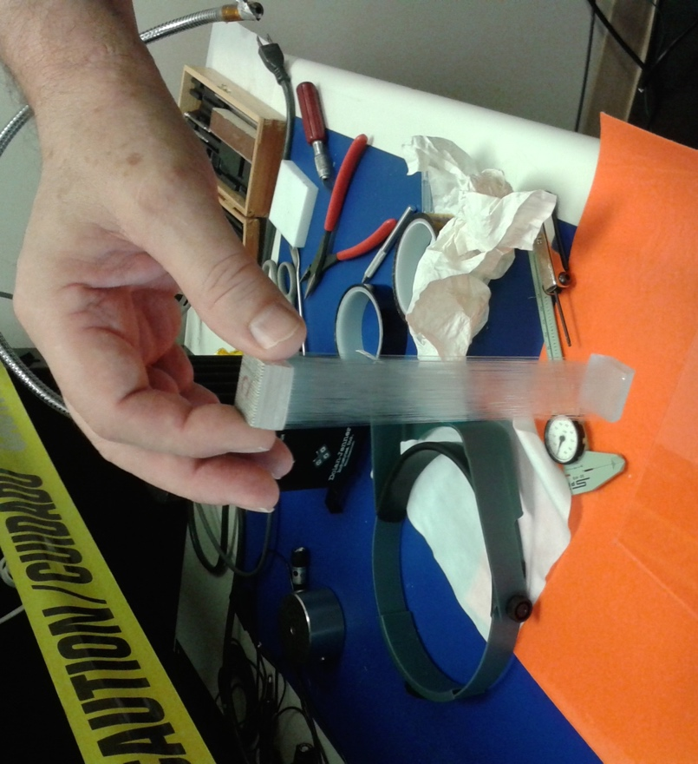
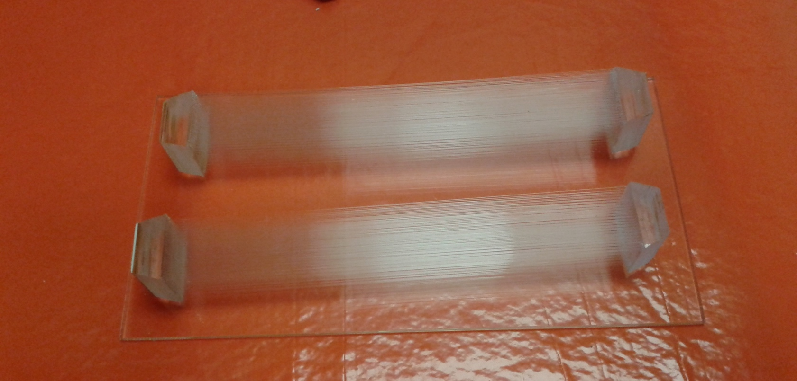
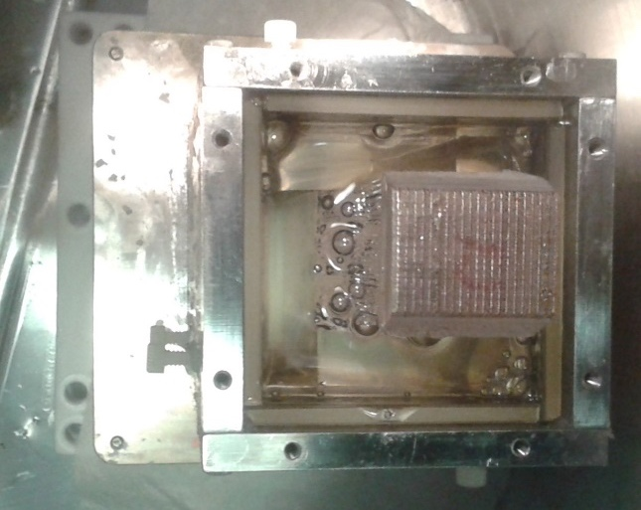
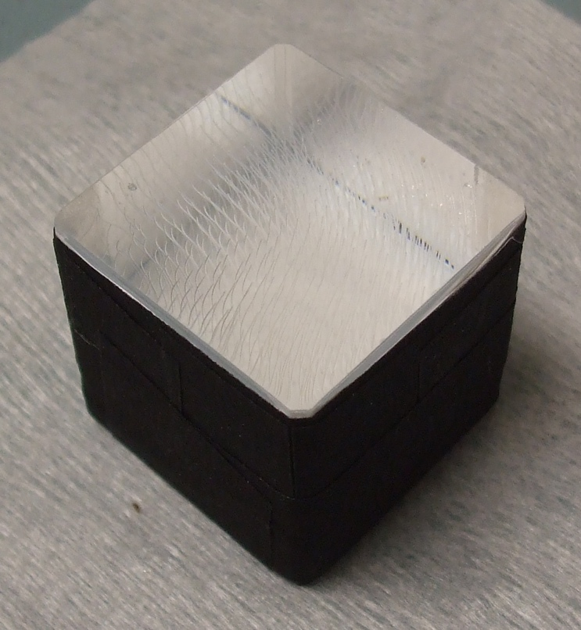
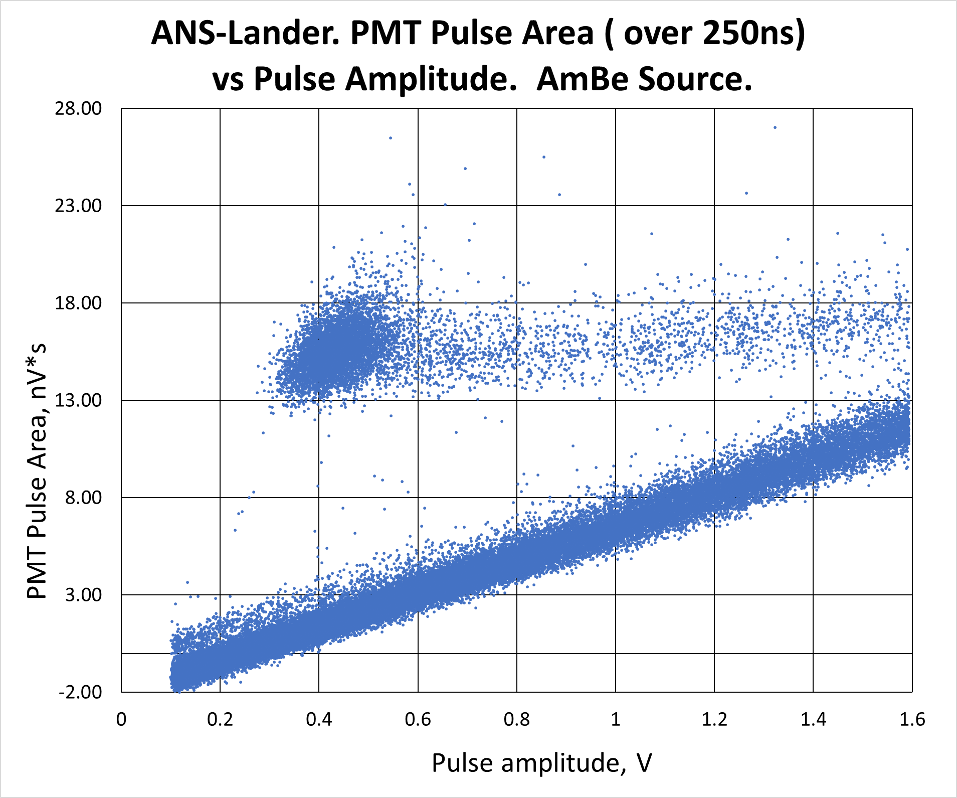
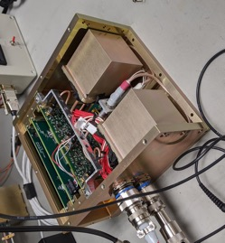
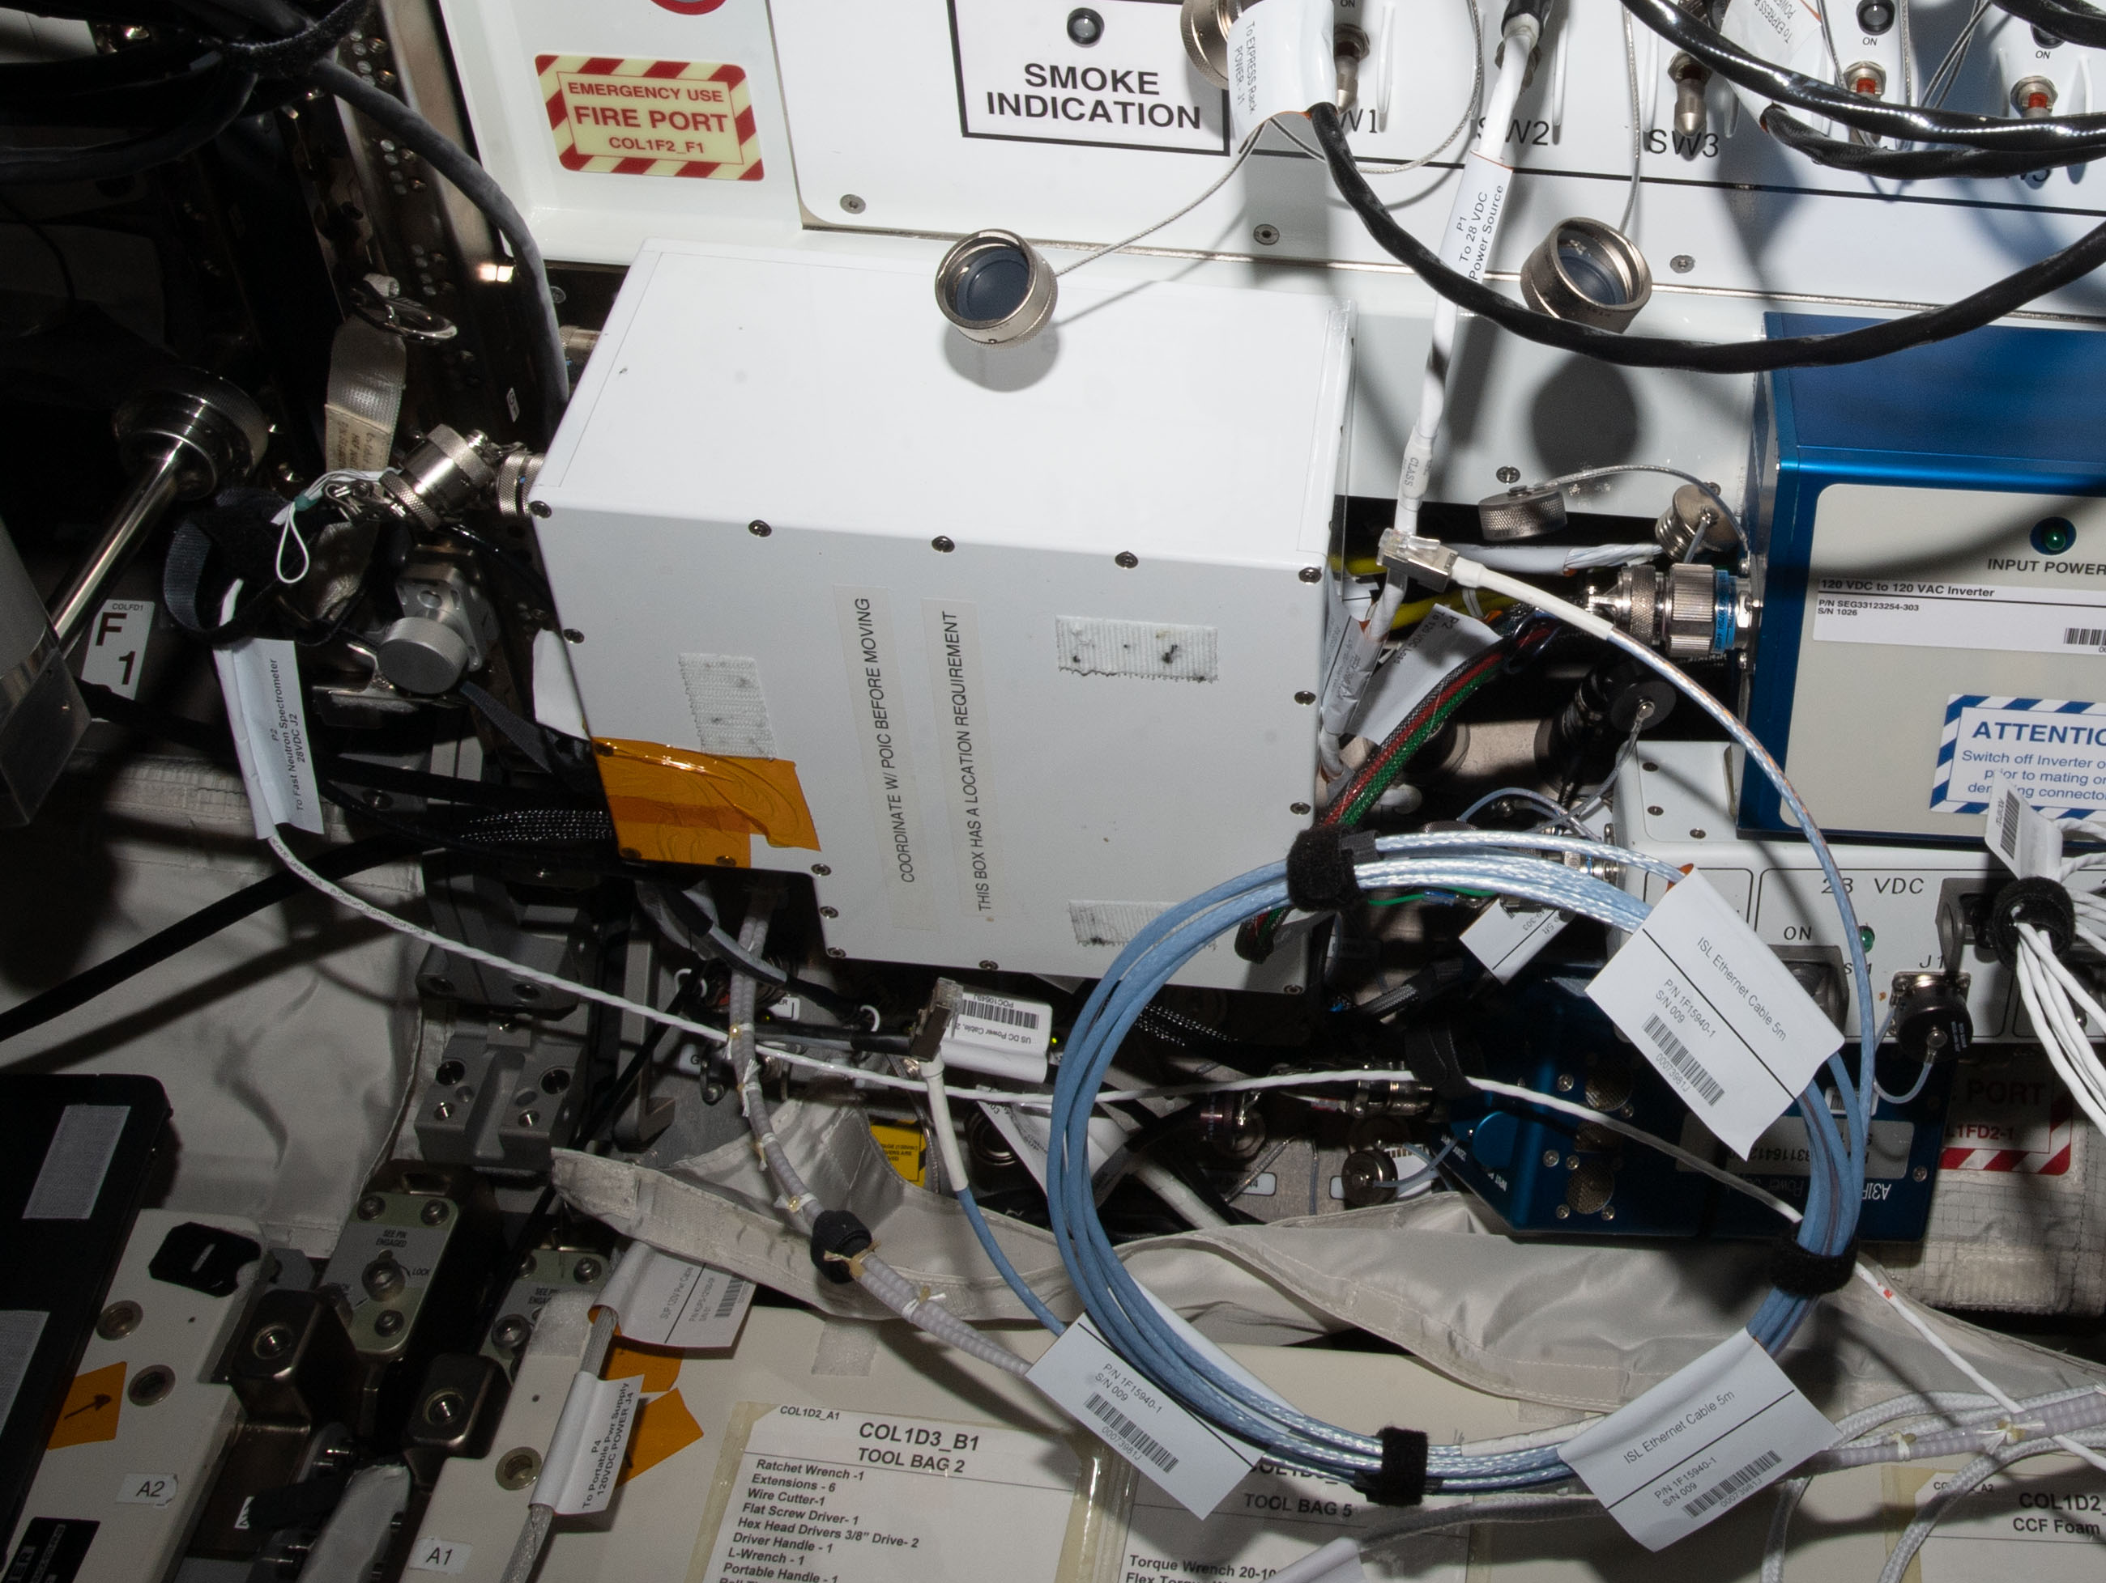
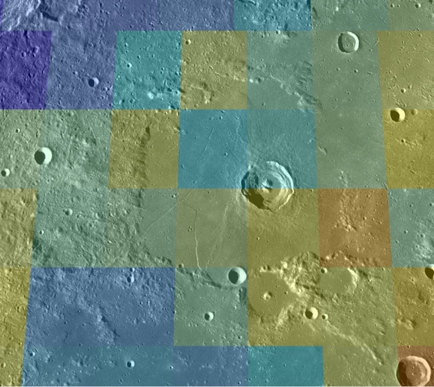
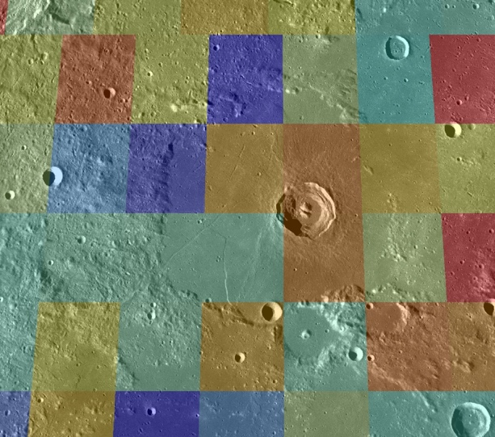
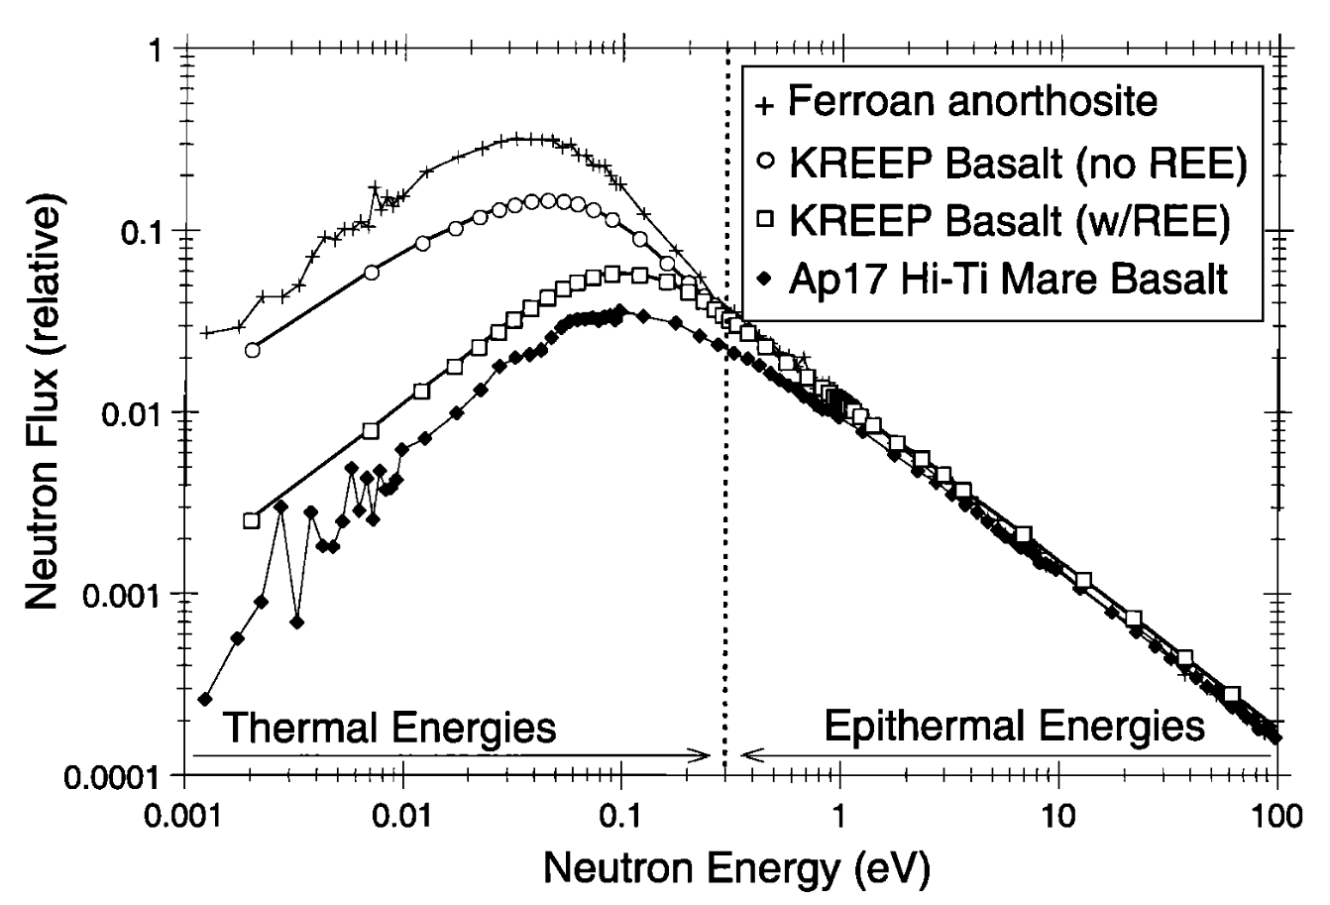


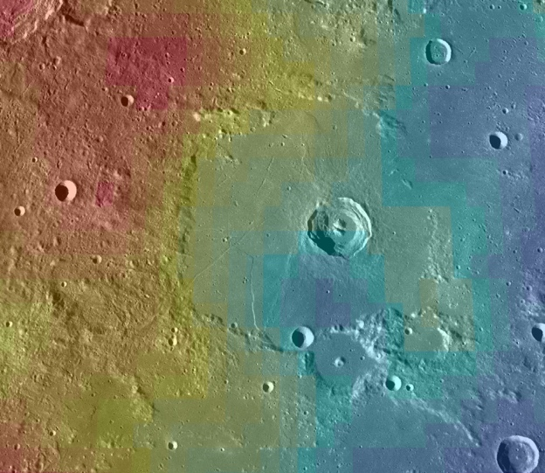
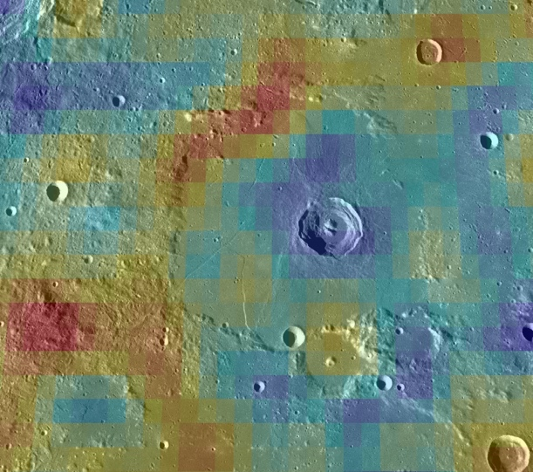
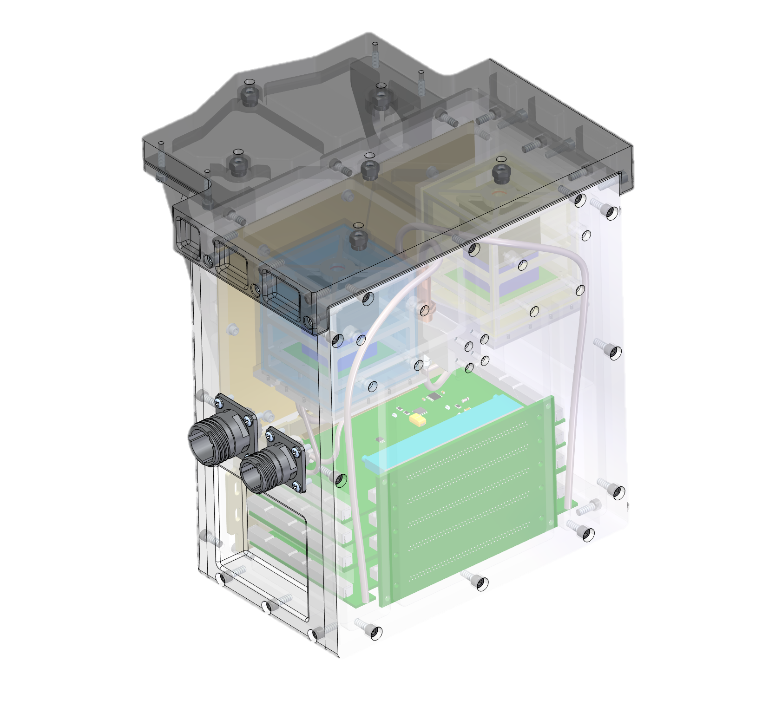


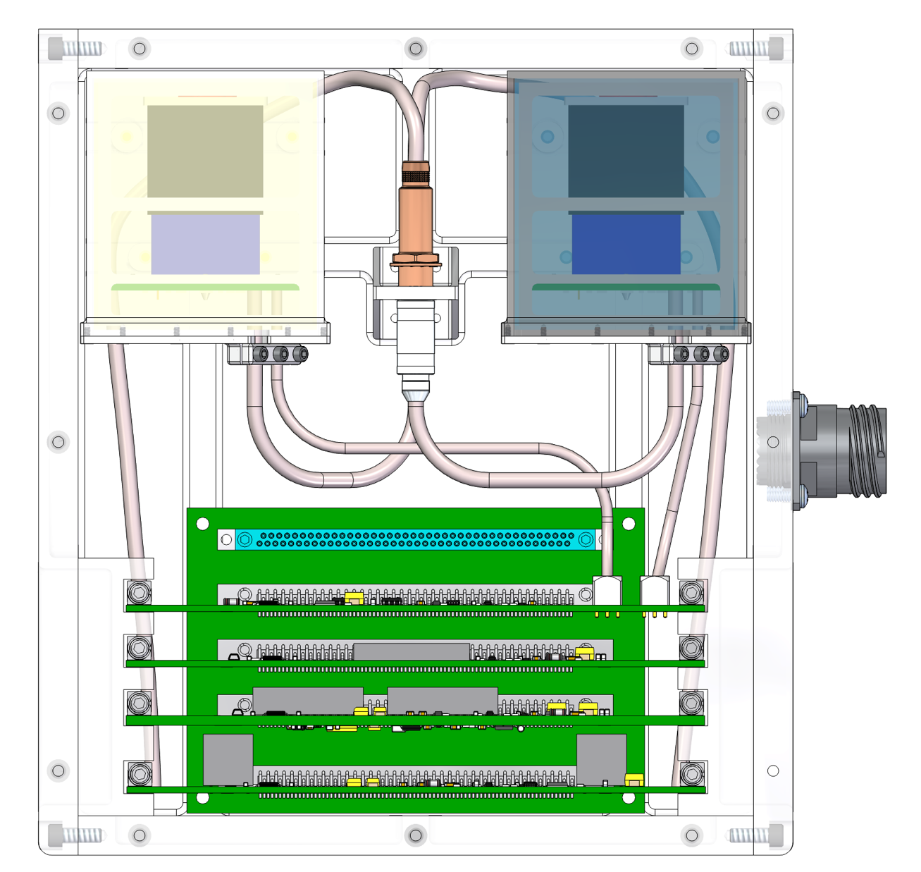
Neutron measurements at the Lunar surface with PRISM
H. Haviland¹, P. Bertone² , M. Christl², J. Caffrey³, J. Apple⁴
¹Heliophysics and Planetary Science Branch, ²Astrophysics Branch, ³Advanced Propulsion Research , ⁴Instrument Development Branch
NASA Marshal Space Flight Center (MSFC)
corresponding author: heidi.haviland@nasa.gov
LEAG 2020
Overview
Neutron measurements at the lunar surface are performed with two goals: characterization of the radiation environment and inference of regolith composition. This submission is focused on quantifying the surface radiation environment to inform mission design and risk mitigation prior to crewed lunar missions. The lunar surface radiation environment includes a unique neutron contribution. MSFC’s Advanced Neutron Spectrometer for Lunar Surface Measurements instrument covers the most biologically significant energies from thermal to ~20 MeV. The ANS-LSM is based on heritage from the Fast Neutron Spectrometer that has measured the ISS crew neutron exposure for the past 3 years, and revealed the significant neutron contribution to total exposure. The relative contribution from neutrons will increase outside the shielding effects of Earth’s magnetic field. To evaluate the radiation risk to astronauts at the lunar surface, precursor fast neutron measurements are needed.
Scintillator Sensor Assembly Buildup
⁶Li-doped glass fibers produce a distinctive signal for neutrons.
120-micron ⁶Li-doped scintillating glass fibers are mounted, stacked, and assembled into bundles with epoxy ends, ~480 glass fibers in each bundle (Fig. 4b, 4c).
Bundles are immersed in a liquid plastic scintillator (polyvinvyl toluene, PVT) using custom molds of AL and optically flat glass. ~4 weeks cure time (Fig. 4d).
Two right square prisms of solid plastic scintillator, with ⁶Li glass fibers embedded within, are cut into 1” cube detector volumes. These are wrapped in tape and coupled with a PMT.
Counting rate is estimated to be 0.1 – 0.5 Hz.
Shield (Cd, Sn)
Background
Composite Scintillator
The Advanced Neutron Spectrometer for Lunar Surface Measurements (ANS-LSM) is based on a flight instrument currently operating aboard the ISS; ANS-ISS aka Fast Neutron Spectrometer (FNS). No performance degradation has been seen in 3 years of continuous operation. ANS-LSM will measure the neutron spectrum and characterize the fast neutron radiation dose environment in support of crewed Artemis missions.
Neutron Measurements at the Lunar Surface (NMLS) is a funded effort to measure thermal and epithermal neutron count rates on Astrobotic Mission 1 (ABM1). Can detect the presence of water, mineral and rare earth element resources. Three instrument versions for varying uses (see Table).
Development Schedule (ATP to delivery): 18 months NMLS-1, 18 months NMLS-2, 24 months for ANS-LSM.
Budget: $2M for NMLS, and $4.6M for ANS-LSM.
*Will be ready for a 2023/2024 flight opportunity.
Photomultiplier tube (PMT)
Figure 4f. Sensor assembly prototype for functional performance testing.
Figure 4a. Scintillator Sensor Assembly CAD model.
Figure 4b. ⁶Li-doped glass fibers built up into bundle by hand.
Figure 4c. Glass fiber bundles are ~0.8”x0.8”x7” with ~480 fibers each.
Figure 4d. Bundle is cast with BC-490 polyvinyl-toluene plastic scintillator.
Figure 4e. 1” cube composite scintillator wrapped in black tape.
Neutron Instruments Description
Science Overview
SEPs & GCRs (~1 GeV)
“Epithermal neutrons” (﻿<~0.5 MeV). ~constant for most lunar compositions (except H).
“Thermal neutrons” (﻿<~0.3 eV). Neutron flux is highly composition dependent (flux is large for Fe, Ti, Fig. 8) and is greater in mafic materials (mare basalts, Mg or Fe-rich, of igneous/volcanic origin, dark in color, olivine, pyroxene) and smaller in the Fe-poor highlands (farside).
“Fast neutrons” (>1MeV) result of impact of high energy particles (SEPs & GCRs).
MSFC scintillator technology effectively discriminates between pulse shapes and distinguishes between neutrons and other false triggers (Fig. 7).
Elemental abundances are calculated including Th, Th is also proportional to the amount of Sm and Gd at the surface. Fe, Ti can be a marker of where Rare Earth Elements (REE).
In-situ Resource Utilization (ISRU) applications.
The Moon’s water cycle varies over the course of a lunar day. This change in hydrogen concentration as a function of time will be detected with NMLS.
Dependent on data and power availability during lunar evening.
 | NMLS-1. Neutron rate counters* | NMLS-2. Neutron rate counter* | ANS-LSM: Fast Neutron Spectrum*
Description: | ABM1. Thermal + Epithermal neutrons. | Epithermal neutrons only. Ideal for integration with rover. | Radiation monitoring and characterization.
Instrument Specs: (Mass, Operating Power, Standby, Volume, Data Rate) | 4.4 kg 5.5 W operating 3.5 W standby 0.0025 kbps | 2.2 kg 3.9 W operating 2.9 W standby 0.00125 kbps | 5.5 kg 6.5 W operating 4.0 W standby 0.4 kbps
Landing Site/Objective: | Surface composition at any landing site. | Poles. Hydrogen/Water sensitivity. | Any site, but poles would be most helpful for preparation and planning for the Artemis missions.
TRL: | Will be TRL 9 after 2021 flight. | TRL 6 | TRL 6. Modify electronics.
neutrons
Thermal (<0.3 eV) neutrons
Epithermal (<0.5 MeV) neutrons
Gamma Rays
Fast neutrons
Inelastic collisions
everything else
K
U
Figure 7. Composite scintillator technology effectively discriminates between pulse shapes and distinguishes between neutron and false triggers such as gamma rays.
Primary cosmic rays
Secondary cosmic rays
Th
Figure 1. NMLS-1 engineering unit for ABM1.
Figure 2. FNS currently in operation on the ISS.
Neutron capture
Natural radioactivity
LP Epithermal Neutron Flux
ANS-LSM Mission Objectives:
The lunar surface radiation environment includes a unique neutron contribution, surface characterization is important for risk identification and mitigation.
Figure 5. Nuclear spectroscopy at the lunar surface. High energy solar energetic particles (SEPs) and Galactic Cosmic Rays (GCRs) impact the lunar regolith producing neutrons. [4]
LP Thermal Neutron Flux
Thorium (ppm)
75 km
Hydrogen (ppm)
75 km
NMLS Mechanical Model
Twin Scintillator assemblies shielded with cadmium or tin.
~5”
NMLS Mission Objectives:
Characterize the neutron radiation environment.
Provide in-situ ground truth for calibrating orbital data.
Provide constraints on composition (e.g., science & ISRU).
Monitor hydrogen cycle through lunar day.
Project Description:
Provide neutron counts at the lunar surface.
  Deliver thermal and epithermal neutron rate counters using ⁶Li-doped scintillators.
  Operate for ~7 Earth days, (~1/2 lunar day).
  Can be single or double sensor configurations.
75 km
75 km
Figure 6. Simulated neutron energy demonstrating neutron flux sensitivity to lunar compositions in the thermal range [5].
Figure 8. NMLS will provide ground truth for calibrating orbital datasets. LP NS maps are ~50 km resolution for thermal and epithermal neutron flux. Star shows approximate ABM1 landing site [3].
Summary
~7”
NMLS provides counts of the thermal and epithermal neutron rates at the lunar surface. These observations will provide a ground truth for calibrating orbital datasets, constraints on composition, and will monitor the dynamic hydrogen cycle over the lunar day.
ANS-LSM provides fast neutron spectra for radiation characterization and monitoring.
Both are offer valuable observations for future CLPS missions and upcoming PRISM investigations.
~7”
References and Acknowledgements
NASA HQ Artemis Phase 1 chart.
Astrobotic Lander, https://www.nasa.gov/press-release/nasa-selects-first-commercial-moon-landing-services-for-artemis-program
Michael Zanetti and Caleb Fasset, personal communications. Data is from the PDS. Inset: Quickmap. https://quickmap.lroc.asu.edu
Image credit: NASA. Schematic after Curran [2017].
Elphic et al. [2000]. JGR. “Lunar rare earth element distribution and ramifications for FeO and TiO2: LP observations.”
ANS & NMLS Team: PI Peter Bertone (ST12), Lead Engineer Jeff Apple (ES63), Science: Narayana Bhat (UAH), Jarvis Caffrey (ER24) Instrument Scientist, Mark Christl (ST12), Heidi Haviland (ST13) Project Scientist, Erin Hayward (EM41), Mohammad Sabra (USRA), John Watts (UAH), Engineering: Carl Benson (operations ES63), Kurt Dietz (software ES63), Michael Dimitriou (stress ES22), Curtis Fox (mechanical ES61), Brian Gibson (FPGA ES63), Brent Knight (dynamics ES63), Evgeny (Jim) Kuznetsov (electrical ST12), Stephanie Mauro (thermal ES22), Miquel Rodriguez-Otero (power ES63), Gary Thornton (mechanical ES63).
Figure 3. NMS mechanical model front (left) and planar (right) views. NMS offers high science reward for minimal spacecraft resources. Key sensor components are labeled above. Cd shielding absorbs all neutrons below ~0.4 eV preventing thermal neutrons from detection.

