Slide 1

CERES Data Management Team Working Group Report
Katie Dejwakh
September 15, 2020

Slide 2
Outline
DMT Overview
Product Availability
Code Re-architecture
Systems & CM
DMT Activities

Slide 3
DMT Overview

Slide 4
Data Management Team (DMT)
Science research
DMT /
ASDC
User community

Slide 5
Data Management Team (DMT)
Instrument
Clouds
Inversion
SARB
TISA
ERBE-like
Systems & CM

Slide 6
Data Management Team (DMT)
Responsibilities:
  Algorithm implementation
  Software:
    Maintenance
    Configuration management
    Processing
  Output data validation

Slide 7
DMT-ASDC Interface
Science
Team
Data Management
Team (DMT)
Atmospheric Science Data Center (ASDC)
Funded by
Radiation Budget Measurements WBS
Funded by ESDIS

Slide 8
Product Availability

Slide 9
Edition 4 Terra & Aqua
Product | Platform | Processed Thru | Publicly Available?
BDS | Terra, Aqua | May ‘20 | Yes
SSF
SSF1deg-Hour |  | Apr. ‘20
SSF1deg-Day/-Month
SYN1deg-Hour/3Hour/MHour | Terra+Aqua
SYN1deg-Day/-Month

Slide 10
Edition 4 Terra & Aqua
Product | Platform | Processed Thru | Publicly Available?
CldTypHist | Terra+Aqua | Apr. ‘20 | Yes
FluxByCldTyp
EBAF |  | Mar. ’20
EBAF ToA |  | May ‘20

Slide 11
Edition 1 S-NPP
Product | Platform | Processed Thru | Publicly Available?
BDS | S-NPP | Jul. ‘20 | Yes
SSF |  | Jun. ‘20
SSF1deg-Hour |  | Sep. ’19*
SSF1deg-Day/-Month |  | Sep. ’19*
SYN1deg-Hour/3Hour/MHour | Terra+S-NPP | Nov. ’17*
SYN1deg-Day/-Month |  | Nov. ’17*
* L3 processing is paused. Instrument in RAPS mode

Slide 12
DMT Activities

Slide 13
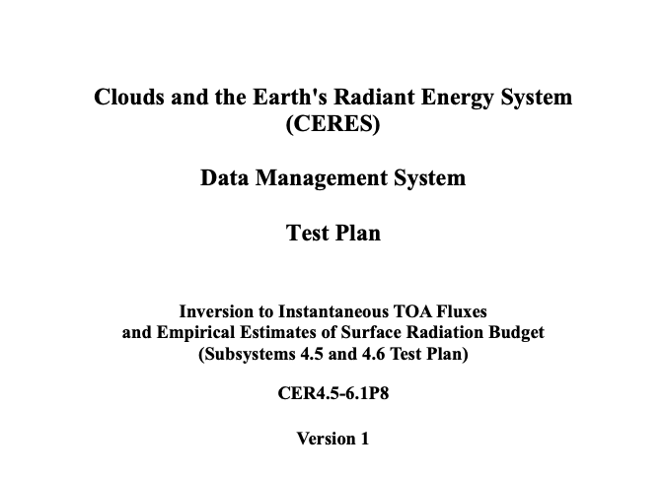
Configuration Management
Improved documentation – PGE-specific:
  Operator’s Manuals
  Test Plans
Quicker access to necessary
information
Distilled information
Notes:
Operator’s Manuals - https://ceres-wg.larc.nasa.gov/ceres/ops_man.php
Test Plans - https://ceres-wg.larc.nasa.gov/ceres/test_plans.php

Slide 14

Production Request Tool
OpenShift
Opportunities to leverage virtual layer to
  Create
  Roll back
  Destroy
  processes as necessary
Flexibility front- and back-end

Slide 15
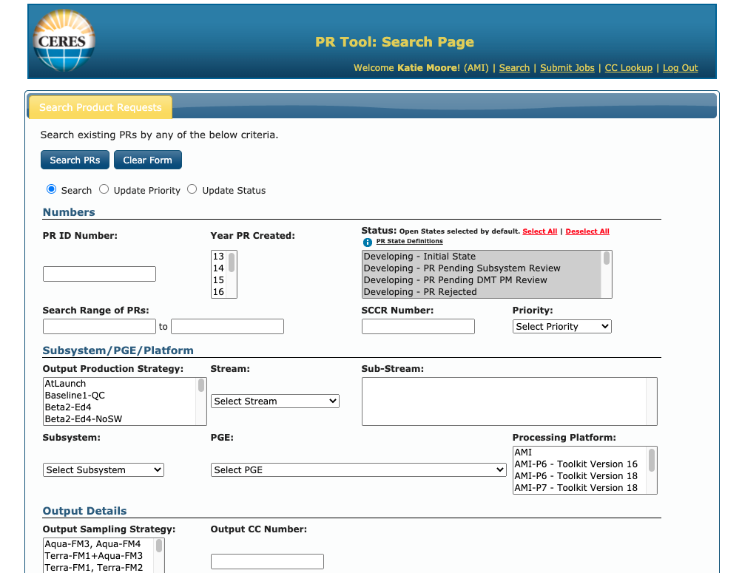
Production Request Tool
Multi-”pod” application deployment
Automated database updates (and rollbacks)

Slide 16
Forthcoming Data Product Editions
Edition 2 S-NPP
  Processing thru: Instrument & ERBE-like
  Available early Winter 2020
  Need VIIRS data
  No L3 products from 9/2019 onward,
  while S-NPP in biaxial mode
Edition 1 NOAA-20
  Processing thru: Instrument, SSF, and Level 3
  Available late Fall 2020 – improved Clouds!
Notes:
Ed 2 S-NPP: Need VIIRS data; assuming our test data is good enough that production can start immediately, will take two months of just Clouds processing
Ed 1 NOAA-20: Record starts from May 2018. Need to finish DQS (documentation). SSF is through September 2019 as of 4/27/20.
Both sets of these gains and SRFs have been delivered through Jan. 2020.

Slide 17
Notable Deliveries
Ed 1 NOAA-20/Ed 2 S-NPP work
  Sampling strategy updates
  Spectral correction coefficients
  SSF, SSF1deg implementation
FluxByCldTyp initial PGE
Libraries
  CERESLib netCDF4/HDF5 support
  CERESLib metadata update support
  PerlLib scoping changes

Slide 18
Code Improvement Activities

Slide 19
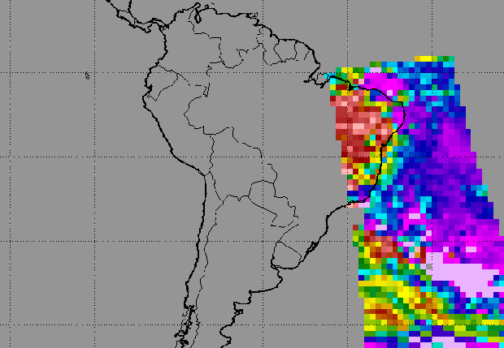
Clouds Status
Cloud mask
  Taking “census” of all mathematical operations/values
  Mapping tentative object-oriented class structure – MagicDraw

Slide 20
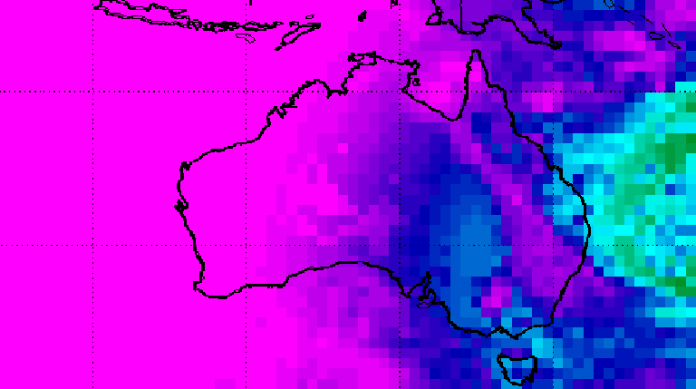
TISA Status
Fortran (current codebase)
  Cloud property container
    Compatibility with JSON format
    Testing averaging routines
C++ (future codebase)
  Gridding implementation
  JSON I/O for properties

Slide 21
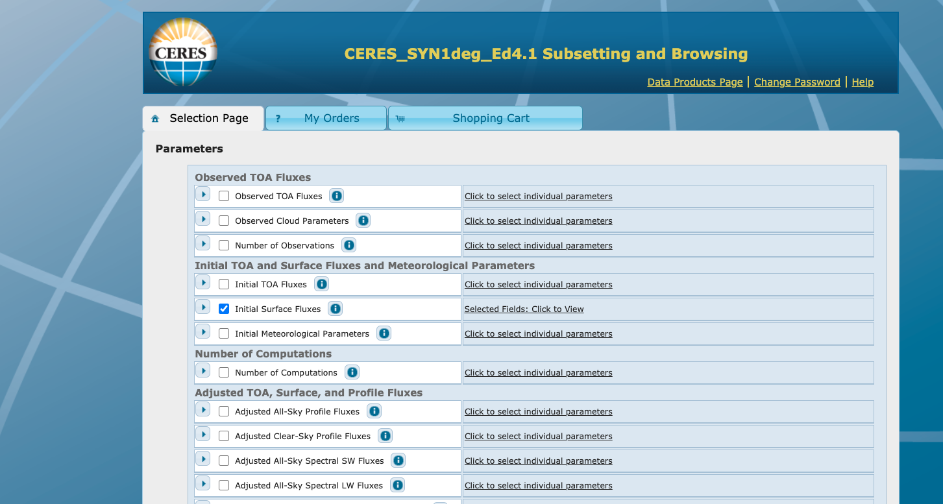
Subsetter/
Ordering Tool
Data visualization and ordering hardware migration – early Fall
Upgrades:
  Python 3
  Java 11 / Tomcat 9
Running on RHEL7 VMs

Slide 22
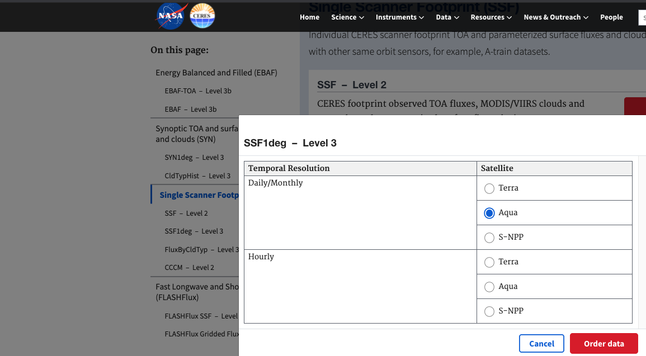
Subsetter/
Ordering Tool
Tailoring new CERES website data product interface
Hooking to Ordering Tool
Continuing to update Tool to accept upcoming Editions

Slide 23
Systems & CM

Slide 24

New Systems
Store… (high-performance, DMZ)
Process…
EMC Isilon Storage
HPE DL360 Servers
Computational Research Facility (CRF)
Configuration in progress
ASDC then CRF
Virtualized (RHEL7)
Batch processing

Slide 25
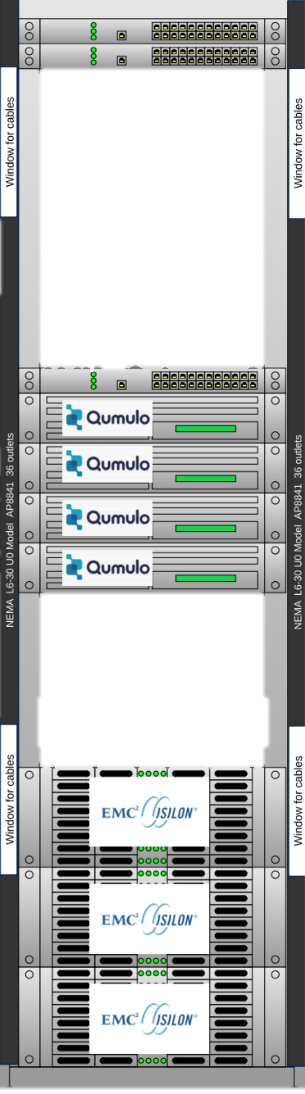
New Systems
Store… (internal)
HPE Scale-Out NAS Storage with Qumulo
CRF
Fall 2020
Storage by-the-yard

Slide 26

Updated Data Formats
Upcoming Editions:
5/netCDF4
Many iterations with ASDC – ingest/metadata check
First products: Ed 1 NOAA-20 and Ed 2 S-NPP SSF
CM Team – lots of work!

Slide 27
Updated Metadata
Upcoming Editions
Conventions:
  Unified Metadata Model (UMM)
  Climate-Forecasting (CF)
  Attribute Convention for Data Discovery (ACDD)
  CERES-specific
Attributes in HDF5/netCDF4 files
Separate ”*.met” file until no longer necessary

Slide 28
Summary
New editions on the way!
Continuing to virtualize
Engaging in cloud preparation
Refreshing file formats, metadata
Improving user experience

