Slide 1
Delay/Disruption Tolerant Networking
11 OCT 2018
Brenda Lyons, Project Manager, JSC-XS

Slide 2
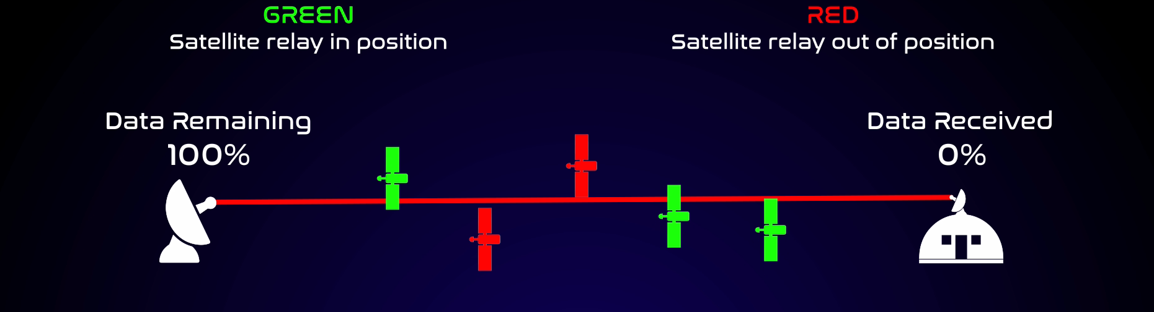
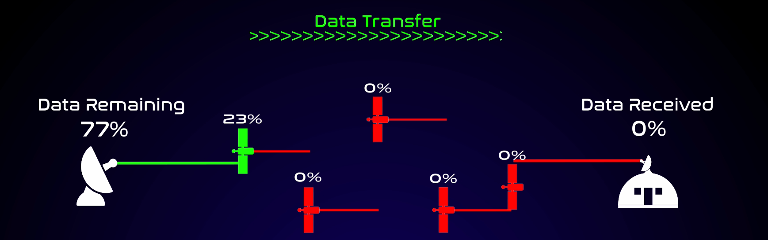
Delay/Disruption Tolerant Networking
Project Overview
Why is DTN important?
Space Communication is subject to delays (due to distance) and intermittent connectivity (due to orbital mechanics)
DTN provides reliable end-to-end data delivery in this environment
Data needs and system complexity are increasing, making networked service and higher bandwidth efficiency necessary
Interoperability and standardization are critical for Gateway, other partnerships, long-term cost control, complexity
Objectives
International standardization of the DTN suite of protocols
Interoperable open-source implementation (ION)
Infusion to NASA missions and networks
Adoption of DTN by industry, agencies, partners
Current activities
IETF DTN Working Group – BIBE, TCP CL, BP, BPSec drafts
ION “Hardening” – flush out defects/error conditions, scale testing
Infusion
  ION Course (NTL)
  ISS (DTN gateway for Payloads, Arcturus project, ENCODE)
  SCaN infusion – DSN, NEN, SN
  Mission infusion – Gateway, SMD, PACE, AES CubeSats/Iris Radio
Traditional Comm – requires end-to-end signal
With DTN – takes advantage of partial comm path

Slide 3
Delay/Disruption Tolerant Networking
Major Accomplishments
Standardization
Bundle-in-Bundle Encapsulation draft was adopted at IETF 102 (mid-July) as a DTN Working Group document
Agreed that BPbis and TCP Convergence Layer drafts will progress together (in Last Call)
BPSec draft will follow BPbis and TCP CL
As part of HEOMD-003 Interoperability Standards in the Communication System, BP, CFDP, and other CCSDS Standards are being called out as requirements, with other relevant protocols being recommended
Core Development
ION 3.6.1 – Part of onboard ISS DTN Gateway upgrade (Z-book laptop, supporting ECOSTRESS payload)
Ohio University upgrades include Wireshark code (result of NTL challenge), IPV6, Windows installer, security testing, multi-node system testbed
Planning for ION “hardening” in FY19
ION 3.6.2 (upcoming release) development includes Schedule-Aware Bundle Routing fixes, AMP implementation
ION Developer’s Course (result of NTL challenge) inaugural offering 10/29/18 at JSC
Infusion
ISS
  ISS DTN gateway upgrade to ION 3.6.1 (Z-book laptop, support to ECOSTRESS payload)
  Arcturus used ION for data transmission from EMU to MCC displays
  ENCODE (ISS Optical and DTN, LCRD) project kickoff
SMD
  Working with SMD on communication plan and implementation options
  PACE mission infusion continues with BP application for cFS
SCaN
  Network infusion planning continues; synergy with project testing, PACE infusion
AES
  iPAS nodes upgraded to ION 3.6.1, implemented SBSP, AMP agent

Slide 4
Delay/Disruption Tolerant Networking
Plans & Partnerships
Plans for FY19
  ION course for developers
    Inaugural offering this month at JSC
    Planning to offer elsewhere (GSFC, JPL, etc.) as demand, schedule dictate
  ION Hardening
    Testing to drive out bugs, limitations of ION so that they can be resolved
    Allow for confidence of adopters in implementation
  Increasing complexity of network demonstrations
Partnerships
  Gateway standards, planning
  Avionics and Software Project, CubeSats, MSU Ground Station
  ISS: payload gateway; Arcturus (institutional availability); ENCODE (high-rate, optical DTN)
  SMD planning – working directly with SMD for plan to adopt DTN
  IETF DTN WG participants includes broad industry representation
  DTN as part of architecture for other government agencies’ solution
  SBIR Antara Teknik

Slide 5
BACKUP

Slide 6





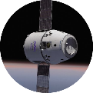

DTN Deployment Plan
FY18 – Operational Usage
FY19 – Operational Usage
FY20+ – Widespread Usage
ION 3.6.1
ION 3.6.2
ION 3.6.3
ION 4.0.0
ION 3.6.4
NASA ION COMPLETE
ION 4.1.0
Android port
Windows installer
SBSP update
Features added to RTEMS port
CGR SABR update
AMP Implementation Security Policy update
Bug fixes
IPV6 port
“Sticky” Routing
OCGR
Contact History Exch
Scalability
Node Auto-config
IETF BP
LTP Simplifications
Contact plan maturity
Bundle deliv times
Node Auto-configuration
Congestion Forecasting
High-Rate Support
Information Centric Networking
IP Sec
BIBE
ISS
DTN GW H/W Upgrade, ION 3.6.1
TReK Demo, HRF, ECOSTRESS
Arcturus
ENCODE
AES
Avionics & SW Integration including CFS
EM-1 Cubesats
Gateway
NextSTEP Habitat
SCaN
Future Architecture Studies
High-Rate DTN Development
Mission & Infrastructure Infusion
NASA Infusion
Advocacy
HEO/SMD Plan
Incorporate DTN into Ground and Flight Segments (RF and Optical)
Significant Operational Use
KARI
DTN Phase III+ Ground Testing
KPLO Support
Commercial Infusion
Industry Engagement
Establish
Pilots
IETF Standards
Commercial Products
OGA Missions
Opportunity Identification
R&D/Proof of Concept
Architecture Inclusion
Widespread Use of DTN

Slide 7
ION Code Updates
Complete
Planned
ION 3.6.1 2/13/2018 | ION 3.6.2 11/2018 | ION 3.6.3 6/2019
Android port Windows installer SBSP update Features added to RTEMS port CGR updated for consistency w SABR | AMP Implementation Security Policy update Bug fixes | IPV6 port “Sticky” Routing OCGR Contact History Exch Scalability Node Auto-config
http://sourceforge.net/projects/ion-dtn/

Slide 8
ION Hardening
The need for ION core capability stress testing was identified
  ISS implementation has uncovered some unexpected performance bugs, limitations
  Additional unexpected problems may exist that should be driven out, understood
Test planning is in work
Test is expected to include existing facilities
  iPAS (JSC)
  PTL (JPL)
  CSTL (GSFC)
  DEN
Currently defining requirements, test cases, schedule
Findings may result in ION modifications in future releases

Slide 9

FY18 Project HQ Milestones
Complete Phase II ground testing with Korea Aerospace Research Institute (KARI)/Electronics and Telecommunications Research Institute (ETRI) – 2/17/2018
Conduct a demonstration over the NASA Space Network (SN) with a DTN node installed at the White Sands Complex – 7/31/18 12/15/18 (Replan in work)
Conduct test of DTN integrated with the Morehead State University 21-meter antenna as part of the Deep-Space Network (DSN) – 9/14/2018 9/27/2018 (partially complete)

Slide 10

ISS Institutional DTN Support
Completed initial deployment of DTN Gateway on ISS using ION 3.3.1 on 5/5/2016
TReK Payload Software Suite now includes ION
  https://trek.msfc.nasa.gov/
The first successful data transfer over the ISS DTN service occurred on 5/27/2016 from the TReK demonstration laptop payload
  Conducted bundle ping tests and both uni- and bi-directional CFDP transfers
Human Research Facility (HRF) became first non-TReK demo user of DTN service on ISS on 7/28/2017
ISS operations and testing has uncovered some bugs/issues that have been addressed in ION updates
ISS upgraded on-board gateway laptop and is now using ION version 3.6.1
Further use of DTN is being worked for ISS
Payloads planning to use DTN:
Payload | Location | Planned Date | TReK? | Platform | Data Rate (kbps)
ASTROBEE1 | USOS | Spx-14 | Y | Linux | 15000
ASTROBEE2 | USOS | Spx-14 | Y | Linux | 15000
Cold Atom Lab | ER7 | Spx-12 | Y | Win | 4000
ECOSTRESS | USL | Active | N | Linux | 4608
Human Research Facility (HRF) Laptop 1 | HRF1 | Active | N | Win | 680
HRF Laptop 2 | HRF2 | Active | N | Win | 680
HRF Laptop 3 | HRF1/HRF2 | Active | N | Win | 680
Multi-Purpose Variable-g Platform (MVP) | ER3 | Spx-13 | Y | Linux | 18000
TangoLab-1 | ER4 | Active | N | Linux | 4000
TangoLab-2 | TBD | Spx-12 | N | Linux | 4000
Plant Habitat | ER5 | Active | Y | Linux | 100
TReK Demo Laptop* | USL | Active | Y | Win | 4000
Spacecraft Atmospheric Monitor | TBD | Spx-15 | Y | Win | 3000
Refabricator | ER4 | Spx-13 | Y | Win | 2400
Spaceborne Computer | ER6 | Active | Y | Linux | 2000
Spectrum | USOS | Spx-15 | Y | TBD | 500
*First User of DTN Service

Slide 11

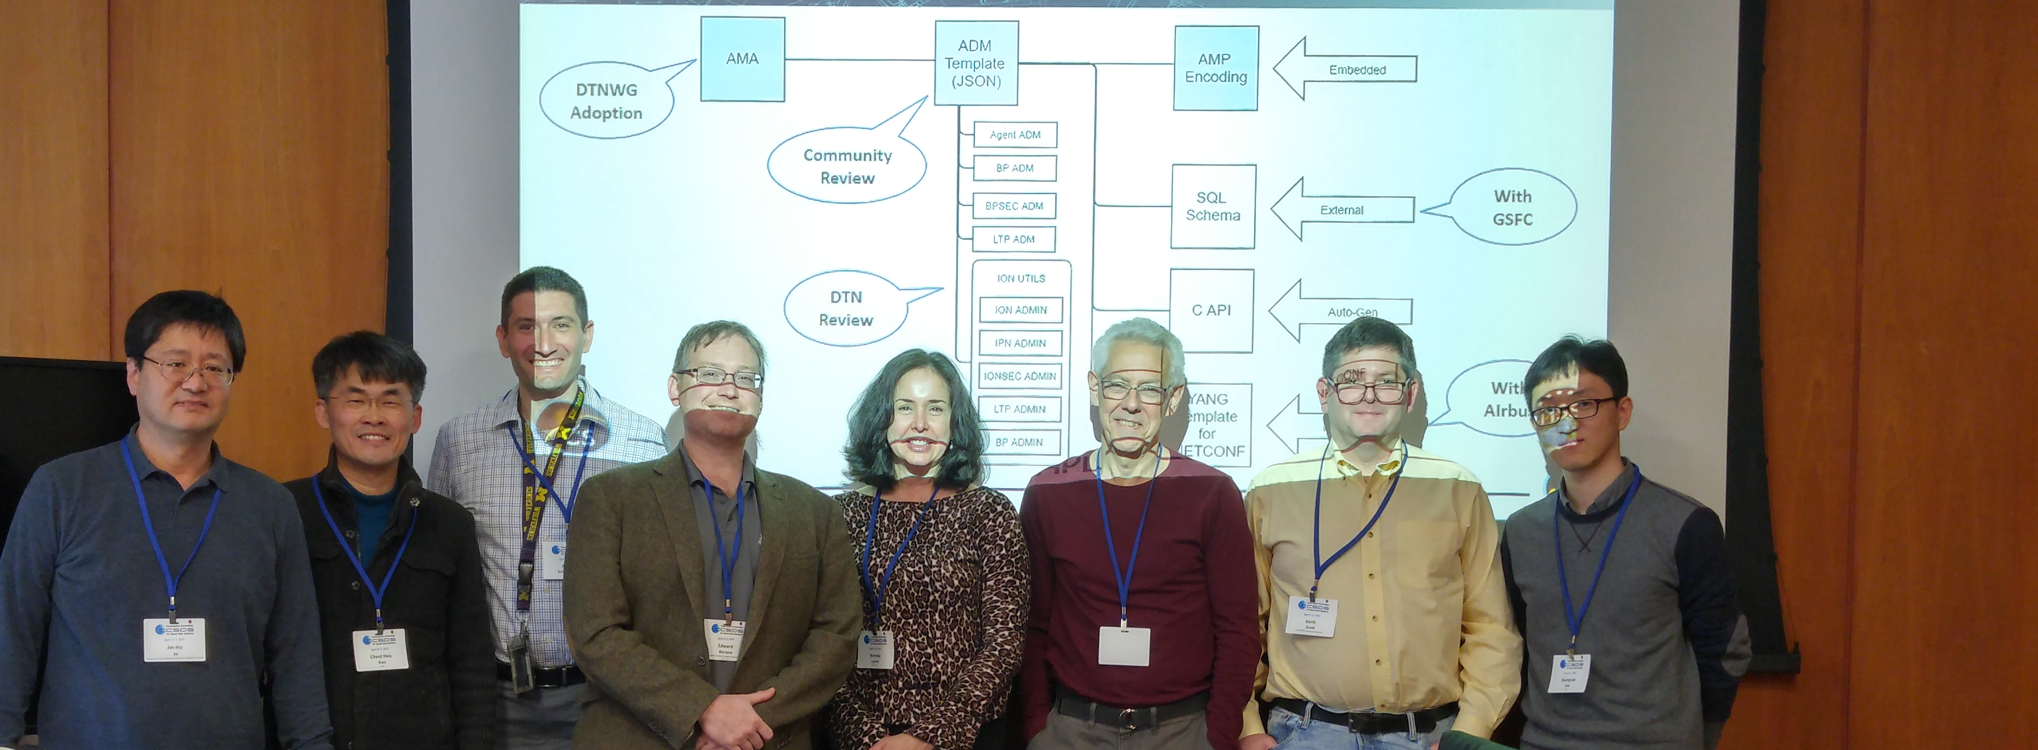


KARI/ETRI Support
The Korea Aerospace Research Institute (KARI) will be launching the Korea Pathfinder Lunar Orbiter (KPLO) in ~2020
  The KPLO spacecraft will contain a DTN Payload to conduct DTN experiments as part of the KPLO mission
KARI is working with the Electronics and Telecommunications Research Institute (ETRI) and Hanyang University to evaluate NASA’s ION DTN implementation for use
NASA/KARI agreement signed 17 Dec 2015 to execute a multi-year DTN ground test campaign, using NASA and KARI assets to exercise components of the DTN protocol suite. The agreement was amended to include discussion of options for the KPLO DTN payload
  Phase I ground testing, exercising CFDP over BP, was conducted over the DTN Engineering Network (DEN) and completed on 3/16/2017
  Phase II ground testing, exercising Asynchronous Messaging Service and Bundle Streaming Service was conducted over the DEN and completed 2/13/2018
  Ground testing will continue, and currently include SBSP demonstrations
  Met with KARI/ETRI at previous CCSDS meetings regarding ground test results and planning, and plan to meet again at the CCSDS meetings in October, 2018 (Berlin)
A separate NASA/KARI KPLO Agreement was signed 12/2016, committing DSN to support KPLO and implement DTN. DTN Ground testing continues under this agreement.
CCSDS Spring 2018 Technical Meetings

Slide 12
SCaN Infusion
NASA PRG calls for a plan to implement DTN in the DSN by 2020 to support KPLO and to be fully operational across the SN, NEN, and DSN by 2022
  DSN infusion plan is partially funded (as of FY19) and underway at JPL
  DTN is also considered essential for optical, and infusion into future optical networks is planned
NEN/SN/DSN inputs to SCaN DTN infusion plan continue as a result of the SMD/HEOMD 90-day study
  Study direction was to provide plan for infusing DTN into SCaN Networks (DSN, NEN, SN) and SMD missions (TBD) within 2-3 years
  SMD coordination also continues for broad DTN infusion as a result of the SMD/HEOMD 90-day study

Slide 13
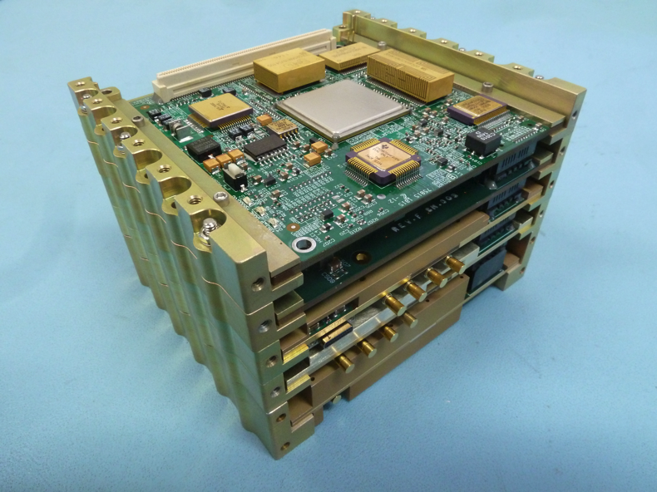
Iris Deep-Space Transponder Infusion
Objectives:
  Extend the capabilities of the Iris transponder by running the Disruption Tolerant Networking (DTN)
  protocol stack using ION on the onboard processer contained within the Iris transponder hardware
  Provide an operational capability for EM-1 CubeSat missions using the Iris transponder
  Motivate/accelerate infusion of DTN into NASA tracking networks
  Provide new capabilities to reduce mission cost and improve science return for cubesats and Iris users
HQ task agreement was signed in December 2016
  Task has started and the schedule is being synchronized to the latest Iris delivery dates
ION deployed on the Iris radio will be a limited subset of the ION open-source software distribution
  Will be adapted to deliver protocol data units over the Iris X-band communication channel
Work will be conducted using the Iris transponder developmental hardware (Xilinx ML605) and software development environment (RTEMS + STRS)
Implementation of DTN-Iris (ION + Firmware device drivers) was delayed in 2017 and pushed into 2018
PTL Testbed at JPL being established and will be used as part of MSU Lunar IceCube/DSN/DTN/Iris demos
X-Band
Transponder

Slide 14
Interaction with other AES Projects
Avionics & Software (A&S) FY18 Integration:
Continue to support the A&S Integrated Testing, demonstrating the use of DTN with CFS applications for off-vehicle communication
Accomplishments:
  Upgraded iPAS DTN nodes to latest ION (3.6.1)
  Updated the Space Data Processor to support CCSDS Space Packet extended header to run alongside cFE 6.6
  Implemented SBSP on iPAS DTN nodes
  Implemented AMP in iPAS DTN nodes
FY19 Objectives:
  Leverage the integrated test environment to support ION hardening testing in relevant scenarios
  Exercise Asynchronous Messaging Protocol (AMP) to perform network monitoring and control
  Exercise Streamlined Bundle Security Protocol (SBSP) with Suite-B ciphersuite to enable authentication, encryption and integrity for some applications
  Develop, incorporate and exercise an operational plan for multiple applications (audio, video, telemetry, commands, file transfer etc.) over DTN simultaneously with priorities
  Exercise and characterize performance of the ION CFS gateway and native Bundle Protocol CFS applications on flight processors, operating with other CFS applications

