Slide 1
ISRU
October 12, 2018
Diane Linne, Project Manager, NASA GRC

Slide 2
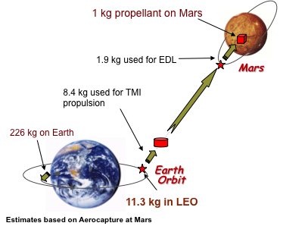
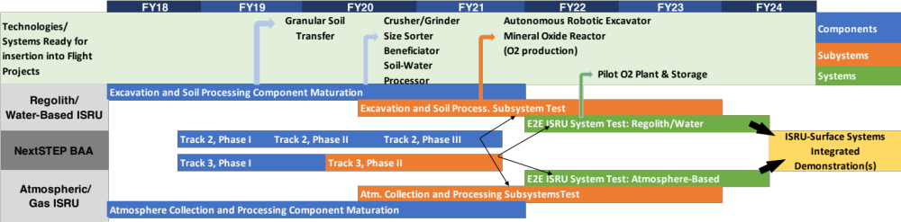
ISRU
Project Overview
Why is this project important?
Production of large consumables (propellants, life support) on the surface of the Moon or Mars significantly reduces launch costs and enables sustained exploration
  Every 1 kg produced on the surface saves 7 to 11 kg launched to LEO
Reliance on in-situ produced propellants and life support consumables has never been done before and represents a new paradigm for space exploration – we must prove the capability at the system level before it will be incorporated
Objectives
Develop and demonstrate, in ground demonstrations, the component, subsystem, and system technology to enable production of mission consumables from regolith and atmospheric resources at a variety of destinations
Current activities
NASA in-house technology
development at GRC, JSC, KSC,
and JPL
10 NextSTEP BAA awards

Slide 3
ISRU
Major Accomplishments – NextSTEP BAA Awards
Track 1: Trade Studies (< 1 year): 4 Awards
  3 architecture trade studies: Blue Origin, ULA, University of Illinois
  1 technology trade study on water electrolysis subsystem: UTC Aerospace
Track 2: Component Development (3 years): 4 Awards
  BlazeTech (dust filtration); Skyhaven (H₂ separation); Paragon (water clean-up and electrolysis); Teledyne (dirty water electrolysis)
Track 3: Subsystem Development (3.5 years): 2 Awards
  Honeybee Robotics (excavation, acquisition, and storage of Mars subsurface ice/water)
  OxEon (oxygen and fuel production from Mars CO₂ and water)
Awards announced May 31st
Total Value ~$10M
Track 1 contracts are underway
Track 2 and 3 are at various stages of the procurement process

Slide 4
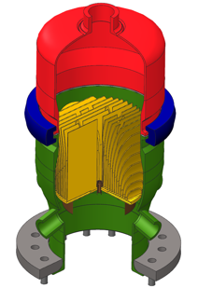
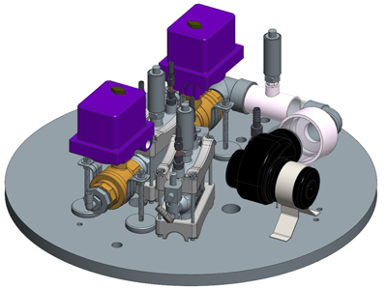
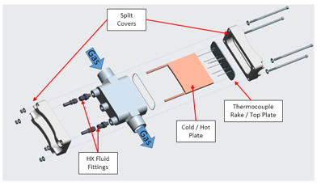
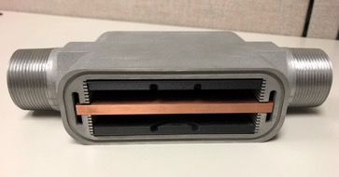
WBS 4.1 Atmosphere Carbon Dioxide Collection Subsystem
Major Accomplishments
Completed flow performance tests of the ISRU Scroll Filter in the Mars Flow Loop
Electrostatic precipitator geometry optimization
  Stack of 137 cylindrical precipitators with a 71 mm diameter and 100 cm length can collect 3 μm-diameter particles flowing at 6 kg/hr at 99% efficiency
Completed design and initiated fabrication of full-scale CO2 cryofreezer
  Cold head design based on lessons learned from sub-scale testing and analysis of multiple cold-heads
Rapid cycle adsorption pump single-stage fabrication and test preparations completed
  Two-stage design 95% complete and procurement
  ~30% complete
Cryofreezer chamber cut-away view of cold head
Cryofreezer two-part cold head
Two-stage rapid cycle sorption pump parts (left) and layout(above) in Mars chamber

Slide 5
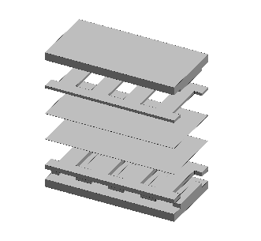
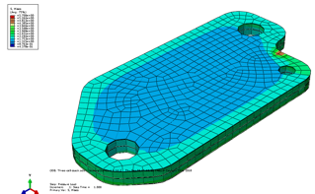
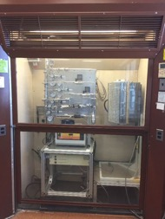
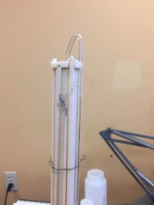
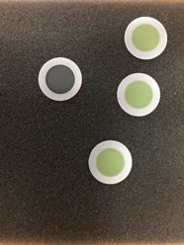
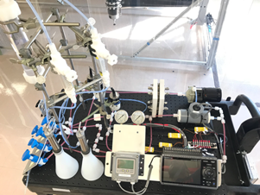
WBS 4.2 Oxygen Production, 4.3 Fuel Production, and 4.4 Water Electrolysis Subsystems
Major Accomplishments
SOE Modeling
  Completed MOXIE stack structural / thermal response at operating conditions
  Created single plate model with reaction kinetics
SOE Materials Selection – Electrode Development
  Completed build-up of 4-gas test facility for button cell testing
  Procured single button cells for evaluation
Completed physical tests of Sabatier catalysts and measured performance post-test
Completed fabrication of dirty-water electrolyzer stack
  Completed test rig
  fabrication and assembly
Exploded view of MOXIE layering
3-cell MOXIE stack stress distribution
Gas flow panel and furnace in fume hood
Single cell test fixture with button cell installed
Vendor supplied button cells
Electrolysis test rig

Slide 6
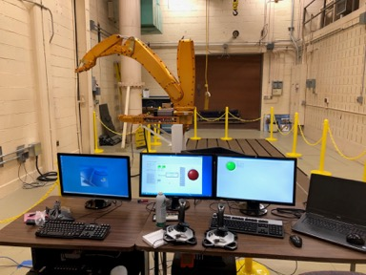
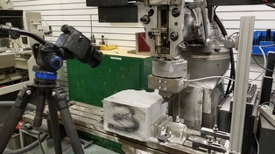
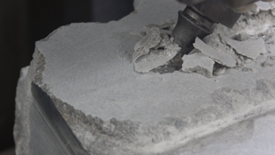
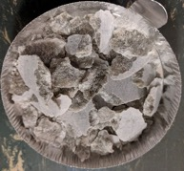
WBS 4.7 Excavation Subsystem
Major Accomplishments
Surface granular material lab space reconditioned and hardware installed
  Multiple pre-programmed bucket trajectory profiles test calibration runs with empty bucket and in pea-gravel (analog mass)
Consolidated / hard excavation testing of single tooth ripper
  Tested in gypsum rock as Mars mineral and lunar icy deposits analog
  Initial testing captured 3-axis forces, cuttings mass and size distributions, excavate volume, and high speed video
Autonomous excavation task initiated and developing concepts for excavation tasks and maintenance and repair design
Initial granular excavator test hardware installed
Hard material ‘ripper’ single tooth test

Slide 7
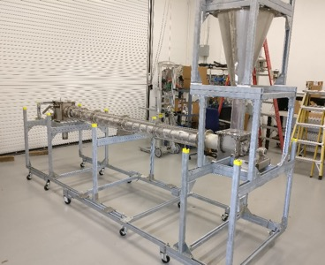
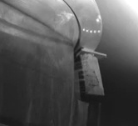
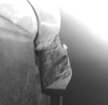
WBS 4.8 Soil Processing Subsystem
Major Accomplishments
Microwave processing tests successfully extracted water in porous tube reactor
  Water release and heat efficiency with new Mars Rocknest simulant performed up to 100 °C
Open air processor tested with Mars Rocknest simulant
  Design modifications to improve soil flow and heating
  significantly different material flow behavior
Auger-dryer soil flow testing completed with acrylic casing
  SS casing with heaters installed and completing test preparations
Partnership agreement (MOU) with the Army Cold Region Research and Engineering Laboratory (CRREL) signed for modification of CRREL Rodwell models to account for Mars environment
  Preliminary experiment design for test apparatus
Auger-dryer with acrylic casing
GRC3 Simulant Scoop
Rocknest Simulant Scoop
Open air bucket wheel scoop of GRC3 simulant compared to Rocknest simulant in Mars chamber

Slide 8
ISRU
Project Performance
= project is meeting its commitments
= project is not meeting its commitments, but has mitigation plans
= project is not meeting its commitments, and needs external assistance
Performance (Project Manager’s overall assessment)
Project | Tech | Cost | Sch | Prg | Status
ISRU |  |  |  |  | First year of funding resulted in slow start while team was built and individual task plans finalized. Many hardware fabrication & test tasks are just entering testing phase now with completion in 1st quarter of FY19.
Milestone Status
FY18 AES Milestones | Planned Completion Date | Actual Completion Date | Comments
Issue NextSTEP BAA for ISRU trade studies and component technologies | 12/4/17 | 12/4/17 | Posted: 12/4/17 Proposals Received: 3/12/18 Awards Announced: 5/31/18
Complete testing of Auger Dryer for soil flow and heating efficiency | 8/1/18 | Soil Flow: 9/18 Heating: 1/19 | Took NSSC 3 months to place a $25K PR with quotes supplied by requester.

Slide 9
ISRU
Challenges, Issues, & Risks
Challenges
Being most popular kid on the block results in a lot of outside (the project) activity requiring time from ISRU leadership to keep up with studies, workshops, calls for proposals, etc. from both within and outside NASA
  Would be easier to manage if we had the budget and FTE commensurate with this popularity
Direction to refocus on the Moon makes it difficult to maintain any Mars work
  Will experience start-up delays on lunar work as we resurrect the tasks and SME’s from the ‘00 ISRU work
  Will likely result in stopping most of Mars ISRU work due to insufficient budget to do both properly
Reduction in FTE allotment at GRC and JSC resulting in loss of key team members
  Challenge in FY18 getting people assigned to ISRU, now in FY19 will only be asking for partial people which will be difficult
Budget Issues
Budget of $10M is half of requested $20M in FY19 as minimum required to maintain schedule of components – subsystem – systems development to meet flight opportunities
Will be unable to post 2nd BAA solicitation to maintain public-private partnership approach
Risks
# | Risk | Mitigation
1 | Lack of sufficient quantities of real lunar regolith (or perfect simulant) for hardware development | - Working with SCLT to forming a simulant advisory committee to create simulant strategy and then find the money for it - Look for opportunities to fly soil handling/processing component hardware demos

Slide 10
ISRU
Plans
Plans for FY19
  Complete testing of filters, cryofreezer, sorption pump (single stage and two-stage), SOE electrode materials, dirty water electrolyzer, granular excavation, microwave processor, auger-dryer, and subsurface ice properties
  Evaluate status of previous lunar ISRU activities and restart key component development in hydrogen reduction, carbothermal reduction(?), size sorting, mineral beneficiation, and soil delivery
  Evaluate, and test, existing soil processors at lunar conditions
  Complete planning of autonomous excavation development path and initiate tasks
  Develop lunar ISRU requirements, evaluate status of existing lunar component models, create new models where needed, perform lunar ISRU system-level trade studies in coordination with power, cryo, lander, and autonomy SMEs

Slide 11
ISRU
Partnerships
AES Autonomous Systems and Operations (ASO) and NASA Platform for Autonomous Systems (NPAS)
  ‘Tiger Team’ formed to develop plans for autonomous excavation and delivery technology development
  Developing plans for joint ISRU, ASO, NPAS, and robotics activity to develop and demonstrate autonomous excavation
AES Life Support Systems
  Sorption pumps: sorbent isotherm data, collaboration on COMSOL models
  Scroll filters: design collaboration
  Process sensors: collaboration with Environmental Monitoring element team to identify ISRU sensor needs, existing SOA, gaps to be filled
  Cryofreezers to separate CO₂ out of cabin air / out of Mars atmosphere
AES Lander Technology
  Funding ISRU liquefaction and storage technology development needed by ISRU
MOXIE
  ISRU project testing MOXIE HEPA filter in Mars Flow Loop
  Modeling MOXIE SOE stack and using MOXIE test data to validate our models
STMD: Low Cost Upper Stage: 3D printing of GR-Cop84 cold heads for ISRU cryofreezer testing
SMD: Supporting landing site characterization (resources and physical), development of Mars simulants

Slide 12
Backup

Slide 13
ISRU FY18 Highlights since mid-year review

Slide 14
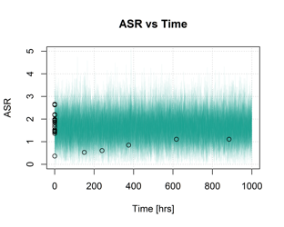
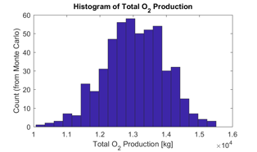
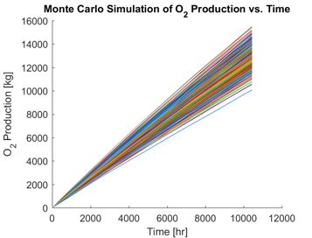
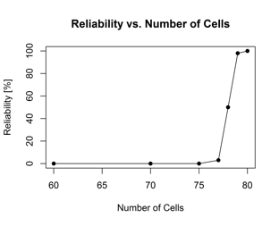
WBS 2.2 System Modeling and Analysis
Summary of Accomplishments
System Modeling & Analysis
Completed reliability model and analysis for ISRU O₂ only system.
  Due to lack of component reliability data, model and analysis was reduced to assessing the solid oxide electrolyzer (SOE) only.
  An empirically-based SOE performance model was developed based on the Area Specific Resistance (ASR) parameter and focused on a single failure mechanism, performance degradation.
  A Bayesian distribution methodology was applied using simple linear degradation model and Monte Carlo simulations were used to compute the SOE reliability, i.e. the probability that total O₂ production requirement is met.
  Analysis results elucidate the sensitivity and need to properly account for degradation in component and system sizing.
  Model and analysis provided a proof-of-concept demonstration, with the aim of extending to a full ISRU system.
SOE degradation model. Degradation parameter is Area Specific Resistance (ASR).
6 stacks
60 cells per stack
30 kg/hour CO₂ inflow
Maximum current density is 0.5 A/cm²
Stack temperature is 800° Celsius
Reliability as a function of # cells/stack where number of SOE stacks = 6.
Sample inputs and results from reliability model analysis.

Slide 15
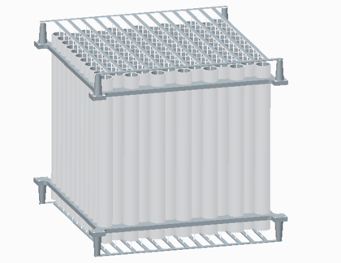
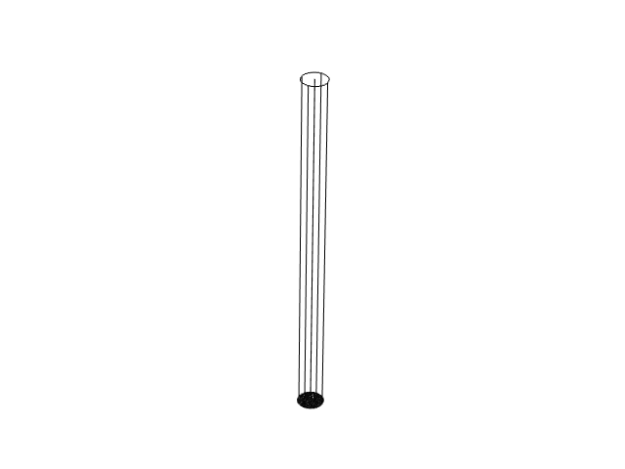
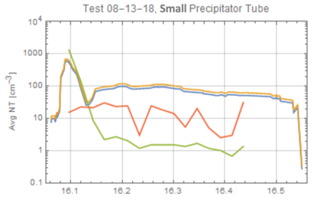

WBS 4.1.1 Electrostatic Filtering
Summary of Accomplishments
ESP-1. Geometry Optimization
Developed a physics-based model in COMSOL Multiphysics ® along with the DC plasma, electrostatics, laminar flow, and particle kinematics modules
Obtained electron density distributions as well as density distributions for negative and positive ions—Analysis showed that CO₂⁺ ions dominate dust particle charging
Produced current-voltage (I-V) curves and ion density data with COMSOL plasma module.
I-V curves match experimental curves in region of interest.
Model shows that a stack of 137 cylindrical precipitators with a 71 mm diameter and 100 cm in length can collect 3 μm-diameter particles flowing at 6 kg/h with an efficiency of 99%
ESP-2. Dust Aerosolization
Modified existing Fine Particle Analyzer to measure particle size and density
Obtained preliminary values of particle sizes and dust particle densities for particles flowing at ~300 cm/s in precipitator at 5 Torr combining Fine Particle Analyzer and laser extension method
Currently using SEM analysis to measure sizes of sampled particles to determine causes of discrepancies in the results of the two methods
The COMSOL model shows that a stack of 137 cylindrical precipitators with an inner diameter of 71 mm, a length of 100 cm, and a wire diameter of 125 μm will collect 3 μm-diameter dust particles aerosolized in a CO₂ flowing at a rate of 6 kg/h with an efficiency of 99%.
Time (h)
Particle density in cm⁻³ and particle diameter in μm using Fine Particle Analyzer and Laser Extinction method. There is a discrepancy in the results of the two methods.

Slide 16
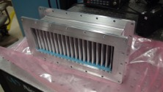
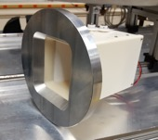
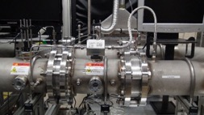
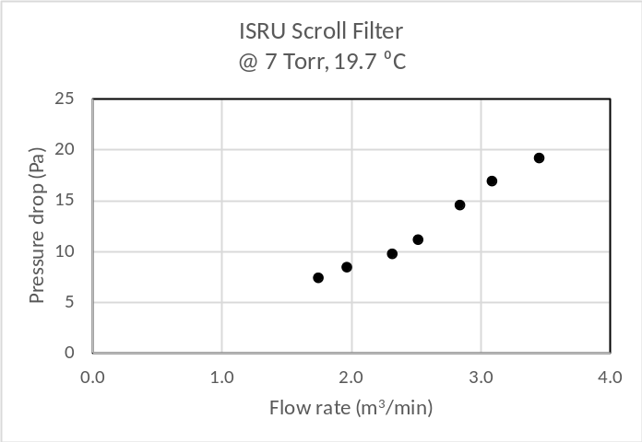
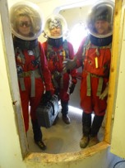
WBS 4.1.1 Media Filters
Summary of Accomplishments
List Significant Accomplishments this FY18:
  MOXIE support
    Completed flow performance tests of the MOXIE HEPA filter in the Mars Flow Loop.
    Completed a set of dust loading tests on the MOXIE HEPA filter.
    Provided guidance on the MOXIE filter Aarhus test plan.
  Filter requirements
    Held first round of discussion with ISRU element team leads to discuss their filtration needs and requirements. Followed up requirement discussions at the KSC ISRU F2F.
  Mars Flow Loop upgrades and improvements
    Installed new more sensitive orifice, improved imaging (reduced stray light), and minimized leak rate through improved pipe component alignment and replacement of fittings. Procured updated instrumentation for the Particle Dynamics Analysis system.
  ISRU Scroll Filter
    Completed flow performance tests of the ISRU Scroll Filter in the Mars Flow Loop.
  Mars Desert Research Station, MDRS (Crew 188)
    Configured ISRU Scroll filter for use in a two week MDRS simulated Mars mission with Crew 188 commanded by Ryan Kobrick (Embry-Riddle Aeronautical University) in January 2018. The filter was tested for its performance inside the Habitat and its susceptibility to the outdoor desert dust environment. Co-wrote conference paper to be be presented at the 69th International Astronautics Congress.
MOXIE Filter
Scroll Filter
Mars Atmospheric Flow Loop
MDRS Crew 188 in airlock

Slide 17
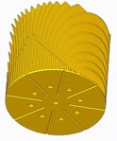

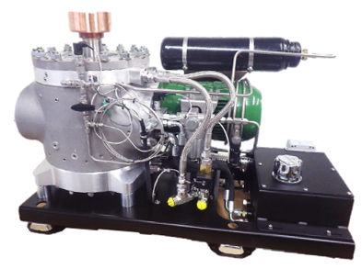
WBS 4.1.3 CO₂ Acquisition - Cryofreezer
Summary of Accomplishments
Full-Scale CO₂ Freezer Design, Component Testing, and Modeling
Wrapped up all testing on the small scale Atmospheric Processing Module (APM).
  Total of five cold head designs were tested, the deposition and sublimation performance of each was assessed, and optimization of entire cycle was analyzed.
Presented two papers at AIAA Space 2018 on CO₂ Freezer work:
  CO2 Freezer Cold Head Design Study
  Full-Scale CO2 Freezer Project Developments for Mars Atmospheric Acquisition.
Preparations for Full-Scale CO2 Freezer testing:
  Completed Preliminary Design Review (7/26/18)
  Completed Software Assurance Classification Assessment (SACA)
  Procured 300 W (min) cryocooler that will be delivered in Q1 FY19
  Finalized design of freezer chamber and the supporting fluid systems
  Finalized design of cold head based on APM test results and modeling of flow field
  Procured all necessary materials, equipment and hardware
  Initiated fabrication of freezer chamber and cold head
  Initiated assembly of the supporting fluid and control/data systems.
Began investigating CFD tools to enable phase change and transient model simulations.
Initiated FY19 planning at the ISRU Workshop held at Kennedy in September of 2018.
Top Left: Freezer Chamber Cut-Away
Top Right: 2-Piece Cold Head with Grooves for Cartridge Heaters
Bottom: AF-Cryo Evercold STC90 Cryocooler

Slide 18
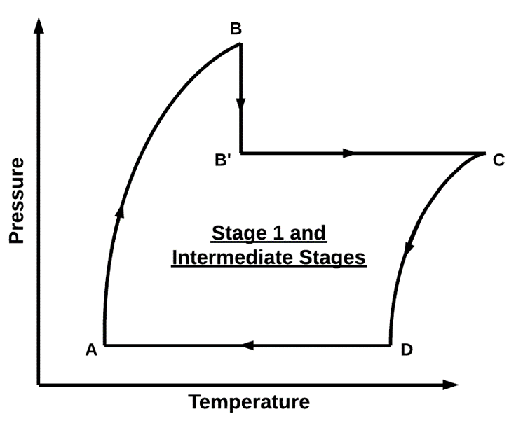
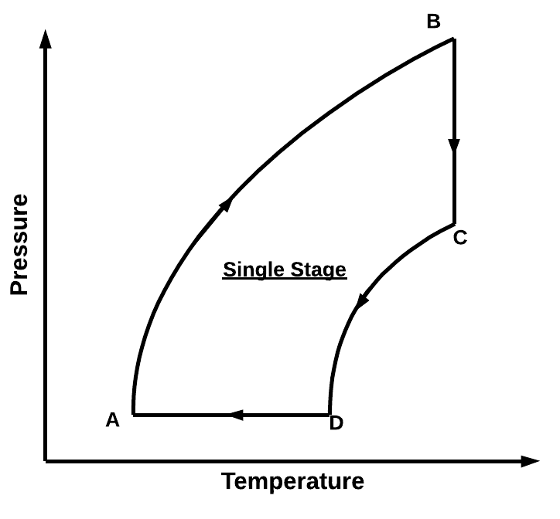
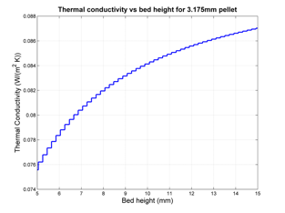
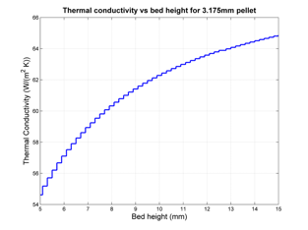
WBS 4.1.3 Rapid Cycle Adsorption Pump
Summary of Accomplishments 1
RCAP Modeling
Cycle Analysis Modeling
  Created version 2 in Matlab
  Better description of multi-stage RCAP analysis
  Optimizes mass collection versus output pressure (top left figure)
  Recuperation and post mechanical compression implemented
Thermal Desktop (Sinda / Fluint) Modeling
  “4BMX” (MSFC) Porous bed conduction heat transfer model implemented
  Modeled both heritage PNNL design and single stage, one-plate configuration
  Results indicate that the “4BMX” constants should be anchored to upcoming single stage, one-plate test
  Conduction paths, especially Aluminum shot, should be considered because of a 750 X increase in thermal conductivity (bottom figures)
Thermodynamic Cycles used for RCAP Cycle Code
Comparison of Porous Bed Thermal Conductivity
Zeolite only (left) Compared against
50 % Aluminum Shot (right), 50 % Zeolite 13 X Adsorbent (By Volume)
~750X Improvement in Thermal Conductivity

Slide 19

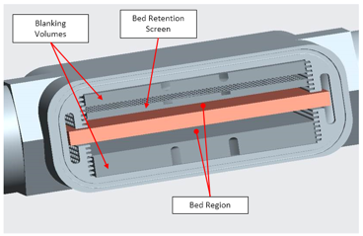
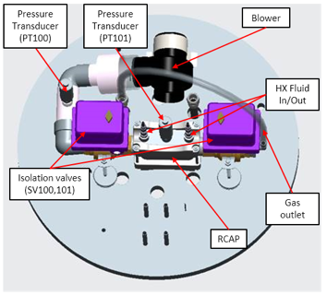
WBS 4.1.3 Rapid Cycle Adsorption Pump
Summary of Accomplishments 2
Single Stage, One-Plate Configuration
Testing starts soon
  Design, procurement complete
  TRR complete
    Evaluating different bed depths and sorbent particles sizes to determine effects on performance and to correlate model
Hardware
  3D printed aluminum alloy housing
  Quickly reconfigurable
  Instrumented for temperature and pressure
  Automated conops for evaluation of short / long period performance transients
Two Stage, Single-Plate Configuration
Design ~95%, procurement ~ 30%
  Design commonality and flexibility to accommodate single stage insights
Single Stage Layout
Two Stage Layout

Slide 20


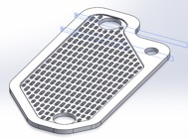
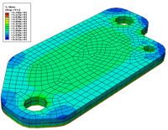
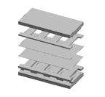
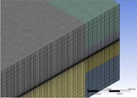
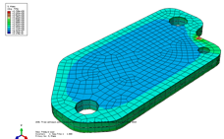
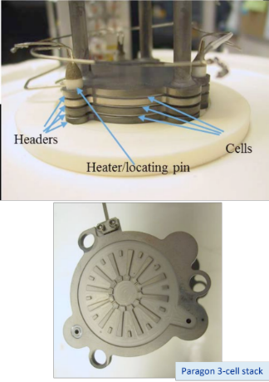
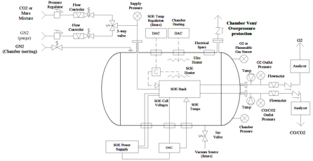
WBS 4.2 Solid Oxide Electrolysis (SOE) Technology
Summary of Accomplishments
SOE Modeling (Thermal, Fluid & Mechanical)
  Created geometry/mesh of a MOXIE stack
  Created geometries within SolidWorks for:
  Created single SOXE plate fluid modeling
  Completed MOXIE stack structural / thermal response at operating conditions
  Created Single plate with reaction kinetics
  Completed parametric analyses on structural / thermal response of stack
  Final report in work
SOE General Test Stand
  Complete a detail SOE Materials Technology Comparison data file
  Completed requirements and design reviews
  Selected Paragon for developing a 3-cells SOE stack
  Completed SOE stack PR: 4200663729
  Test Stand fabricate, installation, instrumentation, controls & TRR completion scheduled for 1/9/2019
  Additional procurements are in progress
  Paragon Stack arrival 1/18/2019
  Testing of Paragon stack scheduled for 1/20/2019
Cathode
Anode
    CO₂ plate
    O₂ plate
    Mid-plate
    Individual element plates
MOXIE/SOXE interconnect plate used for molding
SolidWorks geometry of element plate
Single cell with electrode stress distribution
Exploded view of layering model
Mesh density of layering model
Three cell stack stress distribution
Paragon 3-cell SOE stack
SOE General Test Stand layout
(in assembly phase)

Slide 21
WBS 4.2 Solid Oxide Electrolysis (SOE) Technology
Summary of Accomplishments
SOE Materials Selection-Electrode Development
  Completed initial research and literature review for cathode electrode materials. Will be documented and revised to include cathode development work under OxEon Phase I SBIR work.
  Completed build-up of test facility including gas flow panel to allow 4 gas mixing, and completed safety permit and pressure exclusion reviews.
  Completed installation of gas flow panel, gas cylinder piping, furnace, etc. in fume hood.
  Procured single button cells for evaluation, and cells with anode only to allow advanced cathode comparison with baseline.
    Complete Test Readiness Review (TRR): 10/19/2018
    Complete testing for baseline cells: 02/27/2019
    Complete In-house electrode fabrication: 05/24/2019
    Post-evaluation report: 09/27/2019
Gas flow panel and furnace in fume hood
Single cell test fixture with button cell installed
Vendor supplied button cells

Slide 22
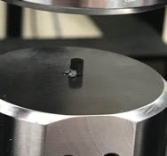
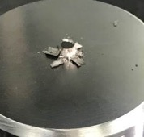

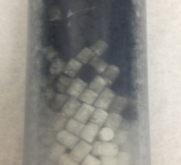
WBS 4.3.1 Sabatier
Summary of Accomplishments
SAB-1 Design Study
Finished modeling Sabatier systems with one or two reactors with different types of thermal management.
Presented this work at 48th International Conference on Environmental Systems:
  P.E. Hintze, A.J. Meier, and M.G. Shah, “Sabatier System Design Study for a Mars ISRU Propellant Production Plant”, ICES-2018-155.
Began trade of different thermal management systems for Sabatier reactor and condenser.
SAB-2 Catalyst Screening
Identified catalyst types (pellets, microlith, microchannel) and potential contaminants (from soil, atmosphere, and liquid water).
Performed physical testing of catalysts showing the changes that occurred after usage.
Performed vibration tests to evaluate different packing materials and methods.
Began performance testing to evaluate catalyst response to vibrations and Mars relevant contaminants.
New pellets, left, generated less dust than used pellets, right, upon crushing
0.5% Ruthenium on aluminum oxide catalyst after vibration test. Dust generated during vibration can be seen in the right image, coating the white aluminum oxide pellets.

Slide 23
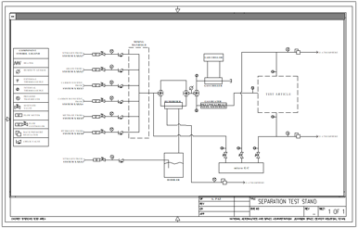

(Multiple WBS) Separators
Summary of Accomplishments
Generic Separation Test Stand
Developed preliminary requirements
Developed schematic
WBS 4.1.3.3.1 CO₂, N₂ and Ar Separation
Collected several papers relevant to separating N₂ and Ar from CO₂
Evaluated multiple conops to determine the impact of not removing N₂ and Ar from the CO₂.
  In all LOX-only ISRU conops, there is no need to separate Ar and N₂ from the CO₂
  In all LOX/CH₄ conops, Ar and N₂ would need to be separated.
Investigated Preparative Gas Chromatography as a candidate for separating these gases without a large pressure/temperature swing
WBS 4.2.3 CO, CO₂ Separation
Collected papers relevant to CO, CO₂ Separation
Phase 1 SBIR awarded to TDA research for high temperature (>650ºC) CO₂ sorbent.
Schematic of Generic Separation Test Stand
Example of CO_{2,} N₂ and Ar Separator Placement

Slide 24


(Multiple WBS) Separators
Summary of Accomplishments
WBS 4.3.2 H₂O, Gas Separation (Condensers)
Investigated COMSOL and SINDA/FLUINT as potential software tools for high fidelity modeling of sophisticated condenser designs
WBS 4.3.3 H₂, CH₄ Separation
Collected several papers relevant to separating H₂ from CH₄
Engaged liquefaction and propulsion community about the impact of not separating H₂ from CH₄
WBS 4.4.3 Regenerative Gas Dryers
Identified necessary test stand modifications and procured components
Recalibrated sensors on the test stand
Identified and procured multiple desiccants
Engaged ECLSS community about their experience with water sorption and regeneration of desiccants
Identified humidity sensors that can work in pure oxygen and pure methane environments
Regenerative Gas Dryer Test Stand
Tunable Laser Diode Humidity Sensor Developed by JPL for Previous ECLSS Application

Slide 25


(Multiple WBS) Separators
Summary of Accomplishments
WBS 4.8.5 Water Cleanup
Analyzed water samples extracted from JSC Mars-1A simulant from previous test program
Manufactured custom pressure vessel lid with no filter (to compare against existing pressure vessel lid with embedded filter)
Developed test stand to extract and condense water from Mars soil simulant.
Pressure Systems Design Review of Test Stand
Water Extraction Test Stand
Water Samples Analyzed from Previous Test Program

Slide 26




WBS 4.4 Water Electrolysis
Summary of Accomplishments
Accomplishments since Mid Term
03/18 Design Test Rig
08/18 Electrolysis Cell/Stack Assembly Completed
09/18 Test Rig completed.
The cell stack will operate using highly salt/mineral laden water that provides the water source and cell stack cooling.
Electrolyze Projected Performance
Number of Cells : 10 Cells
Cell Area : 100 cm2/cell
Power Usage : 340 Watts
H₂O Conversion : 67 gm H2O/hr
O₂ Production : 59.6 g O2/hr, (0.69 slpm)
H₂ Production : 7.4 g H2/hr, (1.38 slpm)
Anode Cell Separator Assy (O2 Side of Cell)
Cathode Cell Separator Assy (H2 Side of Cell)
Cathode Cell Separator w Porous PTFE Membrane
Electrolysis Test Rig Top View
Electrolysis Test Rig

Slide 27





WBS 4.7 Excavation / Resource Acquisition
Summary of Accomplishments
Excavation / Resource Acquisition - Grouped for Comparisons:
    Questions identified to be addressed
    Accomplished to date
Surface Granular Material (4.7.1)
  Fundamental excavation terramechanics (vs. location)
  Actuation / automation / life limiting mechanisms (common)
  Transport / surface mobility / storage (common to WBS 4.7)
  New ISRU laboratory space at GRC reconditioned / in use
  Excavation test hardware installed, calibrated, and reviewed
  Pre-programmed bucket trajectory profiles run multiple times, comparison between bucket empty and with pea-gravel (analog mass)
Surface Consolidated / Hard Material (4.7.2)
  Fundamental forces / energy to fracture (vs. material type)
  Water content / variability (vs. location)
  Method / mechanism (e.g. variable spacing ripper)
  Redirected ripper assessment, to measure single tooth forces in KSC lab
  Acquired bulk gypsum rock, as Mars target and lunar icy deposits analog
  Re-tasked, instrumented shop equipment for quantitative pick testing
  Initial testing captured 3-axis forces, cuttings mass and size distributions, excavated volume, and high speed video
Initial excavator test lab hardware installed,
and excavation testing initiated.
(4.7.1)
Hard material “ripper” pick test
(4.7.2)

Slide 28



WBS 4.7 Excavation / Resource Acquisition
Summary of Accomplishments
Excavation / Resource Acquisition - Grouped for Comparisons:
    Questions identified to be addressed
    Accomplished to date
Subsurface Resource Access / Acquisition (4.7.3)
  Locating / characterizing subsurface water-rich resources
  Drill / melt vs. mine vs. expose / mine (“strip-mine”)
  Rate for efficient extraction of water (vs. loss, heat loss)
  JPL initial assessment, then personnel redirected to autonomy
Surface Granular & Surface Consolidated / Hard Material (4.7.1 & 4.7.2)
  What sensors are required for autonomy? (e.g. for navigation, health management)
  How many autonomous excavators of what size?
  How to autonomously decide where/how to navigate?
  What communication is needed for autonomy? Between excavators, and w/processing?
  Decomposed autonomous resource acquisition into representative tasks
  Developed concepts for tasks: breaking, scooping, hauling, dumping and crushing
  Developed maintenance and repair design concepts for autonomous operations
  Gathered equipment data from terrestrial mining operations, analyzed for rules-of-thumb on sizing, energy and mass, to estimate comparable systems requirements for ISRU excavation and material delivery
Subsurface Resource
Access / Acquisition
(4.7.3)
Example functional
decomposition
Autonomy
Commercial crushers output vs mass

Slide 29


WBS 4.8.2 Soil Processing
Summary of Accomplishments
Microwave Processor (JPL): Granular hydrated regolith
  Laboratory tests have validated water extraction from porous tube reactor:
    Initial heating runs performed up to 100C
    Water release and heat efficiency with new Mars Rocknest simulant
  Two microwave systems tested for efficiency: Solid state amplifier and magnetron.
    Control system implemented for active frequency tracking
  Initial power efficiency numbers show good agreement with model predictions
  Agreement in place with Honeybee Robotics to develop soil feed system and condenser
    Testing of current breadboard system will take place in Honeybee Robotics thermal vacuum chamber in Nov. 2018
Open ‘Air’ Processor (GRC): Granular hydrated regolith
  Paper on initial breadboard tests (2017) presented at the Earth and Space conference in April 2018
  Design modification to improve repeatability and data accuracy
  System tested with new Mars Rocknest Simulant; significantly different material flow behaviour
  Initial data analysis of flow parameters incorporated into model for scaling
Microwave Processor, JPL: Soil feeds into porous tube which is inside waveguide cavity. A pump used to extract water moving through porous Pyrex tube.
Open ‘Air’ Processor, GRC: Soil is deposited on a vibrating heated tray using a bucket wheel. A sweep gas of Mars ‘air’ conveys water vapor to the condenser.

Slide 30


WBS 4.8.2 Soil Processing
Summary of Accomplishments
Auger Dryer (JSC): Granular hydrated regolith
  Phase 1 system: Testing complete
    Clear Acrylic casing to characterize flow behavior
    Tested with new Mars Rocknest Simulant
  Phase 2 system is in hand
    Stainless Steel casing with heaters for water release tests
    Heaters installed and control system is in place
Rodwell Ice mining (JSC): Subsurface Ice
  Partnership agreement (MOU) with the Army Cold Region Research and Engineering Laboratory (CRREL) signed
    CRREL developed the Rodwell model that is currently being used and is helping to modify/validate for Mars environment
  Technical Interchange Meeting (TIM) held at JSC with CRREL
    Test parameters identified and preliminary test matrix developed
  Preliminary experiment design for test apparatus
    Facility identified at JSC for initial sublimation testing at Mars conditions.
  Paper published and presented at AIAA Space 2018
Auger Dryer, JSC: An auger is used to convey material through a heated tube. Vapor pressure drives water out of system. Auger pitch and soil column are used to seal.
Rodwell Ice mining (JSC): A preliminary test apparatus design to measure key parameters under Martian environmental conditions

Slide 31



WBS 5.2.2 Simulants
Summary of Accomplishments
Rocknest Soil Simulant
Production of ~780 kg of Mars soil simulant
  Developed recipe based on hundreds of analyses of commercially available material
  Matched volatile content found by MSL Rover
  Utilized the Mojave Mars Simulant (MMS) from JPL as the core component
  Mixed at USGS – shipped at end of Sept 2018
    100 kg to GRC
    100 kg to JPL
    580 kg to JSC
Opportunities w/ New Simulants
Mars
  Highest H2O content material on Mars: Polyhydrated Sulfate (identified a potential commercially available ingredient – Ferric Sulfate – for a new martian simulant)
  Constructed wiki-page reviewing information about a wide range of different ISRU targets on Mars & Earth analogs
Moon
  Collaboration with USGS – new batch of Lunar Highlands Simulant (NU-LHT) available for purchase
Rocknest Mars Simulant
Mars Hydrated Minerals Wiki Page
Notes:
Wiki page link: https://wiki.jsc.nasa.gov/fod/index.php/Review_of_Hydrated_Minerals_on_Mars_for_ISRU

Slide 32
Next Space Technologies for Exploration Partnerships-2 (NextSTEP) Broad Agency Announcement
Appendix D – ISRU Technology

Slide 33

Enhancing Lunar Exploration with ISRU Strategies
BAA Track 1
Team
Dr. Christie Iacomini (Blue Origin Principal Investigator)
Kent Joosten (Subcontractor)
Technology Transfer and Commercialization
Spin-in: Existing liquid propulsion and space system technologies
Spin-out: Blue Moon commercial lunar lander
Objectives & Approach
Lunar ISRU Study
Model volatile lunar resources needed for various missions
Sensitivities based upon concentrations
How commercial architectures can utilize and/or transfer ISRU derived commodities

Slide 34



ISRU Affordability Thresholds
BAA Track 1
Team
United Launch Alliance
Technology Transfer and Commercialization
ULA has keen interest in emergence of commercial cislunar activity, and in potential for less expensive propellants to fuel ULA in-space transportation
ULA upper stages Integrated Vehicle Fluids have capability well matched to emergence of lunar ISRU propellant transportation
Objectives & Approach
Identify production rate requirements, and maximum price for ISRU propellants at the lunar surface in order to be less expensive than earth-based propellants in support of a range of potential missions & propellants utilizing ISRU LH₂, LO₂, or H₂O
Requirements assessment and economic analysis grounded by experience with stage designs to derive transportation usage and cost

Slide 35



Integrated Architecture Trade Studies on ISRU Technologies for Human Space Exploration
BAA Track 1
Team
Koki Ho, University of Illinois, PI
Technology Transfer and Commercialization
‘Spin-in’: leveraging organization/PI’s expertise and capabilities in multi-disciplinary design optimization, space logistics modeling, and ISRU modeling.
‘Spin-out’: enhancing organization/PI’s capabilities in ISRU trade study modeling and general network optimization methods; promoting collaboration with industry and government in space and terrestrial applications; education of next generation of engineers.
Objectives & Approach
Major project objectives: perform trade studies to evaluate the benefits of ISRU, analyze the tradeoff on ISRU options, and optimize the design of infrastructure and architecture elements.
Technical Approach
Perform optimization and trade studies on ISRU surface infrastructure.
Perform space logistics optimization and trade studies with both ISRU infrastructure and in-space architecture elements integrated.
Upgrade the NASA’s past/existing studies.
Fig. Network modeling of space logistics enables architecture optimization and evaluation of the value of ISRU (Credit: UIUC, MIT, NASA)

Slide 36


NextSTEP-2 ISRU Technology – Water Electrolysis
BAA Track 1
Technology Transfer and Commercialization
Program – Darren Samplatsky will act as the team lead. He has proven repeated success in efficiently meeting challenging ECLSS objectives
Advanced Technology – Phillip Baker will provide the technical leadership for the trade study effort with expertise in water electrolysis cell design and system architecture.
Safety – Scott Schneider will provide safety and hazards assessment during the trade study effort, with relevant experience in ISS systems employing hazardous fluids.
Relevant system design and operational experience from both the ISS Oxygen Generation Assembly (below left) and the U.S. Navy Oxygen Generator (below right) will prove valuable in assessing technical approaches for the Mars ISRU water electrolysis system for propellant production.
Objectives & Approach
Conduct a trade study of available water electrolysis cell and system designs to identify an optimal solution for generating oxygen and hydrogen as key reactants in a propellant manufacturing process for a Mars ascent vehicle.
Identify and assess trade study factors to appropriately weigh key requirements for a water electrolysis system – factors to be considered include launch mass and volume, operational efficiency, safety and reliability and simplicity.
Select a baseline system design and create a development pathway to burn down technical risks.
ISS OGA
U.S Navy OG
Notes:
Note: Template provided to convey required content and general layout. Fonts (type and size), quadrants / image size, etc. are at the discretion of the Proposer.

Slide 37
Compact High Efficiency Self-Cleaning Dust Filter for Martian Air
BAA Track 2
Team
Dr. Vijay V. Devarakonda, BlazeTech Corp., PI
Dr. N. Albert Moussa, BlazeTech Corp., Analysis
Dr. Raheem Bello, Afthon, Testing
Mr. Kevin Goold, AGS, Fabrication
Technology Transfer and Commercialization
Spin-in: BlazeTech’s Martian dust filter technology developed through a recent NASA SBIR project is the starting point for the proposed project
Spin-out: successful completion of proposed technology advancement will benefit BlazeTech’s technologies for controlled dust aerosolization and fine particle characterization
Objectives & Approach
Objective: Develop and demonstrate a compact high efficiency self-cleaning dust filter to remove > 99% of 0.05 to 10 μm sized particles from Martian gas
Mature filter technology from current level (TRL 4) to TRL 5 in the proposed effort through:
  Controlled parametric testing under Martian environment simulated in a 75 ft³ vacuum chamber to fine-tune filter operation for > 99% filtration efficiency
  Design and analysis to lower filter size, mass, and power requirement
  Characterization, documentation, and delivery of β-prototype
Filter Prototype at TRL 4

Slide 38

Hydrogen and Methane Separator for Martian ISRU Processing
BAA Track 2
Team
Skyhaven Systems, LLC
Technology Transfer and Commercialization
The separator is applicable for NASA’s rocket engine testing and launch support operations that need to separate hydrogen and helium gas mixtures
Commercial separations for MRI and nuclear energy processes
Objectives & Approach
Develop and demonstrate a H₂/CH₄ separator for NASA’s Martian ISRU processing at a TRL 5.

Slide 39



ISRU-derived Water Purification and Hydrogen Oxygen Production (IHOP) Component Development
BAA Track 2
Technology Transfer and Commercialization
Paragon draws on our Ionomer-membrane Water Processing (IWP) technology applications including Contaminant Robust In situ Water Extractor, Brine Processor Assembly for ISS, and Humidity Control Subsystem for Boeing CST-100 to develop the Water ISRU-derived Purification Equipment (WIPE) and Hydrogen Oxygen Production Assembly (HOPA) components
Giner’s lightweight electrolyzer technology is the direct descendant of Giner’s first stack built in 2004 under NASA contract
Lifetime testing feeds directly into NASA future utilization of this technology
IHOP advancement will be applied to Paragon’s ISRU and water processing applications for NASA and commercial deep space exploration and planetary uses
Paragon Space Development Corporation
Laura Kelsey, Principal Investigator & Program Manager
Barry W. Finger, Chief Engineer
Patrick Pasadilla, Deputy Program Manager
Chad Bower, Thermal Systems Technical Lead
Giner, Inc.
Jason Willey, Senior Project Engineer
Winfield Greene, Mechanical Engineer
Simon Stone, Director – Applied Electrochemistry
Objectives & Approach
Rapidly advance the maturity of IHOP water purification and electrolyzer components through completion of design work and component-level testing
Optimize the integration of the WIPE and HOPA Assemblies and develop the IHOP high fidelity prototype components through preliminary design.
Demonstrate integrated performance of the WIPE and HOPA assemblies at full scale under relevant operating conditions and advance key component technologies from TRL 4 to 5

Slide 40

Advanced Alkaline Electrolyzer to Support NASA ISRU Application
BAA Track 2
Team: Teledyne Energy Systems
Dr. Thomas I. Valdez – PM
Michael Miller – PI
Stuart Pass – System design
Ying Song – MEA design
Technology Transfer and Commercialization
Provide high pressure water electrolysis stack for life support and/or fuel cell reactant in space
Offer high pressure electrolysis within the commercial hydrogen market where TESI is presently an active participant.
Objectives & Approach
Develop and test a high pressure, alkaline based water electrolysis stack. The chemistry and cell configuration being proposed will require less feed water processing then present commercial high pressure electrolyzers require. The goal is to develop an electrolysis process that can support the level of contaminants expected in ISRU water.
The approach is to build and test a single cell stack followed by a 10-cell breadboard based on the full size stack design.

Slide 41
RedWater: Extraction of Water from Mars’ Ice Deposits
BAA Track 3
Water Team (Engineering team):
•Kris Zacny, Honeybee Robotics, PI
•Gale Paulsen, Honeybee Robotics, Systems Engineer
•Phil Morrison, Honeybee Robotics, Water extraction/engineering lead
•Bolek Mellerowicz, Honeybee Robotics, Lead Electrical/Controls
•Kristian Mueller, Honeybee Robotics, Project Manager
Red Team (Review team)
•Michael Hecht, Massachusetts Institute of Tech., Mars melt probes, ISRU (Phoenix, MOXI, Chronos)
•Nathaniel Putzig, Planetary Science Institute, Mars ice deposits (SHARAD, TES, THEMIS)
•Fredrik Rehnmark, Honeybee, drilling/engineering
•Dara Sabahi, NASA Jet Propulsion Lab (retired), Systems Eng. and Mars Ops. (MSL, MER, Phoenix)
•Paul van Susante, Michigan Technological University, Mars excavation and ISRU
Technology Transfer and Commercialization
Terrestrial and space technology relevant to project
•Coiled Tubing (mining, oil and gas) – commercial technology
•Rodriquez Well (water extraction in Antarctica and Greenland) – commercial technology
•Melt Probes (Europa, Mars) – Honeybee and NASA JPL (Chronos) technology
•Heat Flow Probe (Europa, Mars, Moon) – Honeybee technology
•Deep Drilling (Europa, Mars) – Honeybee technology
Terrestrial and space technology that will benefit from project
•Coiled Tubing (mining, oil and gas) – spinoff into terrestrial market
•Rodriquez Well (water extraction in Antarctica, Greenland) – spinoff to terrestrial market
•Melt Probes (Europa, Mars) – spinoff into space market
•Heat Flow Probe (Europa, Mars, Moon) – spinoff into space market
•Deep Drilling (Europa, Mars) – spinoff into space market
Objectives
RedWater is a water extraction system from Mars ice deposits (e.g. Arcadia Planitia; 10s of meters ice deposits underneath <20m regolith). It combines two terrestrial technologies into one: Coiled Tubing for making a hole and RodWell for melting/pumping water.
The goals are:
•Develop TRL6 water extraction system,
•Demonstrate feasibility of mining water in Mars chamber
•Provide engineering and performance data for extracting 16 tons of water.
Technical approach
•Demonstrate critical components of the RedWater for Mars
  •Making a hole (drilling, pneumatic chips transport, tube assembly and injector, drum)
  •Extracting water (melting, water-jetting, pumping)
•Test components in Mars chamber and freezer to reach TRL5
•Develop and validate thermal model for hardware and melting
•Design and hold Primary Design Review (PDR)
•Fabricate RedWater TRL6 subsystem (drilling/water extraction)
•Test RedWater in 5 m freezer and 3.5 m Mars chamber to reach TRL6

Slide 42


Production of O₂ & Fuels from In-Situ Resources on Mars
BAA Track 3
Key Members: Joseph Hartvigsen, Principal Investigator
S. Elangovan, Scientist
Organization: OxEon Energy, LLC
Role: Electrolysis Stack
Fuel Synthesis Reactor
Component integration
JPL Facility: Mars Environmental Chamber
Technology Transfer and Commercialization
OxEon personnel designed high temperature electrolysis modules working with DOE, NASA, Phillips 66
Delivered SOXE stacks for MOXIE on 2020 Mars Rover launch
Conducted fuels synthesis work for Department of Energy, Naval Research Laboratory, Hunt Oil, State of Wyoming
Current contracts with State of Utah on high temperature electrolysis / co-electrolysis; commercial entity
Current contracts on fuels synthesis with American Refining Group, Naval Research Laboratory, Calvert Energy, Verdis
Proprietary design for modular, transportable fuel synthesis reactor
NASA specific development of rugged, hermetic CO₂-steam co-electrolysis stack with fuel synthesis reactor integration will enable commercial application of renewable energy storage as synthetic hydrocarbon fuels
Objectives & Approach
Objectives:
Produce a large format electrolysis stack that
produces high purity oxygen, H₂, & CO
Produce a methanation reactor
Use the H₂, CO from electrolysis to produce CH₄ at desired volumes
Approach:
Phase 1: Individual component fabrication and testing; component integration design; test components in relevant environment
Phase 2: Finalize integrated design; build an integrated system; test system in relevant environment
OxEon CO₂ Electrolysis Stack and Methanation Reactor Renderings

