Slide 1
Synthetic Biology Applications
10/12/2018
John Hogan, PI, Ames Research Center

Slide 2
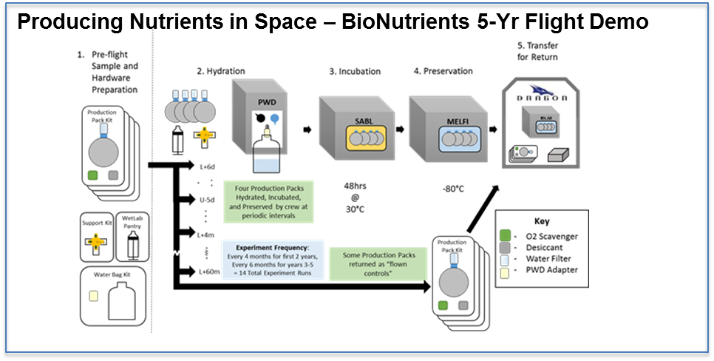
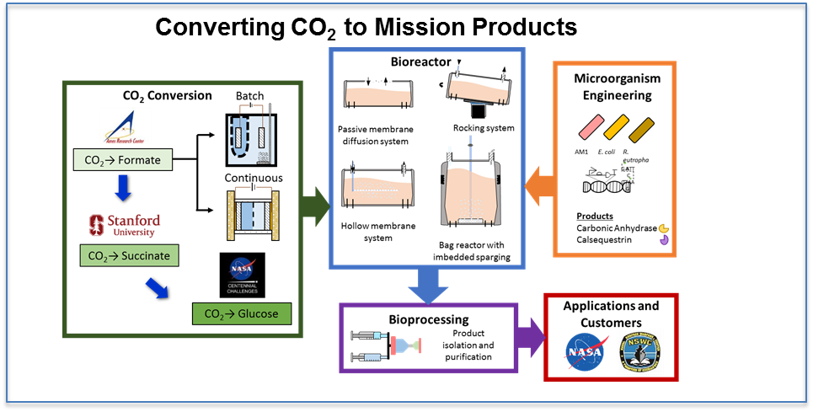
Synthetic Biology Applications
Project Overview
Why is this project important?
Biomanufacturing systems are needed for future long-duration missions to reduce supply costs and increase mission sustainability.
This project is developing methods to manufacture needed, complex compounds in space. Novel methods are also being created to use CO₂ as a feedstock for biomanufacturing.
Objectives
Conduct a 5-year ISS-based demonstration of a new method for on-demand microbial biomanufacturing of human nutrients and probiotics.
Develop a prototype system that rapidly converts CO₂ to microbial feedstock with subsequent bioproduction of valuable mission products.
Current activities
Preparing BioNutrients demonstration hardware and operations for 5-year flight demonstration on ISS.
Developing CO₂ conversion system for media production (Stanford University collaboration), microbe engineering, and bioreactor design.

Slide 3
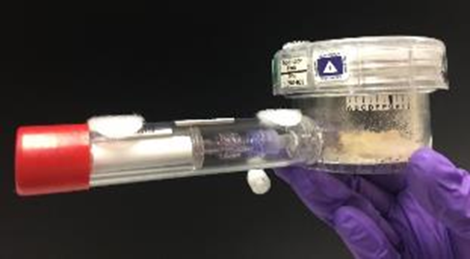
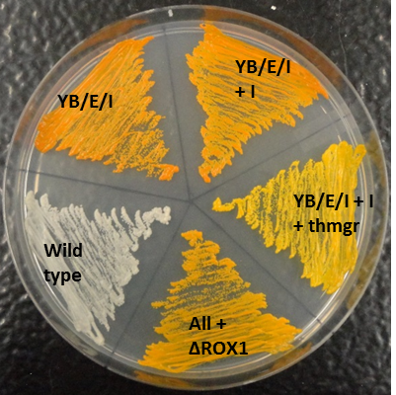
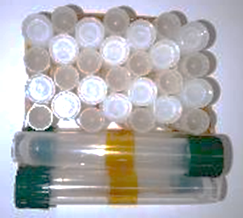
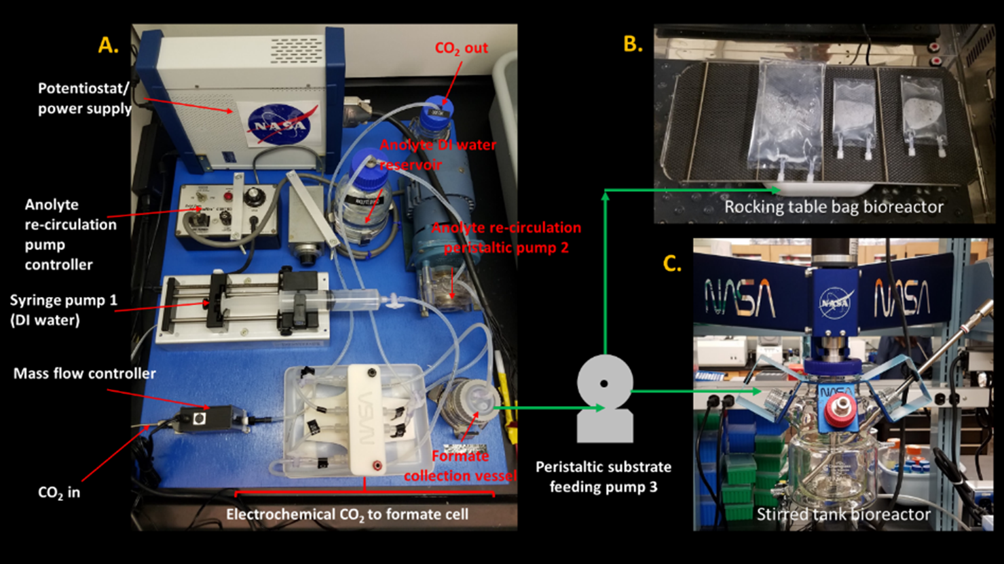
Synthetic Biology Applications
Major Accomplishments
BioNutrients
Microbial Engineering
Developed multiple test organisms for flight experiment (zeaxanthin, beta-carotene, vitamin K) and stasis tests
Yield/sporulation optimization and increased stasis
Stasis Pack - 14 treatments for low-cost testing: probiotic/yogurt orgs. & 3 media
Flight Preparation
Flight Schedule baselined – targeting SpaceX-17 – Feb 17, 2019
Critical Design Review – No issues – 09/21/2018
Phase III Safety Data Package (presented to Payload Safety Panel and approved with comments 09/26/18) BSL Level I, Tox O (except O₂ scavenger - I)
Flight Production Pack developed – EVT conducted – awaiting results
CO₂-Based Manufacturing
CO₂ Conversion to Media
Developed CO₂/H₂O to formate production reactor using SOA COTS hardware
Stanford collaborator – high-yield acetate production (from CO) and growth by C. utilis
Bioreactor Development
Bag-based reactor system developed and tested (milestone)
Organism Engineering and Product Testing (Carbonic Anhydrase - CA)
Development of engineering tools for non-model organisms (AM1, Ralstonia)
Preliminary CA production and function demonstrated
Flight Production Pack
Stasis PackProbiotic
w/ beta-carotene
Stasis Pack
CO₂- Manuf. Prototype Components - CO₂ to Formate Reactor; Bioreactor and Engineered Organisms

Slide 4
Synthetic Biology Applications
Project Performance
= project is meeting its commitments
= project is not meeting its commitments, but has mitigation plans
= project is not meeting its commitments, and needs external assistance
Performance (Project Manager’s overall assessment)
Project | Tech | Cost | Sch | Prg | Status
Synthetic Biology Applications |  |  |  |  | BioNutrients production pack is on tight schedule to meet hand-off, but is on-track. Extra personnel added to meet schedule.
Milestone Status
FY18 AES Milestones | Planned Completion Date | Actual Completion Date | Comments
Bioreactor System Fabricated and Preliminary testing complete | 1/30/18 | 1/30/2018 | Completed
Complete ground testing of combined packet growth system and enhanced organism. | 5/30/15 | 7/16/18 | Completed (Biocompatiblity verification in final flight pack). Vendor delay and design change led to short delay.
P/C CO₂ Conversion System Fabricated and Preliminary Analysis Complete | 7/15/18 | 7/15/18 | Completed

Slide 5
Synthetic Biology Applications
Plans & Partnerships
Plans for remainder of FY18 & FY19
  BioNutrients –
    18-19 – Build and load BioNutrients-1 hardware for handover to SpaceX-17 in 01/19 for start of 5 year test/demonstration
    19 – Engineer system to make multiple nutrients; probiotic studies
  CO₂-Based Manufacturing
    19 – Integrate systems, preliminary testing, improve CO₂ conversion products
Partnerships
  AES – Collaborating with two LSS projects (Liquid Amines/COHO) re: carbonic anhydrase production/testing
  Stanford University – M. Kanan – CO₂ conversion to microbial feedstock molecules – extending cooperative agreement for FY2019/2020
  STMD STRI – BioManufacturing – UC Berkeley/A. Arkin PI – Hogan COR (in year 2 of of 5)
  CO₂ Centennial Challenge – Phase I launched – over 1000 registrants
  New STTR Phase I 2018 – Advanced Bioreactor Development for In Situ Microbial Manufacturing – 1 Award to: R. Macur. “A Robust Biofilm-Biomat Reactor for Conversion of Mission-Relevant Feedstocks to Products” Sustainable Bioproducts LLC

Slide 6
Synthetic Biology Applications
10/12/2018
John Hogan, PI, Ames Research Center

Slide 7
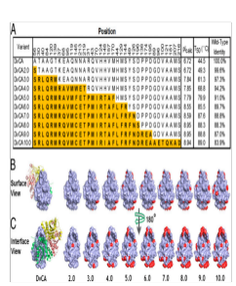
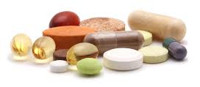
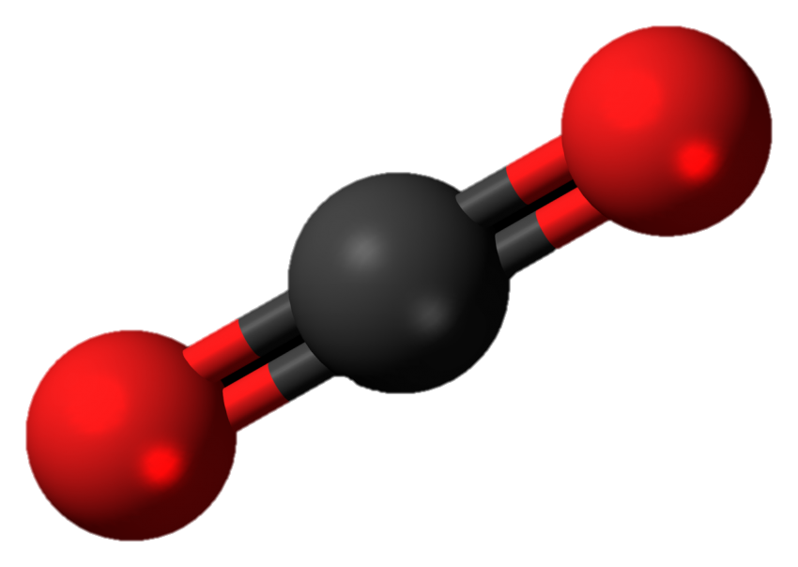
Synthetic Biology Applications - Objectives
Overall Project Goal
Identify and develop viable synthetic biology approaches that demonstrate substantial improvements for mission architectures.
Specifically to:
• Increase potential for in situ resource utilization.
• Enable an array of in situ manufacturing capabilities.
• Flight testing to demonstrate targeted product generation in space
with low mass, power, and volume systems.
BioNutrients
CO₂-Based Manufacturing for Mission Extensibility

Slide 8
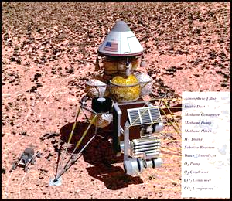
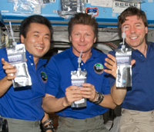
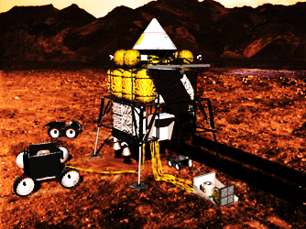
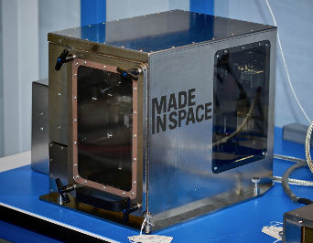
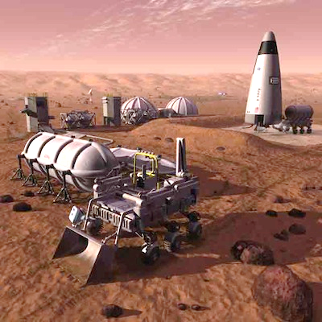
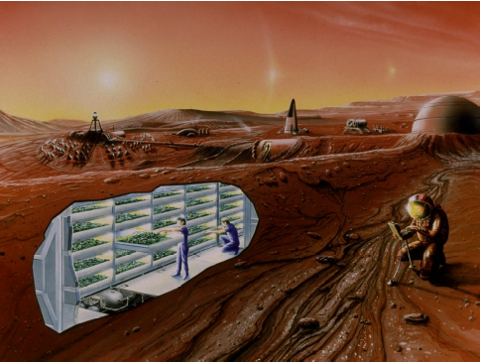
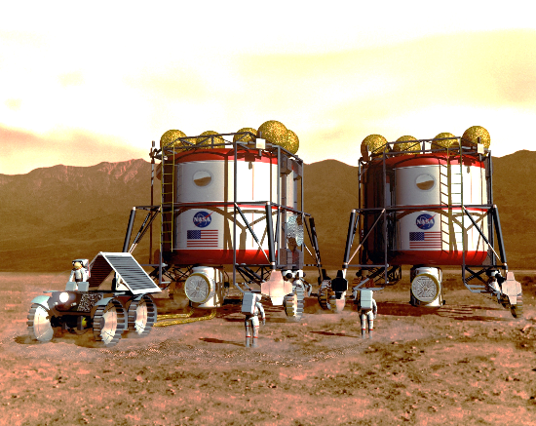
In Space Production of Mission Products
A wide array of different mission resources will eventually need to be produced on-site for mission sustainability/cost effectiveness
  Fuels, food, chemicals, plastics, binders, medicine, etc.
  Biomanufacturing can provide compounds abiotic systems cannot

Slide 9





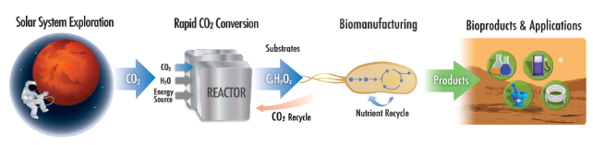
CO₂ - Based Manufacturing for Mission Extensibility
CO₂-Based Manufacturing Project Overview
Bioreactor development and testing
CO₂ conversion
Products and applications
CO₂ → Formate
Passive membrane diffusion system
Rocking system
+
CO₂ → CO→ Acetate
Microorganism engineering and testing
Pathway engineering
Metabolize uncommon substrates
Genetic Tools
Development of expression systems
Products
Carbonic Anhydrase
E. coli
R. eutropha
C. utilis
CO₂→ Glucose
AM1
S. cerevisiae
P. pastoris

Slide 10
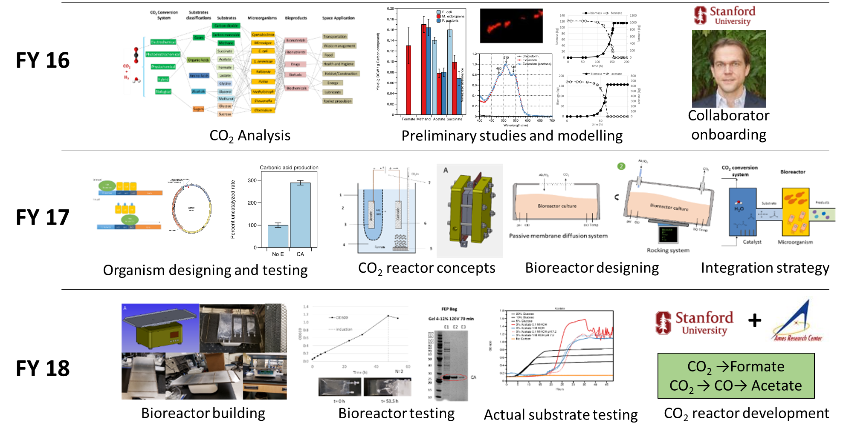
CO₂-Based Manufacturing Advancements

Slide 11
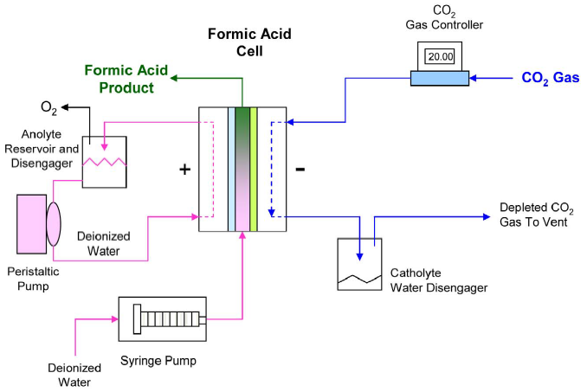
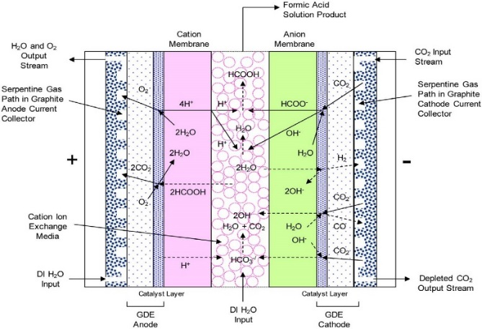
CO₂ Conversion to Formic Acid – ARC System
ARC Formate Reactor Efforts
Dioxide Materials Inc. released a novel (2018) GDE and novel membrane system for CO₂ conversion to formic acid.
Obtaining custom formic acid cell system from developer (should be in-house by end of April).
Conversion cell contains a novel 3-compartment design with a 5 cm² active area with serpentine flow path.
System can generate 5-20 wt% Formic Acid in product stream and studies have been carried out to demonstrate product recycling.
State of the art COTs system has stable performance for over 500h – at ambient temperatures.
Cathode Reaction:
CO₂ + H₂O + 2e⁻ → HCOO⁻ + OH⁻
Anode Reaction:
2H₂O → 4H⁺ + 4e⁻ + O₂
Formate (HCOO⁻) and hydroxide (OH⁻) pass into center compartment and react with protons (H⁺) to produce Formic acid (HCOOH) and water (H₂O).
Formic Acid will serve
as microbial substrate
Yang et al. 2017 (Dioxide Materials, Boca Raton FL)
Fabricated System
and Tested in FY18

Slide 12
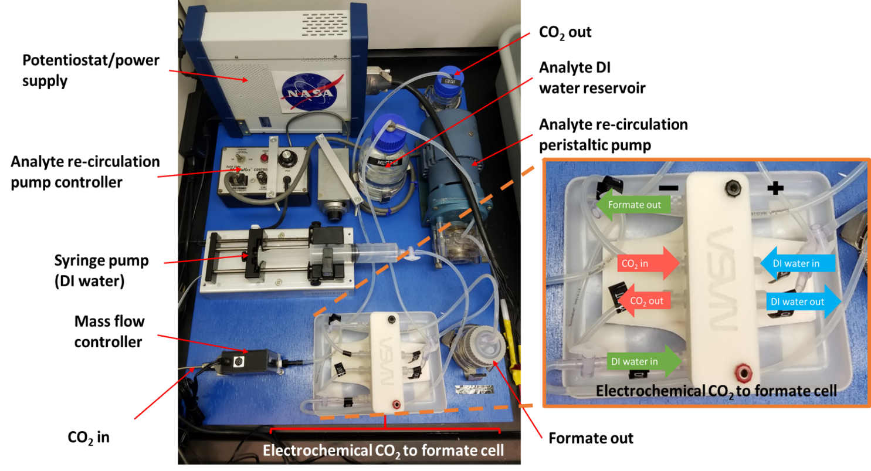
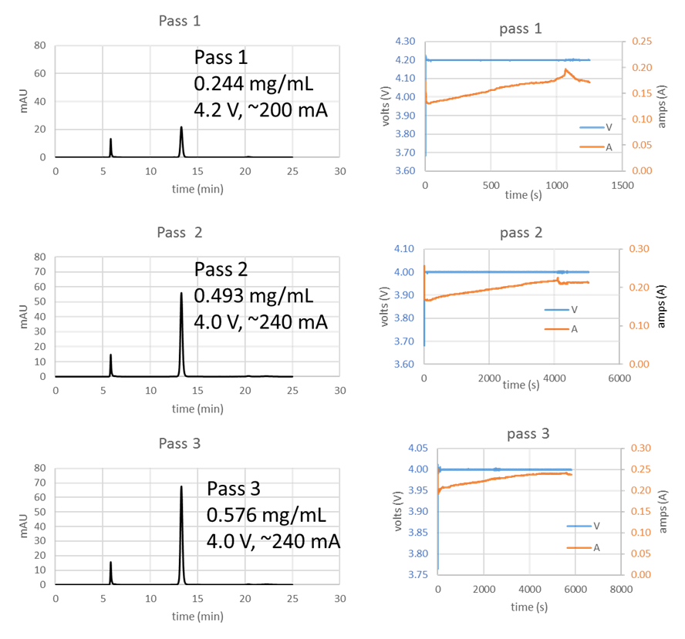
CO₂ Conversion to Formic Acid – ARC System
HPLC chromatographs and potentiostat operating conditions for a three-pass operation. Formate concentration and current increased over the course of operation.
Electrochemical CO₂ to formate cell system at ARC: CO₂ is electrochemically reduced to formate in an electrochemical cell configuration. System is modular thus different catalysts can be tested and prototyped. Syringe pump and peristaltic pump can be adjusted depending on the requirements for CO₂ conversion. Electrochemical cell was purchased from Dioxide Materials (Baton Raton, FL).

Slide 13
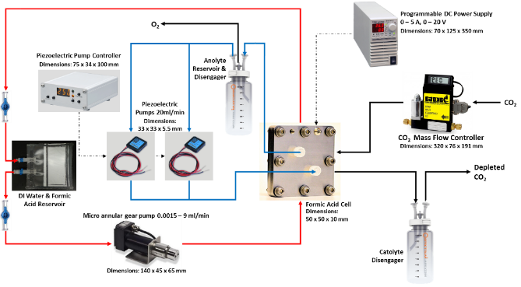
FY19 Planned CO₂-Based Manuf. Ground Demonstration
FY19 TASKS
Using integration plan developed in FY 18, integrate CO₂ to formate, engineered microbes, and bioreactor into a single functioning process
Demonstrate feasibility of producing carbonic anhydrase from CO₂ and H₂O to enable liquid amine CO₂ removal (with ARC Air Revitalization team).
Continue acetate production development (Kanan-Stanford) – improved substrate for lower mass/volume and higher yield

Slide 14

Prototype Components and Integration Plan
Integration of CO₂-to-formate reactor with bioreactors. A. NASA-ARC CO₂-to-formate reactor system with electrochemical cell from Dioxide Materials, B. NASA-ARC Rocking table with FEP bag bioreactors, and C. NASA-ARC Stirred tank bioreactor. Preliminary integration will consist of a peristaltic feeding pump to provide formate to either the rocking table or stirred tank bioreactor.

Slide 15
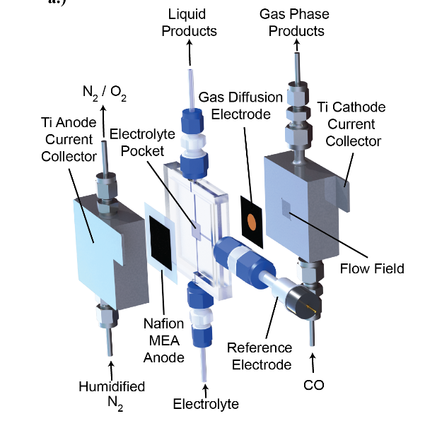
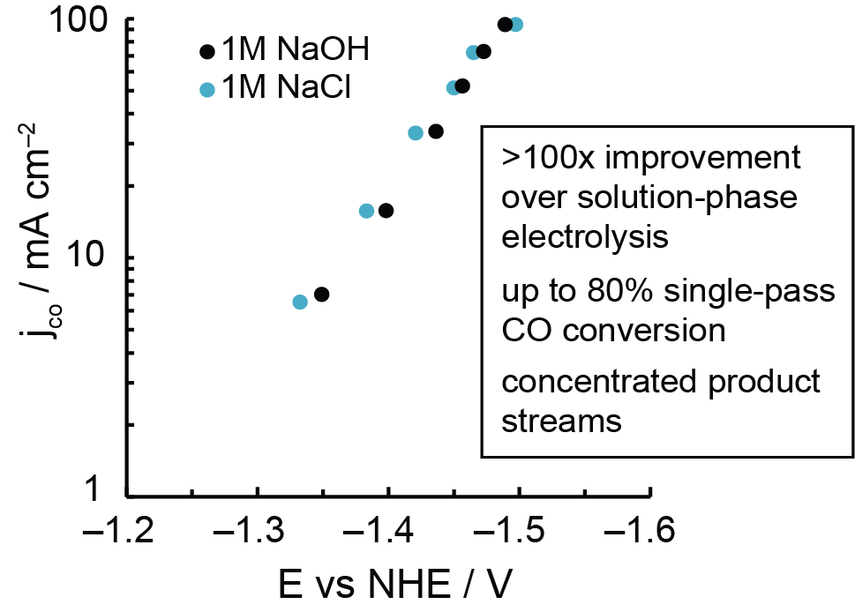
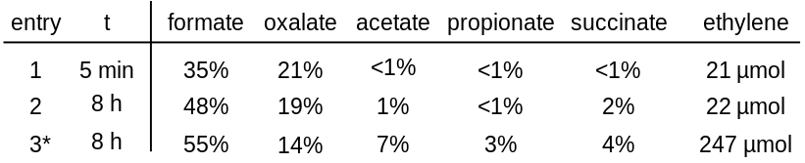
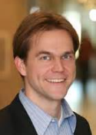

CO₂ Conversion Progress – Stanford University
Electrochemical Carbon Monoxide Reduction at Gas Diffusion Electrodes
xCO + yH₂O
electricity
ethylene, acetate, ethanol
Many routes to generate CO from CO₂
CO conversion is a bottleneck for CO₂ to microbial feedstocks
Developed first gas diffusion CO electrolysis cell
Cell operates at >100x higher current density than traditional electrolysis cells with up to 65% single pass CO conversion
Carbonate-Promoted CO₂ Hydrogenation
H₂ already available from electrolysis
Simple alkali carbonates (eg. M₂CO₃) promote CO₂ hydrogenation to formate and C₂₊ products
No catalyst or solvent is used
Ongoing studies to increase formate or acetate selectivity and reduce the operating pressure
*reaction seeded with Cs₂C₂O₄
Seeking to Extend Cooperative Agreement in FY19/20
Dr. Matthew Kanan

Slide 16
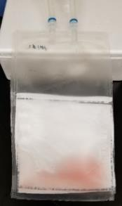
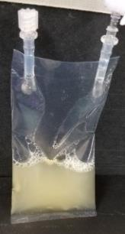
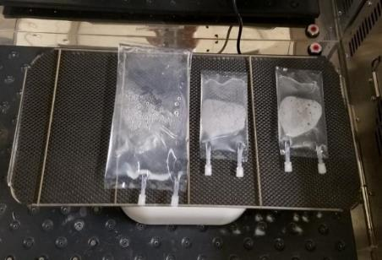
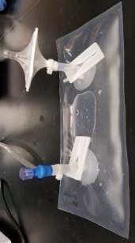
Bioreactor Design and Testing
Multiple bag reactor designs tested – FEP material selected due to suitable gas permeability, high durability, and flight qualified (flight water bag material)
Bag selection and static testing
Rocking table design and bioreactor testing
Biotransfer bag with Celgard membrane
GE
rocking
bag
FEP
bag
FEP bags on
rocking table bioreactor
Milestone task – completed on schedule

Slide 17
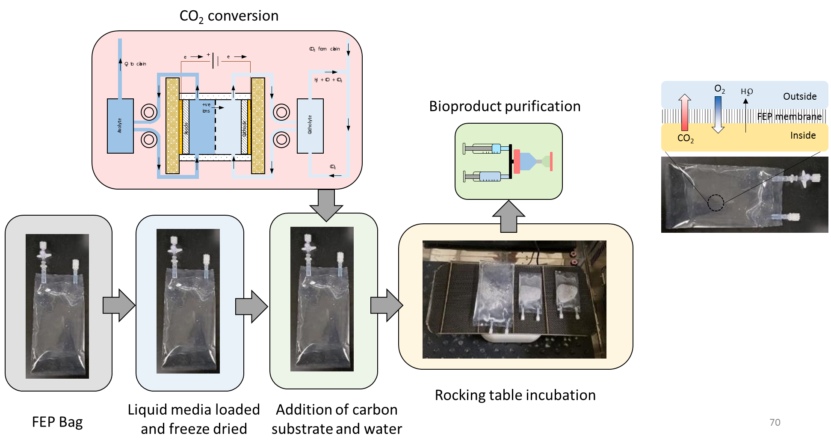
Bioreactor Design and Testing
Bag Reactor Potential Concept of Operation

Slide 18
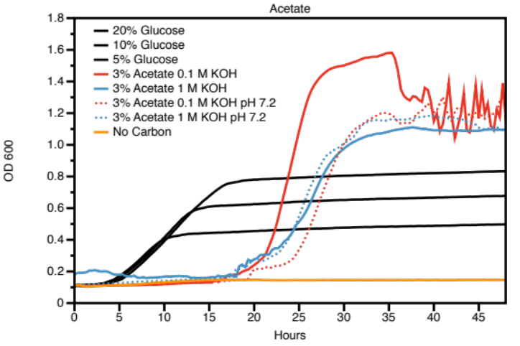
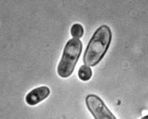

Media Production and Growth
Demonstration of Media Production for Biomanufacturing
Electrochemical
cell
Reaction Products
Growth Demonstration
Compound | Conc. (M)
Potassium Acetate | 0.5
Ethanol | 0.03
Propanol | 0.012
Allyl Alcohol | 0.003
CO
1 M KOH
62% Single pass efficiency CO conversion and ~30% energy efficiency at 100 mA cm^{–2}
Candida utilis
Yeast used for bioremediation and food additive
Genetic tools available
Engineerable yeast (C. utilis) determined to have higher yield on electrochemical products (acetate) than on glucose.

Slide 19
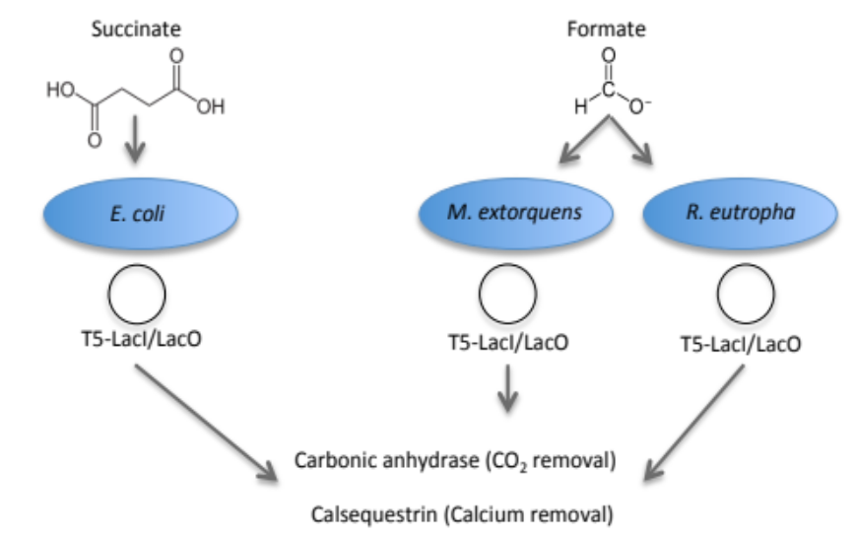
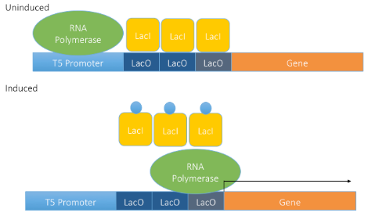
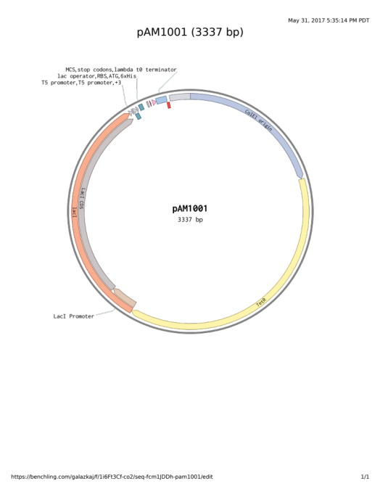
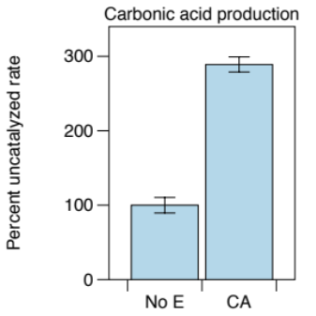

CO₂ - Based Manufacturing for Mission Extensibility
Organism Engineering
Organism engineering plan
Focus of FY18
FY17 demonstrated production of Carbonic Anhydrase in E. coli from Succinate (potential CO₂ substrate).
FY18 protein expression tool development for M. extorquens
Completed in FY17
Carbonic anhydrase produced in E. coli from succinate
Inducible protein expression in M. extorquens. To drive CA and CS expression in M. extorquens, we are recapitulating the T5/LacI/LacO system from E. coli.

Slide 20
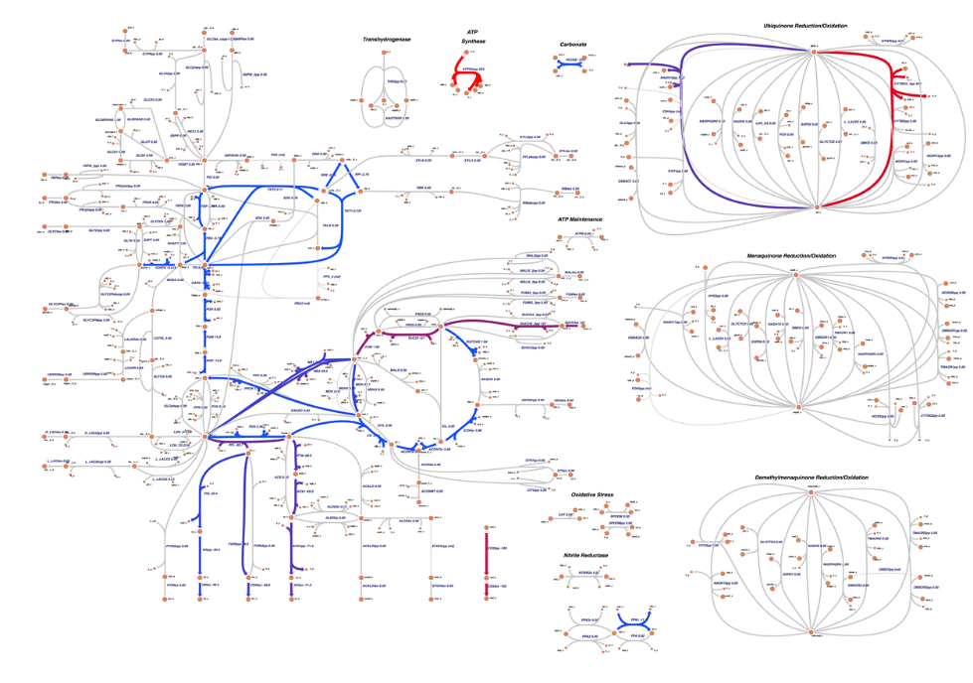


CO₂ - Based Manufacturing for Mission Extensibility
Organism Engineering – Metabolic Modeling
Seeking Memorandum of Understanding (MOU) with Dr. Chris Henry - Argonne National Laboratory (DOE). Collaboration will focus on modeling
our substrate/organism metabolisms to identify system constraints and to guide engineering solutions.
Example:
Succinate as substrate and E. coli as platform organism

Slide 21

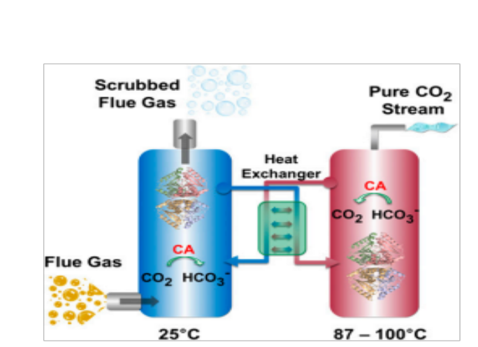
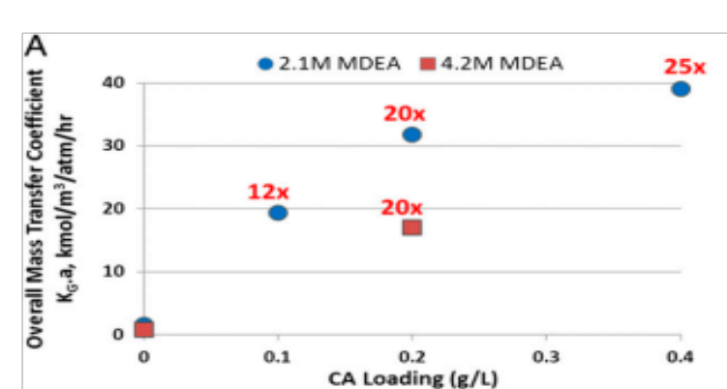
CO₂ - Based Manufacturing for Mission Extensibility
Carbonic Anhydrase & Tertiary Amines for CO₂ Capture
Tertiary amines (MDEA) absorb CO₂ by stabilizing CO₃⁻ (bicarbonate) (A).
Conversion of CO₂ to CO₃⁻ is rate limiting (A).
Carbonic anhydrase catalyzes the hydration of CO₂ to bicarbonate (B).
Carbonic anhydrase could improve performance of tertiary amine systems (C).
A.
Tertiary Amines
MDEA
R₂NCH₃ + H₂O <-> R₂NH⁺CH₃ + OH⁻
CO₂ + H₂O <-> HCO₃⁻ + H⁺ (rate limiting)
B.
Carbonic Anhydrase
CO₂ + H₂O <--> HCO₃⁻ + H⁺
C.
Spontaneous: 1.5⁻¹ s⁻¹
With CA: 10⁴ – 10⁶ s⁻¹
10⁵ – 10⁷ fold rate improvement
Alvizo et al 2015
Collaboration with AES LSS Liquid Amines and COHO projects

Slide 22
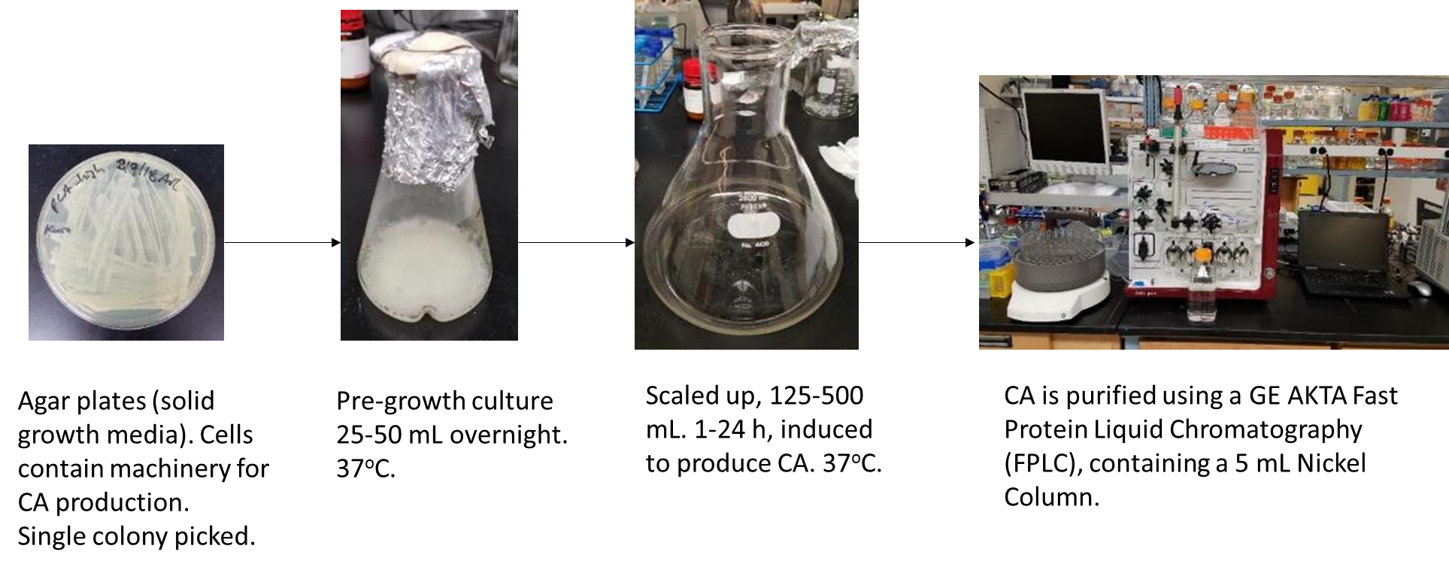
Carbonic Anhydrase Production at Ames
Production of Carbonic Anhydrase (CA) for Testing by
AES Liquid Amine and COHO projects
CA titer in E. coli
~7 mg/ 125 mL or ~0.056 mg/ mL
~56 mg/ L of culture if scaled up.
Initial testing protocols developed and initial liquid amine system device operation/testing initiated
May be instrumental for success of these projects
Will examine multiple candidate CO₂ capture liquids
Multiple discussions with Lawrence Livermore National Lab personnel regarding potential collaboration
This work has led to an AES funded collaboration with the AES LSS program for custom evolved CA production in FY19/20

Slide 23
CO₂ - Based Manufacturing for Mission Extensibility
Potential Flight Experiment Concept
1
+
CO₂ from cabin
2
Air/O₂ from cabin
CO₂
O₂ to cabin
e-
e-
Catholyte
Lyophilized Bioreactor Bags
Lyophilized media and buffer bags
H₂ + CO + CO₂
Media
Buffer
+ve ions
Sparging system
Media
Buffer
DO
Media
Buffer
OD
Temp
Anolyte
Cathode
Catholyte
pH
Media
Buffer
Anode
Formate
Media
Buffer
Pt
Sn
Clamp
Sparging system
Media
Buffer
CO₂
Bioreactor culture
DO
Media
Buffer
OD
Temp
pH
Media
Buffer
Lyophilized Anolyte and Catholyte bags
Media
Buffer
Anolyte
Sparging system
Media
Buffer
Anolyte
Anolyte
Anolyte
Anolyte
Anolyte
Anolyte
Anolyte
Anolyte
Anolyte
Anolyte
Anolyte
Sparging system
Media
Buffer
DO
OD
Temp
pH
DO
OD
Temp
pH
Catholyte
3
4
Catholyte
Catholyte
Catholyte
Catholyte
Catholyte
Catholyte
Catholyte
Catholyte
Catholyte
Catholyte
Catholyte
Protein purification consumables
Electrochemical cell
Temp:
pH:
CO₂:
mmHg:
Potential:
Current:
Bioreactor
DO:
Temp:
pH:
CO₂:
Cell lysis solution
Buffers
CO₂-based manufacturing demo
Electrochemical reduction of CO₂ to microbial media
Bag bioreactor section
Product isolation and purification
Controllers and data logging
Cell lysis solution
Nickel column
Protein purification buffers
Product
Data logger
Bioreactor culture
Column regeneration buffer
Electrochemical
controller
Waste
Bioreactor
controller
Nickel columns

Slide 24
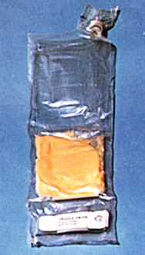
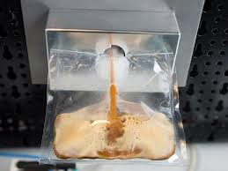
BioNutrients Project - Overview
OBJECTIVE: To enable rapid, safe and reliable in situ production of needed dietary nutrients using minimal mass, power and volume for long duration missions.
DESCRIPTION: Developing a platform technology that employs hydratable, single-use packets that contain an edible growth medium and a food microbe that has been engineered to produce target nutrient(s) for human consumption. The packet is hydrated, allowed to grow for a short period, microbes deactivated, and the contents consumed.
5-Year ISS Storage-Reactivation Demonstration Planned Post-FY18

Slide 25
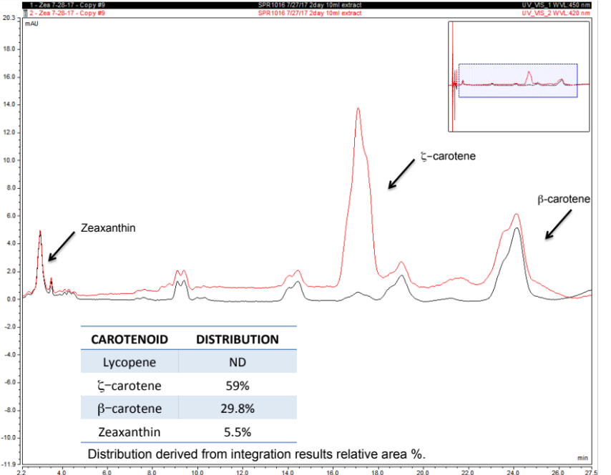
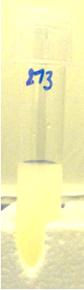
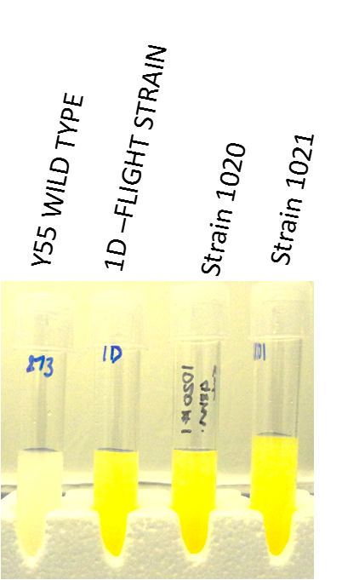
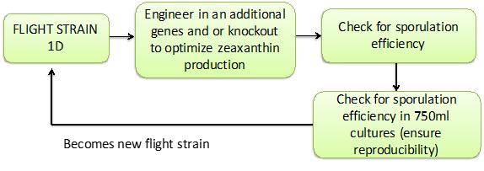
Enhancement of Zeaxanthin Production
Constructed an organism that meets overall requirements for BioNutrients flight experiment. (Y55 Strain 1020)
Engineered S. cerevisiae Y55 to produce zeaxanthin and other carotenoids
Efficient sporulation >70%
Germinated spores can produce zeaxanthin.
Wild-type
Engineered
“Tunable”
By tuning the system we can move the profile towards zeaxanthin or β-carotene. Continued optimization to increase both zeaxanthin and β-carotene levels.

Slide 26
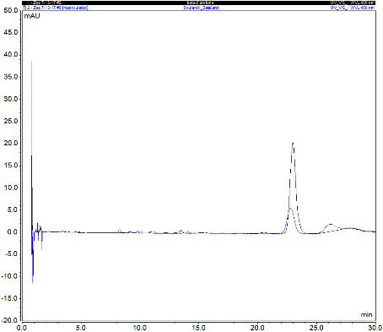
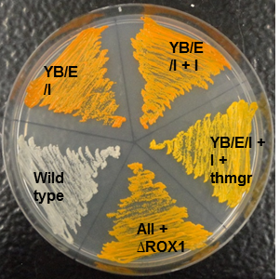
Probiotic Development
Probiotic Yeast S. boulardii with Beta-carotene
Natural
Probiotic
Engineering Nutrient Production
Desiccation Tolerance for Long-term Storage
“Generally Regarded Safe Status” by Federal Food and Drug Administration
Known for its beneficial effects in treating gastrointestinal disorders and promoting gut health
Genomically integrated expression of beta-carotene by S. boulardii
Genomic integration of two tardigrade-specific intrinsically disordered proteins
Gene knockouts to increase desiccation tolerance
Long-duration storage studies ongoing
~0.5mg/production pack (48h)
HPLC of β-carotene with β-carotene standard overlay

Slide 27
Effects of Engineering on Y55 Yeast Growth
Initial Revival (directly after desiccation) of Un-engineered Y55 vs Strain 1020 (zeaxanthin producer) Spores
Average Starting Biomass
Y55: 0.0765
1020: 0.0754
Growth after 25 hours
Y55: 16.4
1020: 5.4 – (Reached an OD of 7.4 after 72 hours)
Strain 1020: crtYB, crtE, crtI, crtI, crtZ, and ∆ROX1
Engineering for nutrient production appears to decrease growth rates
We are examining the role of gene knock-outs on biomass yield for mitigation

Slide 28
Long Duration Cell Storage Tests
2.5 year storage tests for both wild-type spore-forming S. cerevisiae Y55 and our developed edible media showed minimal and acceptable reduction (Tests to continue for three years). Full growth expected at 48 hours.
Room temperature storage tests of S. boulardii vegetative cells show a loss of ~4E+07 cells per year. If initial cell biomass is increased to 10^9 cells/pellet or higher, expected survival will last well over five years with this rate of decline in viability.
Vegetative Cell Storage Over 1 Year

Slide 29


Characterization of Packet Contents: Y55
Microbial Safety Testing:
Heat Kill Successful
Vitamin Content
Vitamins | Conc. /100g | Unit
Total Vitamin A | <30 | IU
Retinol | <30 | IU
beta-carotene | <30 | IU
Vitamin D | <4.00 | IU
Vitamin D2 | <4.00 | IU
Vitamin D3 | <4.00 | IU
Vitamin B1 | 0.0318 | mg
Vitamin B2 | <0.100 | mg
Vitamin B5 | <0.0550 | mg
Vitamin B6 | 0.059 | mg
Biotin | <0.00370 | mg
Vitamin B9 | 0.0446 | mg
Vitamin B12 | <0.440 | µg
C Vitamin | < 0.440 | mg
Aerobic count (AC), Coliform count (CC), Staphylococcus (STX), Yeast & Mold (YM), and Salmonella (SALX) . TNTC: Too numerous to count
Biomass, Protein and Carotenoids
Total biomass/50ml bag/24hrs = 0.14g
Total protein/50ml bag/24hrs = 450mg [with BSA as reference]
Total carotenoid/50ml bag/24hrs = 910µg
Total carotenoid is 615µg/g dry cell weight.
All values for engineered S. cerevisiae Y55

Slide 30
BioNutrients Flight Demonstration
Key Completed Flight Milestones
Event | Date
Requirements Development – Determination of Required Return Samples | 9/12/17
Biosafety memo and Hazard Materials Summary Table developed | 9/13/17
Payload Integration Management meetings initiated | 9/13/17
Flight payload developer team core staffing completed | 9/17/17
Sample lifecycle development completed | 9/28/17
Concept of Operations developed | 9/28/17
Science-PD team technical interchanges to understand to-date prototyping, anticipated sample loading process, and post-flight sample processing | 10/11/17
System architecture developed | 10/20/17
Rapid prototyping initiated | 10/20/17
Mission Concept Assessment Review Gate – Received Authority to Proceed | 11/8/17
Phase 0/1/2 Payload Safety Review Completed and Approved | 2/7/18
System Requirements Review Gate – Received Authority to Proceed | 2/23/18
Event | Date
Preliminary design complete – proceed to fabrication of qualification parts | 4/11/18
COTS hardware received for qualification builds | 4/23/18
Flight lab ready for use with flight hardware | 4/24/18
Receipt of non-COTS components for qualification builds | 5/22/18
Vacuum chamber assessed, identified, procured | 6/15/18
Procedures complete for qualification builds | 6/20/18
Qualification build #1 complete | 6/22/18
Qualification testing #1: Biocompatibility, Freezer thermal cycle, Pressurization | 6/29, 7/13, 7/27
Incorporation of design changes per qualification testing #1 results | 8/24/18
Qualification build #2 | 8/30/18
Qualification testing #2: Biocompatibility, Maximum Design Pressure, Pressurization, Ethanol Release, Static Load Test | 9/6, 9/12, 9/17, 9/12
Critical Design Review – Received Authority to Proceed | 9/21/18
Phase 3 Payload Safety Review Completed and Approved | 9/26/18

Slide 31



BioNutrients Flight Demonstration
Types of Flight Samples
Production Samples – Demonstrate production of nutrients on ISS and compare with production of nutrients on Earth over five years.
  ISS Samples – Hydrated and incubated on-orbit, producing target nutrient as organisms grow. Samples frozen after incubation for return and analysis.
  Earth Samples – Exposed to ISS environment; returned to Earth for hydration, incubation and analysis. “Flown control” for ISS Samples.
Stasis Samples – Flown matrix of various sample types to study characteristic changes in a variety of organisms and media after exposure to ISS environment over five years. Samples are candidates for future BioNutrients payloads.

Slide 32



BioNutrients – Production Pack Development
Hard Shell Production Pack
Flight team transitioned growth system from flexible bag design to a hard shell concept to enhance membrane security and provide double containment.
Clear polycarbonate allows internal viewing/video of processing.
Pack is designed to be gas-permeable to allow gaseous by-products to escape
Pack includes a check valve (with cap) to allow for the crew to inject water
Membranes passed JSC Cold Stowage testing (for ⁻80ºC storage)
Microbial filter (and sleeve) used to sterilize the injected water during hydration.
Passed Phase III Safety Review
ISS Flight Production Pack
Lid/Membrane Assembly
ISS Production Pack Kit

Slide 33


Additional Organisms for Stasis Tests
Concurrent 5-Year ISS Storage Testing – Organisms & Growth Media
Stasis testing on a wide variety of relevant microbes, 3 media types
Small sample size, low crew effort, high return on science
Studying effects of engineering vs. wild-type, stasis engineering, encapsulation, probiotic organism survival
No growth in space – storage and return only
All growth and testing on ground
Stasis Pack Contents

Slide 34
BioNutrients Flight Demonstration
Flight Payload Hardware Summary Table
Purpose/Activity | Engineering Name, Part Number, Contents | Sample Types | Label Color/Indicator | Qty Launched
Launched to ISS, opened by the crew, hydrated, shaken, incubated, and frozen on-orbit. Returned to Earth frozen. | ISS Production Pack (P/N 110554-002) Two ISS Production Packs are packed into each BioNutrients-1 ISS Production Pack Kit (P/N 110532-002) | Saccharomyces boulardii (yeast) | Light Blue | 32 total (24 + 8 spares) ISS Production Packs (16 total kits)
 |  | Y55 strain of Saccharomyces cerevisiae (yeast) | Purple | 32 total (24 + 8 spares) ISS Production Packs (16 total kits)
Launched to ISS as a “flown control” but never opened by the crew. Returned to Earth in soft stowage. | Earth Production Pack (P/N 110554-001) One Earth Production Pack is packed into each BioNutrients-1 Earth Production Pack Kit (P/N 110532-001) | Saccharomyces boulardii (yeast) | Light Blue | 24 Earth Production Packs (24 Total Kits)
 |  | Y55 strain of Saccharomyces cerevisiae (yeast) | Purple | 24 Earth Production Packs/Kits
Launched to ISS but never opened by crew. Returned to Earth in soft stowage. | BioNutrients-1 Stasis Pack (P/N 110534-001) | Matrix of various organisms and media, all BSL1, Tox0 | A | 15 total (13 + 2 spares)
 |  |  | B | 15 total (13 + 2 spares)
Contains adapter and 1L bag for drawing water from the Potable Water Dispenser (PWD) on-orbit to hydrate ISS Production Packs. | BioNutrients-1 Support Kit (P/N 110533-001) This kit contains one (1) PWD Adapter and one (1) Post-Flight Analysis Packet Assy (1L bag). | None | Standard | 14 Support Kits
A duplicate of the above set of hardware will be built in-parallel with the to-be-flown hardware, for execution of near-synchronous ground controls.

Slide 35

BioNutrients Production Pack Lifecycle
ISS Concept of Operations
Hardware
Production Pack Kit
  Production Pack is a hard-shell pack that contains the engineered yeast and a yeast nutrient
  Kit will also contain a 0.2 μm microbial filter, desiccant, and O₂ scavenger
Some Production Packs will be wetted by the crew on-orbit, others will remain un-wetted as an experiment control and will return to ground
Stasis Pack Kit
  Contains sealed vials that contain control organisms in varying configurations
  Vials are vacuum-packed in MRE-type material and will also include a desiccant and O₂ scavenger
Stasis Pack vials will remain in their sealed packaging and will not be wetted by the crew
Control organisms may be used in future experiments

Slide 36

BioNutrients Flight Demonstration
Overview of On-Orbit Operations
Crew uses PWD water to fill water bag (source)
Syringe pulls water from bag and injects 33ml into production pack
Crew shakes for 1 minute, then incubates in SABL at 30ºC.
Crew shake again at 6 hrs, then incubate until 48hrs.
Crew removes pack and transfers to MELFI freezer for storage prior to frozen return to Earth.

Slide 37
BioNutrients Flight Demonstration
Launch, Experiment, and Descent Timeline Overview
SpX-17
Post-SpX-17 Unberth
On-Orbit: 8 ISS Production Packs (110554-002)
On Ground:
8 Earth Production Packs (Blue/Green)
16 Ground Controls (not flown)
SpX-18 Descent
Ascent
(soft stow)
All BioNutrients-1 hardware
Descent (soft stow)
8 Earth Production Pack Kits (110532-001)
4 Stasis Pack (110534-001)
2 Stasis Pack A
2 Stasis Pack B
Cold Stow:
8 ISS Production Packs (110554-002)
Soft Stow:
2 Stasis Packs (110534-001)
1 Stasis Pack A
1 Stasis Pack B
4 Blue
4 Blue
Single SABL residence event (30C) @ U+7 to 9d (4±d)
4 Green
4 Green
4 Blue
4 Green
SpX-19 Descent (tentative; depends on SpX launch schedule)
Post-SpX-19 Unberth
On-Orbit: 8 ISS Production Packs (110554-002)
On Ground:
8 Earth Production Packs (Blue/Green)
16 Ground Controls (not flown)
SpX-20 Descent
Descent (soft stow)
8 Earth Production Pack Kits (110532-001)
2 Stasis Pack (110534-001)
1 Stasis Pack A
1 Stasis Pack B
Cold Stow:
8 ISS Production Packs (110554-002)
Soft Stow:
2 Stasis Packs (110534-001)
1 Stasis Pack A
1 Stasis Pack B
4 Blue
4 Blue
Single SABL residence event (30C) @ U+7 to 9d (4±d)
4 Green
4 Green
4 Blue
4 Green
Experiments run during unberthed periods – more crew time available.
Enables synchronous ground controls.
Repeated 4x more for approximately every odd-numbered SpX
Repeated 4x more for approximately every even-numbered SpX

Slide 38
BioNutrients Flight Demonstration
Flight Safety Panel Key Hazards
Two unique hazards:
  Release of Toxicity Hazard Level 1 Material
    The Oxygen Scavenger has been identified as Toxicity Hazard Level 1 as a potential eye and respiratory irritant
    Hazard report shows the required two levels of containment (COTS sachet, Kit bag) for almost all operations
    NCR addresses temporary loss of failure tolerant containment when the Kit bag is opened to retrieve the Production Pack
  Release of Ethanol
    For 8 packs (the number to be activated in each experiment), ~2.57g ethanol is produced, with ~2.55g in liquid phase contained in the pack and ~0.02g (18.4mg) in gas phase release to the cabin
    Pressurized leak testing shows the design contains the liquid phase with positive margin
    PD team will pursue a Category 1 Volatiles Usage Agreement (release of ≥10mg/d) for the gaseous release

Slide 39

BioNutrients Flight Demonstration
Ethanol Production Test
ISS Production Pack sealed in a tedlar bag, and incubated.
Produced gas collected. Liquid and gas phases analyzed for ethanol content.
For 8 packs (the number to be activated in each experiment), ~2.57g ethanol is produced, with ~2.55g in liquid phase contained in the pack and ~0.02g (18.4mg) in gas phase release to the cabin
Pressurized leak testing shows the design contains the liquid phase with positive margin
PD team will pursue a Category 1 Volatiles Usage Agreement (release of ≥10mg/d) for the gaseous release

Slide 40
BioNutrients Flight Demonstration
Flight Demonstration Schedule Summary
Event | Date
EVT TRR | 10/4/18
EVT Start | 10/8/18
Flight Build Start | 10/16/18
Nominal Load Build Complete | 12/6/18
Nominal Load PSR | 12/10/18
Ship Nominal Load | 12/12/18
Nominal Load On-Dock | 12/16/18
Late Load Build Complete | 1/2/19
Late Load PSR | 1/4/19
Ship Late Load | 1/9/19
Late Load On-Dock | 1/13/19
Launch (SpX-17) | 2/17/19

Slide 41


BioNutrients – Continued Development
Future planned BioNutrients research –
Producing two or more nutrients simultaneously in same pack.
Identify stable precursor compounds and develop processes to convert to product of interest. This could dramatically increase yield.
For example is it feasible to convert
D-galactose to L-ascobate (Vit C)?
Rosa et al. Microbial Cell Factories 2013, 12:59
http://www.microbialcellfactories.com/content/12/1/59
Switching from biomass production mode to product formation mode (non-growth).
Use alternate GRAS organisms to produce products of interest. Eg. Kluyveromyces lactis or K. marxianus - high biomass producing yeast.
Investigate probiotic organisms/engineering
Improving the design of our hard-shell/bag growth systems – use flight experience.

Slide 42

FY 18 Milestone Status
Synthetic Biology Applications FY 18 Milestones | Due Date
BioNutrients
Growth packet flight operational safety analysis complete | 2/15/2018
Ground testing of combined packet growth system and enhanced organism complete | 5/30/2018 (7/16/2018)
Overall system safety testing and review complete | 7/15/2018 (9/26/2018)
BioNutrients flight experiment plan review complete | 9/15/2018
CO₂-Based Manufacturing
Bioreactor system fabricated and preliminary testing complete | 1/30/2018
Selected organism engineering and product production complete | 4/10/2018
P/C CO₂ conversion system fabricated and preliminary testing complete | 7/15/2018
Integration plan for individual components complete – internal review | 9/20/2018
All milestones met – two were late due to vendor delays and design change.

Slide 43












































Partnerships and Customers
Dr. Matthew Kanan
Collaborator
Dr. Fuzhong Zhang
Early career award
Dr. Mark Blenner
Early career award
Dr. Adam Arkin (PI)
CO₂ conversion
Bioreactor
Product
Refinement
Manufacturing
H₂O
Substrates
Products
CO₂
CO₂
capture
CH₄
Probiotic
Yogurt
Microorganism Engineering
Microbial fuel cell
Jerry Sanders (ISRU)
Air Lab NASA-ARC
CIF
Niki Werkheiser (ISM)
Biosentinel
NAVY

Slide 44




Partnerships and Customers
Completed a two-year cooperative agreement with Dr. Matthew Kanan at Stanford University for advanced microbial substrate production. Key to CO₂-Based Manufacturing project success. Seeking to extend agreement for FY19-20.
Collaborating with 2 ARC/JSC AES LSS projects regarding liquid amines and COHO via carbonic anhydrase production. SB team providing carbonic anhydrase for testing. Led to LSS Project-funded collaboration for custom CA production for liquid amines.
Continued communications and seeking collaboration with N. Werkheiser/AES ISM team. Building from previous joint NIKS project (MSFC/ARC/KSC) examining production of plant growth media/systems.
Communicating with JSC HRP for BioNutrients Project for guidance regarding in-space application of concept.
Coordination with ARC AES BioSentinel Project team regarding ongoing yeast storage experiments/methods.
Discussions with US Navy regarding carbonic anhydrase production.

Slide 45



Infusion from STMD or SBIRs/STTRs
STMD Space Technology Research Institute (STRI) BioManufacturing Topic
  Awarded to Dr. Adam Arkin, UC Berkeley.
  Researchers at Stanford, UC Davis, Utah State
  $15 M Total - $3M/year for 5 years.
  Hogan (COR), Joshi, Wheeler, Sanders, Anderson,
  Werkheiser, Ewert, Kliss, Rothschild, Galazka serve
  as NASA Panel.
  One year complete – Arkin presented to NASA Advisory Council
STMD Centennial Challenge Program – Developing $1.0M “Carbon Dioxide Conversion Centennial Challenge” regarding CO₂-derived products that support microbial growth. Over 1000 registrants – worldwide attention. Recruited OGA personnel as contest judges.
Galazka/Hogan assigned as technical collaborators with 2 Early Career Faculty Awardees (Both continued for FY 18 for year 3)
  Engineering Cyanobacteria for the Production of Lightweight Materials (F. Zhang – Washington U. in St. Louis) (SIMB Young Investigator Award)
  Synthetic Biology for Recycling Human Waste into Food, Nutraceuticals, and Materials: Closing the Loop for Long-Term Space Travel (M. Blenner – Clemson U - funded by STMD to conduct sabbatical in Hogan lab in FY19.

Slide 46

Infusion from STMD or SBIRs/STTRs (2)
Phase II STTR – Mango Materials – Methane bioreactor concept. Hogan – COR – Starting year 2.
STTR topic included for FY18 – Advanced Bioreactor Development for In Situ Microbial Manufacturing – 1 proposal awarded - R. Macur. “A Robust Biofilm-Biomat Reactor for Conversion of Mission-Relevant Feedstocks to Products” Sustainable Bioproducts LLC Hogan – COR;
Ames CIF Project FY17 – J. Galazka – Methane Metabolism by Yeast
  Engineer platform yeast Pichia pastoris to utilize methane - CH₄ is readily made from CO₂ using Sabatier process
Ames CIF Project FY 17 – J. Hogan – In Situ Yogurt Production for Probiotic and Nutrition Delivery
  Leveraged BioNutrients project results/hardware to develop safe and reliable system to produce human probiotics via fresh yogurt from dried milk solids/starter culture
  Food safety merging as important R&D area for in situ food production
  Will seek opportunities to develop flight test for yogurt production.

Slide 47
Education and Public Outreach Activities
Stanford collaborator (Kanan) graduate student became NASA NSTRF working on CO₂ conversion to products (M. Abney – MSFC is Mentor – Hogan co-mentor).
Funding for Stanford collaborator primarily for Ph.D. student working on electrochemical conversion – significant acetate production breakthrough.
Advisor to multiple student flight projects – Valley Christian High School in San Jose, CA. (Hogan). Provided input on biological system development for flight. Continued interactions anticipated.
Galazka and Hogan separately featured in NASA@SiliconValley PodCasts.
Student internships in our laboratories - 4 undergraduates hosted in the summer of 2018.
Multiple interviews with journal representatives regarding the role of Synthetic Biology in space and CO₂ Conversion Centennial Challenge.
ARC Synthetic Biology laboratory tours specifically for students – 3.
Advisor to Carlmont High School (Belmont, CA) Biotechnology Symposium - feedback on Biotech projects, career advice to Grade 10-12. (Rahman)
A. Rahman - Presidential Citation from the Institute of Biological Engineering

Slide 48
Education and Public Outreach Activities (2)
Missions
Manuscripts (Submitted and Planned):
  Published/Submitted
ICES 2018 - Methane as a Carbon Substrate for Biomanufacturing - Asif Rahman,
Jonathan M. Galazka, Michael J. Dougherty, Harry W. Jones, and John
A. Hogan
ICES 2018 - In Situ Yogurt Production for Probiotic and Nutrition Delivery - Hiromi
Kagawa, Aditya Hindupur, Asif Rahman and John Hogan
  ICES 2017 - Development of Storage Methods for Saccharomyces Strains to be utilized for In situ Nutrient Production in Long Duration Space Missions” Natalie Ball, Hiromi Kagawa, Aditya Hindupur and John Hogan
  Galazka presented “Methane Metabolism by Yeast for Solar System Exploration” at the American Chemical Society (ACS) National Meeting, San Francisco, 2017. Session Chaired by M. Blenner (Clemson University-NASA Early Career faculty).
  Planned/In Preparation
  Metabolic Engineering of β-carotene production in the probiotic Saccharomyces boulardii. (Metabolic Engineering/Microbial Cell Factories)
  Genome-wide host engineering to enhance zeaxanthin production using CRISPER/Cas9 in Saccharomyces cerevisiae (Y55). (Metabolic Engineering/Microbial Cell Factories)
  Two papers in preparation by Stanford Team (Kanan) on CO₂ conversion:
    A. Banerjee & M.W. Kanan “Carbonate-promoted CO₂ hydrogenation”
    D. Ripatti, T.R. Veltman & M.W. Kanan “CO reduction at gas diffusion electrodes”

Slide 49
Overall Project Accomplishments (2015-2018)
Obtained two separate AES pilot projects (seed funding) that led to two 3-year projects.
Completed BioNutrients ground development for long duration flight demonstration.
BioNutrients flight phase – ready to start flight loading procedures October 16.
Flight experiment would be the longest microbial stasis mission to date.
Completed first two years of CO₂-Based Manufacturing prototype development milestones – on schedule. Ready to integrate systems components to complete and test integrated demonstration system.
Stanford collaborator Dr. Matthew Kanan demonstrating unprecedented electrochemical performance for acetate production.
Developed a flight-compatible bioreactor useful as a platform technology for the growth of an array of organisms and their bioproducts.
Engineered microorganisms to produce several human nutrients, CO₂-removal enzymes critical to current AES LSS technology development, and numerous other example products.
These projects were key in the establishment of multiple STMD programs, including the STRI CUBES, the NASA CO₂ Conversion Centennial Challenge, an Early-Career Faculty topic, a growing ecosystem of NASA-related Biomanufacturing researchers, as well as multiple STTRs.

Slide 50
Team Members
BioNutrients:
Science:
Dr. Aditya Hindupur (Wyle Labs)
Dr. Hiromi Kagawa (SETI)
Natalie Ball (Wyle Labs)
Dr. Michael Dougherty (Wyle Labs)
Flight:
Julie Levri – PM - NASA
Emanuel Barros - (Wyle Labs)
Kevin Sims - (Wyle Labs)
Chris Barreras - (Wyle Labs)
Alan Noblitt – JSC Safety (Wyle Labs)
Rudy Cotillion - NASA
Sean Sharif - (Wyle Labs)
CO₂-Based Manufacturing for Mission Extensibility:
Dr. Jonathan Galazka (NASA)
Dr. Asif Rahman (U. of New Mexico)
Dr. Matthew Kanan (Stanford)
Dr. Michael Dougherty (Wyle Labs)
Jason Samson – NASA ARC
Dr. John Hogan - PI

Slide 51
Back-Up
Slides

Slide 52

BioNutrients Project Overall Plan
Bionutrients Preparation for Flight (FY19)

Slide 53
Nutrition System Progression
MISSION APPROACH
Frequent Resupply
Infrequent Resupply
No or Rare Resupply
Stored Food
Enhanced Food Storage
Enhanced Food Storage
Supplements
Enhanced Supplements
Enhanced Supplements
Fresh Food
Produce Key Nutrition Limiters
And Probiotics
Extensive or Complete Production of Nutrition
BioNutrients Project

