Slide 1
LaRC Park
A Deep Learning Approach to Parking
Douglas Trent
LaRC Park Project Lead
douglas.m.trent@nasa.gov

Slide 2
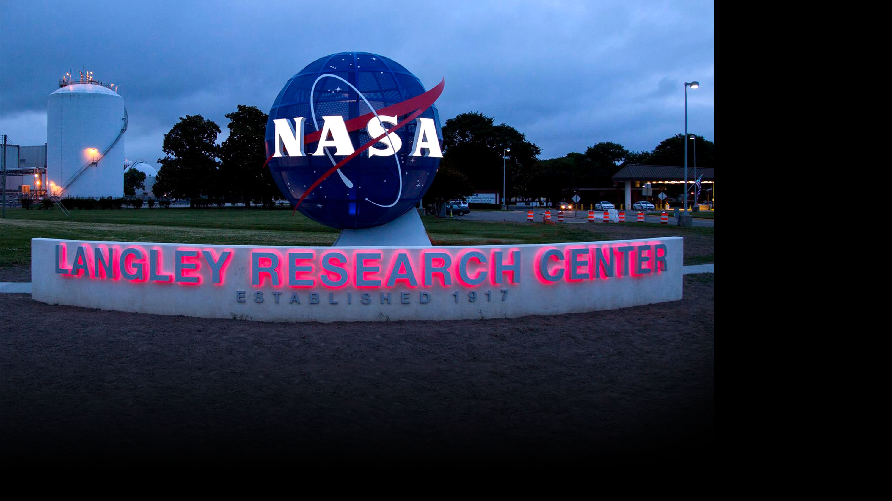
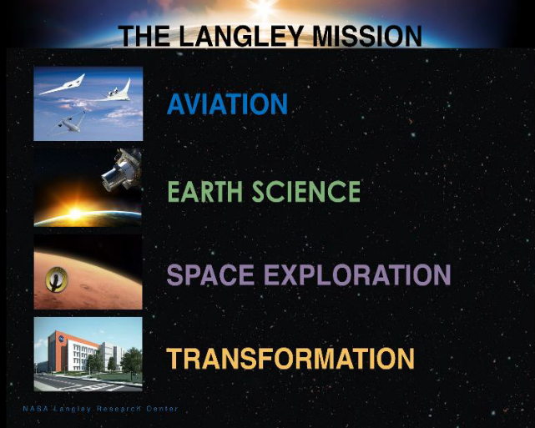
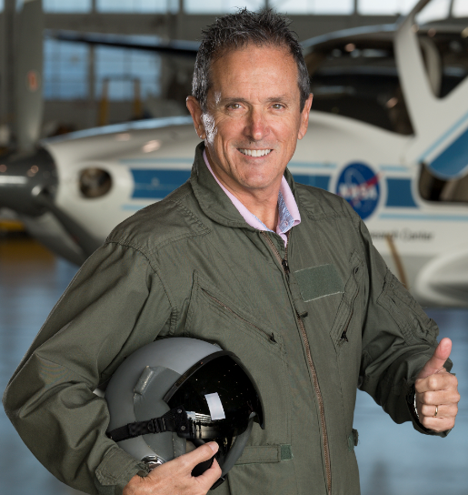
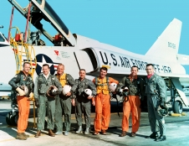
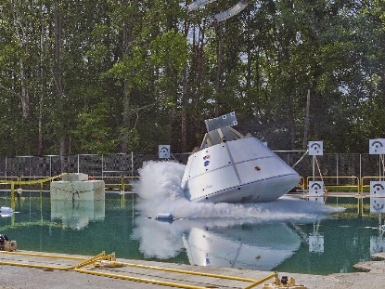
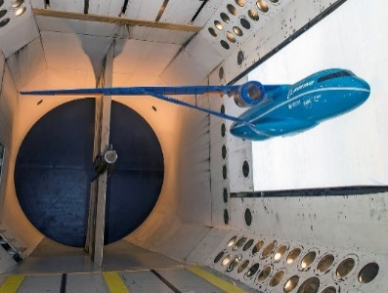
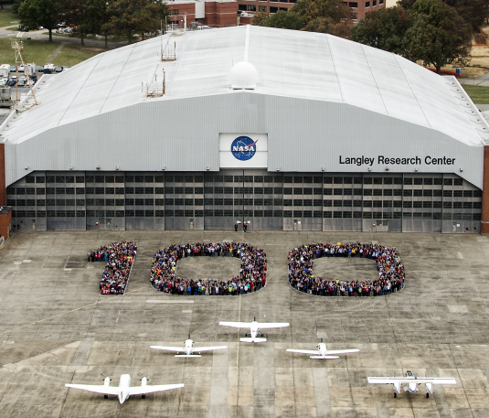
Douglas Trent
- Data Scientist
- Office of the
Chief Information
Officer (OCIO)

Slide 3
The Problem

Slide 4
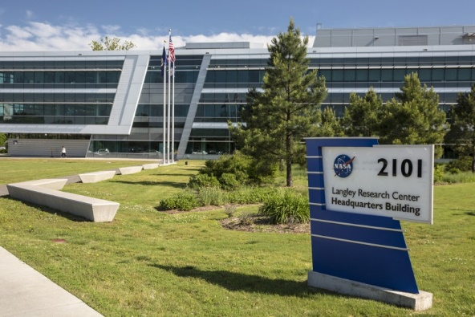
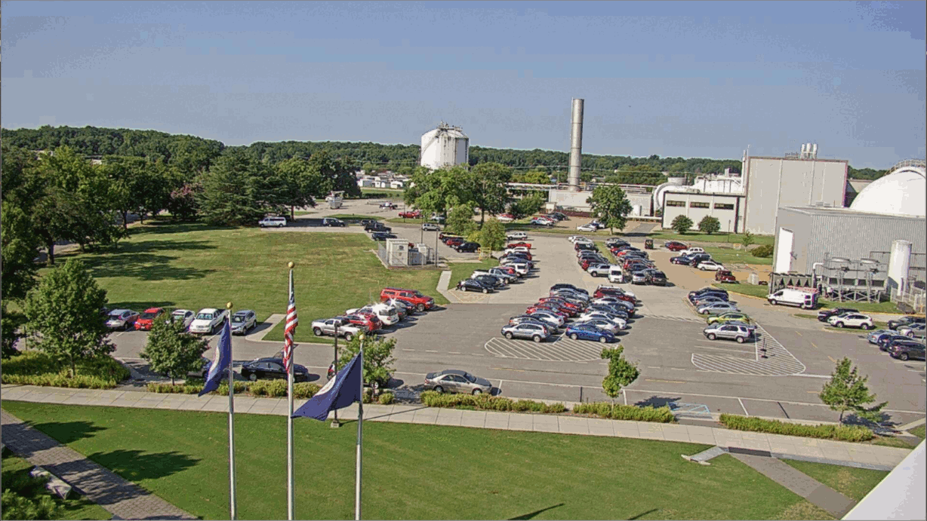

2101: a parking space odyssey
Langley Landscape
  764 acre campus, 200 widely-scattered buildings
  3,400 employees + visitors/suppliers
  Renovated core: Buildings 2101, 2102, 2103, 2104
Employees drive to meetings
  Spend time searching for spots
  Arrive to meetings late
NEEDED: Real-time intelligence
on available parking

Slide 5
The Approach

Slide 6


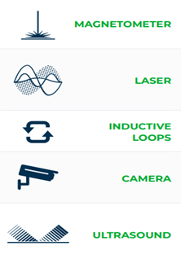


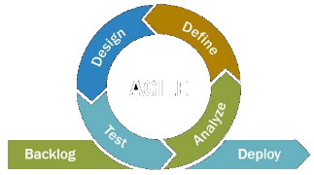
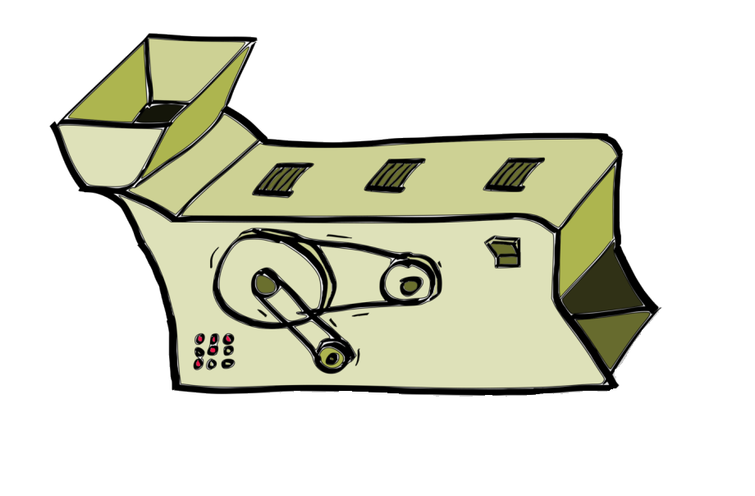
An Agile “Sherpa” Approach
Sherpa
Interns
Customer
Requirements
Agile
Methodology
Data
Science
University
Collaboration
Sensor
Alternatives
Minimum Viable Product Sprints
LIDAR Spot Detector
ComputerVision Gate Counter
Raspberry Pi Edge Processor
AWS Cloud Implementation
DT_{x}
Deep Learning Algorithm
Langley Data Center (ODC)
Six Semesters
Data
Science

Slide 7
The Solution

Slide 8
Vehicle Detection with Deep Learning
B2101
B2102
Langley OCIO Data Center
https://park.larc.nasa.gov
Back-End
Front-End
R-CNN
Web App
Roof-top
Cameras
End User
1
Neural Network
2
Convolutional
3
Region-based

Slide 9
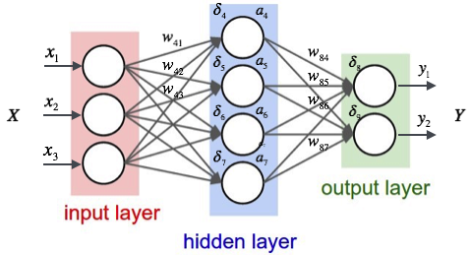
Vehicle Detection with Deep Learning
1
Artificial Neural Network
2
Convolutional
3
Region-based

Slide 10
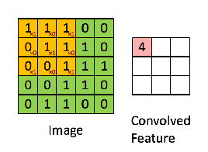
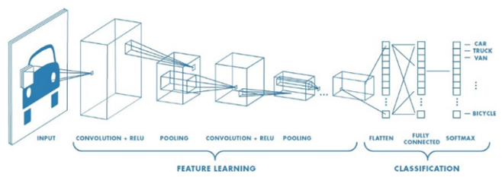
Vehicle Detection with Deep Learning
1
Neural Network
2
Convolution to recognize features
3
Region-based

Slide 11
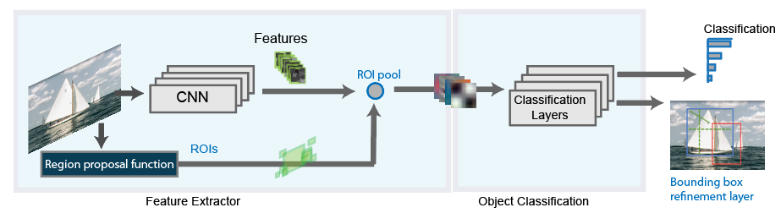
Vehicle Detection with Deep Learning
1
Neural Network
2
Convolutional
3
Mask to identify Regions of Interest

Slide 12
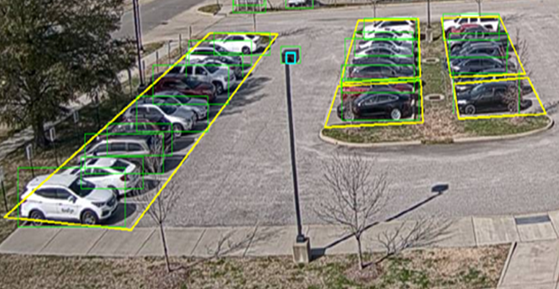
Getting Into the Zone
Predefined parking zones (yellow)
Bounding boxes on detected vehicles (green)
Open spots = Zone capacity – detected count
Counts written to MySQL database
  Multiple sensors/methods can collaborate
Algorithm
Zone Counts
Cam Login
Configuration
Definitions
Web App
User
SERVER A
SERVER B

Slide 13
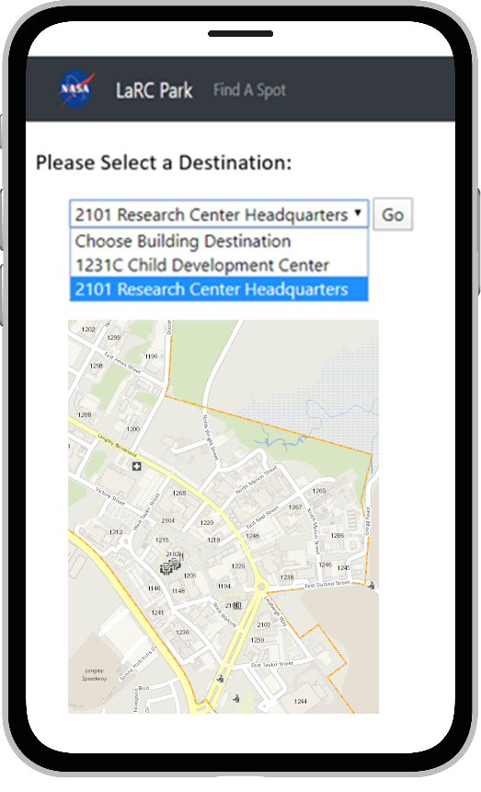
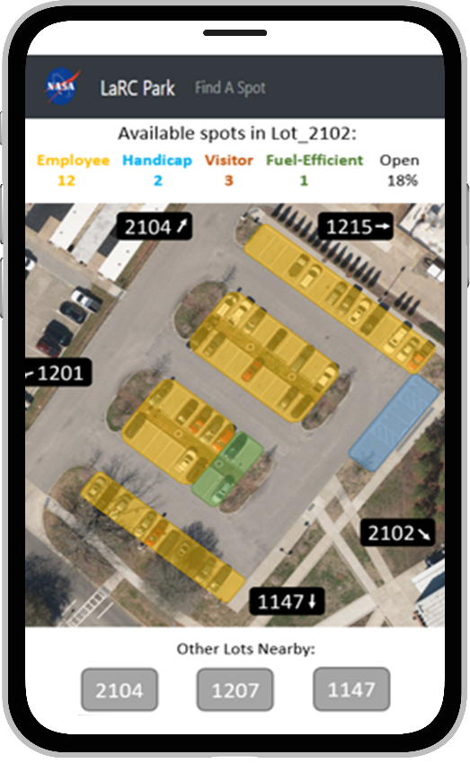
Presentation to User
https://park.larc.nasa.gov
  Responsive web app
  Improved morale/productivity
Modularity benefits
  Sensor/algo flexibility
  Multi-sensor lot detection
  Config/deployment options
  Scalable to new buildings/lots
  Extendable to new use cases
Packaged for open-source
  Containerization
  Quick-start documentation
  GitHub repository

Slide 14
Conclusion

Slide 15
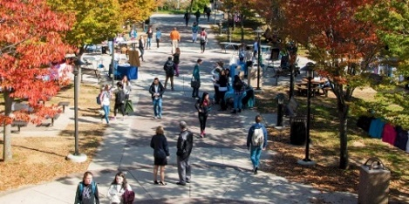
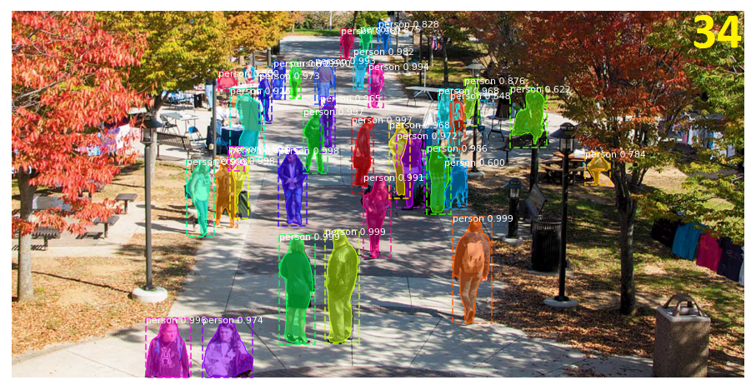
Extension to Other Use Cases
Langley’s UAS Flight Range (CERTAIN)
  Need counts of people in various corridors
  Risk mitigation for routing, landing, and ditching
Where’s WAHLDO?
- Wide-Area Hazard Locator for Drone Overflight
LaRC Park Platform
- For use with your customer, please contact me:
- douglas.m.trent@nasa.gov

Slide 16
Project Lessons Learned
Broad requirements gathering
Agile rapid prototyping approach
IT Security involvement in early stages
Modular architecture for extendibility/re-use
Documentation and commented code

Slide 17
Customer Testimonial
“LaRC Park is a unique, innovative smart-center app designed to provide parking advice based on an inexpensive camera sensor and machine learning algorithms. This is a forerunner for many envisioned methods to sense remotely, gain insight via machine learning, and provide decision quality insight for the customer. Such sensing techniques could not only apply broadly across Langley Research Center, but across NASA, other federal organizations, and ultimately to remote Moon and Mars outposts.”
Ed McLarney
Digital Transformation Integration Lead,
TDD and Data Science Strategic Lead, Langley

Slide 18
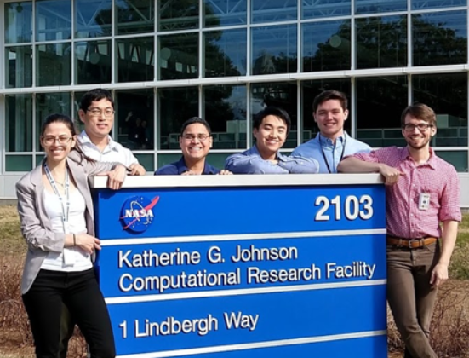
Acknowledgements
INTERNS
Fall 2018
Jrei Dimaano
John Graham
Tanner Griffin
Fernando Juaregui
Douglas Trent
Spring/Summer 2019
Justine Forrest
Rob Garcia
Brandon Hutton
Spring 2020
Aditya Chackonal
Summer/Fall 2020
Hari Ilangovan
ADVISORS
Mentors
Ed McLarney
Jeff Brandt
Tony Arviola
Mayhar Malekpour
Cory Gilbert
Georgia Tech ASDL
Dr. Olivia Fischer
Michael Balchanos
Scott Duncan
Woong Je Sung
Jet Propulsion Lab
Brent McWaters

Slide 19
Questions and Answers

