Slide 1

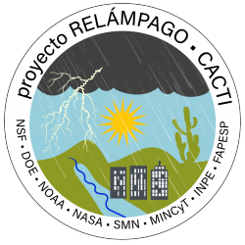
Lessons for SENSER from the
RELAMPAGO GLM validation campaign
Timothy Lang
NASA Marshall Space Flight Center

Slide 2
Background
RELAMPAGO (Remote sensing of Electrification, Lightning, And Mesoscale/microscale Processes with Adaptive Ground Observations) was an NSF field campaign in north central Argentina that occurred during late 2018/early 2019
CACTI (Clouds, Aerosols, and Complex Terrain Interactions) was a Department of Energy (DOE) field campaign that was concurrent with RELAMPAGO
Both field campaigns leveraged significant logistical and scientific support from Argentina and Brazil, and were focused in part on thunderstorms and intense convection
NOAA GOES-R Program Office funded the deployment of an 11-station VHF Lightning Mapping Array (LMA) to leverage RELAMPAGO-CACTI and assist with GLM validation in intense thunderstorms
The LMA was installed and operated by NASA MSFC and its partners (particularly UAH and the National University of Cordoba) during November 2018 thru mid-April 2019.

Slide 3
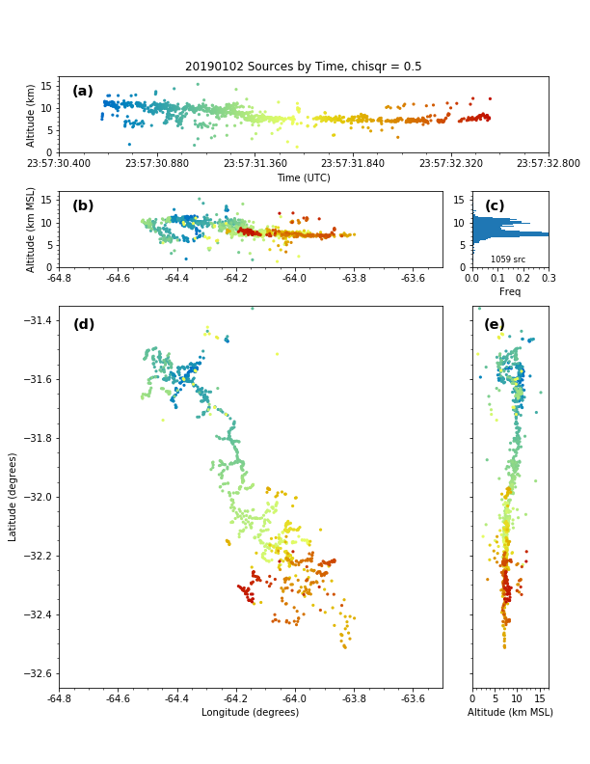
Why use Lightning Mapping Arrays (LMAs) for satellite validation?
Within LMA networks individual lightning flashes are mapped in 3D with very high temporal (<< 1 ms) and spatial (~10s of m) resolution using GPS TOA
Within LMA networks lightning detection efficiency is likely near 100%
LMAs have been actively deployed for more than two decades, their data are well understood scientifically, and they feature significant scientific and technical support (e.g., community experts, commercially available and/or open-source processing and visualization tools)
LMAs have proven track record as validation data sources for other space-based lightning mappers (e.g., LIS, GLM)

Slide 4
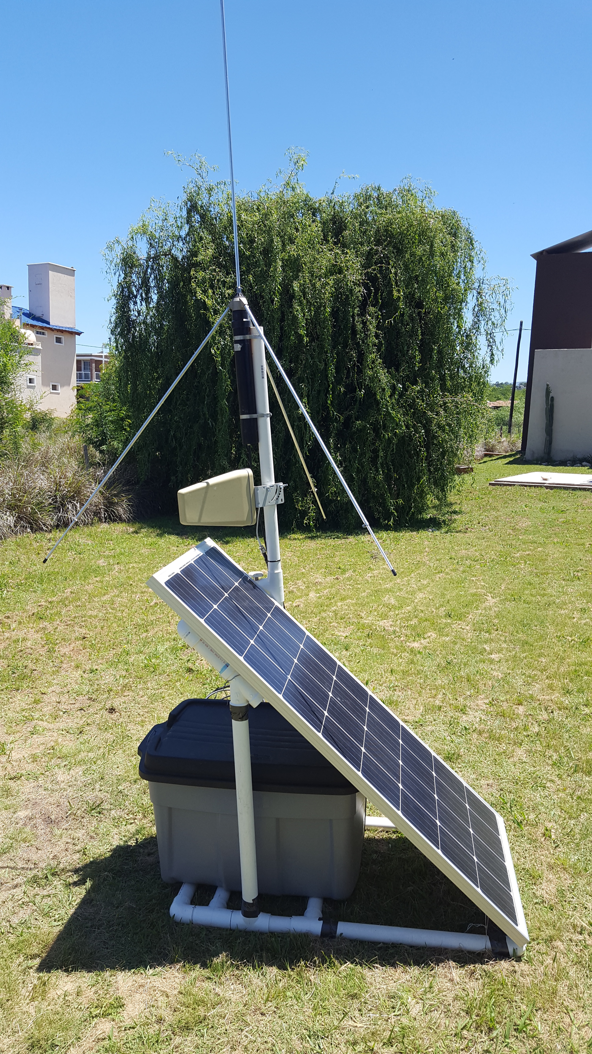
RELAMPAGO LMA Station
PVC construction, joints and connections supported with duct tape, wire, zip ties, and glue
Tetrahedral VHF antenna
GPS antenna
PVC tube containing channel 3 filter
Rubbermaid container with LMA box (Rev. 3), two marine deep cycle batteries, VHF preamplifier, excess cable length
Yagi directional cellular antenna
Solar panel
(pointed northward)

Slide 5
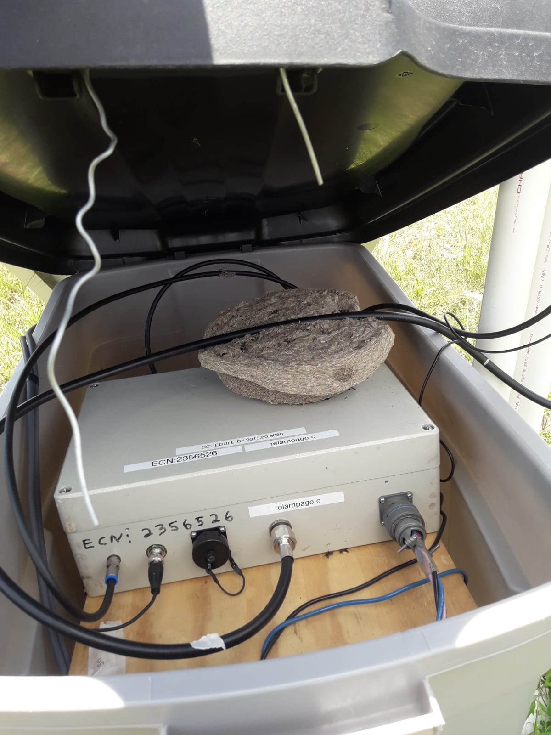
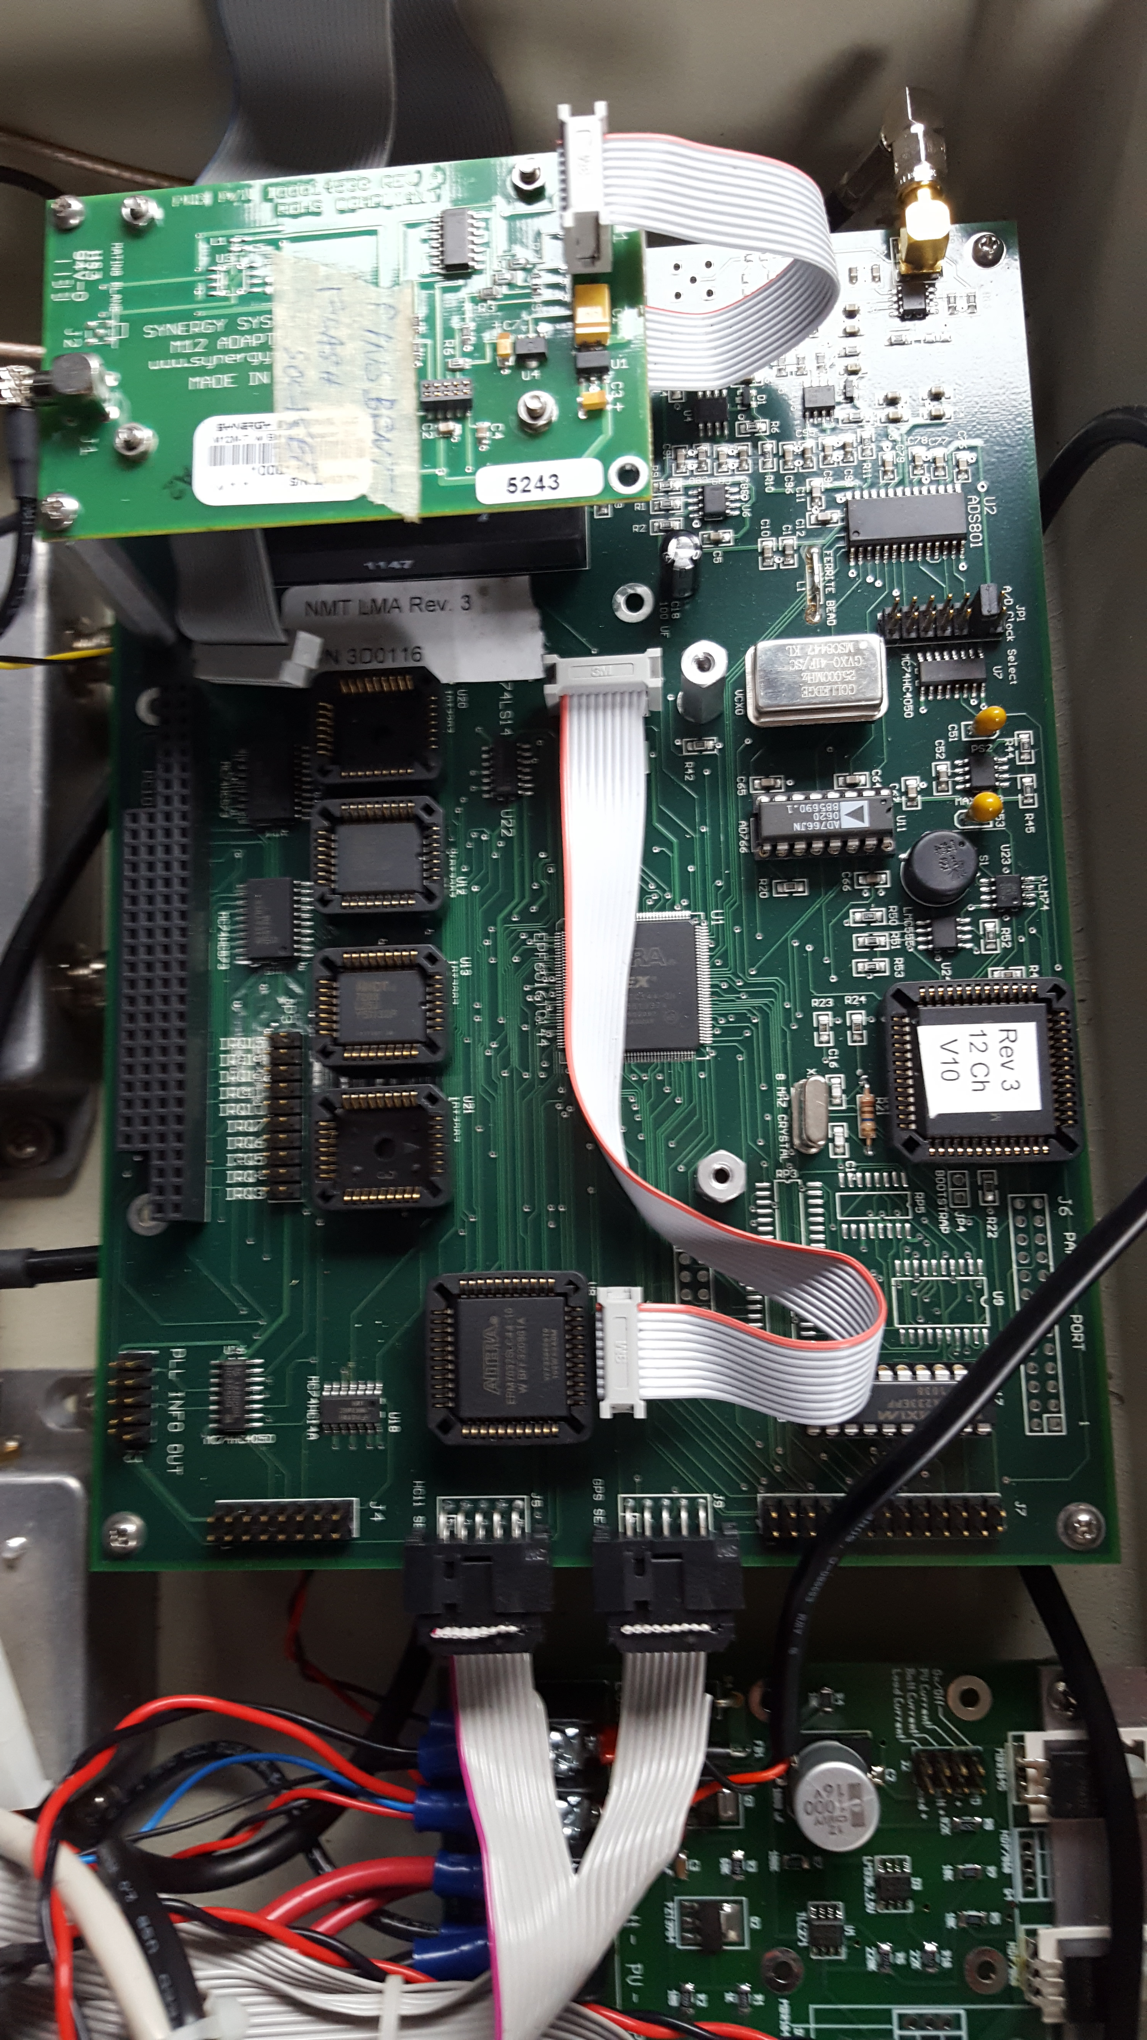
LMA box on top of batteries
(Also an insect nest …)
LMA electronics

Slide 6
Network status map
(updated hourly)
Networking established via CloudGate modem with 3G speed, 1 GB monthly bandwidth per station
Reverse SSH tunnel to central NSSTC server enabled remote login and cronjob-driven reporting
Useful for diagnosing and helping troubleshoot power, connectivity, GPS, and LMA board issues

Slide 7
LMA Data Products
Near-Realtime Data
(not available in RELAMPAGO)
Processing of individual station triggers (Level 0) to source locations (Level 1) is computationally expensive
Processing time >> actual observing time if significant lightning
Process decimated/reduced LMA dataset to create near-realtime imagery and other products
Example to right from North Alabama LMA

Slide 8
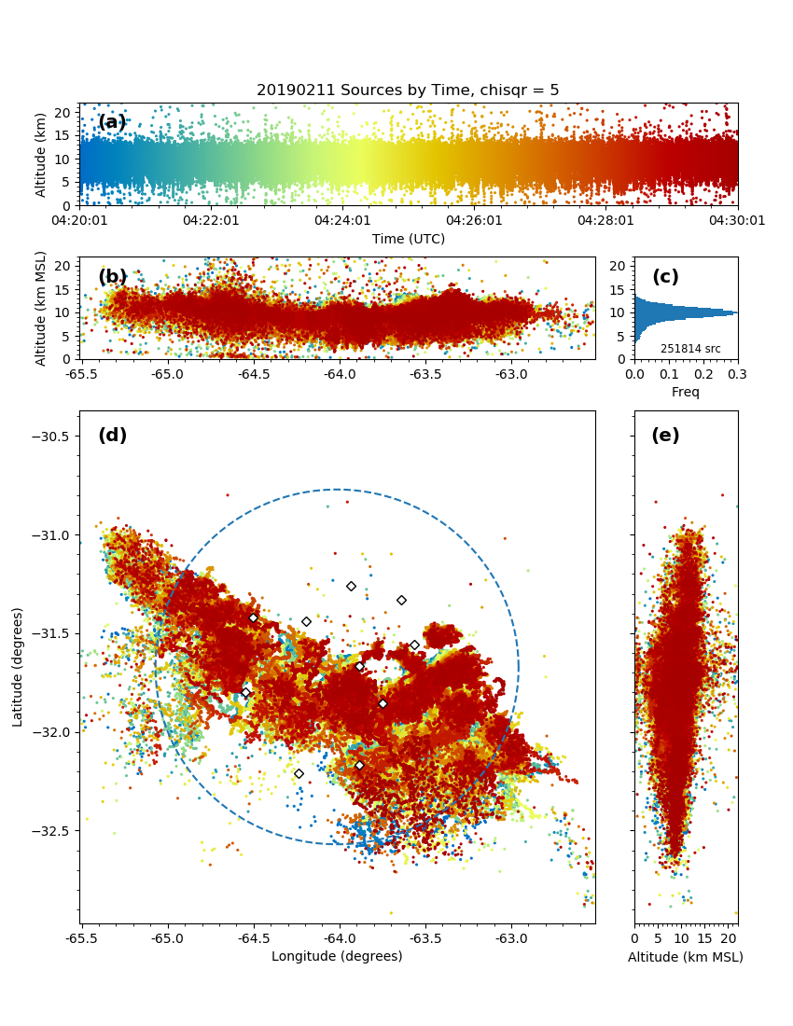
LMA Data Products
Level 1 Source Locations
Unclustered Level 1 source locations
Point display useful for examination of individual flashes, not for bulk thunderstorm analysis
Typically need to determine empirically the most useful thresholds for number of contributing stations per source and chisqr goodness-of-fit value

Slide 9
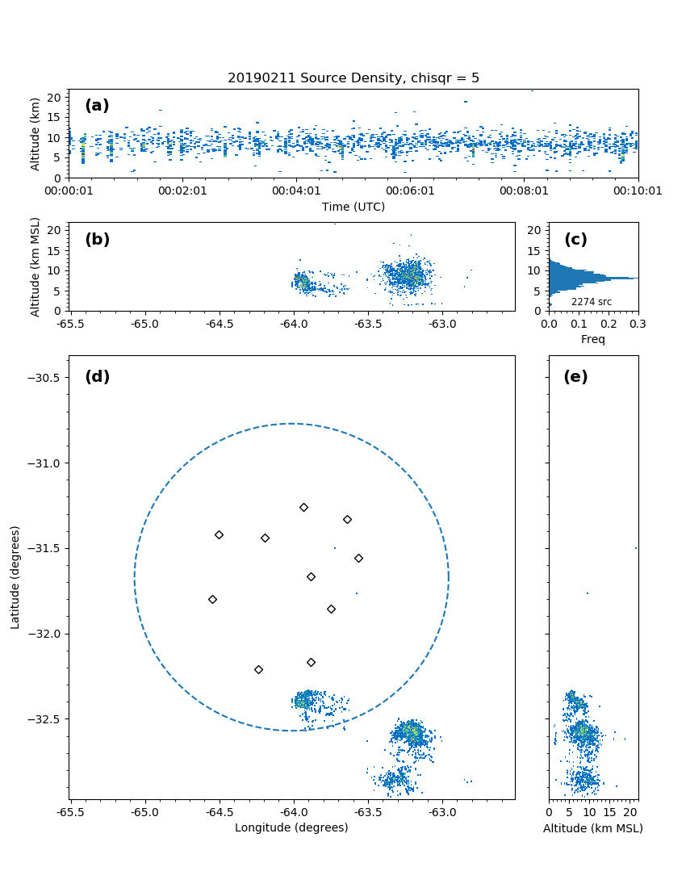
LMA Data Products
Level 1 Source Locations
Compute gridded source density
Density display useful for examination of bulk thunderstorm 3D thunderstorm behavior
Typically need to determine empirically the most useful thresholds for number of contributing stations per source and chisqr goodness-of-fit value

Slide 10
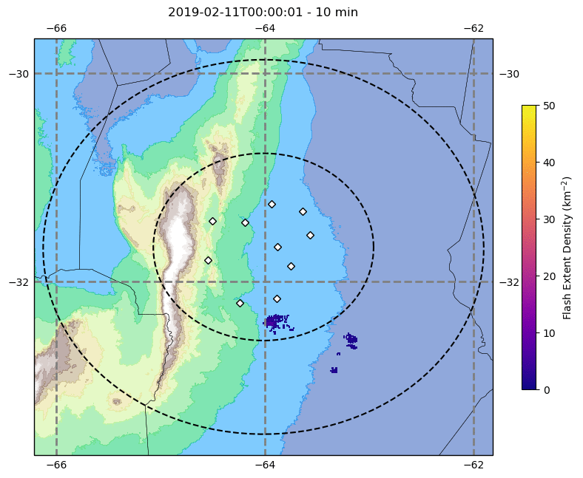
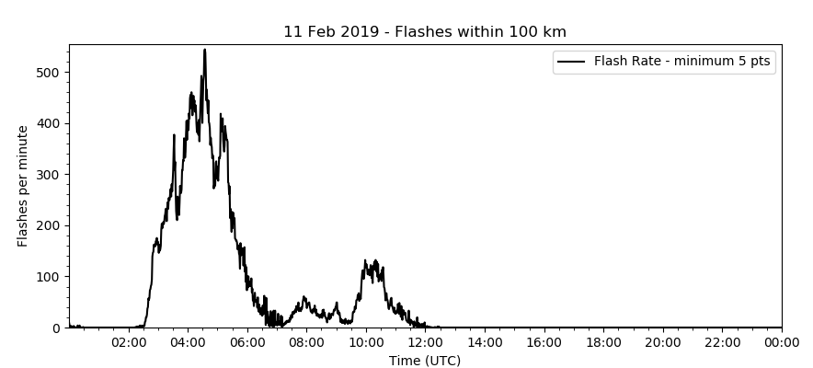
LMA Data Products
Level 2 Flashes and Level 3 Grids
Cluster sources to flashes using spatiotemporal criteria and open-source algorithms
Can create derived gridded products like Flash Extent Density (FED)
Level 2 & 3 data more useful for comparison to satellite

Slide 11
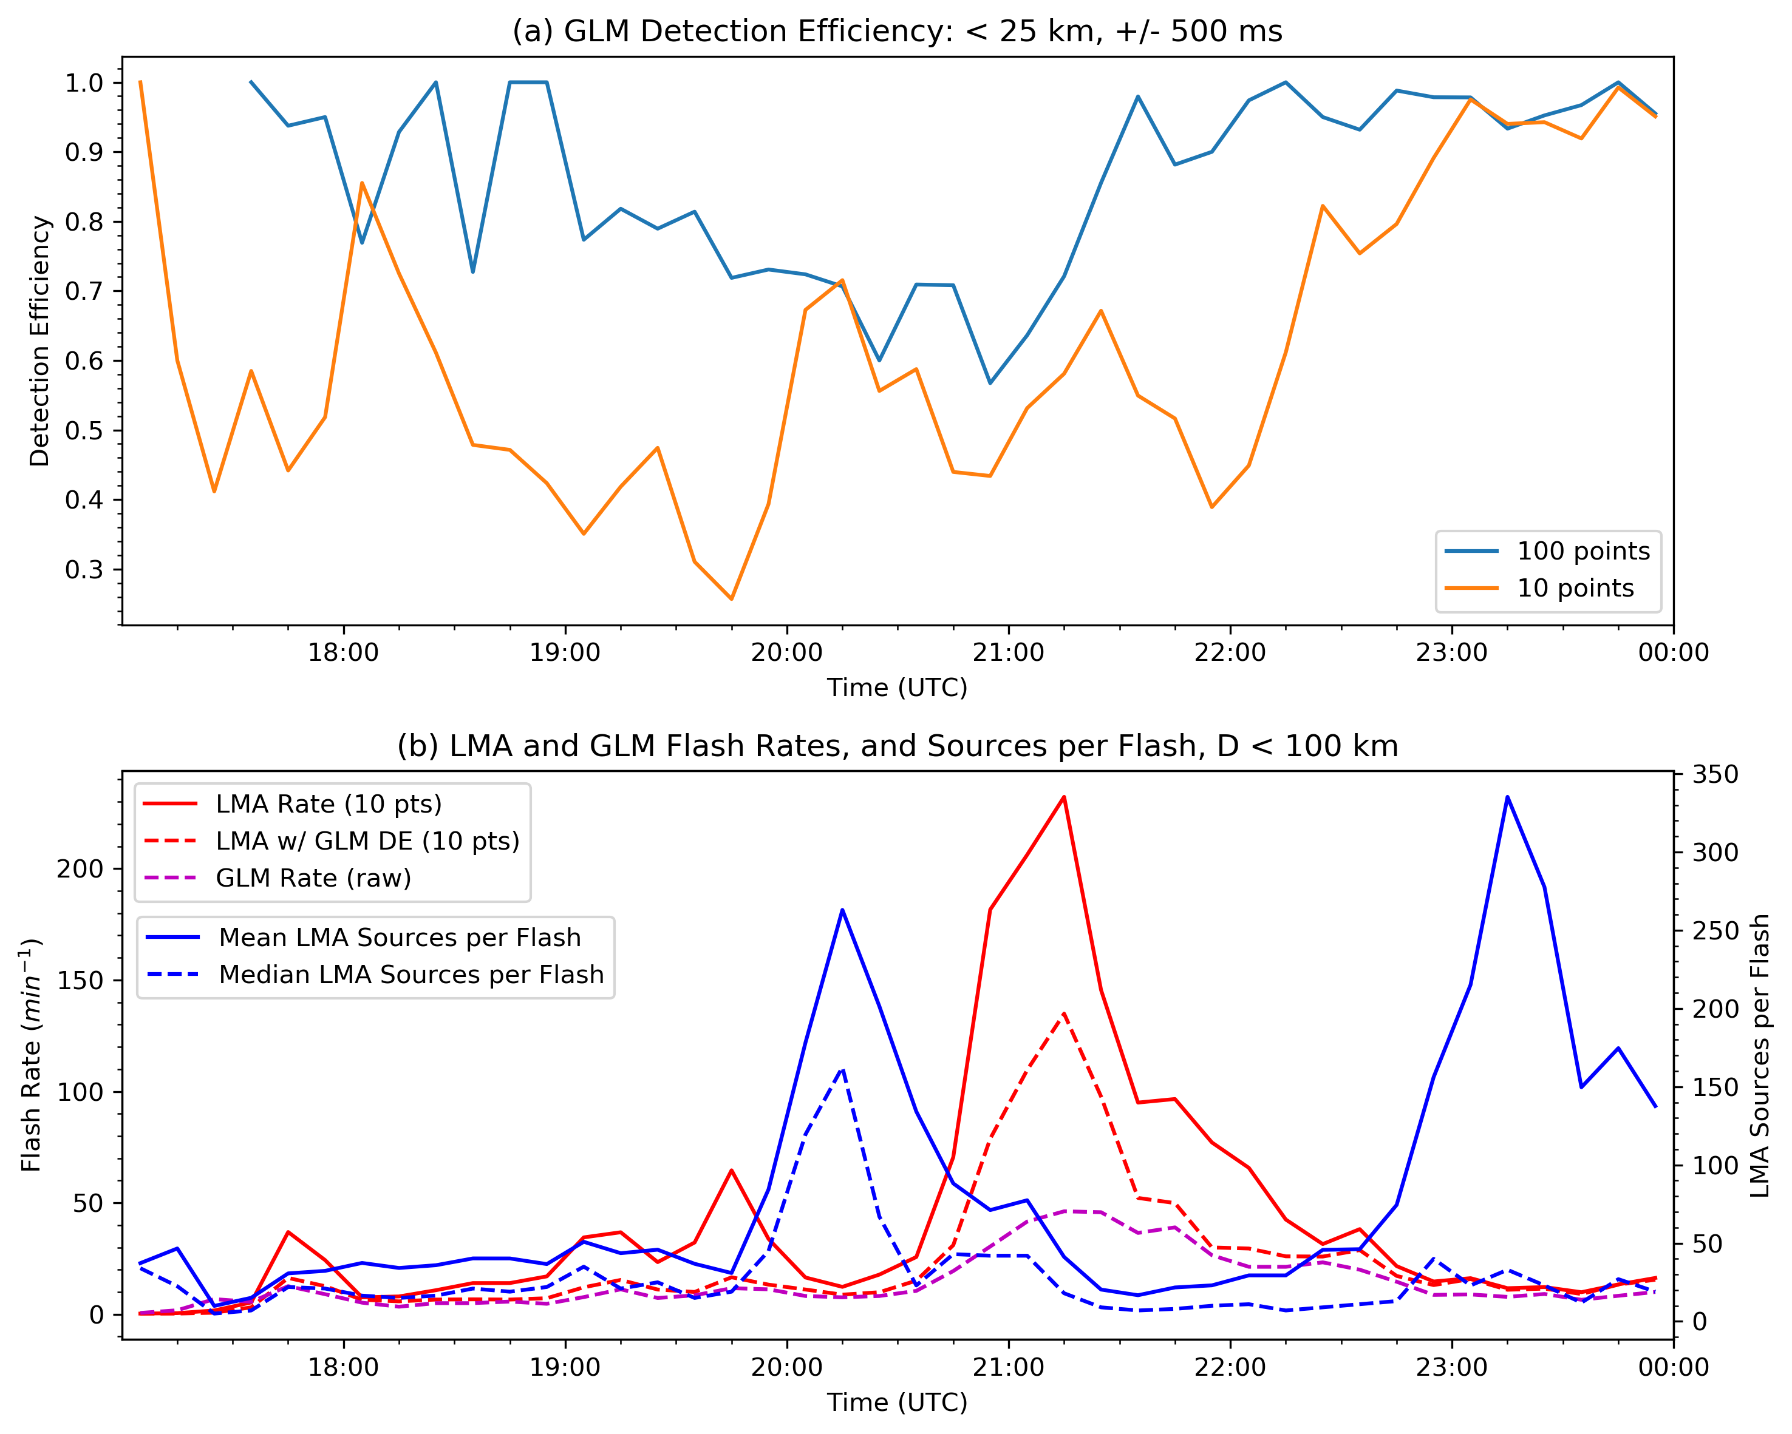
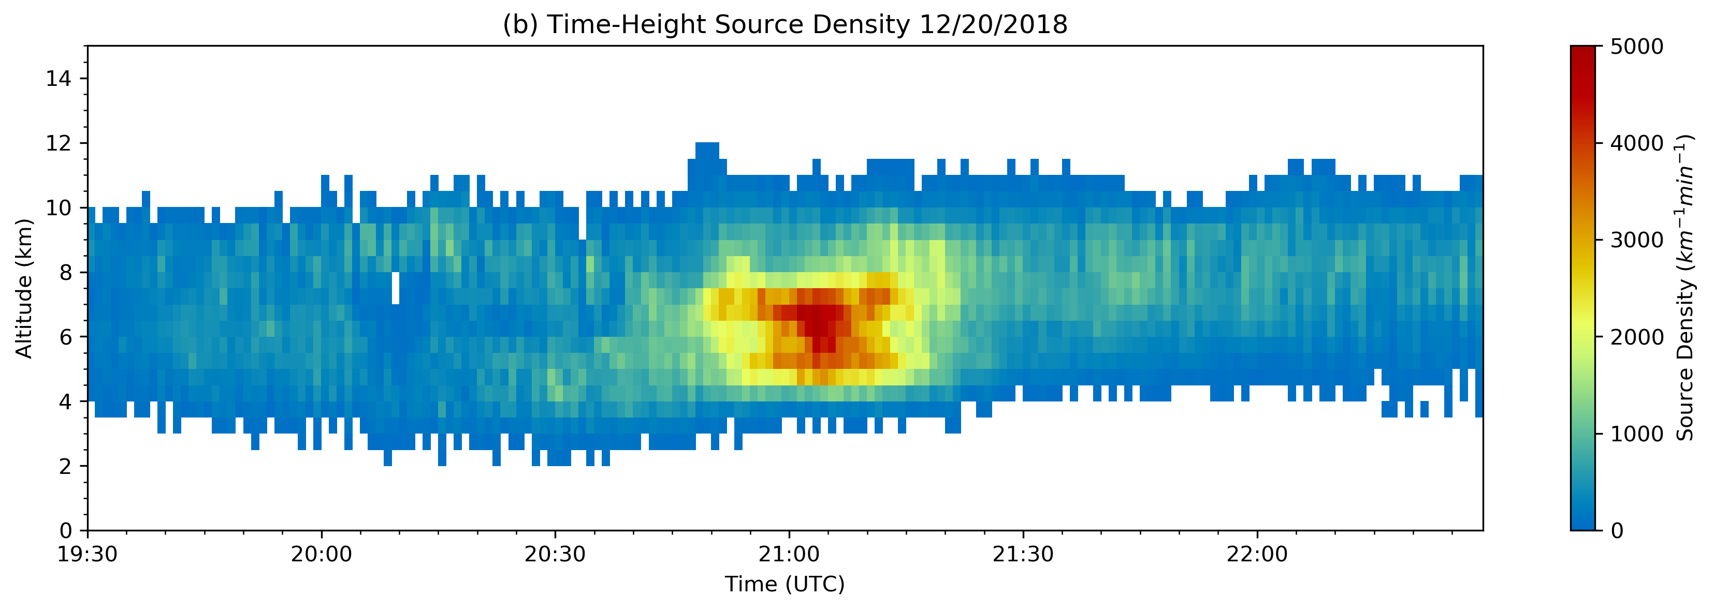
Case Study Example
20 December 2018
Anomalous storm
Low-altitude convective flashes
Lightning flash rate anti-correlated with flash size
GLM flash detection efficiency (DE) declines both for small (10+ sources) and large (100+ sources) LMA flashes during anomalous period
GLM DE
LMA Rate/Size
Altitude

Slide 12
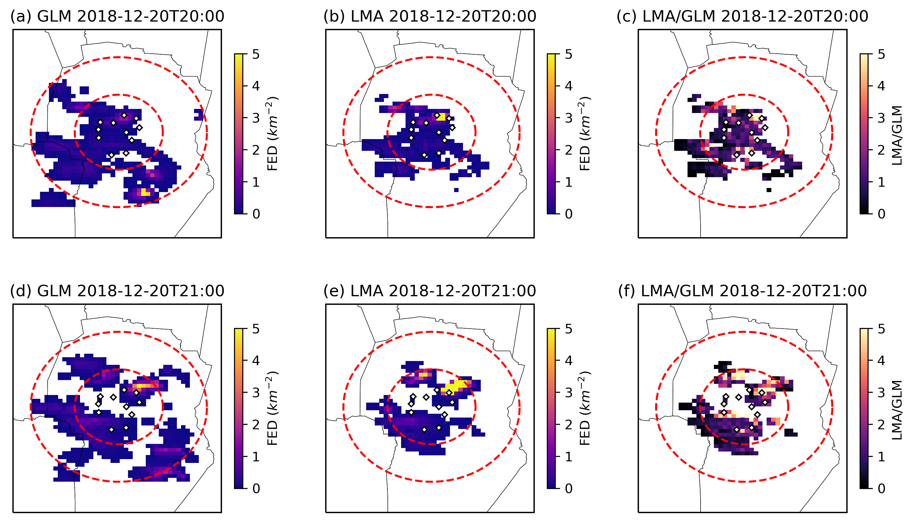
Flash Extent Density (FED) Comparison between GLM and LMA
GLM LMA Ratio

Slide 13
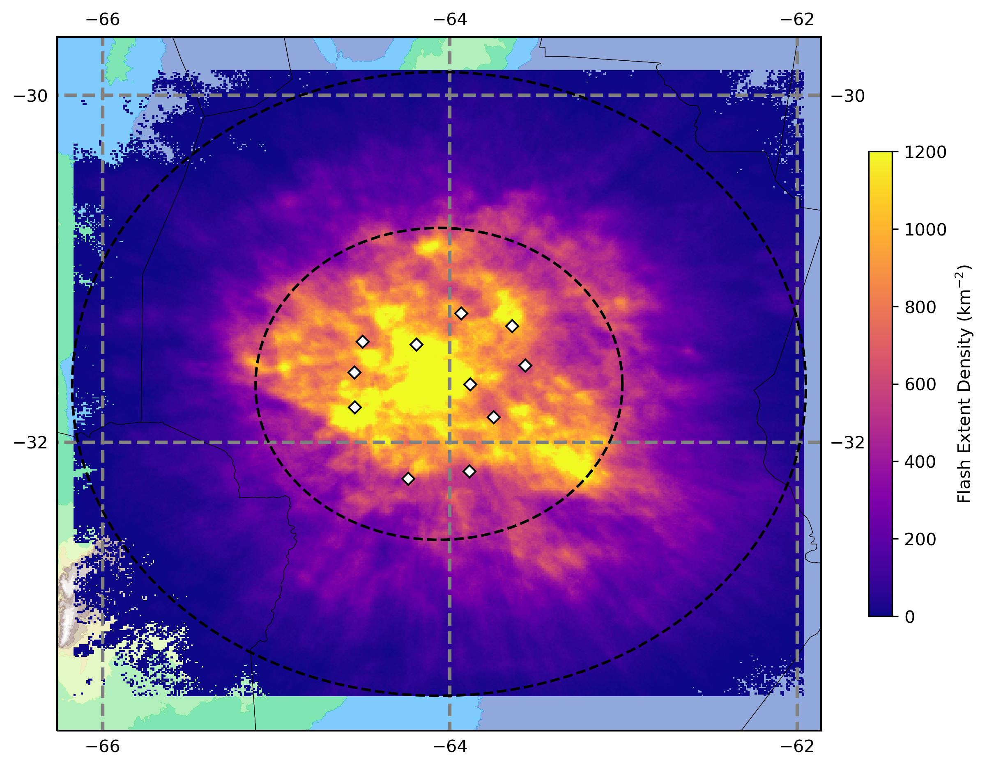
Statistical Analysis Methods
Focus on lightning within 100 km of LMA
71 case days – Full thunderstorm spectrum
LMA source data processed to flashes using open-source tools
Flash-level GLM-16 from L2 LCFA
Unit of comparison: 10-minute blocks
Thresholding: 25-km distance and +/- 500 ms
Allowing 1 GLM flash to correspond to multiple LMA flashes
Day = 11-22 UTC; Night = 00-08:30 UTC
RELAMPAGO LMA FED – Whole Deployment

Slide 14
Statistical Results
Overall good GLM performance in north-central Argentina
DE negatively correlated with flash rate – implications for usage in case studies
(Spearman rank correlations significance
p << 0.01)
 | Day | Night | Overall | Notes
GLM Detection Efficiency | 71% | 84% | 77% | 10+ LMA pts (2% less for 3+ pts)
GLM/LMA Flash Rate Correlation | 0.95 | 0.97 | 0.95 | 3+ LMA pts
Correlation of DE w/ TFR | -0.38 | -0.62 | -0.50 | 3+ LMA pts
Correlation of DE w/ Points per LMA Flash | 0.28 | 0.22 | 0.24 | 3+ LMA pts
Correlation of DE w/ Flash Altitude | -0.28 | -0.35 | -0.31 | Influence of stratiform lightning

Slide 15
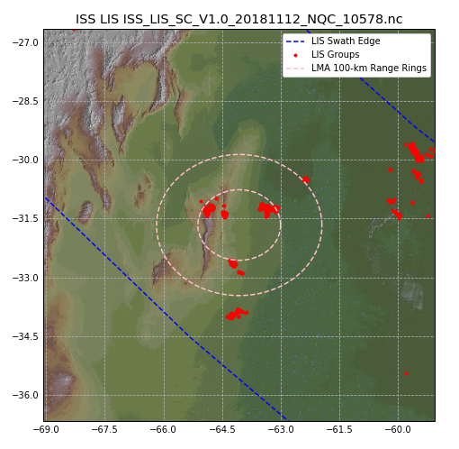
Limitations of LMAs
Limited range (~100 km for good 3D, ~200 km for good 2D) that covers only a small part of satellite field of view (even for LEO instruments like ISS LIS)
Longer deployment required if viewing time is limited (e.g., LEO or shared GEO platform)
Example to right is ISS LIS overpass of RELAMPAGO LMA; Only about 4 quality overpasses over ~5-month deployment

Slide 16
Conclusions
LMA deployments are very useful for satellite lightning sensor validation campaigns. Leverage existing field campaigns/infrastructure if possible!
Do not underestimate logistical challenges, planning and redundancy are key.
Once LMA data are acquired, numerous tools and substantial community knowledge exist to simplify processing to higher data levels that are more useful for comparison to satellite, and to support best practices in the analysis.
Consider fundamental differences between the ground-based (VHF) and spaceborne measurements in the validation approach.
RELAMPAGO LMA data available @ http://dx.doi.org/10.5067/RELAMPAGO/LMA/DATA101
RELAMPAGO LMA References
Lang, T. J., and Coauthors, The RELAMPAGO Lightning Mapping Array: Overview and initial comparison to the Geostationary Lightning Mapper. J. Atmos. Oceanic Technol., doi: https://doi.org/10.1175/JTECH-D-20-0005.1.
Peterson, M. J., Lang, T. J., Bruning, E. C., Albrecht, R., Blakeslee, R. J., Lyons, W. A., et al. (2020). New WMO Certified Megaflash Lightning Extremes for Flash Distance (709 km) and Duration (16.73 seconds) recorded from Space. Geophysical Research Letters, 47, e2020GL088888. https://doi.org/10.1029/2020GL088888
Zhu, Y., Bitzer, P., Stewart, M., Podgorny, S., Corredor, D., Burchfield, J., et al. (2020). Huntsville Alabama Marx Meter Array 2: Upgrade and capability. Earth and Space Science, 7, e2020EA001111.https://doi.org/10.1029/2020EA001111
Borque, P., L. Vidal, M. Rugna, T. J. Lang, M. G. Nicora, and S. W. Nesbitt (2020). Distinctive Signals in 1-minute Observations of Overshooting Tops and Lightning Activity in a Severe Supercell Thunderstorm. Conditionally accepted in Journal of Geophysical Research: Atmospheres.

