Slide 1
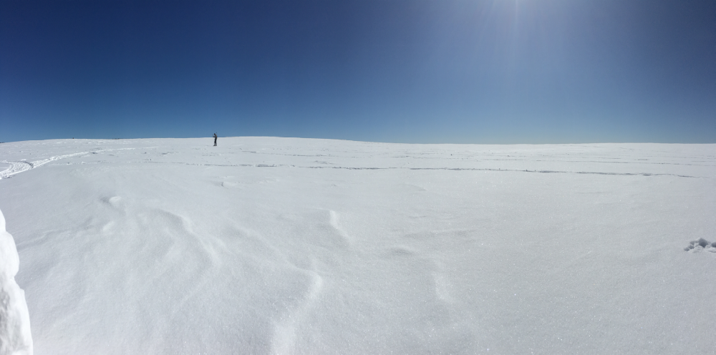
THP Snow Program
Future Planning and Activities
Carrie Vuyovich
THP Snow Science Lead
NASA / Goddard Space Flight Center

Slide 2
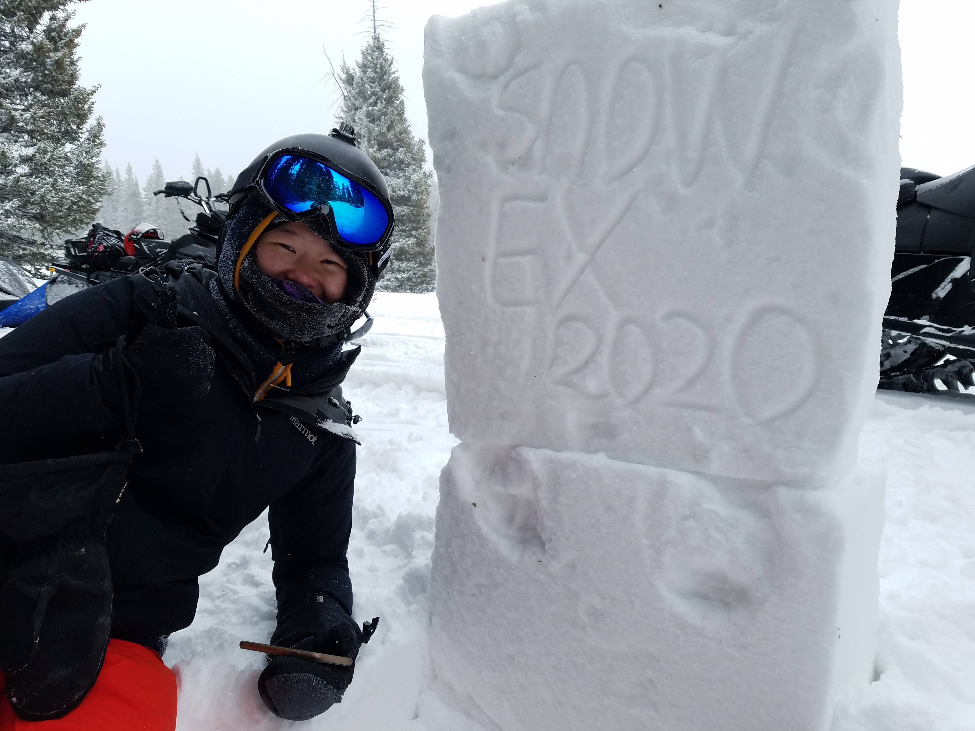
Outline
THP Snow Program goals
Upcoming satellite opportunities
Development of the Roadmap
THP Snow Community
Ongoing and upcoming activities:
  Progress since Baltimore Meeting
  Field campaign planning
  Community engagement
  Objectives of this meeting
Kehan Yang at Grand Mesa, CO. Photo Credit: Chris Hiemstra

Slide 3
THP Snow Program
Science Goal: To understand the time and space variation in the snow’s energy and mass balances along with the extensive feedbacks with the Earth’s climate, water cycle, and carbon cycle.
Vision: Advance global snow remote sensing to achieve Science Goal
Albedo
Snow Covered Area
SWE/Snow Depth
Upcoming opportunities will benefit snow community, but need to prepare!
Progress made in recent decades.
Mature algorithms and satellite observations available
Biggest gap in snow remote sensing: Need combined, multi-observational, modeling approach to develop global estimates

Slide 4
Upcoming opportunities and new developments
In this decade several potential opportunities for spaceborne snow observations are possible:
Earth Venture Mission
NISAR – L-band InSAR
TSMM – Ku-band SAR
SBG – Hyperspectral
Earth System Explorer (ESE)
  Identify possible satellite technologies that meet criteria of mission
  Define activities required to evaluate potential concepts
In addition, new techniques and advances are being demonstrated with existing satellites:
C-band SAR - Sentinel-1
Stereo-photogrammetry – Worldview, Planet, Pleiades
Spaceborne lidar – ICESat-2, GEDI

Slide 5
THP Snow Roadmap
Roadmap Goal: A near- to medium-term plan for future activities designed to prepare the snow community to be ready for upcoming opportunities, improve global snow characterization capabilities and meet identified snow data needs.
Establish baseline snow assessment of operational and modeling capabilities
Identify the satellite missions (operating and in development) that could help improve snow estimates
Help the community prepare for upcoming mission proposal calls
Identify algorithm development needs
Conduct modeling experiments/OSSE
Conduct field experiments
Establish calibration/validation sites
Engage the community

Slide 6
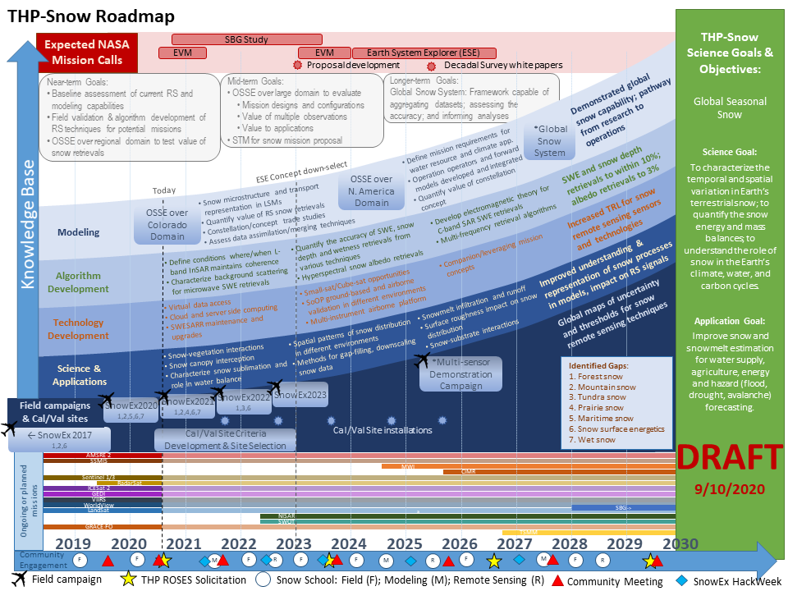
THP Snow Roadmap

Slide 7
THP-Snow
Organization
THP Snow Program
Jared Entin – THP Program Manager
Carrie Vuyovich – THP Snow Science Lead
Strategic Planning
(Paul Houser)
Exploratory Groups and Activities
Key Partners
Remote Sensing
(HP Marshall)
Ground Observations
Evaluation Process (Ed Kim, Dorothy Hall)
SINTER
NOAA
CRREL
AF Weather
CSA
ECCC
ESA
JAXA
FMI
Universities
Research Labs
Others
L-band InSAR (Eli Deeb, Jewell Lund)
K/Ku-Band (Leung Tsang)
Lidar (Nancy Glenn)
Passive Microwave (Leung Tsang)
Ka-band InSAR (Delwynn Moller)
SoOP (Xiaolan Xu, Rashmi Shah)
FMCW (Tate Meehan)
Stereophotogrammetry (David Shean)
Gamma (Eunsang Cho)
Hyper/Multi-spectral (McKenzie Skiles)
BDRF (Charles Gatebe)
Thermal IR (Steven Pestana, Jessica Lundquist)
Sampling Strategy (Chris Hiemstra)
Protocols (Kelly Elder)
Cal/Val Sites (Kelly Elder, Paul Houser)
Modeling
(Jessica Lundquist, Mark Raleigh, Ethan Gutmann)
SnowEx 2021
L-band InSAR (HP Marshall)
Albedo (McKenzie Skiles, Kelly Gleason)
Prairie (Sam Tuttle, Eric Sproles)
SnowEx 2022
SWE/SD (Chris Hiemstra, Mike Durand)
Albedo (Anne Nolin, Charles Gatebe)
Modeling (Mark Raleigh, Melissa Wrzesien)
Prairie (Sam Tuttle)
OSSE (Sujay Kumar, Bart Forman, Rhae Sung Kim)
OSSE (Sujay Kumar, Bart Forman)
Data Assimilation
Scaling Studies
RTM
Training
(Kelly Elder, Jessica Lundquist, HP Marshall)
Working Groups
Albedo (Charles Gatebe, Anne Nolin)
SEUP (Melissa Wrzesien)
Snow Microwave Remote Sensing (Leung Tsang, Mike Durand)
Stereo/Lidar (David Shean, Nancy Glenn)
Applied Sciences
Support Elements:
NASA Airborne Outreach/PR Data Archival
Notes:
Strategic Planning group: Help develop the roadmap, which includes helping to: refine the overall THP-Snow Goals and Objectives; develop a list of data, publications, algorithms, etc that need to be developed to reach our goals; identify the timing of key milestones and activities and planning snow efforts to meet those milestones; reach out to community members for input in various areas; develop and assist in the process for evaluating activities against the roadmap and science plan
Snow Community roles: Provide input to the roadmap in specific areas on what is the current science; what specific activities (i.e. observations, validation, etc) are needed or ongoing to push the community forward; help evaluate proposed activities in specific areas. POC for each area will help organize members and serve as contact for those looking to get involved
Working Groups: Investigate specific areas of interest to the snow community where additional effort is needed, e.g. to determine what observations are critical or evaluate value, conduct targeted analysis.
Planning and Exploratory Groups: Determine primary THP Snow and SnowEx objectives to be accomplished through specific activities, based on input from SnowEx Science Plan, Roadmap and 1-pagers. Define instruments, observations, site characteristics and strategy needed to meet the objectives. Develop rough cost estimate and schedule.

Slide 8
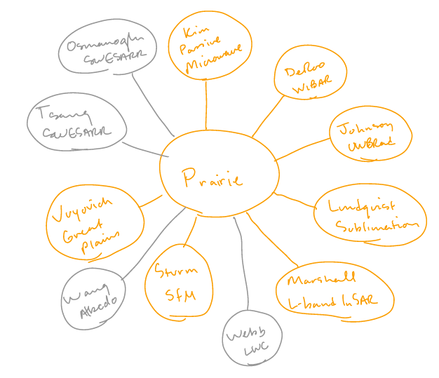
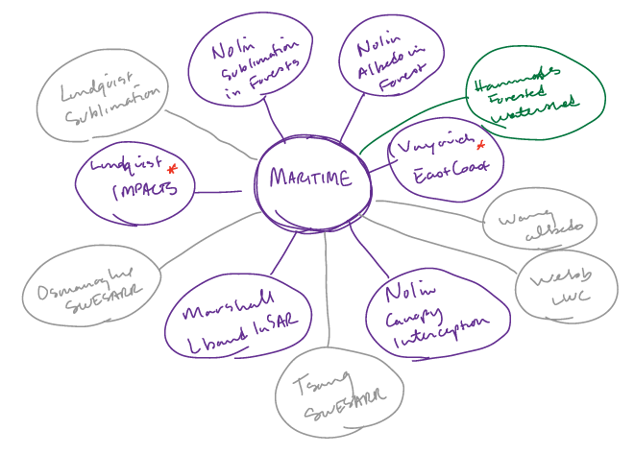
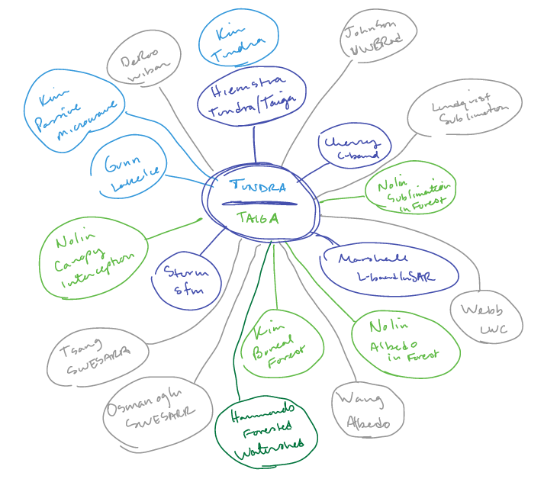
Ongoing Activities – Progress since Baltimore meeting
SnowEx 2019 Workshop, Baltimore, MD
24 “1-pagers” submitted
Break-out groups on 2nd day to discuss 3 potential activities based on submissions
Other outcomes and recommendations:
Albedo working group
Data availability after campaigns
Modeling/Observing System Simulation Experiment (OSSE) to support snow mission
Test bed sites

Slide 9
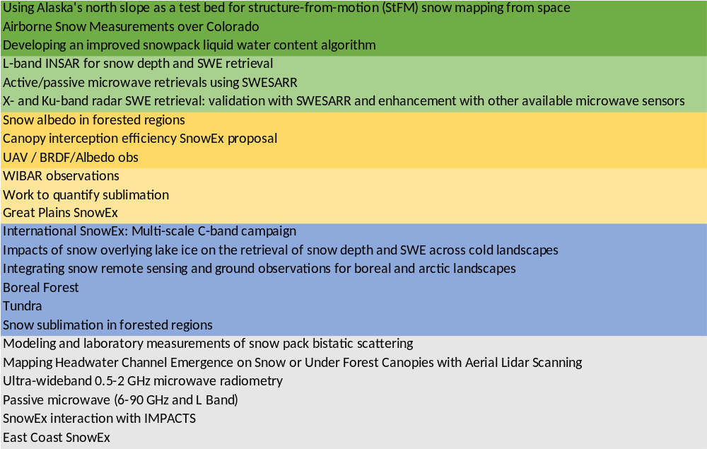
Ongoing Activities – SnowEx Campaigns
1 (to 5) Pagers – covered (at least partially) or potential activities
SnowEx 2017
SnowEx 2020
SnowEx 2020-2021
Continue Time Series, L-band InSAR
Prairie
Albedo
SnowEx 2022 – Tundra/Taiga focus
Plans developed which address objectives:
  Albedo
  SWE/Snow depth
Currently evaluating & prioritizing needs
SnowEx 2023
Small scale
Need input on remaining needs
2020
2021
2022

Slide 10
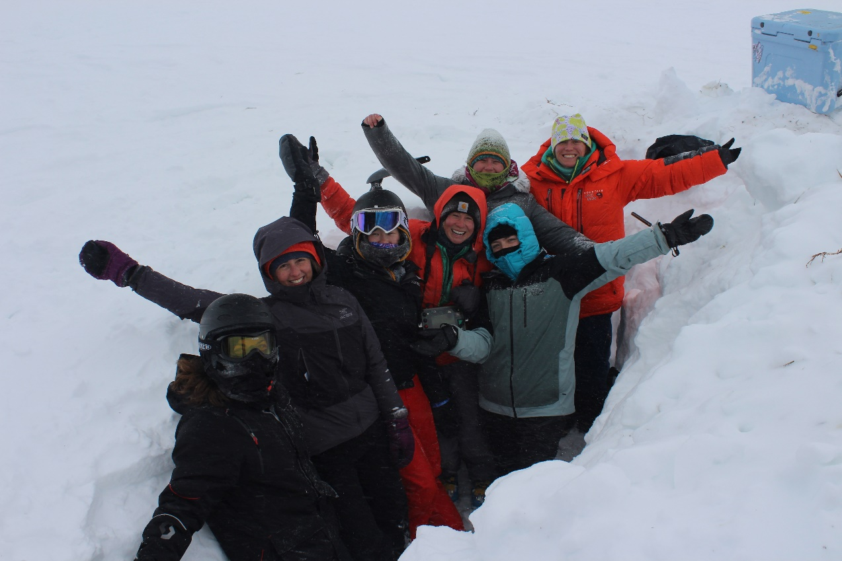
Community Engagement
  Promote a diverse, inclusive, and welcoming community
  Increase opportunities for participation
  Improve communication
  Update website
  Training:
    Schools (field, modeling, RS)
    Meetings
    Hackweeks, etc
Photo credit: C Vargel

Slide 11
Objectives of 2020 SnowEx Virtual Meeting
  Share snow campaign and research results
  Discuss ongoing efforts towards advanced snow estimation and a future snow satellite mission
  Solicit feedback on Roadmap and Implementation plans
  Identify and prioritize remaining gaps
  Engage early-career scientists and wider community in efforts

Slide 12
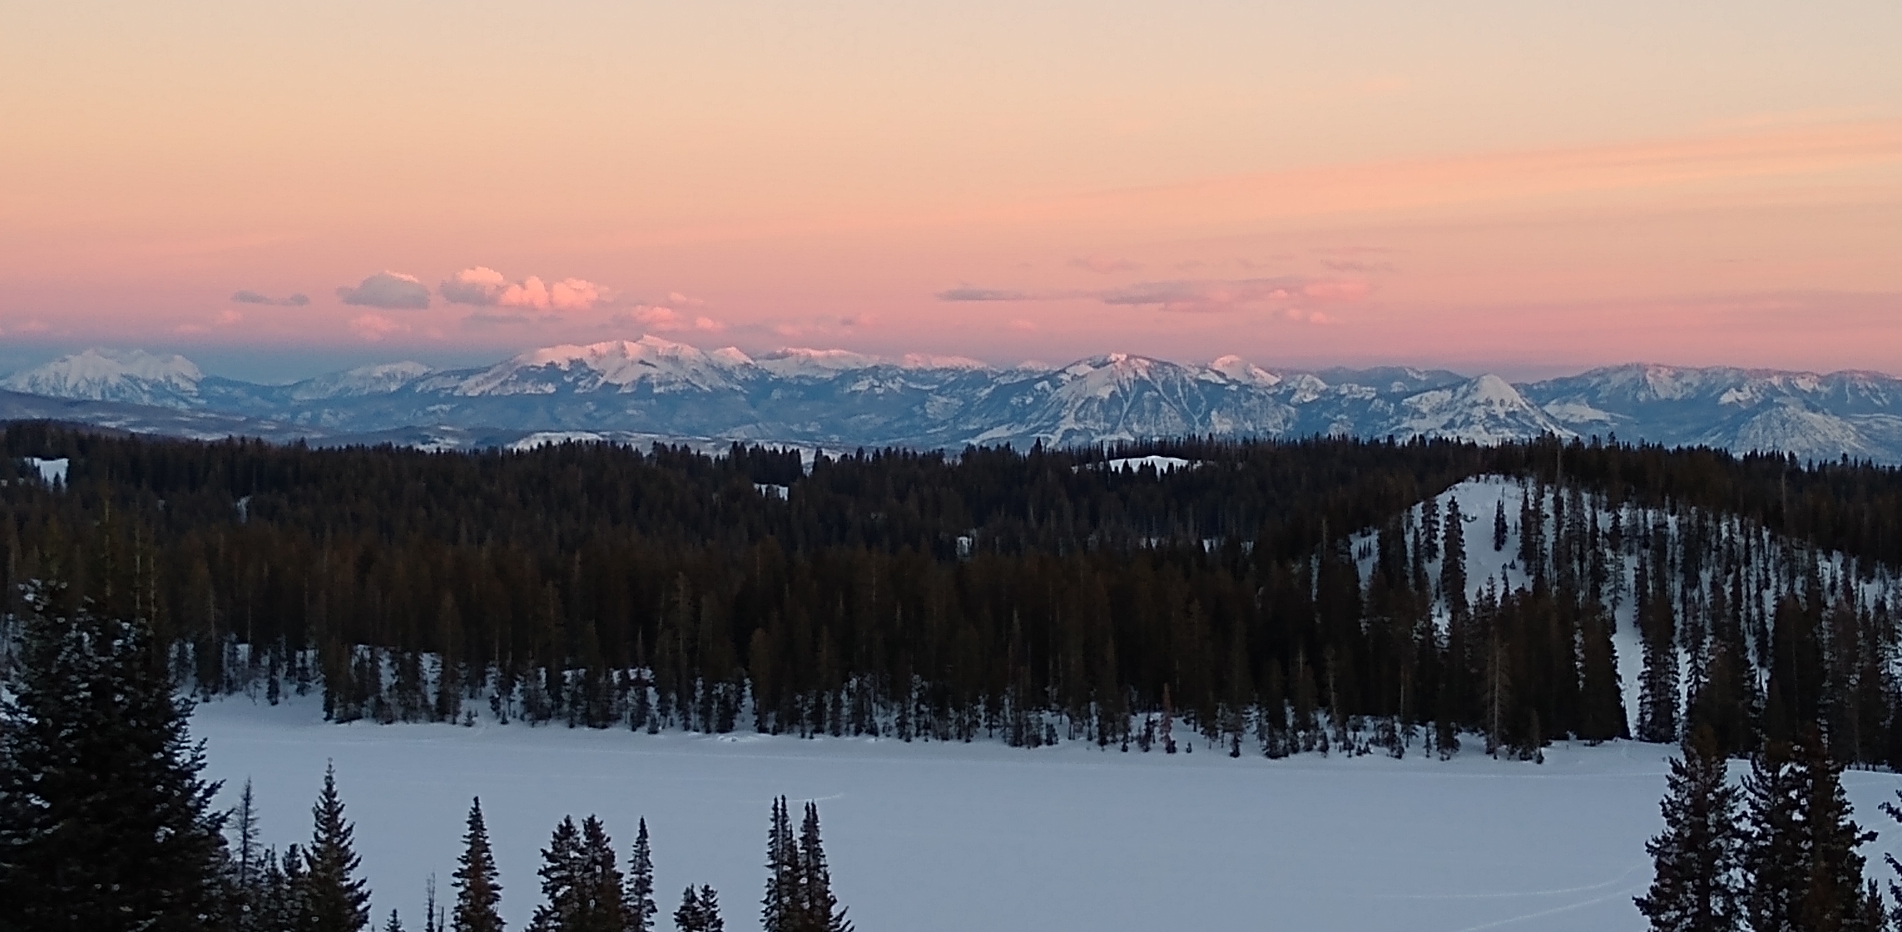
Questions?
Photo credit: J. Lund

