Slide 1
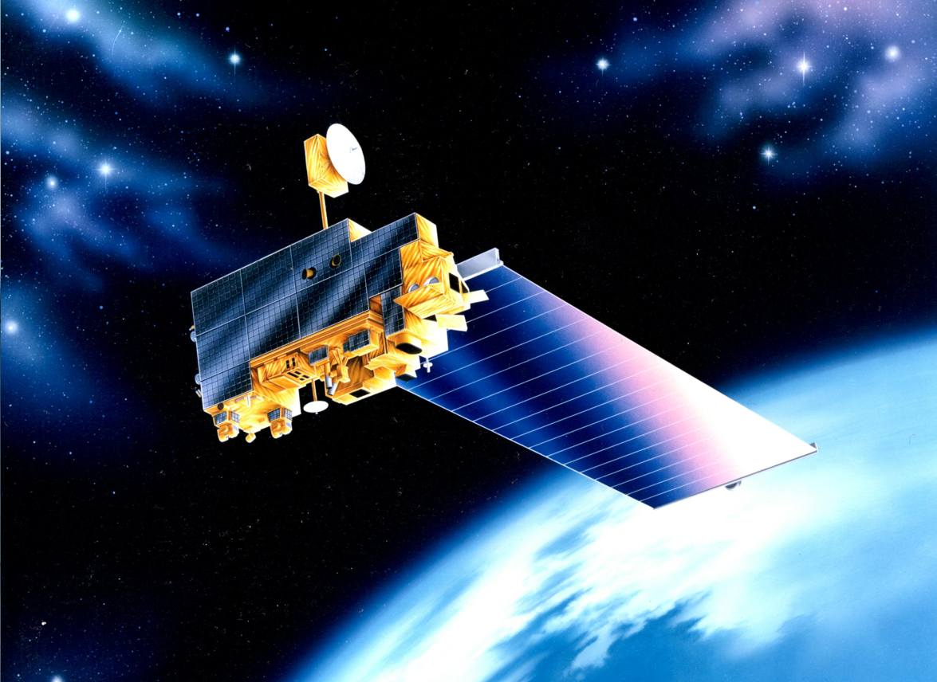
EOS Terra
Mission Status
Constellation MOWG
Virtual (GSFC)
Sept. 29th- Oct. 2nd, 2020
Dimitrios Mantziaras
Terra Mission Director - Code 428
phone 301-614-5234
Dimitrios.C.Mantziaras@nasa.gov

Slide 2
Topics
Mission Summary
Spacecraft Subsystems Summary
Recent Activities
Inclination Adjust Maneuvers
Conjunction History
End-Of-Mission Plan
Upcoming Activities
Summary
Backup Slides

Slide 3
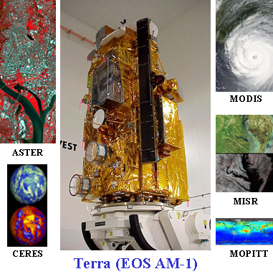
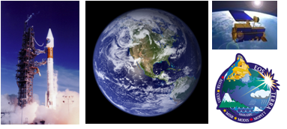
Terra Mission Overview
Terra Features
Launch Date: December 18,1999 (Atlas IIAS, VAFB)
Orbit: 705 km, Sun-synchronous polar, 98.2º Inclination, 10:30 AM MLT descending node
Instrument Payload:
  ASTER (SWIR, TIR & VNIR) - Advanced Spaceborne Thermal Emission and Reflection Radiometer (Japan)
  CERES (Fore & Aft) - Clouds and the Earth's Radiant Energy System (USA – Langley)
  MISR - Multi-angle Imaging Spectro-Radiometer (USA – JPL)
  MODIS - Moderate Resolution Imaging Spectro-radiometer (USA – GSFC)
  MOPITT - Measurement of Pollution in the Troposphere (Canada)
Project Management: Earth Science Mission Operations (ESMO)
Spacecraft Flight Operations: Contracted by GSFC to KBR team and supported by NASA NENs and TDRSS
Instrument Operations and Science Data processing: Performed at respective Instrument Locations where developed
Mission Duration: Successfully completed Prime mission of 5 years. Currently in Extended Operations.
Distributed Active Archive Centers: LP DAAC – MODIS, ASTER; Langley DAAC – CERES, MISR, MOPITT
Science
The primary objective of the Terra Mission is to simultaneously study clouds, water vapor, aerosol, trace gases, land surface and oceanic properties, as well as the interaction between them and their effect on the Earth’s energy budget and climate.

Slide 4
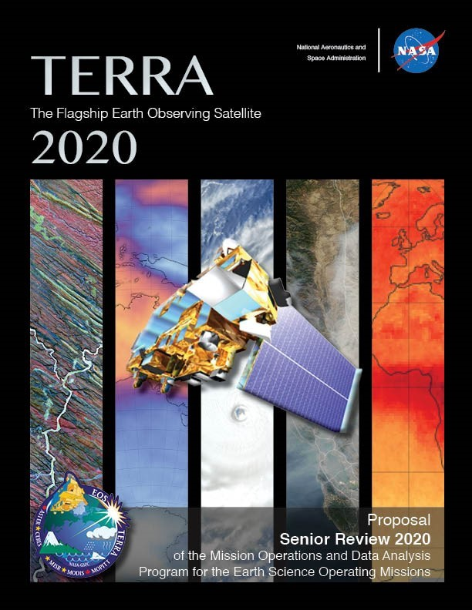
EOS Terra Mission Summary
2019 Inclination Adjust Maneuvers
  Fall 2019 Inclination Maneuvers
    IAM #55 – October 17th
    IAM #56 – October 23rd
12/18/19: Terra 20-Year Anniversary
  5-Year Design Life, 6 year goal
  Reliability Estimates thru 2025+
  Consumables through 2020+
EOS Flight Operations Annual Review #14 – Jan/Feb 2020
2020 Inclination Adjust Maneuvers (Final)
  Spring 2020 Inclination Maneuvers
    IAM #57 – February 20th
    IAM #58 – February 27th
March 2020: Mission Extension Senior Review Proposal Delivered to NASA HQ
  Mission extension through FY26
  Results from Panel Review expected Sept 2020

Slide 5
Terra Spacecraft Status
(NO CHANGE)
All subsystems on Primary Hardware except as noted
Command & Data Handling (CDH) – Nominal
  Solid State Recorder (SSR) – holds ~1 orbit of data
  13 of 58 SSR Printed Wire Assembly tripped off resulting in reduced recording capacity
Communications (COMM) – Nominal
  DAS Modulator Failure on 05/29/2008 (Operating on Redundant)
  Use K-Band primarily, X-Band as needed for Science Playback
Electrical Power System (EPS) – Good
  Battery Cell and Heater Controller Anomaly (10/13/2009)
  1 of 24 Solar Panel Failed (9/24/2000)
Flight Software (FSW) – Nominal
Guidance, Navigation & Control (GN&C) – Nominal
  Minor loss of sensitivity in SSSTs – updated tracker biases to compensate
Propulsion (PROP) – Nominal
Thermal Control System (TCS) – Nominal
Instruments (INST) – Nominal
  Only ASTER SWIR failed, all other instruments are taking science

Slide 6
Spacecraft Component Status
(NO CHANGE)
Subsystem | Component | Design | Current | Capability | Comments
EPS | Solar Array | 24 Shunts | 23 Shunts | 96% | Degradation is minimal. Fully capable of supporting mission thru 2020 unless future failures occur
 | Batteries | 108 Cells | 107 Cells | 99% | BBAT cell #50 failed on 10/15/09.
 | Batteries | 36 Heater Controls | 28 Heater Controls | 77% | BBAT heater control failed on 4 of 9 heater groups on primary, redundant, and survival. Battery cell charging/discharging and the remaining heater groups are preventing cells from freezing. PBAT heater control performance is nominal.
TCS | MOPITTCPHTS | 2 | 2 | Full | Performance is nominal
 | SWIR CPHTS | 2 | 2 | Full | Performance is nominal
 | TIR CPHTS | 2 | 2 | Full | Random temperature fluctuations. Performance within requirements.
SCC | SCC | 2 | 2 | Full | Performance is nominal
COMM | HGA | 2 | 2 | Full | MDA BITE failures occur 2-3/week due to SEU. Recoverable
 | X-Band | 2 | 1 | 75% | DAS Modulator 1 failed (50%). Solid State Power Amplifier redundancy still available (100%).
 | CTIU | 2 | 2 | Full | Performance is nominal
 | OMNI | 2 | 2 | Full | Performance is nominal
CDH | MO | 2 | 2 | Full | Drift rate changes have occurred since 10/3/10. Performance is within requirements.
 | SFE | 2 | 2 | Full | SFE SEU occur 1-2/year. Recoverable
 | SSR | 59 PWA | 46 PWA | 78% | Recycle of Data Memory Unit likely to recover all Printed Wire Assemblies
GNC | IRU | 3 | 3 | Full | Performance is nominal. 2 for 3 redundancy
 | TAM | 2 | 2 | Full | Performance is nominal
 | SSST | 2 | 2 | Full | Minor loss of sensitivity in SSSTs – tracker biases updated
 | CSS | 2 | 2 | Full | Performance is nominal
 | ESA | 2 | 2 | Full | Performance is nominal
 | FSS | 1 | 1 | Full | Performance is nominal. Not currently used
 | RWA | 4 | 4 | Full | Performance is nominal. 3 for 4 redundancy
 | MTR | 3 | 3 | Full | Performance is nominal
Prop | REAs | 16 | 16 | Full | Performance is nominal
Instruments | ASTER - SWIR | 2 | 2 | 0% | Cooler is unable to maintain detector temperature. Science Data is unusable (Fully Saturated) and is no longer being recorded. Still collecting and monitoring Engineering data.
 | ASTER - TIR | 2 | 2 | Full | Performance is nominal
 | ASTER - VNIR | 2 | 2 | Full | Performance is nominal
 | CERES - Aft | 1 | 1 | Full | Performance is nominal
 | CERES - Fore | 1 | 1 | Full | Performance is nominal
 | MISR | 2 | 2 | Full | Performance is nominal
 | MODIS | 2 | 1 | 50% | Power Supply #2 failed, Formatter A degraded, cross-strapped. All Science is nominal.
 | MOPITT | 2 | 1 | 50% | Displacer B and Chopper Motor failed. Loss of redundancy only. All Science is nominal.

Slide 7
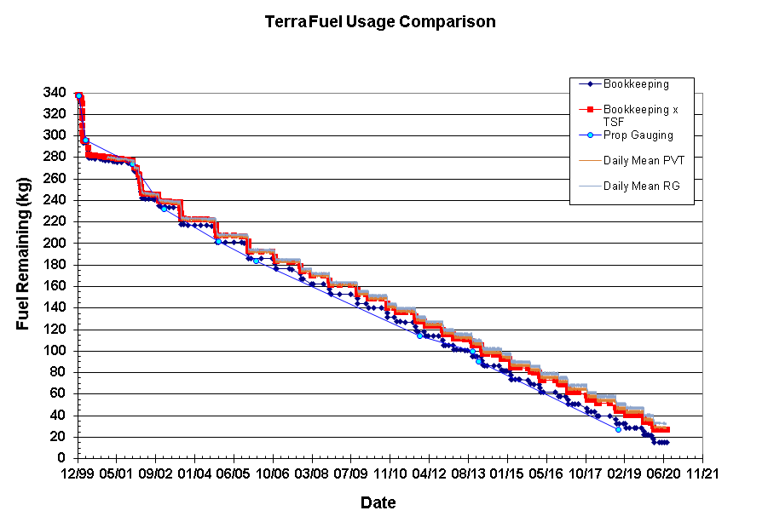
Lifetime Estimates
Fuel Remaining
Fuel Reserve = 12kgs

Slide 8
Recent Activities
  Propulsive Maneuvers
  Risk Mitigation Maneuver (RMM) #17 (DMU #114) executed on 09/12/19
  Inclination Adjust Maneuver (IAM) #55 executed on 10/17/19
  Inclination Adjust Maneuver (IAM( #56 executed on 10/23/19
  Risk Mitigation Maneuver (RMM) #18 (DMU #115) executed on 11/19/19
  Drag Make-up Maneuver (DMU) #116 executed on 12/11/19
  Risk Mitigation Maneuver (RMM) #19 (DMU #117) executed on 01/10/20
  Inclination Adjust Maneuver (IAM) #57 executed on 02/20/20
  Final Inclination Adjust Maneuver (IAM) #58 executed on 02/27/20
  Drag Make-up Maneuver (DMU) #119 executed on 04/30/20
  Drag Make-up Maneuver (DMU) #120 executed on 06/04/20
  Drag Make-up Maneuver (DMU) #121 executed on 07/08/20
    First NM transition Maneuver
  Drag Make-up Maneuver (DMU) #122 executed on 08/12/20
  Drag Make-up Maneuver (DMU) #123 planned for 09/16/20
  Calibration Maneuvers
  MODIS Roll #199 executed on 08/20/19
  MODIS Roll #200 executed on 09/19/19
  MODIS Roll #201 executed on 10/18/19
  MODIS Roll #202 executed on 11/17/19
  MODIS Roll #203 executed on 12/16/20
  MODIS Roll #204 executed on 01/13/20
  MODIS Roll #205 executed on 02/13/20
  MODIS Roll #206 executed on 03/13/20
  MODIS Roll #207 executed on 06/10/20
  MODIS Roll #208 executed on 07/09/20
  MODIS Roll #209 executed on 08/08/20
  MODIS Roll #209 planned for 09/09/20
    First using Earth View Door
  06/27/19: SSR PWA #38 Failure (MISR Buffer)
  07/02/19: CERES Solar Presence Sensor Response Patch Uplink
  07/26/19: MOPITT Sieve #4/PMC #2 Failure (SEU)
  08/07/19 – 08/21/19: MOPITT Sieve #4/PMC #2 Failure Recovery
  08/21/19 – 08/22/19: MODIS SRCA XTALK Calibration
  08/30/19: SSR PWA #55 Failure (MODIS Buffer)
  09/18/19 – 09/19/19: Terra SWAMP/Science Team Meeting @ Boulder, Co
  11/22/19: TMON 16 SFE Anomaly
  12/17/19: Constellation Exit Maneuver ORR
  12/18/19: Comm. RTCS update Uplink (improved Blind Acq)
  12/26/19: Lunar Induced Solar Eclipse #46
  02/13/20: ADE-B Solar Array Park RTCS Update Upink
  02/19/20: MODIS SRCA Spectral Calibration
  03/14/20: GSFC transition to COVID-19 “Stage 2” - FOT prioritize telework
  03/17/20: GSFC transition to COVID-19 “Stage 3” - FOT Mandatory telework
  03/24/20: GSFC transition to COVID-19 “Stage 4” - FOT Mandatory telework (no change in posture)
  03/28/20: SFE Anomaly (HDI Card Error)
  05/25/20 – 05/30/20: TDRS 171 Outage
  06/21/20: Lunar Induced Solar Eclipse #47
  07/20/20: GSFC transition to COVID-19 “Stage 3” - FOT Mandatory telework (no change in posture)

Slide 9
Inclination Adjust Maneuvers
Inclination Adjust Maneuvers used to maintain nominal spacecraft mean local time (descending node) of 10:30 AM
  10/17/2019 IAM #55 (320 sec burn) executed successfully
  10/23/2019 IAM #56 (320 sec burn) executed successfully
  02/20/2020 IAM #57 (320 sec burn) executed successfully
  02/27/2020 IAM #58 (320 sec burn) executed successfully
Predictions indicate need to perform 3-4 maneuvers per year
  2017: (2 in Spring, 2 in Fall) -- COMPLETE
  2018: (1 in Spring, 2 in Fall) – COMPLETE
  2019: (1 in Spring, 2 in Fall) – COMPLETE
  2020: (2 in Spring, 0 in Fall) -- COMPLETE; last inclinations for Terra mission

Slide 10
Terra High Interest Events
Year | Jan | Feb | Mar | Apr | May | Jun | Jul | Aug | Sep | Oct | Nov | Dec | Total
2019 (T1-T4) | 0 | 2 | 0 | 2 | 0 | 2 | 1 | 1 | 1 | 2 | 2 | 1 | 14
Tier 3 | 0 | 1 | 0 | 0 | 0 | 0 | 0 | 1 | 0 | 2 | 0 | 0 | 4
Tier 4 | 0 | 1 | 0 | 1 | 0 | 0 | 1 | 0 | 1 | 0 | 1 | 0 | 5
2020 (T1-T4) | 2 | 0 | 1 | 0 | 0 | 1 | 0 | 0 |  |  |  |  | 4
Tier 3 | 1 | 0 | 1 | 0 | 0 | 0 | 0 | 0 |  |  |  |  | 2
Tier 4 | 1 | 0 | 0 | 0 | 0 | 0 | 0 | 0 |  |  |  |  | 1
Tier Definitions: T1 – Notify (email/phone), T2 – Conduct Briefing, T3 – Plan Maneuver, T4 – Execute Maneuver
2010: 5 HIEs – 1 DAM performed on 01/22/2010: Terra vs. 34700 CA on 1/23 @ 20:46z
2011: 20 HIEs – 2 DAM planned and waived off
2012: 19 HIEs – 1 maneuver waived off due to CA
2013: 17 HIEs – 7 that required significant action
2014: 24 HIEs – 6 that required DAM execution or nominal maneuver waive-off and replanning
2015: 33 HIEs – 8 that required DAM execution or nominal maneuver waive-off and replanning
2016: 11 HIEs – 0 that required DAM execution or nominal maneuver waive-off and replanning
2017: 8 HIEs – 1 that required DAM execution or nominal maneuver waive-off and replanning
2018: 6 HIEs – 2 that required DAM execution or nominal maneuver waive-off and replanning
2019: 9 HIEs - 5 that required DAM execution or maneuver waive-off and replanning
2020 to present: 3 HIEs that required DAM execution or maneuver waive-off and replanning
  DAM #19 performed on 01/10; Terra vs. 80326 with TCA = 01/10 @ 21:55z

Slide 11
ESMO RMM Planning Automation
ESMO updated its Close Approach (CA) Process Flow to move towards a more Automated approach
  Prepares for future increased object catalog w/ Space Fence
  Reduces workload for each event
  Keeps solution “at the ready” for short notice events
ESMO Flight Dynamics team developed an autonomous ephem generation tool
Ephems built off optimal and constrained cases solved for by the Collision Risk Management System (CRMS)
Ephems posted directly to SpaceTrack and sent to CARA for screening
  Delivery to CARA is now automatic based on logic built into the FDS ephem tool to whittle ephems down from maximum of eight generated to a maximum of five delivered
  Any other options needed can be sent manually
Screening results automatically compiled and outputted via an email report from CRMS
Auto Ephem Generation implemented in February 2017
Auto Ephem Delivery implemented in February 2018
ESMO has completed CARA Devolution Parallel Operations (Sept 2019) and now in an “interim” quasi-devolved state

Slide 12
Retrograde Maneuver Preparation
Summer 2018 Terra was predicted to violate Ground Track Error (GTE) due to RMM execution March 2018
  FOT planned summer IAM with Retrograde (orbit lowering) component
  Summer IAM was not needed and was waived off
    Terra did not violate GTE limits as predicted
FOT developing pure retrograde capability
  Short Duration Retro : Complete
    Only executed to prevent GTE violation
    Performed in S/C night
    Design Complete -- ORR Held on 5/30
  Long Duration Retro : Complete
    Constellation Exit and Deorbit Burns
    Executed in S/C Day and Night
    ASTER to be in Safe Mode
    Design Completion : December 2019
Reviewed retrograde plume risk with S/C Manufacturer, ETD and ASTER IOT
  No contamination concerns from retrograde plume
Terra Retrograde Capability - COMPLETE
All instrument configurations understood

Slide 13
Upcoming Activities
Upcoming Activities
Terra MODIS Roll #210 | 09/09/20
Terra FSSE CCB | 09/09/20
Terra DMU #123 | 09/16/20
MISR Bi-Monthly Calibration | 09/22/20
Terra 21-year Anniversary | 12/18/20
Constellation Exit Maneuvers | September 2022
Decommission Preparation | Ongoing

Slide 14
Future Maneuver Plans

Slide 15
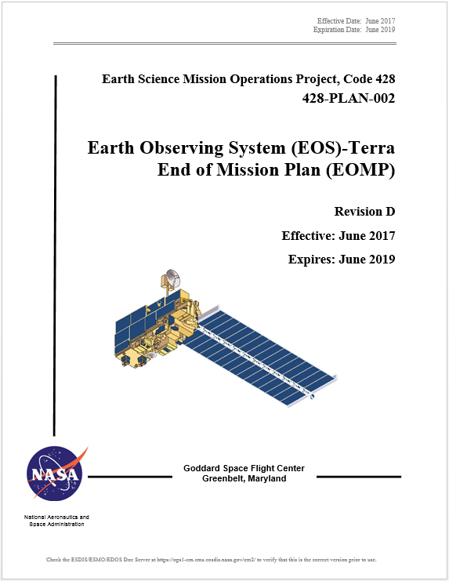
Terra End-of-Mission Plan
  Document Status
  Rev D - End-of-Mission Plan Document has been revised and under review cycle
  APPROVED - NASA HQ Signed in October 2018
  Content
  Terra will continue normal operations through October 2020
  Once all non-reserved fuel has been used, MLT will be drifted to 10:15 AM
  September 2022, Terra exits constellation
  Remaining fuel used to lower perigee prior to spacecraft passivation
  Exit plan is consistent with the current Constellation Operations Coordination Plan

Slide 16
Terra Lifetime Maneuvers
Remaining Orbit Maintenance Maneuvers
Mission Year | Inclination Maneuvers | DMU Maneuvers | Fuel Used (kg) | Fuel Remaining (kg)
2018 | 1 Spring, 2 Fall | 4 | 10.783 | 44.998
2019 | 1 Spring, 2 Fall | 5 | 10.752 | 34.245
2020 | 2 Spring, 0 Fall | 3 | 6.890 (6.835 YTD) | 27.066
2021 | 0 Spring, 0 Fall | 4 | 0.355 | 26.710
2022 | 0 Spring, 0 Fall | 5 | 0.713 | 25.998
Constellation Exit and Deorbit Maneuvers
Mission Date | Maneuver Type | Fuel Used (kg) | Fuel Remaining (kg)
10/19/2022 | CEM #1 | 3.441 | 22.586
10/26/2022 | CEM #2 | 3.392 | 19.194
02/19/2026 | PLM #1 | 3.352 | 15.842
02/26/2026 | PLM #2 | 3.334 | 12.508
03/05/2026 | PLM #3 | 3.316 | 9.192
03/12/2026 | PLM #4 | 3.299 | 5.892
03/19/2026 | PLM #5 (96.875%) | 3.182 | 2.711

Slide 17
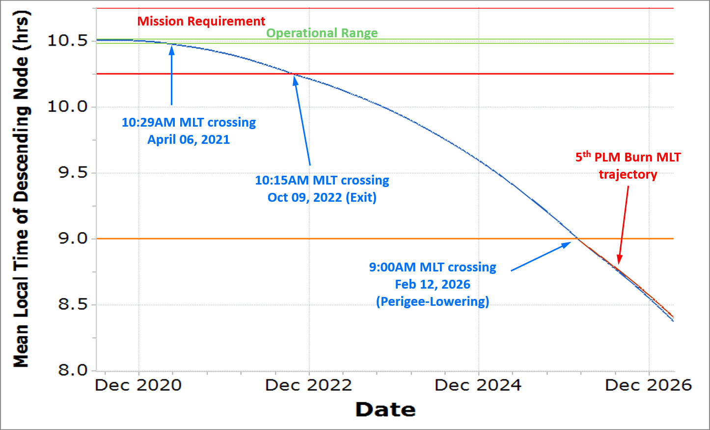
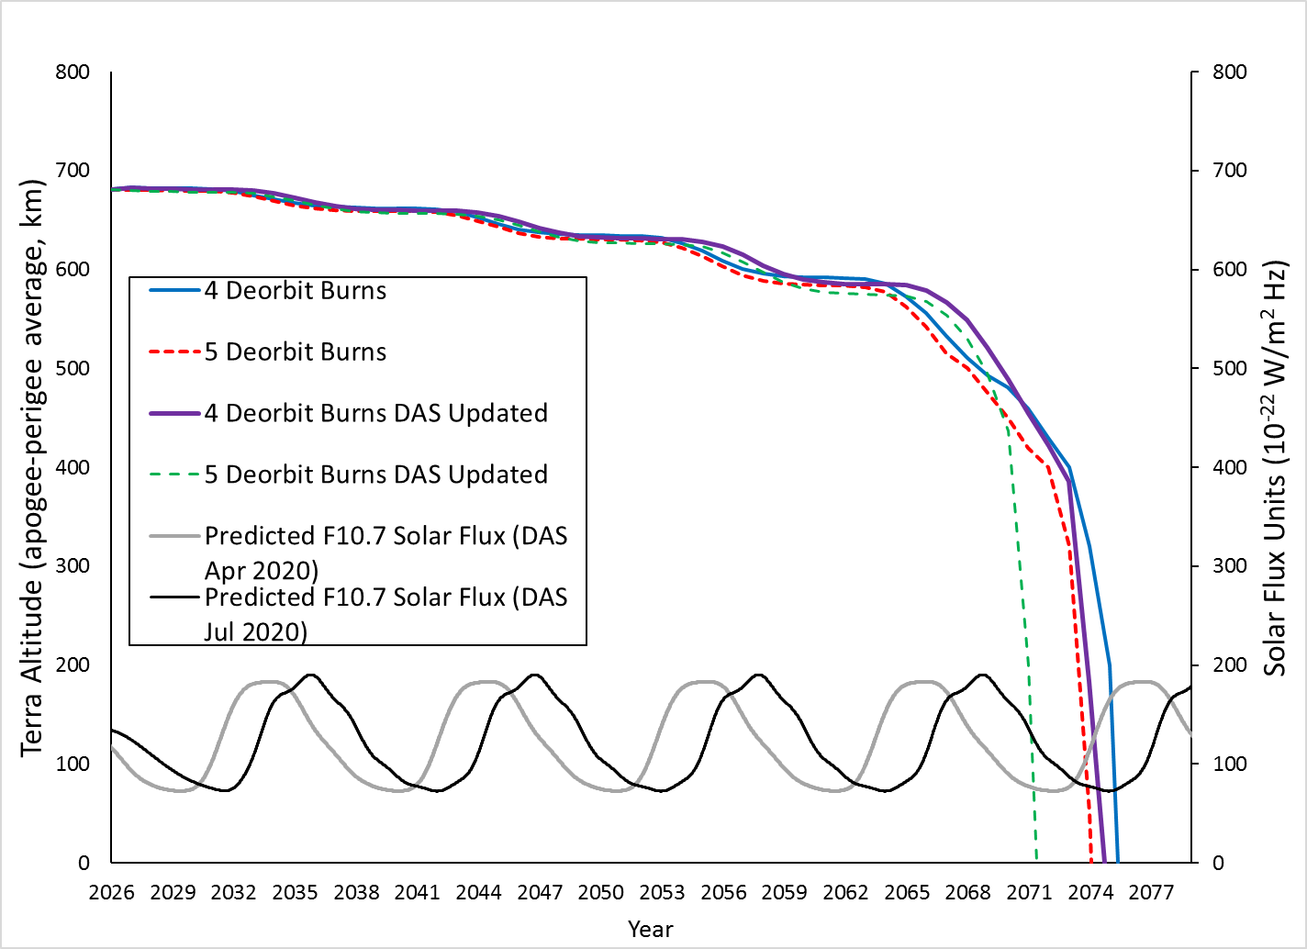
Terra Lifetime Maneuvers
MLT and Altitude Predictions
Decommissioning Plan | Exit Year | Deorbit Year | De-orbit Burns (#) | Apogee at Depletion (km) | Perigee at Depletion (km) | End of Mission (EOM) | EOM to Reentry (years) | Reentry Date
Baseline (4 x 320-sec burns) | 2022 | 2026 | 4 | 696.1 | 672.1 | 2026.25 | 48.6 | 2074
Baseline plus 5th 310-sec deorbit burn | 2022 | 2026 | 5 | 695.4 | 667.9 | 2026.25 | 45.2 | 2071

Slide 18
Summary
  Terra remains very healthy 20+ years into the mission
    Electrical Power Subsystem performance has been stabilized following 2009 anomaly
    Fuel Remaining to continue operations to 2020 and beyond
  Data Capture percentages continue at ~100%
  Collision Avoidance events continue to be part of routine ops
    Low atmospheric drag is providing additional challenges
  End of Mission Plan (Rev D) officially approved/signed
    Goddard signed/approved version made it to NASA HQ on 05/11/18
    All signatures received in October 2018
  Plan is for Terra to Exit Constellation in October 2022 and end mission in March 2026

Slide 19
Questions

Slide 20
Additional Slides
  Fuel Usage
  Final Orbit Altitude
  Orbit / Inclination / MLT Maintenance
  WRS Ground Track Error
  OSMA Waiver Email
  NASA HQ Email

Slide 21
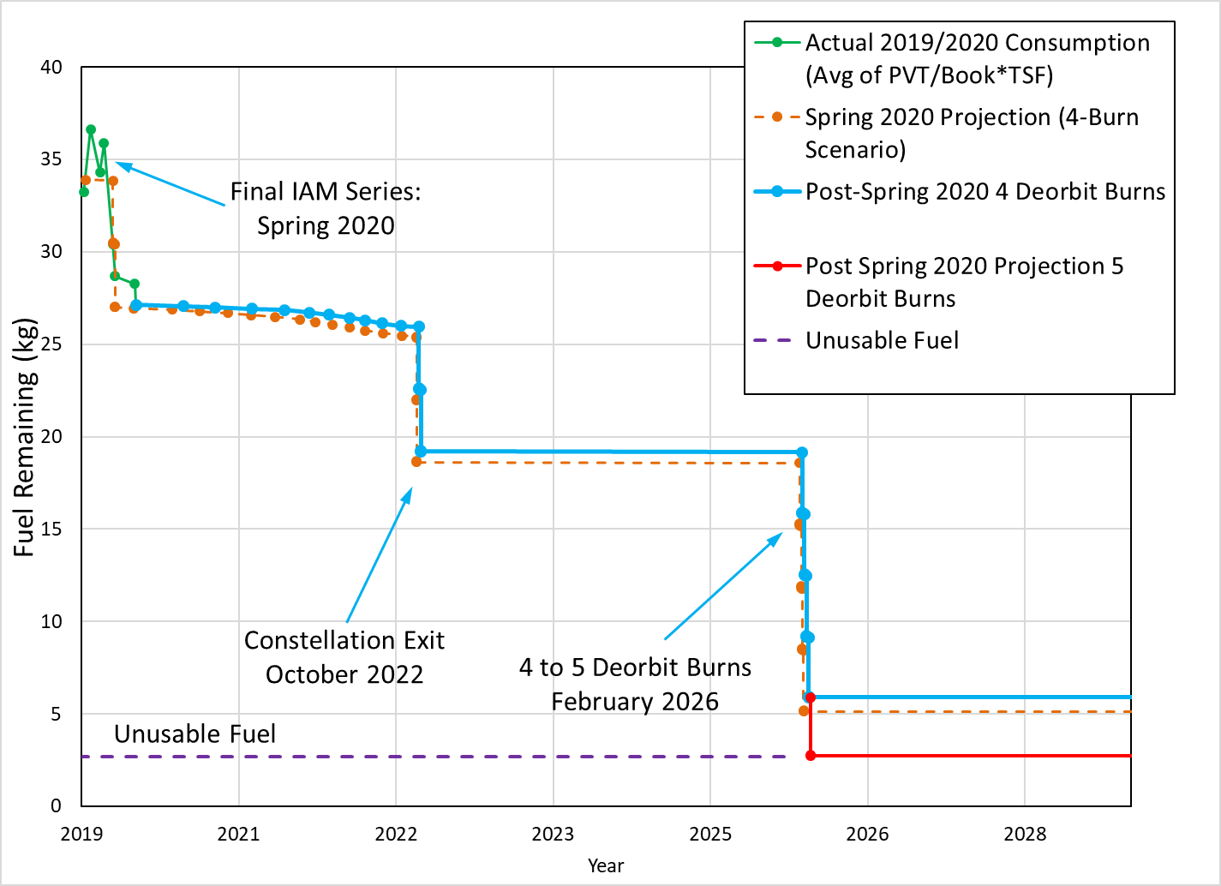
Terra Fuel Usage

Slide 22
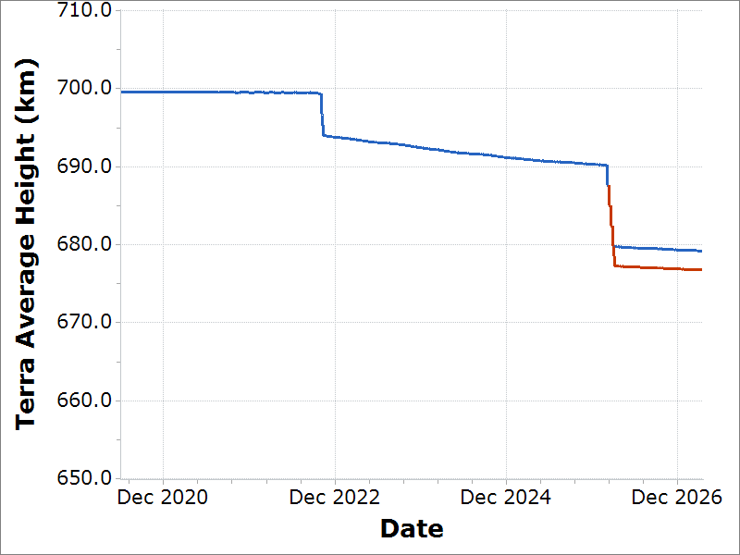
Final Average Height
(semi-major axis minus Earth radius)
Exit to 694 km
Oct 2022
Deorbit to 679.5 km
Feb 2026
Deorbit to 677.2 km after 5th Burn

Slide 23
Orbit/Inclination/MLT Maintenance
Requirement: Mean Local Time (MLT) maintained between 10:15 and 10:45 measured at the Descending Node.
Goal: Maintain Terra mean local time of the descending node (MLTDN) below 10:31.
Constraint: OCO-2 has requested Terra maintain a MLT less than 10:31 for the duration of its lifetime to maintain a safe separation at the poles.
Requirement: Maintain WRS-2 ground track error, 0 +/-20 km.
Requirement: Maintain Frozen orbit with Argument of Perigee at 90 degrees +/-20 and Eccentricity of 0.0012 +/- 0.0004.
Constraint: Maximum burn duration limited to 320 seconds by spacecraft manufacturer. Complete yaw slews and inclination maneuvers during spacecraft orbital night. Maneuver close to spring and fall equinox to maximize efficiency.

Slide 24
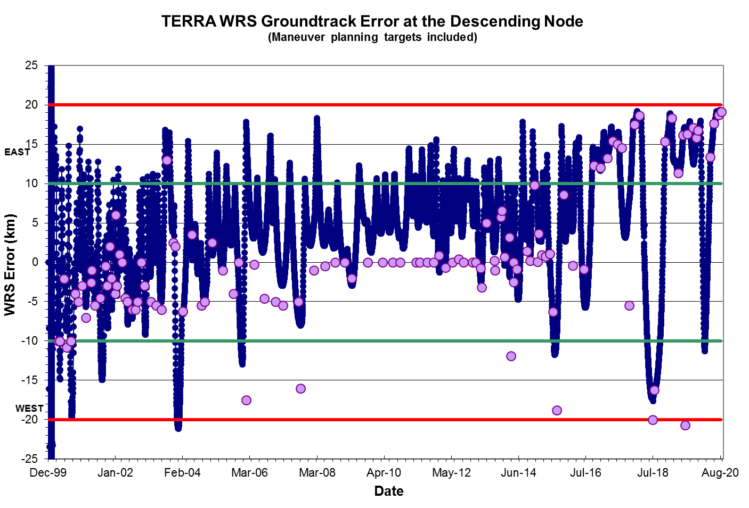
WRS Ground Track Error (GTE)

Slide 25
OSMA Official Direction
From: Aleman, Suzanne M. (HQ-GD000)
Sent: Wednesday, November 02, 2016 11:37 AM
To: Yuhas, Cheryl L. (HQ-DK000) <cheryl.l.yuhas@nasa.gov>
Cc: Liou, Jer-chyi (JSC-XI411) <jer-chyi.liou-1@nasa.gov>; Hull, Scott M. (GSFC-5920) <scott.m.hull@nasa.gov>
Subject: FW: Terra need for Orbital Debris waivers
Hi Cheryl,
I received you voice mail regarding the question on whether a waiver is needed for the 25 year rule for TERRA.
I consulted with J. C Liou on this question we have concluded that a waiver is not needed. Please see the e-mails below.
Please let me know if you have any questions.
Best regards,
Sue Aleman
NASA HQ OSMA
MMOD Program Executive

Slide 26
NASA HQ Official Direction
From: Webb, Charles E. (HQ-DK000)
Sent: Friday, February 02, 2018 3:45 PM
To: Mantziaras, Dimitrios C. (GSFC-4280) <dimitrios.c.mantziaras@nasa.gov>
Cc: Watson, Wynn J. (GSFC-4280) <wynn.j.watson@nasa.gov>; Moyer, Eric M. (GSFC-4280) <eric.m.moyer@nasa.gov>; Dell, Gregory T. (GSFC-4280) <gregory.t.dell@nasa.gov>; Thome, Kurtis J. (GSFC-6180) <kurtis.thome@nasa.gov>; Wilson, Jamie Leigh (HQ-DK000)[SCIENCE SYSTEMS AND APPLICATIONS INC] <jamie.l.wilson@nasa.gov>; Cauffman, Sandra A. (HQ-DK000) <sandra.a.cauffman@nasa.gov>; Ianson, Eric (HQ-DK000) <eianson@nasa.gov>; Neeck, Steven (HQ-DK000) <steven.neeck@nasa.gov>
Subject: Re: Terra Future Maneuver Plans Slides
Dimitrios,
Sandra Cauffman has given HQ/ESD concurrence on the IAM plans for Terra through 2020. You're all set for the February maneuvers and beyond.
Have a good weekend,
Charles

