Slide 1



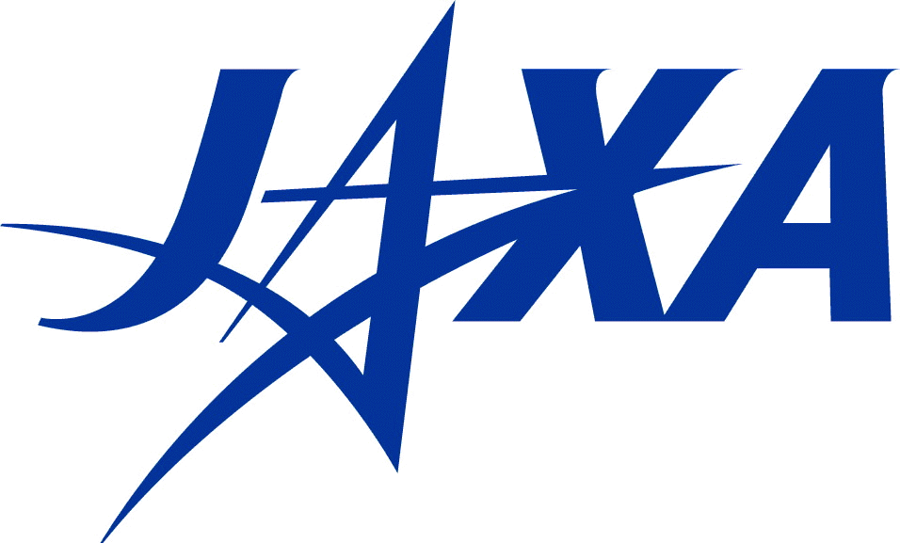

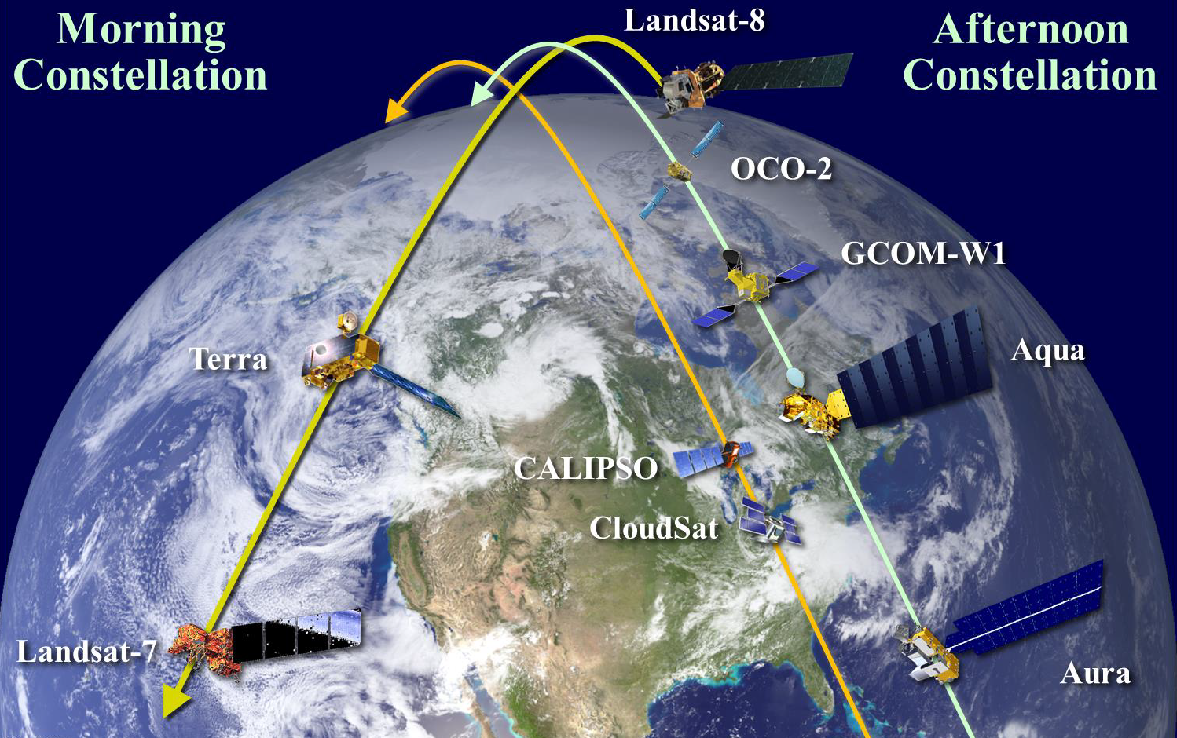
International Earth Science Constellation
Mission Operations Working Group (MOWG)
September 29 – October 2, 2020
Aqua IAM Fall Series 2020 Updates
Nathaniel Johnson, a.i. solutions
EOS FDS, esmo-eos-fds@lists.nasa.gov, +1.301.614.5050

Slide 2
Agenda
Aqua Fall 2020 Inclination Adjust Maneuver (IAM) Campaign
  Series Summary
  Maneuver Results
  Post-2020 IAM Mean Local Time (MLT) Evolution
Aqua’s Recent IAM Performance
Aqua Spring 2021 IAM Campaign Dates and Planning
Summary

Slide 3
Aqua Fall 2020 Series Summary
Aqua performed 3 inclination maneuvers, IAMs #71-73, on August 20th, September 10th, and September 17th.
The IAMs each used the 560-second burn duration set in 2018
  Keeps Aqua within the “mission goal” MLT constraints.
Aqua continued to use the Reaction Wheel Assembly (RWA) to slew to perform the maneuvers.
Aqua yaw offset trend is maintained.
  Yaw offset achieved of -3.0453 degrees on August 20th IAM# 71
The total IAM series performance was 0.823% cold.

Slide 4
Aqua Fall 2020 Series Results
IAM # | Date | Commanded Yaw (deg) | Achieved Yaw (deg) |  | Delta Velocity (m/s) |  | Delta Inclination (deg) |  | Delta RAAN* (deg)
 |  |  | Predicted | Definitive | Predicted | Definitive | Predicted | Definitive | Predicted | Definitive
71 | Aug 20 | -79.4 | -78.5059 | -78.5519 | 0.8118 | 0.8033 | -0.006075 | -0.006025 | 0.000359 | 0.000347
72 | Sep 10 | -79.0 | -78.1151 | -78.1151 | 0.8107 | 0.8022 | -0.006070 | -0.006020 | -0.000010 | -0.000010
73 | Sep 17 | -79.0 | -78.1151 | -78.1151 | 0.8087 | 0.8002 | -0.006050 | -0.006000 | -0.000010 | -0.000010
 |  |  |  |  |  |  | Total: | -0.018045 | Total: | 0.000327
 |  |  |  |  |  |  | % Error | 0.823 (Cold)
*Right Ascension of the Ascending Node (RAAN)
Final % Error based on advertised series delta inclination from the Constellation Coordinated Plan (-0.018195 deg)

Slide 5
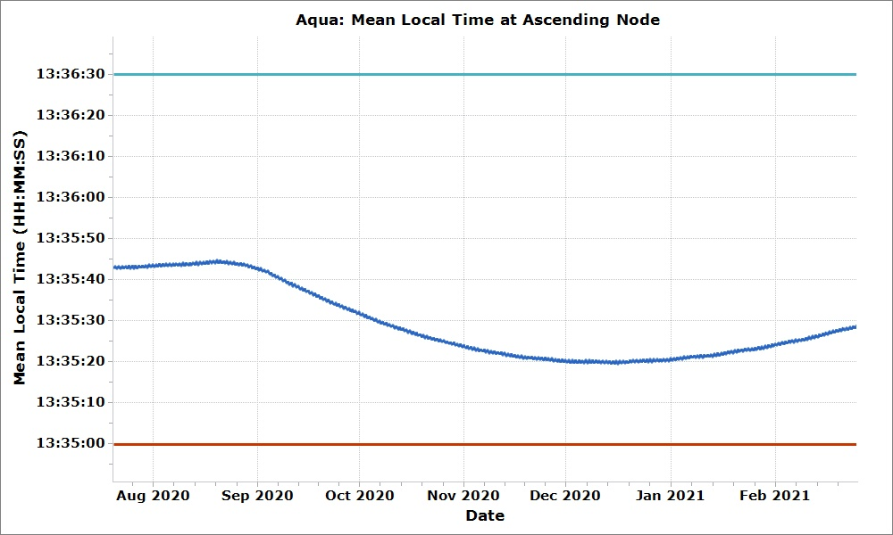
Aqua Post-2020 Series Predicted MLT
Operational Upper Limit (13:36:30)
The achieved MLT rate changes will maintain Aqua within science MLT requirements until the spring 2021 IAM Series; delta-I performance matched predictions closely.
Operational Lower Limit (13:35:00)

Slide 6
Aqua’s IAM Performance (1/3)
Aqua successfully transitioned to using the Reaction Wheel Assembly (RWA) when slewing for the Spring 2020 inclination series and continued to use wheeled slews for the Fall 2020 inclination series.
  RWA slews allow the spacecraft to burn on the node for all IAMs in the series and save fuel when slewing, increasing fuel efficiency.
Aqua’s series performance was less cold than expected based on thruster test results and thruster degradation predictions.
  A recent on-orbit thruster test fire confirms that there has been thruster degradation, but teams are still working to accurately predict its effects.
  Data from the 2020 Fall Series will be used to more accurately predict performance of future maneuvers.

Slide 7
Aqua’s IAM Performance (2/3)
2020 IAMs
Roll and Pitch continue to drift from their historic mean but remain within family for the current trend. Yaw remains consistent with previous RWA IAMs.
RWA slewed IAMs have two values for yaw offset, the yaw error from telemetry (grey) and calibrated yaw (red). The calibrated yaw is the angle necessary to achieve the delta-SMA observed.
Notes:
-Mention Aqua inclination procedure (slew out, inc, slew back)
-Maneuver working group analyzing man parameters etc.

Slide 8
Aqua’s IAM Performance (3/3)
2020 IAMs
Large jump in efficiency caused by switching to slewing on the Reaction Wheel Assembly

Slide 9
Aqua Spring 2021 IAM Campaign Planning
The Aqua Spring 2021 IAM plan consists of 4 inclination maneuvers.
  Burns will continue to slew using the RWA
  Since burn can be centered on node with RWA slewed maneuvers, the ideal date is no longer a factor in efficiency
  Proposed Plan –
    February 25 (IAM #74)
    March 04 (IAM #75)
    March 11 (IAM #76)
    March 18 (IAM #77)
As planned, IAM #77 will be the final inclination maneuver performed before Constellation Exit in January 2022.

Slide 10
Proposed Aqua/Aura 2021 Maneuver Schedule
Sunday | Monday | Tuesday | Wednesday | Thursday | Friday | Saturday
February 21 | 22 | 23 | 24 Aura IAM #71 | 25 Aqua IAM#74 | 26 | 27
28 | March 1 | 2 | 3 Aura IAM#72 | 4 Aqua IAM#75 | 5 | 6
7 | 8 | 9 | 10 Aura IAM#73 | 11 Aqua IAM#76 | 12 | 13
14 | 15 | 16 | 17 Aura IAM#74 | 18 Aqua IAM#77 | 19 | 20*
21 | 22 | 23 | 24 Aura Back-up | 25 Aqua Back-up | 26 | 27
28 | 29 | 30 | 31 | April 1 | 2 | 3
4 | 5 | 6 | 7 | 8 | 9 | 10
* Spring Equinox on March 20

Slide 11
Predicted Maneuver Performance – Reaction Wheel Slewed
IAM # | Date | Commanded Yaw* (deg) | Duration (sec) | Delta SMA** (m) | Delta Inclination (deg) | Delta RAAN (deg) | Delta Velocity (m/s)
74 | Feb 25 | -79.16 | 560 | 0.2145 | -0.00590 | 0.00113 | 0.8030
75 | Mar 04 | -79.16 |  | 0.2145 | -0.00594 | 0.00083 | 0.8011
76 | Mar 11 | -79.16 |  | 0.2174 | -0.00596 | 0.00051 | 0.7991
77 | Mar 18 | -79.16 | 200 | 0.1805 | -0.00216 | -0.00001 | 0.2849
 |  |  |  | Total: | -0.01996
*Preliminary angles
**Semi-Major Axis (SMA)
Performance estimates based on average RWA data from the 2020 Spring IAM series.
  Small number of RWA slewed IAMs limits ability to effectively trend data. Further predictions using the data from the Fall series will be used to form new predictions

Slide 12
Summary
The 2020 Fall IAM series did not exhibit the same degrading performance observed in the Spring IAM series.
  Further investigation by FDS and FOT is underway
Aqua is predicted to remain within the “mission goal” MLT constraint up to and during the 2021 IAM series.
The 2021 IAM series will have 4 maneuvers in the Spring and is predicted to push Aqua low in its MLT box.
  The 2021 Spring Series will be the final IAM series until Constellation Exit.
The predicted 2021 IAM series may be updated after further analysis of the observed 2020 Fall IAM series and continued analysis of thruster degradation.
  FDS predictions currently allow Aqua to remain in constellation through January 2022.
Notes:
Updated parameters will be sent out as necessary

