Slide 1
Aqua vs TanSat – Long-Term Analysis
September 29 – October 2, 2020
Eliot Toumey, a.i. solutions, Inc.
EOS FDS, esmo-eos-fds@lists.nasa.gov

Slide 2
Agenda
Background
Schatten Solar Flux Predictions
Predicted Phase Crossings
Orbital Elements Comparison
Synodic Period

Slide 3
Background
Long-term Aqua/TanSat assessment
TanSat Ephemerides
  Generated by propagating state file from Aug 18 2020.
  State propagated for 3 years with May 2020 Schatten solar flux profiles:
    Plus 2-σ, Early (+2-σ of uncertainty, early timing for next solar maximum)
    Mean, Nominal (mean uncertainty with nominal timing for next solar maximum)
    Minus 2-σ, Late (-2-σ of uncertainty, late timing for next solar maximum)
  Assumption of no maneuvers

Slide 4
Background
Aqua Lifetime Ephemeris from Spring 2020 lifetime and decommissioning analysis
  Ground Track Error and Mean Local Time maintenance through nominal Constellation Exit in January 2022.
  May 2020 Mean, Nominal Schatten solar flux profile
  Fall 2020 Inclination Adjust Maneuvers (IAM) modeled according to the original plan (no waived maneuvers)
    3 IAMs
    Burn durations: 560 sec
  Spring 2021 IAMs included
    4 IAMs
    Burn durations: 3 IAMs at 560 sec and 1 IAM at 200 sec

Slide 5
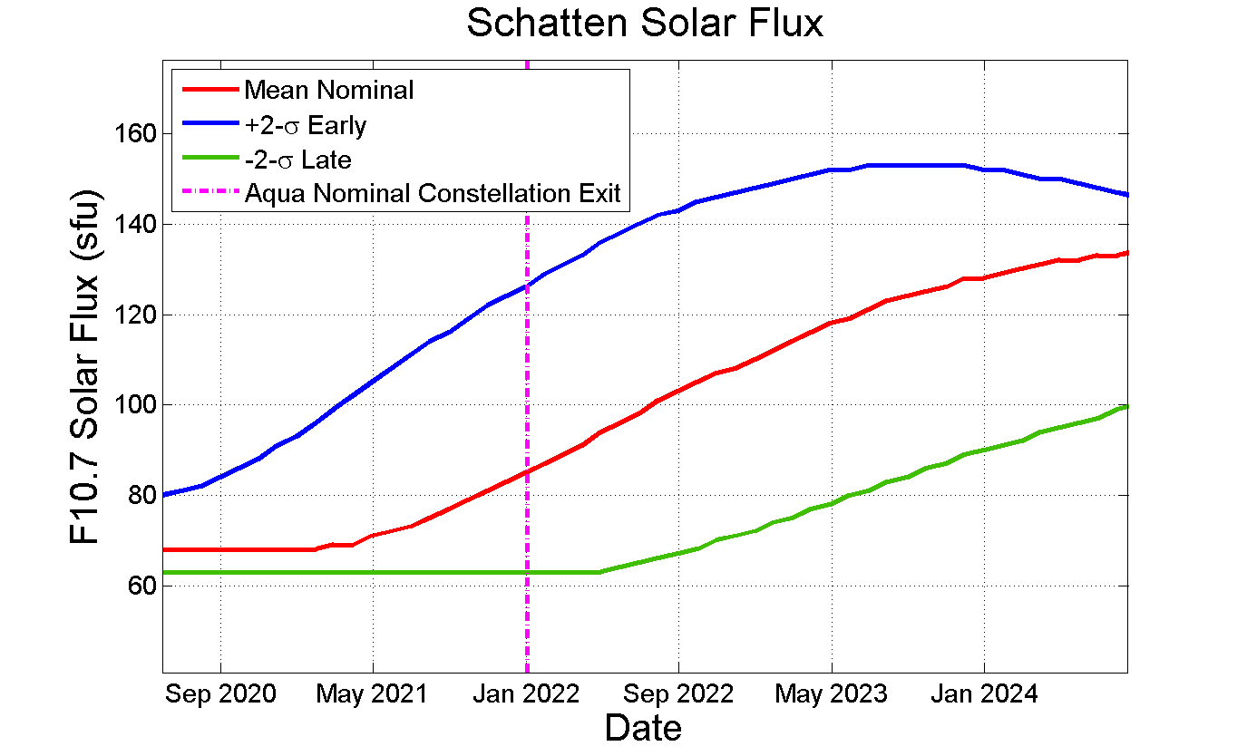
Schatten Solar Flux Predictions

Slide 6
Next Phase Crossing
One predicted crossing in the analysis span before Aqua Constellation Exit
Past Crossings : Future Predicted Crossings:
Plus-Early | Mean-Nom | Minus-Late
- | Sep 11 2019 | -
- | May 10 2020 | -
Mar 18 2021 | Mar 05 2021 | Mar 03 2021

Slide 7
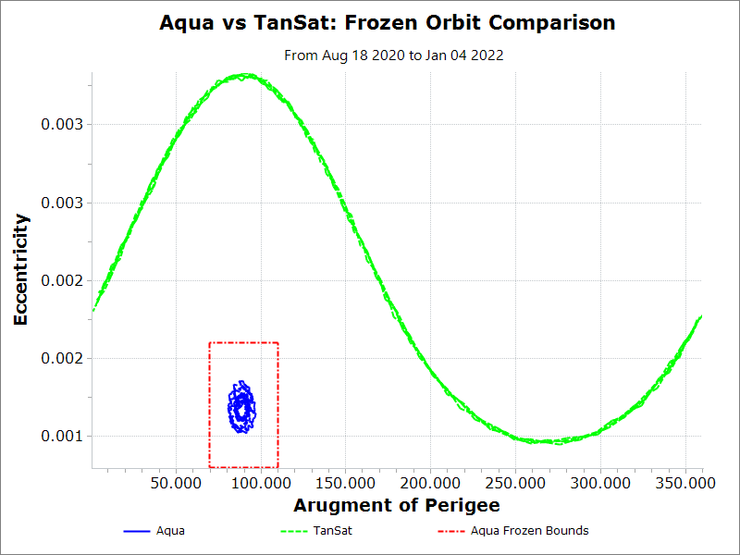
Frozen Orbit Comparison
TanSat
Frozen Orbit comparison prior to Aqua Constellation Exit and Perigee-Lowering Maneuvers
Aqua

Slide 8
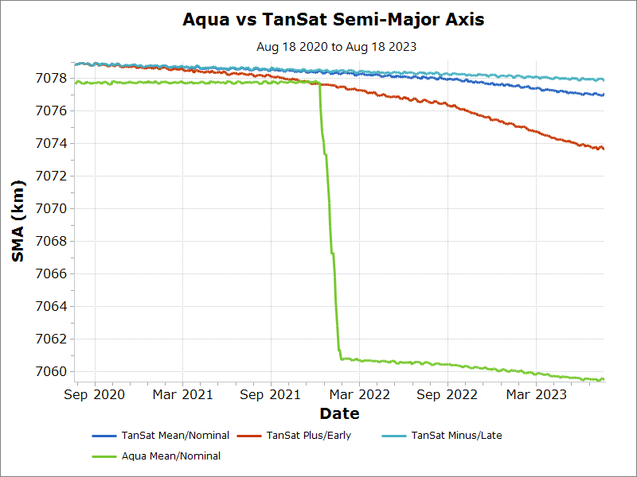
Semi-Major Axis Comparison
-2σ-Late Timing
Mean-Nominal Timing
+2σ-Early Timing
Aqua Nominal Constellation Exit

Slide 9
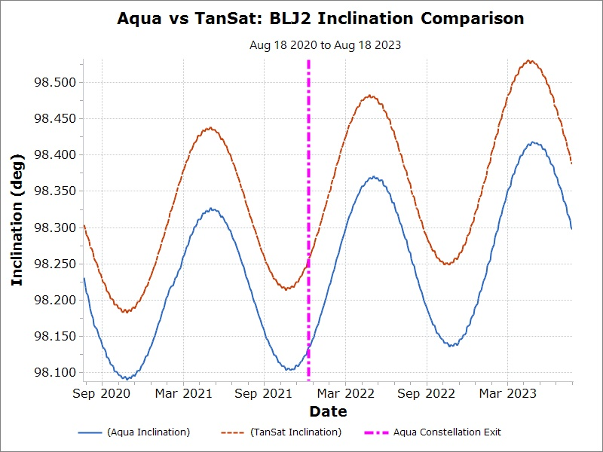
Inclination Comparison
TanSat
Aqua

Slide 10
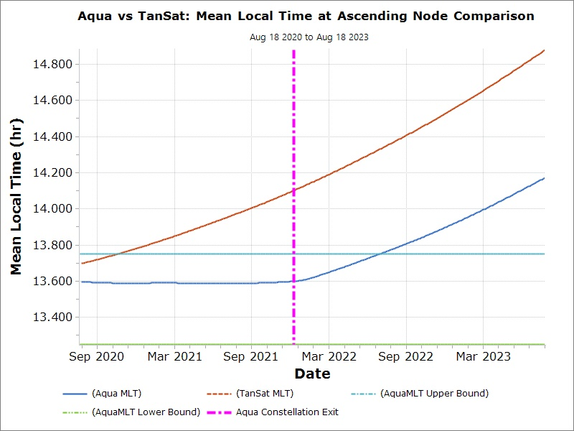
Mean Local Time Comparison
TanSat
Aqua

Slide 11
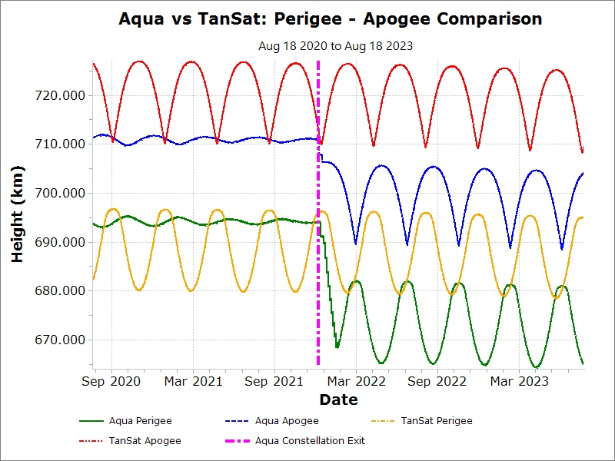
Perigee-Apogee Comparison
TanSat
Aqua

Slide 12
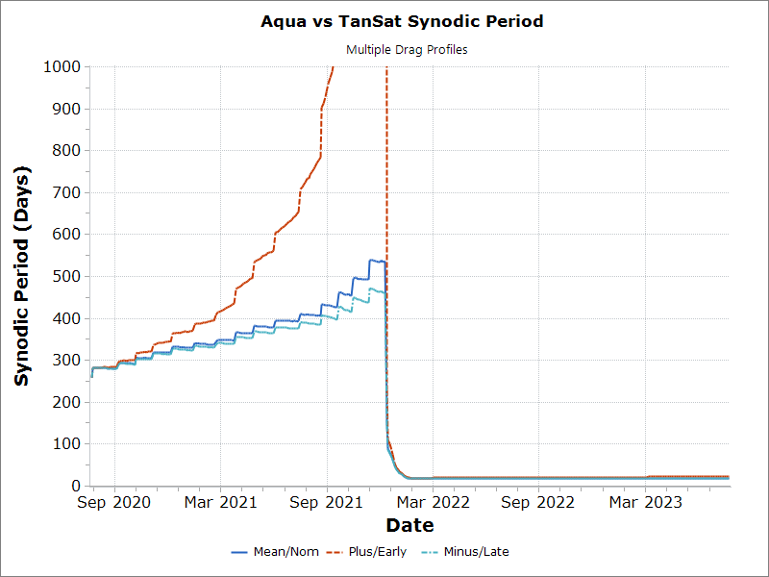
Synodic Period
Mean Nominal Synodic Period at Constellation Exit is approximately 550 days

Slide 13
Conclusions
TanSat is predicted to cross Aqua one time prior to Aqua’s Nominal Constellation Exit in January 2022
There is no predicted TanSat phase crossing near Aqua’s Nominal Constellation Exit Date.
The Mean Nominal Synodic period at Constellation Exit is around 550 days.

Slide 14
Backup

Slide 15
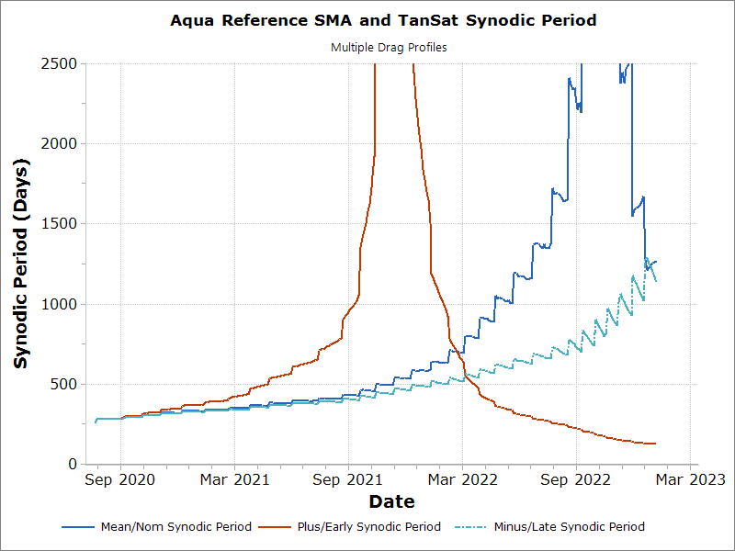
Synodic Period
Aqua Ephemeris with Ground Track Error Maintenance only used for reference SMA in the synodic period computation.

