Slide 1



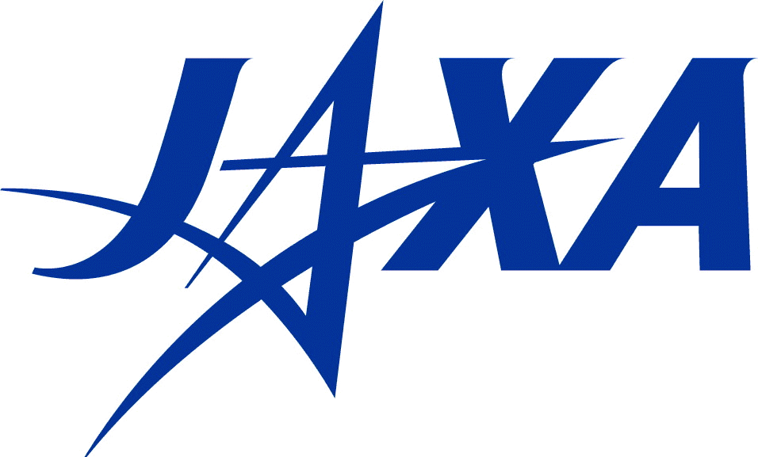

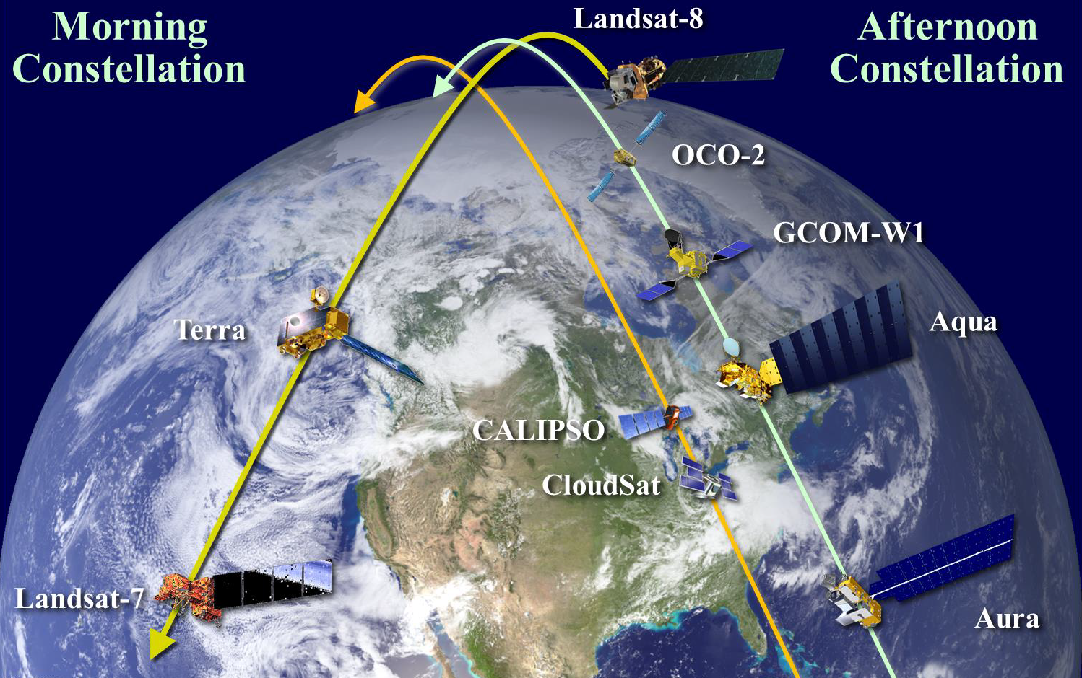
International Earth Science Constellation
Mission Operations Working Group (MOWG)
September 29 – October 2, 2020
Aura IAM Fall Series 2020 Updates
Nathaniel Johnson, a.i. solutions
EOS FDS, esmo-eos-fds@lists.nasa.gov, +1.301.416.5050

Slide 2
Agenda
Recap Aura Fall 2020 Inclination Adjust Maneuver (IAM) Campaign
  Series Summary
  Maneuver Results
Aura’s IAM Performance Trends
2021 IAM Campaign Dates and Planning
Aura Latest Lifetime MLT Predictions

Slide 3
Aura Fall 2020 Series Summary
Aura performed three inclination maneuvers, IAMs #68-70, on August 19th, September 9th, and September 16th.
As in the 2019 series, Aura’s Reaction Wheel Assembly (RWA) was successfully utilized to slew to the desired angle for the inclination maneuver.
For the Fall, results from the 2019 IAM Series were used as predictions.
The delta-inclination from IAM #68 was close to predictions and the maneuver was 0.788% cold.

Slide 4
Results
IAM # | Date | Burn Dur (sec) | Commanded Yaw (deg) | Achieved Yaw (deg) |  | Delta Inclination (deg) |  | Delta RAAN* (deg)
 |  |  |  | Predicted | Definitive | Predicted | Definitive | Predicted | Definitive
68 | Aug 19 | 200.0 | -77.6 | -75.7229 | -75.5958 | -0.00358 | -0.00355 | -0.00001 | 0.00001
69 | Sep 9 | 415.0 | -75.3 | -75.4048 | -75.4048 | -0.00745 | -0.00739 | -0.00001 | -0.00001
70 | Sep 16 | 415.0 | -75.3 | -75.4048 | -75.4048 | -0.00743 | -0.00737 | -0.00001 | -0.00001
*Right Ascension of the Ascending Node (RAAN) |  |  |  |  |  | Total: | -0.018314 | -0.00001
Aura’s achieved delta-inclination for the series was 0.783% COLD, based on the Constellation Coordinated Plan

Slide 5
Aura Fall 2020 Performance Trends
The roll and pitch attitude errors during the burn have continued the trend of previous maneuvers
The yaw offset has once again flipped signs from previous maneuvers but is much lower in magnitude.
  More positive semi-major axis change was achieved than predicted
The delta-inclination efficiency of the Fall IAMs was in family with the Spring series

Slide 6
Aura’s IAM Performance (1/2)
2020 IAMs
INC #68’s yaw offset value has once again flipped signs.
RWA slewed IAMs have two values for yaw offset, the yaw error from telemetry (grey) and calibrated yaw (red). The calibrated yaw is the angle necessary to achieve the delta-SMA observed.

Slide 7
Aura’s IAM Performance (2/2)
2020 IAMs
The inclination efficiency has remained consistent with the previous RWA slewed IAMs

Slide 8
Aura Spring 2021 IAM Campaign Planning
The Aura Spring 2021 IAM plan consists of 4 inclination maneuvers
Since burn can be centered on node with RWA slewed maneuvers, the ideal date is no longer a factor in efficiency
  Proposed plan –
    February 24 (IAM #71)
    March 3 (IAM #72)
    March 10 (IAM #73)
    March 17 (IAM #74)
Dates are set so Aura maneuvers a day before Aqua
Five maneuvers are planned for the Fall 2021 IAM campaign in addition to the Spring 2021 IAMs.

Slide 9
Proposed Aqua/Aura 2021 Maneuver Schedule
Sunday | Monday | Tuesday | Wednesday | Thursday | Friday | Saturday
February 21 | 22 | 23 | 24 Aura IAM #71 | 25 Aqua IAM#74 | 26 | 27
28 | March 1 | 2 | 3 Aura IAM#72 | 4 Aqua IAM#75 | 5 | 6
7 | 8 | 9 | 10 Aura IAM#73 | 11 Aqua IAM#76 | 12 | 13
14 | 15 | 16 | 17 Aura IAM#74 | 18 Aqua IAM#77 | 19 | 20*
21 | 22 | 23 | 24 Aura Back-up | 25 Aqua Back-up | 26 | 27
28 | 29 | 30 | 31 | April 1 | 2 | 3
4 | 5 | 6 | 7 | 8 | 9 | 10
*Spring Equinox on March 19

Slide 10
Predicted Maneuver Performance
Inc # | Date | Commanded Yaw* (deg) | Duration (sec) | Delta SMA** (m) | Delta Inc (deg) | Delta RAAN (deg)
71 | Feb 24 | -75.3 | 315 | 4.64771 | -0.00559 | -0.00001
72 | Mar 03 |  |  | 4.64281 | -0.00558 | -0.00001
73 | Mar 10 |  |  | 4.63728 | -0.00557 | -0.00001
74 | Mar 17 |  |  | 4.63204 | -0.00556 | -0.00001
 |  |  |  | Total: | -0.0223 | -0.00004
*Preliminary angles
**Semi-Major Axis (SMA)
The above predictions are based on maintaining phasing with the nominal Aqua plan until Aura performs the 2021 Fall IAM series.

Slide 11
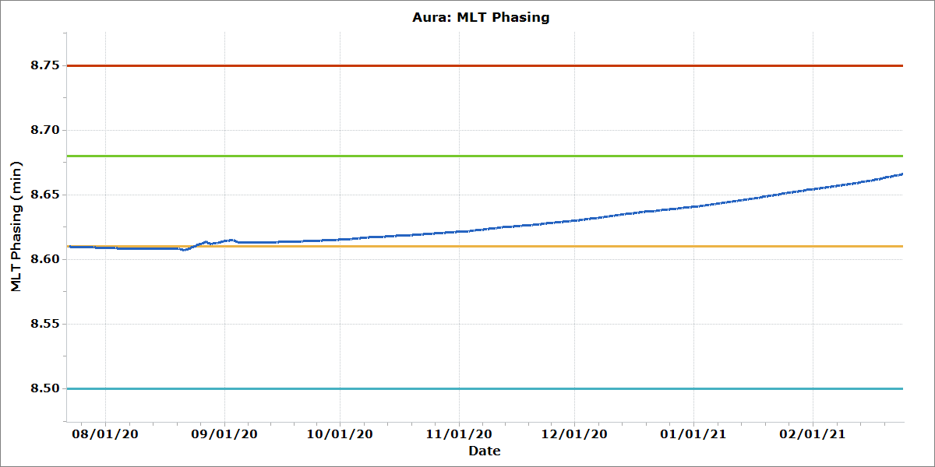
Predicted Post- Fall 2020 IAM MLT
Upper Phase Limit
The Aura MLT phasing is predicted to be maintained through the next series
Target Range
Phase Center

Slide 12
Summary
Similar to the Spring series and previous Fall series, Aura used the RWA to slew to the necessary angle for IAMs #68-70
Aura’s maneuver performance for the 2020 Fall IAM Series was 0.783% cold.
The Spring 2021 IAM series will have 4 maneuvers and is predicted to keep Aura near the middle of the MLT phasing control box prior to the Fall 2021 series.

