Slide 1



Lessons Learned: Using UTM paradigm for Urban Air Mobility Operations
Savvy Verma (NASA)
Christabelle Bosson (Uber)
This material is a work of the U.S. Government and is not subject to copyright protection in the United States.
Notes:
Lag due to not seeing slides right away

Slide 2
Co-Authors
NASA
Spencer Monheim
Kushal Moolchandani
Priyank Pradeep
Annie Cheng
David Thipphavong
Victoria Dulchinos
Heather Arneson
Todd Lauderdale
Uber
Eric Mueller
Bogu Wei
Notes:
Acknowledge Software team

Slide 3
Background

Slide 4
Why Urban Air Mobility?
Improve mobility
Decongest Road traffic
Reduce transport time
Reduce strain on public transit systems
Reduce traffic accidents
Photo: Noah Berger
Notes:
UAM refers to operations in the metro area ranging from 25-50 miles and

Slide 5
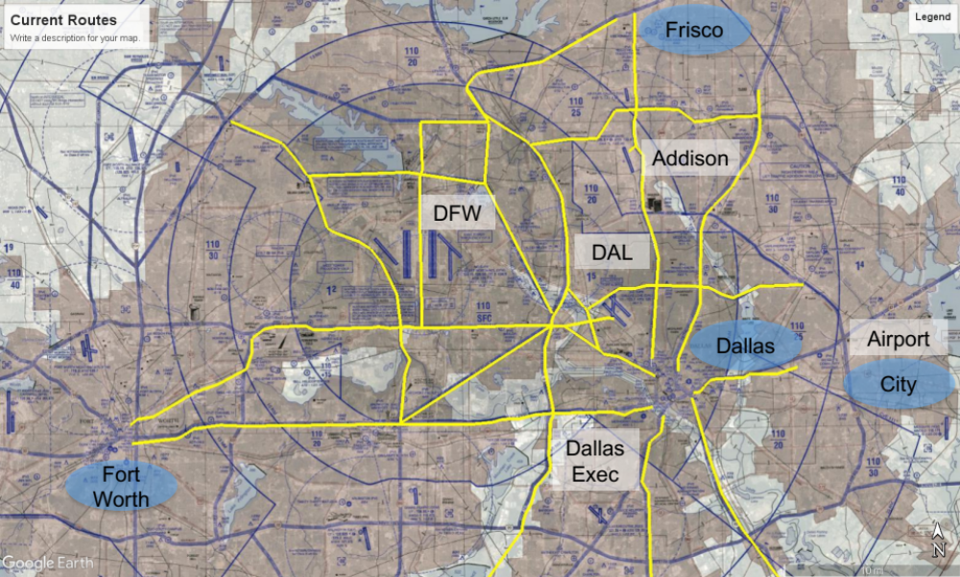
Problem Statement
Explored procedures for accessing controlled airspace using current day helicopter routes and procedures
  Limitations in scalability
  Digital communications change nature of workload not reduce workload
Current day helicopter routes in Dallas Area
Need to explore alternative solutions that could scale UAM operations in the NAS

Slide 6
Presentation Roadmap
Background: FAA UAM Concept
Experiment Setup
Results
Summary and Next Steps

Slide 7
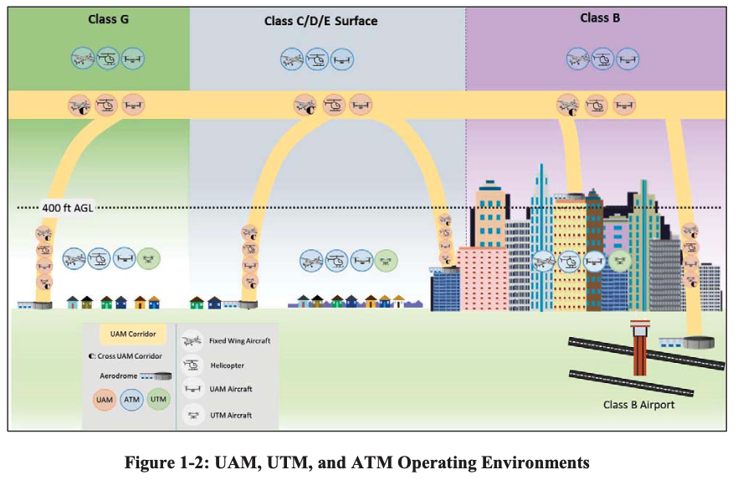
FAA UAM Concept
Air traffic management vision for near-term UAM operations
FAA-defined UAM corridors with specific performance requirements
Aircraft operator connection to a “Provider of Services for UAM” (PSU) will be required
Separation within corridors assigned to pilots, operators, and PSUs, not ATC
UAM operations will start with today’s rules and procedures and evolve to incorporate Community-Based Rules (CBRs)
FAA Conops was published in June 2020, this study used assumptions that were built in collaboration with the FAA
Notes:
These did not exist but most of these were used for assumptions for X2
The FAA's conops was developed in part through "round tables" with government/industry/academia, and what we learned in X2 was communicated during several of those round tables. So alignment between the FAA’s and X2’s conops is not coincidental.
Original bullets:
The FAA retains regulatory authority and is responsible for establishing operational parameters and maintaining oversight
There will be high-density routes/corridors for UAM operations
The FAA will have on-demand access to information regarding UAM operations
The FAA reserves the right to increase individual aircraft operational performance requirements in order to optimize the capacity utilization

Slide 8
Experiment Setup

Slide 9
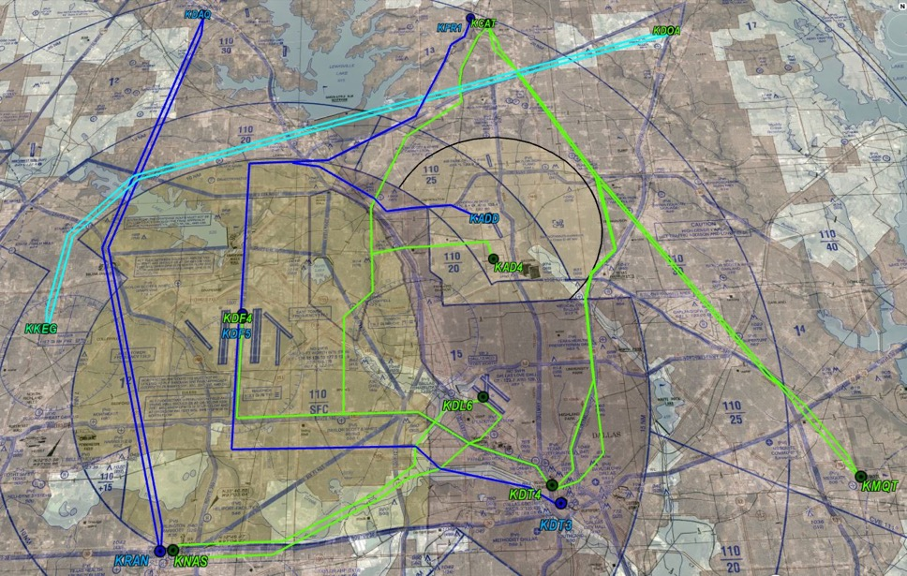
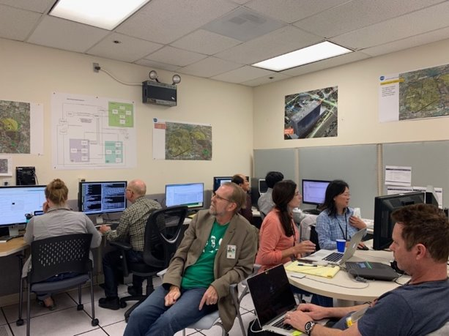
Overview of Engineering Evaluation
Goal: Develop a UAM airspace system extended from UTM TCL4 implementation and determine if it can enable the information exchange required between simultaneous UAM operations by multiple operators in shared airspace
Approach: Conduct joint NASA-Uber lab evaluation using the UAM airspace system
NASA/Uber Vertiport/Routes
NASA-Light Green
Uber-Blue
NASA route in light blue has shared resources with Uber routes
* Routes were planned for testing only and are not representative of operations
Engineering Evaluation conducted at NASA Ames
Notes:
Routes in Class B/D are for testing NASA and Uber services and are not representative of operational routes
Aircraft are equipped to navigate routes​
All operations will fly along these routes between sites that are known and acceptable to the local ANSP and communities
UAM operations can access Class B, C, or D airspace without first receiving a verbal clearance or making verbal contact with ATC
Aircraft are equipped to navigate routes​

Slide 10
Extending UTM TCL4 Implementation to UAM
Collaborated with UTM TCL4 team to identify issues and develop solutions for UAM Use Cases
UTM | UAM
Airspace access constrained in controlled airspace | Airspace access will be needed in controlled airspace
Length of Transit-Based Operational Volumes (TBOVs) : 6000 ft (~1 nmi) | Length of TBOV: 100,000 ft (~ 16 nmi)
*TCL-4: Technical Capability Level-4
Notes:
Constraints in controlled airspace since operations are primarily in uncontrolled
Removed constraints in controlled airspace since operations will need access to controlled airspace

Slide 11
Multiple UAM Operators: Use Cases
Explore UAM operations in shared airspace conducting safe and efficient operations
Multiple UAM operators in shared airspace
A: Managing to separate constrained resources
B: Managing to the same constrained resources in a strategic timeframe
C: Managing to the same constrained resources in a tactical timeframe due to a contingency
Notes:
We're exploring how UAM interoperate after authorization been granted,

Slide 12

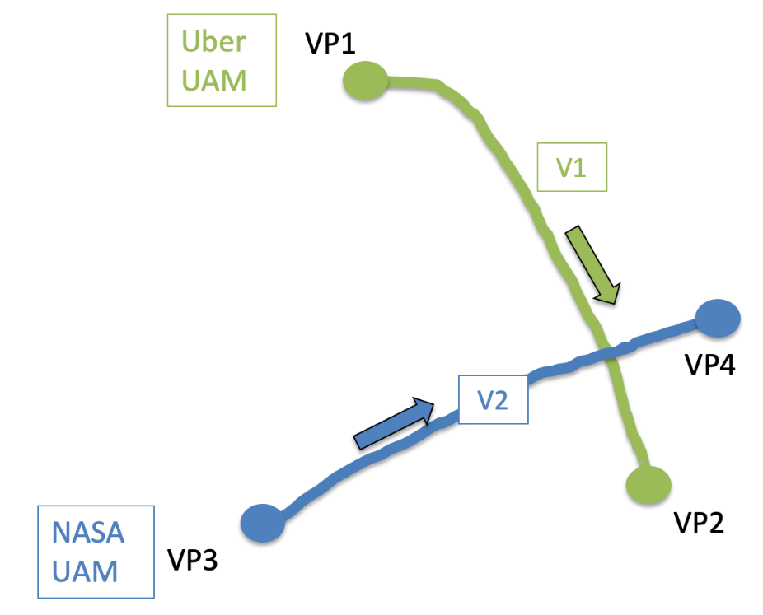
Use Case B
Use Case B: Multiple UAM operators managing to the same constrained resources in a strategic timeframe
The cyan route allows for multiple NASA/Uber conflicts
Uber anticipates having high demand on the blue routes that intersect the cyan route
Both NASA and Uber need to schedule and separate their own flights and share operational information with each other
Notes:
The routes are all at 500 AGL and 1000 AGL in the opposite direction​
Indicated airspeed is assumed to be between 110-140 knots​

Slide 13
Operational Volume Parameters
Width
Vertiport B
½ Height
Vertiport A
Length
 | Length | Width | Height
NASA | 60 sec | 1500 ft | 500 ft
Uber | Waypoint-dependent | 150 ft | 200ft
Notes:
Take-away: implications for operations
Volume dimensions depend on RNP of UAM operations
The length of the volume segment affects aircraft sequencing and impacts capacity on routes
RNP planned, length of time affects the sequence aircraft – capacity issues,
Flight planning vs. piloted vehicles
Notes:
Each waypoint must be the start / end points of TBOV no longer required
Each TBOV has buffers: default + conformance buffer (UTM param) + protective buffer (UTM param)
For consecutive waypoints farther than 1 minute apart, additional TBOVs need to be created
To account for turns at the waypoint, TBOVs should be in shape of trapezoid instead of rectangles (curve)

Slide 14
Services
Uber USS/PSU
Basic Services
Route Generation Service
Operation Management Service
Operation Volume Service
Flight Monitoring Service
Vehicle Integration Service
NASA USS/PSU
Basic Services
Target Generator
Fleet Operator (Operational Management and Volume Generation service)
Additional/Optional Services
Scheduling Service (Network Scheduler or NS)
Separation Service (Auto Resolver or AR)
*PSU= Provider of Services for UAM

Slide 15
Experiment Setup
 | Basic Services only (Baseline) | NASA uses Scheduling Service (NS) | NASA uses Separation Service (AR) | NASA uses NS and AR
Use Case A
Use Case B
Use Case C
12 combinations of simulations
NASA and Uber agreed to
  Overlap their operational 4D volumes
  Disable the negotiation function
Notes:
Position messages exchanged between NASA and Uber at a rate of 1 hz
Disable the negotiation function, in order to leverage other separation services

Slide 16
Experiment Setup
Use Case B:
  Uber submitted operational volumes on the crossing fixes about 6 min prior to departure time
  NASA scheduling service conditioned the NASA traffic flows using the Uber operations as fixed constraints (pre-departure)
Traffic Scenarios
  40 minutes per simulation run
  110 NASA UAM operations
  85 Uber UAM operations
  No non-UAM traffic
  Vertiports assumed to have a 1-nmi “bubble” around the vertiport
Notes:
See if I can create a table here
Arrival compression taken into account for the vertiport bubble

Slide 17
Separation Minima
Service | NASA to NASA flights | NASA to Uber flights
Scheduling Service
In-trail | 45 sec | NA
Crossing points | 15 sec | 15 sec either side of op vol
Separation Service
Lateral | 1200 ft | 750 ft from op vol
Vertical | 400 ft | 250 ft from op vol
Notes:
Shuld know the reasons for this:
400 ft

Slide 18
Results
Use Case B Only
Notes:
Centered on volumes / TBOV and its differences

Slide 19
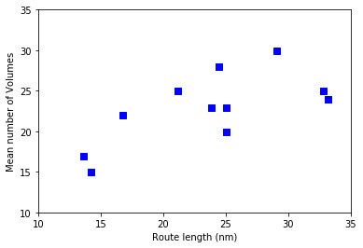
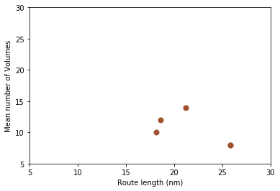
Volumes per Operation per Route
NASA
Uber
UAM Operations will use pre-defined routes, thus length and structure of routes will impact number of operational volumes
Notes:
UAM ops will be on structured routes
Number of volumes per operation per route proportional to the length of the route and depends on the route structure
Flight route length depends on the route structure; a route with more turns is likely to have a greater number of waypoints and thus greater number of volumes generated around those waypoints
Uber had four flight routes (fewer volumes per route because volumes generated based on waypoints vs. NASA had more volumes per route because volumes generated for fixed flight time 60 seconds)

Slide 20
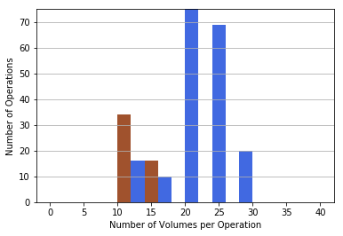
Number of Volumes per Operation with Basic Services (Baseline)
Uber
NASA
Different operators in the real world will make different design choices that will impact the number of volumes per operation
Notes:
Different operators in the real world will make different design choices- time based choices made by NASA (up to 60 sec) and waypoint based by Uber, that allowed overlapping
NASA operated on more routes than Uber
NASA and Uber differ in number of volumes per operation due to using different volume generation (e.g., lengths)
The difference in the volume generation – less than 60 sec for volumes
Uber: Longer volumes based on waypoints,

Slide 21
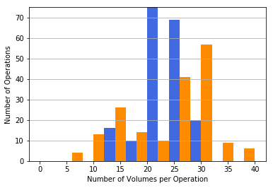
Number of Volumes per Operation with Additional Services
NASA Only
Scheduling & Separation Services
Basic Services
Design of additional/optional services should account for the additional volumes per operation that would be submitted and communicated to other UAM operators
Notes:
NASA used both scheduling and separation services to condition and manage NASA traffic, more volumes were submitted due to increased flight length and complexity, also due to resolution maneuvers
Pertinent to NASA operations only
NASA used both scheduling and separation services to condition flow

Slide 22
Considerations for Design of Operational Volumes
UAM operational volumes are built around pre-defined routes
The size and number of operational volumes are inversely proportional
Small size volumes pose challenge for conformance monitoring
Operators can make different design choices:
  Time-based vs. Waypoint-based
  Overlapping volumes allows for longer volumes shared between operations
Recommend hybrid approach where longer volumes are built on straight route segments, time-based volumes are designed over crossing points

Slide 23
Summary

Slide 24
Summary and Next Steps
Summary
This engineering evaluation demonstrated that the UTM architecture is scalable for UAM operations
NASA and Uber were able to conduct simultaneous UAM operations in shared airspace using their own respective services
The design of the operational volumes is likely to have an effect on system performance
Future Research:
Identify data exchanges between different actors in UAM ecosystem
Explore the use of a pointer to a pre-defined set of frequently-used 3D volumes
Investigate use of Scheduled Time of Arrival (STA) as an alternative to scheduling of volumes
Interactions with non-UAM (e.g., small Unmanned aircraft, General Aviation)
Explore interactions with ATC and pilots
Notes:
Separation: Time required to submit and receive authorization for the new operational volumes of a resolution maneuver on the order of several seconds could require the algorithm to take this delay into account
Next Steps: 1) Basic Services, 2) Advance Services, 3) concept
An alternative to pre-departure scheduling of volumes is the use of scheduled times of arrival at merge points and crossing points that could also be achieved tactically
is the use of scheduled times of arrival at merge points and crossing points

Slide 25
Thank you !
savita.a.verma@nasa.gov
cbosson@uber.com

Slide 26
Bibliography (Images)
San Francisco Traffic by Noah Berger, Source: https://www.sfgate.com/traffic/article/bay-area-worlds-worst-traffic-study-2018-13614431.php. Image used by permission of creator, text applied on bottom of image on slide 4.

