Slide 1
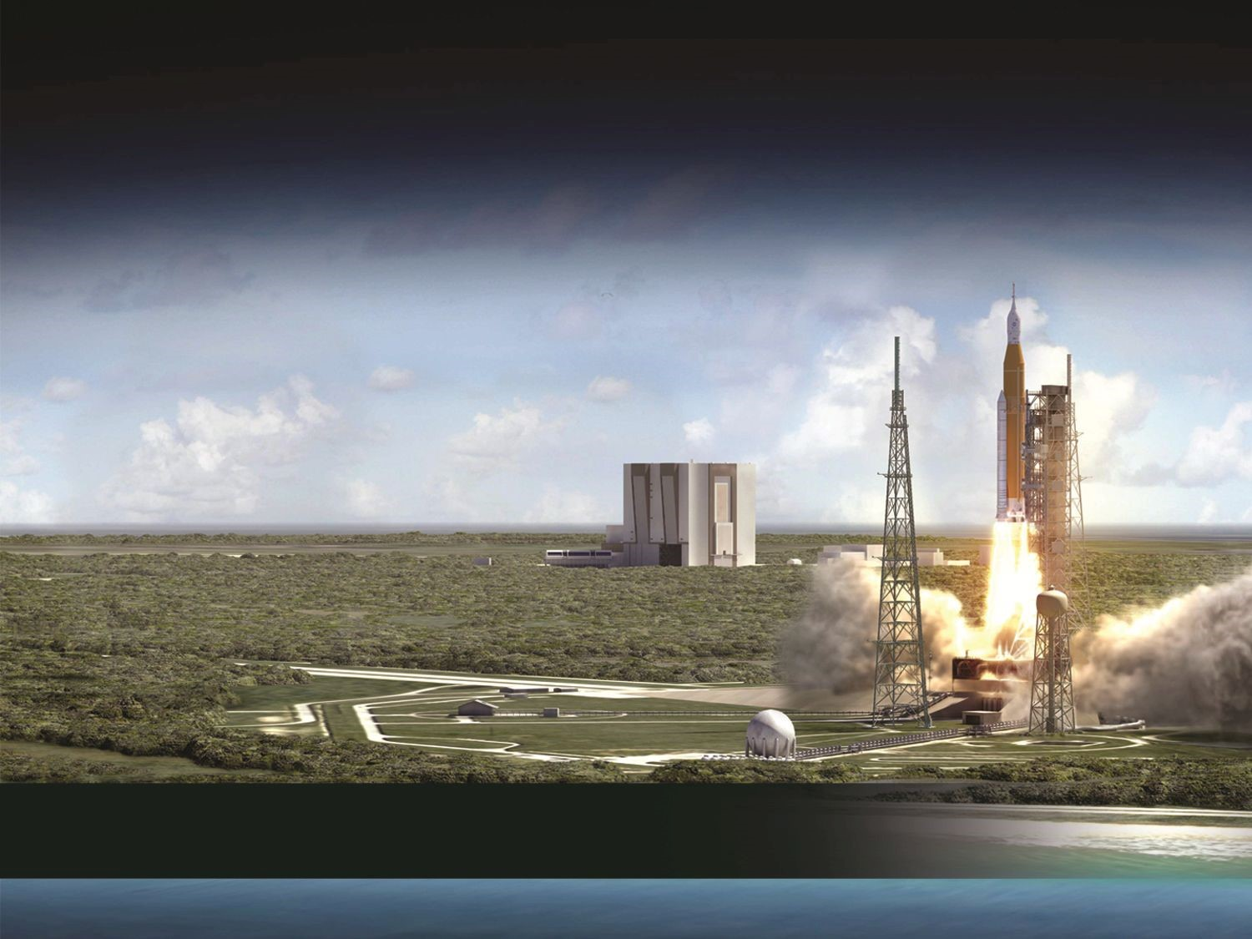
KSC Engineering Directorate -
Laboratories, Development and Testing Division
“Engineering The Future… Today.”
Vision: To be the First Choice to Engineer the Exploration of Space

Slide 2
Organizational Structure
Engineering Directorate
(NE)
Chief Engineers
Workforce Management
Office (NE-A)
Commercial
Systems Division (NE-C)
Laboratories,
Development & Testing
Division (NE-L)
Technical
Performance &
Integration Division (NE-T)
Exploration Systems
& Operations
Division (NE-X)
2

Slide 3
Organizational Structure
Laboratories,
Development &
Testing Division (NE-L)
Testing
& Design Branch (NE-L1)
Materials & Processes Branch (NE-L4)
Fabrication
& Development Branch (NE-L2)
Exploration Payloads Branch (NE-L5)
Analytical Laboratories Branch (NE-L3)
v
Advanced Engineering Development Branch (NE- L6)
Materials Laboratories Branch (NE-L7)
3

Slide 4

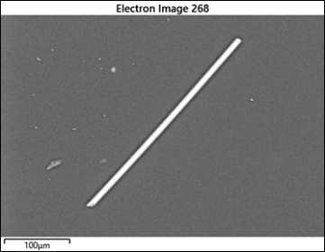
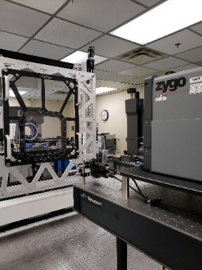
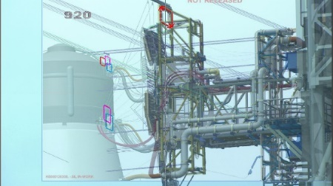
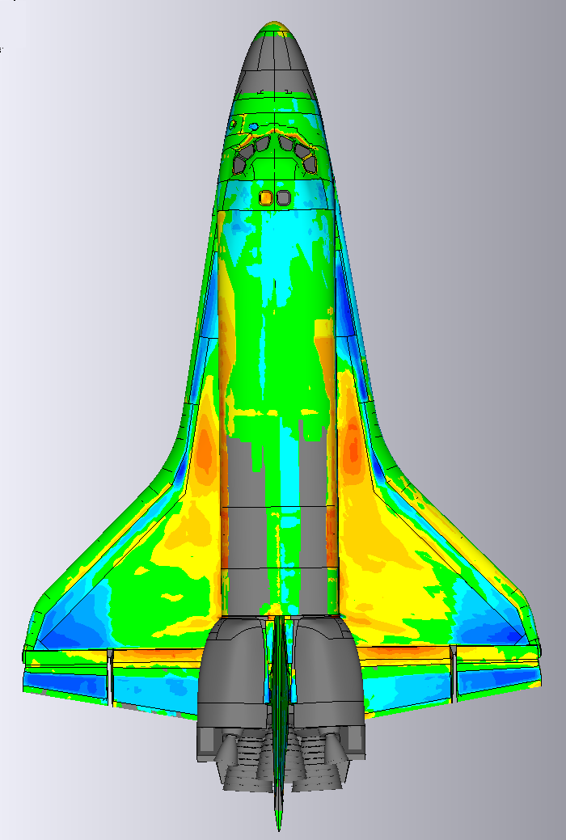
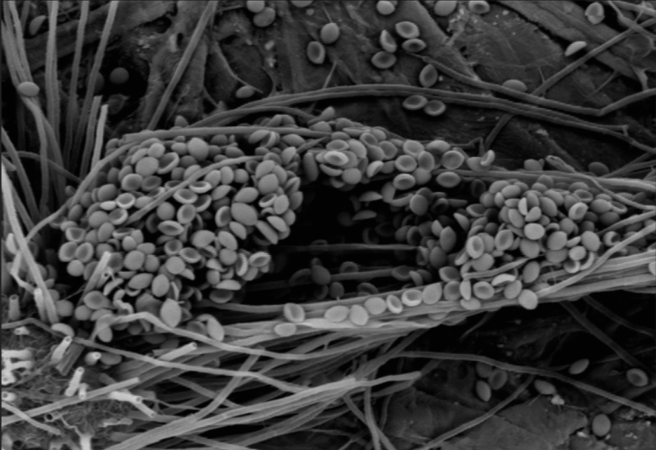
Analytical Laboratories Branch
Advanced Imaging and Analysis
Metrology
Photogrammetry, particle tracking, contour tracing, and image stabilization for anomaly investigations and verification and validation testing
Dimensional analysis on flight hardware, tools, test articles, test fixtures, and ground support equipment for failure analysis
Chemistry and Life Sciences
Precision Measurement & Alignment
Chemical and biological analyses of unknown materials; and ground support research and technology development
Alignment for vehicles and large structures, field metrology and measurements over long distances and on complex geometric shapes

Slide 5
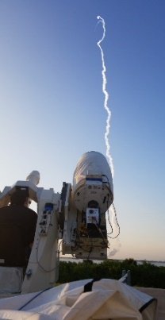
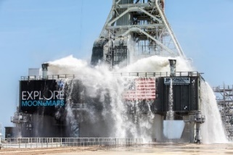
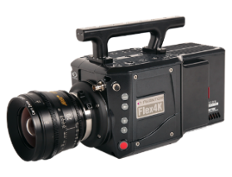
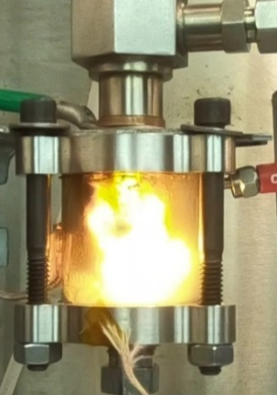
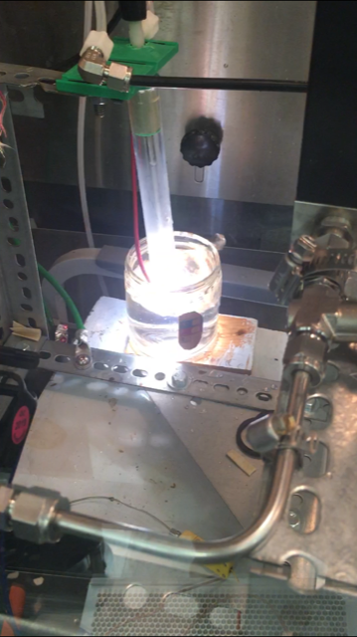
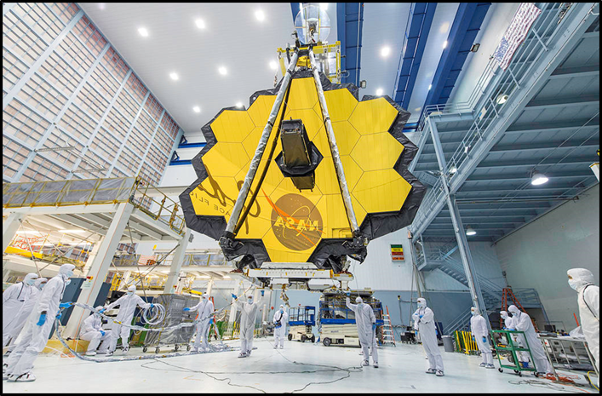
Intern Projects
Univ. of Michigan
Nuclear Eng. & Radiological Sci.
Polytechnic University PR
Chemical Engineering
University of Cincinnati Aerospace Engineering
Plasma waste gasification for spacecraft trash volume reduction and fuel production
Plasma activated water for sanitation
Plasma sanitation of space seeds
Develop novel forced air sampling method for fast sampling and routine identification of unknown contaminants within a cleanroom facility
Scanning electron microscopy with energy dispersive spectroscopy (SEM/EDS) to size for identification of captured particles
Use photogrammetry vs. laser surveying to determine uncertainties on the positions of targets
High speed camera survey
Photogrammetric analysis of sound suppression water flows on the Mobile Launcher
Evaluate high speed camera on a tracker during Orion abort test
5
5

Slide 6
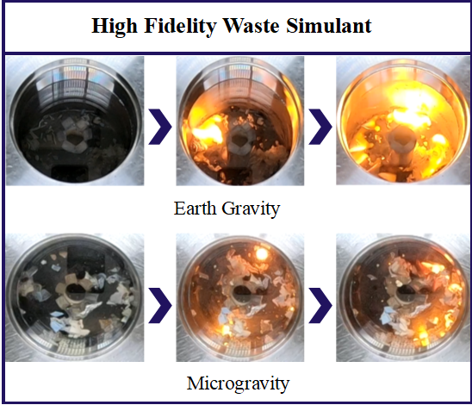
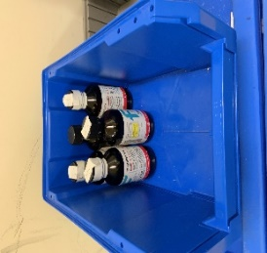
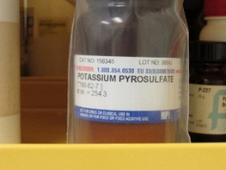
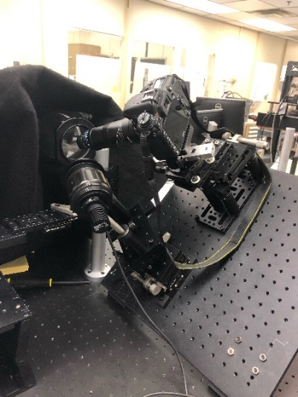
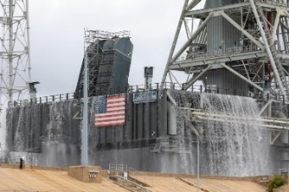
Intern Projects
Cal Poly Pomona
Electrical Engineering
Prairie View A&M Univ.
Chemical Engineering
Loras College
Mechanical Engineering
Florida Institute of Tech
Chemical Engineering
Image analysis for Artemis 1 preparation
Replacement of 71 film cameras with High-Speed Digital cameras
Imagery analysis and camera testing
Develop a method to inspect spacecraft windows in orbit
Design prototype components using CAD for tools that will measure defects of windows in orbit
Improve organization of the chemical inventory for multiple laboratories
Regular communication with vendors for inventory management
Apply proper storage and disposal practices to prevent hazards to improve overall safety
Modify OSCAR reactor waste simulant to reflect expected space waste chemical compositions
Perform moisture and ash analysis, ignition temperature characterizations, and duty optimizations for operation
Calibrate Gas Chromatograph
Perform SEM/EDS analysis on ash samples
6
6

Slide 7
Analytical Laboratories Branch (NE-L3)
What we are looking for?: The best qualified and most enthusiastic interns from the pool of Engineers, Chemists, Industrial Engineers and Systems Engineering student candidates, who seek the challenge of contributing to our Agency and our Directorate’s Vision and Mission
Opportunities at INTERN.NASA.GOV
Pathways – Mechanical/Aerospace Engineer
Intern – Laboratory Safety
Intern – Industrial and Systems Engineering Principles Applied to Analytical Laboratories
Intern – Imagery Operations for Space Operations
7

Slide 8

8

