Slide 1
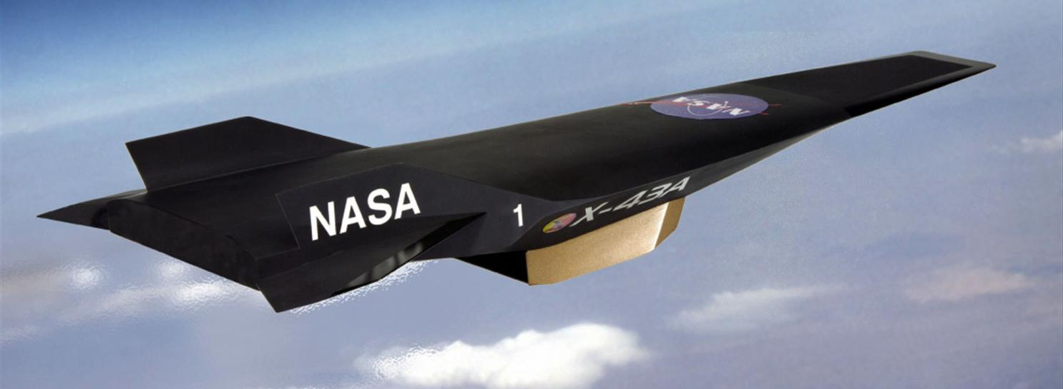

Dr. Robin Hunt
Research Aerospace Engineer
Hypersonic Airbreathing Propulsion Branch
NASA Langley Research Center
Wind Tunnel Testing of Next-Generation High-Speed Engines

Slide 2
What is Supersonics? Hypersonics?
Mach number = speed of an object / speed of sound
the transmission speed of a small disturbance through some medium
Subsonic
(Pressure waves travel all directions)
Supersonic
(Pressure waves travel downstream)
Transonic
Hypersonic
Mach Number
0
0.3
0.8
1.0
1.2
5.0
Nearly incompressible
(Air density is roughly constant)
Compressible
(Air density varies)
The flow physics depend on the Mach number

Slide 3
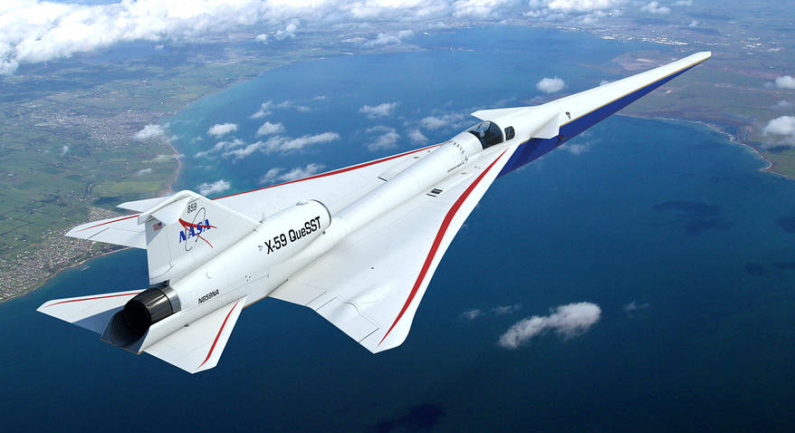

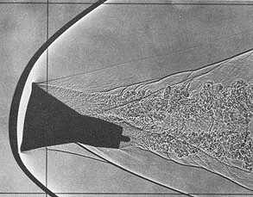
Supersonic Flow Physics: Shockwaves
For Mach numbers > 1, strong pressure waves (shock waves) form
Across a shock wave:
  Pressure and temperature increase
  Mach number decreases
Conceptual image of NASA’s X-59 QueSST Airplane (designed to reduce the loudness of a sonic boom to that of a gentle thump)
NASA’s Air-to-Air Background Oriented Schlieren flights
Shadowgraph of Gemini capsule model

Slide 4
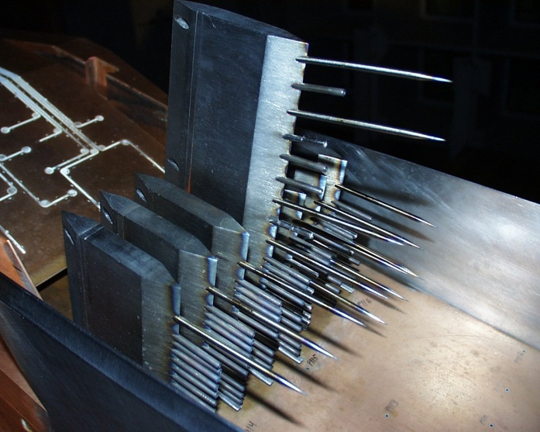
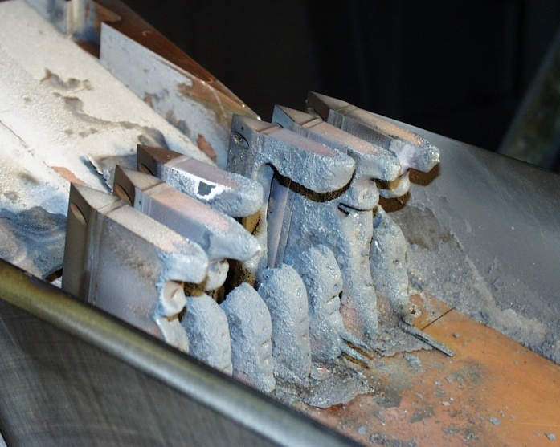
Hypersonic Flow Physics: High-Temperature Effects
High speed means high velocity (V) and high kinetic energy (1/2 V²)
As air flows around the vehicle, some kinetic energy is converted to internal energy = things get very hot
  Vibrational energy states are excited
  Chemical reactions
  Dissociation (O2 -> 2O, N2 -> 2N)
  Ionization (+/- electrons)
One major challenge is dealing with the vehicle heating
  High temperature materials
  Active cooling
  Aerodynamic shapes/design
Other physics: low density flow, viscous interactions (friction), etc.
We melt metal!

Slide 5
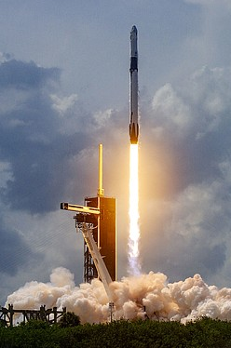
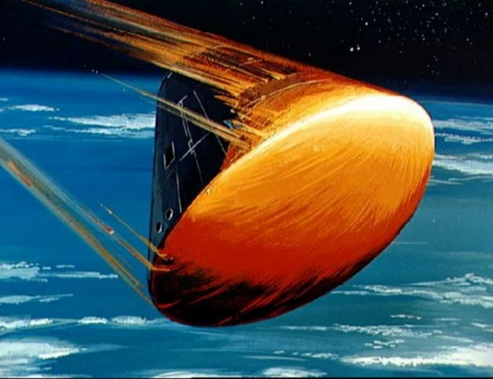
Why are these speed regimes important?
Access to space
Unpowered reentry to Earth or other planets for exploration
Rocket Launches
Ultimate goal: Air-Breathing propulsion systems
  Two-stage to orbit with airplane-like first stage for routine, affordable, safe access to space with increased launch flexibility
  Planetary atmospheric flight for exploration
Artist’s sketch of Apollo 11 reentry vehicle
NASA, SpaceX launched first astronauts to Space Station from U.S. since 2011

Slide 6
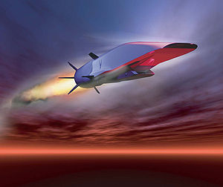
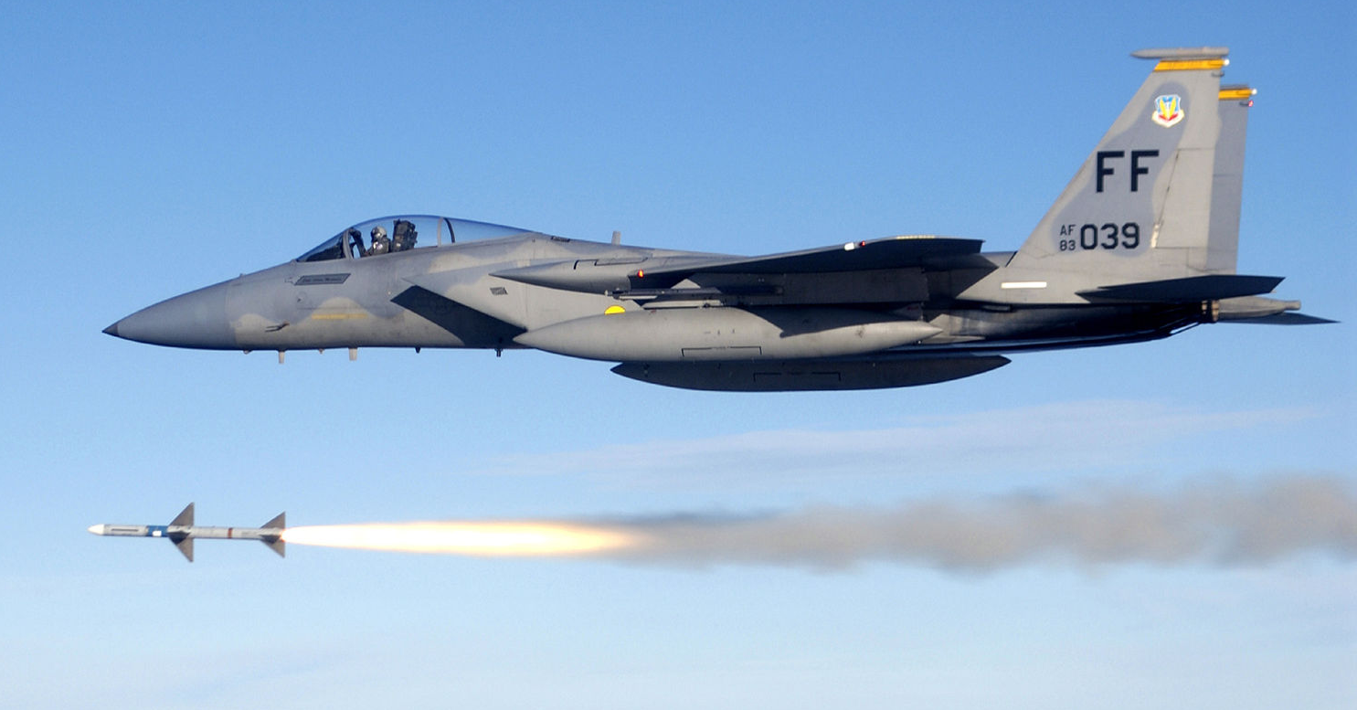
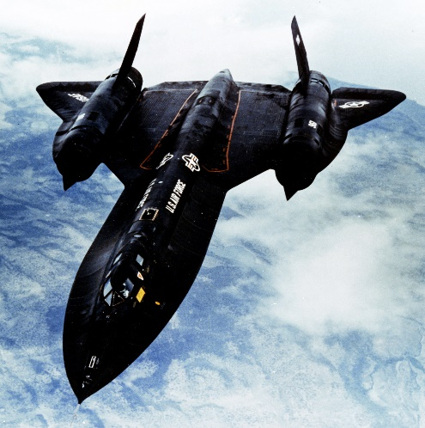
Why are these speed regimes important?
Military applications
Missiles
  Ballistic: High-altitude or sub-orbital flight with predictable trajectory
  Nonballistic: Sustained, maneuverable atmospheric flight
Reusable Vehicles for ISR (Intelligence, Surveillance, Reconnaissance)
Boeing X-51 waverider
SR-71 Blackbird - reconnaissance

Slide 7
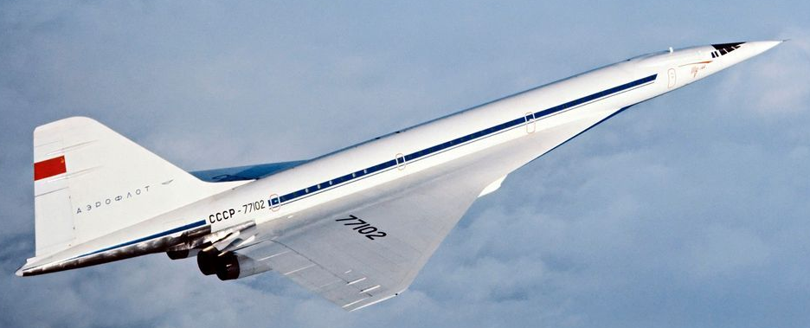
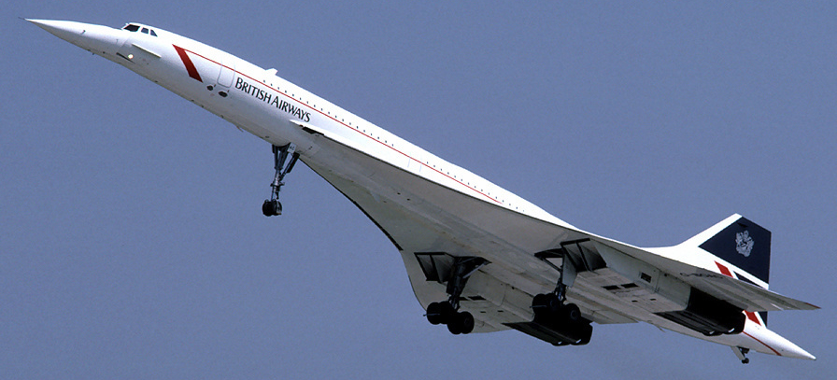
Why are these speed regimes important?
Commercial transport
International day trips
Emerging market for a supersonic business jet?
  Boeing
  Lockheed Martin
  Boom Technology
  Aerion Supersonic
  Spike Aerospace
  The Spaceship Company
  Gulfstream Aerospace
Challenges:
  Costs
  Regulations
  Environmental impact
Tu-144 (1970s): Mach 2 Soviet passenger airliner
Concorde (1976-2003): Mach 2 British-French passenger airliner

Slide 8
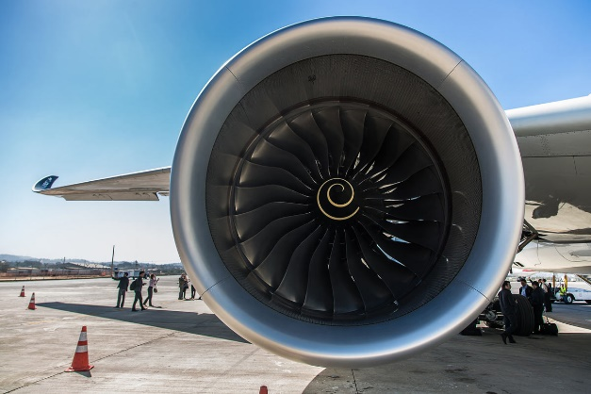
Air-Breathing Propulsion Options
8000
Turbofans
6000
Turbojets
I
sp
4000
Hydrogen Fuel
Ramjets
Hydrocarbon Fuels
Turbojets
2000
Scramjets
Ramjets
Scramjets
Rockets
0
0
2
10
20
MACH NUMBER
I_{SP} = Thrust force / fuel mass flow rate.
Higher ISP = larger range and payload capability

Slide 9
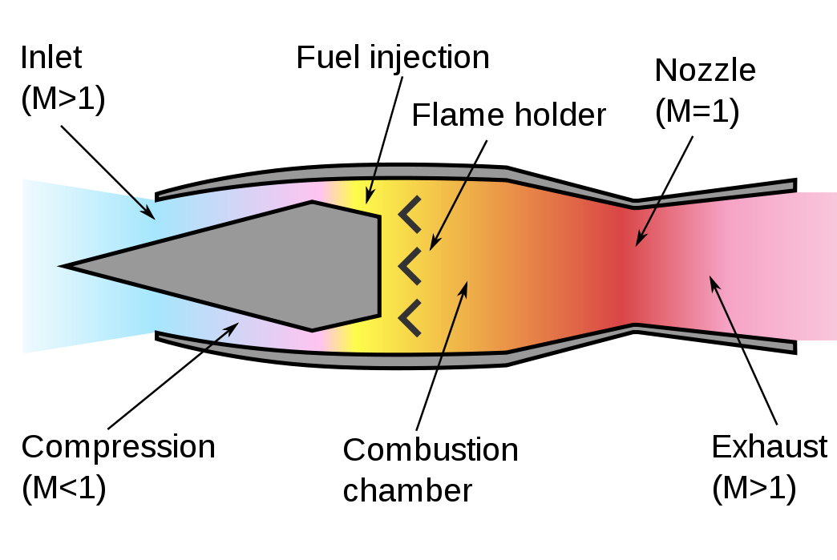
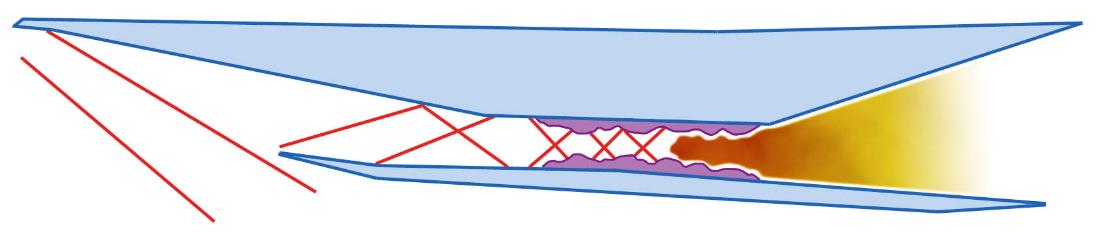
High-Speed Air-Breathing Engines: Ramjets & Scramjets
Rely on shock waves created by the engine's forward motion to compress incoming air.
Cannot produce thrust at zero airspeed!
Dual mode ramjets capture both of these operating regimes to work over a wider range of Mach numbers.
Challenges: Extending the Mach number range, fuel mixing, ignition, flame holding, engine control, keeping structures cool
Flow
Ramjet (subsonic combustion)
Combustor
Inlet
Isolator
Nozzle
Scramjet = Supersonic Combustion Ramjet

Slide 10
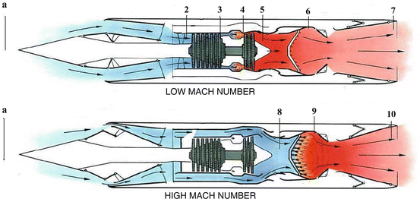
Use a combined cycle engines for an even wider operating range
Runway to supersonic / hypersonic
Turbine-based combined cycle engine
Rocket-based combined cycle
Challenges: transitioning while maintaining thrust, integration with the airframe + all the other issues associated with the different engine components
Flow
Flow
Combined-Cycle Engines

Slide 11
Designing a High-Speed Air-Breathing Engine
How do we design these engines?
  Engineering Design and Analysis
  Computational Fluid Dynamics
  Wind tunnel testing
  Rinse and repeat…
Converging-diverging nozzle delivers flow with desired Mach number to test section
Test section
Heated test gas
(Subsonic: Mach <1)
Colder test gas
(Supersonic: M>1)
Test model

Slide 12
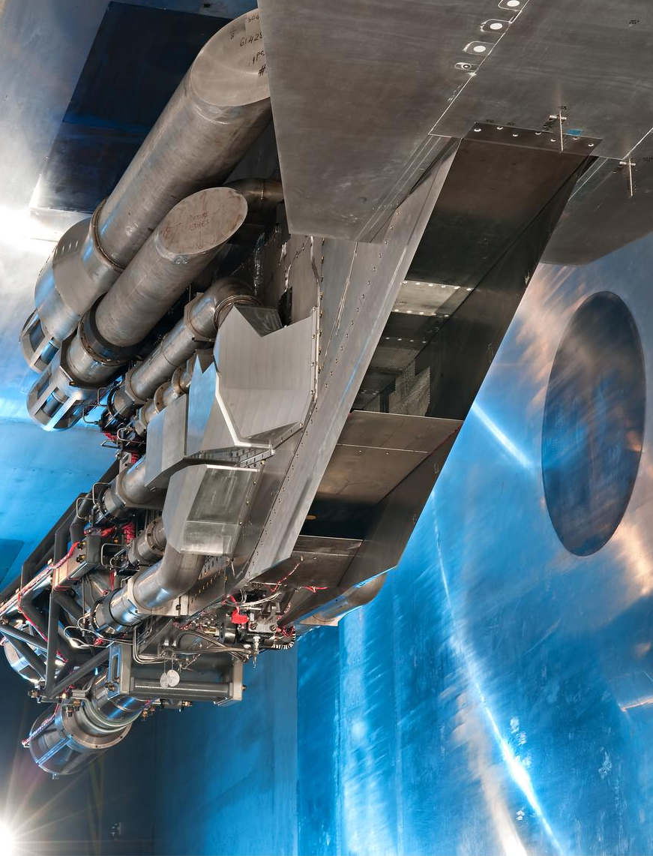
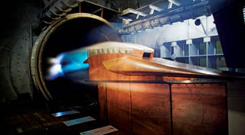
Why do we need wind tunnel tests?
Less risk and expense than flight tests
Test models of the entire vehicle or its specific components (e.g., propulsion system)
Computational code validation
Ability to study of complex flow phenomena that cannot be assessed in computational codes
Combined cycle engine tested @ NASA Glenn 10 x 10 ft. supersonic wind tunnel
Hypersonic Ground Demonstrator Engine No. 2 tested @ NASA Langley 8 ft. high-temperature tunnel
Ground testing has historically, is currently, and will continue to be a critical part of the design of hypersonic vehicles, alongside computational techniques and flight testing.

Slide 13
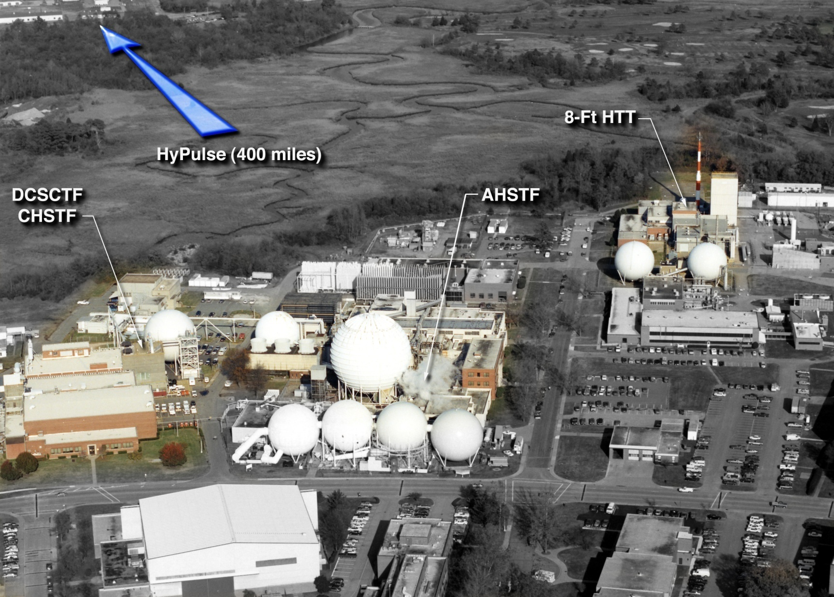
Key hypersonic testing facilities @ NASA Langley

Slide 14
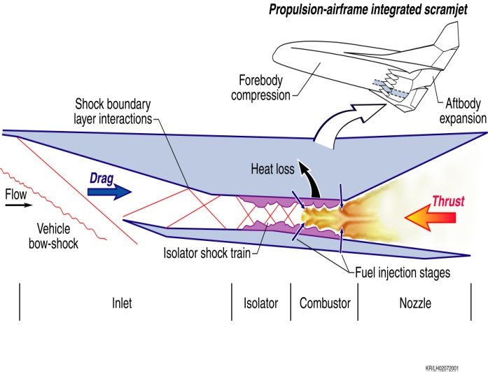
8-Ft. High-Temperature Tunnel: Free-jet testing
FLIGHT
GROUND TEST
Air flows through and around the model
Facility nozzle exit conditions match flight freestream or inlet entrance conditions
Complete “tip to tail”, propulsive flowpath when facility is large enough
Pre-flight verification of complete flowpath, engine subsystems

Slide 15
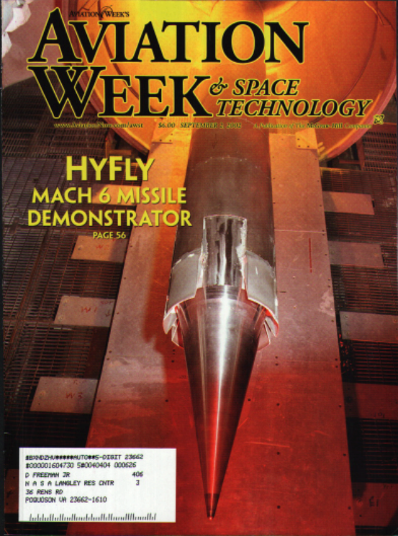
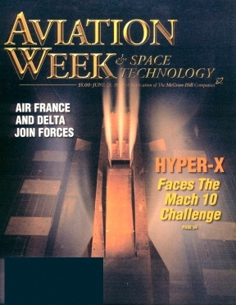
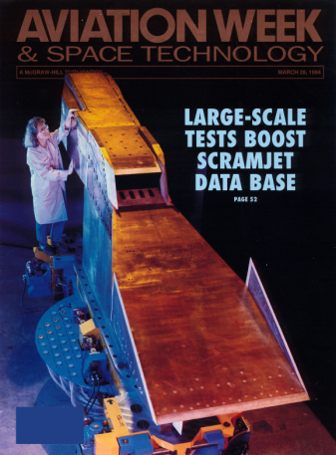

8-Ft. High-Temperature Tunnel: Free-jet testing
Heated by methane-air combustion
Total temperature: 1640 – 3560 R (1180 – 3100 deg. F)
Total pressure: 160 - 2000 psia (10.9 – 136 atm)
Multiple facility nozzles: Mach 4, 5, 7 (8’ diameter exit), Mach 3, 5 (4.5’ diameter exit)
Test section is 14 ft. long
Run duration up to 3 minutes (but only 2-3 runs per week)
March 1994
Sept 2002
June 1999

Slide 16
Arc-Heated Scramjet Test Facility: Semi-free-jet
FLIGHT
GROUND TEST
Air flows through and around the model
Facility nozzle exit conditions simulate conditions near the inlet entrance
Model of the partial flowpath
Flowpath / engine component development and verification

Slide 17
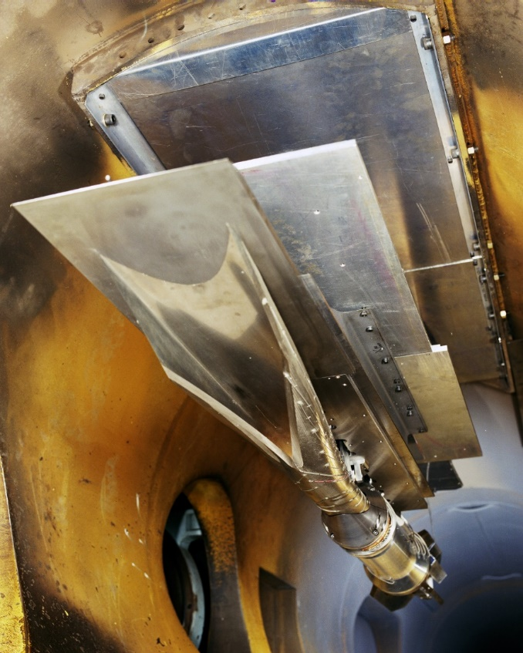
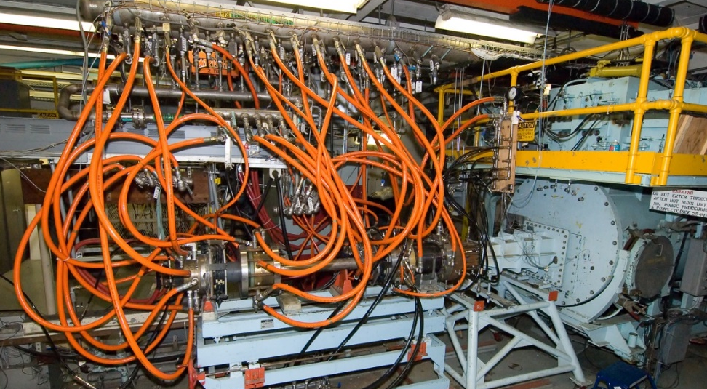
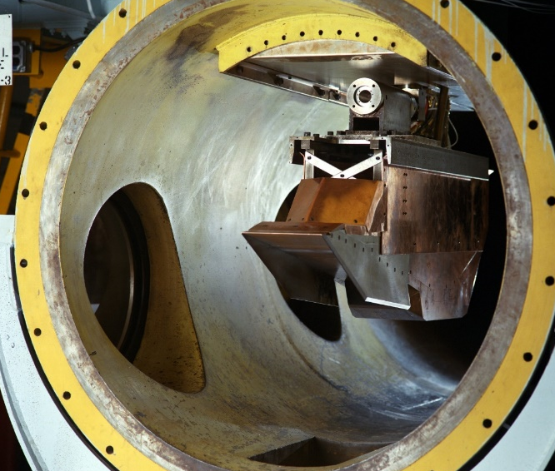
Arc-Heated Scramjet Test Facility: Semi-free-jet
Multiple facility nozzles: Mach 2.2, 3.5, 4.7, or 6.0
Heated by electric arc-jet discharge (total temperatures up to 4540 deg. F)
94’ long (37’ inside, 57’ outside) with 4’ x 11’ cylinder test section
Run times up to 5 minutes with 5 – 10 runs / day
Rectangular-to-Elliptical Shape Transition (REST) inlet installed
Hyper-X Engine Module: hypersonic technology development leading up to the X-43

Slide 18
Direct-Connect Supersonic-Combustion Test Facility: Direct-connect testing
FLIGHT
GROUND TEST
Sub-component(s) of internal flowpath directly bolted to nozzle exit
Facility nozzle exit conditions simulate component entrance conditions
Component operability and performance verification

Slide 19
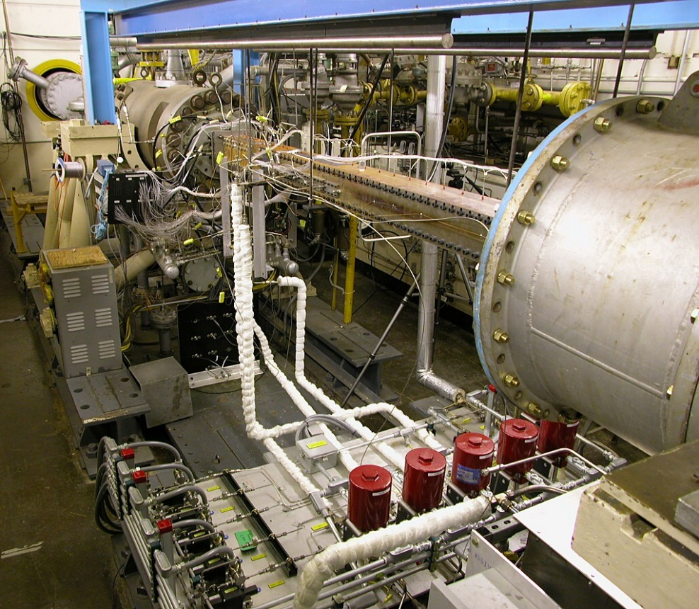
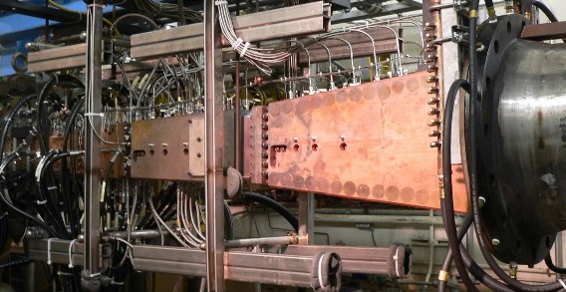
Direct-Connect Supersonic-Combustion Test Facility: Direct-connect testing
Interchangable nozzle usually designed with the test article to match the cross-sectional shape and achieve the desired Mach number
Heated by hydrogen-air combustion (total temperatures up to 3340 deg. F)
Run times up to 15 minutes
5-20 runs / day
DCR in DCSCTF

Slide 20
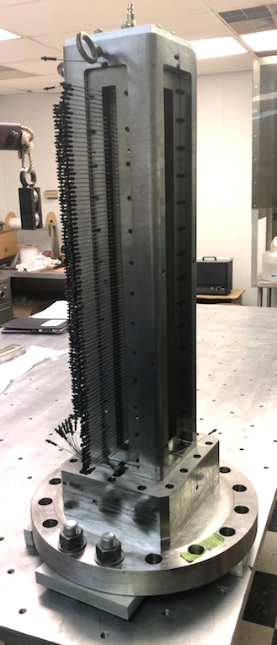
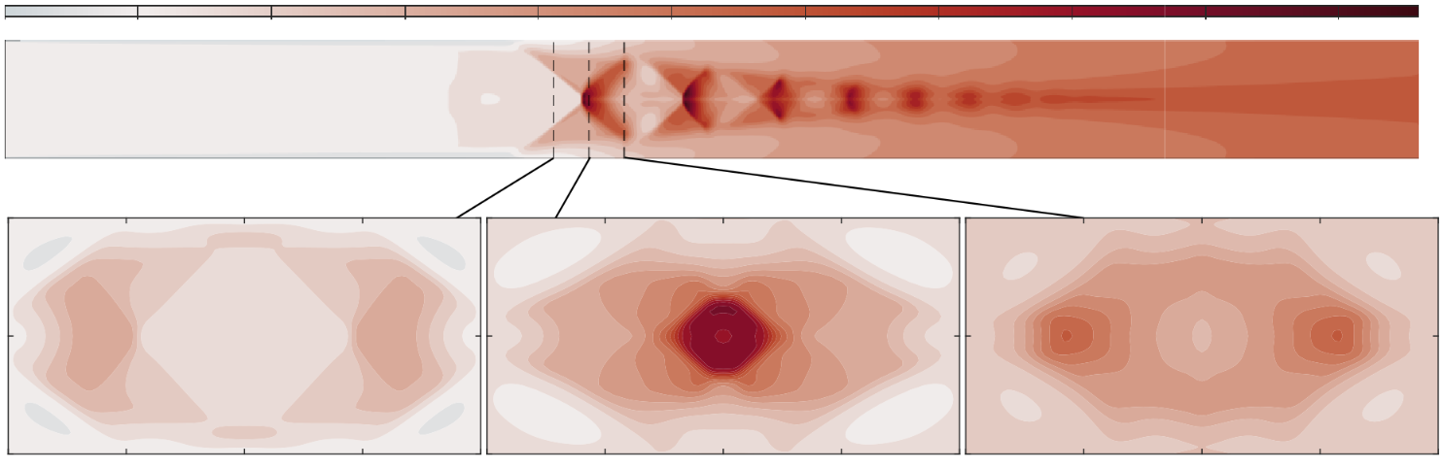
Isolator Dynamics Research Laboratory (IDRL)
Direct-connect facility for fundamental research on isolators
  Investigate shock wave structure and dynamics related to isolator stability / unstart
  Flow control methods to improve isolator performance
  Test-bed for laser diagnostics and advanced measurement techniques
  CFD code validation
Scramjet = Supersonic Combustion Ramjet
Isolator
Combustor
Inlet
Nozzle
Flow

Slide 21
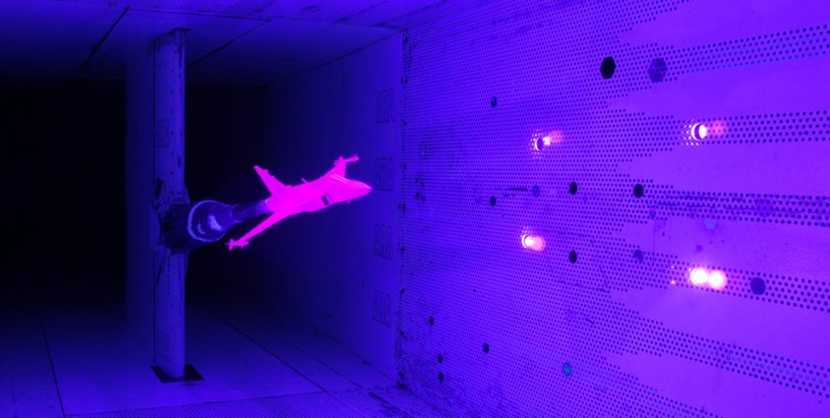

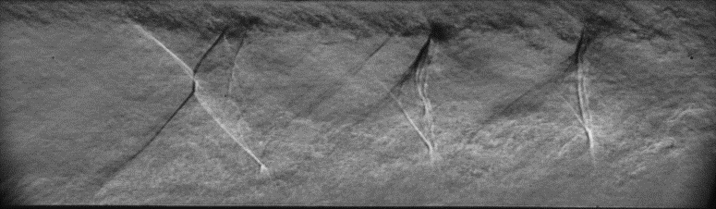
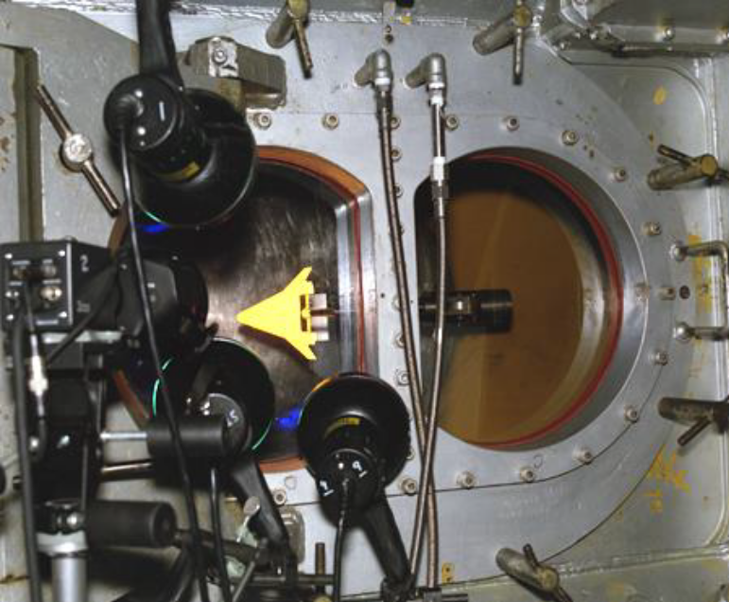
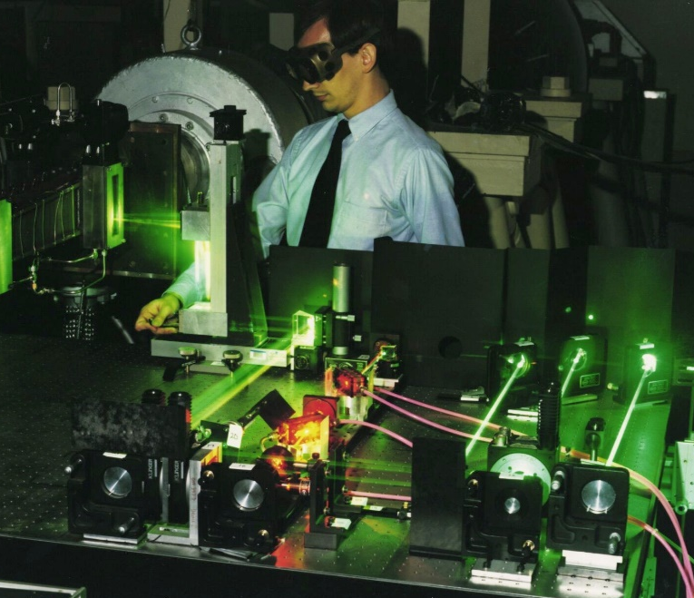
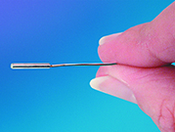
Instrumentation and Test Techniques
Pressure and temperature sensitive paint
Oil flow
Schlieren /shadowgraph
Pressure transducers
Phosphor thermography
Laser diagnostics

Slide 22
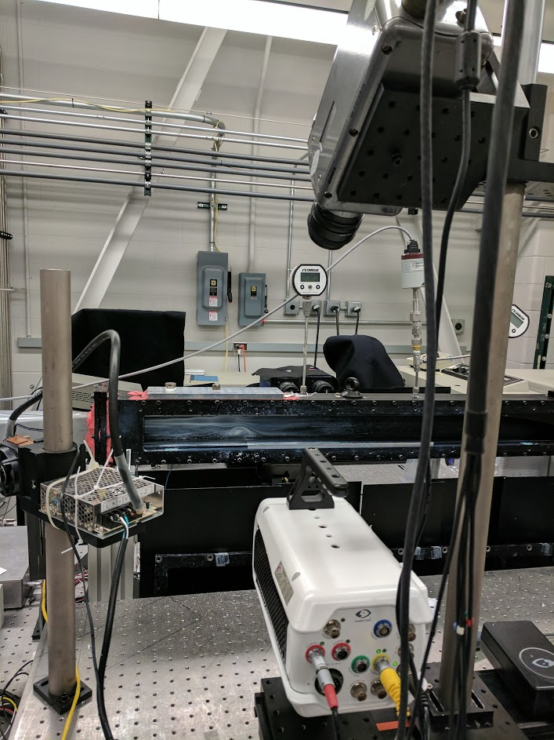





My path to NASA Langley
Undergraduate @ U. Maryland (College Park, MD)
  Summer internships at Arnold Engineering Development Complex Tunnel 9 (White Oak, MD)
  AIAA Student conferences
Masters & PhD @ U. Michigan (Ann Arbor, MI)
  More AIAA conferences: Scitech, Aviation, Propulsion & Energy
  Summer fellowship at the Air Force Research Lab (Dayton, OH)
  NASA Pathways Program

Slide 23
Student programs at NASA
NASA Internships, Fellowships and Scholarships (NIFS) (https://www.nasa.gov/langley/education/internships)
  For high school to graduate school students
  Various sessions during the course of the year (summer, fall, spring)
  Program tries to match student and researchers interests
NASA Fellowships
  (https://www.nasa.gov/stem/fellowships-scholarships/index.html)
  For graduate students (Masters or PhD)
  Applications accepted once a year
  Fully funds tuition, stipend, health insurance, etc.
Pathways (https://www.nasa.gov/careers/pathways-program)
  For current students and recent graduates
  Sort of a co-op program with easy path to convert to full time civil servant position
  Exposure to NASA research during time at sponsoring org.
  Time at school can count towards service time

Slide 24
Dr. Robin Hunt
Research Aerospace Engineer
Hypersonic Airbreathing Propulsion Branch
NASA Langley Research Center
Questions? Comments?

