Slide 1



Future Opportunities for Aero Supply Chain
Aerospace Supply Chain
Parimal Kopardekar, PhD (PK)
Director, NASA Aeronautics Research Institute (NARI)
Parimal.H.Kopardekar@nasa.gov

Slide 2

Opportunities
Future Aircraft
  Environmental footprint
  Aircraft development cycle
  Aircraft production rate
  Supply chain resiliency

Slide 3
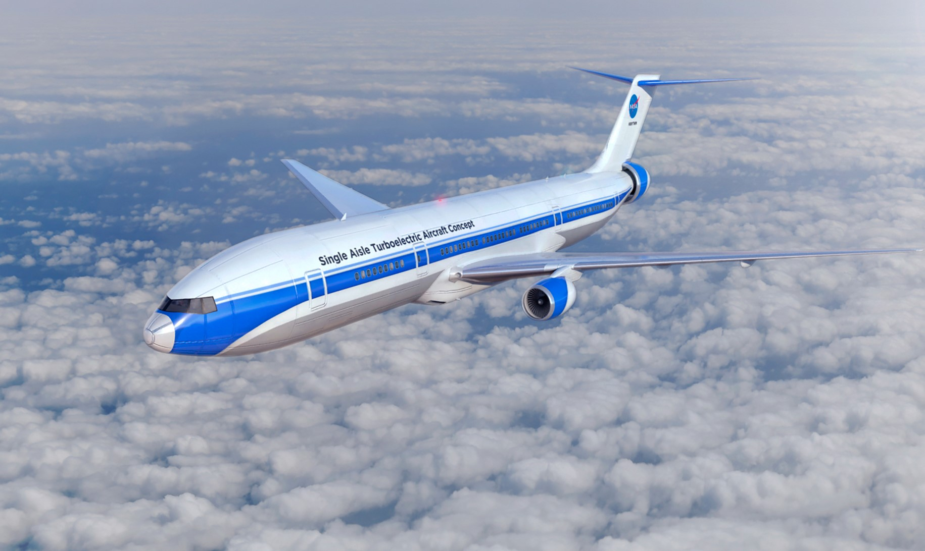
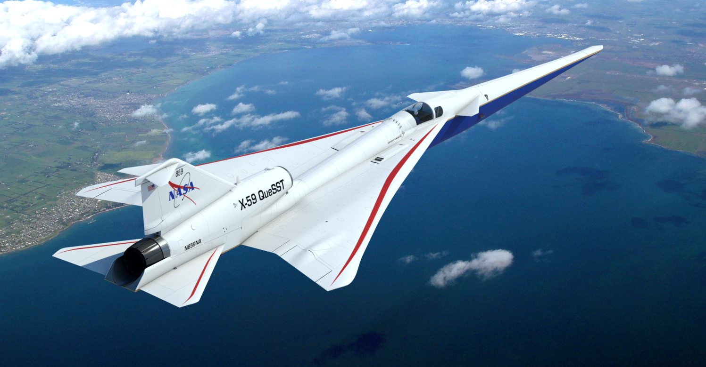
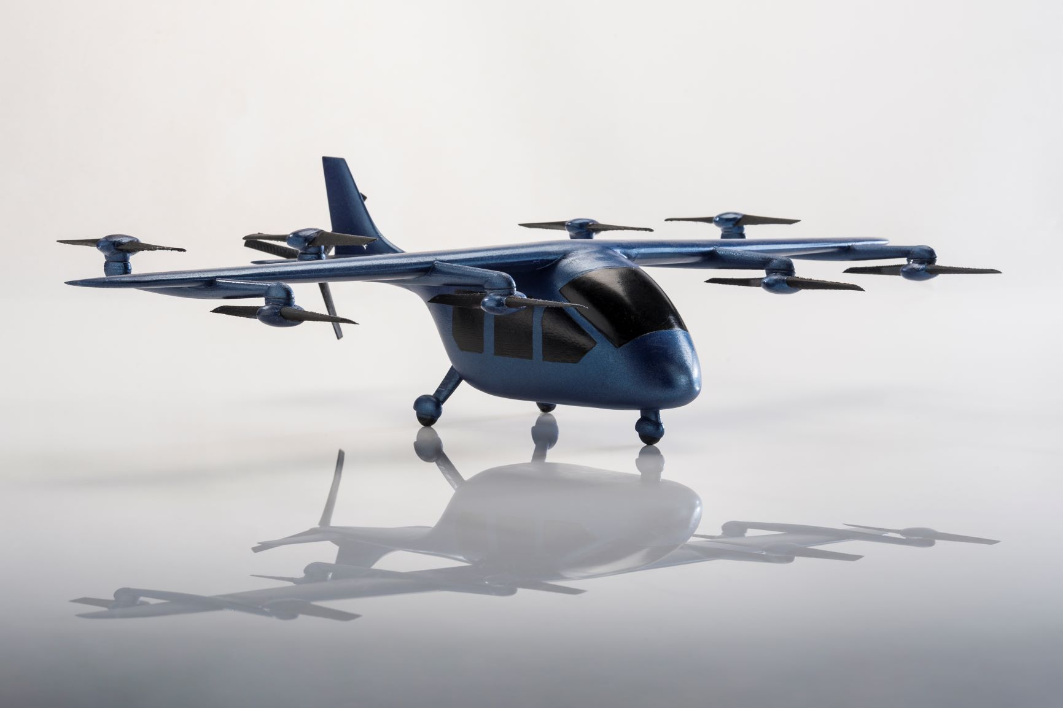
Future Aircraft

Slide 4
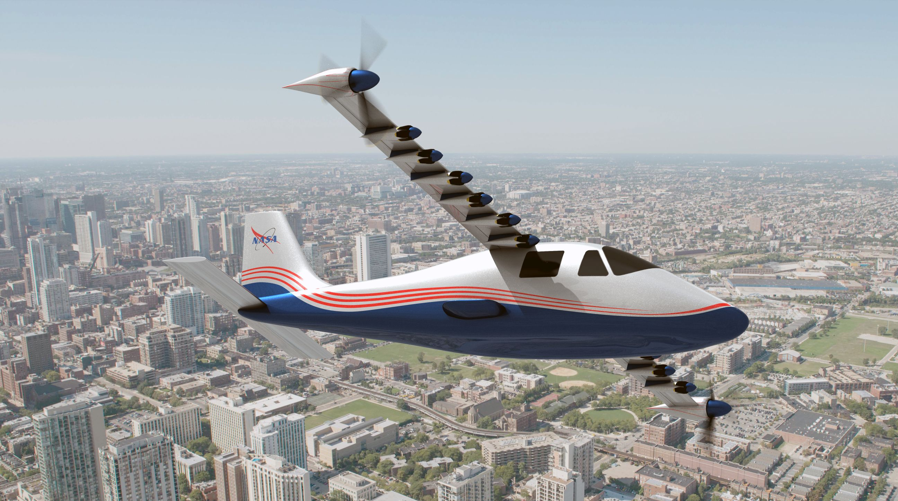
More Electrified Aircraft for Reduced Emissions
Challenge: Battery for Aviation Needs

Slide 5
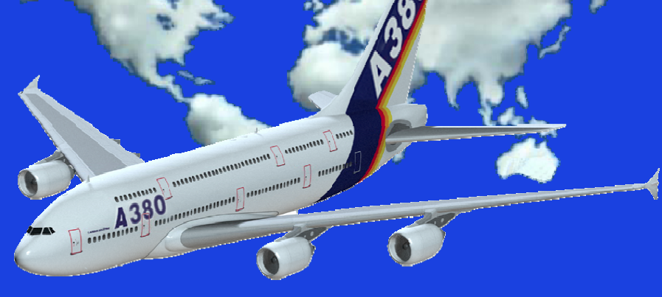
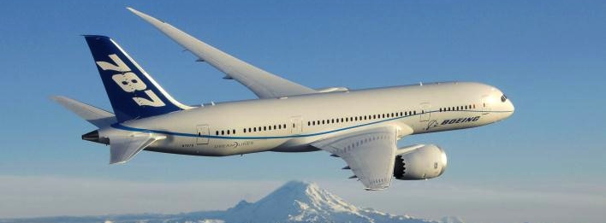
Reduce Aircraft Development Cycle Time
Every modern aircraft was:
  Delayed
  Over budget
  Heavier initially
Design complexity:
  A380-800 has about 100,000 wires, 470 km, 5700 kg of weight, and additional 30% weight for harness to hold wiring.

Slide 6
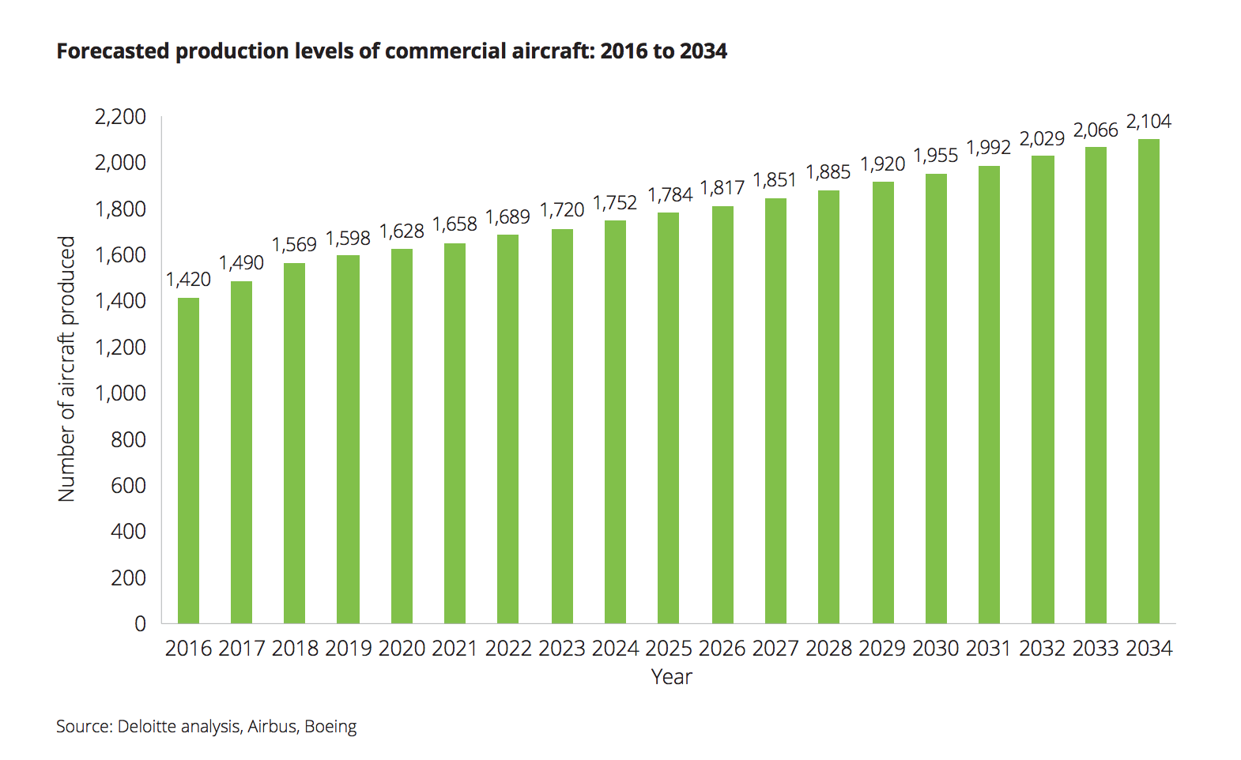
Current Situation
($800+B backlog)
Increase Aircraft Production Rate
Boeing and Airbus have backorders (~5000+, with ~55/month rate)
  2016: Boeing had 5715 undelivered orders and Airbus had 6874
  2018: Boeing delivered 806 aircraft and Airbus delivered 800
  2019: Airbus delivered 863 (up 7%)

Slide 7
Aerospace Needs Sustainable Supplier, Manufacturer, and MRO Network
Car companies are entering aero industry
Need to understand the production certificate, and aviation grade manufacturing needs

Slide 8
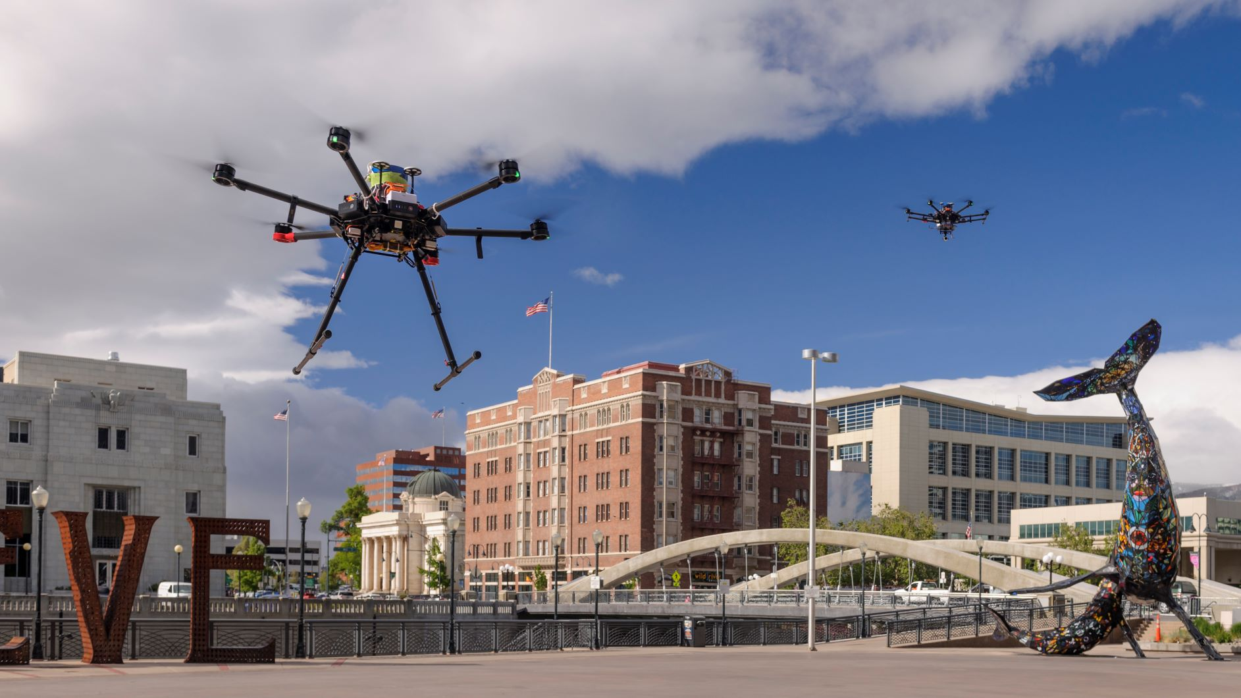
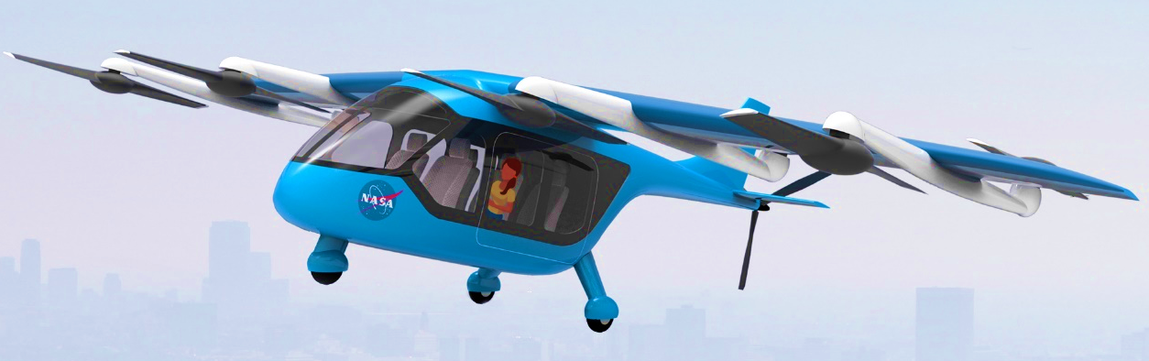
Set Up U.S. Supply Chain and Maintenance, Repair, and Overhaul for Small Unmanned Aircraft Systems (sUAS) and Electric Vertical Take-off and Landing

Slide 9
Supply Chain Basics
Supply chain consists of all parties involved, directly or indirectly, in fulfilling a customer need
Aerospace supply chain is an ecosystem of different supplier tiers
Includes manufacturers, suppliers, transporters, warehouses, etc.
Supply chain management refers to coordination of all activities

Slide 10
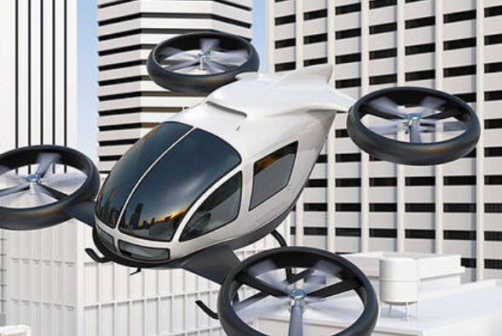

Supply chain impacts the entire life cycle—from early conceptual design to high volume manufacturing
All types of aircraft in all phases – design to final production
Maintenance, repair, and overhaul
Ability to scale up

Slide 11
Basic Statistics on Manufacturing
Boeing and Airbus: 1600+/year
General Aviation: ~2000
(piston, turboprop, business jets)
Rotocraft: 1020
Cars: 70M (OICA, 2018)
Cars in US: 2.8M

Slide 12
Needs
Many calls, texts, and interactions about looking for suppliers and manufacturers
Over-molding
Actuators
Electric motors
Propellers
Casting
Many other components and manufacturing needs
Need suppliers for entire life cycle:
Design to high volume manufacturing

Slide 13
Challenges
Castings and forging
Composites
Auxiliary Power Units
Printed Circuit Boards
Actuators
Software
High volume manufacturing and assembly methods
Many others
Cycle Time and Production Rates

Slide 14
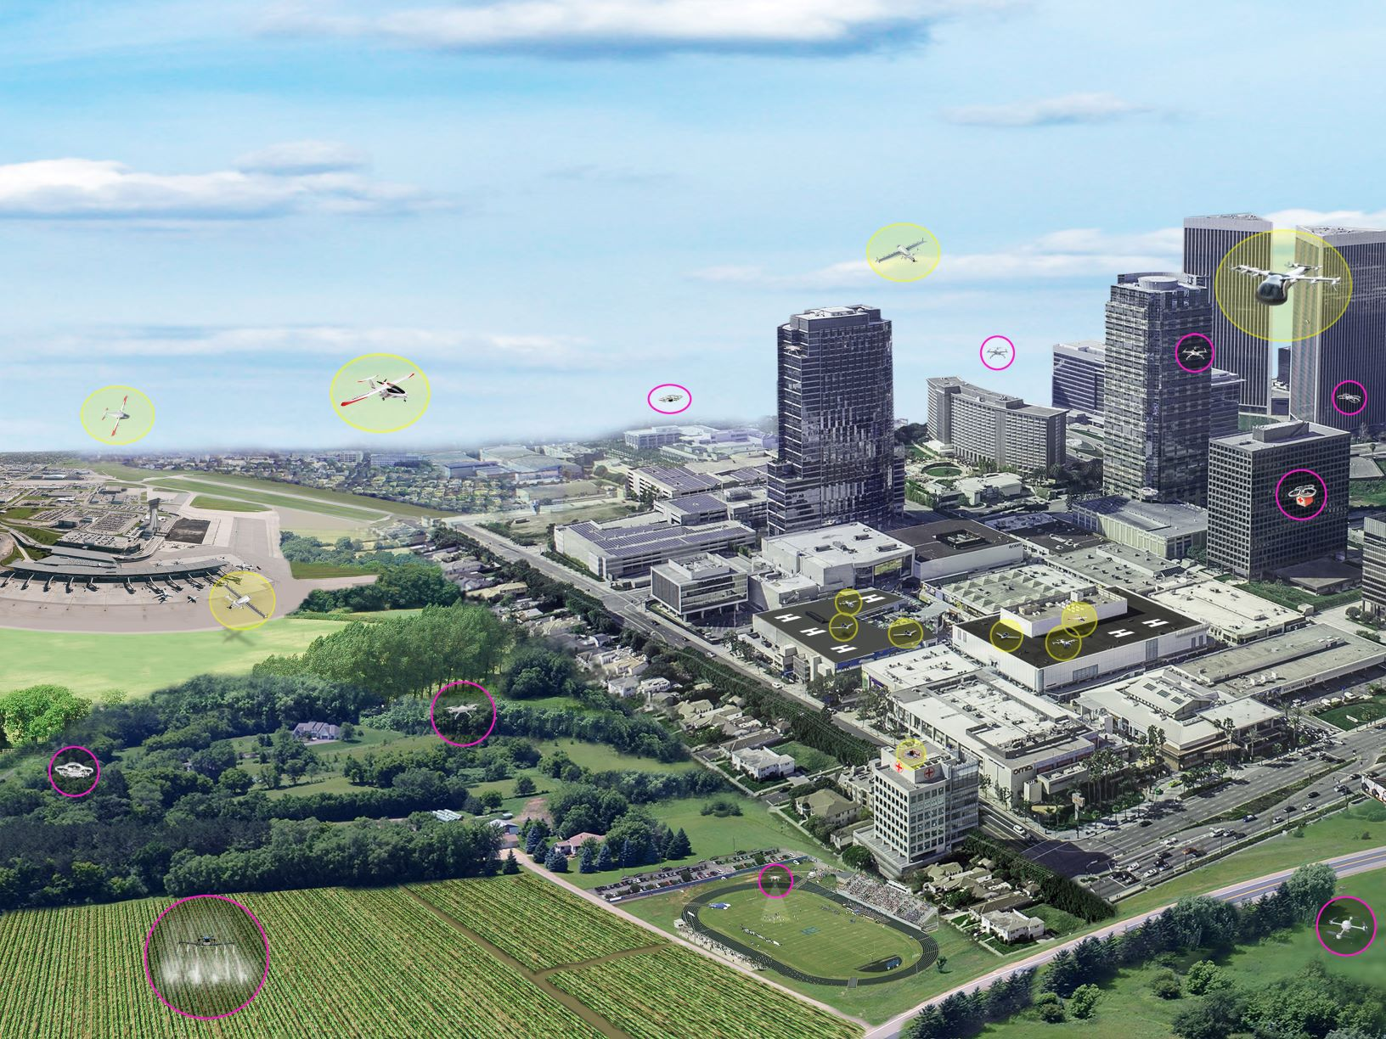

Opportunities
Standardization where possible
Reduce total cycle time
Increase scaling potential

Slide 15
Known Aero Supply Chain Related Issues
(California Manufacturing Network, 2018)
Sourcing of raw materials – aluminum, steel, copper, etc.
Mitigating supply disruption risks (e.g., geopolitical considerations)
Coping with modernization and emerging technologies (e.g., wiring problems, software issues, late deliveries of lavatories)
Shortage of skilled workers (Tim Cook’s view on outsourcing)

Slide 16
Supply Chain Strategies
Many suppliers
Few suppliers
Vertical integration
Joint ventures
Horizontal integration
Keiretsu networks (part collaboration, part few suppliers, part vertical integration)
Virtual companies

Slide 17
Recommendations: Supply Chain for
Drones and Vertical Take-off and Landing (VTOL)
Time to start building an entire new eco-system
Take advantage of ALL manufacturing capabilities
Rebuild/train auto, heavy industries, and traditional aerospace suppliers to consider VTOL and drones as needed
Get regional manufacturing and supply chain associations exposed to emerging aero needs

Slide 18
Recommendations: Supply Chain for
Drones and Vertical Take-off and Landing (VTOL)
Build an electronic exchange platform to connect VTOL customers with suppliers
Train workforce: curriculum, skills, and entrepreneurs
Build modeling and simulation capability to assess supply chain preparedness: gaps, resiliency, scale, and cycle time
Build a tier system of supply chain all the way to the raw material

Slide 19
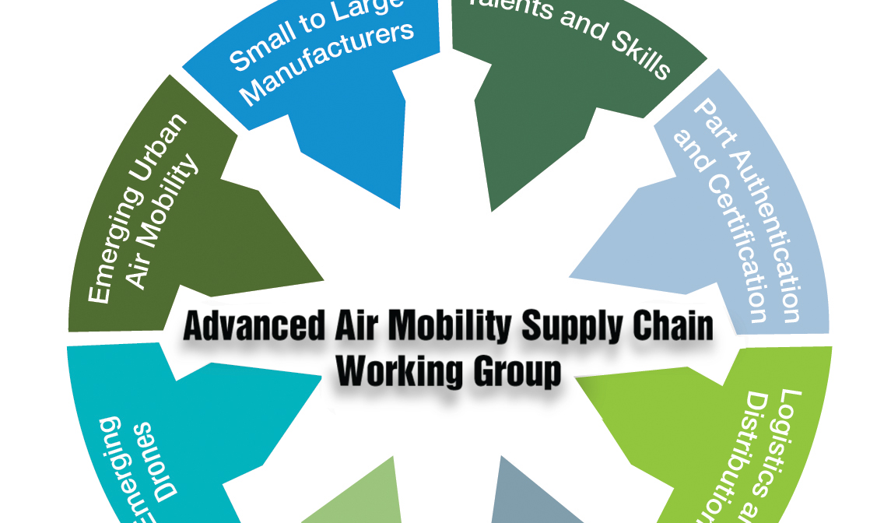
Join NASA’s AAM Supply Chain Working Group!
Workgroup meets every month
NEXT MEETING:
Thursday November 12th
11:00 AM - 1:00PM ET
(8:00AM - 10:00AM PT).
To register and learn more, visit our webpage:
https://nari.arc.nasa.gov/aamsupplychain
Feedback: arc-cal-nari@mail.nasa.gov
Parimal.H.Kopardekar@nasa.gov

