Slide 1
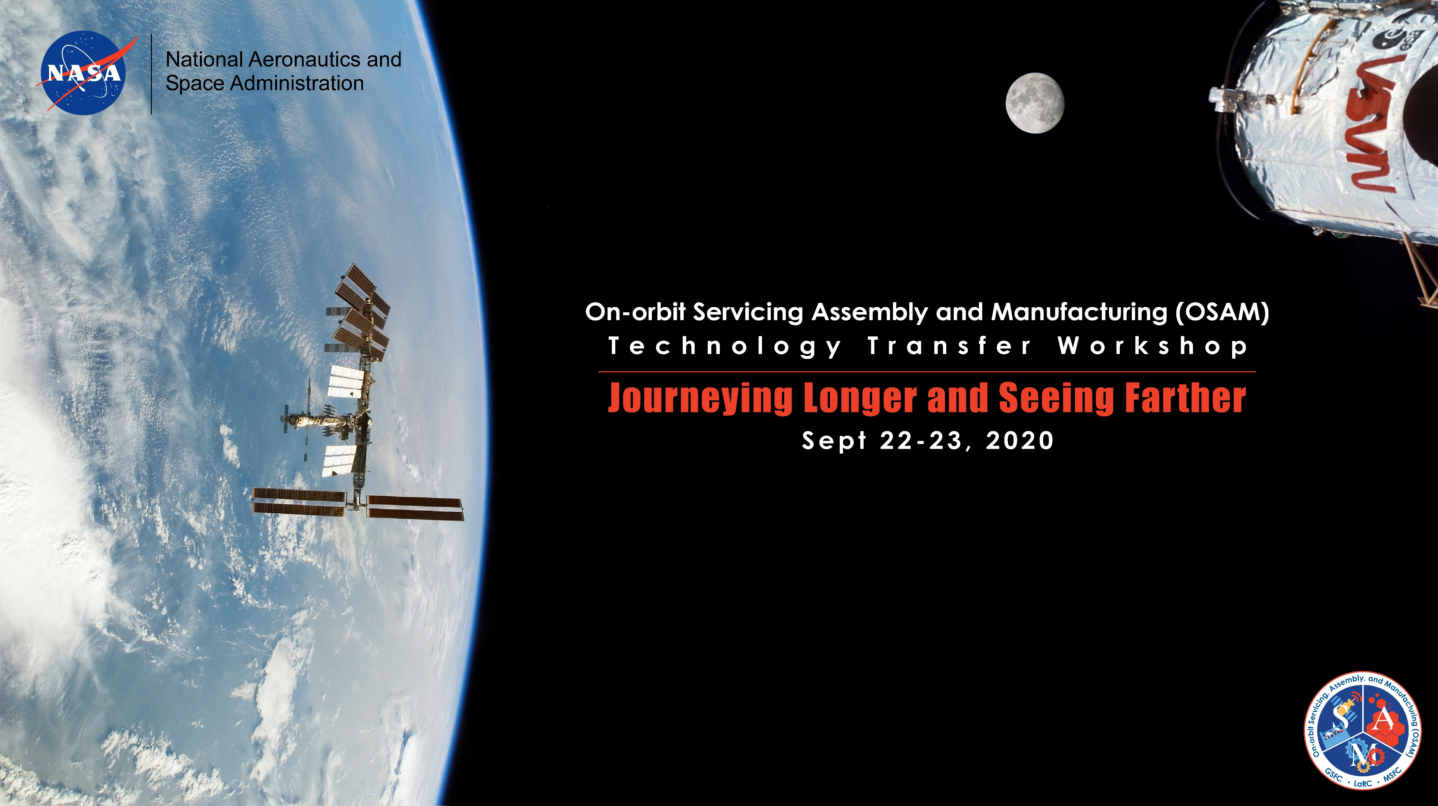
Assemblers: A modular and reconfigurable manipulation system for autonomous in-space assembly
Project Lead: Jim Neilan
Co-I: John Cooper, Matt Mahlin
This document is approved for public release.

Slide 2
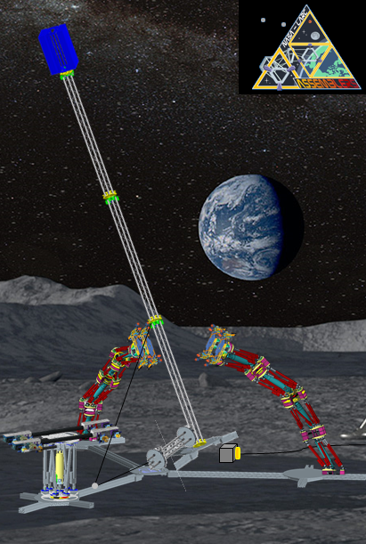
Assemblers - Overview
The Problem: Upper bound on space platform size due to launch vehicle mass and volume limitations, requiring complex stowage and deployment methods driving high complexity and high costs.
State of the Art: Robotic manipulation systems that are large and mission specific, are incapable of smaller, higher precision tasks unless equipped with bulky end-effectors.
Payload mass and size, reach required, and height and size of space components during long term missions will need to change. Having specific manipulators for differing requirements drives up costs.
Adaptability limited for new missions
Places limitations on new mission designs and requirements
Requires human operation/oversight
The Solution: A modular and reconfigurable manipulation system composed of smaller, highly stiff and accurate Stewart Platforms, capable of handling a wide range of component payload sizes and mission tasks.
Autonomy
Modularity
Adaptability
Notes:
GENERAL SLIDE TEMPLATE

Slide 3
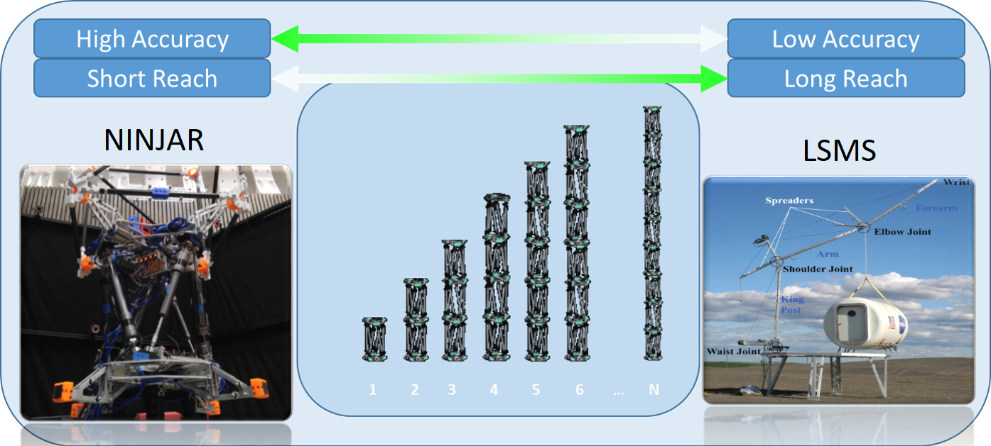
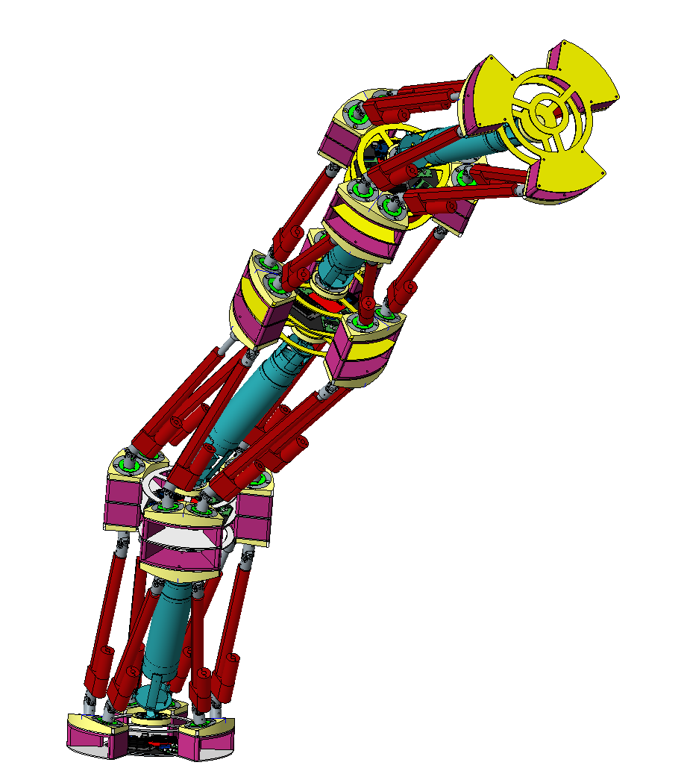
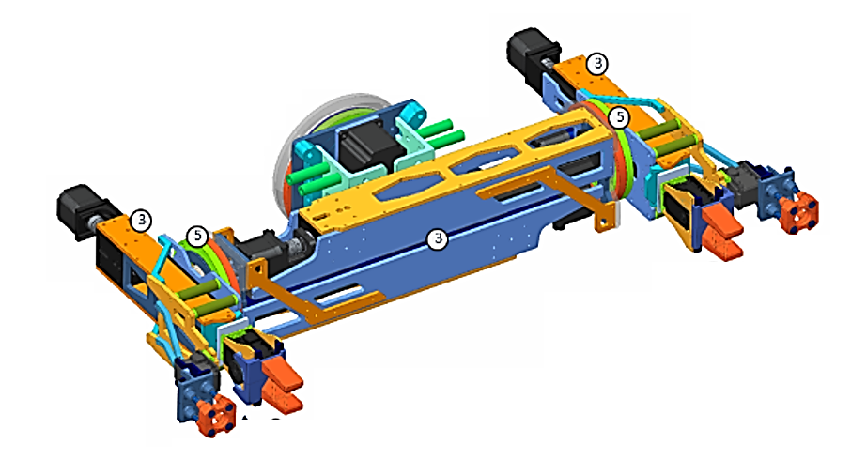
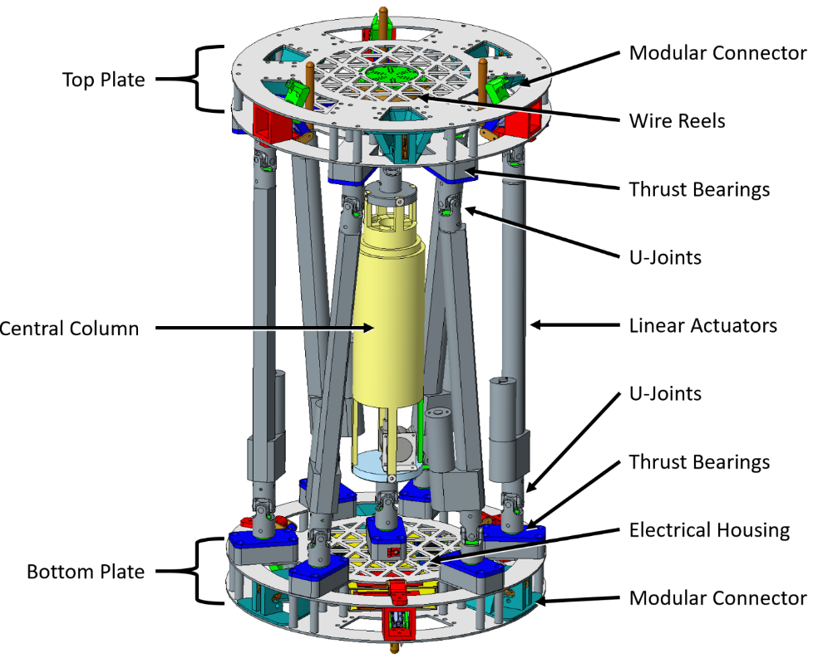
Assemblers: Modular, Reconfigurable and Versatile
Modularity Enabling Re-configurability
NASA Versatile Platform
Short reach
Long reach
Fault tolerant
Autonomous
Tele-op capable
Multiple End-effectors
Modular End-Effectors
Quick tool changing
Standard power/data
Transfer
Stewart - Gough Platform
Modular Connections
Data and Power
Redundancy
Fault tolerance
Re-configurability
Autonomy Enabling Software
Modeling and Simulation
Modular Software Framework(DDS)
Task Planning/re-planning
Sensing and Controls
Situational awareness
Error detection and correction
Notes:
GENERAL SLIDE TEMPLATE

Slide 4
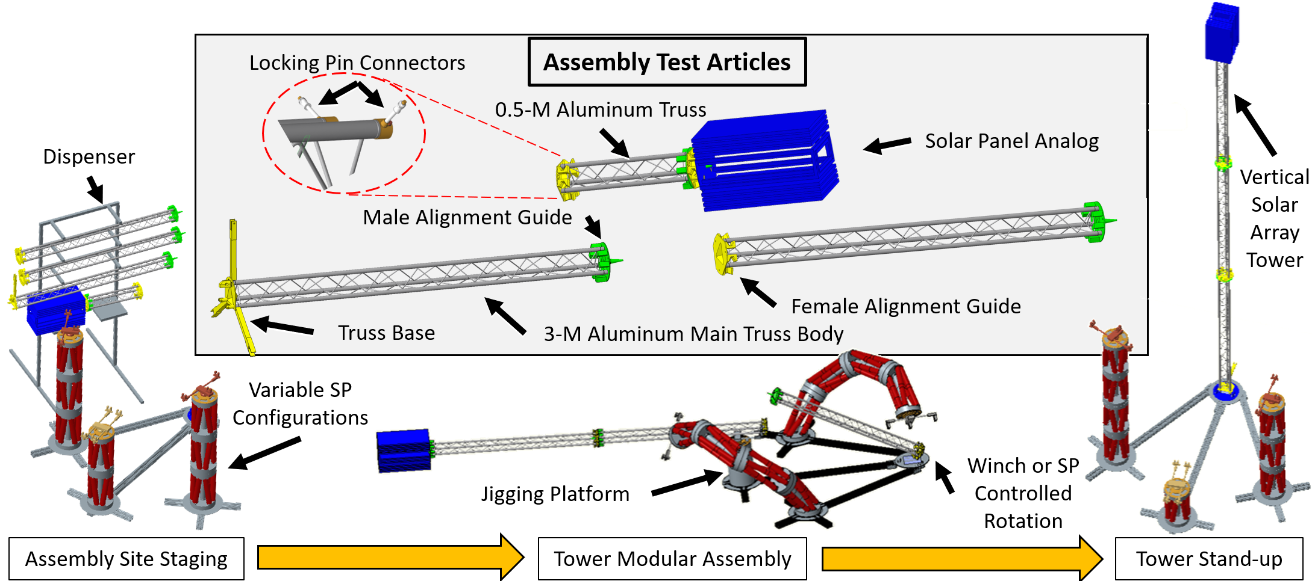
Assemblers: Concept of Operations
Notes:
GENERAL SLIDE TEMPLATE

Slide 5
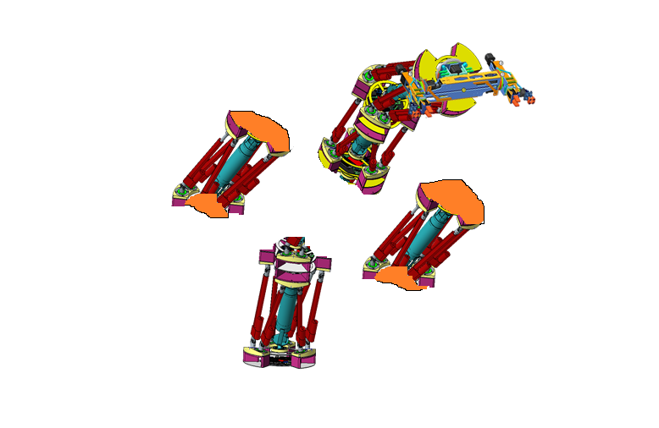
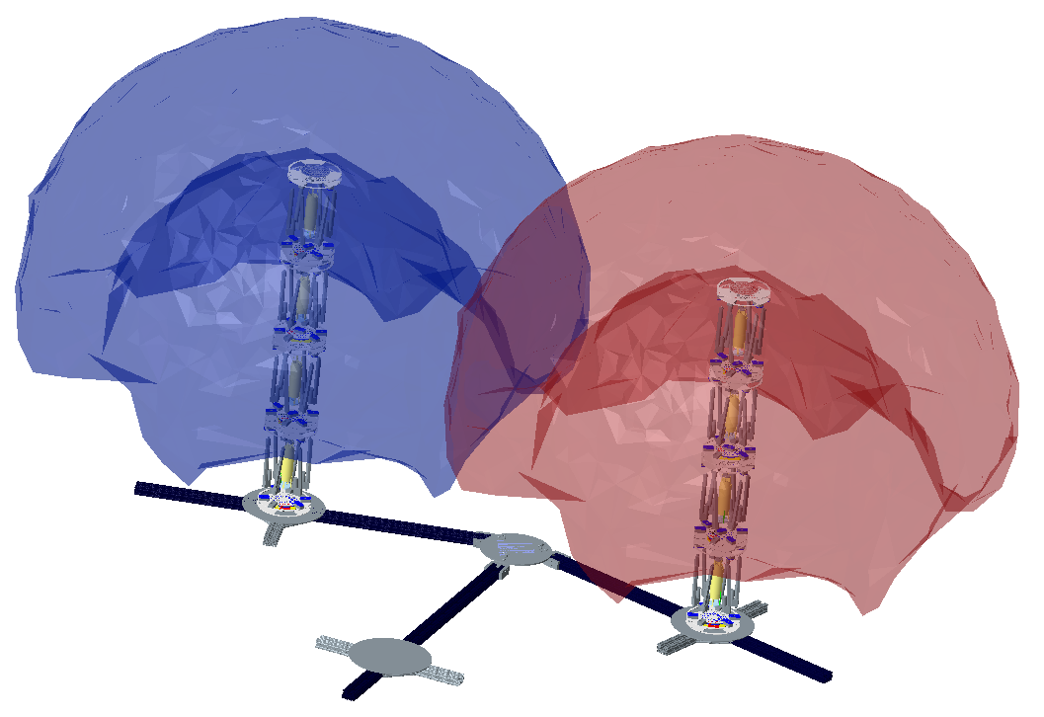
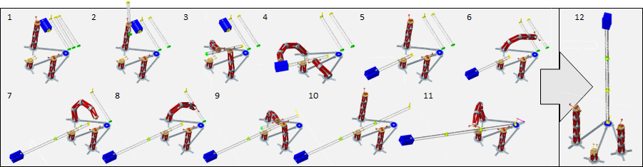
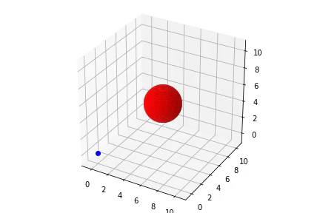
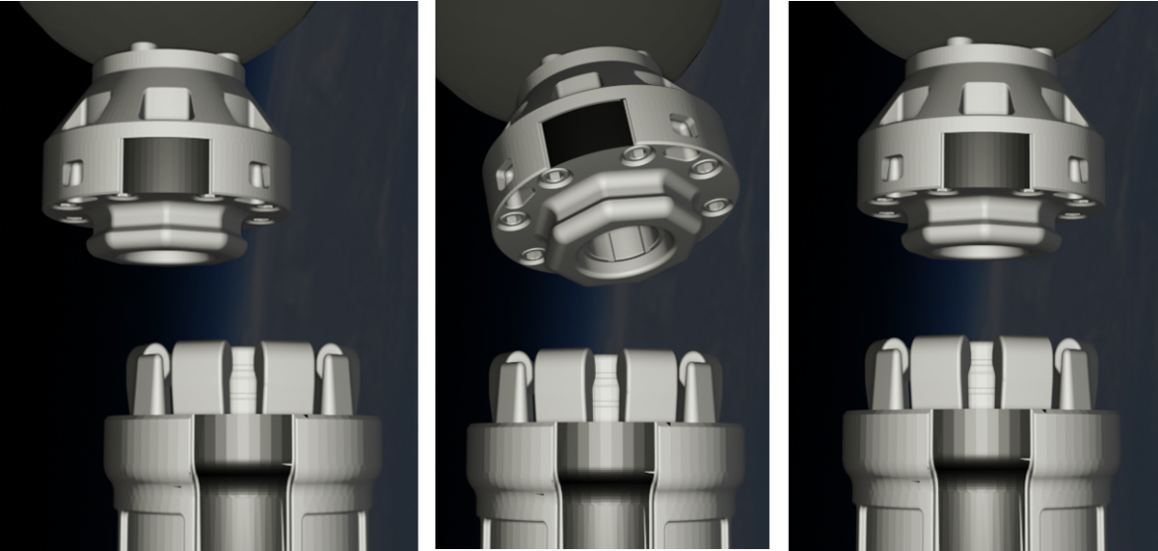
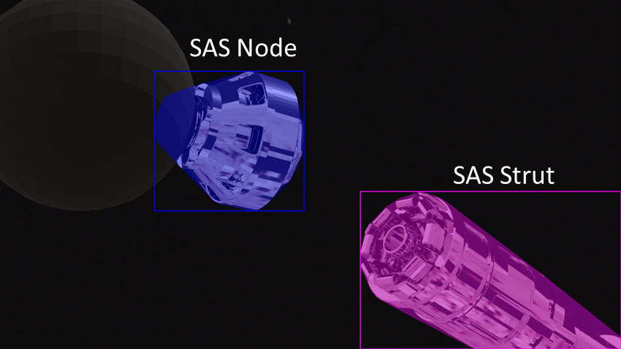
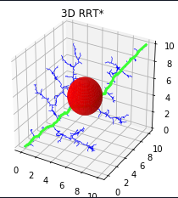
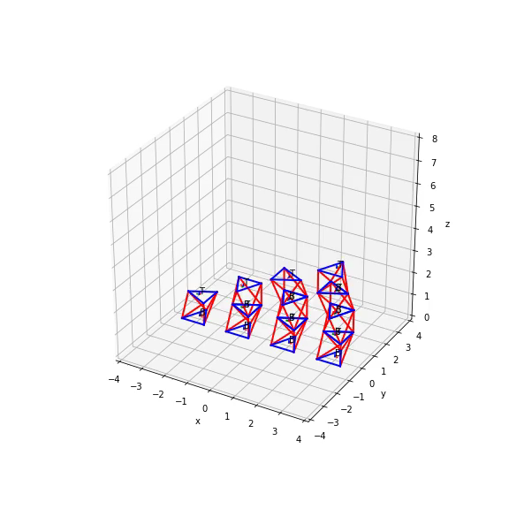
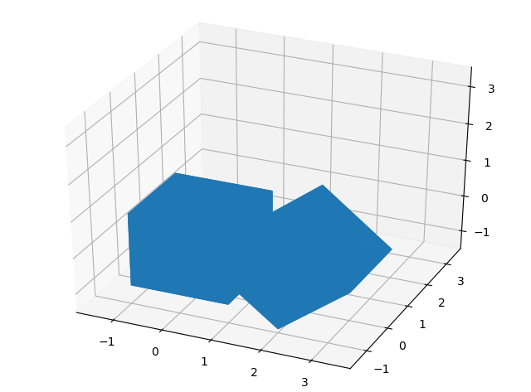
Assemblers: Pushing the Bounds of Autonomy
Multi-Agent Task Scheduling
Solutions to the NP-Hard Job Shop scheduling problem
Optimizes configuration and build given constraints
Planning and re-planning given off-normal situations
Configures, sequences and executes build
Fault Tolerance
Actuator redundancy
Modular interchangeability
Fault detection isolation and recovery
Modeling and Simulation
Reachability analysis
Modeling and V&V
Assembly Feasibility
Assembly Error Detection and Correction
Strut and Node alignment checks and
structural integrity checks using machine learning
Collision Checking and Trajectory Generation
Valid movement of structural components
Valid manipulator configurations
Safe paths through workspace
Reachability of Assemblers
configuration
Traveling through the waypoints with continuous velocity, acceleration, and jerk
Synthetic Images of Honeybee Robotics Strut Attachment System
This document is approved for public release
Notes:
GENERAL SLIDE TEMPLATE

Slide 6
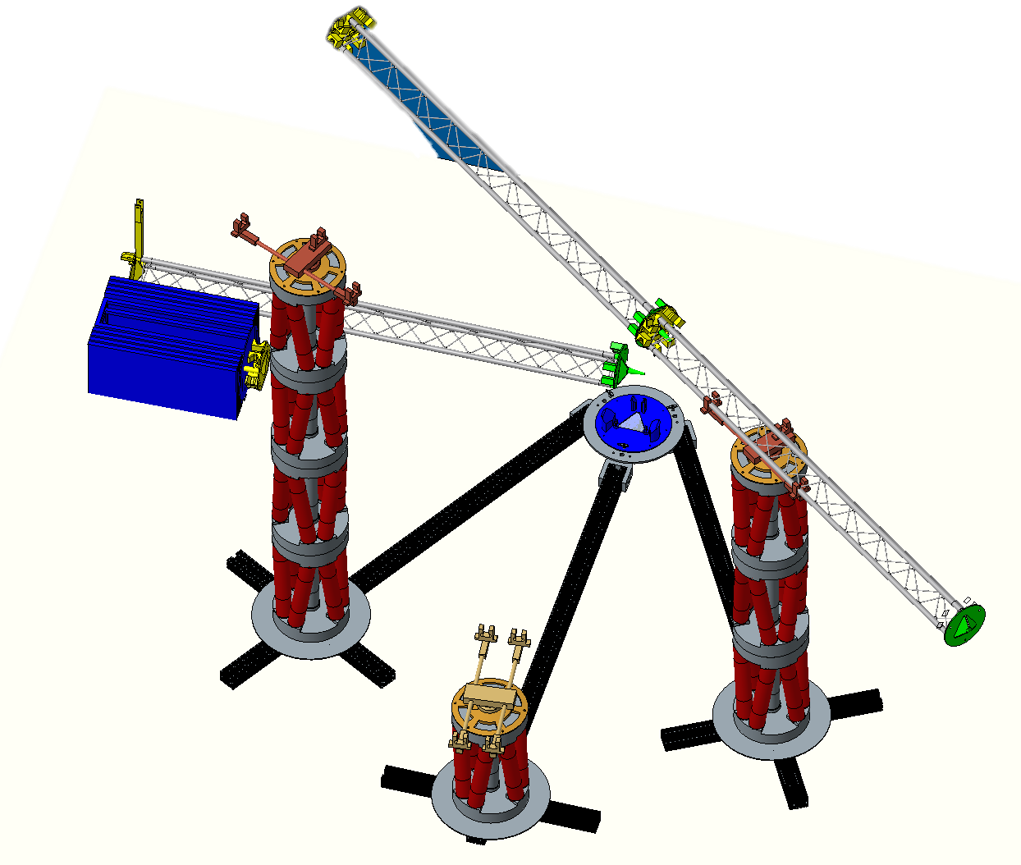
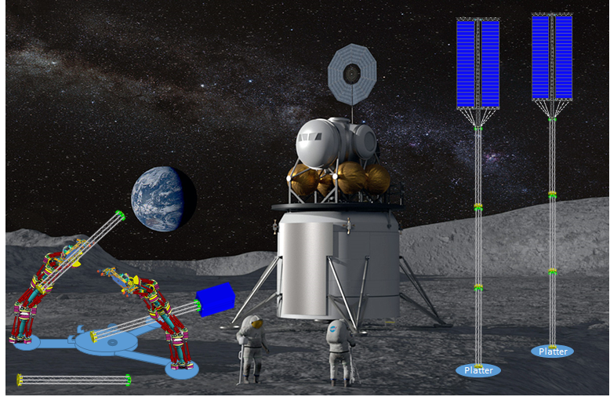
Assemblers: Project Summary and Opportunities for Infusion
Value:
Addresses negatives of current practice → Point designs that incur a large development cost up front and are inflexible during flight
Provides a modular design that can reconfigured to meet changing mission needs
Tool box approach which reduces the need for developing purpose-built hardware to perform additional critical functions
Strong, stiff, and accurate. No clunky motors as on traditional serial manipulators.
Addresses need for robust and reliable autonomous operations in high latency communication locations and environments
Versatile and long-lived manipulator system for on-orbit and surface assembly tasks
Opportunity:
High interest and support of Assemblers at NASA → 2-year funded STMD Early Career Initiative project. ~$2.5M
Low to Mid-TRL technology ready for TRL maturation into a flight project
Looking for partnerships to continue technology maturation in Autonomous in-space assembly and modular and reconfigurable long-life assembly manipulators
Partnerships:
Leveraging academia and industry for research and development ongoing
  Virginia Tech FASER Lab
  Honeybee Robotics
Multi-organizational collaboration between engineering, research, and operations groups at Langley Research Center
Notes:
GENERAL SLIDE TEMPLATE

Slide 7
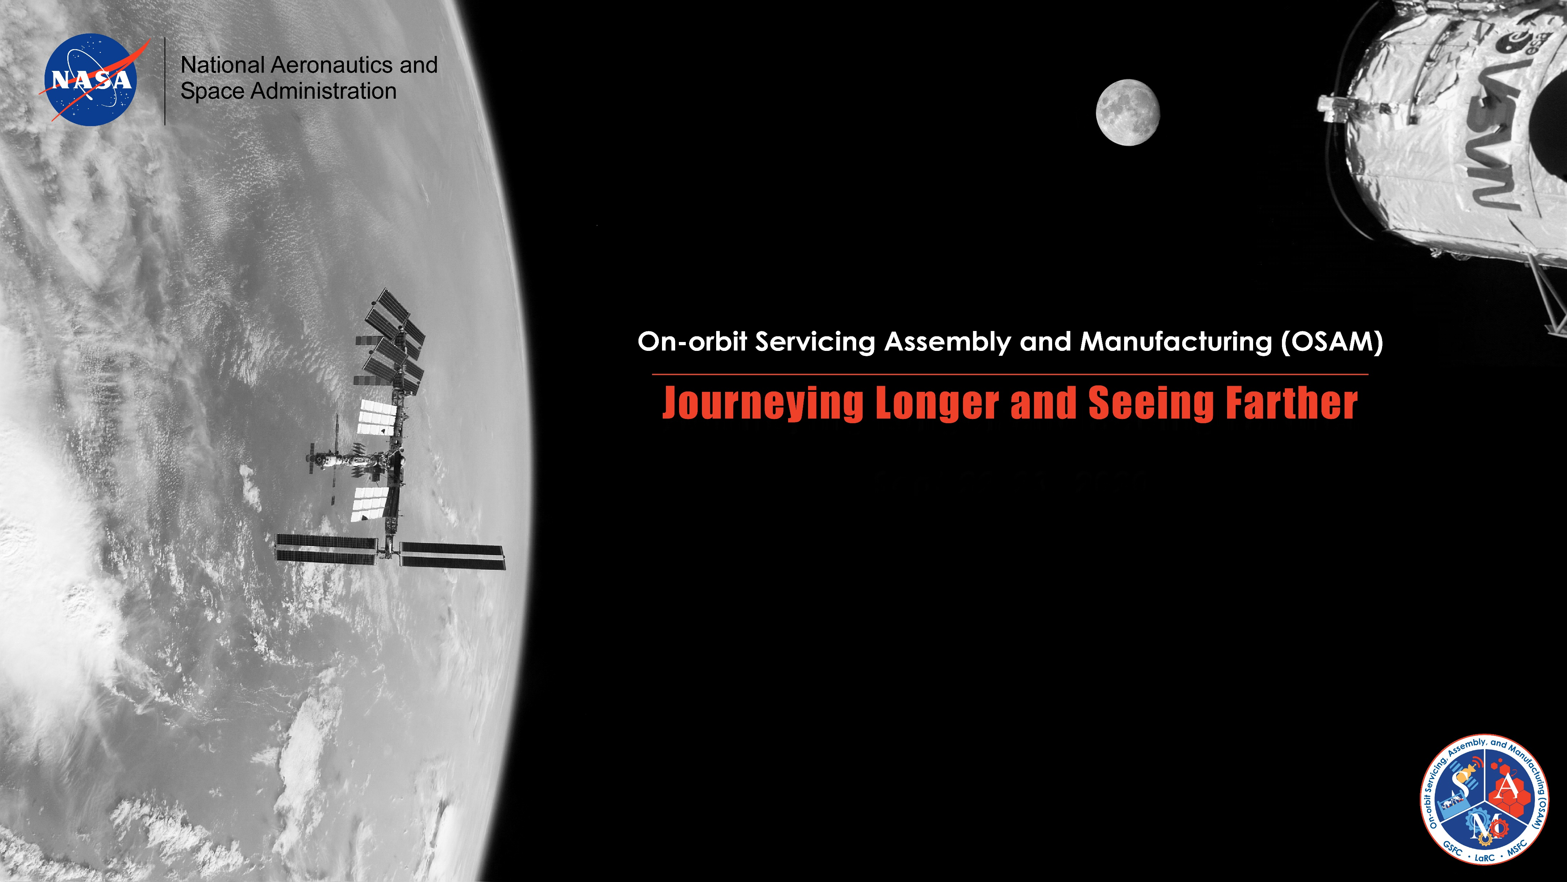

Project Team:
Jim Neilan: PI
John Cooper: Co-I Lead DCS
Matt Mahlin: Co-I Lead ME
Ben Kelley
Matt Vaughan
Laura White
Emma Brand
Jim Ecker
Walter Waltz
Iok Wong
John Mulvaney
Chris Herdey
Damon Schaefer
Students:
Sarah Frey, Sharon Toenjes, Tony Medina, Hamilton Payne, Jacob Martin, Jonah Vanke, Nate Hoege, Dominic Bisio, Conner Pulling, Jack Pope
Partners:
Virginia Tech
Honeybee Robotics
Robots are poised to make what was once thought to be impossible in space a reality. From extending the lifespan of satellites, to assembling massive life-seeking telescopes in space, to refueling and repairing spacecraft on journeys to distant locations, the possibilities are endless. Key to these endeavors is demonstrating the foundational capabilities – servicing, assembly, and manufacturing.
To arrange further discussion of on-orbit servicing technologies contact
Patrick Cosgrove (Patrick.a.cosgrove@nasa.gov)
Background Graphic: OSAM technologies continue the legacy of the Hubble Space Telescope (HST) Servicing Missions, and will be implemented to assist astronauts span and expand orbiting stations like the International Space Station (ISS). OSAM technologies will also support lunar surface and orbiting operations.

