Slide 1
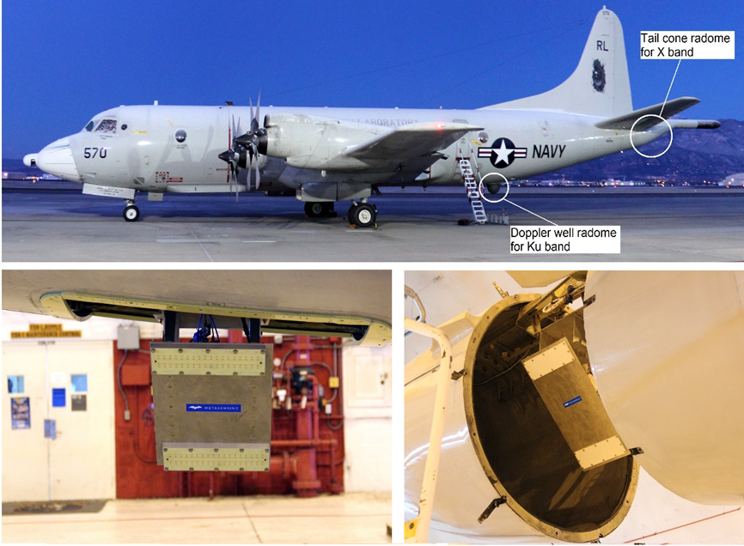




Preliminary SnowSAR Results from SnowEx 2017
Edward Kim^{1,} Jiyue Zhu², Leung Tsang², Do-Hyuk “DK” Kang^{1,3} and A. Coccia⁴
¹NASA Goddard Space Flight Center, Greenbelt, MD 20771, USA
² Radiation Laboratory, Department of Electrical Engineering and Computer Science, The University of Michigan, Ann Arbor, 48109-2122 MI USA
³ESSIC, University of Maryland, College Park, MD, 20740, USA
⁴MetaSensing, DKNoordwijk, 2201, The Netherlands
SnowEx 2017 central question:
How is SWE retrieval by volume scattering radar affected by forest?

Slide 2
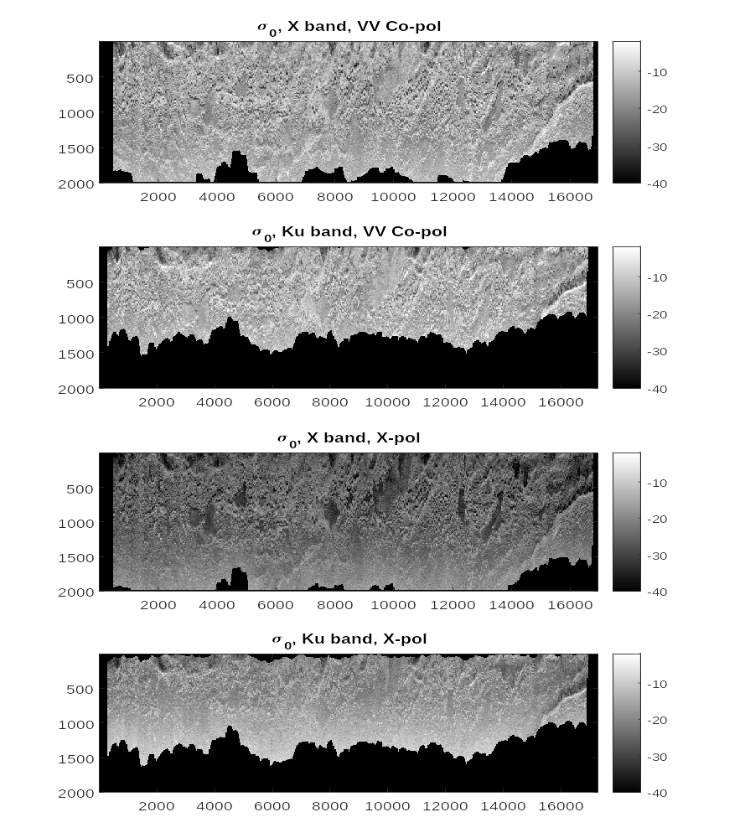
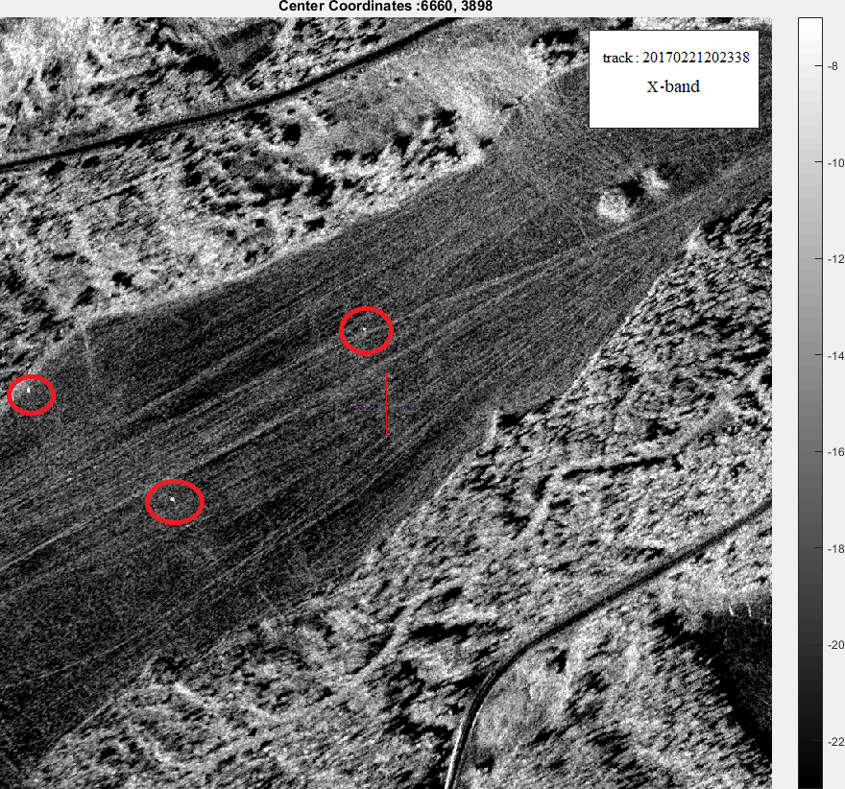
SNEX17_SnowSAR_20170221174335
Example 2017 data
SnowSAR observations from SnowEx 2017:
  X- (9.6 GHz) and Ku- (17.2GHz) bands
  full polarizations (VV, HH, VH, HV)
Flights: Feb. 16, Feb. 18, Feb. 21, and Feb. 22, 2017
  Most of the data from Feb. 21
pixel index
Sigma0 in dB
SnowSAR Ku-band backscatterer (sigma-0) image. VV polarization. Feb 21 2017 at 20:23 UTC. White linear streaks on lake are snowmobile tracks.
pixel index

Slide 3
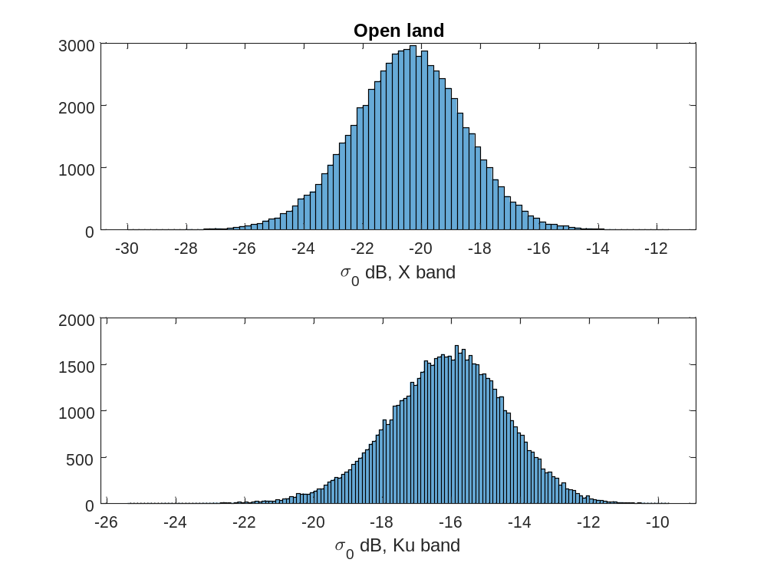
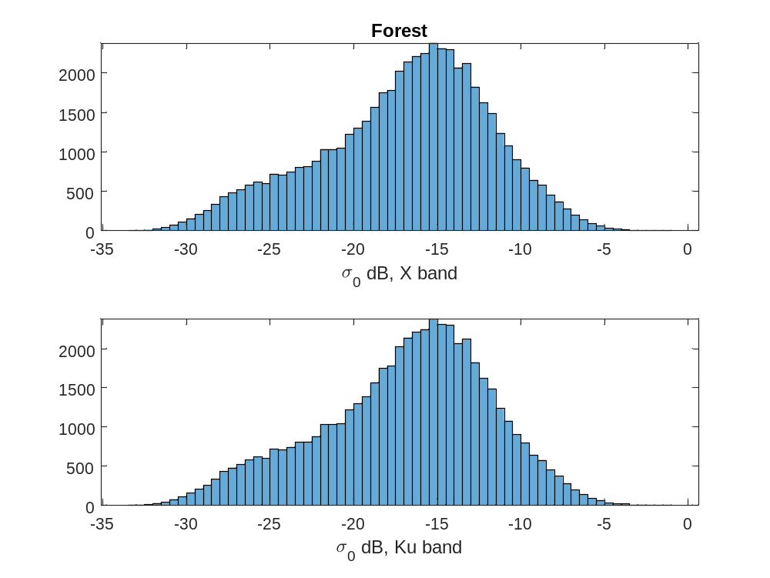
Backscatter difference: forest and open areas
Backscatter of forest area larger than that of open land
Backscatter at open land close to the Gaussian distribution, while more complex at forest areas
Check out SNEX17_SnowSAR data at NSIDC

Slide 4
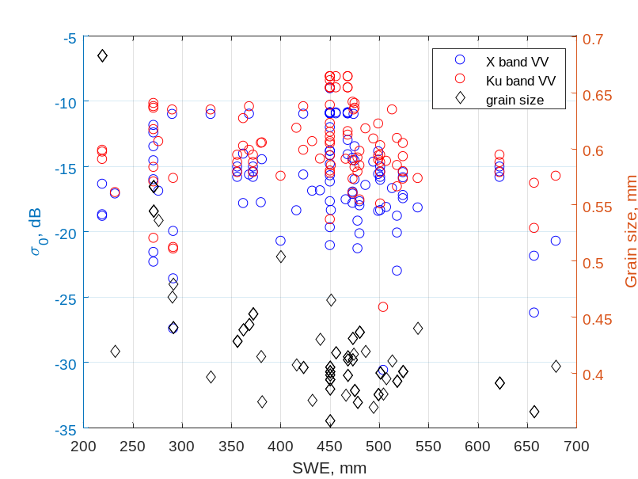
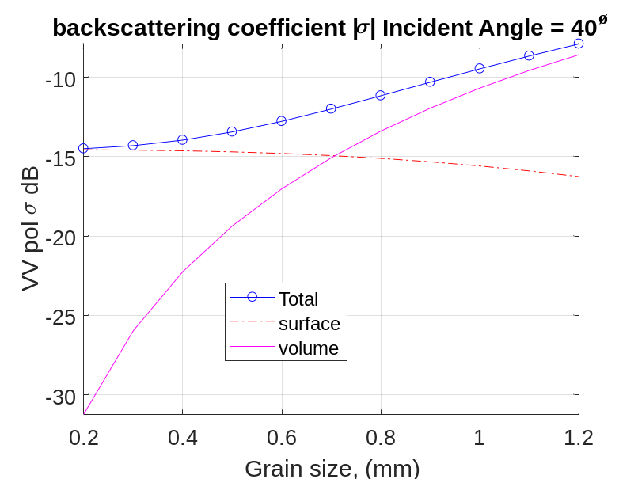
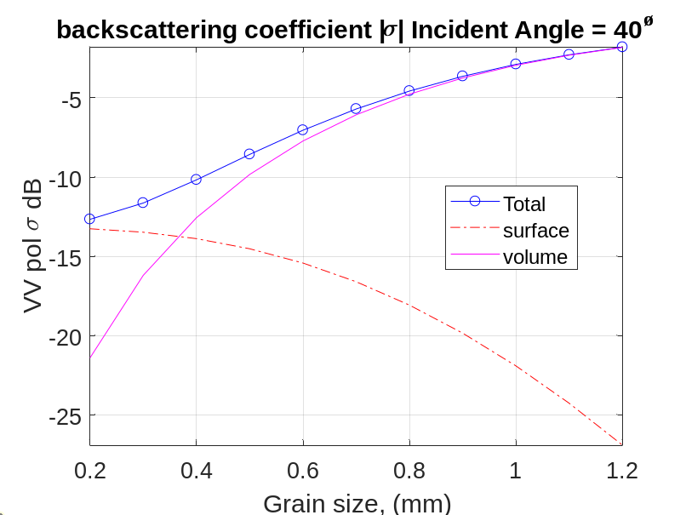

EM Simulation & SnowSAR Data are Consistent
Radar data
X band simulations
Ku band simulations
rms height= 0.5 cm,
OH for surface scattering,
snow depth 1.4m
$ε_{snow}=1.43$
$ε_{g}=4+1i$
Most Ku band data located between -16 dB to -10 dB
Most of X band data -22 dB to -10 dB
Mean grain size:0.4 mm
For grain size of 0.4 mm
Ku band: total -10 dB, surface -14 dB, vol -12 dB
X band: total -14 dB, surface -14.5 dB, vol -22 dB
Ku band backscatter expected mainly from snow volume scattering
X band backscatter expected mainly from surface scattering
Check out SNEX17_SnowSAR data at NSIDC

