Slide 1

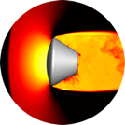
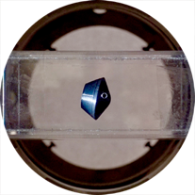
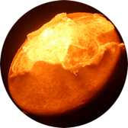
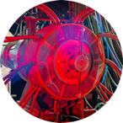
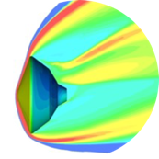

Space Technology Mission Directorate
Game Changing Development Program
Michael Barnhardt | Aaron Brandis | FY20 Entry Systems Modeling Annual Review Presentation | 09.16.20

Slide 2



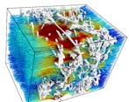
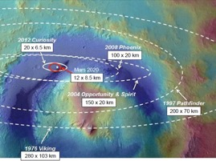
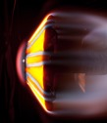
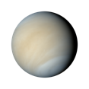
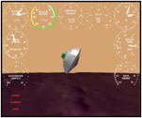
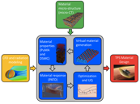
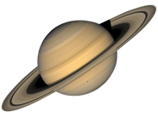


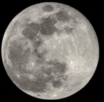


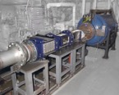
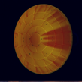

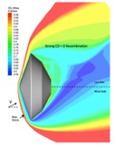

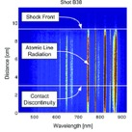

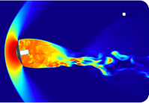
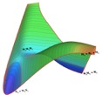

ESM Core Investment Areas
Predictive Materials Modeling
Advanced models for PICA, Avcoat and woven TPS; Micro- to engineering-scale analysis tools; Detailed material characterization and model validation
Guidance, Navigation, and Control
Entry guidance methods to enable precision landing of large robotic and human Mars missions
Aerosciences
Parachute dynamics; Free-flight CFD; Magnetic suspension wind tunnels; Experimental validation; Roughness, Advanced computational methods
Shock Layer Kinetics and Radiation
Radiation databases and models for Earth entry and other destinations of interest; High-fidelity coupled analysis tools

Slide 3
Predictive Material Modeling (PMM)
&
PICA-NuSil

Slide 4
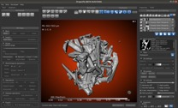
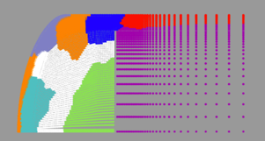
PMM
Technology Overview
Technology Goal: Develop and validate a high-fidelity volumetric ablation computational capability to support materials development and uncertainty analysis through a rigorous examination of the physical and chemical processes of ablation.
Technology Product Capability
  Span the length scale from microstructural to full aeroshell
  Extensive validation at the component and system level.
  Develop truly predictive models of material thermal and thermo-structural behavior that not only power next generation Aeroshell design, but also
  provide the framework for TPS failure mode prediction, reliability modeling,
  and eventually computational materials design.
Exploration & Science Impact
  Benefits all NASA missions with an EDL segment, including lunar return
  Save mass and/or improve system reliability
  Failure modeling will be critical path for high-reliability EDL applications (MSR and humans-to-Mars)
  Computational materials design will dramatically reduce development
  costs for new materials and will enable mission-tailored multi-functional TPS

Slide 5
PMM
Mission Infusion & Partnerships
Contributing partners & stakeholders
  NASA SMD/PSD, STMD/STRG, STMD/Flight Opps., SMD/ATAP, HEOMD/Orion, EPSCoR
  NASA ARC & JSC
  LBNL, Sandia, AFOSR, LLNL, MDA
  VKI, Ecole-Poly, Swiss Light Source
Infusion/transition plan
  Primary application to all NASA missions with entry thermal protection systems; partnerships with line organizations to act as software and data stewards after ESM
  Microstructural modeling has transformed the entire global ablation modeling paradigm
  Icarus infusion to OGA via partnerships, PATO & PuMA infusion to broad OGA/industry/academic base
  Orion, MEDLI, MEDLI2, MSR-EEV, Dragonfly
Approximate Contribution Value: $2.5M

Slide 6
PICA-NuSil
Mission Infusion & Partnerships
PICA-NuSil is a special topic leveraging the advances of PMM area
Contributing partners & stakeholders
  STMD/MEDLI2, STMD/Mars 2020, EPSCoR
  LBNL
  Idaho Space Grant Consortium
Infusion/transition plan
  Primary infusion path to MEDLI2 post-flight analysis
  Future application to all missions that fly NuSil-coated PICA
Approximate Contribution Value: $0.1M

Slide 7

PMM
Technology Goals & Project Objectives
Technology Goals
Goal #1 | Produce high-fidelity material models to reduce mission risk and improve design reliability
Goal #2 | Build efficient computational tools for benchmark and engineering analysis
Goal #3 | Obtain data for material model development and validation
Goal #4 | Create predictive capability for mission-tailored material design and reliability assessments
Project Objectives
Objective #1 | Support & supplement PICA-NuSil model development
Objective #2 | Modeling toolkit for woven TPS materials
Objective #3 | Collaborate with ESI-17 awardees on thermostructural modeling
Objective #4 | Update production engineering code Icarus with a focus on dust erosion modeling

Slide 8

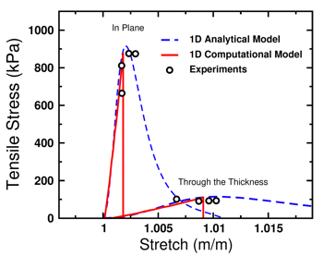
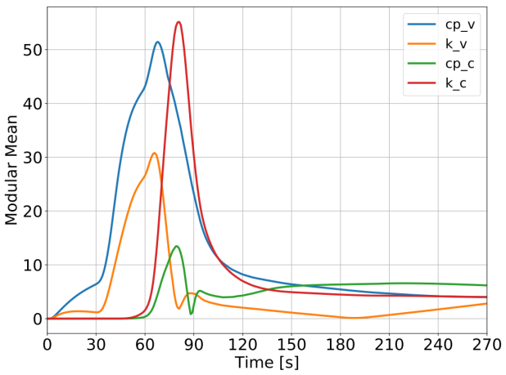
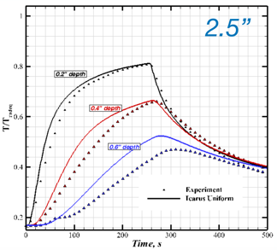
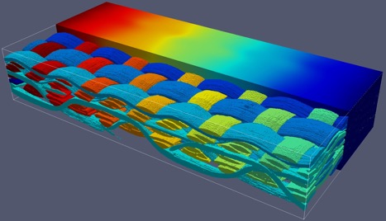
Accomplishments (PMM)
Key FY20 Technical Accomplishments:
  A material damage model for TPS developed (API)
  Sensitivity analysis of MEDLI TCs to environment and material properties
  Model of ADEPT weave
  Multi-D HEEET and baseline dust erosion models developed and implemented
Damage model applied to FiberForm
Material properties sensitivity for MISP2:TC2
2.5” off center
Thermal conductivity model for ADEPT
Multi-D LHMEL HEEET comparison (MSR-EEV)
Dust-erosion recession for Schiaparelli

Slide 9
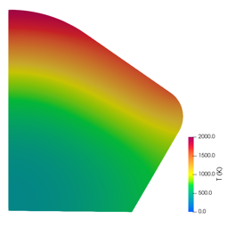
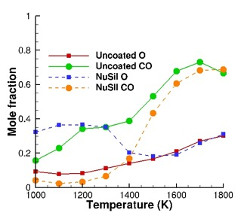
Accomplishments (PICA-NuSil)
Key FY20 Technical Accomplishments:
  High fidelity and engineering models developed for PICA-N material response (API)
  Molecular Beam Experiments on FiberForm & PICA
  Simulating HyMets to inform PICA-N model updates
Penetration Depth of NuSil
PATO simulation showing TC jump when NuSil layer ablates
Fibers
Coating
Details of gas surface interactions measured
Temperature at 35s (type 3 PICA-N)
CFD/ML of HyMets

Slide 10
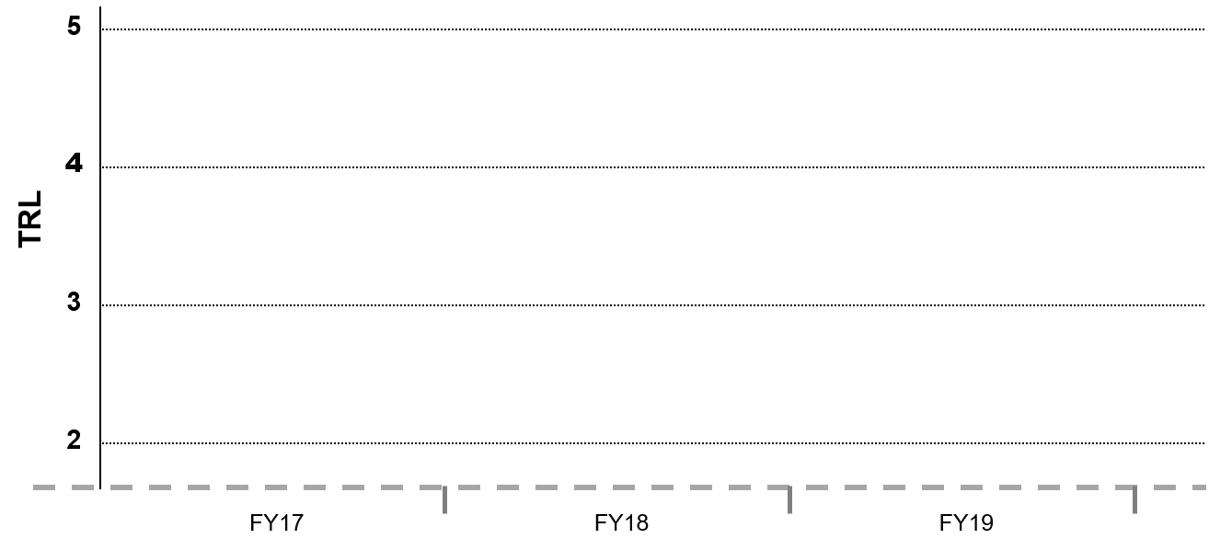
TRL Progression
PMM
Project Milestone
GCD (Key) Milestone
Controlled Milestone
TRL Progression
Solver for modulus of elasticity
Release of Icarus v1.3
PATO with updated RTV differential recession
3D Sizing
PuMA v3.0 release
PATOx v1.0 release
Couple PATO to DPLR
Solver for anisotropic conductivity
PATO
PuMA
Icarus
FY19
FY20
FY21

Slide 11
TRL Progression
PICA-NuSil
Project Milestone
GCD (Key) Milestone
Controlled Milestone
TRL Progression
Type 3 PICA-N model update
AHF/SPRITE validation
Analysis of LM articles
NuSil coating process development
HyMETS test #1
Demo initial Type 3 PICA-N model
--> MEDLI2 Reconstruction
Characterization of PICA-N gas-surface interactions
Develop basic SiO₂ chemistry models
Specify Finite-rate model for PICA-N
Graded material model
Initial graded model dev
Erosion model for SiO₂
Finite-rate chemistry
NuSil coating process
FY19
FY20
FY21

Slide 12
Shock Layer Kinetics & Radiation
(SLKR)

Slide 13
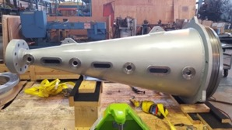
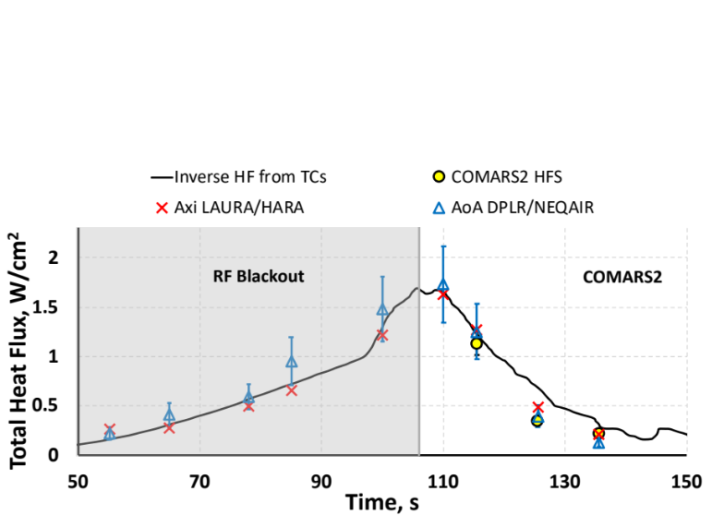
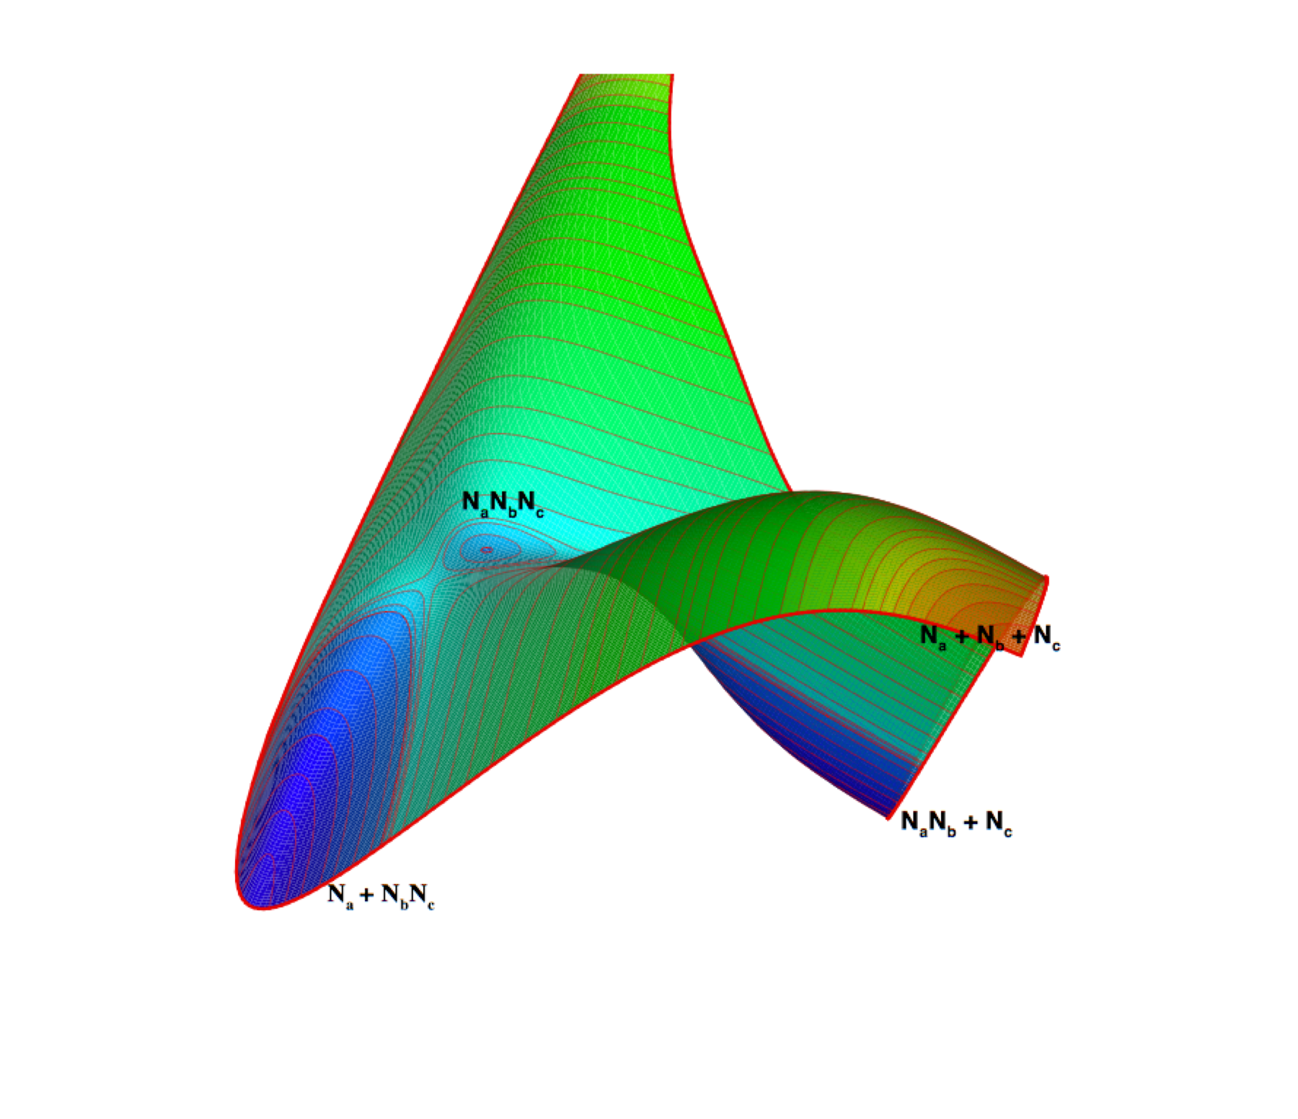
SLKR
Technology Overview
Technology Goal: Advance our understanding and modeling capability for atmospheric entry missions where shock layer radiation is a driver for TPS material selection and sizing. For missions where radiation is important, it is often the largest source of uncertainty in aerothermal predictions.
Technology Product Capability
  Experimental facilities and computational capabilities used to develop and validate new models and databases for the full spectrum of NASA missions.
  Fundamental quantum mechanical simulations that underpin the physics
  Emerging new models incorporated into Agency workhorse radiation codes.
  Exploration & Science Impact
  ​Benefits all NASA missions with an EDL segment, including lunar return
  Radiative heating is a substantial aeroheating contributor and the
  largest uncertainty for many missions
    As recently as MSL the community was unaware of its contributions for many applications (25% of heatshield heating and 50% of backshell heating for MSL)

Slide 14
SLKR
Mission Infusion & Partnerships
Contributing partners & stakeholders
  NASA SMD/PSD, STMD/STRG, SMD/ATAP, HEOMD/Orion, SCAP
  NASA ARC
  AFOSR
  University of Queensland, CentraleSupalec
Infusion/transition plan
  Primary application to all NASA missions with entry radiation; partnerships with line organizations to act as software and data stewards after ESM
  NEQAIR and HARA broad infusion to OGA/industry/academia
  Direct critical contributions to Orion, OSIRIS-ReX, InSight, Mars 2020, MSR, Dragonfly
  Working closely with funded efforts to return engineering data from flight missions, including Artemis/Orion, Mars 2020 and Dragonfly
Approximate Contribution Value: $2.6M

Slide 15
SLKR
Technology Goals & Project Objectives
Technology Goals
Goal #1 | Provide benchmark experimental databases & high-fidelity aerothermal models
Goal #2 | Reduce mission risk & aerothermal design margins due to radiation
Goal #3 | Anticipate mission needs in advance, and identify knowledge gaps
Goal #4 | Validate and improve models using flight data
Project Objectives
Objective #1 | EAST testing with new expansion cone in Air
Objective #2 | EAST testing with new expansion cone in CO₂/N₂
Objective #3 | Simulate the EAST facility with CFD to understand state of shocked test gas
Objective #4 | New quantum chemistry code to allow calculations for PES, dissociation rates, and line strengths

Slide 16
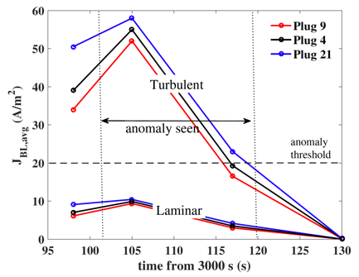
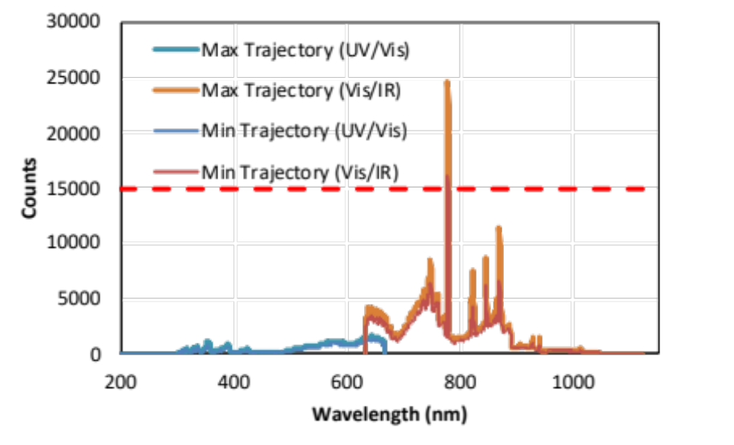
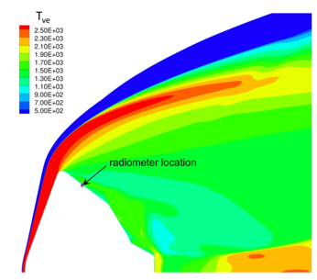
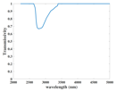
Accomplishments (SLKR)
Key FY20 Technical Accomplishments:
  Orion spectrometer calibration and conops completed
  Method for calculating attenuation of MEDLI2 radiometer due to ablation products derived
  Simulation of EAST expansion cone flow
  Potential cause for TC anomaly seen in Shuttle and Orion EFT-1 described
Analysis suggests flowfield-induced electric currents are the cause TC anomalies
Simulating the deposition of ablation products on MEDLI2 radiometer
Understanding flow inside EAST expansion cone
Calibrated Artemis II Flight Spectrometer and recommended signal levels

Slide 17
TRL Progression
SLKR
Project Milestone
GCD (Key) Milestone
Controlled Milestone
TRL Progression
Air expansion test
Comparison to EAST air data
Simulation of expansion section
Initial air testing
Expanding Flows
Simulation capability
Experimental capability
FY19
FY20
FY21

Slide 18
Computational &
Experimental Aerosciences
(CEA)

Slide 19
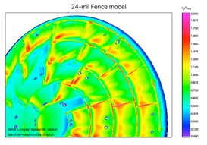
CEA
Technology Overview
Technology Goal: Develop numerical and physical models, along with supporting experimental techniques and validation databases, to address key gaps in modeling of complex entry and descent-specific aerosciences phenomena. Three of the four pacing challenges for NASA’s aerosciences discipline are directly relevant to entry and descent.
Technology Product Capability
  Fundamental improvements to the tools for aero-thermal simulation.
  Accurate prediction of unsteady flows with application to modeling base flow dynamics, vehicle dynamic stability, and parachute dynamics
  Generating mission-relevant databases to better understand the influence of roughness on aeroheating and flow transition
  Capability enhancements to support fluid flow and rocket plume interactions
  Exploration & Science Impact
  ​Benefits all NASA missions with an EDL segment, including lunar return
  Aerosciences modeling impacts all phases of EDL and encompass some
  of the largest technical challenges.
    Vehicle dynamics/separation, parachute dynamics, aeroheating, RCS interaction

Slide 20
CEA
Mission Infusion & Partnerships
Contributing partners & stakeholders
  NASA SMD/PSD, STMD/STRG, STMD/ADEPT, STMD/HEEET, SMD/ATAP, SMD/ASPIRE, SMD/MSR, ARMD/HTP, ARMD/AETC, NESC, EPSCoR
  NASA ARC, JSC, GRC, JPL, LaRC
  University of Queensland
Infusion/transition plan
  Primary application to all NASA EDL missions with an appreciable atmosphere
  Products transition to mission customers and line orgs for stewardship; each investment has a direct infusion plan
  Direct contributions to Orion, Mars 2020, MSR, Dragonfly, ADEPT SR1
Approximate Contribution Value : $3.5M

Slide 21
CEA
Technology Goals & Project Objectives
Technology Goals
Goal #1 | Expand and improve capabilities for predicting dynamic behavior including passive vehicle dynamics, parachute dynamics, supersonic retropropulsion, and RCS/jet interactions
Goal #2 | Generate foundational data for model development and tool validation
Goal #3 | Design and evaluate high-order computational methods for aerothermodynamics applications
Project Objectives
Objective #1 | Design, build, and test magnetic suspension wind tunnel for low-cost, high-fidelity measurements of vehicle dynamics and aero model development
Objective #2 | Validate computational tool(s) for simulating vehicle dynamics
Objective #3 | Develop and validate benchmark tool for simulating parachute descent dynamics
Objective #4 | Generate experimental databases of turbulent heating/transition due to block and woven TPS pattern roughness
Objective #5 | Develop numerical methods for high-order shock capturing and evaluate accuracy v. cost on irregular meshes

Slide 22
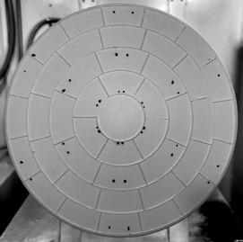
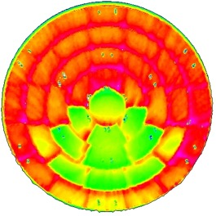
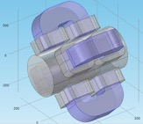
Accomplishments (CEA)
Key FY20 Technical Accomplishments:
  MSWT: Successful dynamic stability test review. Tested several flight vehicles
  Free Flight: Drag skirt separation event demonstrated (API), Genesis range experiment and flight simulated
  MRR: Roughness augmented heating evaluated for block & woven TPS
  Numerical Methods: Implementation of arbitrary high-order FE basis and geometrical shape functions for standard elements.
First free-to-pitch tests of EEV geometry
Block–gap roughness
(e.g Avcoat, PICA)
Free flight simulation for the separation of a drag skirt and aeroshell
Supersonic MSBS design configuration

Slide 23
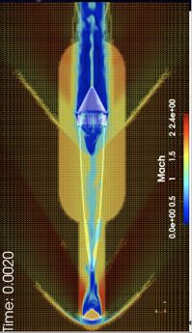
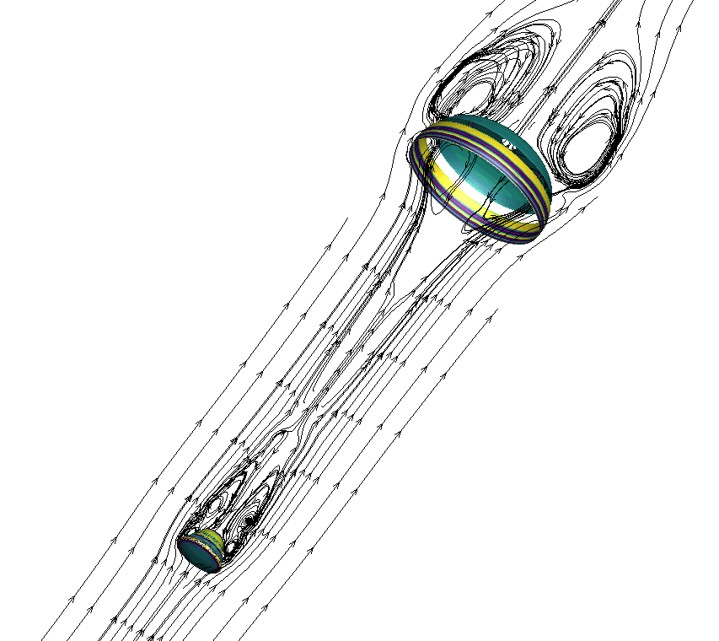




FY20 Accomplishments (Parachute FSI)
Supported continued development of Stanford FSI capability and its transition to JPL stakeholders
6-DOF simulations of a capsule-canopy system during descent
Shell structural model with arbitrary-order in time and space
Novel arbitrary-order eikonal solver to support meshing, immersed elements, turbulence models, …
Spectral multigrid preconditioning techniques across Navier-Stokes, mesh deformation, level set, and shell structural solver
Experiment planning for validation of inflation modeling
Biaxial test design for parachute material property measurement
Parachute TIM planning (NASA, academia, industry)
Early Stage Innovations (STRG Program) topic to be awarded this fall
Flow around Decelerating
(rigid) Capsule-Canopy System
Stanford FSI capability to simulate supersonic parachute deployment
8th-order Level Set Around NACA 30P30N
Continued integration between technical teams and stakeholders in SMD (Mars and Titan probes), HEOMD/CCP (Orion, CCP vehicles), and NESC
Micro scale
Meso scale
Extension of structural shell model
Multiscale Structural Shell Modeling

Slide 24
TRL Progression
CEA
Project Milestone
GCD (Key) Milestone
Controlled Milestone
TRL Progression
MSWT Phase I Test Review
Subsonic Validation
Supersonic Validation
Transonic Validation
Measure Subsonic Stability Coefficients
Single canopy simulation
MSWT Subsonic Wind On
Mesh motion and 6-DOF capability
Magnetic Suspension Wind Tunnel (MSWT)
Free-flight CFD
Near-body mesh generator
Parachute FSI
FY19
FY20
FY21

Slide 25
Guidance, Navigation & Control
(GNC)

Slide 26
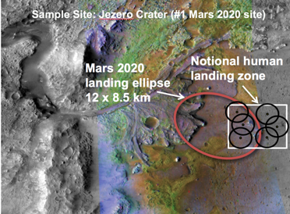
GNC
Technology Overview
Technology Goal: Develop robust and precise guidance, navigation, and control techniques to meet requirements of future missions, including humans-to-Mars. Implement and verify end-to-end EDL simulation capabilities.
Technology Product Capability
  ESM focus on entry GNC; collaborate closely with SPLICE, DSS for descent and landing technologies
  Improved entry guidance algorithms and controllers that will enable accurate placement of high-mass payloads to the point where descent and landing systems become autonomous
  Exploration & Science Impact
  ​Enabling for precision human landing on Mars
  Increase landed payload and/or site access, optimize
  propellant usage

Slide 27
GNC
Mission Infusion & Partnerships
Contributing partners & stakeholders
  NASA SMD/PSD, STMD/STRG, STMD/ECI, STMD/SPLICE, STMD/DSS
  NASA LaRC, JSC
Infusion/transition plan
  Application to all NASA missions with a guided entry phase
  Direct interfaces with SPLICE and Descent Systems Study
  Transition to human Mars exploration effort, potentially MSR lander
Approximate Contribution Value: $1.3M

Slide 28
GNC
Technology Goals & Project Objectives
Technology Goals
Goal #1 | Develop methods for guidance and control to enable precision landing of high-mass planetary spacecraft
Project Objectives
Objective #1 | Construct 6-DOF guided entry and descent simulations for HIAD and CobraMRV architectures
Objective #2 | Demonstrate basic performance and design feasibility within architecture constraints of one or more methods of multi-axis control
Objective #3 | Incorporate navigation sensor models for end-to-end simulation capability

Slide 29
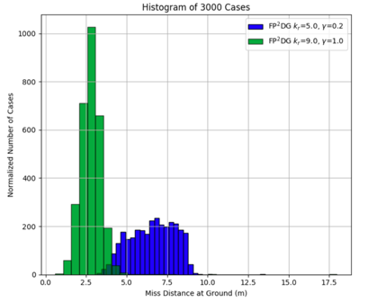

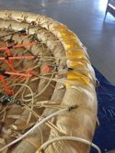
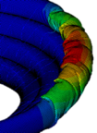
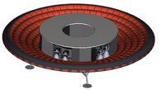





FY20 Accomplishments (GNC)
Model updates for Mid-L/D configurations demonstrate potential to achieve 50m target landing radius
Controllers and models developed and implemented for Low-L/D direct force control (flaps, shape morphing), with both demonstrating a feasible approach with NPC guidance
Multiple special sessions and papers presented at AIAA SciTech 2020 conference
Adapted end-to-end simulation framework to support Artemis Human Lander System (HLS) evaluations
2018 ECF awards now 2/3 through period of performance, with other universities interested in participating in entry guidance development
ESM GNC Task Rescope for FY21:
  Parallelize POST2 to ultimately enable advanced modeling for all subsystems including GNC
  Develop interoperability framework for POST2 to integrate with external applications and physical modeling capabilities
Mid-L/D miss distance results
Miss distance at ground well within 50m target
Low-L/D shape morphing with benchtop model

Slide 30
TRL Progression
GNC
Project Milestone
GCD (Key) Milestone
Controlled Milestone
TRL Progression
Proposing efforts to incorporate morphing shape model in LOFTID EDU (e.g., DSS, ESI, etc.)
Complete Morphing Shape Sizing and Performance
Paper on updated 6-DOF model for mid L/D configuration
6-DOF EDL performance comparison of HIAD and Mid-L/D concepts
Complete Flap Sizing and Performance
TRL Advancement limited by lack of hardware development/validation
Incorporate ECF algorithms
Morphing Shape
Flaps
FY19
FY20
FY21

Slide 31
ESK Key Performance Parameters (KPP) to Close
Key Performance Parameters
Parameter | Units | State of the Art (SOA) | Threshold Value | Project Goal | Current Value To Date | Current Value: Technical Basis of Estimate | Expected Exit Value | Exit Value: Technical Basis of Estimate
FF: Pitch damping coefficient Supersonic | % | 100 | 75 | 25 | 5 | Comparison to ballistic range data | 5 | KPP met
FF: Pitch damping coefficient Transonic | % | 125 | 100 | 50 | 10 | Comparison to ballistic range data | 10 | KPP met
FF: Drag coefficient Supersonic | % | 5 | 3 | 1 | 1 | Comparison to ballistic range data | 1 | KPP met
FF: Drag coefficient Transonic | % | 15 | 10 | 5 | 1 | Comparison to ballistic range data | 1 | KPP met
GNC: Landing accuracy and precision | m | 20000 | 5000 | 50 | 10 | Monte Carlo analysis, but some constraints still need to be lifted | 10 | KPP met, task re-scoped
GNC: Payload-to-entry mass fraction | Ratio | 3 | 2.75 | 2.5 | 3 | Not improved over SOA | 3 | Task re-scoped
Parallel scaling of Icarus | % | N/A | 50 | 100 | 80 | Icarus scaling performance evaluated | 80 | Parallel scaling threshold surpassed

Slide 32
ESK Key Performance Parameters (KPP) to Close
Key Performance Parameters
Parameter | Units | State of the Art (SOA) | Threshold Value | Project Goal | Current Value To Date | Current Value: Technical Basis of Estimate | Expected Exit Value | Exit Value: Technical Basis of Estimate
PICA-N: NuSil temperature jump | % | N/A | 50 | 20 | 50 | Comparison to PICA-N HYMETS data | 50 ⁽¹⁾ | Task rolled into MEDLI2
PICA-N: Accuracy of reconstructed heating using in-depth TCs | W/cm² | 45 | 25 | 10 | 45 | Delays in experiments | 45 | Task rolled into MEDLI2
Fidelity of air model Forebody: Margin | N/A | 1.81 | 1.65 | 1.50 | 1.81 | No change | 1.81 | Model error KPP met
Fidelity of air model Forebody:Model error | % | 100 | 60 | 20 | 8 | NEQAIR, HARA, EAST comparison | 8 | KPP met
Fidelity of air model Backshell: Margin | N/A | 1.60 | 1.55 | 1.50 | 1.60 | No change | 1.60 | Focus on model error KPP
Fidelity of CO2 model Forebody: Margin | N/A | 2.67 | 2.30 | 1.80 | 2.67 | No change | 2.67 | Focus on model error KPP
Fidelity of CO2 model Backshell: Margin | N/A | 1.50 | 1.45 | 1.40 | 1.50 | No change | 1.50 | Focus on model error KPP
Notes: ⁽¹⁾ Agreement with HYMETS data closer to 6%, but need to compare against future experiments from AHF and with high-fidelity model.

Slide 33
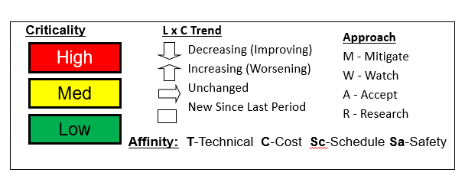
Risk Summary
L
I
K
E
L
I
H
O
O
D
 |  | 53 56
5
Risk ID | Affinity | Description/Status | Trend
57 | Sc | GNC: Personnel Availability
56 | Sc | MRR: Facility Availability
53 | R,M/T | PICA-N: Model Accuracy
49 | R/T | MSWT: Separating Magnetic and Aero Forces
34 | M/T | MSWT: Model Free Motion
40 | M/T | HVST: Data Interpretation of Expanding Flow Expt.
36 | M/T | HVST: Expansion Cone Flow Quality
4
3
36 40 49
2
1
1
2
3
4
5
CONSEQUENCES
CLOSED:
ID | Date | Title | Impact
34 | 01/22/2020 | MSWT: Model Free Motion | Accepting limitations and will run in 1-DOF mode
57 | 08/28/2020 | GNC: Personnel Availability | GNC scope replanned per request of TAPR board. New scope aligned with available personnel.

Slide 34
Project Assessment Summary
Project Name | Performance |  |  |  | Comments
 | C | S | T | P
Mid Year |  |  |  |  | Schedule – Facility delays across multiple tasks due to repairs: Electric Arc Shock Tube (EAST), Langley Aerodynamic Laboratory (LAL), HYMETS
Annual |  |  |  |  | Schedule – Facility delays across multiple tasks due to COVID-19. Largest impact to PICA-NuSil effort has been inability to obtain arc jet data for model validation. Thanks to support of STMD, ESM has obtained mission critical approval and is positioned for arc jet entry at the end of October.

Slide 35
EPO Summary
50+ publications and presentations in FY20, with many journal articles in process
  AIAA Thermophysics Best Paper: Palmer et al, “Modeling Heatshield Erosion due to Dust Particle Impacts for Martian Entries”
  AIAA Thermophysics Best Student Paper: Erb et al, “Investigation of Galileo Probe Entry Heating with Coupled Radiation and Ablation”
50+ student collaborations (interns, fellows, and grants)
Other EPO activities
Date | EPO Activity | Representative
Jul. 2020 | Published in NASA.gov as a contributor in the article: Ames Contributions to Mars 2020 Mission | Mike Barnhardt
Mar. 2020 | Tour and discussion of HFFAF with Nathan Tichenor, Director of Hypersonic Facilities, Bush Combat Development Complex, Texas A&M. | Mike Wilder
Mar. 2020 | Best AIAA student paper in thermophysics for “Investigation of Galileo Probe Entry Heating with Coupled Radiation and Ablation,” which was presented at last summer’s AVIATION meeting | Erb, West, Johnston
Mar. 2020 | Best AIAA in Thermophysics for "Modeling Heatshield Erosion due to Dust Particle Impacts for Martian Entries", which was presented at last summer's Aviation meeting | Grant Palmer
Mar. 2020 | Ph. D. Thesis Committee, Maitreyee Sharma, Univ. Illinois Urbana-Champaign | Rich Jaffe
Jan. 2020 | Ph. D. Thesis Committee, Matt Leibowitz, CalTech | Brett Cruden & Aaron Brandis
TBD | Ph. D. Thesis Committee, Jesse Streicher, Stanford Univ. | Brett Cruden
Dec. 2019 | Participated in Career Day at Peninsula Catholic High School, in Newport News, VA | Monica Hughes
Nov. 2019 | M. Sc. Thesis: Numerical Study of Aerothermal Environments in NASA Arc-jet Facility was awarded the Robert Bird Group Prize for the best thesis at the Imperial College, London. | Almudena Parente Rodriguez
Nov. 2019 | Ph. D. Thesis Committee, Durgesh Chandel, Univ. Minnesota | Aaron Brandis
Nov. 2019 | Ph.D. Thesis Committee, Ayoub Gouasmi, Univ. Michigan | Scott Murman
Ongoing | Vargas/IST Lisbon Thesis Committee | Brett Cruden
Ongoing | Secretary, Executive Committee, AVS (Nor. Cal. Chapter) | Brett Cruden
Ongoing | Chair, Scholarship Committee, AVS (Nor. Cal. Chapter) | Brett Cruden
Ongoing | Technical Committee, AIAA Thermophysics | Multiple
Ongoing | Oganizing Committe, International Planetary Probe Workshop | Multiple
Ongoing | Scientific & Organizing Committee, Ablation Workshop | Michael Wright

Slide 36
Project Summary
Summary Highlights
ESM continues to deliver impactful capabilities for NASA missions on budget and (mostly) on time
50+ papers and presentations in FY20, including two AIAA best paper awards
Expanding partnerships
  Mars Sample Return EEV
  Tighter collaboration with Orion/JSC on Avcoat modeling
  New agreements in work with DLR (Germany), CentraleSupelec (France), Instituto Superior Tecnico (Portugal)
Lesson Learned
Plan and execute experiments before you need the data
Looking Ahead to FY21+
Close out PICA-NuSil arc jet test and analysis to support MEDLI2 post-flight
Backshell radiation validation in air and CO₂ environments with Electric Arc Shock Tube (EAST)
HEEET thermal response model for MSR-EEV
Validation of parachute inflation and descent simulations
New-look GNC: High-performance version of POST2 and interoperability with higher-fidelity models, e.g. CFD
Kick-off new content: MEDLI2 Deep-dive; TPS Certification by Analysis; Hypersonic Wake Flows

Slide 37
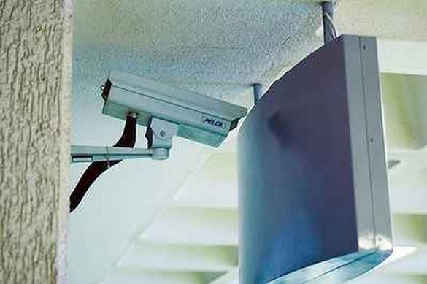
BACKUP

Slide 38
Predictive Material Modeling (PMM)
&
PICA-NuSil

Slide 39
Shock Layer Kinetics & Radiation
(SLKR)

Slide 40
Computational &
Experimental Aerosciences
(CEA)

Slide 41
Guidance, Navigation & Control
(GNC)

Slide 42
EPO Summary Chart: Conferences Attended
Conference Name | Papers/Posters/Panel Discussions
10/2/2019 | Materials Science ant Technology
10/28/2019 | Gaseous Electronics Conference
11/23/2019 | 72nd APR-DFD
1/6/2020 | AIAA SciTech (22 presentations)
5/30/2020 | European Geophysical Union
6/15/2020 | AIAA Aviation

Slide 43
EPO Summary Chart: Students/Professors (1/3)
Topic | Center | Mentor | Student | School
Computational chemistry for Panesi radiation-ablation ESI | ARC | Rich Jaffe | Maitreyee Sharma | UIUC
Parachute FSI | ARC | Scott Murman | Ayoub Gouasmi | U. Michigan
Data Reduction Dev in Support of Subsonic MSWT | LaRC | Mark Schoenenberger | Colton Finke | Texas A&M
Electromagnetic position sensing development for MSWT | LaRC | Mark Schoenenberger | Michell Weinmann | ODU
Uncertainty Analysis of the Pitch Damping Coefficient of Blunt Bodies, Measured from Magnetic Suspension Wind Tunnel Tests | LaRC | Mark Schoenenberger | Quincy Mckown | Stanford
Study of Uncertainty Associated with Various Dynamic Stability Testing Techniques | LaRC | Mark Schoenenberger | Otoniel Ramirez | ODU
6-DOF simulation and data reduction for MSWT | LaRC | Dave Cox | Shane Scott | Va. Tech
Generation of Virtual Woven Composites | ARC | Nagi Mansour | Robert King | U. Utah
PATO uncertainty quantification with Dakota | ARC | Nagi Mansour | Derick Ober | Los Gatos HS
High-order DG with shock fitting | LaRC | Alireza Mazaheri | Luke D'Aquila | Clarkson
MPI IO in DNA | LaRC | Alireza Mazaheri | Sergio Servantez | Northwestern U.
Nonequilibrium Chemistry | LaRC | Alireza Mazaheri | Dean Yuan | Michigan U.
High-order DG with shock fitting | LaRC | Alireza Mazaheri | Tristen Ball | Clarkson
Diagnostic development for arc jets: plasma magnetic field measurements | ARC | Nagi Mansour | Sebastian Colom | Cornell
Refactoring of existing modules and extensive unit and system testing | ARC | Nagi Mansour | Ian Taylor | Portland State U.
Implementing rotation tensors on the thermal conductivity matrix on PATO | ARC | Nagi Mansour | Marina Sessim | U. Florida
Implementing a 1-D finite rate solver in PETSc/OpenFOAM | ARC | Nagi Mansour | Uman Agarwal | Stanford
Melt flow modeling in TPS simulation | ARC | Nagi Mansour | David Henneaux | VKI
Uncertaity quantification for TPS modeling | ARC | Nagi Mansour | Joffrey Coheur | VKI
Magnetic reconnection modeling for ArCHeS | ARC | Nagi Mansour | Quentin Wargnier | Ecole Polytechnique

Slide 44
EPO Summary Chart: Students/Professors (2/3)
Topic | Center | Mentor | Student | School
Autimatic Lagrange basis evaluation for the DNA code | LaRC | Alireza Mazaheri | Micaiah Smith-Pierce | Georgia Tech
Free-flight CFD | ARC | Joe Brock | Madilyn Drosendahl | Georgia Tech
Thermostructural modeling of TPS | ARC | Eric Stern | David Dang | U. Michigan
MMOD TPS Impacts | ARC | Eric Stern | Olivia Schroeder | U Minnesota
 | ARC |  | Umran Duzel | U. Kentucky
CO2 radiation in HET | ARC | Brett Cruden | Matt Leibowitz | CalTech
Vib-specific CO/CO2 modeling and UCLA data | ARC | Brett Cruden | Christopher Jelloian | UCLA
1-D modeling of EAST | ARC | Aaron Brandis | Ali Lasemi | UIUC
NEQAIR modeling of ablation products (Add NH; improve CN non-Boltzmann) | ARC | Brett Cruden | Sam Chen | U. Michigan
NEQAIR/DPLR coupling for Orion | ARC | Aaron Brandis | Oscar Klempay | Georgia Tech
Modeling the melt of Arc Jet electrodes | ARC | Meurisse, Mansour | Andrea Fagnani | VKI
Uncertainty Quantification of thermal response models | ARC | Nagi Mansour | Przemyslaw Rostowski | UIUC
Diagnostics in the mini-Arc and EAST | ARC | Brett Cruden | Diana Luis | VKI
US3D-NEQAIR Coupling | ARC | Khalil Bensassi | Luis Sandoval | Lisbon
EAST Simulations with US3D | ARC | Aaron Brandis | Durgesh Chandel | Uminn
Machine Learning for fitting potential energy surfaces | ARC | Rich Jaffe | Simone Venturi | UIUC
Ro-vibrational specific transport coefficients | ARC | Rich Jaffe | Sharanya Subramaniam | UIUC
Guidance, Navigation and Control | JSC | Jeremy Rae | Ran Dai | University of Ohio
Guidance, Navigation and Control | LaRC | Alicia Dwyer Cianciolo | Jay McMahon | UC-Boulder
Guidance, Navigation and Control | JSC | Dave Woffinden | Zachary Manchester | Sanford University
Multiscale modeling for fabrics | ARC/GRC | Brett Cruden | Brandon Hearley | NC State

Slide 45
EPO Summary Chart: Students/Professors (3/3)
Topic | Center | Mentor | Student | School
Segmentation of Lightweight Ablator Micro-Tomography Using Deep Learning | ARC | Brody Bessire | Ben Ringel | UIUC
Catalysis modeling in the UVT Plasma Torch and validation against US3D | ARC | Khalil Bensassi | Samuel Whitmore | Univ Vermont
The Impact of Particle-Laden Flows on Planetary Entry Aerothermodynamics | LaRC | Chris Johnston | Andrew Hinkle | Missouri Univ. of Science and Tech
O3 PES validation with Minton data | ARC | Rich Jaffe | Eric Geistfeld | U. Minnesota
 | ARC |  | Joseph Ferguson | Stanford
Visiting Scholar | ARC |  | Almudena Parente Rodriguez | UIUC
Visiting Scholar | ARC |  | Alba Arona Maranchon | UIUC
Visiting Scholar | ARC |  | Marcos Acin | UIUC
Visiting Scholar | ARC |  | Alexandre Quintart | UIUC

Slide 46
EPO Summary Chart: International Partners
Partner | Title | Owner | Status
U. Queensland | Study of Radiative Heating in Strongly Expanding Flow | ESM | Completed
U. Queensland | Study of Turbulent and Transitional Heating in CO2 (Annex) | ESM | Active
CentraleSupelec (Paris) | Equilibrium Radiation Measurements in the Plasma Torch Facility | ESM | Completed
DLR | Experimental and Computational Multi-Body Aerodynamic Studies | ATAP | Active
DLR | Experimental and Computational Dusty Flow Studies (Annex) | ESM | Active
JAXA | Experimental Studies of Radiation in the HIEST Shock Tube | Orion | Active
Oxford | Experimental and Computational Study of Shock Layer Radiation | ESM | Active
U. Queensland | Proposal submitted on "Non-equilibrium reacting shock layers" | ESM | In Process
Inria Bordeaux-Sud Ouest (France) | High-Order Shock Capturing for DG | ESM | Completed

Slide 47
EPO Summary Chart: Publications (1/4)
52 Publications published or submitted in FY20
Title | Primary Author | Venue | Date
Icarus v1.2: a scalable tool for spacecraft TPS modeling | Stern, Eric | Materials Science & Tech | 10/2/2019
Icarus User Manual: Release v1.2.0 | Schulz, Joey | NASA TP | 10/11/2019
Dissociative recombination (DR) and associative ionization (AI) cross section calculations for the NO+ + e ---> N + O reaction for atmospheric entry modeling | Papajak, Eve | Gaseous Electronics Conference (College Station, TX) | 10/28/2019
Experimental Investigation of Hexcomb-Pattern Roughness Effects on Transition Onset and Turbulent Heating Augmentation at Mach 6 | Hollis, Brian | NASA Report | 11/1/2019
Effect of mass transfer on aeroheating in hypersonic chemically reacting boundary layers | Karimi, Mona | 72nd APS-DFD | 11/23/2019
A Minimum Entropy Principle in the Compressible Multicomponent Euler Equations | Gouasmi, Ayoub | ESAIM: M2AN | 1/1/2020
A Comparison of Models to Compute Dust Particle Trajectories and Heatshield Surface Erosion for Martian Entries | Palmer, Grant | SciTech (Orlando, Fl) | 1/6/2020
A Simulation Framework for Precision Landing and Hazard Avoidance Technology Assessments | Dwyer Ciancolo, Alicia | SciTech (Orlando, Fl) | 1/6/2020
Analysis of spallation products using arc-jet experiments | Price, Kristen | SciTech (Orlando, Fl) | 1/6/2020
Analysis of Three Multi-Band Models for Radiative Heat Transfer in LTE Air Plasma | Fraile, Sergio | SciTech (Orlando, Fl) | 1/6/2020
Comparison of Algorithms for High-Order, Metric-Based Mesh Optimization | Sanjaya, Devina | SciTech (Orlando, Fl) | 1/6/2020
Desorption kinetics of O and CO from Graphitic Carbon Surfaces | Gopalan, Krishnan | SciTech (Orlando, Fl) | 1/6/2020
Exploration of Performant Nonlinear Solver Algorithms for Compressible Navier-Stokes Applications | Thompson, Kyle | SciTech (Orlando, Fl) | 1/6/2020
Hexcomb Patterned Roughness Effects on Blunty Body Transition and Heating | Hollis, Brian | SciTech (Orlando, Fl) | 1/6/2020

Slide 48
EPO Summary Chart: Publications (2/4)
Title | Primary Author | Venue | Date
High-Fidelity Material Response Simulations of Arc Jet Aerothermal Environments | Ventura, Patricia | SciTech (Orlando, Fl) | 1/6/2020
Human Mars Entry, Descent, and Landing Architecture Study: Phase 3 Summary | Dwyer Ciancolo, Alicia | SciTech (Orlando, Fl) | 1/6/2020
Low Lift-to-Drag Morphing Shape Design | Dwyer Ciancolo, Alicia | SciTech (Orlando, Fl) | 1/6/2020
Measurements of CO 4th positive emission in the UV and VUV | McGuire, Sean | SciTech (Orlando, Fl) | 1/6/2020
Mid Lift-to-Drag Rigid Vehicle 6-DoF Performance for Human Mars Entry, Descent, and Landing: A Fractional Polynomial Powered Descent Guidance Approach | Johnson, Breanna | SciTech (Orlando, Fl) | 1/6/2020
Multigrid preconditioning for a space-time spectral-element discontinuous-Galerkin solver | Franciolini, Matteo | SciTech (Orlando, Fl) | 1/6/2020
Navigation Sensor Evaluation for Precision Lander Missions | Dwyer Ciancolo, Alicia | SciTech (Orlando, Fl) | 1/6/2020
Overview of a generalized numerical predictor-corrector targeting guidance with application to human-scale Mars entry, descent, and landing | Lugo, Rafael | SciTech (Orlando, Fl) | 1/6/2020
Predicting Nozzle Outlet Conditions on a Miniature Arc Jet | Vasser, Sander | SciTech (Orlando, Fl) | 1/6/2020
Preliminary Measurements of the Motion of Arcjet Current Channel Using Inductive Magnetic Probes | Haw, Magnus | SciTech (Orlando, Fl) | 1/6/2020
Quasi-Steady Thermoelastic Modeling of Woven Thermal Protection Systems | Dang, David | SciTech (Orlando, Fl) | 1/6/2020
Toward Predicting Transition in High-enthalpy Boundary Layer Flows: Mars Applications | Karimi, Mona | SciTech (Orlando, Fl) | 1/6/2020
Development of Unsteady-PSP Data Processing and Analysis Tools for the NASA Ames Unitary 11ft Wind Tunnel | Powell, Jessica M | SciTech (Orlando, Fl) | 1/6/2020
Desorption kinetics of O and CO from Graphitic Carbon Surfaces | Swaminathan-Gopalan, Krishnan | SciTech (Orlando, Fl) | 1/6/2020

Slide 49
EPO Summary Chart: Publications (3/4)
Title | Primary Author | Venue | Date
Modeling of Emission Spectra in Nonequilibrium Plasmas for Testing Pyrolyzing Ablators | Chen, Samuel | Journal of Thermophysics and Heat Transfer | 1/10/2020
Stagnation-Point Aeroheating Correlations for Mars Entry | West, Tom | Journal of Spacecraft and Rockets | 1/15/2020
Measurement of Radiative Non-equilibrium for Air Shocks Between 7-9 km/s | Cruden, Brett | Journal of Thermophysics and Heat Transfer | 2/1/2020
Radiative Heating on the After-Body of Martian Entry Vehicles | Brandis, Aaron | Journal of Thermophysics and Heat Transfer | 2/1/2020
Comparative analysis of reduced-order spectral models and grouping strategies for non-equilibrium radiation | Sahai, Amal | Journal of Quantitative Spectroscopy and Radiative Transfer | 2/1/2020
On the Unsteadiness of Ship Airwakes Subject to Atmospheric Boundary-layer Inflow from a Helicopter Operation Perspective | Thedin, Regis | AIAA Journal of Aircraft | 3/17/2020
Measurements and modeling of CO(4+) radiation | McGuire, Sean | Journal of Quantitative Spectroscopy and Radiative Transfer | 4/1/2020
Formulation of Entropy-Stable schemes for the multicomponent compressible Euler equations | Gouasmi, Ayoub | Computer Methods in Applied Mechanics and Engineering | 5/1/2020
Aerothermal Modeling Challenges for Ice Giant Entry Probes | Wright, Michael | European Geophysical Union (Vienna, AUS) | 5/30/2020
Anisotropic analysis of fibrous and woven materials. Part 1: Estimation of local orientation | Semeraro, Federico | Computational Materials Science | 6/1/2020
Recent Improvements to the LAURA and HARA Codes | Thompson, Kyle | AVIATION (Reno, NV) | 6/15/2020
High-Order Shock Fitting with Finite Element Methods | Aquila, Luke | AVIATION (Reno, NV) | 6/15/2020
Efficient basis derivatives evaluations for high-order discontinuous Galerkin schemes | Smith-Pierce, Micaiah | AVIATION (Reno, NV) | 6/15/2020
Modeling Heat-Shield Erosion due to Dust Particle Impacts for Martian Entries | Palmer, Grant | Journal of Spacecraft and Rockets | 8/1/2020
Structural Response Modeling of a Woven Thermal Protection System | Dang, David | Journal of Thermophysics and Heat Transfer | 8/1/2020

Slide 50
EPO Summary Chart: Publications (4/4)
Title | Primary Author | Venue | Date
Investigation of CO2 Test Conditions Generated in an Expansion Tunnel | Gu, Sangdi | AIAA Journal | TBD
Coarse-grain cross sections for rovibrational excitation and dissociation of the N2-N system | Torres, Erik | Chemical Physics | TBD
State-resolved transport collision integrals for the O+O2 system | Subramaniam, Sharanya | Journal of Chemical Physics | TBD
A Bayesian Neural Network Approach to the Quantification of Uncertainties on Ab Initio Potential Energy Surfaces | Venturi, Simone | Journal of Physical Chemistry A | TBD
Gas-surface interactions in lightweight fibrous carbon materials. Part 1: Reactive and non-reactive scattering | Swaminathan-Gopalan, Krishnan | Carbon | TBD
Gas-surface interactions in lightweight fibrous carbon materials. Part 2: Effective oxidation model | Swaminathan-Gopalan, Krishnan | Carbon | TBD
Anisotropic analysis of fibrous and woven materials. Part 2: Computation of effective conductivity | Semeraro, Federico | Computational Materials Science | TBD
A novel stabilization method for high-order shock fitting with finite element methods | D'Aquila, L. | Journal of Computational Physics | TBD
A Multiscale Cohesive Law for Carbon Fiber Networks | Schill, W. | Carbon | TBD
52 Publications published or submitted in FY20

Slide 51
SLKR
Data Quality of HVST Expanding Flow Exp: Brandis/Cruden
Risk ID #
36
Trend
Criticality
Current L/C
2x3
Affinity Group
Technical
Planned Closure
5/31/2020
Open Date
09/19/2016
Risk Statement : Approach: Mitigate
Given the lack of predictive simulations for HVST, there is a possibility that the design of the expanding flow experiments will not replicate relevant backshell environments, resulting in data that does not support backshell radiation model development.
Context
ESM is adding an expanding section to the HVST for the purpose of measuring emission in an expanding flow representative of the backshell environment. While some simulations and analysis have indicated feasibility, confidence in available tools is low and significant uncertainty remains. This could result in a design of experiment that does not produce an environment relevant to typical backshell radiation environments, and thus data that are not valuable for development of flight-relevant models. Until we conduct the experiments and improve confidence in characterization of the shock tube flowfield, we will not know for sure the data quality.
Status
4/28/2020. Risk mitigation is on hold until centers re-open from COVID-19.
2/21/2020: Currently under evaluation. Tests indicate flow can be uniform, but is not always. Currently addressing contamination (aluminum) in expansion region. Need 6-8 weeks of testing plus 1 month of transformer downtime.
8/26/2019: No Change. Expect update Q2 FY20
5/6/2019: No Change. Will have a more informed estimate of whether or not there will be a delay in about 6 months.
Med
Mitigation Steps | Dollars to implement | Trigger/ Start date | Schedule UID | Completion Date | Resulting L/C
Scored diaphragm/30” driver configuration

Slide 52
SLKR
Data Interpretation of HVST Expanding Flow Exp: Brandis/Cruden
Risk ID #
40
Trend
Criticality
Current L/C
2x3
Affinity Group
Technical
Planned Closure
7/31/2020
Open Date
11/02/2016
Risk Statement : Approach: Mitigate
Given the lack of predictive simulations for HVST, there is a possibility that the design of the expanding flow experiments will not replicate relevant backshell environments, resulting in data that does not support backshell radiation model development.
Context
ESM is adding an expanding section to the HVST for the purpose of measuring emission in an expanding flow representative of the backshell environment. While some simulations and analysis have indicated feasibility, confidence in available tools is low and significant uncertainty remains. For the measurements to be useful, even if the diagnostic uncertainty is low, they must be tied to a well-characterized flowfield state.
Status
4/28/2020. Risk mitigation is on hold until centers re-open from COVID-19.
2/21/2020: Initial simulation results are encouraging, evaluation ongoing. Should be able to close this risk about 2 months after risk 36.
8/26/2019: No Change. Expect update Q2 FY20
5/6/2019: No Change. Will have a more informed estimate of whether or not there will be a delay in about 6 months.
Med
Mitigation Steps | Dollars to implement | Trigger/ Start date | Schedule UID | Completion Date | Resulting L/C
Variable enthalpy flow

Slide 53
CEA: MSWT
Separating Magnetic and Aero Forces: M. Schoenenberger
Risk ID #
49
Trend
Criticality
Current L/C
2x3
Affinity Group
Technical
Planned Closure
3/31/2020
Open Date
3/01/2018
Risk Statement : Approach: Research
Given that the separation of magnetic forces and moments from the aerodynamic forces and moments is a complicated task, there is a possibility that it may be more complex than expected due to nonlinearities in the MSBS magnetic fields, resulting in a decrease in accuracy to which pitch damping can be measured.
Context
Recent tests show that the controller affects capsule dynamics. The effects vary with tunnel conditions and the ”aggressiveness” of the controller parameters. Simulations do well replicating the test data at different conditions. We have used simulation to remove controller effects and expect to measure pitch damping with quantified uncertainties with proper test design. We may be able to eliminate controller effects with WT model design. If not, we are confident that we can separate capsule aerodynamics from controller effects.
Status
8/31/20. Preliminary uncertainty analysis was completed which identified the relative contribution of the know sources of Cmq measurement error. The impact of magnetic forces on capsule dynamics must be accounted for, but simulations show that these effects can be quantified using dynamic calibration of the MSBS. Recent analysis helps define a range of tests and calibrations to be done when team returns to lab.
5/4/2020. Investigating data collected and analyzing with simulations. Will look at retiring the risk once we can validate simulations in the tunnel, after COVID-19 extended teleworking status is lifted. Would like to validate methodology in the subsonic tunnel before decision is made on supersonic tunnel.
2/25/2020. The controller may corrupt capsule dynamics in the tunnel so much that we can’t measure capsule pitch damping. Recent data reduction and comparisons to simulation indicates we should be able to retire this risk for Phase 1, but not yet for Phase 2.
Med
Mitigation Steps | Dollars to implement | Trigger/ Start date | Schedule UID | Completion Date | Resulting L/C

Slide 54
SLKR
LDST Facility Availability: Brandis/Cruden
Risk ID #
52
Trend
Criticality
Current L/C
4x1
Affinity Group
Schedule
Planned Closure
1/31/2021
Open Date
03/16/2018
Risk Statement : Approach: Watch
Given that the Low Density Shock Tube is a hardware fabrication project that is started from scratch, there is a possibility of delays in delivery, installation and/or qualification of the facility, resulting in a reduced database or slip in schedule.
Context
The Low Density Shock Tube (LDST) is being rebuilt to correct flaws in the original tube manufactured in the 1970s. LDST will be used to obtain data at lower densities than are possible in the current 4” diameter EAST shock tube. Data collected in this facility feeds the low density Mars database scheduled for FY2020. Late delivery or delays in installation are possible, due to availability of vendor/machinists, delays in procurement quotation process, imposition of additional requirements by pressure systems safety, availability of facility support crew for installation and set up, and/or errors in fabrication or drawings that require re-work.
Status
4/28/2020. Risk mitigation is on hold until centers re-open from COVID-19.
2/21/2020: Order has been placed for the tube, depends on fabrication and installation time. Contractual delivery date for the LDST is mid-December. Holding monthly meetings with contractor to try to keep delivery on track.
8/26/2019: Procurement is delayed until additional funding becomes available. The deliverables associated with LDST, however, have been moved back to FY22 to accommodate slips in expansion cone tests to FY20 and prioritization of tests for Titan entries in FY21.
5/6/2019: No Change.
Low
Mitigation Steps | Dollars to implement | Trigger/ Start date | Schedule UID | Completion Date | Resulting L/C

Slide 55
PICA-N Model
PICA-N Model Accuracy – B. Bessire
Risk ID #
53
Trend
Criticality
Current L/C
4x3
Affinity Group
Technical, Schedule
Planned Closure
9/30/2020
Open Date
06/30/2018
Risk Statement : Approach: Research/Mitigate
Given the lack of precedent for modeling silica coatings on TPS materials, it is possible that there are unanticipated challenges or gaps in the development plan, resulting in an inability to deliver a model with sufficient accuracy to satisfy MEDLI2’s requirement.
Context
While the ESM material modeling team, in coordination with MEDLI2, has assembled a detailed plan for high-fidelity model development of the PICA-N system, there are a number of unknowns that raise the possibility that the planned effort cannot achieve its goal of meeting MEDLI2’s accuracy requirement. For example, Lockheed’s NuSil application spec for MSL is incomplete and ESM will therefore have to analyze the system parametrically in order to infer traceability for validation. Also, the MEDLI2 requirement was developed under assumption of a less complicated, NuSil-free system, which may be too constraining given the added complexity of silica coating.
Status
8/11/2020 The AHF test campaign has been delayed to October. Will use MEDLI-2 test results in place of AHF.
4/28/2020 The second HyMETS test campaign and the AHF test campaign have been impacted by COVID-19 and will very likely not take place until late summer. PATO-Mutation ++ team is meeting once a week to speed along a type-3 model. Will use MEDLI-2 test results for validation of the type-3 model in place of AHF.
11/22/2019 A second HyMETS test campaign was planned for October 2019 and will now take place in March/April of 2020. The plan will focus on a “Mars” simulation to address modeling needs for MEDLI-2. Testing delays may effect model delivery accuracy if anomalous behavior is observed in the CO₂ atmosphere.
9/9/2019. Greg Gonzales and I were present during the LMA coating process last week and we learned that the heatshield receives 1 to 1.5 box coats. The upcoming HyMETS test campaign is going to focus on 1.5 box coats. It is expected that the modelling effort will benefit from this as the effort is now able to focus in on tests that are relevant to flight hardware. Keeping LxC the same until we are able to run simulations on the new models.
Med
Mitigation Steps | Dollars to implement | Trigger/ Start date | Schedule UID | Completion Date | Resulting L/C

Slide 56
CEA: MRR
Wind Tunnel Testing at LaRC – B. Hollis
Risk ID #
56
Trend
Criticality
Current L/C
4x3
Affinity Group
Schedule
Planned Closure
9/30/2020
Open Date
02/25/2020
Risk Statement : Approach: Watch/Accept
Given limitations of the facility availability, it is possible that the Blocked-TPS test program (which is only 2/3 complete) will not be completed this Spring, resulting in delays to MRR project goals.
Context
Infrastructure at LaRC, particularly high-pressure air supply required to operate facilities is “stressed”. Frequently unable to operate all LaRC tunnels simultaneously, leading to time-sharing and drawn-out schedules. Additionally, AETC implement new costing model for wind tunnel testing leading to drastic reduction for internal NASA programs has led to large increase in test requests. LaRC hypersonic tunnel requests for 2020-2021 expected to be 150% of optimal capacity.
Status
04/23/2020. MMR testing is 100% affected by NASA being at Stage 4. Risk mitigation is on hold until centers re-open.
02/25/2020. Flight programs (e.g. LOFTID and BOLT) will retain highest priority in scheduling and infrastructure improvements are a long-term issue. Therefore, schedule slip is almost a certainty.
Med
Mitigation Steps | Dollars to implement | Trigger/ Start date | Schedule UID | Completion Date | Resulting L/C
Track milestones and delays and continuously update LaRC RD and LaRC OD on issues

Slide 57
GNC
Personnel Availability: Dwyer-Cianciolo
Risk ID #
57
Trend
Criticality
Current L/C
Affinity Group
Schedule
Planned Closure
8/28/2020
Open Date
02/25/2020
Risk Statement : Approach: Watch/Accept
Given that new projects are standing up and require the EDL skillset (like HLS), it is possible that key team members will be pulled off of ESM to support these new projects, resulting in a delay in completing GNC tasks and milestones.
Context
During the first quarter of FY20, several new projects began formulating, including HLS, DAVINCI+, and VERITAS, all of which require LaRC EDL participation. As these projects continue to formulate, they will begin to draw on the current GNC team. There is some uncertainty surrounding the timing and scope, but impact is inevitable.
Status
08/28/2020: CLOSED: Reformulation of the task (per the 2020 TAPR action) has resulted in a pause in the GNC implementation and evaluation effort for the second half of FY20. Funds were reallocated to other aspects of ESM. In FY21, the GNC project will pivot to upgrading POST2 to be multi threaded, a task that will ultimately benefit mission and vehicle design by allowing advanced computing capabilities and ensure the trajectory code relevance in the future. (Full description of re-scope is provided in project plan). As funds allow, GNC may incorporate models developed in the 2018 ECF solicitations.
04/28/2020: No Change. Planning reformulation in May.
02/25/2020.Opened risk. Dependent on reformulation (per the 2020 TAPR action) and what resources are required for the reformulated scope.
CLOSED
CLOSED
CLOSED
CLOSED: Revectoring to work relevant task with available personnel
Mitigation Steps | Dollars to implement | Trigger/ Start date | Schedule UID | Completion Date | Resulting L/C
Coordinating with LaRC D205 management on resources to try to fill the gap

Slide 58

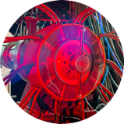
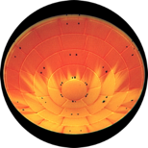
ESM – Annotated Cover Pictures
Caption: Unsteady Computational Fluid Dynamics simulation of the dynamic behavior of the Orion capsule at transonic speeds
Caption: HyMETS testing of NuSil-coated PICA models reveals that the coating peels away under certain conditions
Caption: Wind-on levitation of a Stardust capsule model in free-to-pitch mode
Caption: The Electric Arc Shock Tube facility is on the critical path to validating entry radiation and kinetics models
Caption: Thermographic image of a simulated tiled MSL aeroshell model in the Langley Mach 6 tunnel
Caption: Computational fluid dynamics simulation of the MSL entry vehicle is used to calculate shock layer radiative heating on the heatshield and backshell

