Slide 1
Thermal Protection Materials Branch (TSM):
Automated Processing of Composite Weave CT Scans
By: Aaron Allred
PhD Student at CU Boulder
Aerospace Engineering – Computational Mechanics (Structures)
CU Advisors: Dr. Doostan and Dr. Maute (TRADES)
Hired through AMA to work with Lauren Abbott in TSM
August 28, 2020

Slide 2
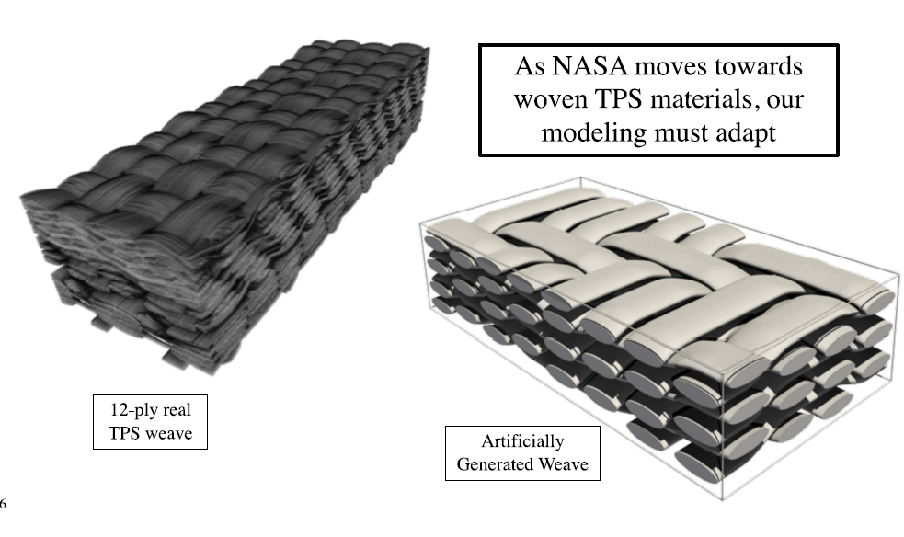
Background
Goal
  Utilize Computed Tomography Imaging to Aid in Material Properties Characterization
    Currently focused on ADEPT and HEEET (composite weaves)
    Potentially can be adapted to PICA
Motivation
  Actual composite weave layups do not exhibit ‘ideal’ configurations
  By modeling the ‘production’ configuration of the weave, a better understanding of the material properties can be captured
  Having a digital representation of a composite weave layup leads to analysis via computational mechanics
Effort
  Currently, an automated process does not exists to process CT scans of composite weave layups
  This effort seeks to automate the process through machine learning
Semeraro et. al, “Computing the Effective Thermal Conductivity of Anisotropic Porous Media from Micro-Computed Tomography,”

Slide 3
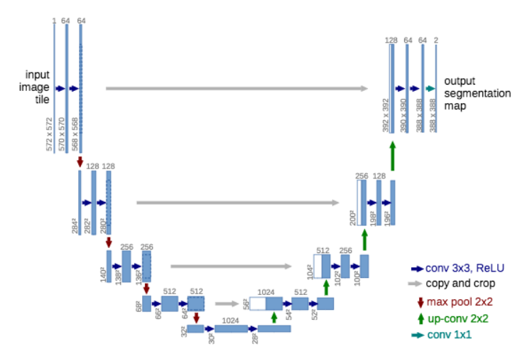
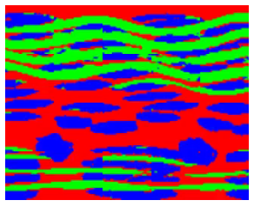
Preliminary Work
Semantic Segmentation – ADEPT
  Semantic Segmentation accomplished via a convolutional neural net (CNN)
  Architecture: UNET
  Trained on Adept 4,6, and 8 ply weaves, inference on 12 ply weave (right)
Output
Ronneberger, O., Fischer, P., and Brox, T., “U-Net: Convolutional Networks for Biomedical Image Segmentation,” Lecture Notes in Computer Science Medical Image Computing and Computer-Assisted Intervention – MICCAI 2015, 2015, pp. 234–241.
Shortcomings
  Semantic Segmentation does not disambiguate between like classes
  Poor interpretation of the boundary
  Uniform masks do not leave room for interpreting the fiber quality

Slide 4
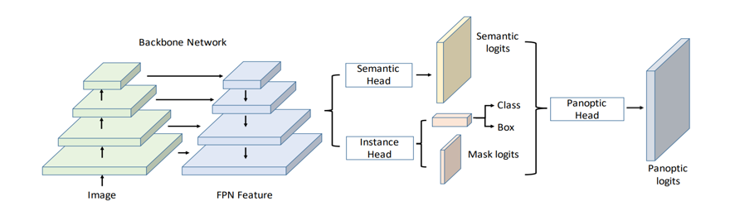
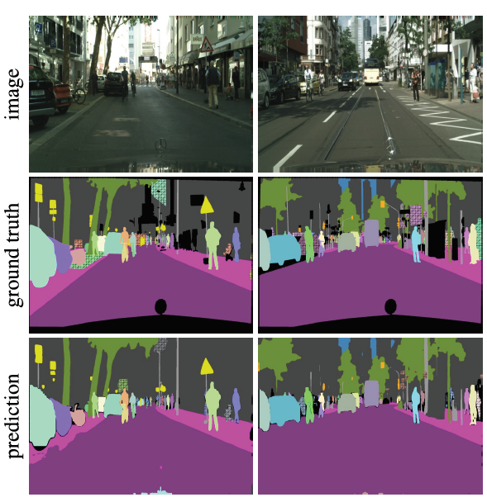
Panoptic Segmentation
Mask R-CNN
Semantic Branch
Kirillov, A., He, K., Girshick, R., Rother, C., and Dollar, P., “Panoptic Segmentation,” 2019 IEEE/CVF Conference on Computer Vision and Pattern Recognition (CVPR), 2019.
All objects are uniquely segmented
Each pixel may belong to only one object
Merging of Instance segmentation and Semantic Segmentation
Previously used instance segmentation via a Mask RCNN
  All accomplished by building onto Facebook’s open source Dectectron2 python software

Slide 5
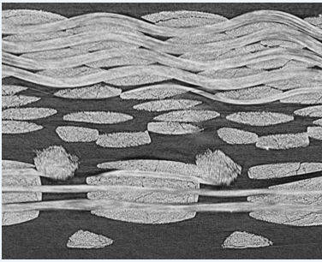
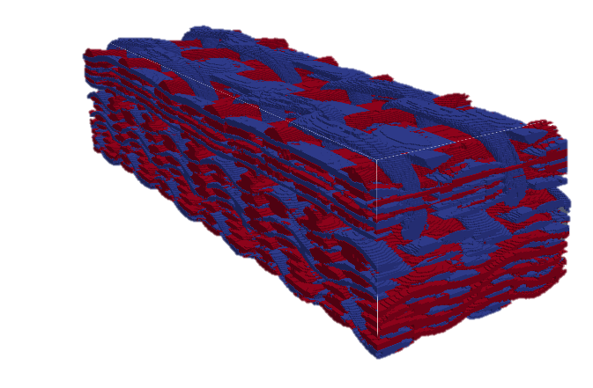
Automated Workflow Processing
Raw XCT Data
Raw Images
via Labelme
Labeled Instances
via Python script
COCO dataset for Detectron2
Training Data
Panoptic Segmentation CNN
Instance Segmented Data
Object Tracking
Voxel TPS Weave
  Identified unique yarn bundles
  Identified principal directions
  Identified contact surfaces

Slide 6

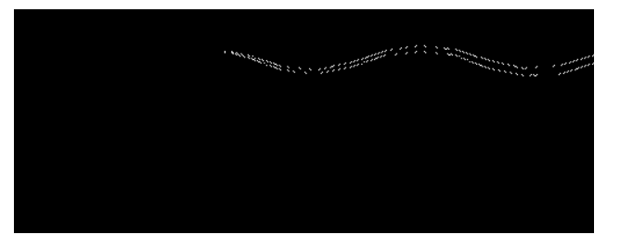
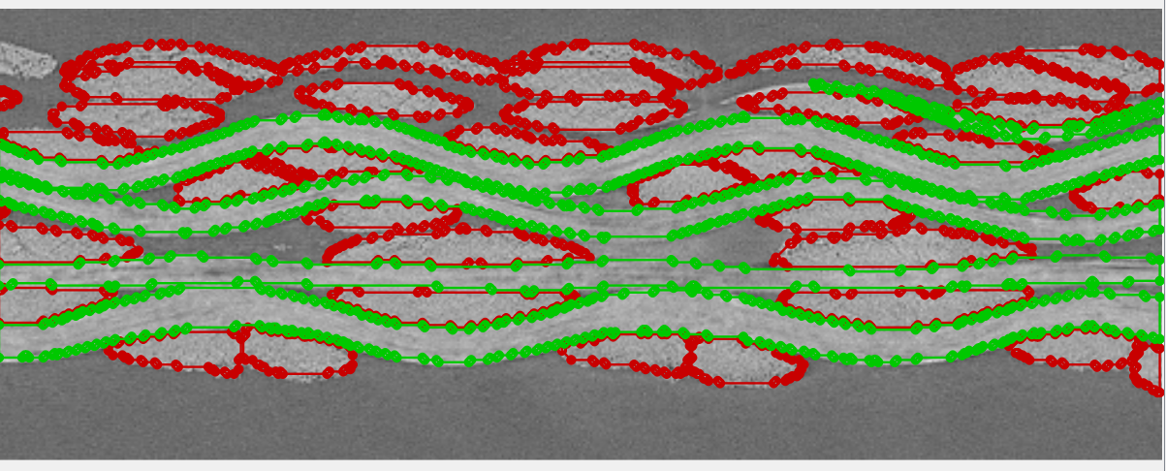
Training Set: Conventional Method
Manual Instance Segmentation:
  Identify individual instances by assigning a pixel-wise id to each instance
    Can convert to a polygon boundary of each instance via contouring
  Identify individual instances by assigning a polygon boundary to each instance
  Requires a lot of time to generate large training sets
Pixel-wise Segmentation
Identify Contours
Instance Segmented Data
Relies on Polygon representations of each instance

Slide 7
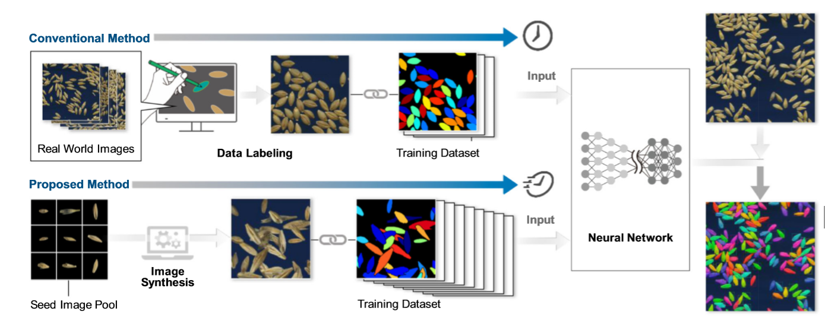
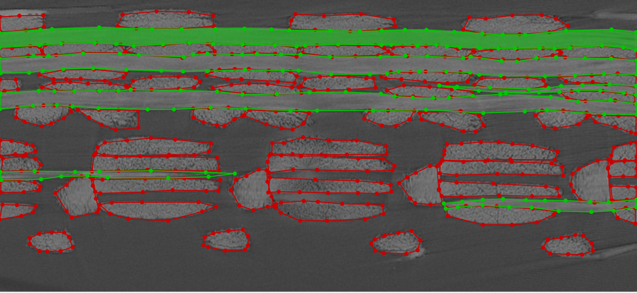
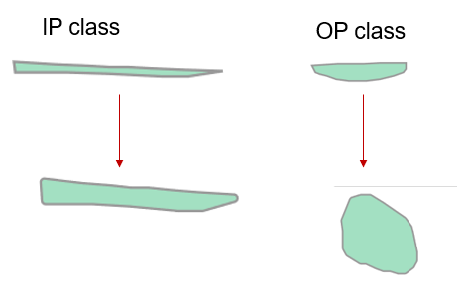

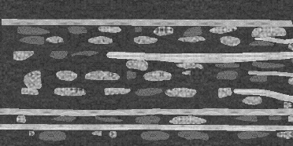
Training Set: Synthetic Generation
Crop Seed Phenotyping
From: “Training instance segmentation neural network with synthetic datasets for crop seed phenotyping”
Weave Segmentation
Conventional Method
Isolate and randomize
Procedurally assembly synthetic weave
Extended Training Set

Slide 8
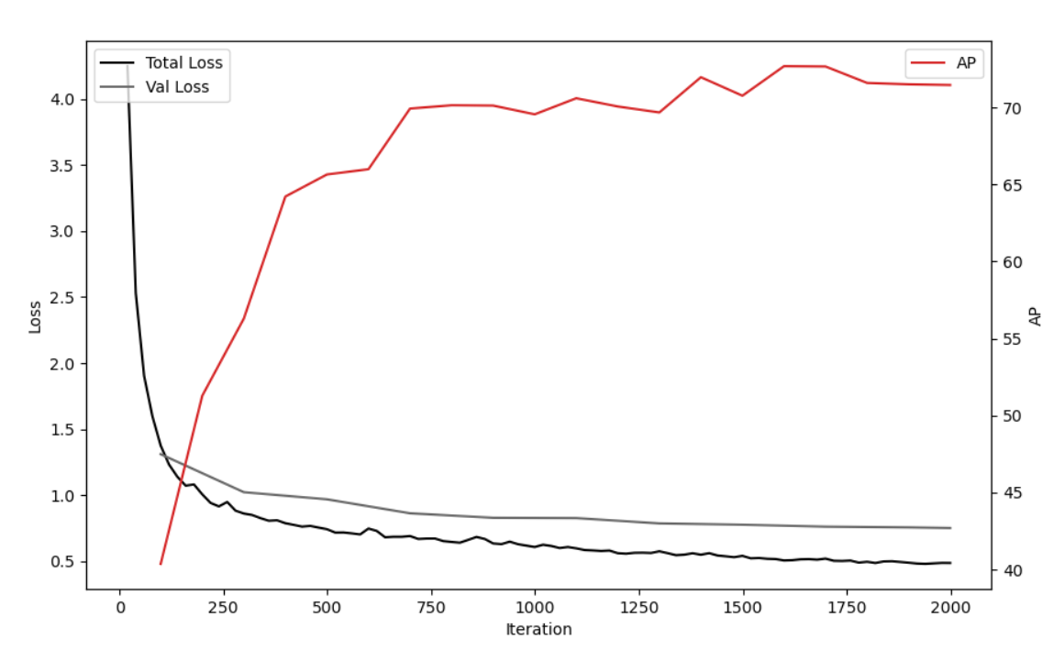
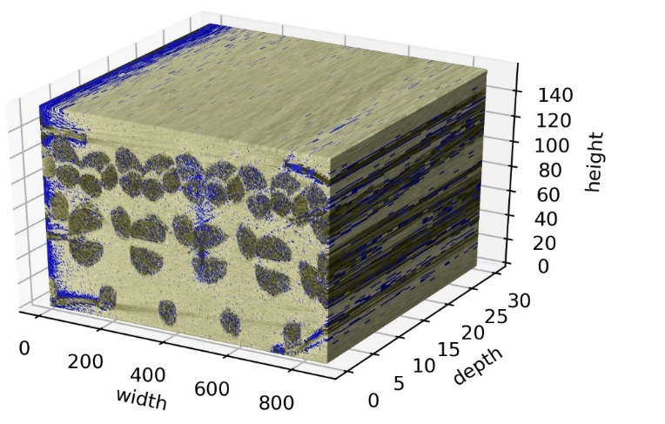
Validation (Conventional Training)
Underfit
  More than likely due to how the train/val/test data is split up
    First 60% is train, next 20% is val, last 20% is test
  Need to distribute train / val / test throughout
Train Set
Val Set
Test Set

Slide 9
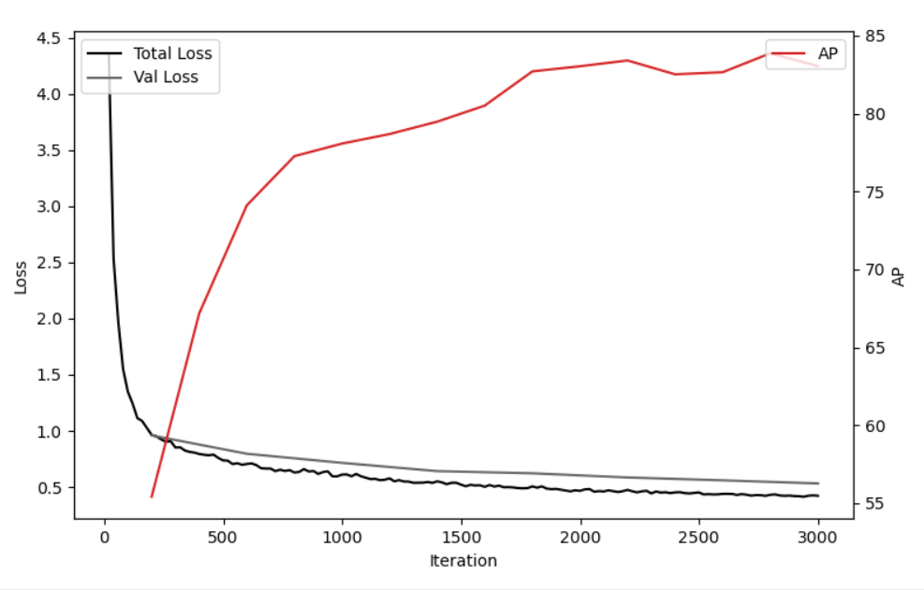
Validation (Conventional Training Mixed)
Good fit
  Mixed Training Data (shown to the right)
  Better fit and less loss
  distributed train / val / test throughout
  AP value ~84 > ~71
  Performs better on val / test sets
Train Set
Val Set
Test Set

Slide 10

Semantic vs Panoptic Results
Prior Work by NASA
Semantic Segmentation UNET
Current
Panoptic Segmentation Resnet101
Comparison of test data inference
  Trained on Adept 4,6, and 8 ply weaves, inference on 12 ply weave (shown above)
  Individual instances are segmented
  Cleaner borders and no artificial gaps between yarns
    Enables contact region detection
  *Note: not the exact same frame

Slide 11
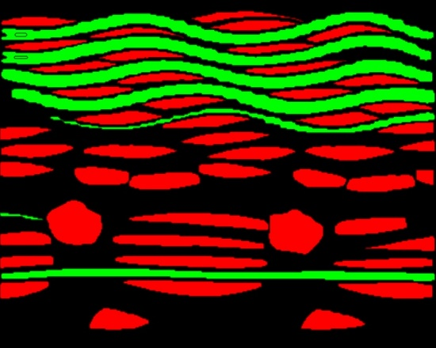
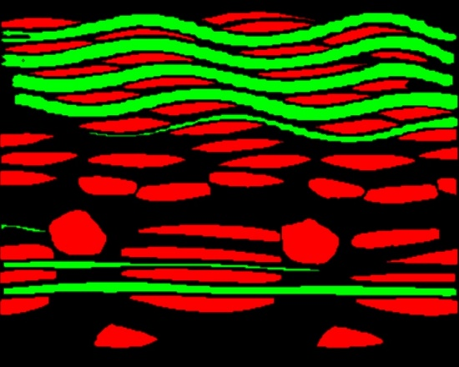
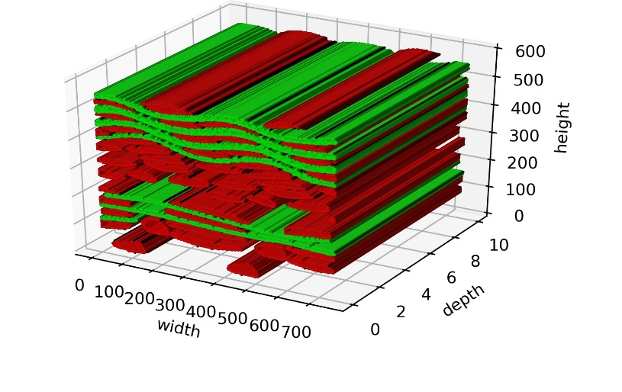
Automated Processing (ADEPT)
Raw XCT Data
Instance Segmented Data
Panoptic Segmentation
Goal: Voxel Representation
  Like classes are shown in red and green
    Instances are also known
  Need to be able to continuously track through the depth direction.
    Enables determining principal directions of yarns / fiber bundles
Continuity?

Slide 12
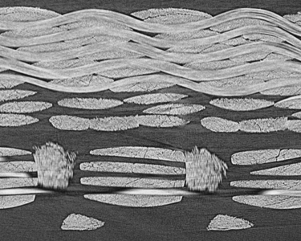
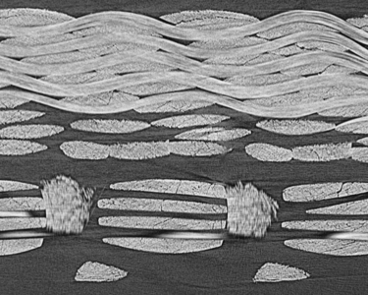
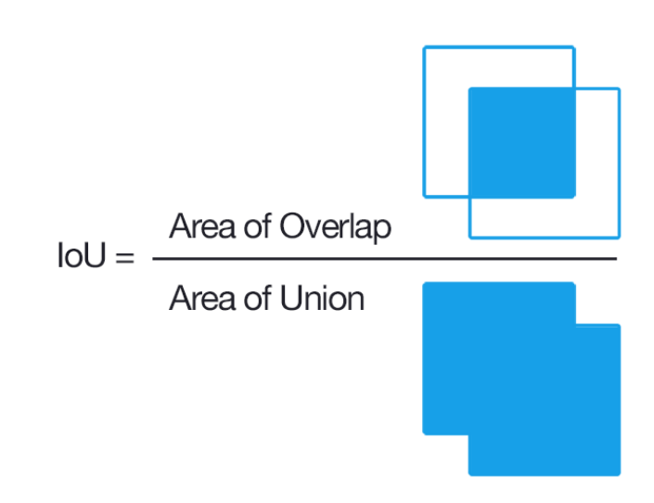
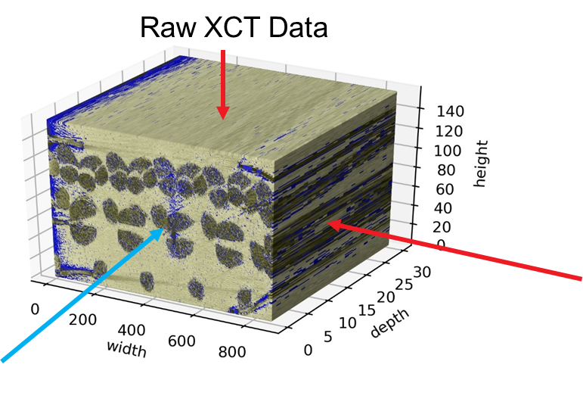
Yarn / Bundle Tracking
2D layer n
2D layer n+1
Tracking Fibers through layers
  Centroid and radius
  Red circle: centroid at layer n
  Blue circle: centroid at layer n+1
  Green: acceptable radii for tracking
Current Functionality:
  Looks at IoU (intersect over union) for consecutive layers
    like classes only
    IoU > 0.6 and same class, objects are the same
  Use centroid method for finding missing objects in frame
Multi-directional segmentation
  Merge the information gained from orthogonal slices and processing of the raw data
Probabilistic Inference
  Wenhan Luo, Junliang Xing, Anton Milan, Xiaoqin Zhang, Wei Liu, Xiaowei Zhao, & Tae-Kyun Kim. (2014). Multiple Object Tracking: A Literature Review.

Slide 13
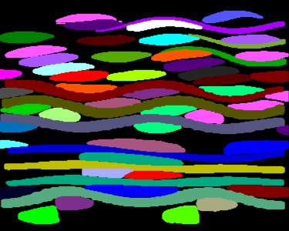
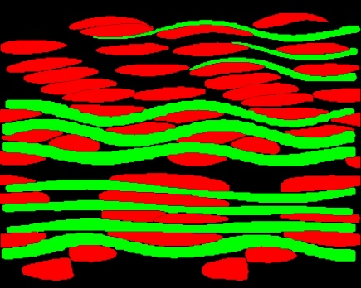
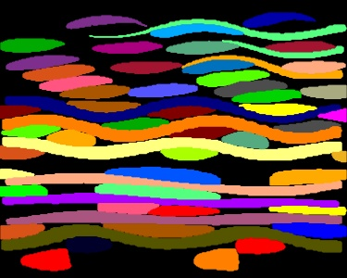
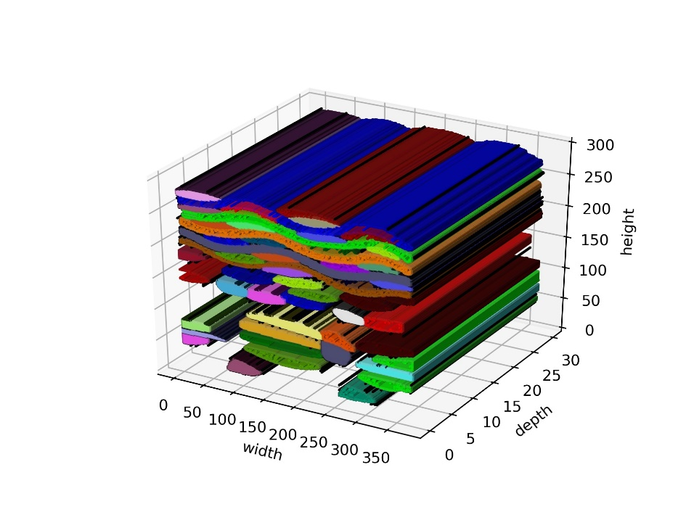

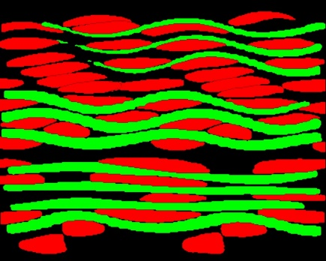
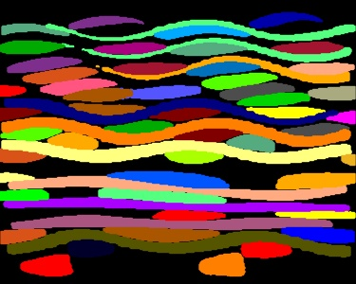
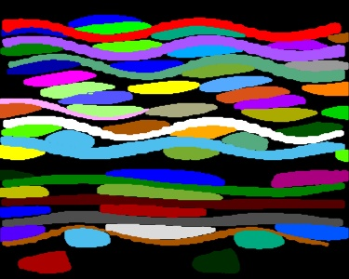
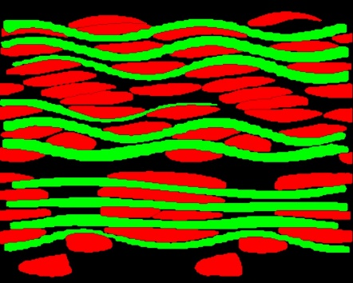
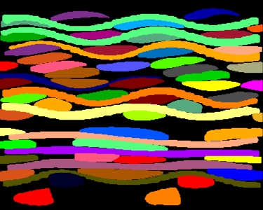
Tracking Results
Instance Predictions
Instance Predictions w/ Tracking
Assembly for Analysis
* Results shown are on test data
Frame n
Frame n+1
Voxel TPS Weave
  When principal / fiber directions and segments are known:
    Micro / Meso scale material properties can be assigned
    Contact zones can be identified
Needs Improving
  Identifying drop out
Frame n+2

Slide 14
Conclusions
Product – Automated Work Flow Processing of Composite Weave CT Scans Using Machine Learning
  Performs image manipulation (e.g. synthetic weave gen)
  Detects contours in pixel-wise segmented images
  Generates MS COCO dataset files for instance data
  Training / Inference using Instance or Panoptic Segmentation
    NAS improves training time ~40x compared to CPU
  Multiple object tracking through multiple images
  Voxel TPS weave generation for computational analysis
  Coded in Python
  User documentation
Future Work
  Explore more object tracking methods
  Apply to other material systems

Slide 15
Thank you!
Thank you to AMA and the NASA TSM team
  Special thanks to mentor Lauren Abbott and Josh Monk,
  And to the Comp Mat Team of Justin Haskins, BJ Tucker, and Charlie Bauschlicher
Enjoyed partaking in the TS Summer Seminar Series and learning about NASA ARC from afar this summer
Looking forward to NSTGRO where I will continue to work with my research collaborator, Lauren Abbott and further establish the working relationship between ARC and CU

Slide 17
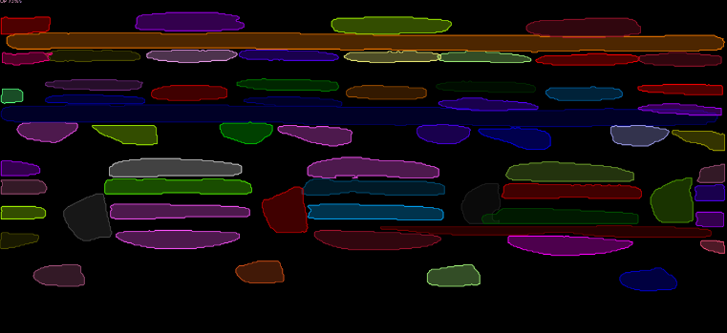
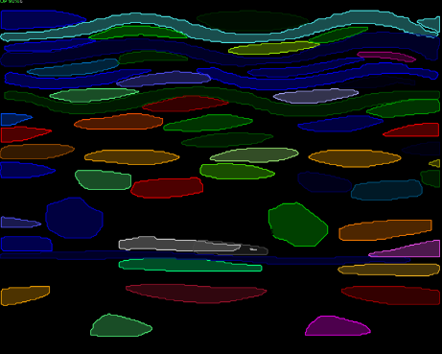
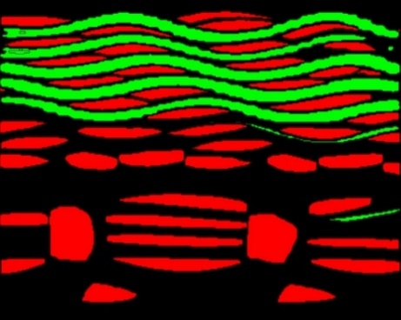
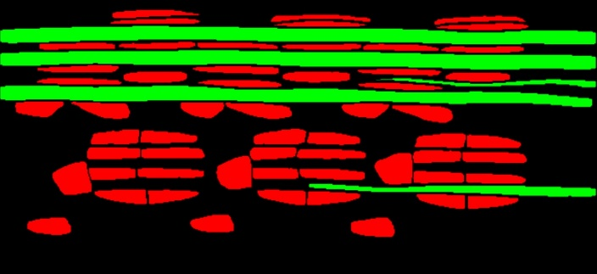
Panoptic Segmentation Output
Can greatly increase the size of the training data
  Before generation: Total Images: 11 (Class “OP”: 362 instances Class “IP”: 64 instances)
  After generation: Total Images: 111 (Class “OP”: 6516 instances Class “IP”: 889 instances)
  90%+ accuracy on validation dataset
    Requires filtering out low accuracy predictions
Alternatively, use conventional method
  Total images: ~1800
  93%+ accuracy on validation dataset

Slide 18
Open Source Software
Detectron2: Developed by Facebook AI
  Background
    Exists to accelerate engineering AI / computer vision research
    Built on PyTorch (not TensorFlow)
    Available on GitHub: https://github.com/facebookresearch/detectron2
  Architecture: Mask R-CNN
    Modular backbone: ResNet, ShuffleNet, or FBNet
  Requires Training data be in custom Detectron2 dataset or MS COCO dataset formats
    Most existing Mask R-CNN rely on MS COCO datasets

Slide 19
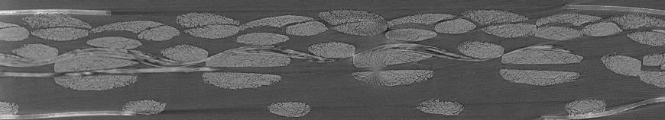
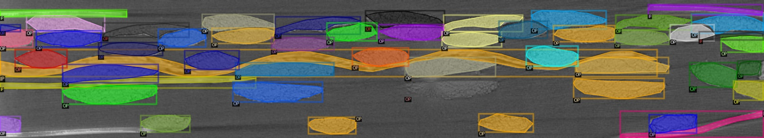
Training
Training for Instance Segmentation
  Existing, masked images are not utilized
    Potential pre-processing can maybe leverage these images
    Current Training is on a small dataset (3 images)
      Flipping and RGB manipulation can increase training data with little effort
Raw Images
via Labelme
Labeled Instances
via Python script
COCO dataset for Detectron2

