Slide 1
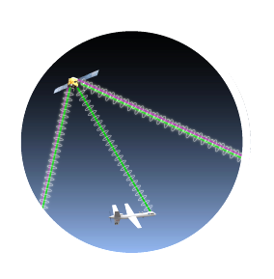



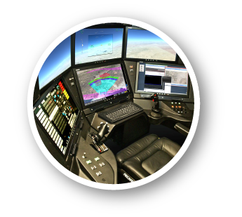
Unmanned Aircraft Systems (UAS) Integration in the National Airspace System (NAS) Project
Alert Timing Assessment for
Unmanned Aircraft System
Terminal Area Operations
Digital Avionics Systems Conference 2020
Devin Jack
Adaptive Aerospace Group
Sagar KC
NASA Langley
Oct 13, 2020
UAS INTEGRATION IN THE NAS

Slide 2
Background
Manned aircraft are required to ‘see and avoid’ other aircraft
  14 CFR 91.113: “…vigilance shall be maintained by each person operating an aircraft so as to see and avoid other aircraft.”
Detect-and-Avoid (DAA) systems enable compliance with ‘see and avoid’ requirements
  Consists of a suite of surveillance sources, trackers, and guidance and alerting algorithm
  Provides Remote Pilot timely traffic alerts and suggestive guidance
Since 2012, NASA’s UAS in the NAS project has provided research findings to reduce technical barriers associated with integrating UAS.
  Human system interaction
  DAA Performance Standards
  Command and Control Performance Standards
  Flight Tests
  Reference DAA alerting and guidance algorithm (DAIDALUS)

Slide 3
Background
RTCA is a standards development organization that serves as a stepping-stone to FAA certification.
RTCA SC-228 is developing technical standards for DAA systems for UAS
  Published DO-365: Minimum Operational Performance Standards (MOPS) for DAA Systems (March 2017, rev A in March 2020)
    Defined UAS separation volume: DAA Well Clear
    Assumed minimal aircraft maneuverability
      Turn Rate: at least 3 deg/sec
      Vertical Rate: at least 500 fpm
      Airspeed: 40 – 200 KTAS below 10,000 feet MSL
    Operational environment:
      Instrument Flight Rules (IFR)
      Transition to/from Class A or Special Use Airspace (DO-365)
      Terminal area operations (DO-365A)
  Current work toward revision of DO-365 to support:
    Reduced non-cooperative sensor requirements
    ACAS Xu Interoperability

Slide 4
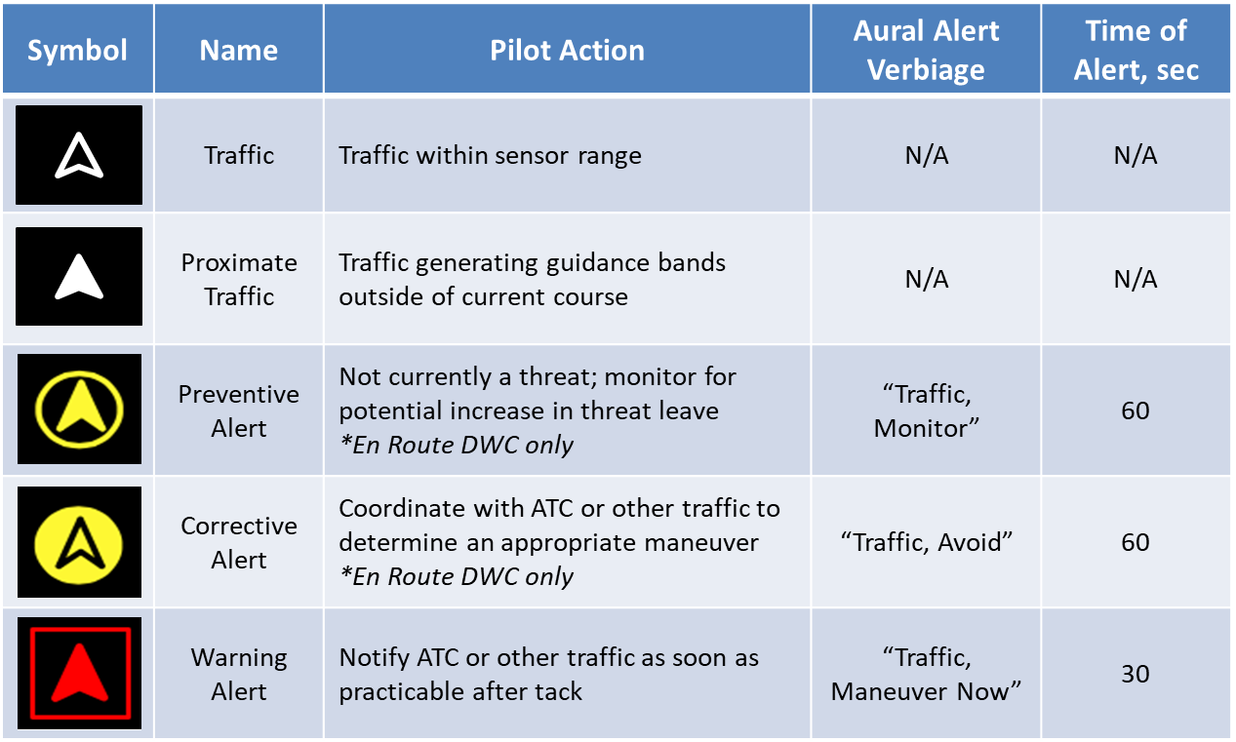
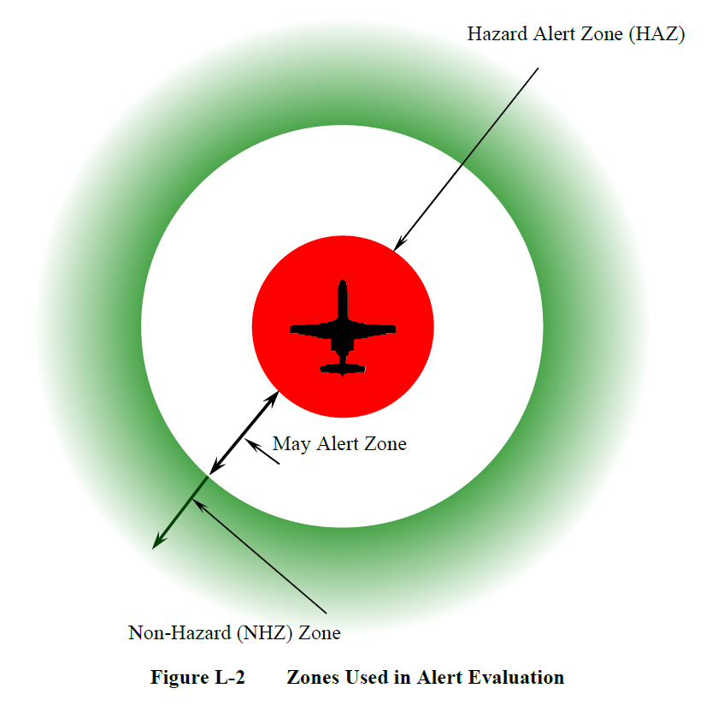
Background: Alerting scheme
The alerting scheme in DO-365 is defined to be generally applicable independent of alerting system design.
Key Points:
  Alerts must be issued for intruders that enter the Hazard Alert Zone (HAZ)
    For actionable alerts (corrective/warning), HAZ = DAA Well Clear!
  Alerts must not be issued for intruders that remain in the Non-Hazard Zone (NHZ)
  Timing requirements for alert issuance are relative to HAZ

Slide 5
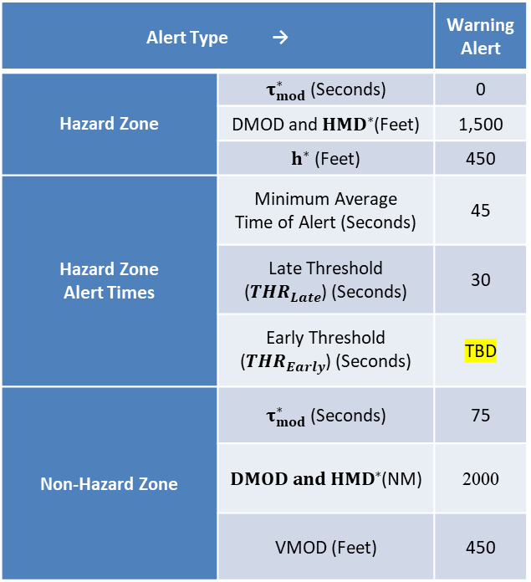
Terminal Alert Analysis Goal
Goal: Determine early alert threshold most appropriate for DAA Terminal Area operations.
Alert Type → |  | Warning Alert
Hazard Zone | $τ_{mod}^{∗}$ (Seconds) | 0
 | DMOD and ${HMD}^{∗}$(Feet) | 1,500
 | $h^{∗}$ (Feet) | 450
Hazard Zone Alert Times | Minimum Average Time of Alert (Seconds) | 45
 | Late Threshold (${THR}_{Late}$) (Seconds) | 30
 | Early Threshold (${THR}_{Early}$) (Seconds) | TBD
Non-Hazard Zone | $τ_{mod}^{∗}$ (Seconds) | 75
 | $DMOD and {HMD}^{∗}$(NM) | 2000
 | VMOD (Feet) | 450
Early Alert Threshold defines the longest acceptable time to HAZ an alert may be issued.
  Enabling alerts earlier may result in excessive alerting
Approach:
  Simulate terminal operations involving a UA on instrument approach and an intruder in VFR traffic pattern.
  Measure the time to HAZ throughout encounter.
  Identify early alert value which do not alert while maintaining safe operations.

Slide 6
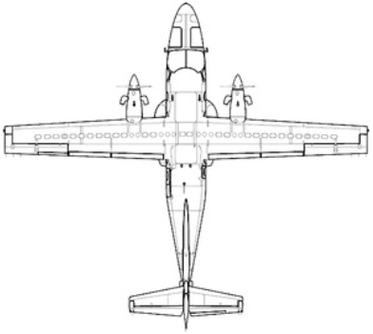


Terminal Area Geometry
Extended Base
Turbine
Downwind
Piston
Base
45 Entry
Final

Slide 7
Analysis Methodology
The figures show, for a unique set of conditions with a 60s Touchdown Time Offset, the time to HAZ and Range throughout the encounter
In this example, min Time to HAZ is 31s, which occurs at 1200 msec sim time. If the Warning Alert Early Threshold is selected to be <31s, no alert would be issued.

Slide 8
Analysis Methodology
Touchdown Time Offset vs Minimum Time to HAZ violation for a single encounter geometry
If 60s is selected to be the nominal Touchdown Time Offset, a Warning Alert Early Threshold of <31s would not result in a Warning Alert

Slide 9
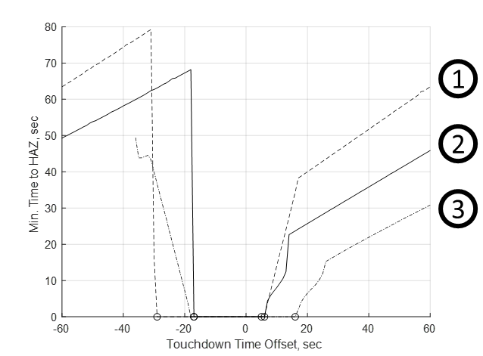
Analysis Methodology
Touchdown Time Offset vs Minimum Time to HAZ violation for several combinations of encounter geometries
All variables held constant with the exception of Touchdown Time Offset, and UA and Intruder speeds.
1) UA at 100 KTAS, INT at 70 KTAS , 2) UA at 80 KTAS, INT at 80 KTAS; 3) UA at 70 KTAS, INT at 100 KTAS.

Slide 10
Conditions
Touchdown Time Offset between UA and intruder: 50, 60, 70, 80, 90 seconds
Unmanned Aircraft
  Approach Path: 3 deg Glideslope
  Constant Airspeed 40 - 200 ktas (in 20 kts increments)
Intruder Aircraft
  Approach Paths: Full VFR Pattern** and Extended Base
  45 Entry Vertical Rate and Time: -500 fpm, 30 sec
  Base Entry Vertical Rate and Time: -3 and -6 deg, 90 sec
  Bank Limit: 15, 30 deg
  Normal Acceleration: 1.25 g
  Final Glideslope: -3 deg
  Runway Length: 8000 ft
Piston Intruder:
  Downwind Offset: 2000 – 4000 ft in 500 ft increments
  Pattern Altitude: 1000 ft
  Base Altitude: 750 ft
  Constant Airspeed: 60 – 120 KTAS in 20kts increments
Turbine Intruder:
  Downwind Offset: 4000 – 9000 ft in 1000 ft increments
  Pattern Altitude: 1500 ft
  Base Altitude: 1125 ft
  Constant Airspeed: 100 – 200 KTAS in 20kts increments

Slide 11
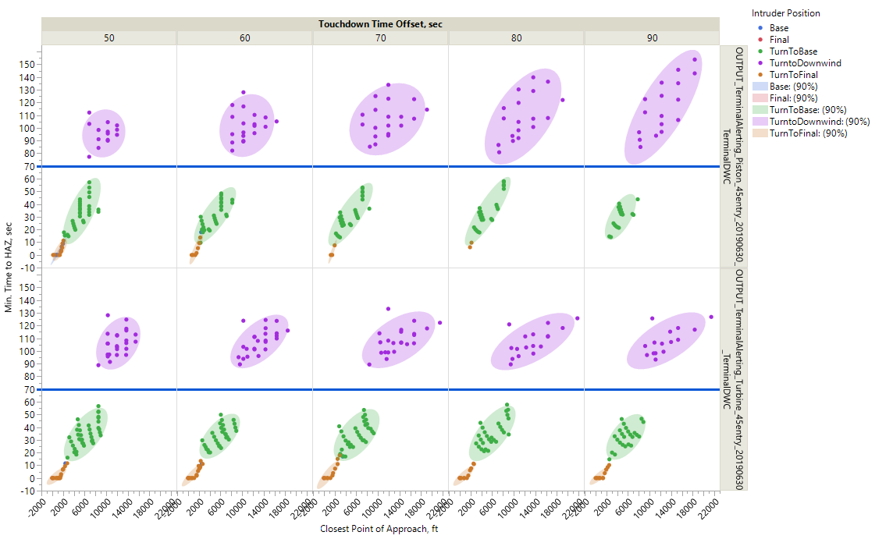
Determining Early Alert Threshold
By capturing which segment of the VFR traffic pattern the intruder is on when Time to HAZ is minimized, we can choose an Early Alert Threshold which:
  Alerts on Intruders turning in front of UA
  Does not Alert on Intruders prior to joining the downwind
Piston – VFR Pattern
Turbine – VFR Pattern

Slide 12
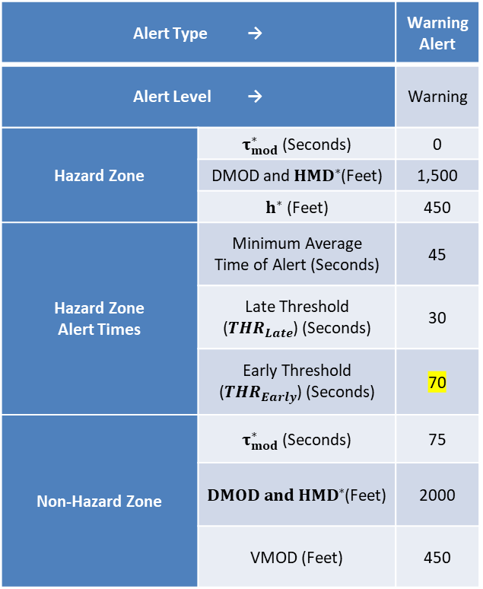
Recommendation
Goal: Determine early alert threshold most appropriate for DAA Terminal Area operations.
Alert Type → |  | Warning Alert
Alert Level → |  | Warning
Hazard Zone | $τ_{mod}^{∗}$ (Seconds) | 0
 | DMOD and ${HMD}^{∗}$(Feet) | 1,500
 | $h^{∗}$ (Feet) | 450
Hazard Zone Alert Times | Minimum Average Time of Alert (Seconds) | 45
 | Late Threshold (${THR}_{Late}$) (Seconds) | 30
 | Early Threshold (${THR}_{Early}$) (Seconds) | 70
Non-Hazard Zone | $τ_{mod}^{∗}$ (Seconds) | 75
 | $DMOD and {HMD}^{∗}$(Feet) | 2000
 | VMOD (Feet) | 450
Summary:
Researchers ran a series of fast-time simulations of the terminal area involving a UA on instrument approach and an intruder flying the VFR pattern.
The encounters were set up for the intruder to land well ahead of the UA.
The selected Early Alert Threshold
  enables alerts for intruders that turned in front of UA
  Does not alert on intruders that are early in the VFR pattern enabling coordination between the two aircraft.

Slide 13
Questions?
Devin P. Jack
djack@adaptiveaero.com
Sagar KC
Sagar.KC@nasa.gov

Slide 14
Background
Manned aircraft are required to ‘see and avoid’ other aircraft
  14 CFR 91.113: “…vigilance shall be maintained by each person operating an aircraft so as to see and avoid other aircraft. When a rule of this section gives another aircraft the right-of-way, the pilot shall give way to that aircraft and may not pass over, under, or ahead of it unless well clear [Emphasis added].”
  “Well clear” is left to pilot discretion.
Detect-and-Avoid (DAA) systems enable compliance with ‘see and avoid’ requirements
  Consists of a suite of surveillance sources, trackers, and guidance and alerting algorithm
  Provides Remote Pilot timely traffic alerts and suggestive guidance
Since 2012, NASA’s UAS in the NAS project has provided research findings to reduce technical barriers associated with integrating UAS.
  Human system interaction
  DAA Performance Standards
  Command and Control Performance Standards
  Flight Tests
  Reference DAA alerting and guidance algorithm (DAIDALUS)

Slide 15
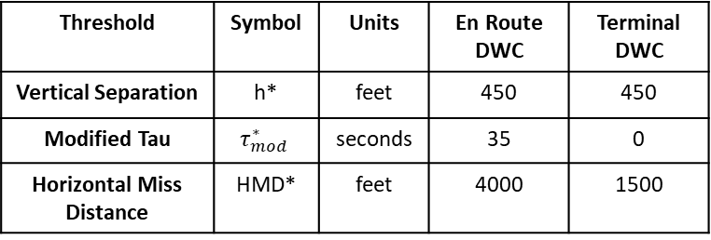
Background: DAA Well Clear
DWC Principles:
  Separation standard between airborne traffic
  Quantitative definition
  Based on acceptable collision risks and compatibility with aircraft collision avoidance systems (e.g., TCAS)
  Basic separation measure:
    In Horizontal: time-based
    In Vertical: distance-based
Notional Diagram
DO-365 DAA Well Clear
Threshold | Symbol | Units | En Route DWC | Terminal DWC
Vertical Separation | h* | feet | 450 | 450
Modified Tau | $$τ_{mod}^{∗}$$ | seconds | 35 | 0
Horizontal Miss Distance | HMD* | feet | 4000 | 1500

