Slide 1
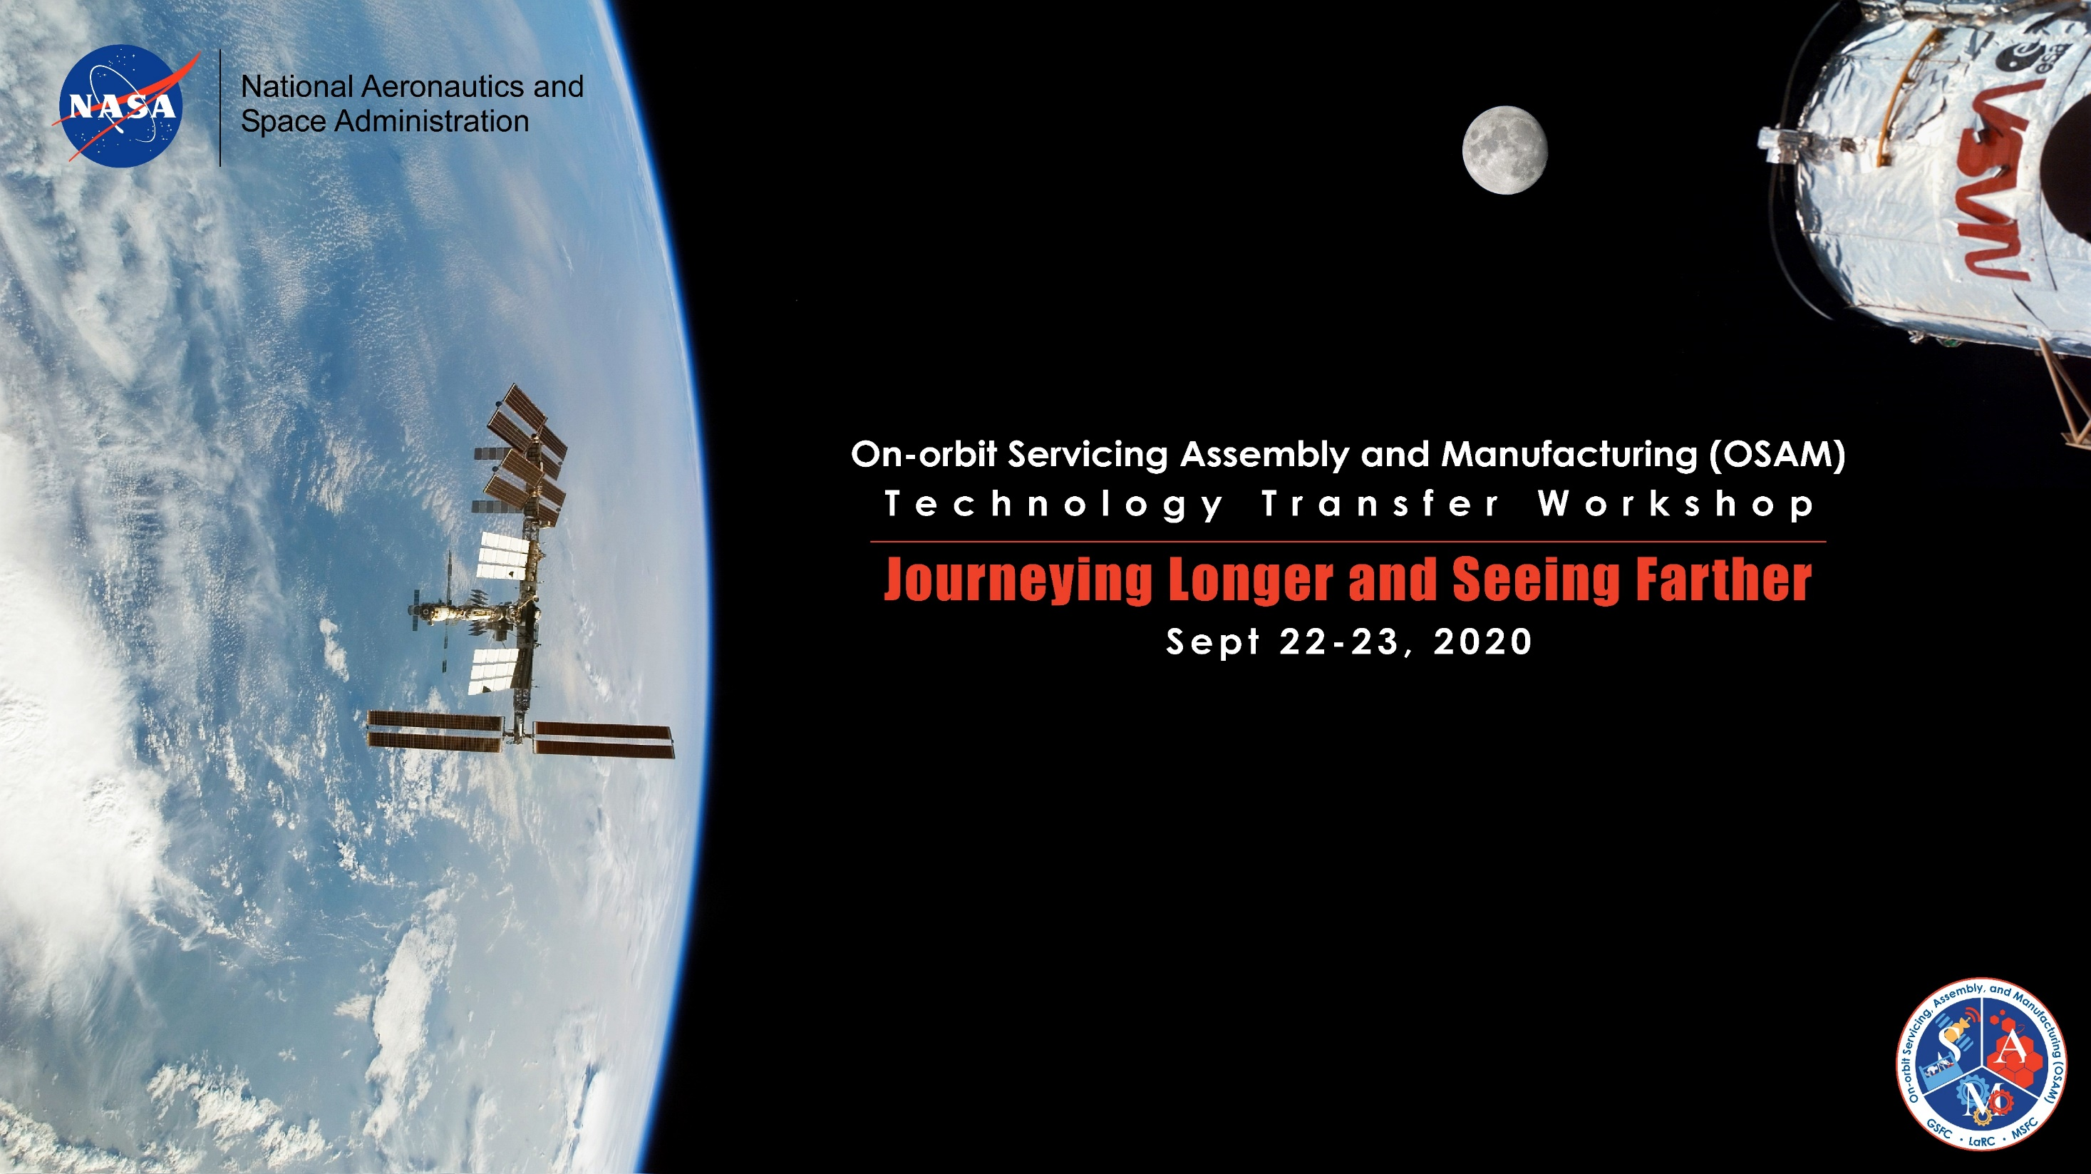
OSAM-2 Project Overview
Lawrence D. Huebner, NASA Technical Lead
Made In Space Contributors: Thorin Tobiassen, Steven W. Rose, Simon C. Patané, Deejay Riley, and Paul Shestople

Slide 2
Introduction
The OSAM-2 mission is the second phase of a STMD Tipping Point solicitation entitled “Robotic In-Space Manufacturing and Assembly of Spacecraft and Space Structures”
Phase I demonstrated extended structure manufacturing and robotic manipulation of hardware in a relevant thermal vacuum environment
The mission is led by Made In Space, Inc., (MIS) and managed by the TDM Program Office
MIS refers to it as Archinaut One; OSAM-2 is NASA’s designation
OSAM-2 plans to manufacture a 10 m beam that will deploy a solar array surrogate and a 6 m stand-alone “engineering” beam
This briefing provides an updated overview of OSAM-2 since last year’s workshop
Notes:
GENERAL SLIDE TEMPLATE

Slide 3
Full Mission Success Requirements
A1-PROG-1. On-orbit Robotic Manipulation: Archinaut (OSAM-2) shall demonstrate on-orbit robotic manipulation of at least one set of representative additive manufacturing components.
A1-PROG-2. On-orbit Manufacturing: Archinaut (OSAM-2) shall demonstrate on-orbit manufacturing of a beam to deploy a solar array [or surrogate solar array] assembly with a length of at least 10 meters.
A1-PROG-3. On-Orbit Beam Build Tolerance: Archinaut (OSAM-2) shall verify that the actual length of the fully deployed solar array (or surrogate solar array) assembly manufactured on orbit is within 1% of the planned length.
A1-PROG-4. On-Orbit Tip Deflection Measurement: Archinaut (OSAM-2) shall measure the tip deflection of the on-orbit, fully deployed solar array (or surrogate solar array) assembly.
A1-PROG-5. Technology Demonstration Duration: Archinaut (OSAM-2) shall complete the technology demonstration in less than 4 months from launch.
Notes:
GENERAL SLIDE TEMPLATE

Slide 4
Spacecraft Overview
Start Block for Beam 2
MIS ESAMM Printer
with V&V System
Motiv Robot Arm
BCT Hyperion
Solar Array
Solar Array Surrogate
Assembly
Beam 1 Lockout Device
Internal Subsystems
MIS Feedstock Canister
MIS Controller
NG Eagle 100 Avionics
BCT Attitude Control System
BCT RF Assembly
Batteries
BCT Bus

Slide 5
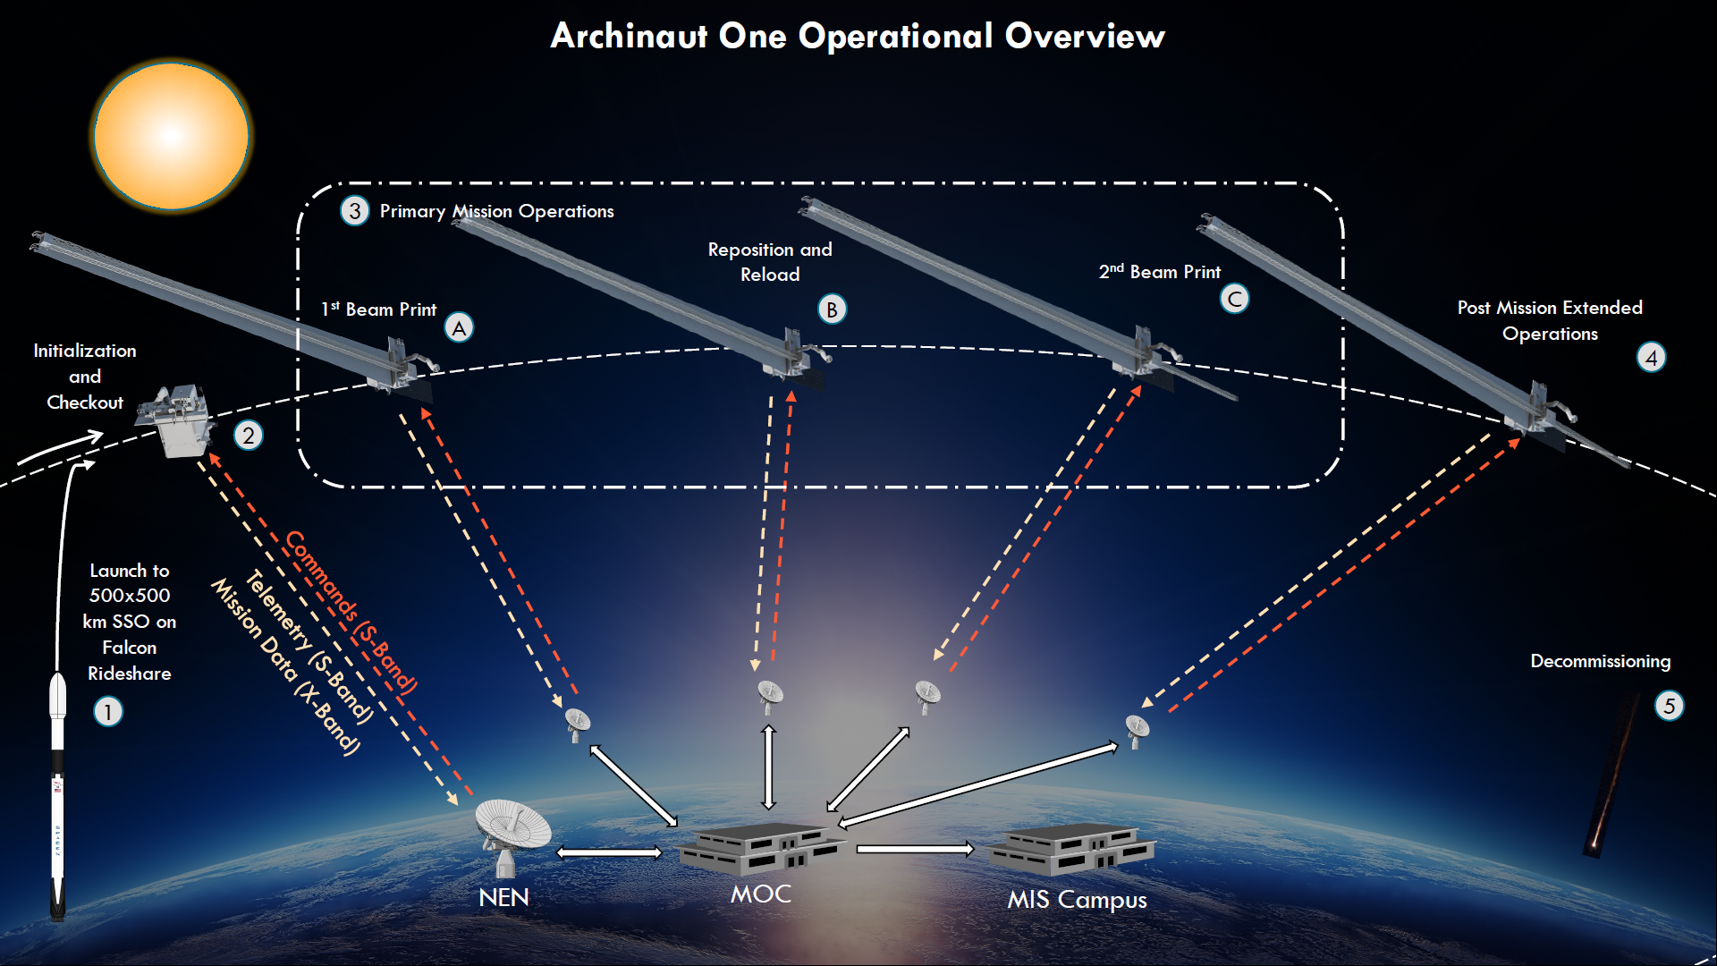
Operational Overview

Slide 6
Detailed Concept of Operations, 1 of 3
Phase 1: Launch
Side-mounted Falcon Rideshare Payload
Inserted into 500 km x 500 km SSO
Phase 2a: Bus Initialization and Checkout
Bus powers on at separation
Bus solar array deploys
Communications established
Bus checkouts and self tests performed
Phase 2b: Payload Initialization and Checkout
Eagle-100 avionics stack initializes and MIS Controller powers on and checked
Extended Structure Additive Manufacturing Machine (ESAMM) checkout
Robot arm deployed and calibrated

Slide 7
Detailed Concept of Operations, 2 of 3
Phase 3a: Print First Beam
Preheat print surface and hot end
Perform tip-tray check
Feed Ultem 9085 filament, prime and purge
Continuous printing planned
Robot arm to lock beam when array is fully deployed
Measure tip deflection and possibly dither spacecraft
Phase 3b: Reposition and Reload ESAMM
Deck actuation system and robot arm used to rotate and lock ESAMM 180 degrees
Robot arm picks up and loads second starting block into ESAMM
Phase 3c: Print Second Beam
Identical printing process a first beam
Beam is secured by ESAMM when completed
Measure tip deflection and possibly dither spacecraft
Notes:
GENERAL SLIDE TEMPLATE

Slide 8
Detailed Concept of Operations, 3 of 3
Phase 4: Post Mission Extended Operations (Optional)
Test reliability and repeatability of ESAMM over time
Measure tip deflection over time
Dither spacecraft periodically
Phase 5: Decommissioning
Orient for largest drag profile
Minimize stored electrical energy
Turn off transmitters
Expected deorbit within ten years

Slide 9
OSAM-2 Project Status
PDR occurred in March 2020
Number of concerns raised by Industry Review Board
Mass margins, power budgets, spacecraft control due to large moments of inertia
Systems Engineering approach
Schedule and Risk Management
Post-PDR Assessment provided significant improvements in design and execution to meet revised Level 1 requirements focused on tech demo
Vertical manufacturing test began last week to mimic ESAMM operation in a relevant loading environment (7 m beam planned)
CDR scheduled for Q2, CY2021
Launch scheduled for Q1, CY2023
Period of Performance ends in July 2023

Slide 10
Technology Gaps Addressed by OSAM-2 Development
Gap ID | Gap Title
OSAM-10 | Robotic actuators, sensors, and interfaces
OSAM-94 | High performance materials tailored for in-space applications
OSAM-96 | Additive manufacturing processes for construction of on-orbit infrastructure and point solution hardware
OSAM-104 | Metrology (of assembly process)
OSAM-105 | In-situ verification and validation of assembly and manufacturing
OSAM-126 | Low cost, commoditized robotic actuators
OSAM-131 | Manufacture of on-orbit Infrastructure
OSAM-177 | ACS modes to accommodate changing mass properties and flex modes during assy/mfg of large objects
OSAM-221 | Spacecraft GNC during assembly
OSAM-222 | Fabrication and repair of on-orbit and lunar surface hardware, components and structures using advanced manufacturing processes
OSAM-229 | Supervisor situational awareness modeling and simulation
OSAM-234 | High-precision arm control
OSAM-273 | Low size, weight, and power Mars surface arm
OSAM-294 | Autonomy for assembly

Slide 11
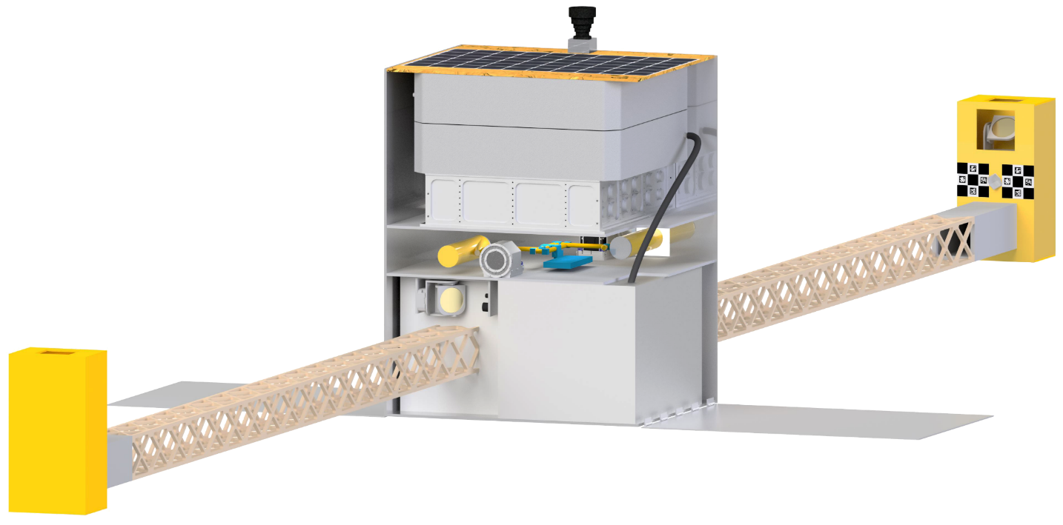
Capabilities of Technology
Archinaut is a concept for exploiting in-space robotic manufacturing and assembly via a suite of proven technologies
Made In Space, Inc., has assessed a variety of design reference missions that can utilize technologies being developed and proven in the STMD/TDM effort, including:
Antenna Manufacturing
Distributed aperture-based missions
Large aperture UV/optical/IR telescopes
Reconfigurable Reflectors
Sunshields/Starshades
In-Space Solar Power/SEP
Optimast Interferometer
Notes:
GENERAL SLIDE TEMPLATE

Slide 12
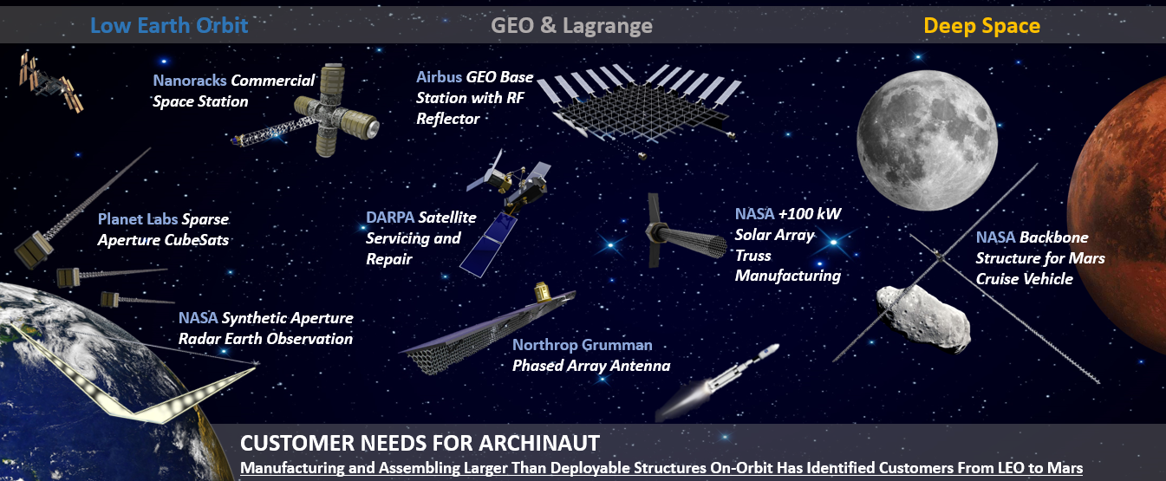
Infusion Potential

Slide 13
Acknowledgements
Made In Space, Inc., Archinaut One Team
Archinaut One Contractors
Northrop Grumman
Blue Canyon Technologies
Motiv Space Systems

Slide 14
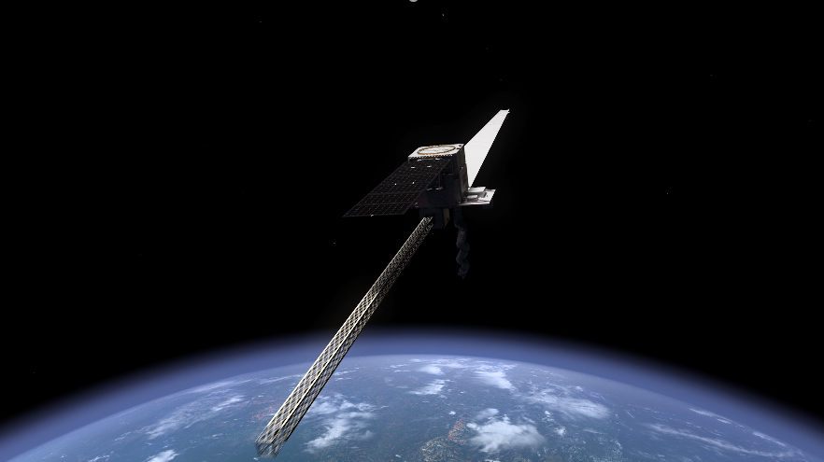
Questions?

Slide 15
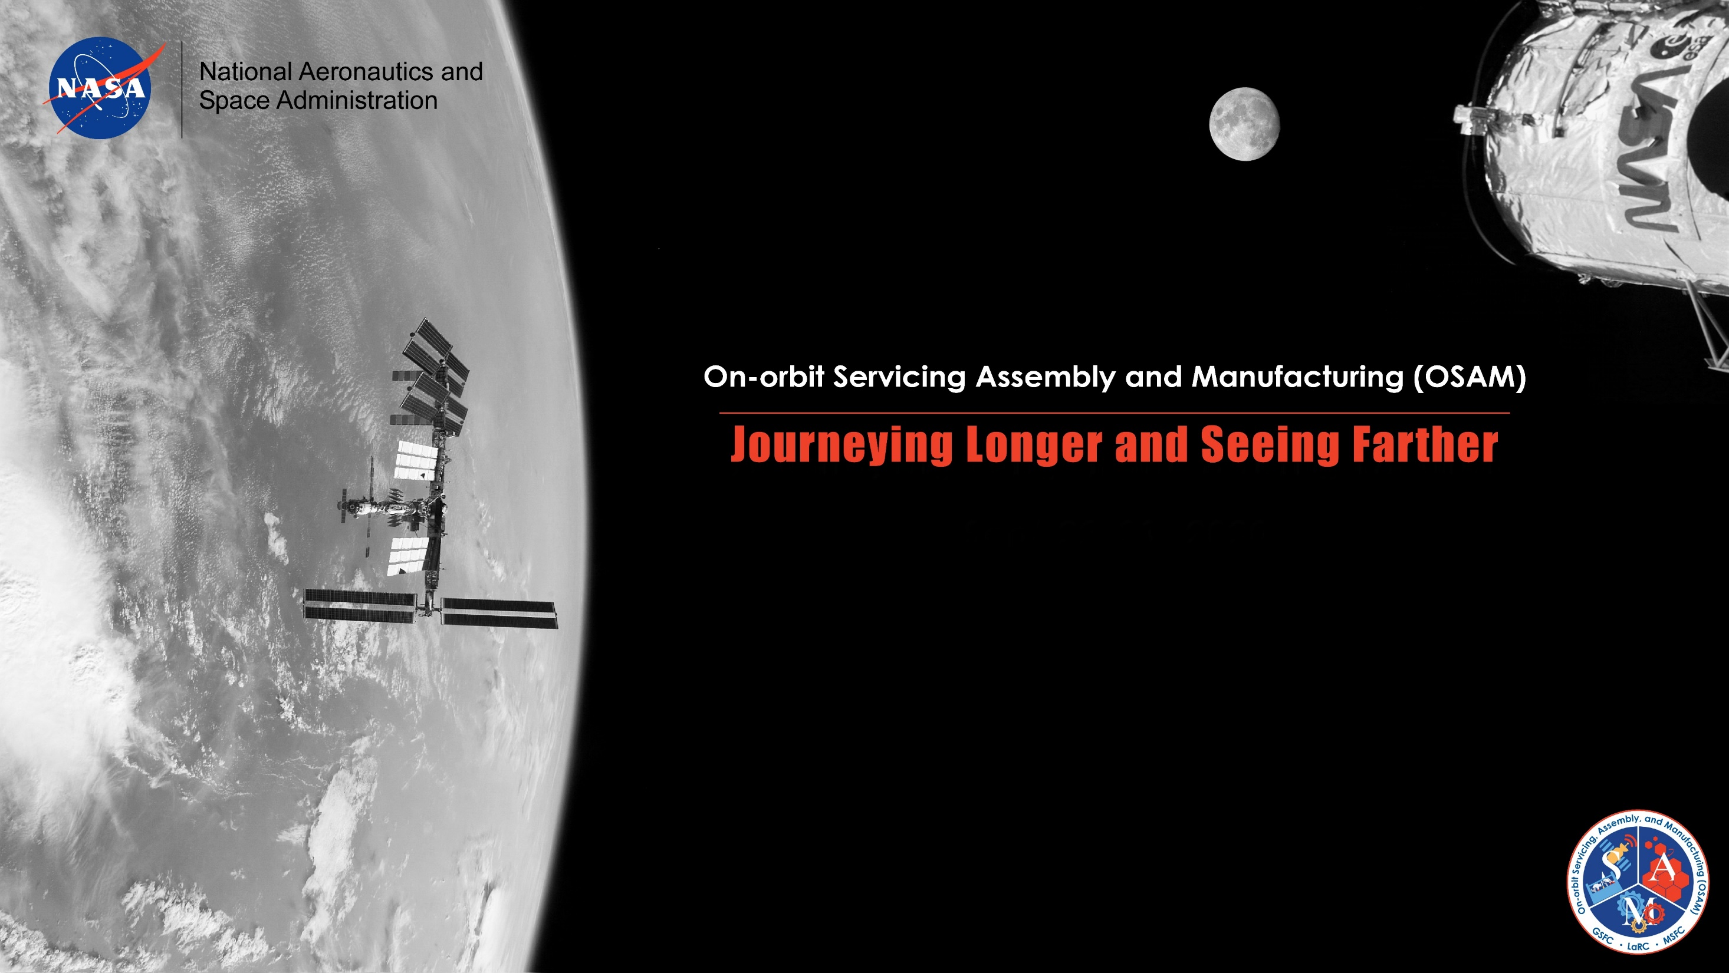

Robots are poised to make what was once thought to be impossible in space a reality. From extending the lifespan of satellites, to assembling massive life-seeking telescopes in space, to refueling and repairing spacecraft on journeys to distant locations, the possibilities are endless. Key to these endeavors is demonstrating the foundational capabilities – servicing, assembly, and manufacturing.
To arrange further discussion of on-orbit servicing technologies contact
Laura Hardin (256-990-1952 or laura.hardin@nasa.gov)
Background Graphic: OSAM technologies continue the legacy of the Hubble Space Telescope (HST) Servicing Missions, and will be implemented to assist astronauts span and expand orbiting stations like the International Space Station (ISS). OSAM technologies will also support lunar surface and orbiting operations.

