Slide 1
Termolecular QCT for Direct Molecular Simulation
Eric Geistfeld, Mentor: Rich Jaffe
NASA Ames Research Center
Summer Internship 2020

Slide 2

Outline
Context: The Dissociation-Recombination Problem
Motivation: Termolecular QCT for DMS
Three Body Sampling
Direct Triple Collisions
Orbiting Pair Triple Collisions
Results: Steric Factors
Results: Rate Constants
Results: Product Distributions

Slide 3
The Dissociation-Recombination Problem
Knowledge of the correct chemical state behind a shock is essential for accurate predictions of radiative and convective fluxes to a TPS
To reach the correct chemical state, simulations must account for all forward and backward reactions, such as dissociation and recombination
There are a variety of techniques to model the evolution of a gas’s composition at different levels of fidelity
  CFD requires conservation equations for each relevant species, controlled by rate coefficients and energy changes from reaction
  DSMC requires cross section models, controlled by parameters fit to atomistic data
  Direct Molecular Simulation (DMS) requires a Potential Energy Surface, determined by electronic structure calculations, used in Quasi-Classical Trajectories (QCT) that determine the relaxed state of the gas
The DMS method simulates the physics of dissociating-recombining gases with only quantum calculations as its input

Slide 4
Termolecular QCT
Quasi-Classical Trajectories are a method of studying reaction dynamics by integrating classical equations of motion for particles on PESs determined by quantum calculations, usually for bimolecular collisions
Recombination reactions are inherently a termolecular process because excess energy must be removed from an unbound pair
To simulate recombination, DMS needs QCT style simulation of three body collisions
“What is needed to accurately simulate recombination reactions with QCT?”
Termolecular sampling routines to get unbiased recombination probabilities
and
Termolecular kinetic theory to get collision rates

Slide 5
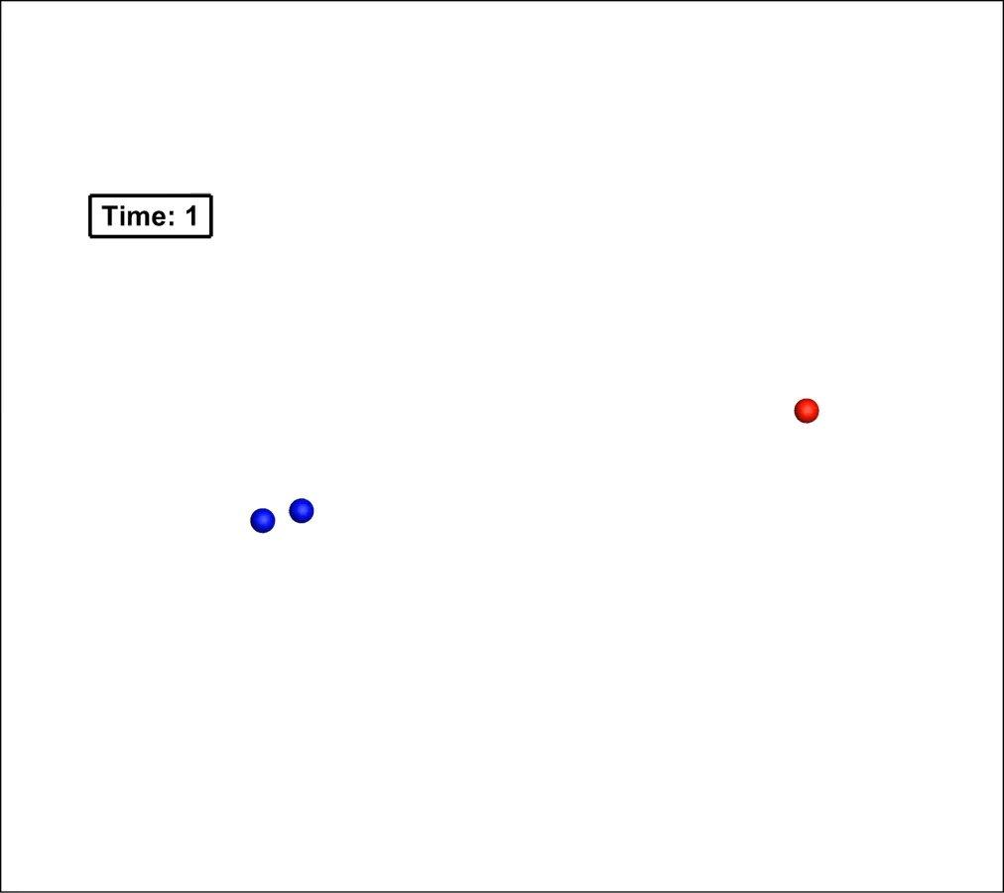
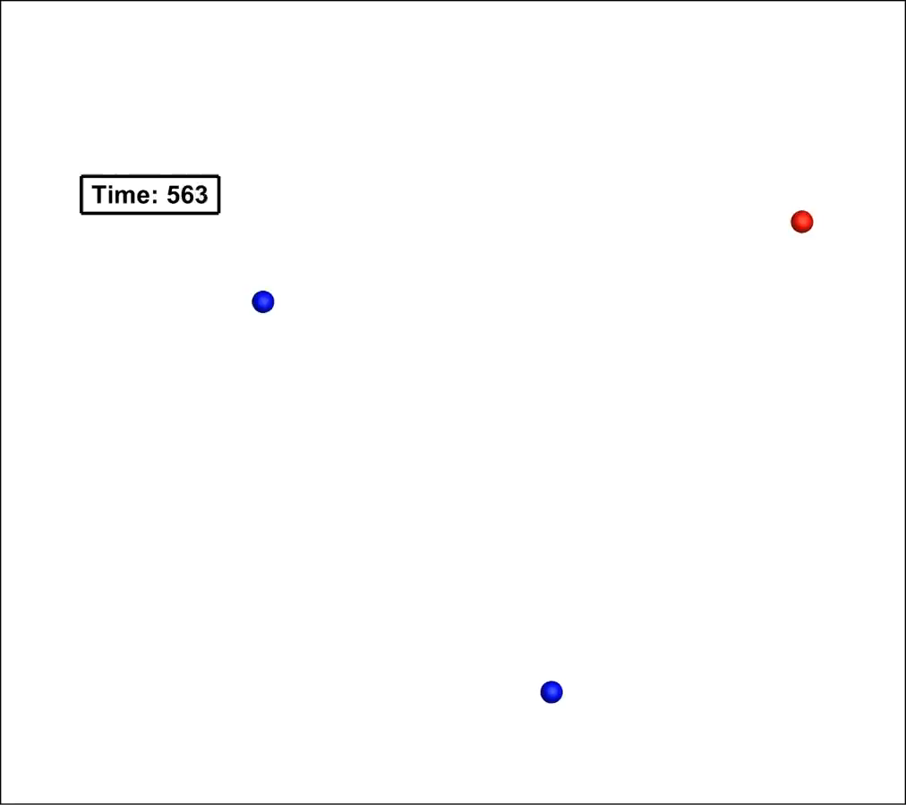
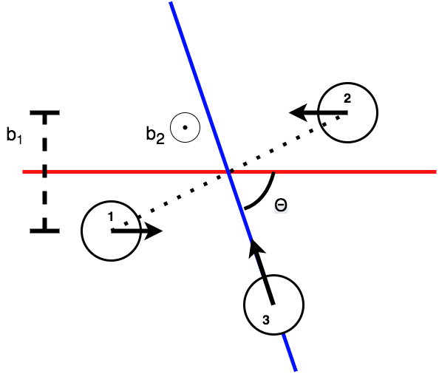
Three Body Sampling in REAQCT
REAQCT performs large numbers of bimolecular collisions in parallel and statistically analyzes the products
Used previously to study dissociation in Oxygen
e.g.) O + O₂→ 3O
and
O₂ + O₂→ 2O + O₂
2 Body QCT | 3 Body QCT
b₁ | b₁
E_{Rel 1} | E_{Rel 1}
 | Θ
 | Φ
 | b₂
 | E_{Rel 2}

Slide 6
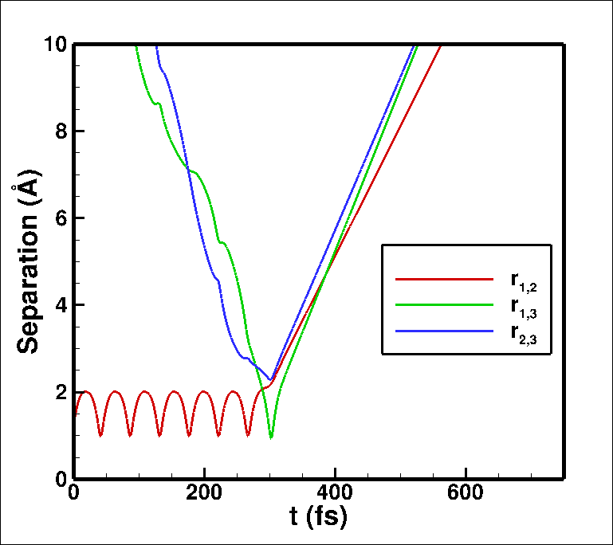
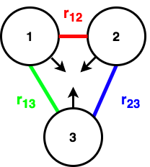
Direct Triple Collisions
Broadly, there are two types of triple collisions
1: Single step, direct triple collisions, e.g.) 3O → O+O₂
Identical to time reversal of single step dissociations
t_{Coll}

Slide 7
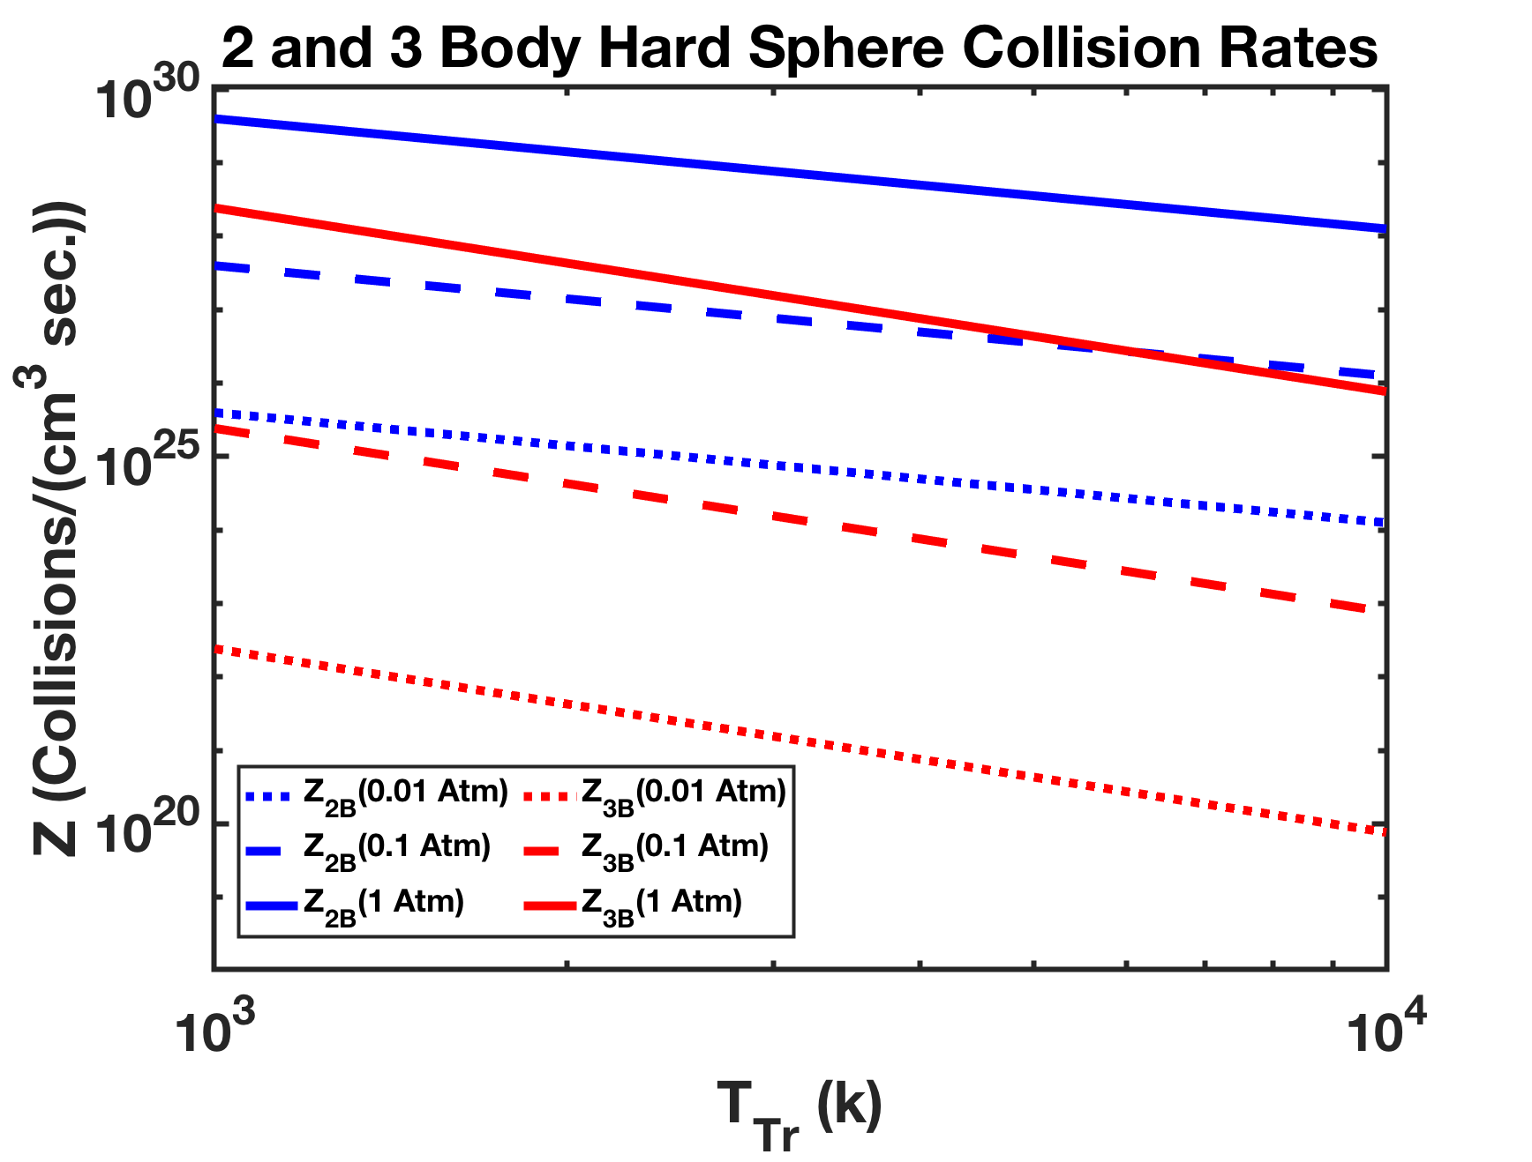
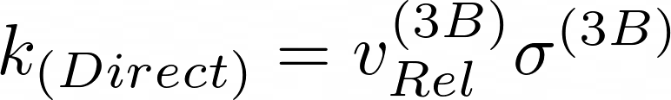


Direct Triple Collision Rate Constant
The direct triple collision rate constant can be approximated with a hard hypersphere cross section
This predicts that direct three body collisions are less frequent than two body ones by orders of magnitude over a wide range of conditions

Slide 8
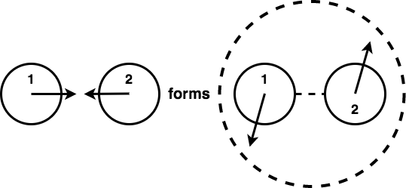
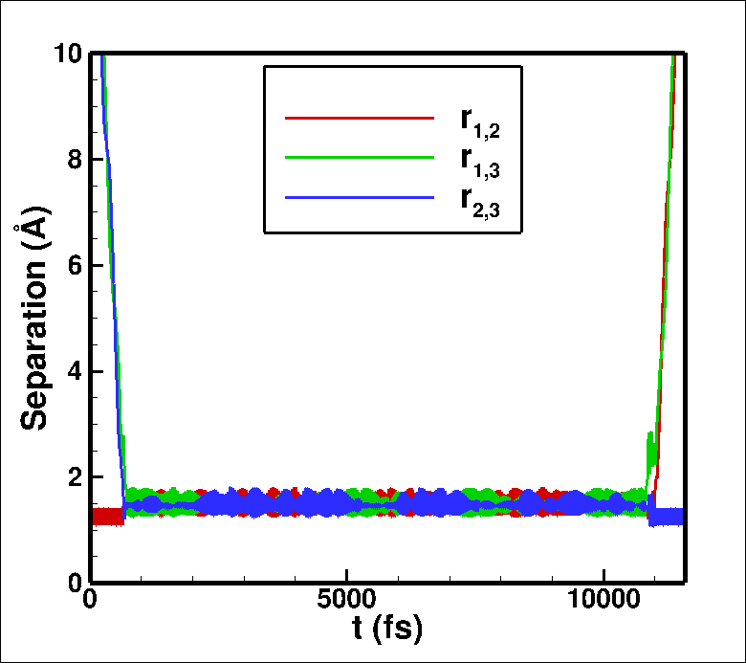
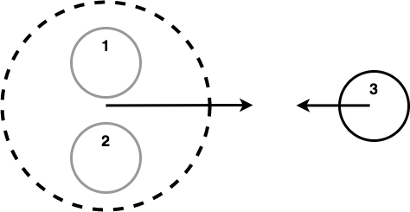
Orbiting Pair Collisions
2: Multi step collisions of orbiting pairs with third bodies
e.g.) O +O₂ → (O+O₂)OP then O + (O+O₂)OP → 2O2
t_{Coll}

Slide 9
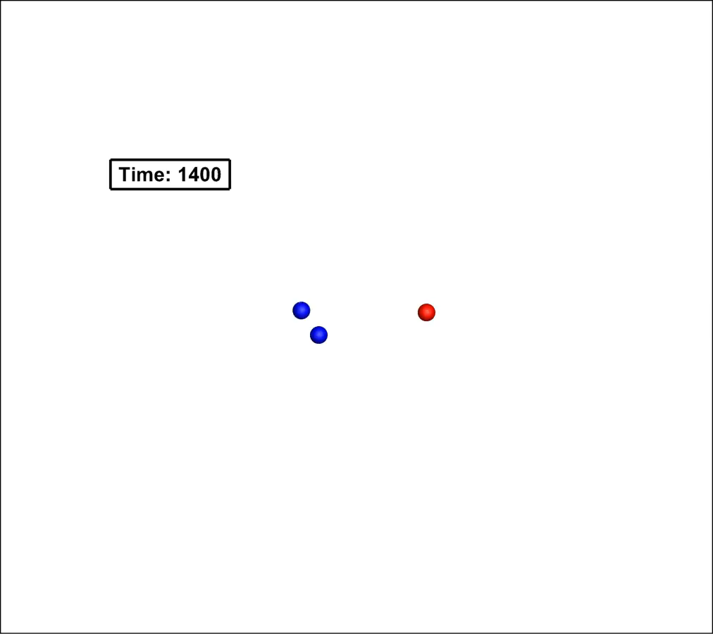
Orbiting Pair Collisions
2: Multi step collisions of orbiting pairs with third bodies
e.g.) O +O₂ → (O+O₂)OP then O + (O+O₂)OP → 2O2

Slide 10
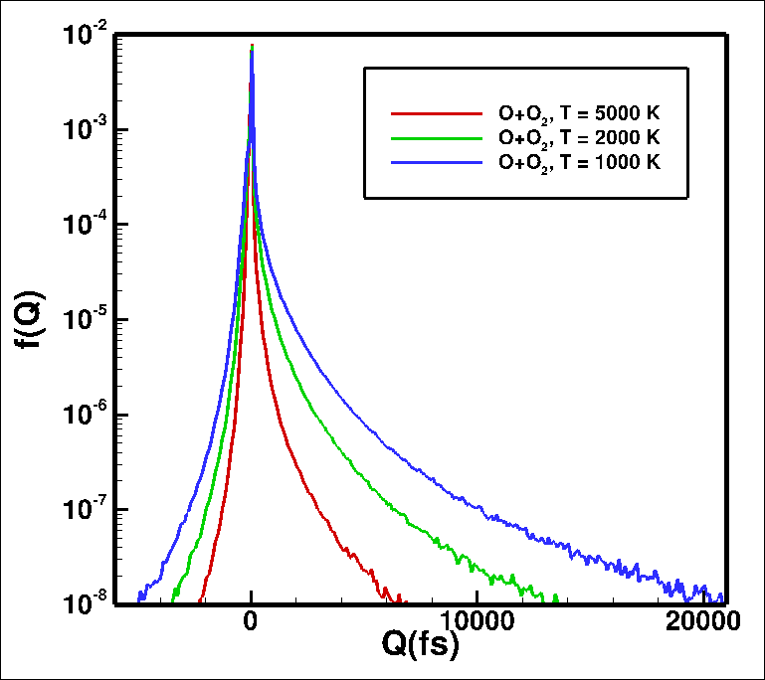


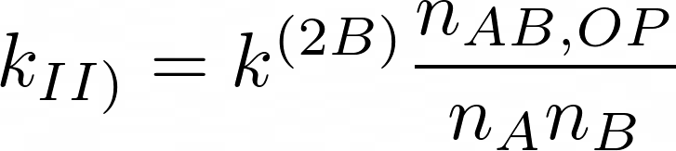
Orbiting Pair Collision Rate Constant
The rate constant for collisions of orbiting pairs with third bodies can be expressed as a function of the collision lifetimes
This function represents the relative concentration of orbiting pairs to non interacting pairs

Slide 11
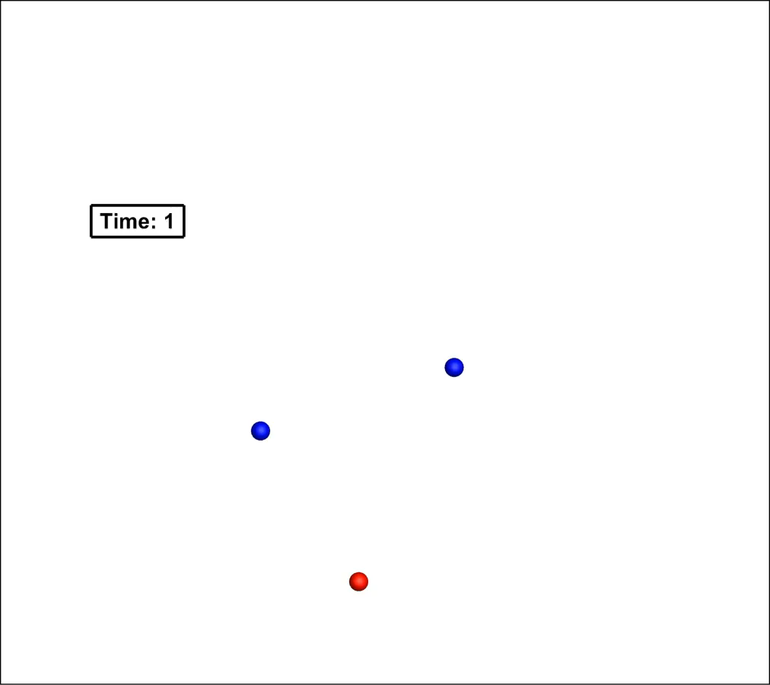
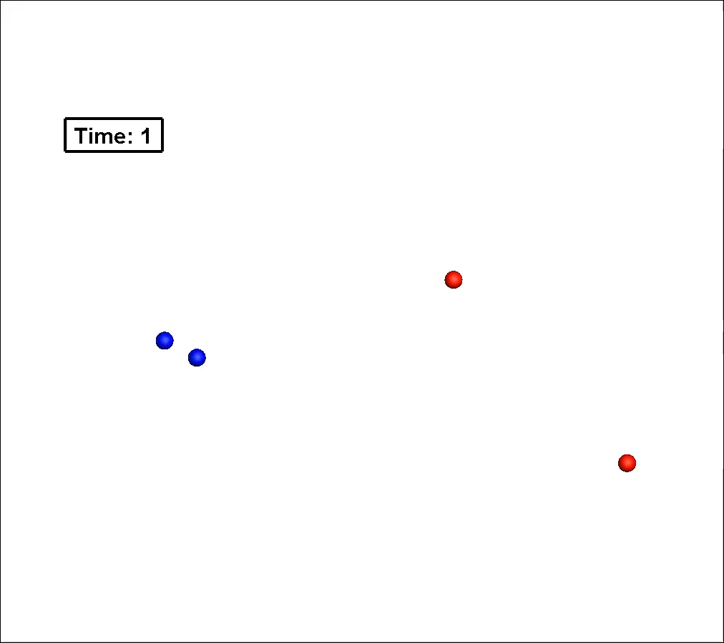
Recombination Collisions
O+O+O
O+O+O₂

Slide 12
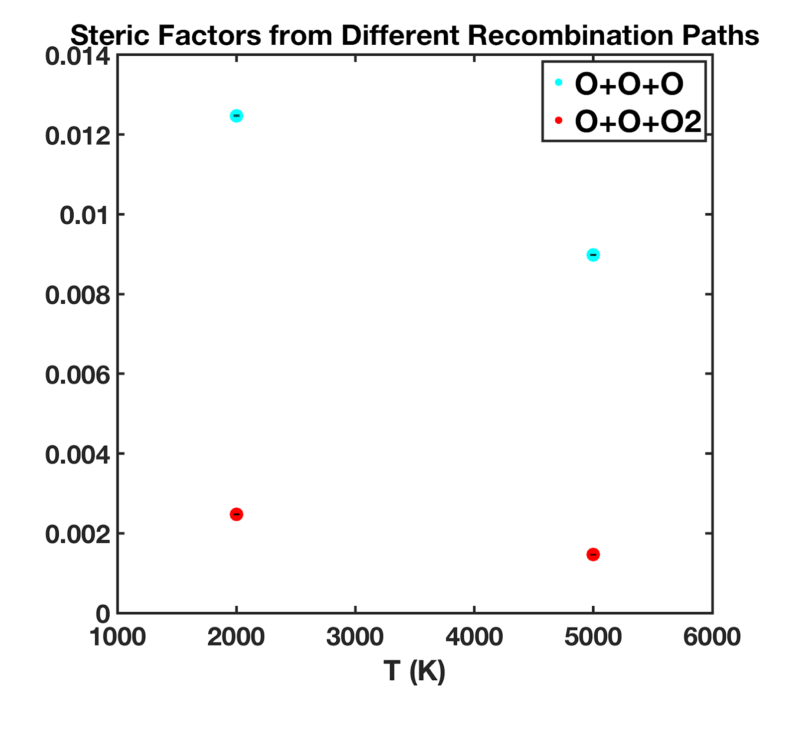
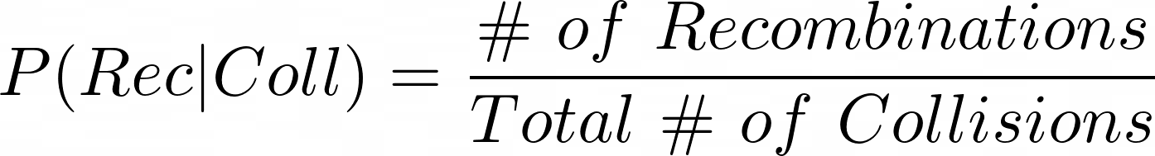
Recombination Probabilities
Sets of trajectories give a steric factor, or probability of recombination given the occurrence of a collision
These can be multiplied by the collision rate constants to get recombination rate constants
Currently assuming the same steric factor for direct and orbiting pair collisions

Slide 13
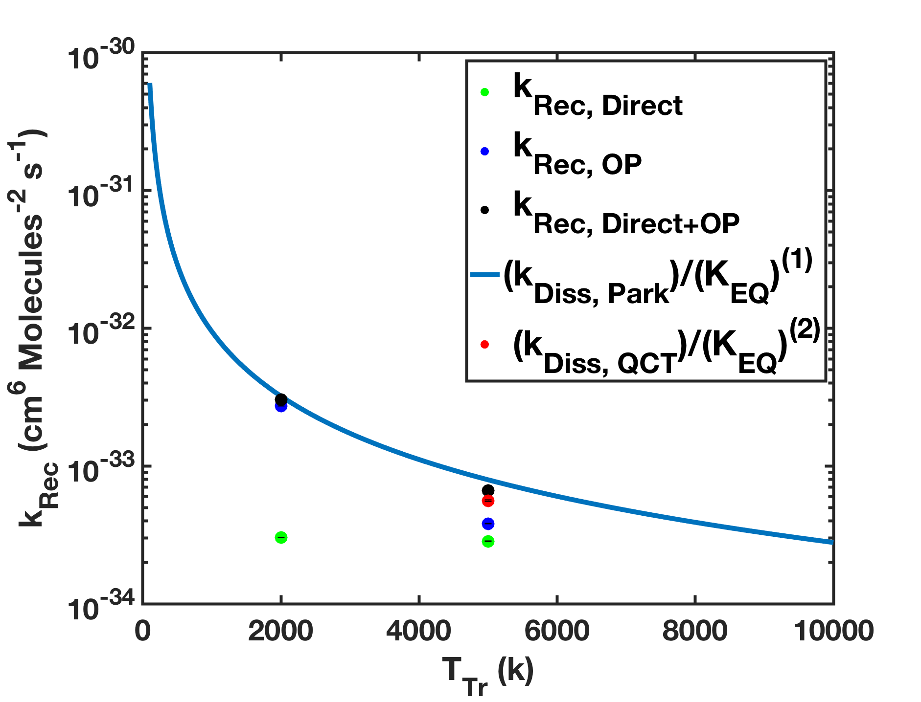
Recombination Rate Constants
Preliminary rate constants are within the same order of magnitude as those inferred from dissociation rate constants from the Park model and from QCT dissociation studies
At the conditions investigated, direct collisions contribute much less than orbiting pairs
(1): Park, Chul. "Nonequilibrium Hypersonic Aerothermodynamics." (1989).
(2): Chaudhry, Ross. "Modeling and Analysis of Chemical Kinetics for Hypersonic Flows in Air." (Ph.D. Thesis, 2018).
EQ Constants from: Johnston, H. S., “Gas Phase Reaction Kinetics of Neutral Oxygen Species” (1968)

Slide 14
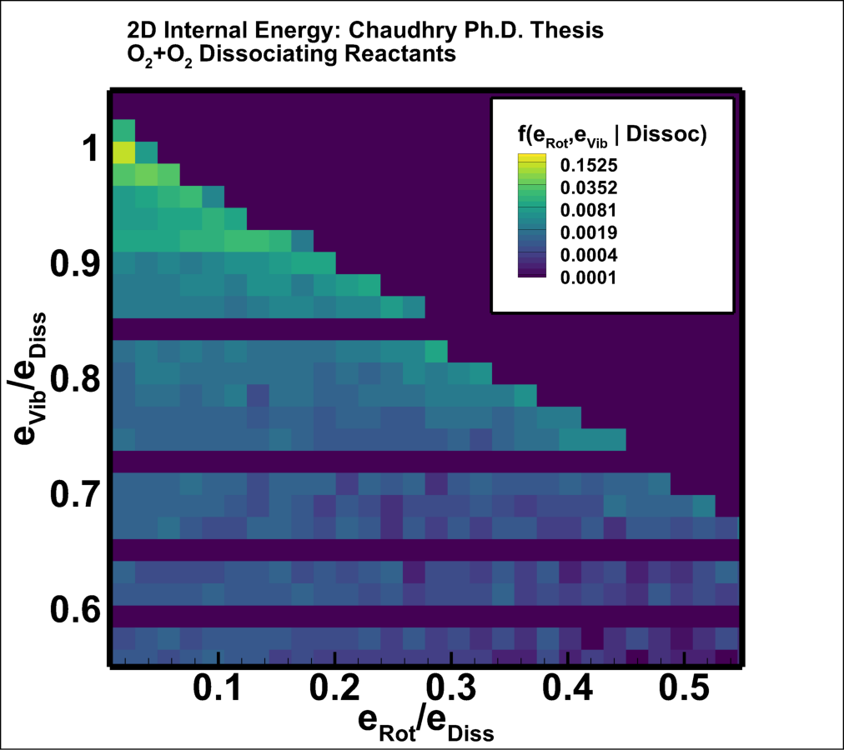
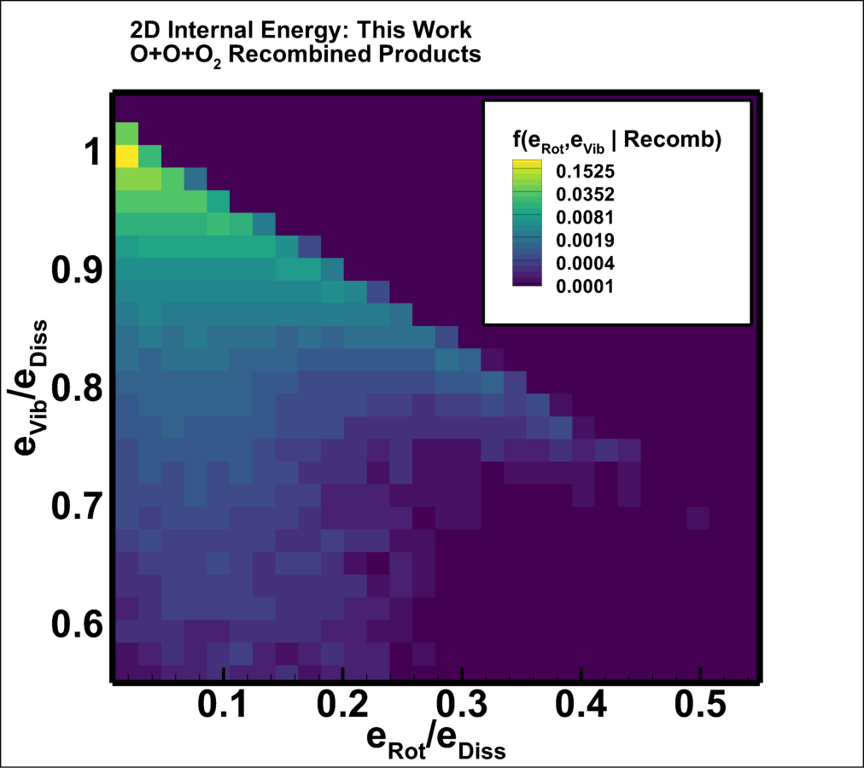
Product Distributions
Recombined product energies from direct collisions are mostly distributed near the dissociation limit
This mirrors the reverse process, where high vibrational states are the most likely to be destroyed by dissociation

Slide 15
Conclusions
Developed procedures and code to perform three body collisions within the REAQCT framework
Preliminary results for rate constants are within an order of magnitude of those implied by dissociation rates from reduced order models and bimolecular QCT
Developed statistical analysis routines that allow detailed study of conditions leading to recombination and the properties of recombined products
These tools will allow the DMS method to simulate all of the relevant the physics for shock-layer gas from first principles

Slide 16
Thank You
Rich Jaffe, Brett Cruden, Jeff Hill,
Tom Schwartzentruber, Erik Torres,
Narendra Singh, Gloria Mertl
Questions?

Slide 17
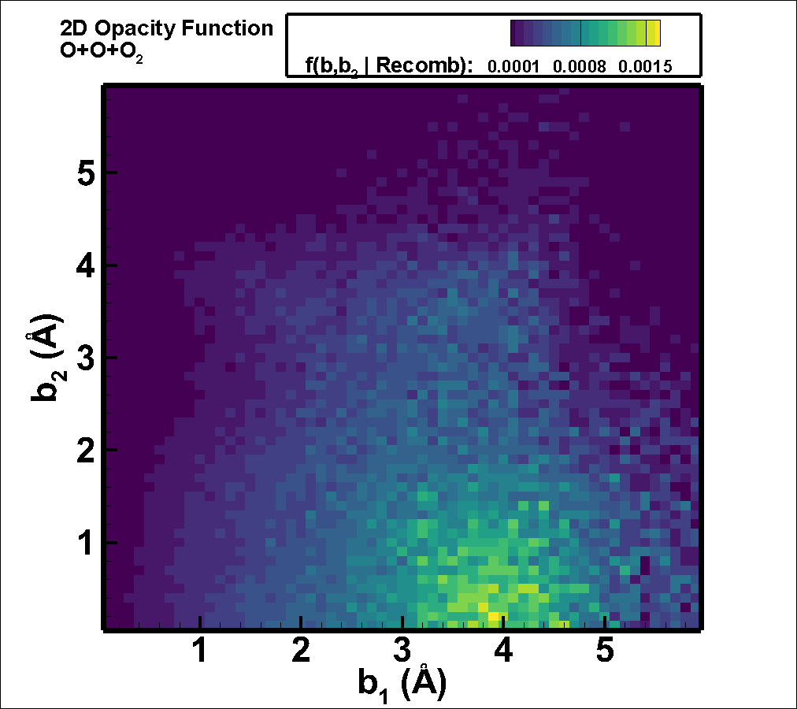
Product Distributions
Two dimensional PDF of recombining trajectories’ impact parameters shows which initial b₁ and b₂ are likely to lead to recombination
Distribution near maximum b₁ suggests that the initial assumption of b_{1, Max} = 6 angstrom was too small

Slide 18
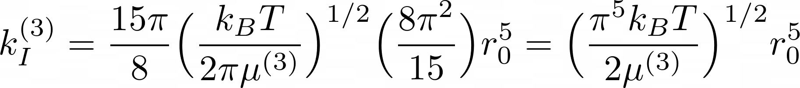

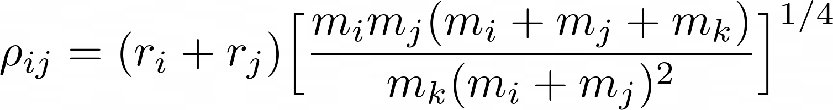
Direct Triple Collision Rate Constant
1
2
3
Equations from Hochstim, A., ed. ”Kinetic Processes in Gases and Plasmas.”, (Elsevier, 2012)

Slide 19
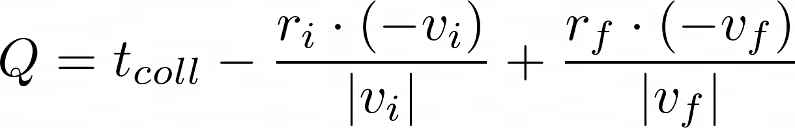
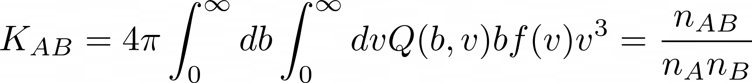
Orbiting Pair Collision Rate Constant
1
2
3
4
Equations from Hochstim, A., ed. ”Kinetic Processes in Gases and Plasmas.”, (Elsevier, 2012)

