Slide 1
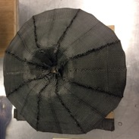
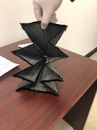
ADEPT Spiderweave Thermal Testing ACO Task
Background
The Adaptable, Deployable, Entry and Placement Technology (ADEPT) mechanically deployable aeroshell uses a multi-layer carbon fabric as the primary drag surface during hypersonic entry. The Spiderweave was produced as part of an SBIR Phase II contract by Bally Ribbon Mills (BRM). The Spiderweave technique addresses challenges of simplified manufacturing and potentially stronger joints between gores with continuous fill fibers connecting each gore in a spiderweave pattern
Technical Approach
The task will evaluate the novel spiderweave against the current stitched joint aeroshells via criteria of mechanical strength, fit and finish, and performance in relevant thermal testing in the NASA Ames Arc-jet facility.
Status
Spiderweave and Stitched Joint (12” diameter) aeroshells were fabricated by BRM and assembled by Thin Red Line Aerospace (TRLA). Design and fabrication of support structure and improved joint strength test rig have been completed. COVID19 has impacted test article integration and arc-jet testing. Task has requested extension to complete in FY21. FY21 work includes test article integration and instrumentation, Arc-jet testing, mechanical and thermal performance evaluation, final report preparation.
a
b
Fill direction
Gore
c
d
Image: Thin Red Line Aerospace
a. Spiderweave aeroshell ‘unfolding’ after weaving
b. Spiderweave aeroshell (BRM) after initial fit check
c. Assembled aeroshell with 2 types of protective layers over rib locations ready for structure integration
d. Design of load test rig for joint strength measurements
POC: Paul Wercinski, NASA Ames, Paul.Wercinski@nasa.gov

