Slide 1
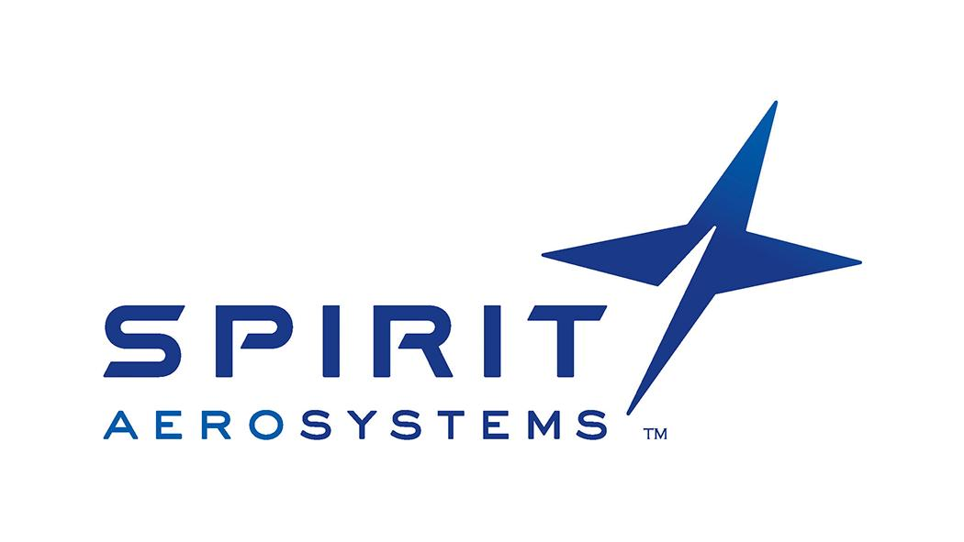
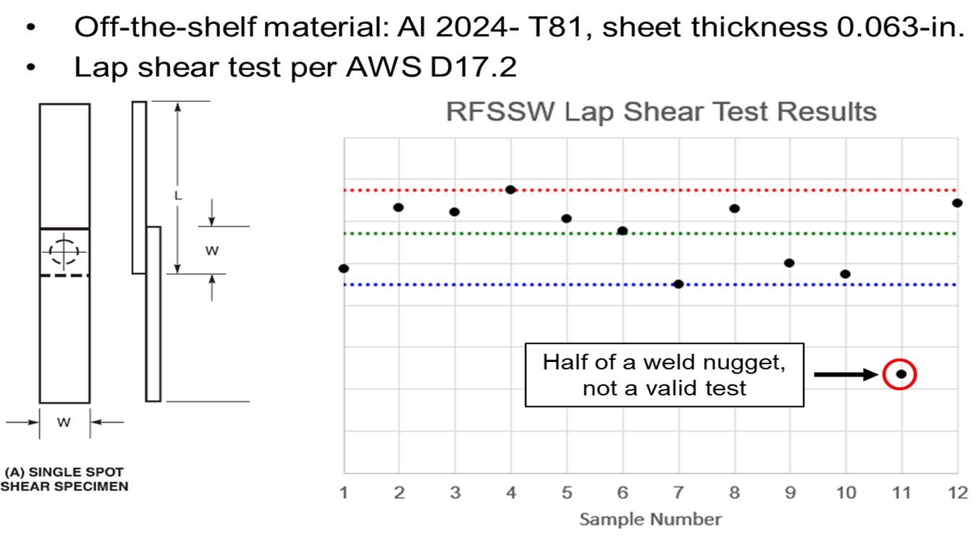
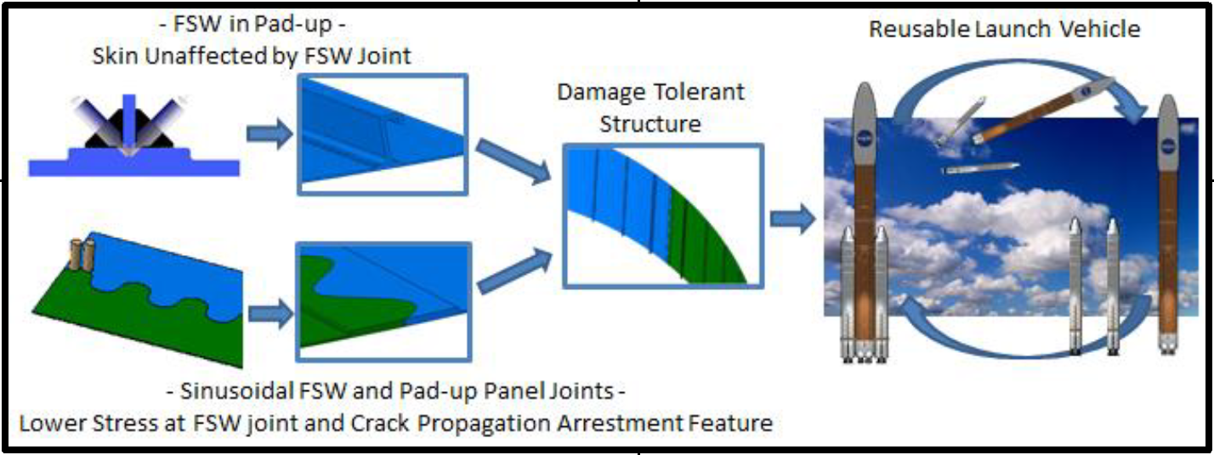
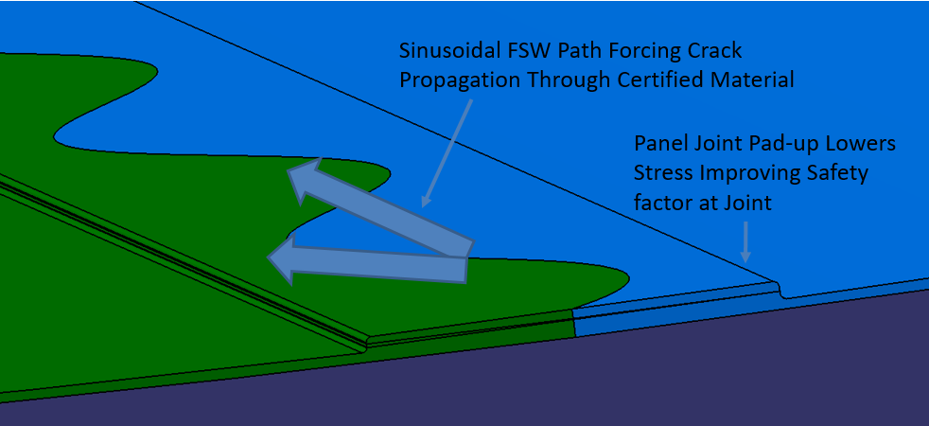
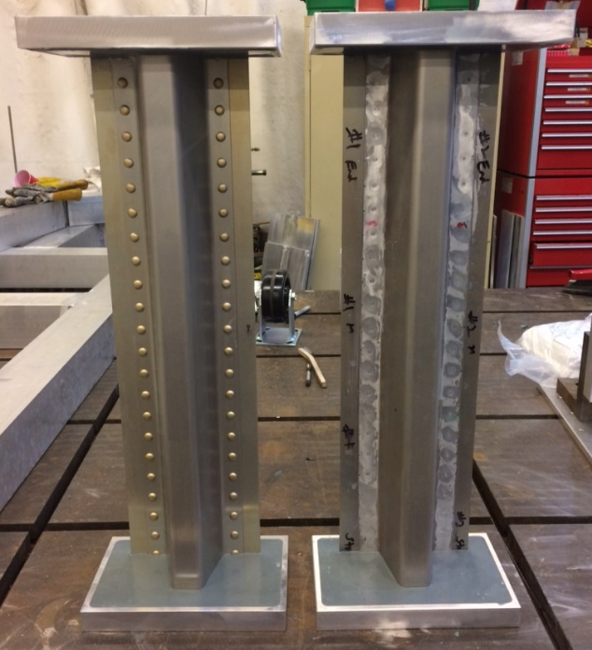
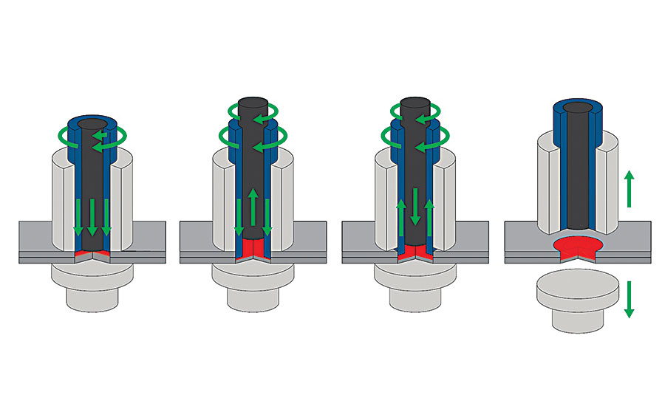
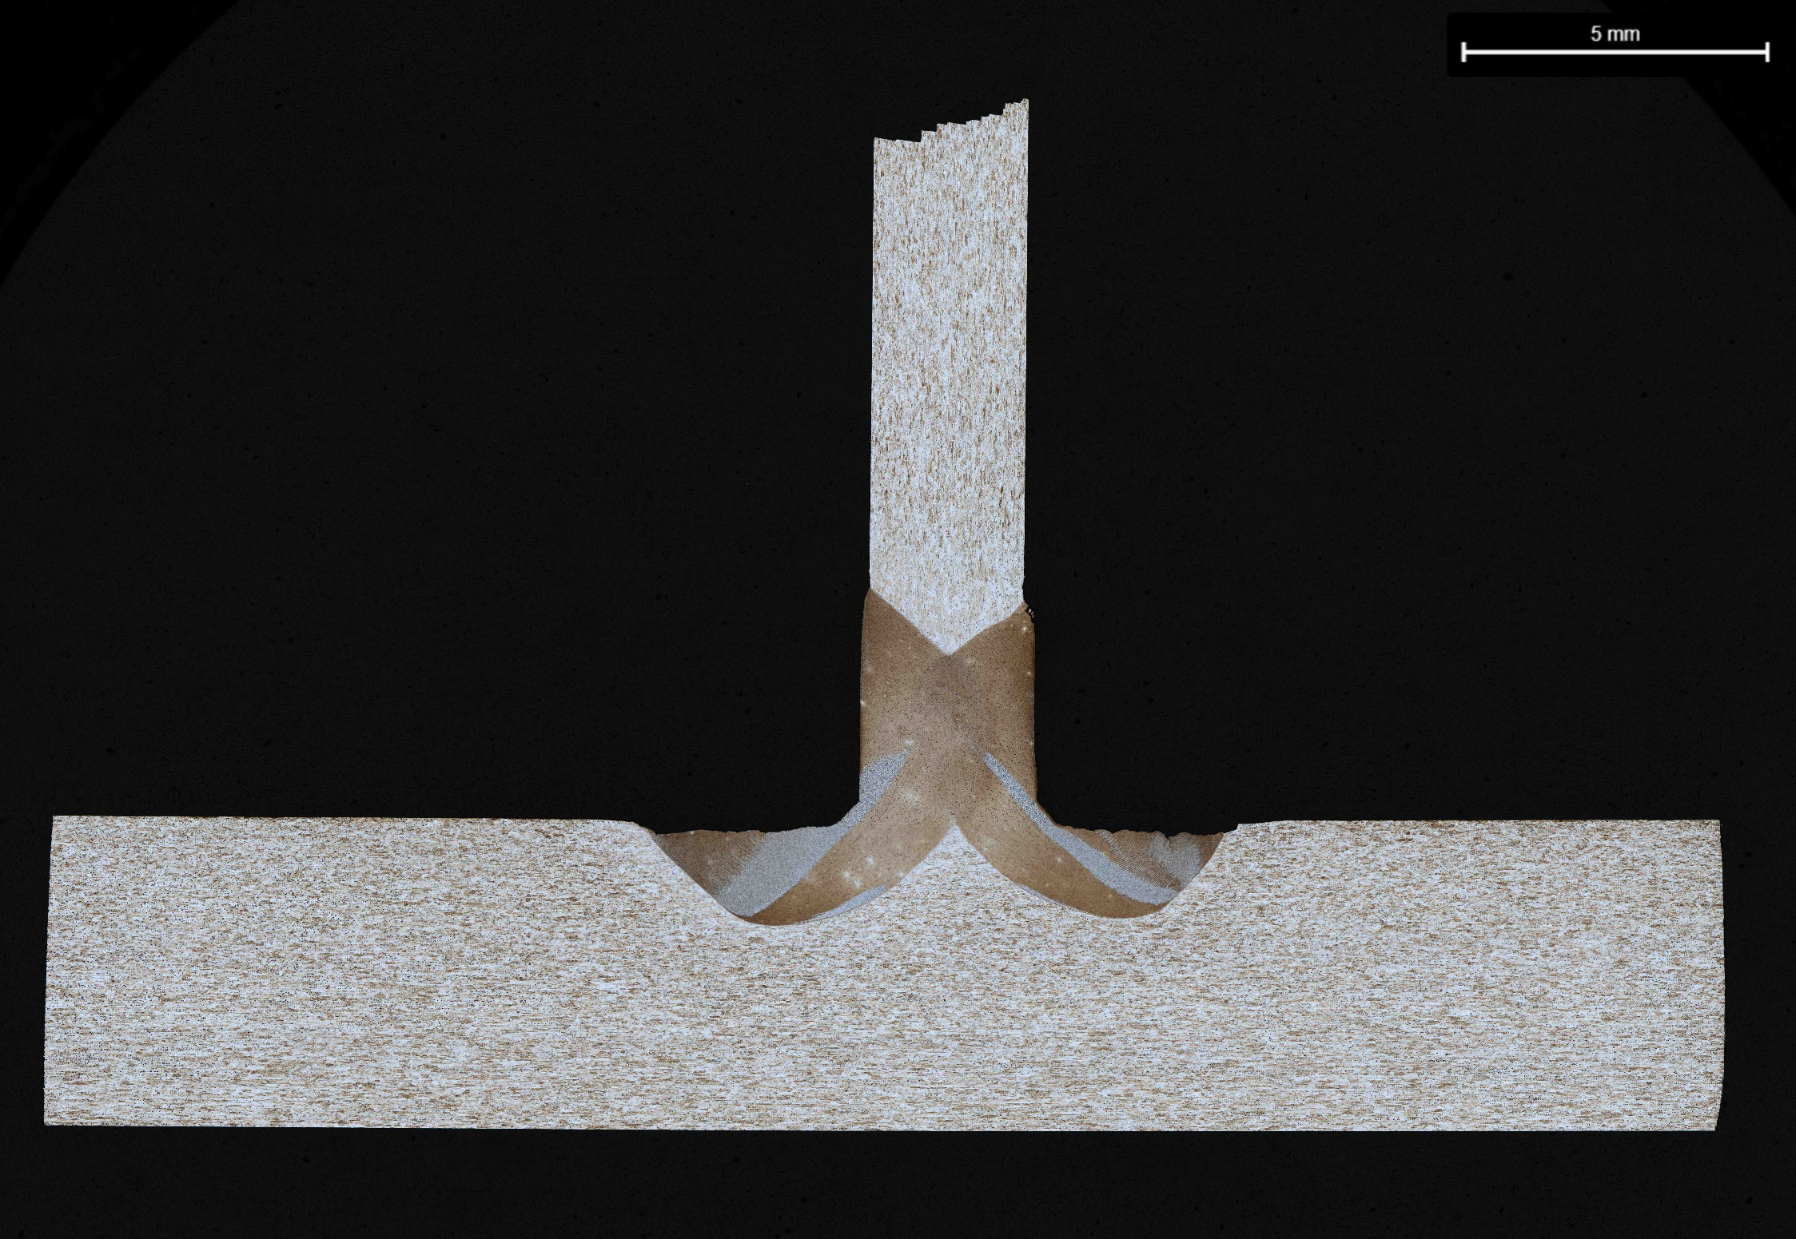
Improved Durability Reusable Launch Vehicle via Friction Stir Welding
Improved Durability Reusable Launch Vehicle via Friction Stir Welding
b
Project Goal
Joining Methods and Results
Joining Methods and Results
This project goal is to develop joining processes that will enable manufacturing of damage tolerant structures for improved durability launch vehicles.
Sinusoidal SR-FSW Welds:
Alternative joint geometry is being explored as a way to improve the damage tolerance of structures. The sinusoidal joint would require a crack that initiates in the weld region to follow the longer sinusoidal path, or turn and propagate through the more robust parent material.
Due to ongoing COVID19 shutdowns NASA & Spirit have partnered with to research South Dakota School of Mines on this project. Work is currently in the early stages.
Figure 6: rFSSW results from work performed in conjunction with Coldwater Machinery
Joining Methods and Results
Friction Stir Welding (FSW) Tee-Joint:
A tee-welding process is being developed to join dissimilar alloy combinations of stringer/skins for aerospace manufacturing. The tee-welding process will only disturb the upper portion of the skin material, leaving parent material below the weld. The combination of dissimilar alloy stringer/skins, and the ability to have parent material properties post weld in the skin (good for fatigue) are both advantageous for build a reusable launch vehicle.
Figure 3: Sinusoidal Weld Joint Profile Showing The Two Possible Crack Paths
Figure 4: Sinusoidal Weld Joint Fatiuge Specimen
Figure 7: Rivets vs. rFSSW crimple test set-up.
Refill Friction Stir Spot Welding:
Refill Friction Stir Spot Welding (rFSSW) is a self contained solid-state join capable of joining materials with joint sizes similar to rivets. Its main advantages over rivets are: Reduced weight due to no added material, less touch labor since the process is robotic, no leak paths (relevant for pressure vessels), and improved visual surface finish.
Lap shear tests and crimple tests showed comparable or better performance of rFSSW vs. rivets, even with the rFSSW joint schedule having limited optimization.
Dissimilar Alloy Selection:
Alloy combinations for the experiments are based on results from a D.O.E. using conventional FSW and a matrix of various aluminum alloys. Mechanical properties (yield and ultimate tensile strength, elongation, and fatigue data) drove a primary alloy combination of 2055 Al (stringer) and 2029 Al (skin).
Figure 1: Tee Weld Tool, Material, and Fixture
Results:
NASA has successfully made tee-weld joints and performed metallographic examination as seen in Figure 2.
Recap
NASA and Spirt are working together to develop manufacturing techniques to enable increased damage tolerant structures for reusable flight demonstrations. The COVID disruptions have presented new opportunities to work with other University partners to complete the desired research.
Figure 5: rFSSW Process Overview
Results:
NASA is leveraging previous work performed with Coldwater Machinery and also partnering with the Center for Friction Processing consortium to perform leveraged research to bring this process to TRL level 6.
Figure 2: FSW Tee Joint

