Slide 1
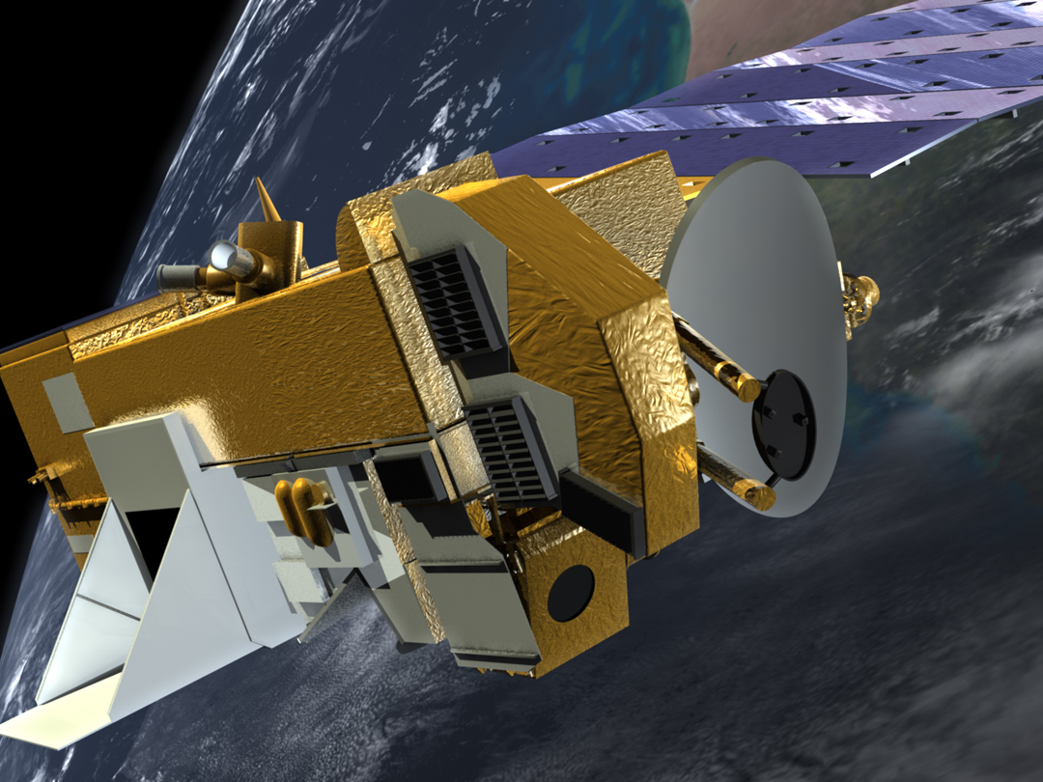
Mission Status for
Earth Science Constellation MOWG Meeting
@ GSFC (Virtual)
EOS Aura
Dominic Fisher
Aura Mission Director
(Code 584 / Aerospace Corp.)
phone 301-286-3171
dominic.m.fisher@nasa.gov
September 29, 2020

Slide 2
Topics
Mission Summary
Spacecraft Subsystems Summary
Recent Activities
Planned Activities
Propellant Usage & Lifetime Estimates
Overall Summary
Additional Slides:
  Spacecraft Maneuvers & Ground Track History
  Conjunction Assessment
  Data Capture & Ops Error Statistics
  Extended Mission Plans

Slide 3
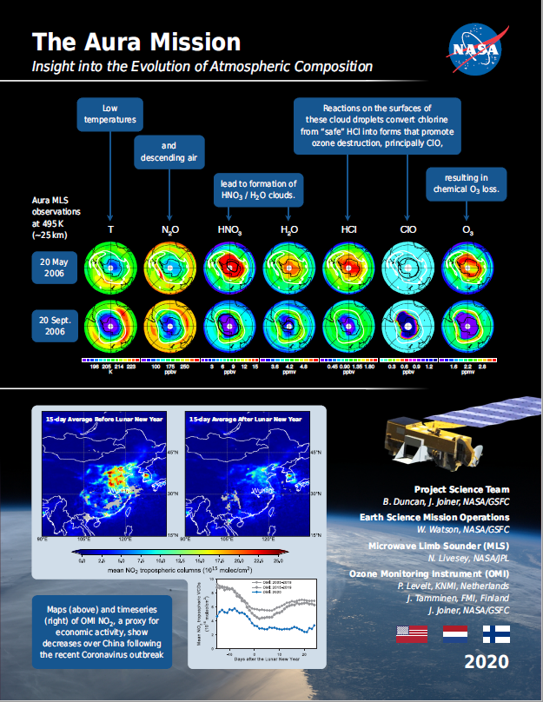
EOS Aura Mission Summary
(Updates since December 2019 MOWG @ Gilbert, AZ)
07/15/04: Launch
  6-Year Design Life
09/30/10: End of Prime Mission Review
09/18/15: 2015 Mission Extension Senior Review Proposal Panel Report
03/03/17: Senior Review Proposal #5
02/04/20: ESMO Annual Review #13
03/03/20: Senior Review Proposal #6
  Reliability Estimates through 2025
  Consumables through 2024
  Updated Aura Phase F Plan
07/10/20: Senior Review Earth Science Subcommittee Presentation
  Awaiting results and NASA HQ Guidance
07/15/20: Aura 16-Year Anniversary

Slide 4
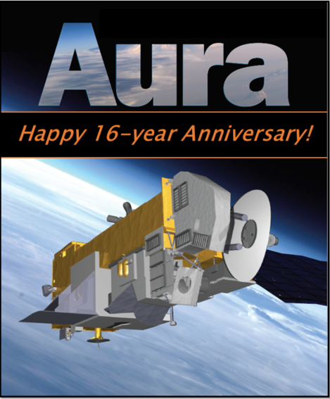
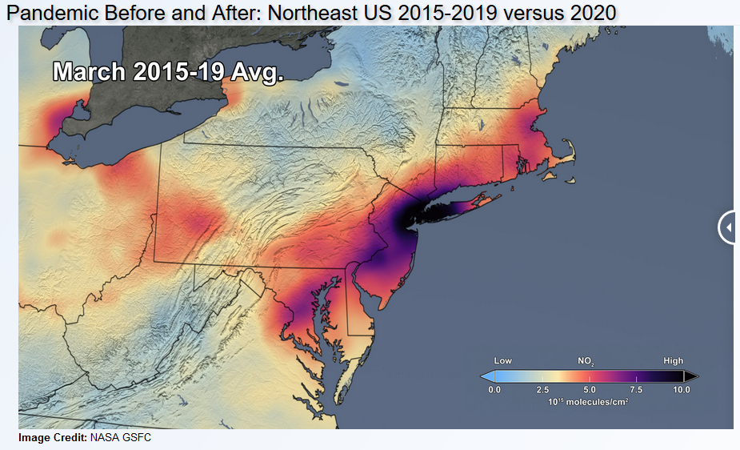
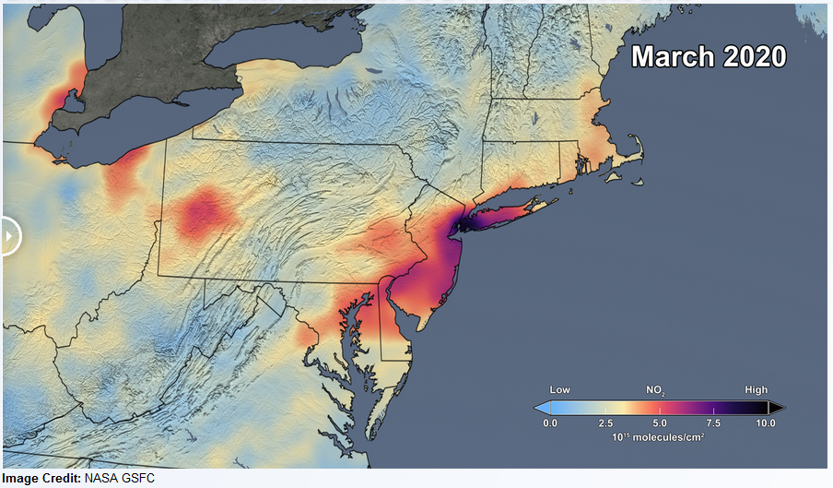
Aura’s 16th Anniversary!
Launch Date:
July 15, 2004
Aura’s long-term data record continues to produce tremendous scientific value
https://airquality.gsfc.nasa.gov/slider/northeast-2020

Slide 5
Aura Extended Mission Timeline
TODAY
2020
2021
2022
2023
2024
2025
2026
Q1
Q2
Q3
Q4
Q1
Q2
Q3
Q4
Q1
Q2
Q3
Q4
Q1
Q2
Q3
Q4
Q1
Q2
Q3
Q4
Q1
Q2
Q3
Q4
Q1
Q2
Q3
Q4
Senior Review Cycle
2017 SR
2017 SR: FY21 – FY23
2020 SR: FY21 – FY23
2020 SR: FY24 – FY26
2023 SR: FY24 – FY26
Spacecraft
& Instrument Activities
Operate WITHIN the A-Train
Fuel Threshold
Operate BELOW the A-Train
Power Threshold
IAMs
IAMs
CEMs
INST Off
IAMs
IAMs
PLMs
Passivate
Meetings
& Milestones
Aura
A-Train Exit
Review
KDP-F
Aqua
A-Train Exit
Aura
A-Train Exit
Aura
20-Years
DR
DRR
SRP
SRP
Senior Review Funding (Approved)
SRP – Senior Review Proposal
INST Off – Power down instruments
Senior Review Funding (Preliminary Guideline)
A-Train Exit Review (~late 2022)
Passivate – Spacecraft passivation
IAMs – Spring Inclination Adjust Maneuvers
DR – Decommissioning Review
IAMs – Fall Inclination Adjust Maneuvers
KDP-F – HQ Key Decision Point to proceed with Phase F
NOTE: Activity & Milestone dates dependent on spacecraft performance
(i.e., fuel and power limitations)
CEMs – Constellation Exit Maneuvers
DRR – Disposal Readiness Review
PLMs – Perigee Lowering Maneuvers

Slide 6
Aura Spacecraft Subsystems
(No changes since December 2019 MOWG @ Gilbert, AZ)
Command & Data Handling (CDH) – Nominal
  Formatter Multiplexer Unit (FMU) / Solid State Recorder (SSR) Anomaly
    Initial symptoms occurred December 4-18, 2007
    Newest symptoms started in January 2017 and remain active (impacting S-Band HK data capture)
Communications (COMM) – Nominal
  Transmitter-B Reflected Power Anomaly (10/17/17, 01/05/18)
Electrical Power System (EPS) – Nominal
  Array Regulator Electronics (ARE) Anomalies:
    Solar Panel Connector Anomaly – ARE-3C (01/12/05) – loss of 11 strings
    MMOD Strike – ARE-5A (3/12/10) – loss of 6 strings
  ARE Degradation (due to aging):
    ARE-1A (3/12/10, 11/5/11), ARE-1C (7/14/17, 12/22/17), ARE-2A (8/24/19), ARE-2C (8/18/17),
    ARE-4A (9/23/14, 12/8/14), ARE-4C (6/6/19), ARE-5A (4/25/13), ARE-5C (9/27/12, 2/4/13), and
    ARE-6A (9/14/13)
  Estimated that Aura has lost 33 strings of solar cells out of a total of 132 strings (~75.0% remain)
Flight Software (FSW) – Nominal
Guidance, Navigation & Control (GN&C) – Nominal
Propulsion (PROP) – Nominal
Thermal Control System (TCS) – Nominal
All subsystems configured to primary hardware

Slide 7
Recent Activities
(December 2019 – August 2020)
0 Spacecraft Bus Anomalies
0 Instrument Anomalies
  0 MLS Anomalies
    Last Anomaly: Receiver 2 Anomaly (07/18/19, recovered on 07/24/19)
  0 OMI Anomalies
13 Spacecraft Maneuvers
  6 Drag Make-up Maneuvers (DMUMs #131 – 136)
    Routine Maintenance: 02/12/20, 04/29/20, 06/03/20, 06/25/20, 07/29/20
    Risk Mitigation Maneuver (RMM): 01/03/20
  7 Inclination Adjust Maneuver (IAMs #64 – #70)
    Spring 2020 IAMs: 03/04/20, 03/11/20, 03/25/20, 04/01/20
    Fall 2020 IAMs: 08/19/20, 09/09/20, 09/16/20
1 Instrument Maneuver
    MLS Yaw #15 (Moon Scan) – 03/11/20
8 High Interest Events (HIEs) (Tiers 1-4) (As of 08/31/20 – more details in back-up)
  4 Tier 3 Events (T3) – maneuver options planned and screened
  1 Tier 4 Events (T4) – maneuver executed
    01/03/2020: Aura vs. 13498 at 22:50:31 GMT – moved up scheduled DMU to earlier date

Slide 8
Recent Activities
(December 2019 – August 2020)
COVID-19 Response & Impacts
  Following NASA / GSFC response framework – currently in Stage 3 (mandatory telework)
  Operations teams have been successful in minimizing on-site presence to only essential personnel
  Meeting mission requirements and performing critical activities with a majority of the staff working remote (i.e., maneuver monitoring & anomaly response)
Aura GNC Earth Sensor Assembly (ESA) Patch
  FOT had been monitoring an on-going roll & pitch bias drift that saw an increased frequency of limit excursions
  Calibration parameters were updated in 2009 to mitigate attitude estimation errors but since that time the errors have slowly continued to drift
  NGSS recommended some new calibration parameters, along with a redesigned pitch filter in June 2020
  FOT generated the new products and verified the contents on the simulator
  FOT uplinked Part 1 of the patch (new calibration parameters) on 08/13/20
  Plans are to uplink Part 2 of the patch (new pitch filter) in October 2020

Slide 9
Recent Activities
(December 2019 – August 2020)
Aqua / Aura Maneuver Working Group (MWG)
  Aqua RWA IAM Development
    Successfully completed the 2020 Spring & Fall IAM Series using RWAs for the slew portion
    FDS estimates fuel savings of ~1.4 kg and ~25% increase in ΔINC efficiency (degrees / kg)
  Thruster Performance Degradation Investigation
    Results from the Spring 2020 IAMs continued to show Aqua thruster degradation (decreasing Thrust Scale Factor (TSF))
    Worked with NGSS to assess performance data – not a spacecraft safety concern
    Successfully performed individual thruster test burns on Aqua – 07/01/20
    Continuing to monitor thruster performance on Aura – no plans for thruster test at this point
  Aqua / Aura IAM Planning
    FOT & FDS debriefed the performance of the Spring series on 04/22/20
      Aqua: 2.9% COLD, Aura: 1.5% COLD
    Following the performance of the Spring 2020 IAMs changes were made to the Fall 2020 IAM plan to increase from 2 to 3 IAMs
  Retrograde Maneuver (RM) Capability Development – CEMs / PLMs
    FOT & FDS presented some preliminary analysis on CEM timing and limitations
    Discussions with Aqua / Aura instrument teams were held to work through details

Slide 10
Recent Activities
(December 2019 – August 2020)
Ozone Monitoring Instrument (OMI) Operations Transition
  Kick-off meetings with the FOT, IOT, and Science Team held in September 2019
  Handed over load approvals to the FOT in December 2019
  Stopped 24/7 support from KNMI as of January 1st, 2020
  Status meetings continue to be held monthly with the FOT & IOT
  Updated OMI baseline orbit-type activities (N1, D1, W2, M2) in May 2020
  Forced to cancel site-visit from KNMI personnel (May 11th – 13th)
  Parallel activity scheduling from June-Sept and handover to occur in Oct 2020
TES Laser End of Life (EOL) Testing [since Decommissioning on 01/31/18]
  Phase 2 testing will alternate leaving Laser A or B ON for extended durations and characterize performance every 6 months
  Previous Phase 2 Testing:
    Round 1 (November 2018), Round 2 (April 2019), & Round 3 (October 2019)
  Round 4 Testing – Postponed due to COVID-19 operations limitations
    Originally planned for April 2020
    Future discussions with the FOT / IOT to see if there is potential to support testing remotely

Slide 11
Planned Activities
Fall 2020: Respond to 2020 Senior Review Guidance
Fall 2020: FDS Lifetime Analysis Updates
  Updates to incorporate Fall IAM performance and new DAS solar flux predicts
February 2021: ESMO Annual Review #14
Spring 2021: Earth Science Constellation (ESC) MOWG
  Update propellant budget, decommissioning analysis, reliability predictions, etc.
Spring 2021: Bi-annual Inclination Adjust Maneuvers (4)
  2/24/20 (#71), 3/3/20 (#72), 3/10/20 (#73), 3/17/20 (#74), 3/24/20 (Backup)
Mid-to-Long-Term Plans:
  Maneuver Working Group (MWG)
    Retrograde Maneuver (RM) capability development (CEM / PLM schemes)
  Decommissioning Working Group (DWG)
    End of Mission activity planning and spacecraft passivation sequence development
  EOS Automation (EA) – automation of routine operations
    Continue FOT automation procedure development into 2021
  Mission Operations Conjunction Assessment (MOCA)
    Continue to improve process - CRMS Release 9.0 expected in early 2021

Slide 12
Spring 2021
Inclination Adjust Plan
Sunday | Monday | Tuesday | Wednesday | Thursday | Friday | Saturday
21 February | 22 | 23 | 24 Aura IAM #71 | 25 Aqua IAM #74 | 26 | 27
28 | 1 March | 2 | 3 Aura IAM #72 | 4 Aqua IAM #75 | 5 | 6
7 | 8 | 9 | 10 Aura IAM #73 | 11 Aqua IAM #76 | 12 | 13
14 | 15 | 16 | 17 Aura IAM #74 | 18 Aqua IAM #70 | 19 | 20
21 | 22 | 23 | 24 Aura Backup | 25 Aqua Backup | 26 | 27
28 | 29 | 30 | 31 | 1 April | 2 | 3

Slide 13
Collision Risk Management System (CRMS)
Process Improvements
ESMO has developed ground system capabilities to autonomously identify and develop maneuver options to assist in Risk Mitigation Maneuver (RMM) / Debris Avoidance Maneuver (DAM) planning
Developed in response to an increased number of predicted close approaches with orbital debris and operational satellites
  More High Interest Events (HIEs) had led to more effort to plan mitigation maneuvers
  Concern is that updates to the US Air Force Space Fence will significantly increase the size of the Space Catalog
Key CRMS capabilities include:
  User defined collision risk thresholds
  Maneuver optimization to address multiple conjunctions with secondary object conjunctions
ESMO developed MOCA CONOPS in support of CARA Devolution initiative
  Completed Parallel Ops test phase in Fall 2019 (09/26/19)
EOC is currently operating with CRMS Release 8 (ORR 02/25/20)

Slide 14
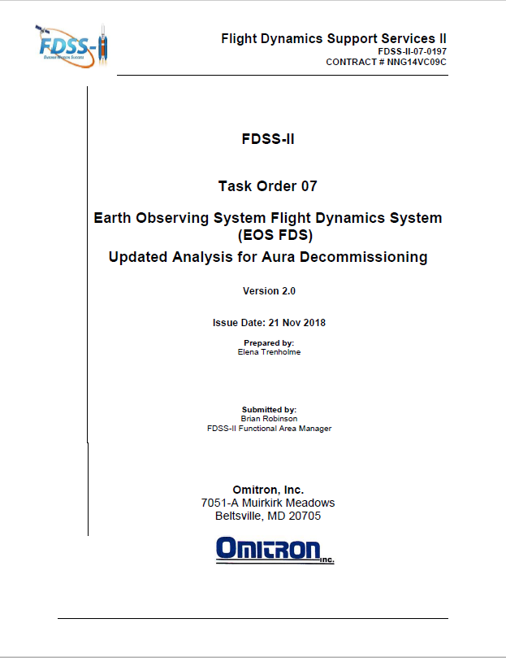
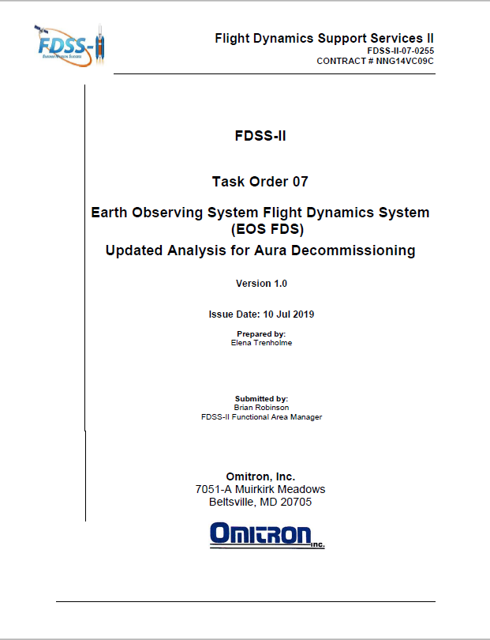
Aura Propellant Usage
(Analysis Updated June 2020)
2006: Initial Aura lifetime fuel analysis
2008: Detailed Aqua & Aura lifetime analysis
  Presented to MOWG and at Aura End of Prime Mission Review in September 2010
2012 (September): Initial Aura Decommissioning Plan
  Included updated Lifetime Estimates
2013 (August): Updated Decommissioning Plan
  Included updated Constellation Exit Plan
2014 (September): Updated Decommissioning Plan
2015 (September): Decommission Plan Update Postponed
  Postponed to evaluate long-term plan and decommissioning maneuvers
2016 (January): Updated Decommission Plan (v1.2)
  Included hypothetical MLT drift analysis with LS-8
2017 (October): Updated Decommission Plan (v1.0)
2018 (July): Updated Decommission Plan (v1.0)
  Summer IAM required update to document and IAM Plans
  Included Appendix B with alternate plan to drift after 2019 IAMs
2018 (November): Updated Decommission Plan (v2.0)
  Updated definitive fuel usage & predicted solar flux levels
  Updated propellant estimates for IAMs w/ RWAs & DMUs
2019 (July): Updated Decommission Plan (v1.0)
  Update definitive fuel usage & predicted solar flux levels
2020 (October): Expect updated report following analysis of Fall 2020 IAM series
Final will be produced 60 days before start of decommissioning

Slide 15
Remaining Fuel Estimate
(Analysis Updated June 2020)
Long-term orbit simulations were run for Aura through Feb 2023
  Used mean nominal Schatten solar flux predictions (May 2020)
  Estimated the frequency of drag make-up maneuvers to maintain Aura’s WRS-2 ground track requirements
  Estimated the required number of annual inclination maneuvers for Aura to maintain it’s mean local time (MLT) requirement (9 IAMs remaining)
  Did not include potential debris avoidance maneuvers
  Utilized FreeFlyer 6.10.0 which incorporated the solid earth tide model allowing greater accuracy for long term predictions of inclination, beta angle, and mean local time
Lifetime predictions for Aura shows that the spacecraft will have sufficient fuel to maintain its current orbit within the Afternoon Constellation through December 2023
Aura will hold sufficient fuel in reserve after exiting the constellation to lower perigee such that reentry will meet the NASA 25-year reentry requirement.
Analyses are updated annually by ESMO Flight Dynamics Team
  Currently developing a retrograde maneuver capability

Slide 16
Debris Assessment Software
(Analysis Updated June 2020)
The Debris Assessment Software (DAS) was created by the Orbital Debris Office at Johnson Space Center and is the Agency standard for end of mission life analyses and lifetime estimations (Version 3.0)
Solar Flux file from April 2020 (New analysis to be run with July 2020 file)
DAS requires several inputs describing the spacecraft’s mission:
  Start apogee = ~696 km (varies slightly each year by constellation exit results)
  Spacecraft Dry Mass = 2791.746 kg (includes 1.2 kg of unusable fuel and 4.8 kg of uncertainty)
  Tumbling Area = 46.1 m² (FDSS-II-07-0085_Aura Average Area _V1.0 (3/1/17))
  Area-to-Mass Ratio = Tumbling Area / Dry mass = 0.016485 m²/kg
  Start inclination = 98.2º
  Launch date = 07/15/2004
In turn, DAS outputs:
  If the mission is compliant with NASA requirements for limiting orbital debris
  A recommended apogee and perigee that will allow the spacecraft to reenter within a specific period and satisfy the NASA requirements
Aura has a waiver to the 30-years from launch requirement
Aura will hold sufficient fuel in reserve to meet the 25-year requirement

Slide 17
Fuel Usage: Actual & Predicted
(Analysis Updated June 2020)
2009
IAM Series
Spring 2020
IAM Series
Fuel reserved to safely exit constellation, lower perigee and meet Agency 25-year reentry requirement is approximately 28.6 kg (including a 6-kg buffer)
Future IAM Series
Fall 2020
IAM Series
Constellation Exit Fuel Limit
Constellation Exit and Perigee Lowering Maneuvers

Slide 18
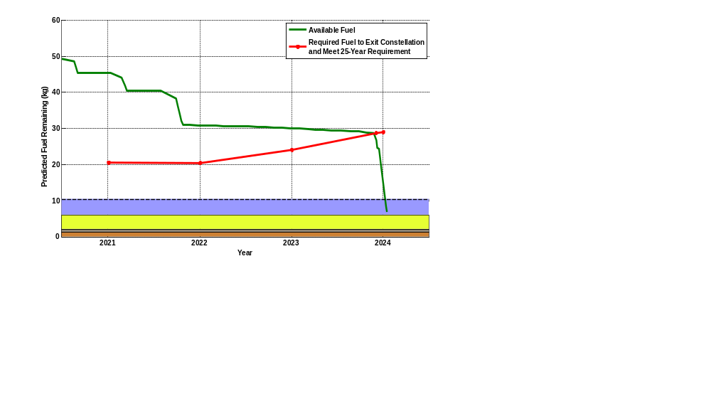
Aura DAS End of Life Predictions
(Analysis Updated June 2020)
Fall 2020
IAMs (3)
Spring 2021
IAMs (4)
Constellation Exit and Perigee Lowering Maneuvers
(Dec 2023 & Jan 2024)
Fall 2021
IAMs (5)
Unusable Fuel (1.2 kg)
Fuel Reserved for RMMs (0.8 kg)
Fuel required to perform 4.4+ km circular constellation exit (4.4 kg)
Estimated uncertainty in EOL fuel measurements (4.8 kg)

Slide 19
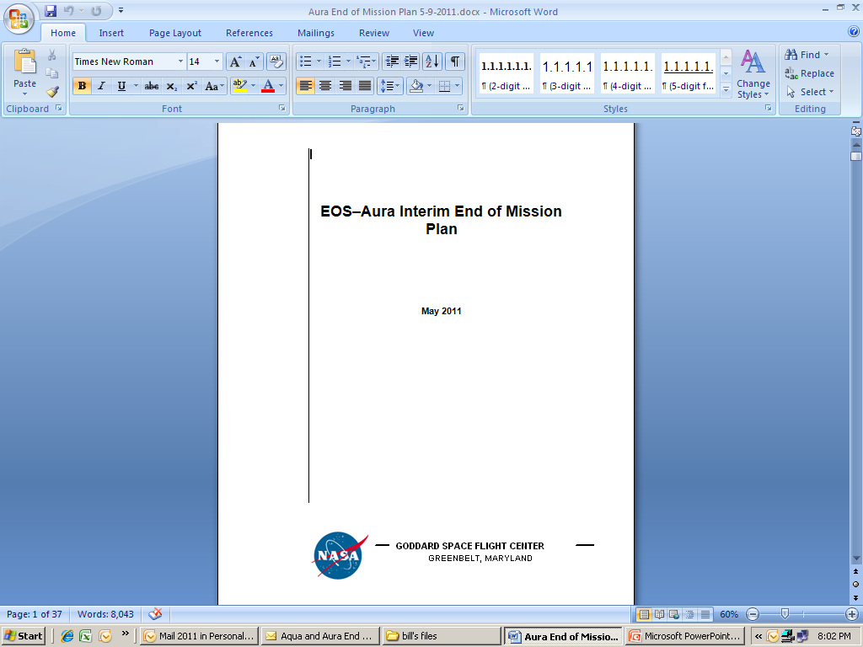
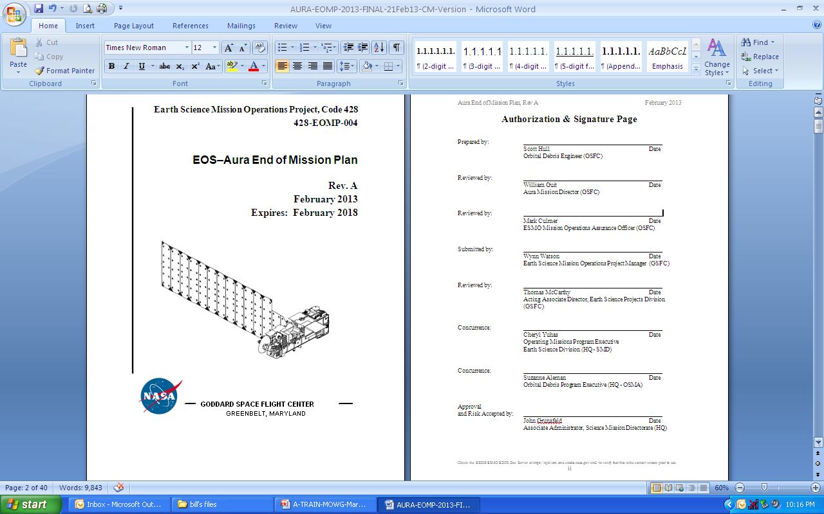
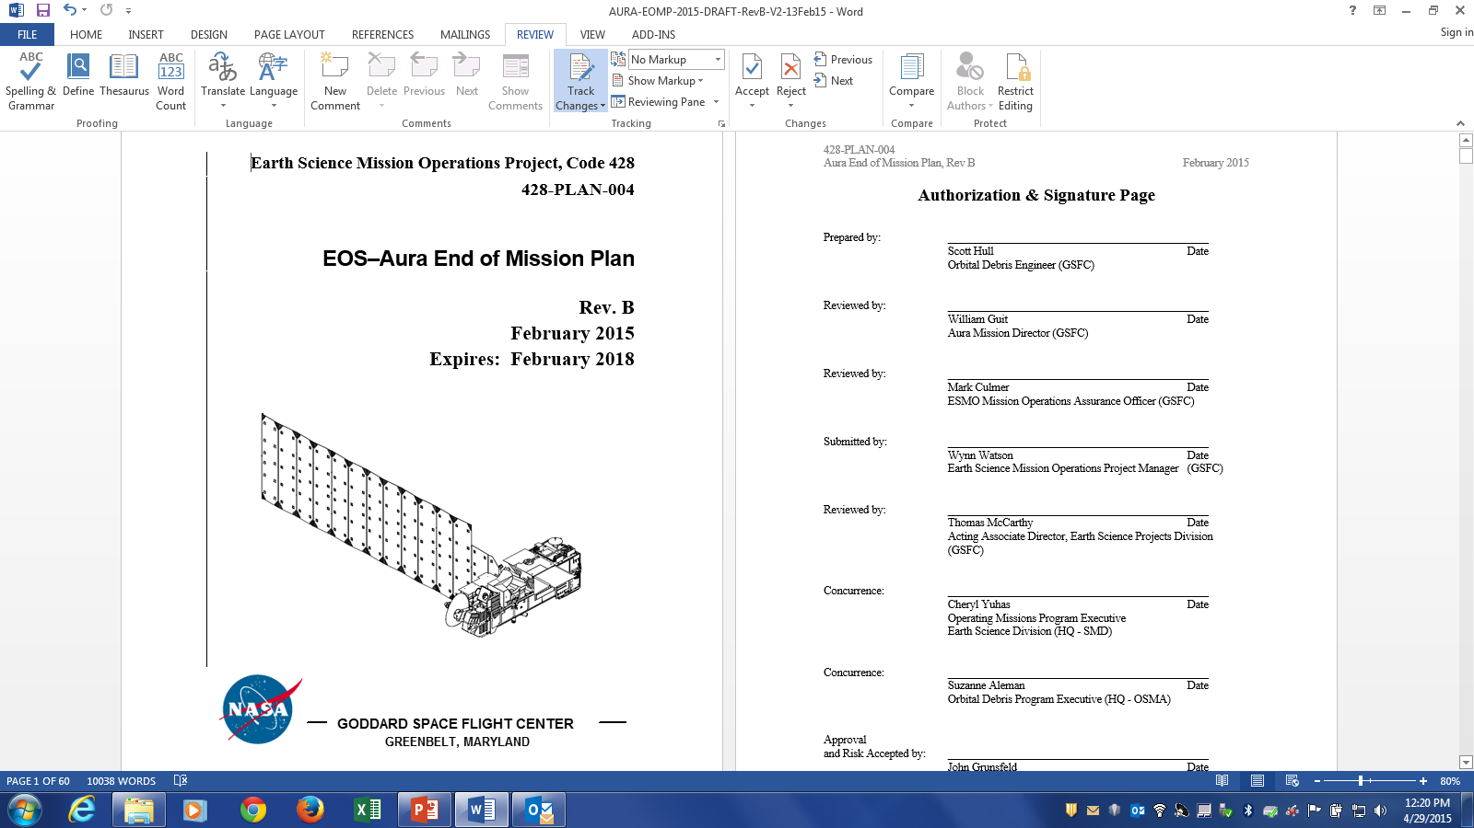
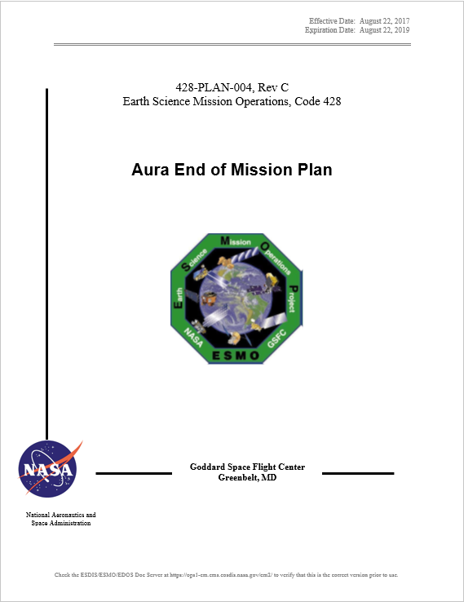
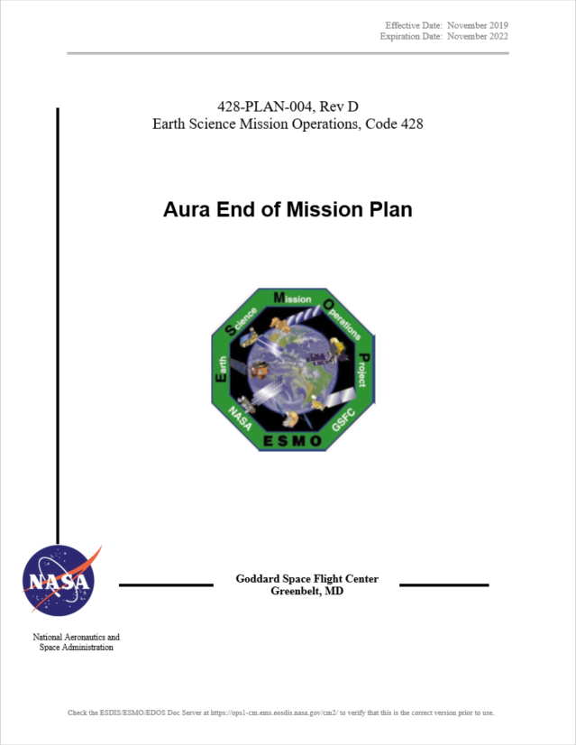
Aura End of Mission Plan (EOMP)
(No Change - Rev. D Updated Fall 2019)
Initial draft February 2009
Produced the first “Interim” End of Mission Plan (EOMP) in May 2011
  Approved by NASA HQ July 2011
Produced EOMP Rev A: February 2013
  Updated Lifetime estimates, Small Object Collision Assessment
  Waivers were approved in May 2013
Produced EOMP Rev B: February 2015
  Updated Lifetime Estimate
Produced EOMP Rev C: August 2017
  Lifetime estimates (as of 12/2016) & Reliability estimates
Produced EOMP Rev D: November 2019 (Under Review)
  Lifetime and Reliability estimates as of October 2019
Content Synopsis:
  Safely exit the A-Train Constellation
  Passivate Aura to the extent possible for uncontrolled reentry
  Aura has five (5) approved waivers for passivation
    Pressurant Passivation, Large Object Collision Probability, Small Object Collision Probability, Orbital Lifetime (30-Year), and Re-entry Risk (Un-controlled)
Final will be produced 60 days before End of Mission

Slide 20
Summary
Spacecraft Status – GREEN
Instrument Status – GREEN
  HIRDLS: Chopper Stalled 03/17/08 – Not collecting science data
  MLS: Operating Normally –
    06/04/2018: 118 GHz Receiver-1A (R1A) Anomaly (Recovered 06/11/18)
    06/20/2018: GHz Mirror Electronics (GME-B) Anomaly (Recovered 06/26/18)
    07/10/2018: MLS Survival Mode Transition (Recovered 07/18/18)
    10/25/2018: GHz Mirror Electronics (GME-B) Anomaly (Recovered 10/25/18)
    01/27/2019: MLS Survival Mode Transition (Recovered 01/31/19)
    07/18/2019: 190 GHz Receiver-2 (R2) Anomaly (Recovered 07/24/19)
  OMI: Operating Normally
    07/30/2018: OMI IAM Warm Restart (Recovered 07/31/18)
  TES: Instrument Decommissioned on 01/31/18
Data Capture/L0 Processing Status – GREEN
  SSR Data Capture to 07/31/20: 99.99530657%
Ground Systems – GREEN
  Responding to new security requirements and upgrades to obsolete hardware or COTS systems, as required
  01/16/2020: Online (Eclipse) Build 22.00 ORR
  09/03/2019: EOS Automation (EA) Release 3.3 ORR

Slide 21
Questions?

Slide 22
Additional Charts
Maneuvers & Ground Track History
Orbital Trends
Aura Conjunction Assessment
High Interest Events (HIEs)
Data Capture & Operations Errors
Extended Mission Plans
(Analysis Updates)

Slide 23
Orbit Maintenance
Mission Requirements: Perform Drag Make-Up Maneuvers (DMUMs) to maintain Ground Track Error (GTE) with respect to the World Reference System (WRS-2)
  Requirement: +/-20 km as measured at the Descending Node
To meet coincident viewing requirements, Aura’s initial ground track was offset from Aqua’s by one WRS path plus 25.4 km
  Aura was maintained -5.4 to -45.4 km west of Aqua until late 2007
  Since May 8, 2008, a new control box, +/- 10 km from a +18 km (east) offset of the Aqua WRS-2 path is used to maintain MLS-CALIPSO viewing request
Control Box Excursions: To date there have been 3 Control box Excursions
  2 on +10km front-side: 9/5/12 to 9/6/12, and 03/23/2015 to 04/17/2015 (increase in drag)
  1 on -10km back-side: 2/12/13 to 3/13/13 (drop in drag after DMUM on 1/16/13)
To date a total of 136 Drag Make-up (DMU) maneuvers have been performed:
  07/19/2012: DMUM # 43 No Yaw Slew Maneuver (NYS) #1
  Last maneuver 07/29/2020 (DMU #136) – Next DMU will be in mid-October
  Variation in performance from –6.7% (cold) to +5.3% (hot)
To date a total of 70 Inclination Adjustment Maneuvers (IAMs) have been performed:
  Fall ‘04 (4), Fall ‘06 (4 of 6), Spring ‘07 (4), Spring ‘09 (9), Spring ‘10 (3), Spring ‘11 (3), Spring ‘12 (4), Spring ‘13 (4), Spring ‘14 (4), Spring ‘15 (5), Spring ‘16 (4), Spring ‘17 (4), Spring ‘18 (5), Summer ‘18 (1), Spring ‘19 (4), Fall ‘19 (1), Spring ‘20 (4), & Fall ‘20 (3)
  Variation in performance from -7.2% (cold) to +3.5% (hot)

Slide 24
WRS Ground Track Error (GTE)
(As of August 22, 2020)
May 8, 2008
Re-Phase Maneuver
Updated Biannually for ESC MOWG Meetings

Slide 25
WRS Ground Track Error (GTE)
(As of August 22, 2020)

Slide 26
Aura Averaged MLT @ Ascending Node
(As of August 22, 2020)
Fall 2004
IAMs
Spring 2007
IAMs
Spring 2010
IAMs
Spring 2012
IAMs
Spring 2014
IAMs
Spring 2016
IAMs
Spring 2018
IAMs
Spring 2019 IAMs
Fall 2019
IAM
Fall 2006
IAMs
Spring 2009
IAMs
Spring 2011
IAMs
Spring 2013
IAMs
Spring 2015
IAMs
Spring 2017
IAMs

Slide 27
Aqua/Aura Mean Local Time (MLT)
@ Ascending Node (As of August 22, 2020)
Fall 2004
IAMs
Fall 2006
IAMs
Spring 2007
IAMs
Spring 2009
IAMs
Spring 2010
IAMs
Spring 2012
IAMs
Spring 2014
IAMs
Spring 2016
IAMs
Spring 2018
IAMs
Spring 2019
IAMs
Spring 2011
IAMs
Spring 2013
IAMs
Spring 2015
IAMs
Spring 2017
IAMs
Summer 2018
IAM
Fall 2019
IAM
Spring 2020
IAMs
Updated after Inclination Adjust Maneuvers

Slide 28
Aura Predicted Beta Angle
(With Yearly Inclination Maneuvers) (Updated June 2020)

Slide 29
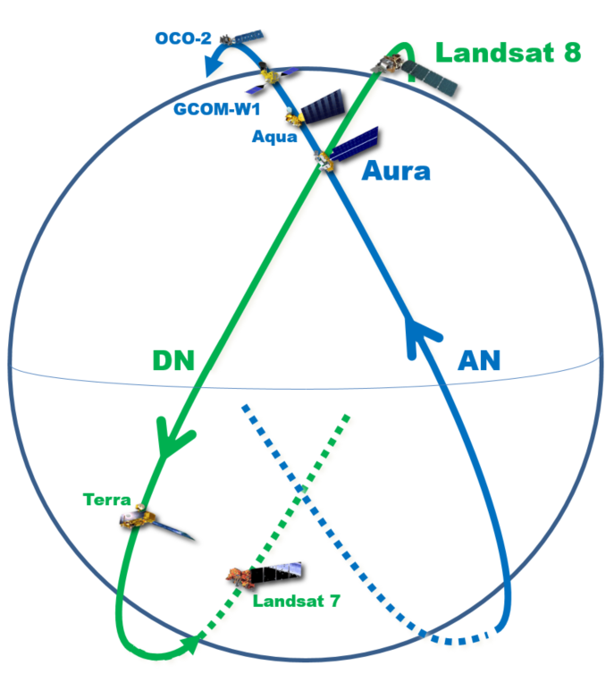
Aura and Landsat-8 (LS-8)
Orbit Phasing
With Aura in the
intersection point
LS-8 will be ~ 77 seconds
away from the intersection
Point worse case
By Design –
LS-8 and LS-7 are ½ orbit apart
In 2020 there has been 276-342 seconds between Aura and LS-8
Terra ~ 30 min
behind LS-7
1 Orbit = ~ 100 minutes

Slide 30
LS-8/Aura Phasing at Poles
@ Northern Intersection Point (Current Baseline Plan – June 2020)
Uses July 2020 Landsat-8 lifetime ephemeris for phasing predictions

Slide 31
Aura Conjunction Assessment
High Interest Events (HIEs)
 | Dec `19 | Jan `20 | Feb `20 | Mar `20 | Apr `20 | May `20 | Jun ’20 | Jul ’20 | Aug ‘20 | Total
Tier 1 | 0 | 0 | 0 | 0 | 0 | 0 | 0 | 0 | 0 | 0
Tier 2 | 0 | 0 | 0 | 0 | 3 | 0 | 0 | 0 | 0 | 3
Tier 3 | 1 | 0 | 1 | 0 | 1 | 0 | 0 | 0 | 1 | 4
Tier 4 | 0 | 1 | 0 | 0 | 0 | 0 | 0 | 0 | 0 | 1
Total | 1 | 1 | 1 | 0 | 4 | 0 | 0 | 0 | 1 | 8
  2016: 24 CARA HIEs – 16 required significant action (T2-T4)
  2017: 19 CARA HIEs – 16 required significant action (T2-T4)
2018: 16 CARA HIEs – 16 required significant action (T2-T4)
2019: 15 CARA HIEs – 15 required significant action (T2-T4)
  12/23/2019: CA vs. 44532 at 14:10:27 GMT – DAMs planned and screened, Self-mitigated (T3)
2020: 7 CARA HIEs – 7 required significant action (T2-T4)
  01/03/2020: CA vs. 13498 at 22:50:31 GMT – DAMs planned and screened, rescheduled DMU earlier (T4)
  02/08/2020: CA vs. 31249 at 02:08:20 GMT – DAMs planned and maneuvers screened (T3)
  04/16/2020: CA vs. 35464 at 05:47:24 GMT – DAMs planned and maneuver screened (T3)
  04/25/2020: CA vs. 45131 at 22:07:12 GMT – Contacted ONEWEB team via CARA, they replanned ascent (T2)
  04/26/2020: CA vs. 45131 at 04:42:42 GMT – Contacted ONEWEB team via CARA, they replanned ascent (T2)
  04/26/2020: CA vs. 45131 at 06:21:36 GMT – Contacted ONEWEB team via CARA, they replanned ascent (T2)
  08/30/2020: CA vs. 44019 at 18:42:21 GMT – DAMs planned and maneuver screened (T3)
Tier 1 – Notify (email/phone), Tier 2 – Conduct Briefing,
Tier 3 – Plan Maneuver, Tier 4 – Execute Maneuver

Slide 32
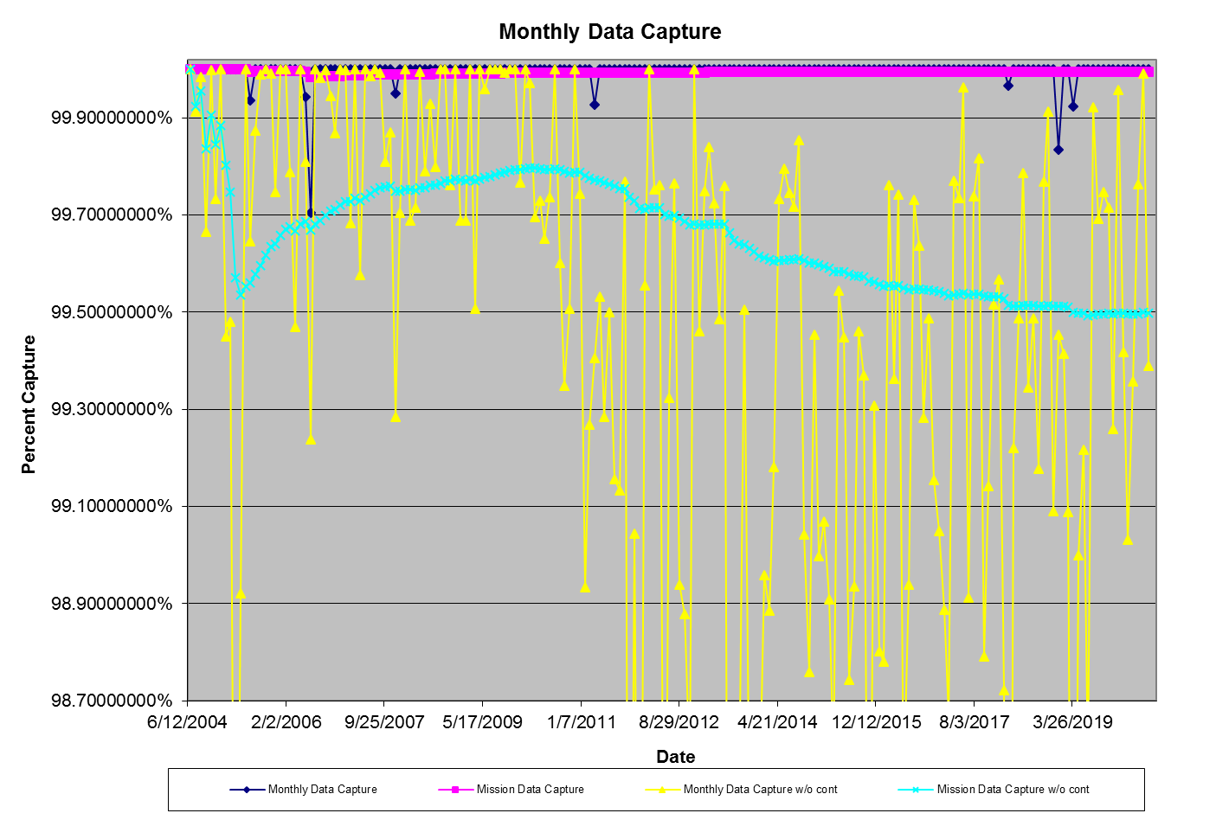
  Aura Monthly Data Capture
  SSR Data Capture to 07/31/2020: 99.99530657%
Mission Capture Req. = 95%
37 months with no data losses
83 months with no data losses
EDOS Ops Error (2005)
SSR Anomaly (2007)
FOT Ops Errors
(2011, 2018, & 2019 (2))
Norway Communication
Outages (2006)

Slide 33
  SSR Data Losses – 2020
Last Data Loss: April 2019 (FOT Ops Error)
April 2019: Data Loss #1029 on DOY 094 (April 04, 2019)
  Data gaps were observed in Low Rate Data from 14:11:54 - 14:46:02 and in OMI data from 14:12:26 - 15:10:47
January: None
February: None
March: None
April: None
May: None
June: None
July: None
August: None

Slide 34
Operational Errors
(18-Months: February 2019 – July 2020)
Aura: 15 Months since last operational error (April 2019)
1+ years of Aura FOT Error Free Operations

Slide 35
Aura Baseline Decommissioning Plan
(Current Baseline Plan – Analysis Updated June 2020)
Baseline Decommissioning Plan Assumptions:
Maintain MLT and WRS-2 Ground Track requirements until the DAS 25-year re-entry fuel limit is reached
  Perform nominal IAMs to maintain MLT
  Perform periodic DMUs to maintain Ground Track Error
Documented in ‘FDSS-III-110-0024_Aura_Lifetime_Analysis_Spring2020_v4.0.pptx’
(06/25/20)

Slide 36
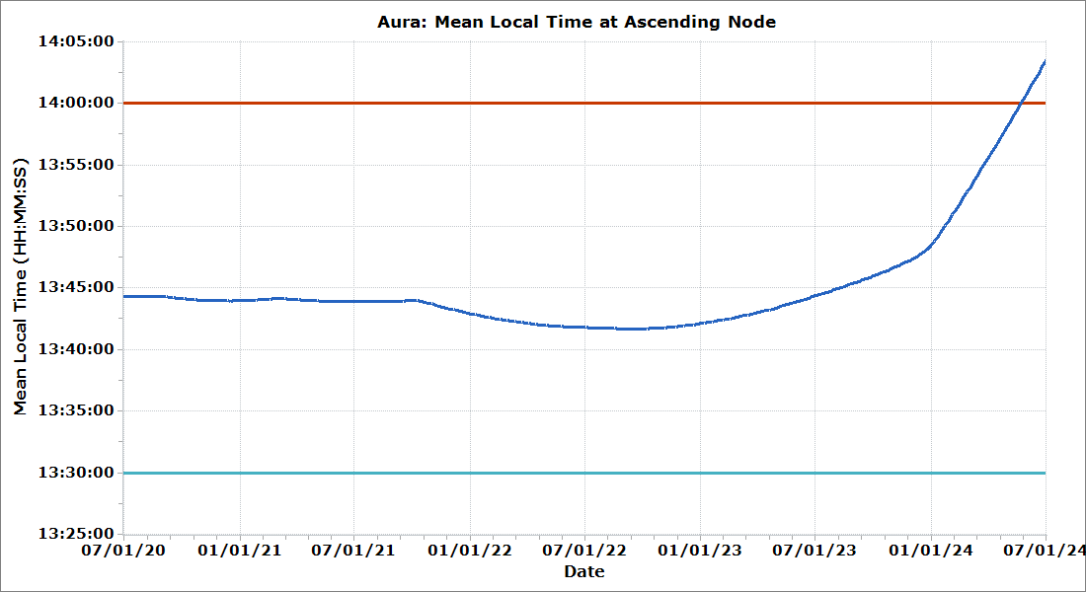
Aura Predicted Mean Local Time
(Current Baseline Plan – Analysis Updated June 2020)
MLT Requirement
Science: 13:45 ± 15 min
Phasing with Aqua has kept MLT 13:38-13:50
Constellation Exit & Perigee Lowering Maneuvers
(Dec 2023 – Jan 2024)
Fall 2020
IAM Series
Spring 2021
IAM Series
Fall 2021
IAM Series
Turnaround
MLT: 13:41:41
(Sep 15, 2022)

Slide 37
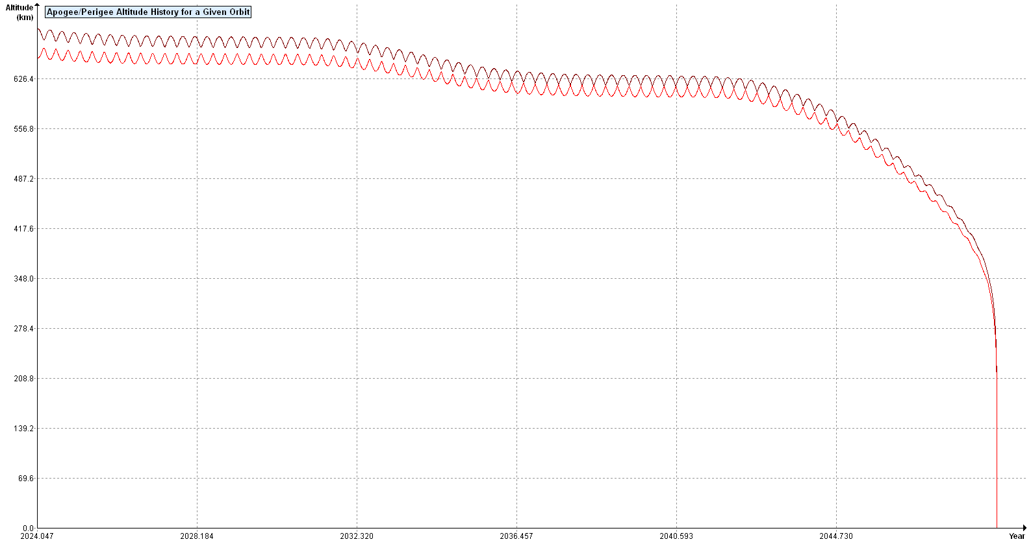
Aura Predicted Re-entry
(Current Baseline Plan – Updated June 2020 – April 2020 DAS Solar Flux File)
Apogee
Perigee
End of Constellation Exit and Perigee Lowering Maneuvers
(Jan 2024)
24.81 year re-entry based on DAS 3.0
Predicted Re-entry
~ Nov 2048

Slide 38
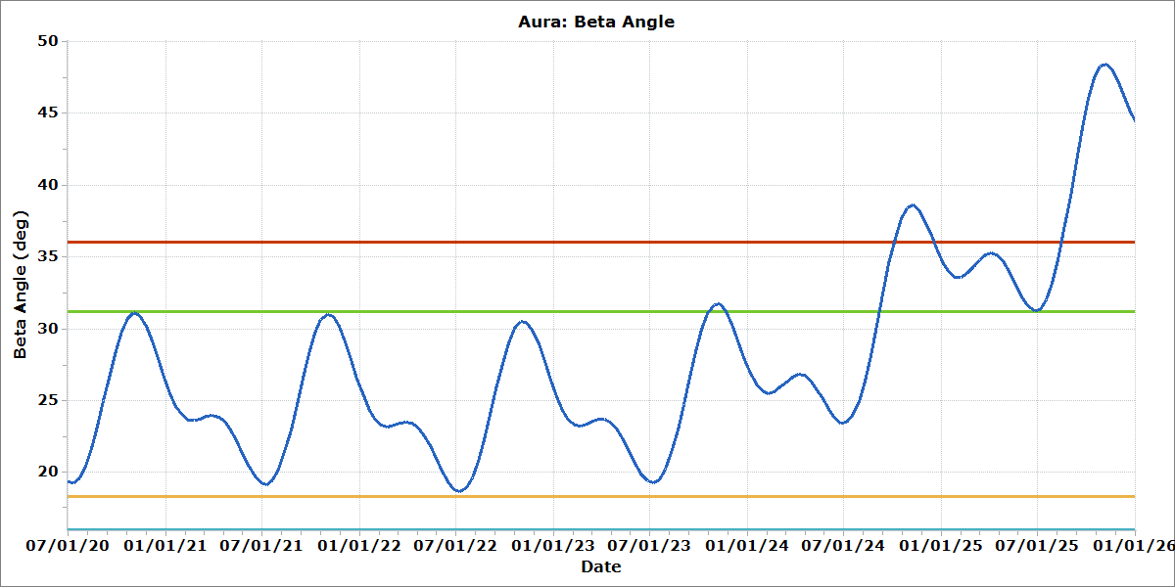
Aura Predicted Beta Angle
(Current Baseline Plan – Analysis Updated June 2020)
Beta Angle
Science: 16 deg – 36 deg
Operational: 18.3 deg – 31.2 deg
Brief OMI Beta Angle Violation Between Oct 21 & Nov 22, 2023
OMI Beta Angle
Threshold Exceeded
(Sep 6, 2024)
Constellation Exit & Perigee Lowering Maneuvers
(Dec 2023 – Jan 2024)

Slide 39
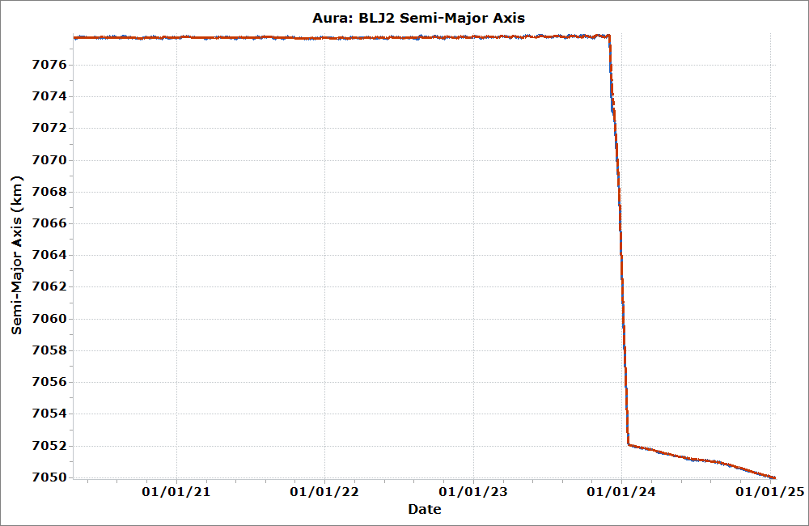
Aura Predicted Semi-Major Axis
(Current Baseline Plan – Analysis Updated June 2020)
Constellation Exit Maneuvers (Dec 2023) &
Perigee Lowering Maneuvers
(Dec 2023 & Jan 2024)
Constellation
Exit
Perigee
Lowering
Semi-Major Axis
Constellation: 7077.7 km ± 0.3 km

Slide 40
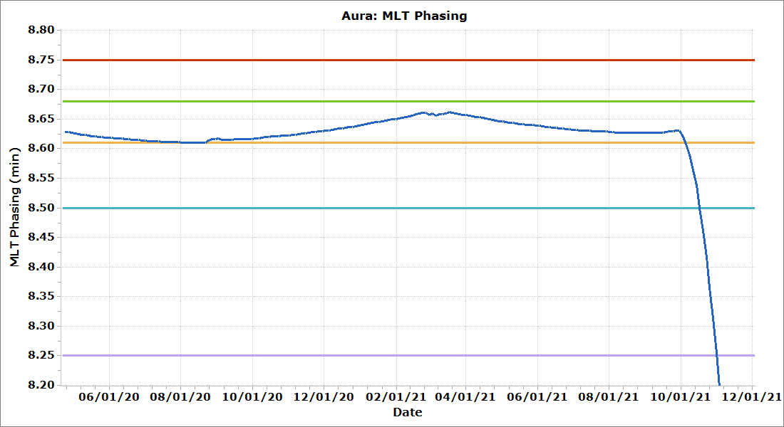
Aura MLT Phasing with Aqua
(Current Baseline Plan – Analysis Updated June 2020)
Fall 2020 IAMs
Spring 2021 IAMs
Fall 2021 IAMs (Aqua does not maneuver)
Aqua-Aura Phasing
Constellation: 8.5 min ± 0.25 min
Operational: 8.61 min – 8.68 min

Slide 41
Abbreviations / Acronyms List
  ARE – Array Regulator Electronics
  CA – Conjunction Assessment
  CALIPSO – Cloud-Aerosol Lidar and Infrared Pathfinder Satellite Observations
  CARA – Conjunction Assessment Risk Analysis
  CDH – Command & Data Handling
  CEM – Constellation Exit Maneuver
  COMM – Communications
  CONOPS – Concept of Operations
  COTS – Commercial-Off-The-Shelf
  CRMS – Collision Risk Management System
  DAM – Debris Avoidance Maneuver
  DAS – Debris Assessment Software
  DMUM – Drag Make-up Maneuver
  DR – Decommissioning Review
  DRR – Disposal Readiness Review
  DWG – Decommissioning Working Group
  EA – EOS Automation
  EDOS – EOS Data Operations System
  EOC – EOS Operations Center
  EOL – End of Life
  EOMP – End of Mission Plan
  EOS – Earth Observing System
  EPS – Electrical Power System
  ESA – Earth Sensor Assembly
  ESC – Earth Science Constellation
  ESMO – Earth Science Mission Operations
  FDS – Flight Dynamics System
  FMU – Formatter Multiplexer Unit
  FOT – Flight Operations Team
  FSW – Flight Software
  FY – Fiscal Year
  GHz – Gigahertz
  GME – Gigahertz Mirror Electronics
  GMT – Greenwich Mean Time
  GNC – Guidance Navigation & Control
  GSFC – Goddard Space Flight Center
  GTE – Ground Track Error
  HIE – High Interest Event
  HIRDLS – High Resolution Dynamics Limb Sounder
  HK – Housekeeping
  HQ – Headquarters
  IAM – Interface Adapter Module
  IAM – Inclination Adjustment Maneuver
  INC – Inclination
  INST – Instruments
  IOT – Instrument Operations Team
  KDP-F – Key Decision Point to proceed with Phase F
  kg – kilogram
  km – kilometer
  KNMI – Royal Netherlands Meteorological Institute
  L0 – Level-Zero
  LS – Landsat
  m – meters
  MLS – Microwave Limb Sounder
  MLT – Mean Local Time
  MMOD – Micrometeorite Orbital Debris
  MOCA – Mission Operations Conjunction Assessment
  MOWG – Mission Operations Working Group
  MWG – Maneuver Working Group
  NASA – National Aeronautics & Space Administration
  NGSS – Northrop Grumman Space Systems
  NYS – No Yaw Slew
  Ops – Operations
  OMI – Ozone Monitoring Instrument
  ORR – Operational Readiness Review
  PLM – Perigee Lowering Maneuver
  PROP – Propulsion
  R1A – Receiver 1A
  R2 – Receiver 2
  RM – Retrograde Maneuver
  RMM – Risk Mitigation Maneuver
  RWA – Reaction Wheel Assembly
  SR – Senior Review
  SRP – Senior Review Proposal
  SSR – Solid State Recorder
  TCS – Thermal Control System
  TES – Tropospheric Emissions Spectrometer
  TSF – Thrust Scale Factor
  WRS – World Reference System

